Slide 1

Post Award Information
NCR-SARE Partnership Grants
Beth Nelson
Regional Coordinator and Director of Research and Education Programs
North Central Region SARE
bethnelson@umn.edu
612.626.4436
Rob Myers
Regional PDP Coordinator and Director of Extension Programs
North Central Region SARE
myersrob@missouri.edu
573-882-1547
Notes:
This is a quick overview about managing your SARE grant. Rob Myers and Beth Nelson coordinate this program.
We encourage you to email or call us with any specific questions you have.

Slide 2
Go over information mostly found on North Central SARE website:
https://northcentral.sare.org/grants/manage-your-grant/partnership-grant-2/
Reporting Requirements
Financial Requirements
Changes (No Cost Extension or Rebudget)
Promoting your Project
Logos and Acknowledgment
Notes:
Most of this information can be found in the section on “manage your grant” on the NCR-SARE website.
I’m going to briefly go over the reporting and financial requirements, how to request No Cost Extensions or rebudgets, and when rebudgets are necessary, how to get help promoting your outreach projects and where to find SARE and NIFA logos and acknowledgement for funding language.

Slide 3
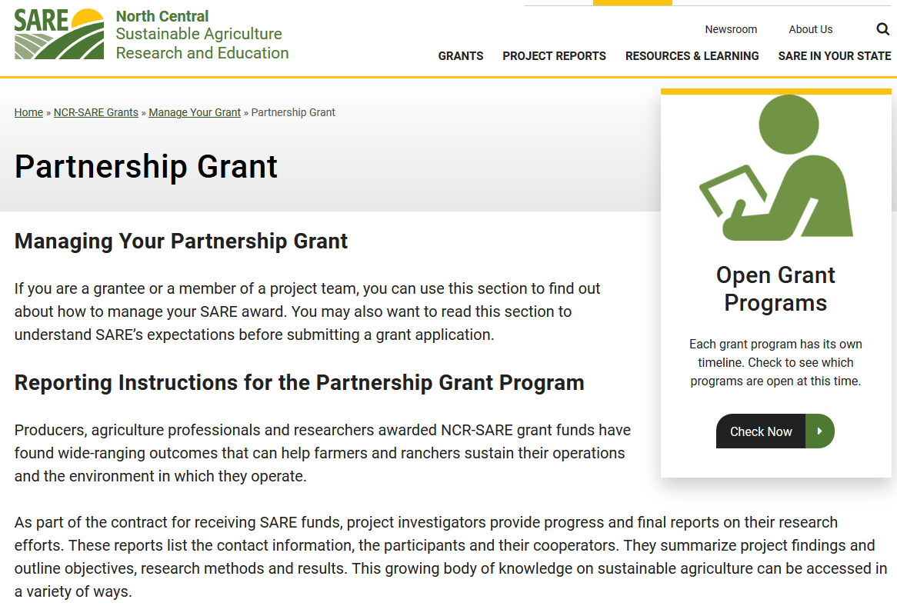
Notes:
Bookmark this “Manage Your Grant” page on our website, so that when you have question down the line you can come back and find the instructions.
Reporting:
Annual reports are due by March 1 the following year. If you were awarded a 2021 Partnership grant, your first report will be due March 1, 2022 on activity from the start of your project through the end of the calendar year the grant was awarded, so through 12/31/2021.
Your next update would be due the following March 1st, reporting on activities in 2021.
You also will owe a final report which will be due 60 days after the end date.
If your project ends April 30 or before—you don’t need to file a separate annual update for the previous year, just include everything in the final report. For example, if you project ends April 15, 2022, you wouldn‘t file a 2021 update on March 1, you’d just file a final report, due 60 days after the end date, so by June 15.
We do send out reminders in November, and then again in January, but you can mark March 1 due date on your calendar.

Slide 4
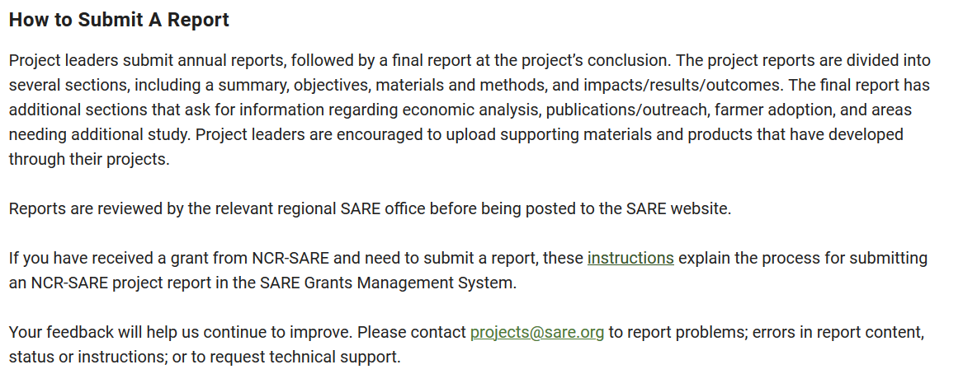
Notes:
Here is the basic information about what is required. Part of the information is autofilled from your proposal, but can be edited. This is a typical report, and you’ll report on any changes you had to make in materials and methods, provide preliminary results and project and outreach activities and number of participants. I want to highlight the section requesting information about project activities and outreach.

Slide 5
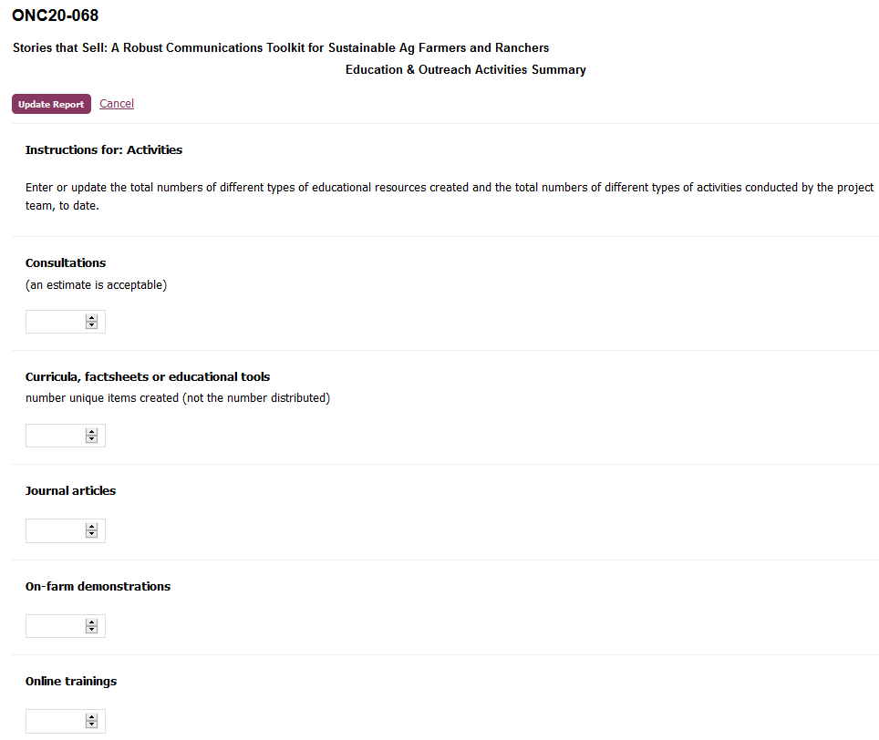
Notes:
You should be able to log into projects.sare.org now and pull up your blank report. It will be helpful for you to look at the options for reporting information and tracking participation at your outreach events, so that you know what type of information to track. You’ll notice that there are a lot of different options under things like project activities and outreach activities—you obviously aren’t expected to be doing all of those, you’re just reporting against what you said you’d do in your proposal—having all the options listed helps us aggregate data.

Slide 6
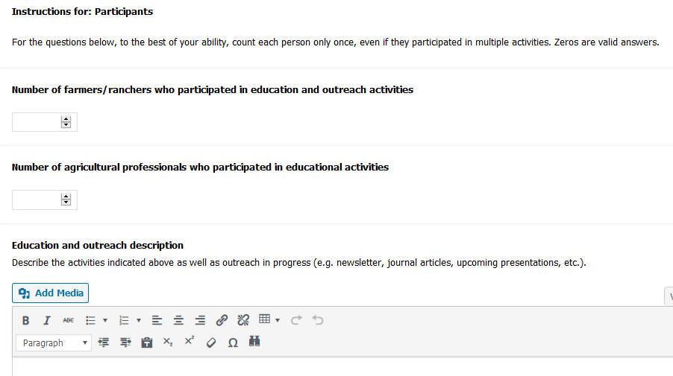
Notes:
You’re asked to track participation at outreach events by both farmers and ag professionals, and track basic information about knowledge gained or behavior changed or intended behavior change by those attendees, so again—good to look through the reporting system to see what information you should be tracking.

Slide 7
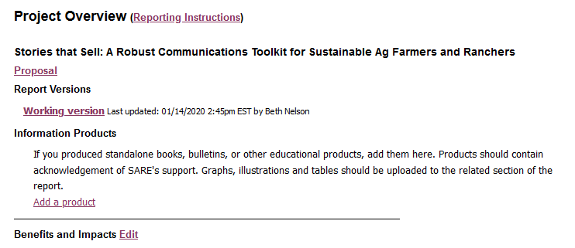
Notes:
In our project reporting system, we use progressive reporting, so we end with only one final comprehensive report for each project. When you go to do your first report, you’ll follow the instructions and choose to “start a new draft report”, whenever you come back to add to the report, you’ll go to “working version” and it will pull up the info you’ve already entered and you’ll add to it. So if you come back to report on progress from 2022, you’ll go into the report system, go to your project, and click on working version, which will be your approved 2021 report. You can alter as needed, or just add 2022 headings and add to the report.
Please take pictures, of the project and of the people involved in your project, and upload those to your reports. Having photos is a great help to Marie, our communications specialist, in telling the story of your work.
One last point about the reporting system and submitting your report. If you didn’t complete the demographic information when you first registered in the SARE system, you will need to enter demographic info before you are allowed to submit a report. Answer options include “prefer not to answer”, but you must respond to each question. This helps us to track whether we are reaching audiences that historically have been underserved by USDA programming. Your demographic data is maintained separately from any of your proposals or funded projects, and is used in aggregated data only.

Slide 8
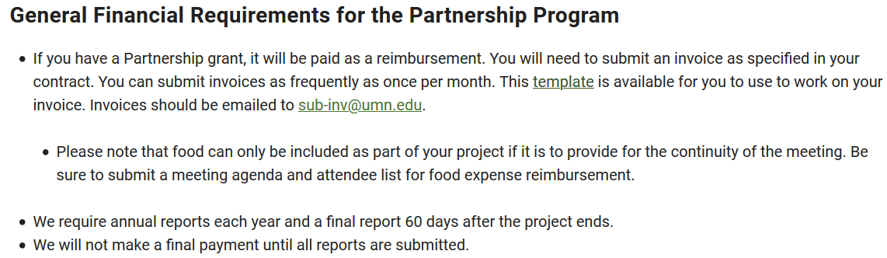
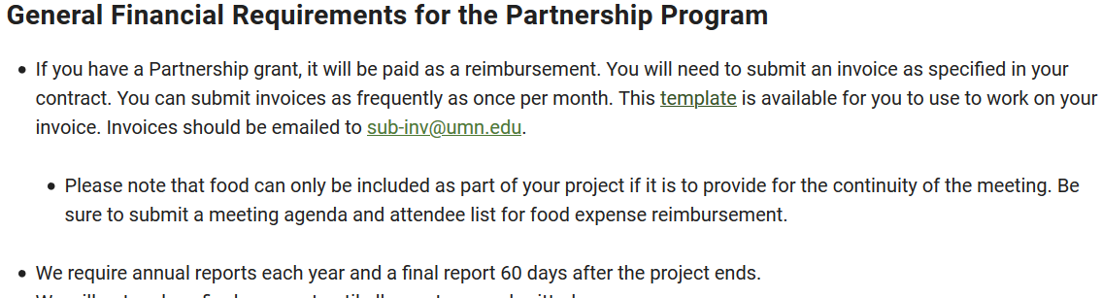
Notes:
Most of you will have someone from your grants office submitting invoices on a reimbursement basis, and invoices can be submitted as often as once a month. If you are not very familiar with administering grants, the invoice is pretty simple, and we’ve provided a template, which I’ll show you in the next slide.
For the most part, we don’t need receipts for expenses, but we do sometimes need a description, especially if the charge is in a general category, like “other”, or “fee for services”.
An exception is that USDA is quite strict about paying for food or meals, and meal costs can only be covered as part of the continuity of a meeting—in other words, it would be disruptive to the program if the meal were not provided, because there is program before and after the meal.
For food charges, we need an itemized receipt, a list of attendees, and a brief justification.
And an important note about reimbursements—we hold payment of invoices until reporting is up-to-date.

Slide 9
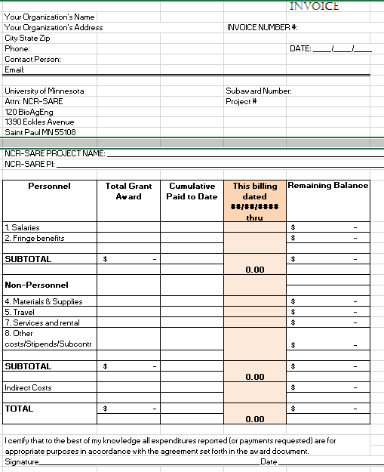
Notes:
This is a screen shot of an invoice template.

Slide 10
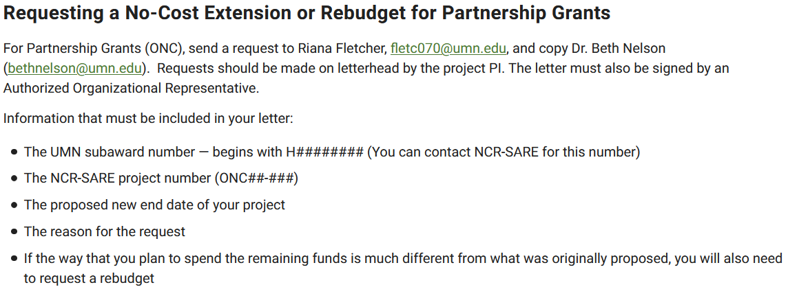
Notes:
The website page contains this specific information about how to request changes to your contract.
We know that during the course of your project, things change, so we allow for changes to original contract. Changes like a no cost extension, which provides more time but no additional funding, and major rebudgeting, must officially be requested and approved between our organization’s grants offices. Write letter addressed to Beth, attached to email, include subaward number, project number and justification and new end date. You should route the request through your grants office and they’ll send it to Riana Fletcher in the University of Minnesota grants office. She sends it to Rob and me for approval.

Slide 11
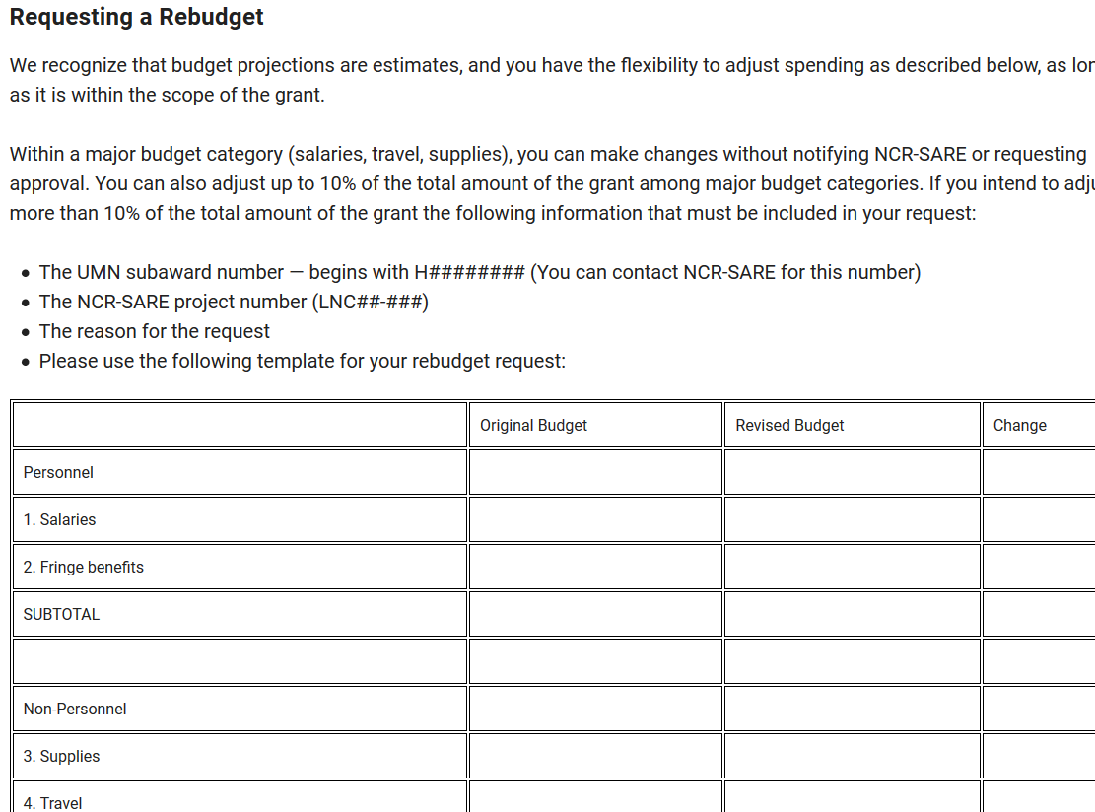
Notes:
We realize that your proposed budget is an estimate so there is some flexibility in the contract.
Within a major category, (travel, personnel, materials and supplies), as long as within scope, no authorization needed to make changes.
In addition, you can change spending between categories up to 10% of the total award without official authorization, so in other words, if you have a $200,000 grant, you can move up to $20,000 from materials and supplies to travel, without requesting a rebudget. If you are making change that exceed that amount, you’ll request a rebudget, following a similar procedure to the request for a NCE.
Change in scope or change in P.I. need a little more scrutiny and we need to take them to our Executive Committee.
COVID-19—would like to see research projects complete proposed goals and objectives, so if possible, get permission to safely proceed, following your state department of health guidelines, and your own comfort level.

Slide 12
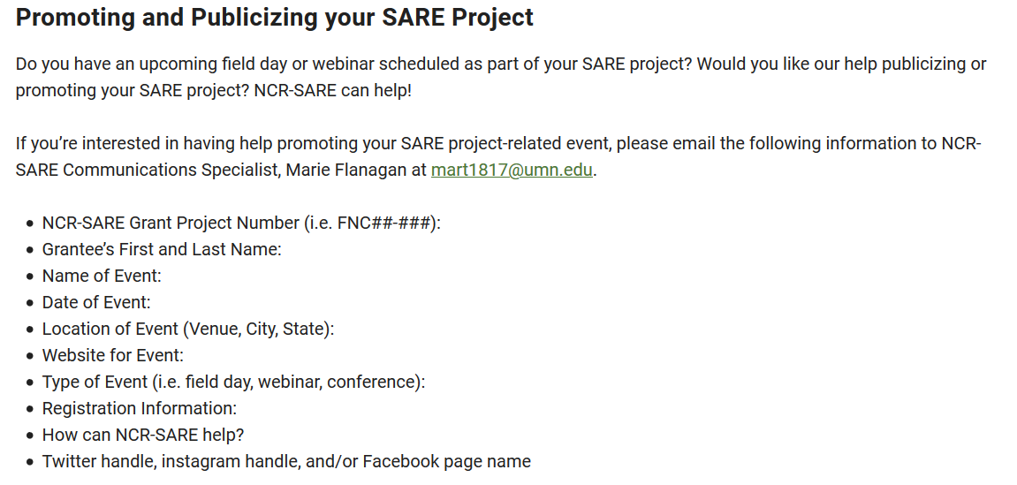
Notes:
Promote and publicize grant projects—our communication specialist Marie Flanagan is happy to help you publicize events, field days or fact sheet articles. Her contact info Is listed here. Send her the info listed and she’ll help get the word out. Youtube channel for videos, Facebook, Instagram,

Slide 13
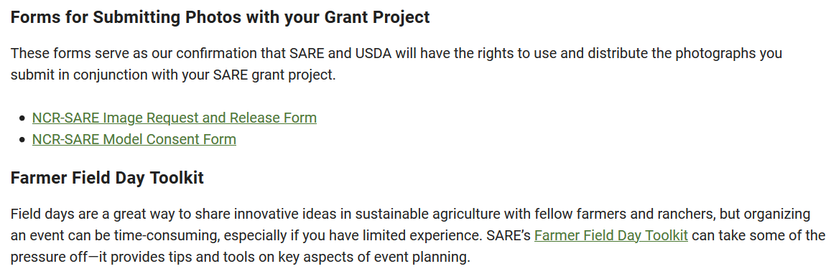
Notes:
Some additional tools that might aid you in doing outreach and sharing information from your project.

Slide 14
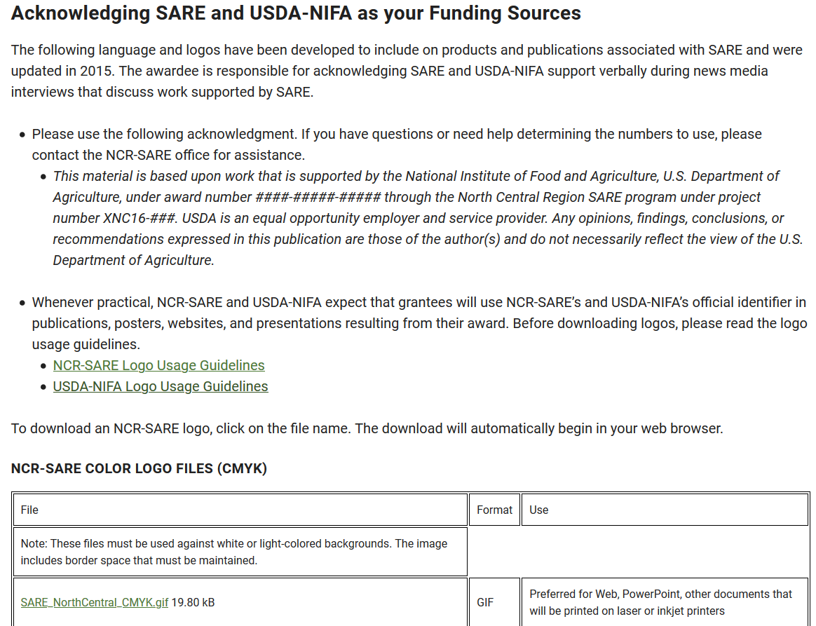
Notes:
Logos and acknowledgements for funding. We appreciate you acknowledging funding sources, it helps people know the good work that you are doing that their federal tax dollars are supporting. We know that you are often doing posters/presentations as deadlines approach, so have tried to put the logos and acknowledgement language you can use online.
The Acknowledgment language provided is formal and intended for more formal uses, like for refereed or extension publication. On posters or power point, please list the project number so people can access more information about your project on our online reporting system, and use the SARE/NIFA logos to acknowledge the funding source.

Slide 15
Post Award Information
NCR-SARE Partnership Grants
Beth Nelson
Regional Coordinator and Director of Research and Education Programs
North Central Region SARE
bethnelson@umn.edu
612.626.4436
Rob Myers
Regional PDP Coordinator and Director of Extension Programs
North Central Region SARE
myersrob@missouri.edu
573-882-1547
Notes:
Please contact us if you have further questions.
We look forward to hearing about your progress.

