Slide 1
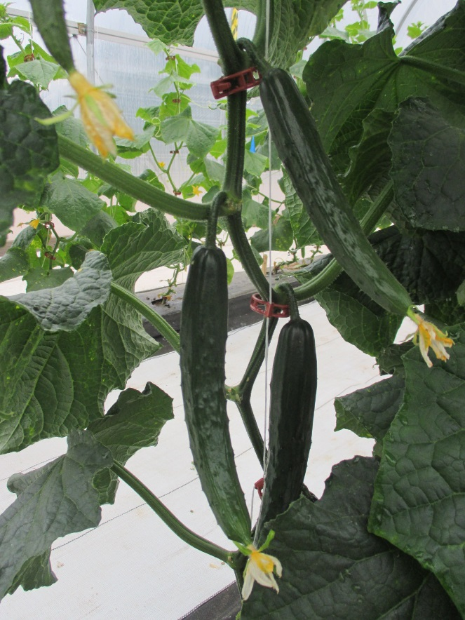
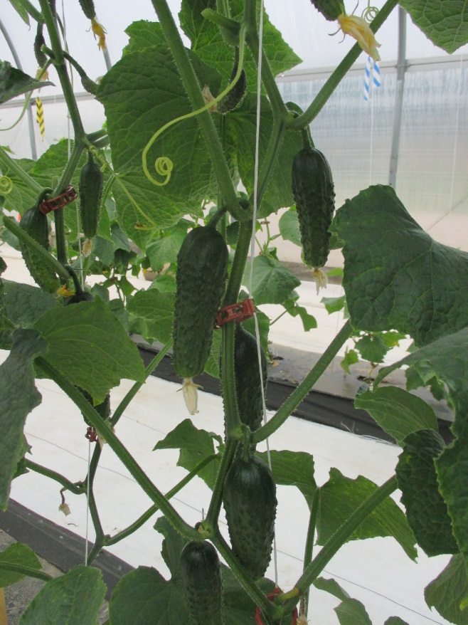
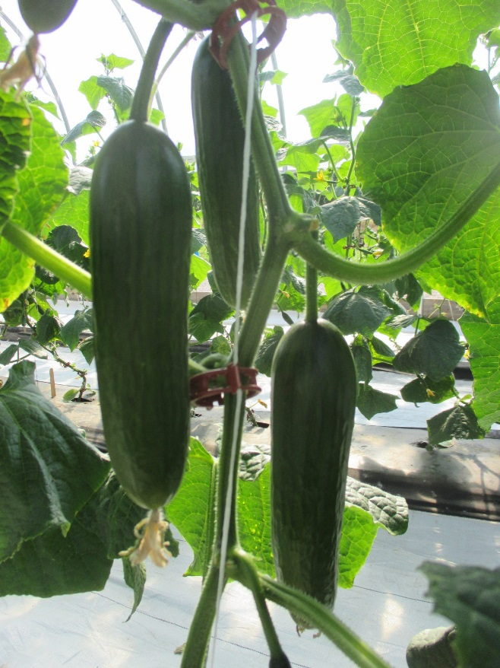
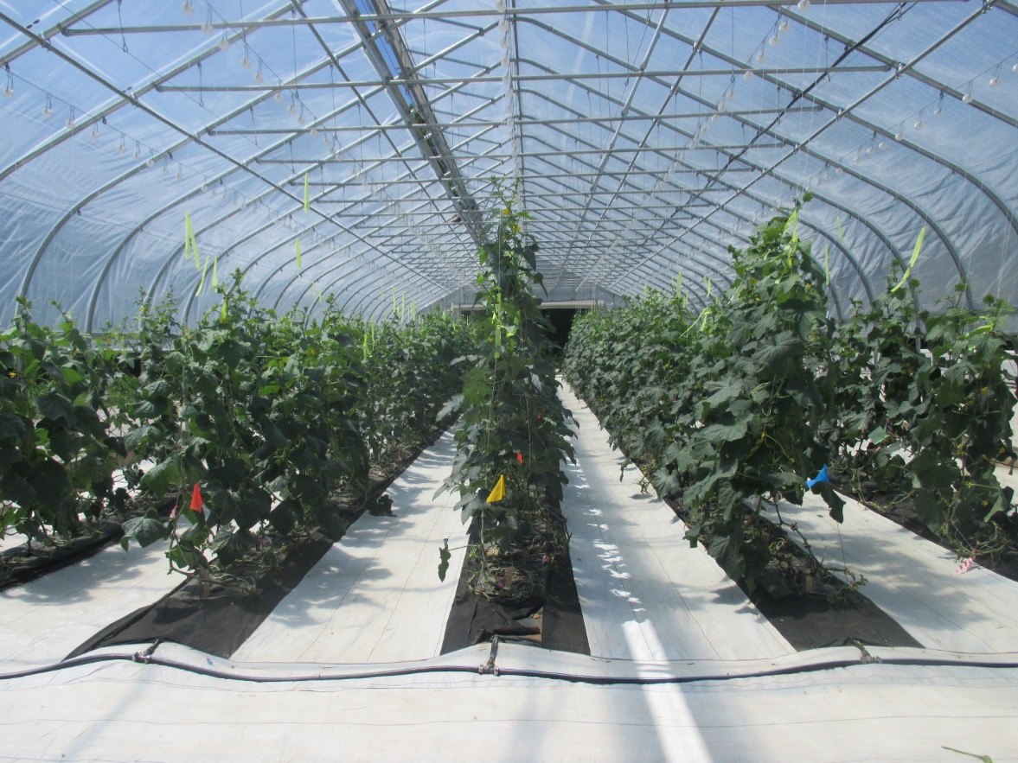
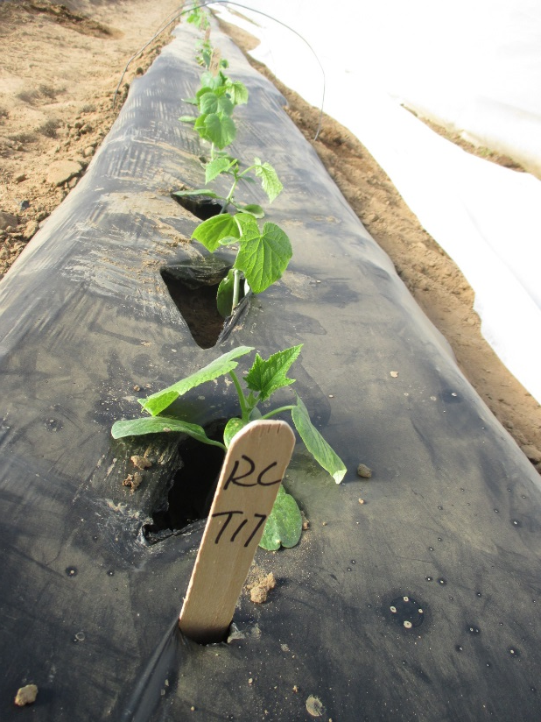
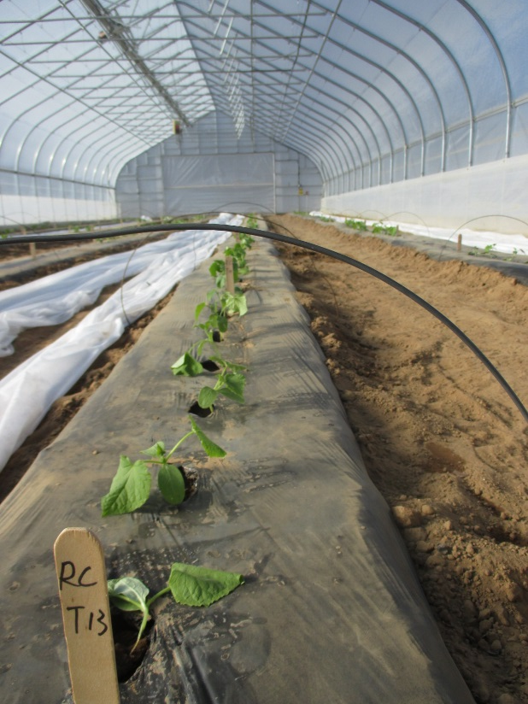
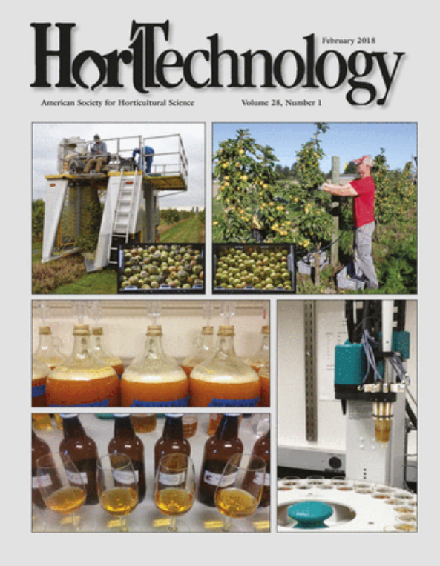
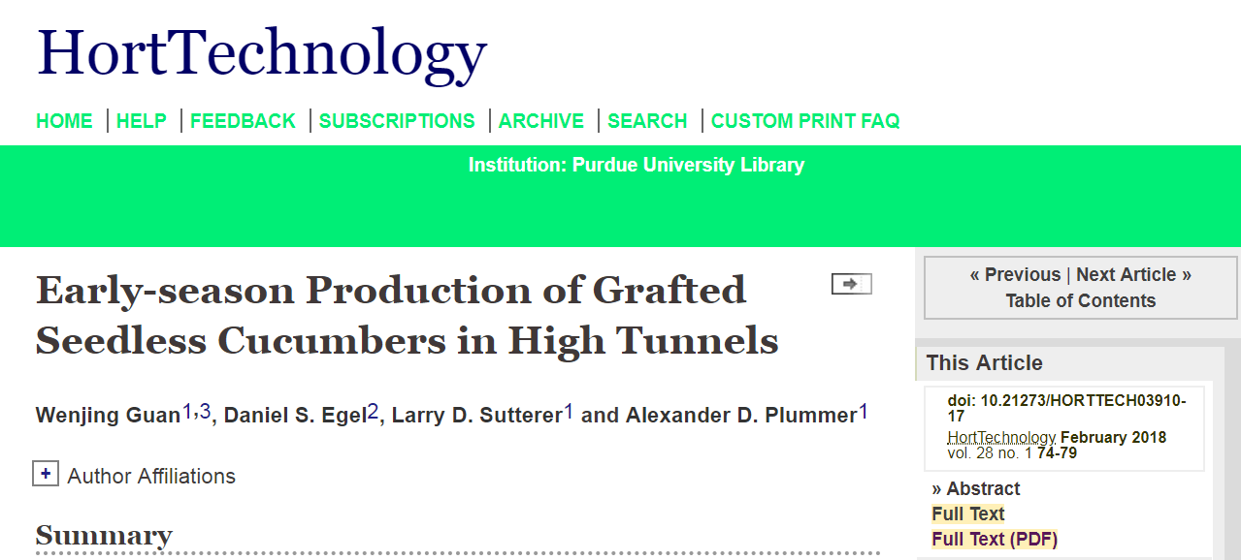
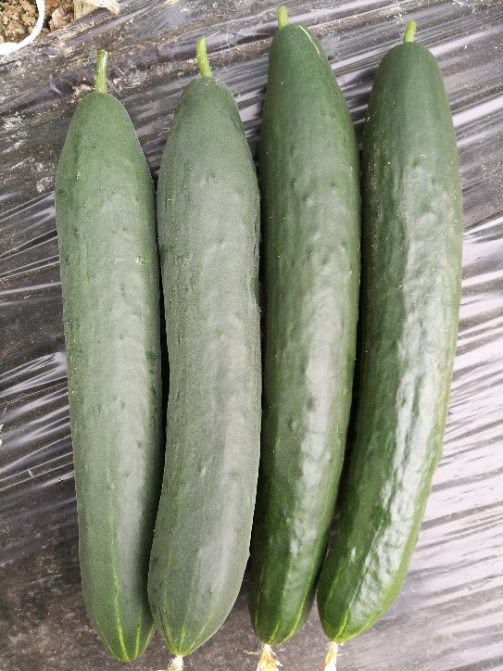
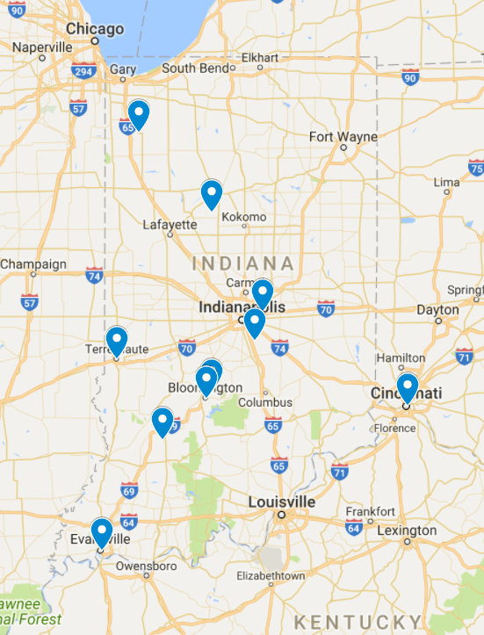
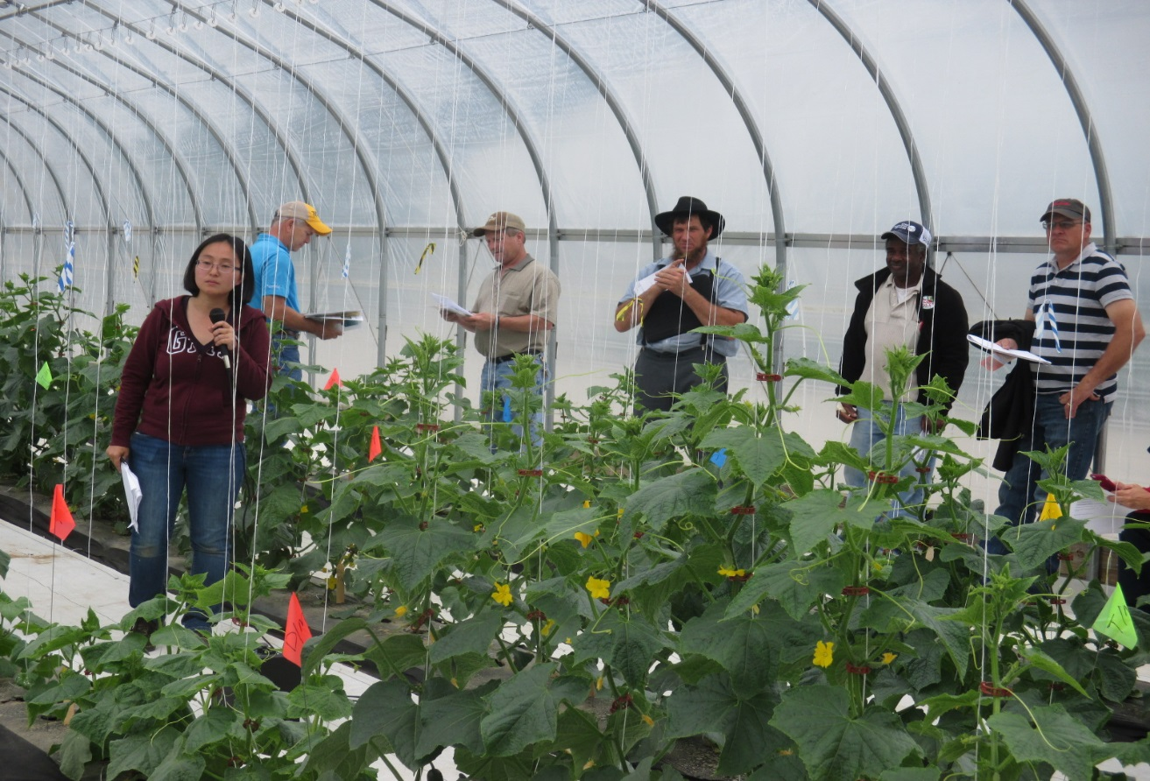
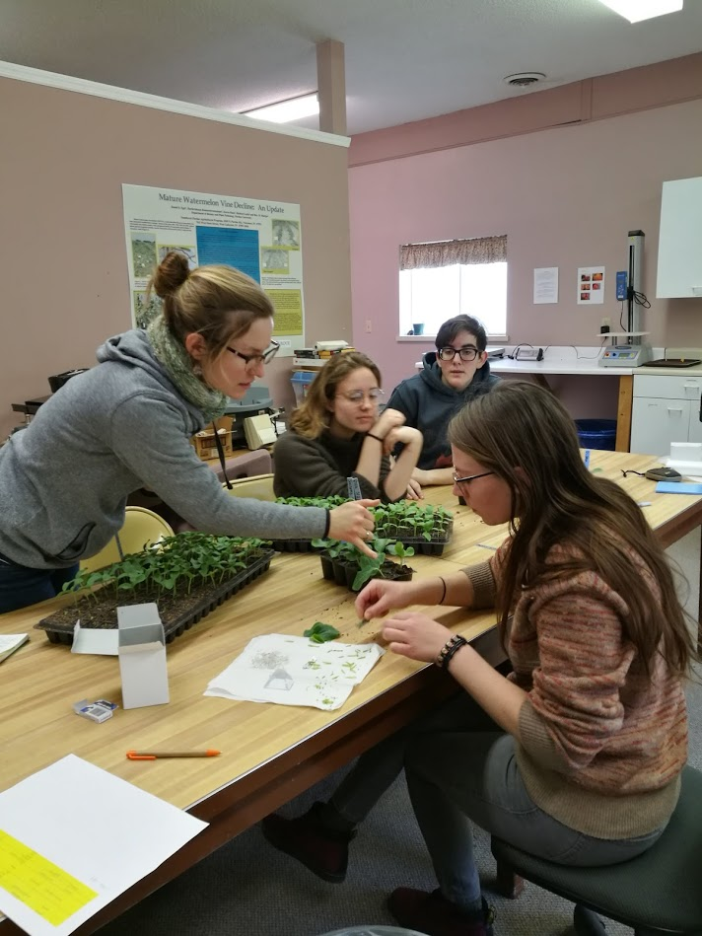
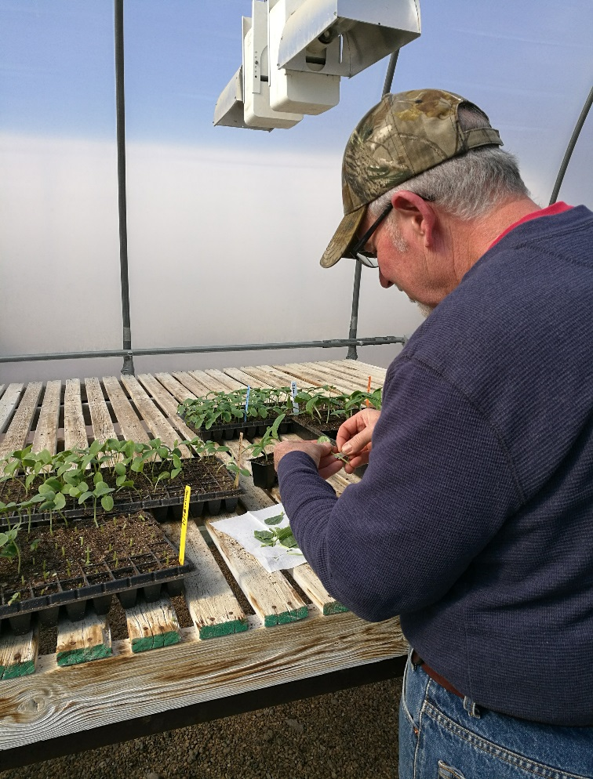
Improving Seedless Cucumber Production to Diversify High Tunnel Crops in the North Central Region
LNC 17-390
Wenjing Guan, Purdue University
Introducing Grafting Technology for Cucumber Production in High Tunnels
Introduction
High tunnel tomatoes have excellent economical returns, and because of this, farmers tend to grow them every year, leading to increased risk of disease and insect pest problems. To reach high tunnels’ full potential and help mitigate the risks, identification of profitable alternative crops is critical to ensure sustainability of the production system. In this regard, seedless cucumber has drawn great interests from farmers in the region due to its great marketing potentials. However, challenges in high tunnel cucumber production do exist. Low soil temperatures in the early season, bacterial wilt, powdery mildew, and two-spotted spider mites have been obstacles preventing farmers from growing this crop in high tunnels. Introducing grafting technology to address some of the production challenges is part of the SARE funded project. Overall goal of the project is to enhance diversify of high tunnel crops by increasing seedless cucumber production.
Cucumber grafting is a widely used technique for winter cucumber production in protected cultural systems in Asia. The primary reason for cucumber grafting is to enhance plants’ tolerance to suboptimal temperatures. In addition, grafting is known to increase cucumber yield, improve fruit quality, and extend harvest period. Squash (Cucurbita maxima, Cucurbita moschata), interspecific squash hybrid (C. maxima × C. moschata), and figleaf gourd (Cucurbita ficifola) are commonly used as rootstocks for cucumber grafting. Although grafting technique has been widely used in other countries, little information is available in the U.S. about seasonal extension potential of growing grafted cucumbers in high tunnels. Information is also missing in terms of comparative rootstock performances on yield and fruit quality of cucumber varieties commonly grown in the U.S. To help high tunnel growers increase profitability of growing seedless cucumbers, this project introduces grafting technology for seedless cucumber production in high tunnels.
Research Activities
1. Evaluate effects of grafting on cucumber yield and plant growth
We tested the effects of grafting with two squash (Cucurbita moschata) rootstocks (‘Titan’ and ‘Marvel’) on vegetative growth and yield of three seedless cucumbers (pickling cucumber: ‘Excelsior’; beit alpha cucumber: ‘Socrates’; and long-type cucumber: ‘Taurus’) in the spring seasons of 2016 and 2017 in high tunnels located in USDA hardiness zone 6. Non-grafted plants were included as controls.
2016
lb/plant
2017
Taurus
Excelsior
Socrates
lb/plant
In 2016, transplant establishment failure was observed for 59% of non-grafted cucumber plants. They wilted three days after transplanting, and failed to recover. No wilting symptoms were observed on grafted plants irrespective of rootstocks. The average soil temperature after transplanting was 58 °F.
Grafted ‘Socrates’
Non-grafted ‘Socrates’
Growing grafted seedless cucumbers improved transplant survival rate under adverse environmental conditions. Grafted plants also improved cucumber yields in the spring months.
Results of this research was published on HortTechnology February 2018 vol. 28 74-79.
2. Rootstock comparison
Variety | Rootstock type | Company
RS 3535 | Cucurbita moschata | Argenta Seeds
Titan | Cucurbita moschata | Takii Seed
Marvel | Cucurbita moschata | Takii Seed
64-063 | Cucurbita moschata | RIJK ZWAAN
Cobalt | Cucurbita maxima | RIJK ZWAAN
Affyne | Cucumis sativus | RIJK ZWAAN
Figleaf gourd | Cucurbita ficifolia | Known-You
3. Understand effects of grafting on cucumber fruit quality
Commercial cucumber rootstocks include Cucurbita moschata, Cucurbita maxima, C. maxima X C. moschata, Cucumis sativus, Cucurbita ficifolia. We will evaluate cold tolerances, and yield potentials of grafted seedless cucumbers with the different types of rootstocks.
Our preliminary experiment indicated that C. moschata rootstock may affect exterior appearance of some seedless cucumber varieties. We will evaluate the effects of the rootstock on cucumber quality through consumer sensory and instrumental measurements. Purpose of the evaluation is to understand how C. moschata rootstock affect cucumber quality, and whether it affects consumers’ preference of grafted cucumbers.
Cucumbers from grafted plants (right two fruit) have a shinier appearance than the fruit from non-grafted plants (left two fruit).
Outreach Activities
On-farm Trials
On-farm trials will be conducted across Indiana to evaluate the effects of grafting to extend early-season seedless cucumber production in high tunnels.
We will also evaluate economic feasibility of using grafting technology in high tunnel cucumber production, and develop enterprise budgets for high tunnel cropping systems involving seedless cucumbers.
Field day and graft training
We invited grower collaborators come to the research farm, and showed them the cucumber grafting and healing processes.
Our plan is to help grower collaborators successfully graft and heal cucumber plants at their own farms. We also plan to organize grafting workshops to reach more growers.
We are in the process of developing grafting video and extension bulletins.
A field day at the Southwest Purdue Ag Center to showcase grafted seedless cucumbers grown in a high tunnel.
This project is supported by the National Institute of Food and Agriculture, U.S. Department of Agriculture, under award number 2017-38640-26916 through the North Central Region Sustainable Agriculture Research and Education program under subaward number LNC17-390. Any opinions, findings, conclusions, or recommendations expressed in this publication are those of the author(s) and do not necessarily reflect the view of the U.S. Department of Agriculture or SARE. USDA is an equal opportunity employer and service provider.

