Slide 1

Tips for Selecting Cover Crops
PRESENTER
Affiliation
Notes:
This presentation was prepared by Rob Myers and Sami Tellatin and provided by the USDA-SARE program to educators and producers for outreach and educational purposes. Other cover crop slide sets are also available at the website: http://sare.org/cover-crops
This slide set provides specific suggestions and tips on how to choose cover crops for many different situations. Interspersed throughout the presentation are photos of several different cover crop species.
Individuals using this slide set in part or in full should keep the SARE logo and photo credits in place.
Tips for presenters:
You are about to give your audience a lot of information; show them that this is worth learning by being interested in the topic yourself and letting that be seen through your presentation.
Make it personal. Tell your own stories (that complement the material and are concise). You want to create a narrative that flows throughout your presentation.
Encourage learning and discussion by asking questions of the audience and encouraging their participation. Moderate your time so that you can cover everything, while also fostering audience participation.
Speak to your knowledge. If you don’t know something, it is okay to say so.
This slide set is a template offered for your use. You can add or delete slides and change things as you need. Use it to best complement your educational style to meet your goals.

Slide 2
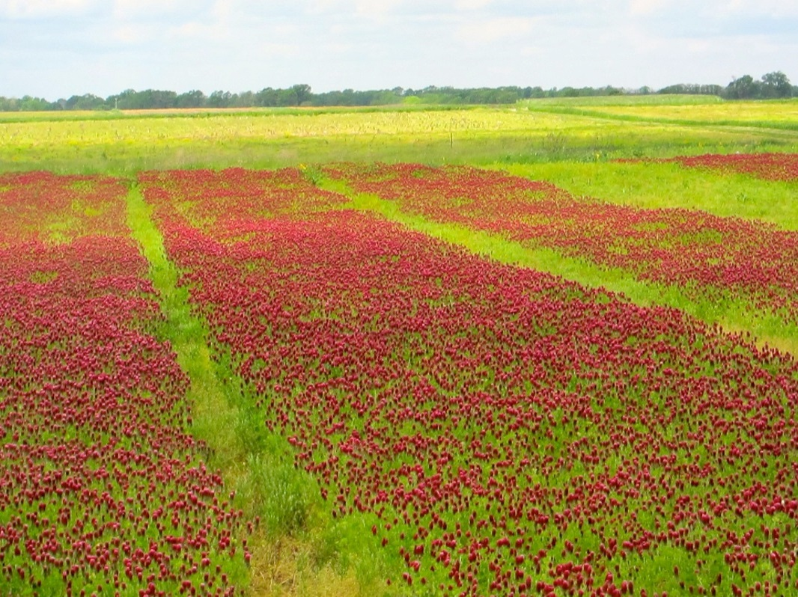
Crimson Clover
Photo: Rob Myers
Notes:
About Cover Crops
Crops grown during a time of the year when we wouldn’t normally plant anything, such as during winter or summer fallow periods in row crop operations.
Over 20 different species in use today in U.S.
Used all over the globe
Very applicable in multiple U.S. agricultural systems, including viticulture, annual row crop agriculture, horticulture systems and as livestock pasture.
Photo taken at Bradford Research Center, Columbia, MO

Slide 3
Factors to consider in selecting a cover crop
What time of year is the cover crop needed?
What are the goals for the cover crop use?
What planting method will be used?
How easy is the cover crop to establish?
What kind of soils are present?
What are the cash crops in the rotation?
What does the seed cost and how available is it?
Notes:
This animated slide shows 7 general considerations for selecting a cover crop. The presentation addresses these 7 areas in the order listed.

Slide 4
What time of year is the cover crop needed?
Fall planting of a cover (August to October)
  Best choices are winter annuals that require a cold period before flowering, eg., winter rye or crimson clover, or cool season annuals that will winter kill, such as oats or radishes
  Need to consider the winter-hardiness of the species
Spring planted cover crops (March or early April)
  Generally want a cool season annual or winter annual
Summer planted cover crops (May through August)
  Use “warm season” annuals – buckwheat, millets, etc.
Notes:
Planting date has a big impact on which cover crop to consider using.
For example, warm season cover crops such as buckwheat should not be planted late in the fall.
More on this topic in the following slides.
A good philosophy for successful cover cropping is to plant early. If you do plan to plant your cover crop early, this decision could impact which species you choose and what planting method you use.

Slide 5
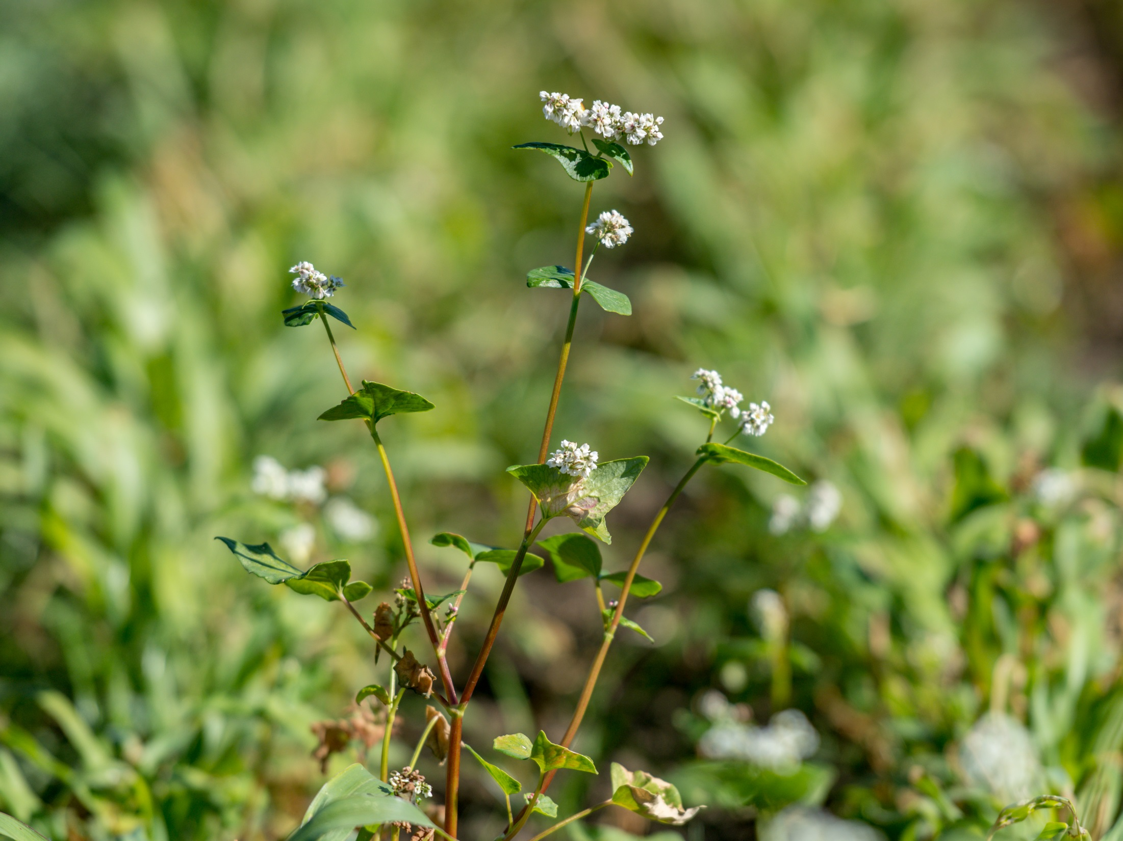
Buckwheat
Photo: Edwin Remsberg
Notes:
Buckwheat is a fast growing cover crop that does best in warm weather. It needs to be planted no later than August in most areas and June or July is better.
Photo taken at Washington State University Organic Farm in Pullman, WA.

Slide 6
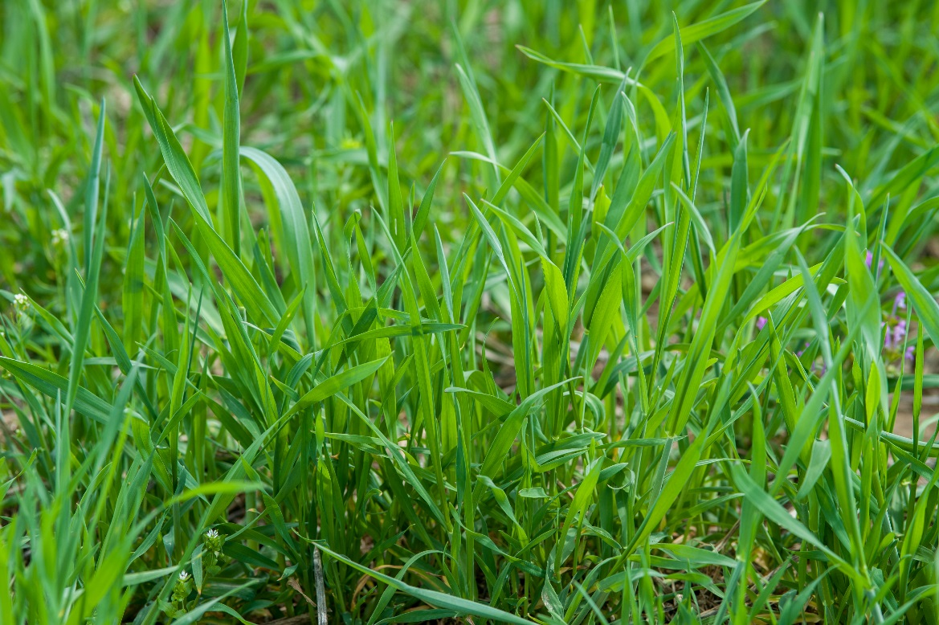
Biology of the cover crop plant
Annuals – fastest plants at getting established
  Winter annuals require a cold period to flower
  Summer annuals will flower in a single growing season
  Cool season annuals do best in spring or fall
  Warm season annuals thrive in the heat of mid-summer
Annual ryegrass
Photo: Edwin Remsberg
Notes:
One way to understand the seasonality of a cover crop is to understand its biology.
The fastest cover crops at establishment are annual cover crops.
Winter annuals must survive a cold period in order to flower.
Summer annuals will flower in their first growing season (like buckwheat)
Buckwheat will reseed and can be terminated after about 6 weeks to avoid this. It’s a fast growing plant, anyway, so it really only needs a 6-week growth window.
Cool season annual cover crops will perform the best if they are planted In spring or fall, whereas warm season annuals perform well in the heat of mid-summer.
Photo taken in Holtwood, PA.

Slide 7
Biology of the cover crop plant
Biennials
  Normally start growth in the spring or summer of one year and don’t flower until the following spring, e.g., sweetclover
Yellow sweetclover
Photo by Patrick J. Alexander, hosted by the USDA-NRCS PLANTS Database
Notes:
A biennial cover crop, like sweet clover, will grow in the spring or summer of the first year but won’t flower until the following spring.
One example of a situation where a biennial may be preferred:
A biennial can be frost-seeded into standing wheat and then, after the wheat harvest, the biennial can be left to grow, even into the following year.

Slide 8
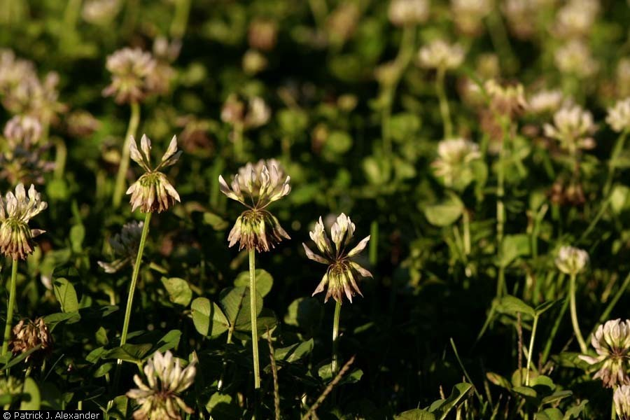
Biology of the cover crop plant
Perennials
  Plants that will live multiple years and can flower every year
  “Weak” perennials tend to die out after a few years
  Perennials are generally much slower at early above ground growth than annuals, as they are putting energy into roots
White Clover
Photo by Patrick J. Alexander, hosted by the USDA-NRCS PLANTS Database
Notes:
A perennial cover crop will survive for multiple years, with flowering every year. Perennials see slow growth in biomass, but build root biomass instead.

Slide 9
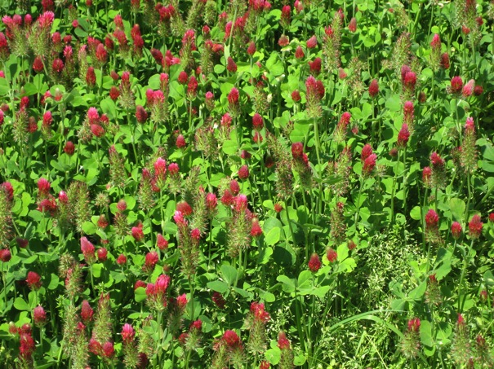
Cover Crops (examples)
Fall planted*
  Cereal (winter) rye
  Oats
  Oilseed radishes
  Annual ryegrass
  Hairy vetch
  Crimson clover
  Austrian pea
Spring planted
  Spring triticale
  Oats
  Austrian peas
  Dwarf rapeseed
  Clovers
Summer planted
  Sorghum sudangrass
  Foxtail millet
  Buckwheat
Crimson clover
Photo credit: Rob Myers
*Depending on region
Notes:
Some cover crops intended to protect the soil in the winter months can be planted in either the fall or the early spring, such as oats or certain legumes.
Of course it’s most beneficial to get them started in the fall if time permits, but if the cover crop doesn’t get established in the fall, an early spring planting can provide a month or two of cover before the summer cash crop needs to be planted.
Photo taken in Columbia, MO

Slide 10
What are the goals for the cover crop?
Soil erosion
Go for fast cover, good rooting, persistent growth
– cereal rye, annual ryegrass
Soil compaction
Cover crops that are deep rooting or taproots
– annual ryegrass, oilseed radishes, sunflowers
Nitrogen fixation
Limited to legumes
– hairy vetch, crimson clover, Austrian winter peas,
sunn hemp, cowpeas
Notes:
There are two text slides on possible goals for cover crops, and examples of some of the better cover crops for those particular goals, such as erosion control.

Slide 11
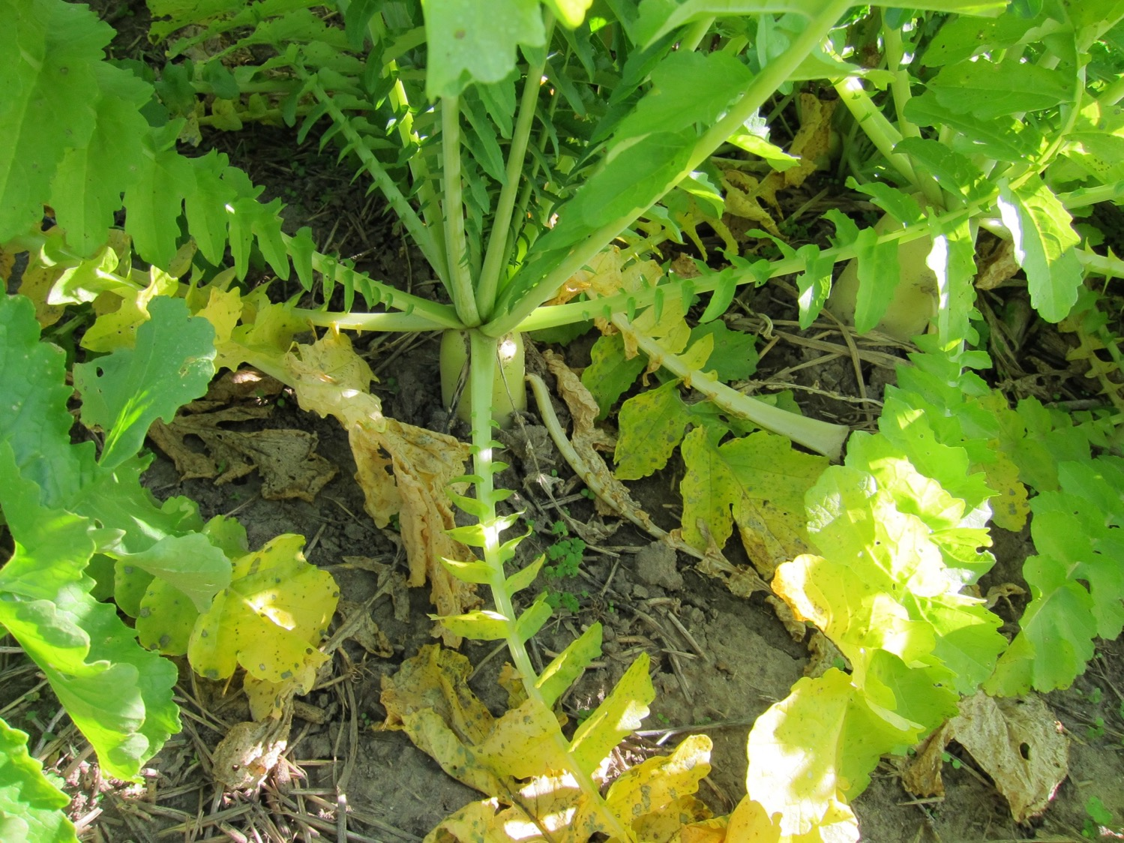
Oilseed Radish
Photo credit: Rob Myers
Notes:
Radishes are the most popular non-legume broadleaf cover crop.
They are very notable for their soil compaction benefits and are a good bet if that is your goal.
Additionally, there are some secondary goals that radishes can help accomplish on the farm.
Farmers like the fast fall growth, the fact that radish suppresses winter annual weeds, and in many areas will winter kill.
They can overwinter in southern states, however.
Radishes may help suppress some types of nematodes.
They can be used for cattle forage, but cattle prefer eating turnips, which are also a member of the Brassica family but a different species than radishes.
Photo taken in central Missouri.

Slide 12
Goals for the cover crop (cont’d)
Nitrogen scavenging
– radishes, cereal rye, ryegrass
Disease/nematode suppression
– Brassicas (e.g. radish), or just good rotation practices – ideally don’t use a grass cover crop before or after a grass cash crop (corn)
Weed control
– cereal rye (allelopathic and good at smothering weeds)
Pollinator habitat and food source
– buckwheat, clovers, diverse mixes

Slide 13
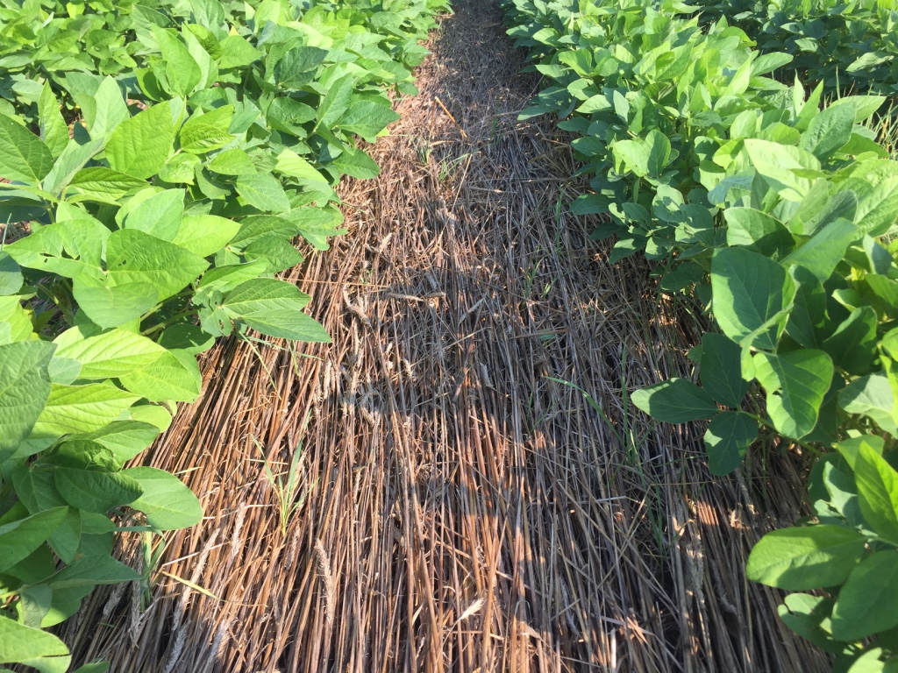
Cereal rye mulch layer in soybeans
Photo credit: Rob Myers
Notes:
Goals: weed control, erosion prevention
Increasingly, farmers are letting cereal rye grow fairly tall ahead of soybeans, sometimes 4-5 feet tall.
In some cases the rye is rolled before planting the soybeans. More often, farmers are planting the soybeans directly into the standing rye.
The planter will knock down much of the rye.
This photo shows rye that has been rolled, either right before or after planting the beans. The rye mulch helps control many weeds, though where there are gaps in the rye mulch, some weeds may poke through.

Slide 14

What planting method will be used?
Traditionally, most cover crop seed has been drilled or broadcast seeded. When broadcasting:
  The larger the seed, the harder it is to get good seed-soil contact
  Cereal rye is often broadcast but success is highly dependent on getting a timely rain
Aerial seeding works best with smaller seeded cover crops like radishes, clovers and ryegrass rather than large seeds like Austrian winter peas
Broadcast seeding methods allow early planting of cover crops
Photo credit: Rob Myers
Notes:
Aerial seeding or other “over the top” broadcast seeding methods, such as high clearance seeders, allow cover crop seed to get planted earlier, typically while the summer cash crop is starting to dry down, but before harvest.
However, broadcast seeding is best done just ahead of a forecast rain, which can be hard to time.
A grain drill or other planters is generally a more reliable method of cover crop establishment.
Broadcasting:
Improve seed-soil contact by roughing up the soil surface and pressing the seed into the soil after it is broadcasted
A roller or light incorporation with a vertical till machine or other shallow tillage may serve this purpose
Cereal rye is often broadcast and is more successful when there is a timely rain
Aerial seeding
Best for cover crops with smaller seeds, like radish, clover, and ryegrass
Larger-size seeds, like Austrian winter pea seeds, would not be suitable for aerial seeding

Slide 15
Planting method (cont’d)
Precision planters (like a corn planter)
  Work well for one or two species but not as well for multi-way blends of cover crop seed
Grain drills
  Provide a high rate of establishment success and can handle cover crop mixes
Planting method is often tied to planting date
  Some species are more important to plant early in fall (like radishes) than others (like cereal rye)

Slide 16
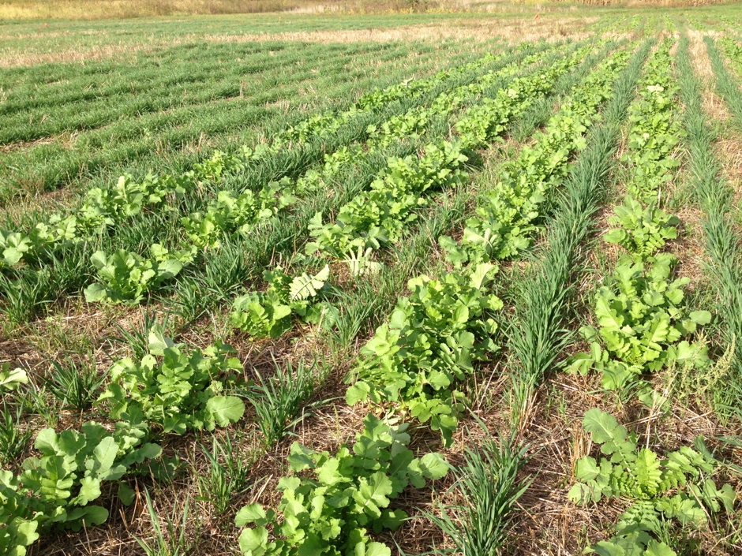
Radishes and cereal rye
Planted with a row crop planter
Photo credit: Rob Myers
Notes:
Some farmers like to plant alternating rows of radishes with a winter annual cereal, such as cereal rye, triticale, barley, or winter wheat.
The idea is that the radishes will winter kill, providing a strip where the corn can be planted the next spring.
In the meantime, the rye or other winter cereal will overwinter and continue to help hold the soil in place.
Because the radishes are high in nitrogen, they contribute to helping microbes break down any stalks left underneath the radish leaves.
This can leave a relatively bare strip by spring planting time, what some farmers call “bio-strip till” because it’s based on the biology of the plant-soil system rather than using a tillage instrument to create the strip.
Photo taken at Bradford Research Center, Columbia, MO

Slide 17
How easy is the cover crop to establish?
Ease of establishment based on:
  Type of seed, method of seeding, time of seeding, soil conditions, and especially moisture conditions and rainfall.
In general:
  Cover crops that are easier to establish:
    Crimson clover, cereal rye, oats, wheat, triticale, radishes, other Brassicas
  Using mixes of cover crops can improve odds of success, especially if just broadcasting or “disking it in” – something is likely to grow!
  Buying quality seed and good varieties can make a big difference – find out the tested germination – should be 85% or above.
Notes:
In surveys, farmers have indicated that getting success with establishing a cover crop is either a reason they don’t try covers or if they have grown them, an initial hurdle they have to learn how to handle.
Thus, having a good plan in place for improving establishment success is important.

Slide 18
Hairy vetch and oat mix
Depending on the region, oats will grow fast in the fall, and winter kill by mid- to late-December
Hairy vetch will go dormant in winter and continue growth in the spring
Photo credit: Rob Myers
Notes:
In this photo, oats and vetch were drilled together in early fall.
The oats grow faster than the vetch in the fall, thus improving erosion control and even helping trap snow and improving survival of the vetch.
The oats will winter kill by mid-to-late December, while the hairy vetch will go dormant and then regrow in spring.
The vetch will really take off in mid or late April, and if allowed to grow till mid to late May, can produce a fair amount of nitrogen and suppress weeds.
The contents of these notes, and this example in particular, may be more applicable for production systems in the Midwest or Northeast. However, though this particular mix may not be universally effective, there are important concepts within this example that can be applied to many production systems.
Combine species to fill different niches in your seasons based on the species’ growing preferences
Photo taken in Columbia, MO at Bradford Research Center

Slide 19
How hard is it to terminate the cover crop?
Possible methods of control:
  Herbicide, tilling, mowing, rolling, roller-crimper, grazing or easiest of all – winter!
With most mechanical methods, best success comes after cover crop reaches reproductive (flowering) phase
If using herbicides, cover crop needs to be actively growing to translocate the herbicide
  Clover termination can require 2,4-D added to glyphosate
  Winter rye pretty easy to kill with glyphosate
Really thick matts of covers (rye or mixes) can be tough to completely kill with a roller crimper
For beginning cover crop users, sometimes easiest thing is a cover crop that winter kills – oats, radishes
Notes:
Having a good strategy for terminating any cover crops that will overwinter is an important part of using cover crops.
Increasingly, farmers are terminating them later in the spring than they used to, especially before soybeans or other later planted summer crops.
However, farmers need to pay attention to soil moisture and think about how they will plant through the cover crop residue.

Slide 20
Crimson Clover
Photo credit: Rob Myers
Notes:
Crimson clover is one of the most striking cover crops, and one of the faster growing clovers.
It’s useful in much of the southern and middle U.S. latitudes, but will often winter kill in areas north of Interstate 70.
Snow cover can improve the odds of winter survival.
Poorly drained fields can be a challenge for crimson clover – that situation is probably better suited to a grass species of cover crop.
Photo taken in Columbia, MO.

Slide 21
What are your soil types?
Good drainage important for some overwintering cover crops like crimson clover
Sandy soils may need a cover crop good at building organic matter and helping hold the soil from blowing
Claypan soils may need a strong rooting cover crop like annual ryegrass, sunflowers, or possibly radishes
Low fertility soils may benefit from a legume, but watch out if pH is really low (grasses can tolerate acid soils better than clovers and other legumes)
Sloping fields that are erosive need a fast-growing, persistent cover crop like cereal rye or clovers
Notes:
- Sloping fields that are erosive, adding a low-growing clover with the grass provides even better ground cover

Slide 22
What are the cash crops in the rotation?
Try to have a diverse rotation in terms of plant families and plant types
  Corn -> cereal rye -> corn -> cereal rye this is not an ideal rotation
  Better approach is to add diversity between grasses and broadleaves, such as:
  Corn -> cereal rye with radishes -> soybean -> crimson clover/oats
May want to adjust cash crop planting dates, herbicides
Mixes of covers adds biodiversity
If grazing can be done with covers, that will influence choices

Slide 23
Building Soil Organic Matter
It can help to plant a diverse, high-biomass cover crop mix for a several month period, such as after winter wheat harvest.
This is one of the fastest ways to build soil organic matter
Sorghum sudangass, sunnhemp,
and other covers
Photo credit: Rob Myers
Notes:
Some corn and soybean farmers are adding wheat back to their rotation in order to have more time to grow a high biomass cover crop mix, with the goal of getting faster soil improvement and building soil organic matter.
Photo taken in Lancaster, PA.

Slide 24
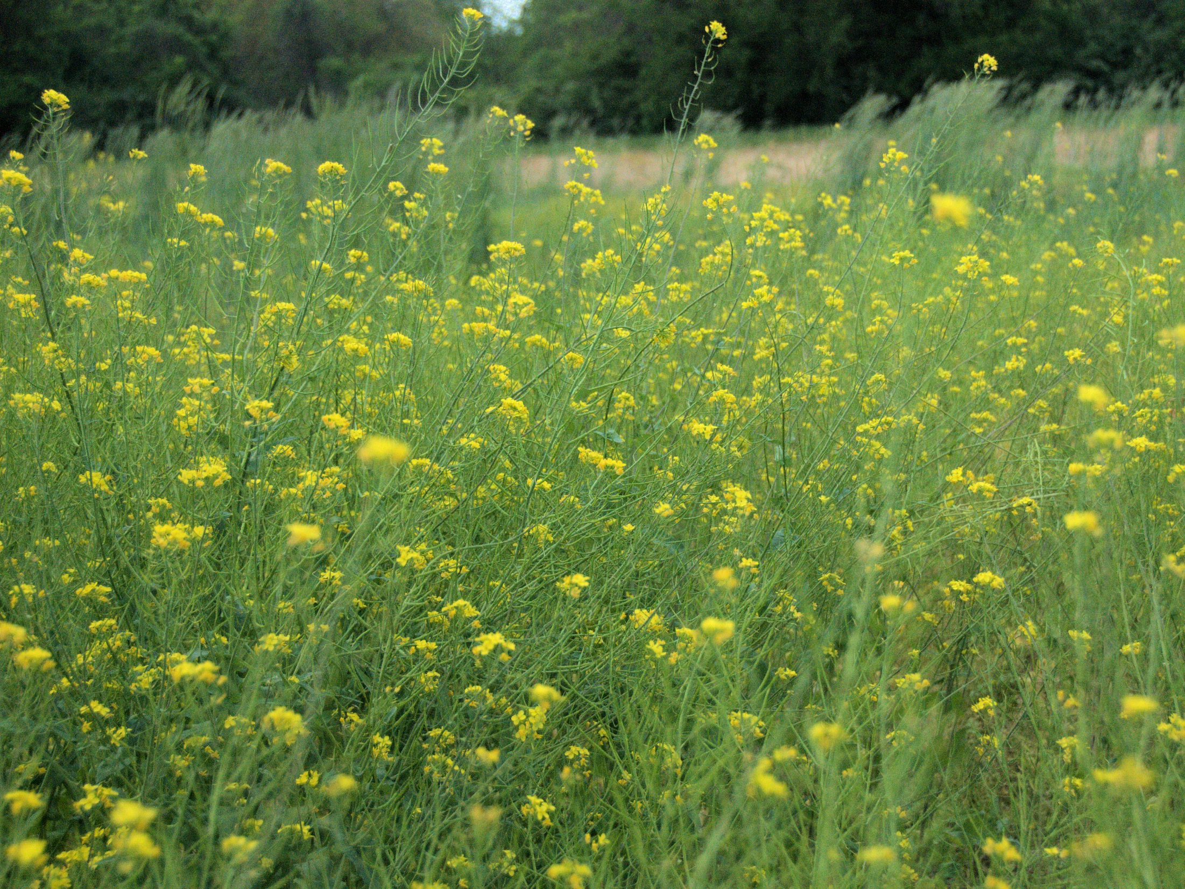
Purple Top Turnip
Photo credit: Jason Vance
Notes:
Turnips are generally preferred over radishes for grazing cattle.
The cattle will eat both the green leaves and the tubers.
The green growth will normally winter kill (except for the deep South), but cattle can paw out tubers or eat the tops throughout the winter.
Eventually the tubers will decompose in the spring.
Photo taken at the USDA NRCS Plant Materials Center in Missouri.

Slide 25
What does the seed cost and how available is it?
Cheap and readily available ≠ good
Buy quality seed of known varieties and appropriate varieties
  Really important for annual ryegrass
Order early, seed often in short supply late in season
Inoculate legumes (keep inoculum cool)
Mixes of species have pluses but can be more expensive
Consider applying for government cost-share programs
Invest in your cover crop like you would your cash crop!
  Buy good seed, don’t plant too thinly, and plant correctly at the right time
Notes:
Buying quality seed with cover crops is just as important as getting good seed for corn, soybeans, or other cash crops.
Too many farmers have made the mistake of going for the cheapest cover crop seed they can find, only to realize after planting hundreds of acres that the seed had very poor germination or other issues.

Slide 26
Some simple recommendations
Just starting out?
  Try something that winter kills, like a mix of oats and radishes
Need a general purpose cover crop that provides fall, winter and spring erosion control and is easy to terminate?
  Cereal rye
Want a legume that can fix some nitrogen and is easy to manage?
  Crimson clover in areas near Interstate 70 or further south (avoid poorly drained soils) or look at hairy vetch or red clover further north
Try mixes, especially as you get experience
Consider warm season cover crops after wheat or vegetable crops, including mixes
Go to field days, talk to other farmers, experiment!
Notes:
This final text slide helps summarize some of the main ideas on what cover crops to select, and simplifies the options down to a few reliable and common choices.

Slide 27
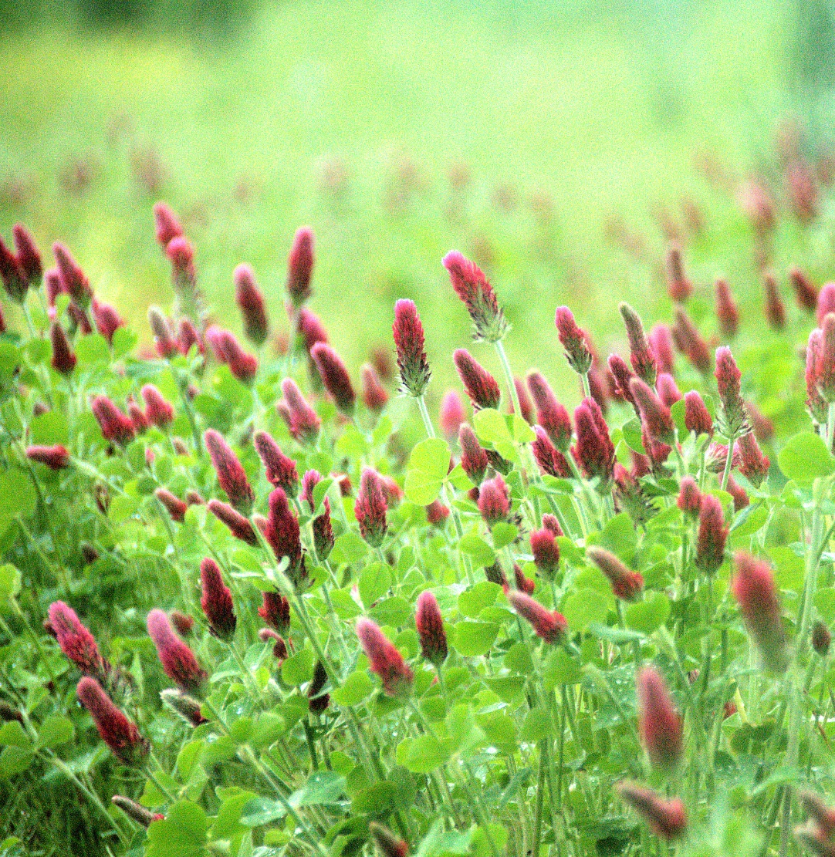
Thank you!
www.sare.org/covercrops
Photo by Jason Vance
Notes:
Photo taken in Columbia, MO

