Slide 1

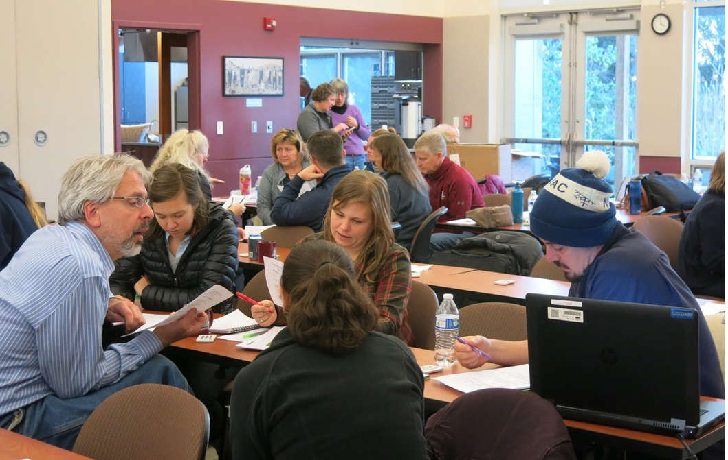
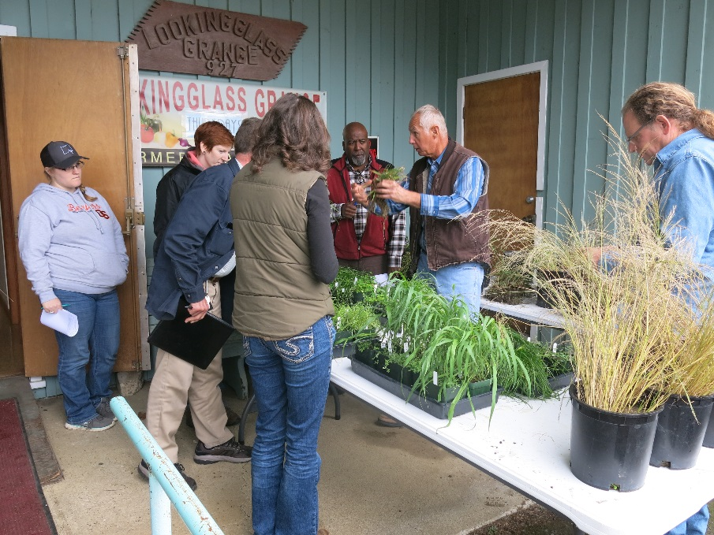
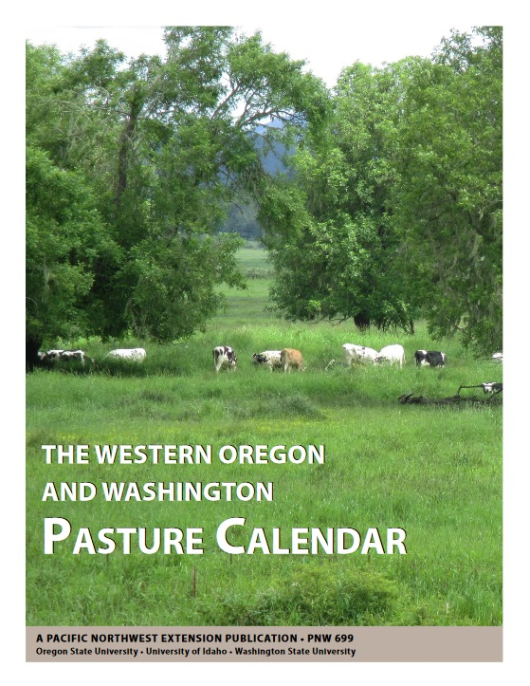
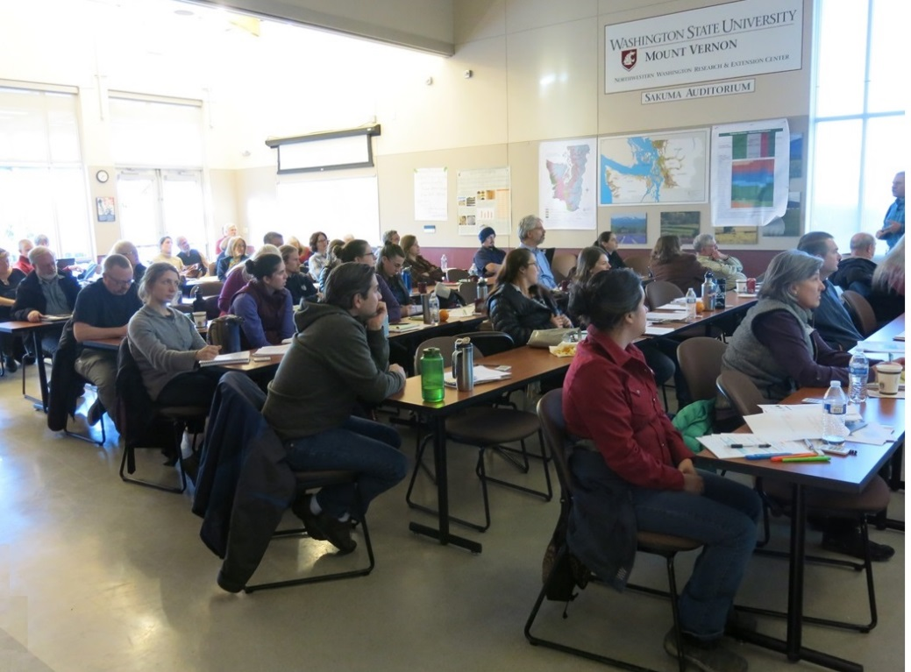
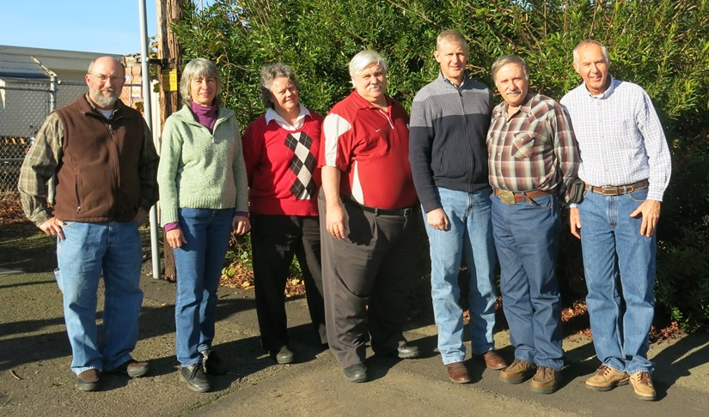
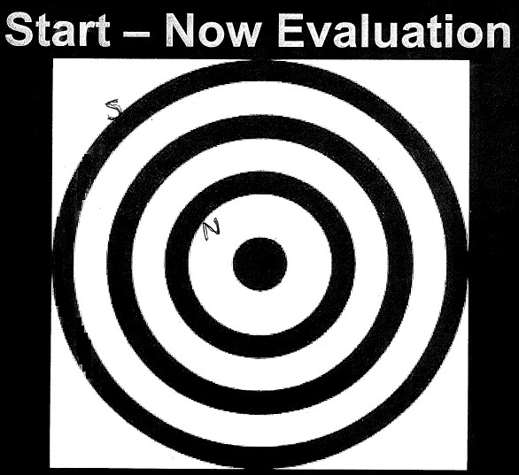
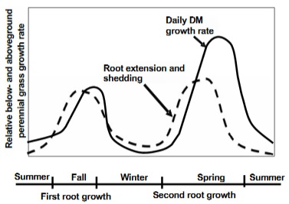
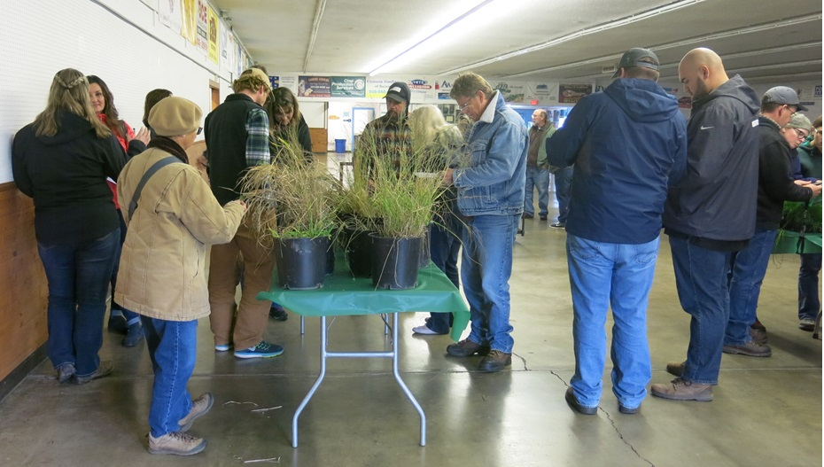


Westside Pasture Calendar for Agricultural Professionals in the Pacific Northwest
P.I. Dr. Steve Fransen Washington State University, Prosser, WA
Marty Chaney, USDA NRCS, Olympia, WA
Gene Pirelli, Oregon State University Extension Service, Dallas, OR
Scott Robbins, USDA NRCS, Portland, OR
*Dr. Susan Kerr, Washington State University, Mount Vernon, WA, kerrs@wsu.edu
Gary Fredricks, Washington State University, Vancouver, WA
Dr. Shannon Neibergs, Washington State University, Pullman, WA
OUTCOMES CONTINUED
What results/impacts do you expect to happen from participating in this program?
Most responses described expected increased forage production, conservation enhancement, knowledge/skill gains for educators and clientele, and improved pasture management skills. Selected specific comments:
•More conservation/agricultural easements implemented.
•Increase retention at ranches after inter-generational transfer
•Increase forage/increase calving rate
•Improved quality and quantity of hay = increased economic viability
•Feel more confident in discussions with landowners
•Better understanding of growth of pasture to timing of the year
•Having the data to show customers will be invaluable
•I feel more empowered to discuss grass biology and pasture economics
•Expand service level to customers
•Improved pasture - improved animal health/production
•Improved environment & animal welfare
•Better able to present science backed information and more options to address pasture issues
•Greater knowledge will lead to increased willingness and ability to work with grazers
For the pre-/post-training “bullseye” self-evaluation (1= outer ring or least knowledgeable, 5 = bullseye or most knowledgeable):
Oregon scores increased 140.35% from an average of 3.29 to 4.62. Only one person reported a 5 before the workshop and 33 of 52 respondents reported a 5 afterwards.
Washington scores increased from an average of 2.92 to 4.32, an increase of 147.95 %. No one reported a 5 before the workshop and 31 of 85 respondents reported a 5 afterwards.
ABSTRACT
Western Oregon and Washington have similar climates, soils, crops, farming systems,
and urban growth issues differing greatly from the rest of the Pacific Northwest. This
area is experiencing increased numbers of new and small acreage farming.
Unfortunately, this increases the risk of pasture abuse by inexperienced landowners
with little animal husbandry or natural resource management knowledge. PNW 699, The Western WA and OR Pasture Calendar publication (free downloading available at https://catalog.extension.oregonstate.edu/sites/catalog/files/project/pdf/pnw699.pdf ) was created as a tool for landowners and educators to use as a guide to understanding,
managing, and improving pastures. Through daylong workshops, the project team
traveled to eight western WA and OR locations to teach more than 200 Extension
faculty, NRCS and Conservation District personnel, consultants, farm advisors, Master Livestock Advisors, and progressive producers about best pasture management principles using the Pasture Calendar. Workshop presentations and activities emphasized sustainability through increased forage production and livestock health, improved water and soil quality, and reduced weed incursions. Pre- and post-test results documented knowledge gains. Participants will be contacted six months after training to measure knowledge retention and determine the extent to which they are implementing (or recommending) management changes based on Pasture Calendar training. Long-term improvement in economic viability, environ-mental health, and social acceptance of livestock and forage production are expected.
“Better pasture management = healthier land, people and animals.”
“I shall not graze below 3”!”
From The Western Oregon and Washington Pasture Guide (PNW 699),
© Oregon State University.
OUTCOMES
A total of 260 people attended workshops in four OR and four WA locations. Participant affiliations were 31 NRCS, 7 other USDA, 3 state departments of agriculture, 15 Extension, 40 Conservation District, 6 consultants, 30 producers, and miscellaneous others.
Knowledge gains documented by the pre-test/post-test included up to 217% increase in average correct scores for individual questions in OR and up to 164% in WA.
How satisfied are you with: (answer averages from 1-4, with 1 being lowest; OR first, WA second)
the relevance of information to your needs? 3.50, 3.51
the presentation quality of the instructors? 3.63, 3.66
the subject matter knowledge of the instructors? 3.75, 3.88
the overall quality of the workshop? 3.56, 3.66
To what extent do you think you can apply the information presented today in your work (1-5, with 5 being “a great deal”): 4.34, 4.34
How will you apply the info you learned in this workshop?
Oregon: 70 of 74 respondents shared their plans; 27 indicated they planned to share information with clientele, 35 shared details of the specific management changes they intend to make, mostly focusing on grazing plans and pasture management.
Washington: 101 of 103 respondents shared their plans; 46 indicated they planned to share information with/educate clientele, 45 shared details of the specific management changes they intend to make, mostly focusing on pasture management and natural resource conservation practices. Selected specific comments:
•Training staff in grazing management
•Pay more attention to grazing good forage - minimum 3"!
•Use it to develop grazing plans, keep records on how grazing was managed, compare results
•To more knowledgeably develop management plans and agricultural/conservation easements
•In making recommendations relating to overall pasture management through seed, fertilizer and fencing
•I have clients with hammered pastures and I will try to draft talking points to increase their appreciation of grass production
INTRODUCTION
Western Oregon and Washington have similar climates, soils, crops, farming systems, and urban growth issues differing greatly from the rest of the Pacific Northwest. Over 2 million pasture acres and 1.1 million grazing animals lie between the Pacific Ocean and the Cascade Mountains (WA NRCS, 2011; USDA Census, 2012; OR NRCS, 2012). This area is experiencing increased numbers of new and small acreage farming. Unfortunately, this greatly increases the risk of pasture abuse by inexperienced landowners with little animal husbandry or natural resource management knowledge.
INPUTS
Personnel (see above)
Funding
  Washington State SARE PDP, $2,500
  SARE Professional Development Grant: EW17-021, $74,555
Forage Samples
Dr. Kerr planted and/or dug 20 varieties of forages and grew them in a greenhouse for about two months before the workshop series started. These were transported to each workshop so participants could learn to identify them, compare their characteristics, and gain other hands-on knowledge about forages. One timothy sample was clipped at ground level every few days to simulate the effects of continuous grazing; a second control sample was not clipped.
OUTPUTS
The team conducted four all-day workshops in Oregon the week of Nov. 13, 2017 and four in Washington the week of Dec. 4. Presentation topics included foundational information about soils, plant growth, pasture management, and forage economics as well as instruction on how to use the Pasture Calendar itself. Each attendee received numerous relevant handouts, including a color copy of the Calendar. Additional handouts and an electronic version of the Calendar were included on a thumbdrive distributed to all. Attendees also received a pasture stick commissioned for this project.
Fellows are exposed to hardships such as heart-wrenching ice cream decisions.
“Better able to convince landowner to manage pasture.”
 | Change* from Pre-test to Post-test (%): OR Sites
Question | Coquille | Roseburg | Dallas | Tillamook
1 | ^216.67 | 23.33 | ^67.31 | ^70.45
2 | 40.43 | ^117.24 | 17.51 | 0
3 | 14.63 | 12.82 | 33.33 | 0
4 | 13.64 | 1.08 | 26.03 | 0
5 | 28.21 | 7.53 | 6.02 | 33.33
6 | 6.38 | 1.08 | 1.08 | 0
7 | 6.82 | ^40.85 | 33.33 | ^58.73
8 | ^113.64 | ^49.25 | 25.37 | 0
9 | 1.12 | 5.71 | 5.88 | 0
10 | 12.77 | 18.52 | 10.84 | ^78.57
11 | ^100.00 | 32.20 | 9.46 | 33.33
12 | ^85.37 | 36.92 | 11.94 | 29.55
13 | ^86.36 | 35.14 | 27.54 | 55.36
14 | 11.36 | ^37.50 | ^110.53 | 8.00
15 | 0 | 1.10 | 4.17 | 12.36
16 | 61.36 | ^60.42 | ^76.09 | 30.30
17 | 67.86 | 16.67 | ^67.44 | ^163.16
18 | 12.36 | 5.00 | 0 | 0
19 | 0 | 3.09 | 7.53 | 12.00
20 | 67.86 | 26.58 | ^315.07 | ^100.00
 | Change* from Pre-test to Post-test (%): WA Sites
Question | Mt. Vernon | Port Hadlock | Tumwater | Vancouver
+1 | ^100.00 | 31.58 | ^105.88 | ^64.29
2 | 6.06 | 13.04 | ^88.46 | 20.00
3 | 10.98 | 1.09 | 16.87 | 13.00
4 | 0 | 1.09 | 2.11 | 6.38
5 | 0 | 19.18 | 2.25 | 23.46
6 | 0 | 0 | 9.20 | 1.06
7 | 1.06 | 36.99 | 21.95 | 24.00
+8 | 22.54 | ^46.67 | ^59.26 | ^58.73
9 | 2.67 | 12.80 | 4.41 | 6.67
10 | 0 | 7.00 | 11.11 | 0
11 | ^83.33 | 22.08 | 31.15 | 23.46
12 | 30.56 | ^163.64 | 39.68 | 55.00
-13 | 13.89 | ^50.00 | 43.18 | 46.15
+14 | ^120.83 | ^96.30 | 4.17 | ^60.00
15 | 3.00 | 7.53 | 4.21 | 0
+16 | ^60.42 | 6.90 | ^137.93 | ^88.68
+17 | ^100.00 | ^70.21 | ^91.43 | ^127.27
18 | 3.00 | 7.53 | 5.26 | 7.00
19 | 6.38 | 7.53 | 5.26 | 1.14
20 | 30.56 | 16.28 | 20.48 | 13.64
*Numbers are percent change of the percent of audience that got each question correct during the pre-test; they are not percentage points themselves.
Red font indicates negative values
^ denotes five highest gains for each site
CONCLUSIONS
This project was a long-time goal of several Extension educators and NRCS staff and will be the crowning achievement of several long careers. The ultimate goal was to train more forage educators in the PNW so farms in the area will be well-served by knowledgeable educators for years to come. Project objectives were achieved: 260 participants were trained to use the Pasture Calendar and are well situated to share their knowledge with others, including producers. To date, three post-training workshops about the Pasture Calendar have been conducted by trainees and impacts of those programs are being received. For example, the writing and outreach of one private consultant has been transformed due to his new understanding of grass growth. 158 downloads in 3 months
This project teams offers the following advice to others who plan to conduct similar training:
Start the process early so you will have plenty of time for each step needed for success
Define the topic well
Partner with other agencies to leverage resources
Clearly identify and address major take-home messages
Have a strong team with members who can works well together--have tons of fun!
Breaking new ground with urban greens.
“I'll be able to more easily talk with producers and help find solutions.”
“Better equipped to help other livestock owners improve pasture management and farm profitability.”
New cool-season grass growth cycle based on above-ground and root growth. Source: The Western Oregon and Washington Pasture Calendar, p. 5.
From The Western Oregon and Washington Pasture Guide (PNW 699), © Oregon State University.

