Slide 1
Soil Health Illustrations
A project of the North Central Region Sustainable Agriculture Research and Education Program (NCR-SARE) & the Howard G. Buffett Foundation

Slide 2
Look at the “notes”
As you proceed through this document and view each illustration, please look at the ”notes” section below each slide for an explanation of the illustration.

Slide 3
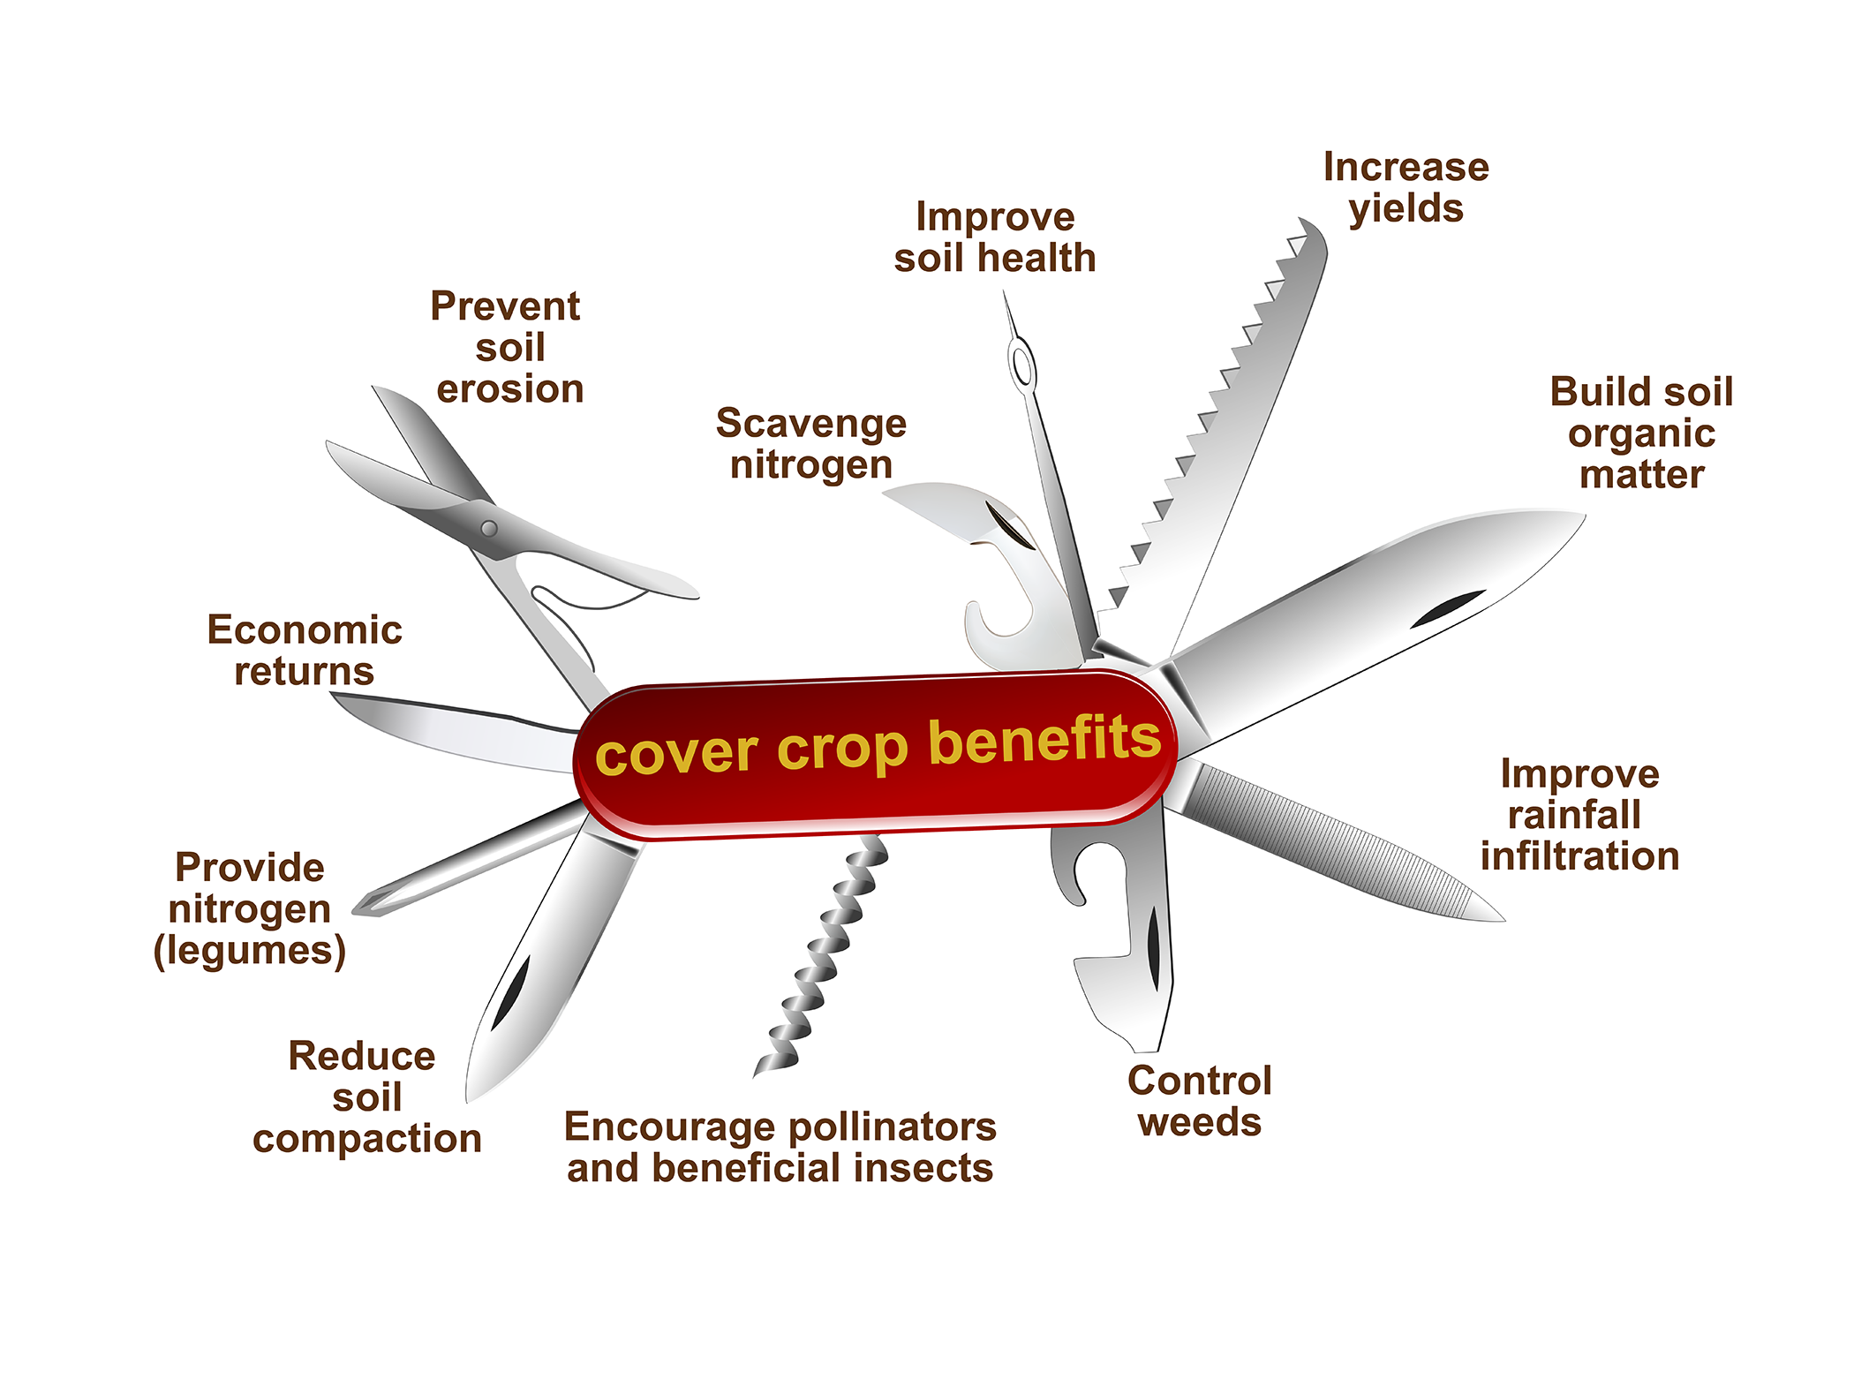
Illustration by Carlyn Iverson.
Notes:
Cover crops are like a Swiss Army Knife because of their dynamic utility on the farm. By planting and managing cover crops, farmers can see multiple benefits to their land, including: improved soil health, increased soil organic matter, reduced soil compaction, decreased soil erosion, improved rainfall infiltration, natural weed and pest management, enhanced presence of pollinators and other beneficial insects, better nutrient cycling including the scavenging of residual nitrogen and the provision of additional nitrogen by legume crops such as clover, and economic returns by saving money spent on inputs and increasing crop yields.

Slide 4
Illustration design by Carlyn Iverson; concept from Michael Lehman.
Notes:
Like cover crops, soil microbes play many important roles, so that they can be likened to a tool kit with several different parts. Microbes provide pathogen and pest protection, promote plant growth, enhance soil structure and aggregation, assist in making nutrients available to plants, retain nutrients in the soil profile, fix nitrogen into the soil ecosystem, and build soil carbon. Considering all of these benefits, it is clear that soil microbes should be considered among the many tools employed on a farm.

Slide 5
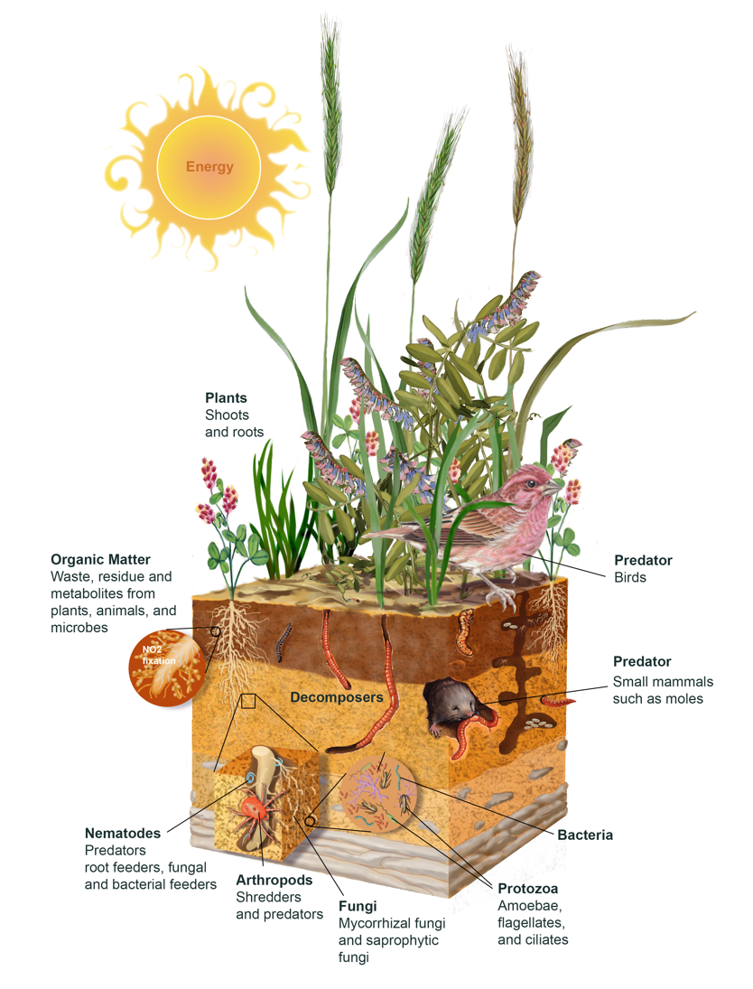
Illustration by Carlyn Iverson.
Notes:
This illustration displays the diversity that is present in a healthy soil ecosystem. When management practices, like cover cropping and no-till, are used that promote soil health and support microbial life, this translates to a diverse ecosystem. Natural predators are given habitat, whether above or belowground, to dissuade the presence of pests which could harm crop production. Wildlife is stewarded during vulnerable times of the year, such as when migrating birds move over the landscape as the seasons change. The presence of earthworms and increased soil organic matter signal that the soil’s fertility is increasing. The channels created by plant roots and earthworm activity allow water to infiltrate into the soil layer rather than running off. The soil, and the nutrients like nitrogen that are attached to it, are held in place.

Slide 6
Illustration design by Carlyn Iverson; concept from Michael Lehman.
Notes:
In this illustration, we see a soil ecosystem, with organisms living within and above the soil surface. We cannot see any microbial life because microbes are so small. But the microbes are playing important roles that shape the ecosystem that we can see. Though we cannot observe the microbes directly with our eyes, we can see the impact they have on the ecosystem through the regulation of nutrient cycling, the promotion of plant growth, the improved fertility of the soil, and the provision of soil structure and aggregation which has so many other tangible benefits such as increased water infiltration and decreased soil compaction. Microbes are an invisible force playing an important role in the entire system.

Slide 7
Illustration design by Carlyn Iverson; concept from Michael Lehman.
Notes:
If we were to see the microorganisms, it would look something like this image, where we can observe the microbes dispersed everywhere in that soil ecosystem. Though we cannot observe the microbes directly with our eyes, we can see the impact they have on the ecosystem through the regulation of nutrient cycling, the promotion of plant growth, the improved fertility of the soil, and the provision of soil structure and aggregation which has so many other tangible benefits such as increased water infiltration and decreased soil compaction. Microbes are an invisible force playing an important role in the entire system.

Slide 8
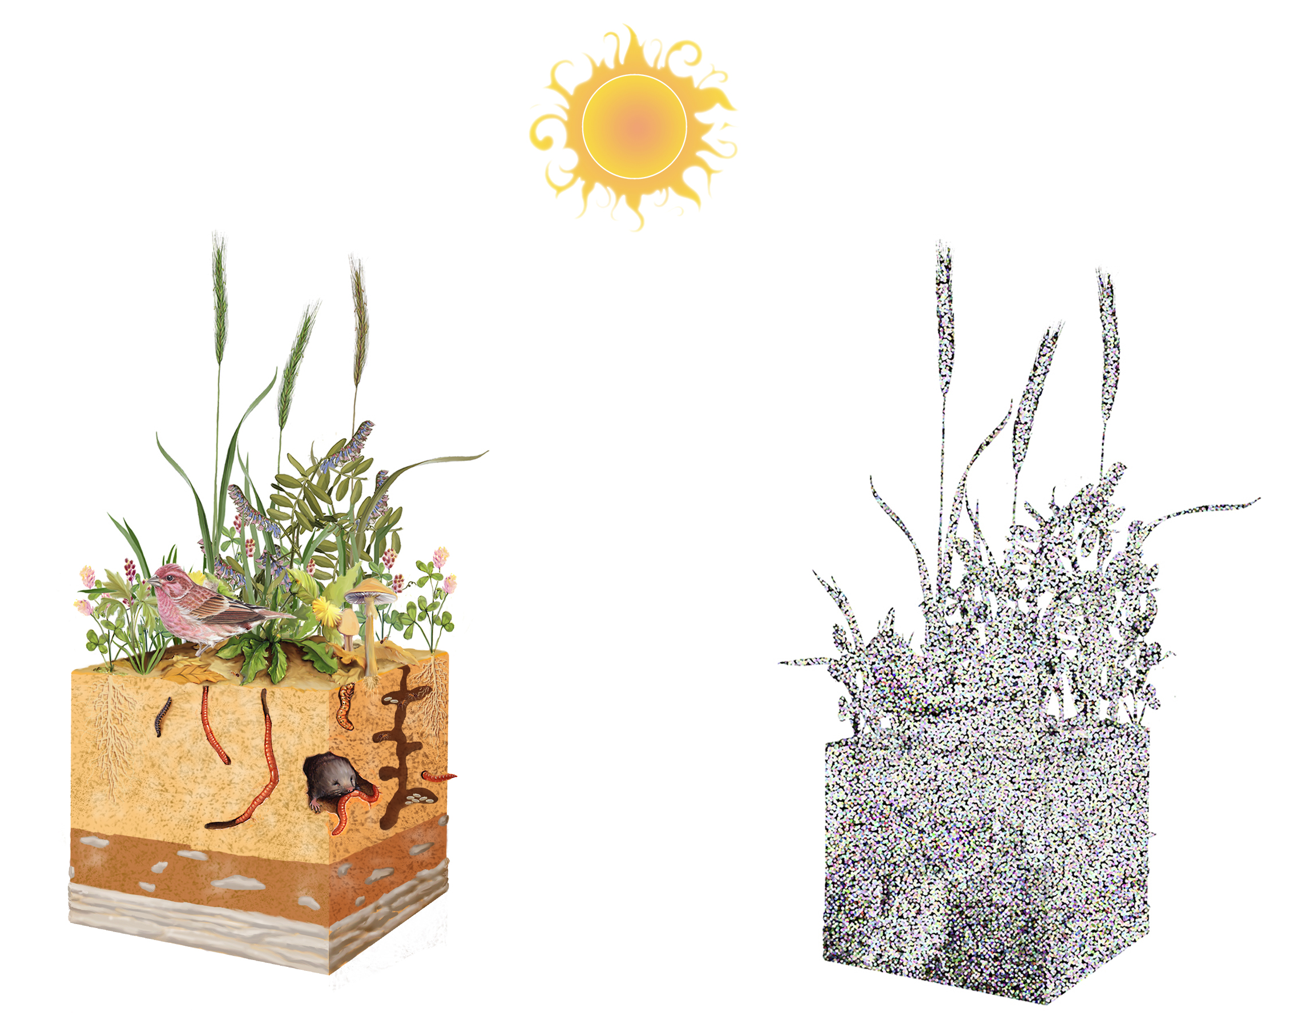
Illustration design by Carlyn Iverson; concept from Michael Lehman.
Notes:
In this illustration, on the left we see a soil ecosystem, with organisms living within and above the soil surface. We cannot see any microbial life because microbes are so small. But if we were to see the microorganisms, it would look something like the right-hand image, where we can observe the microbes dispersed everywhere in that soil ecosystem. Though we cannot observe the microbes directly with our eyes, we can see the impact they have on the ecosystem through the regulation of nutrient cycling, the promotion of plant growth, the improved fertility of the soil, and the provision of soil structure and aggregation which has so many other tangible benefits such as increased water infiltration and decreased soil compaction. Microbes are an invisible force playing an important role in the entire system.

Slide 9
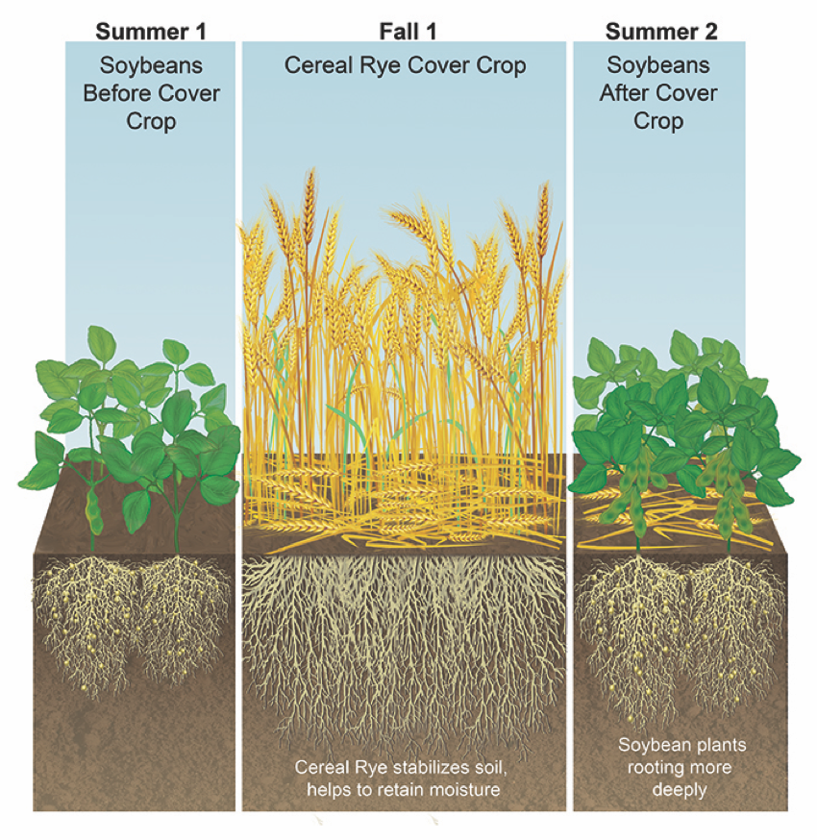
Illustration by Carlyn Iverson.
Notes:
Cover crops, like cereal rye, are often planted to cover the soil and prevent erosion. How exactly do they do this? In this illustration, cereal rye is planted in the fall after a soybean crop was harvested. Cereal rye is a fast growing crop with high volumes of above and belowground biomass, and during its growing cycle, its roots are able to grow deeper into the soil than the soybean roots before it. By rooting deeply and providing plenty of aboveground cover, the rye cover crop stabilizes the soil, preventing erosion, and retains moisture. Its roots create channels that allow crops planted after the cereal rye to root more deeply and benefit from the enhanced soil structure and moisture. This is apparent by looking at the soybean crop on the righthand side of this illustration.

Slide 10
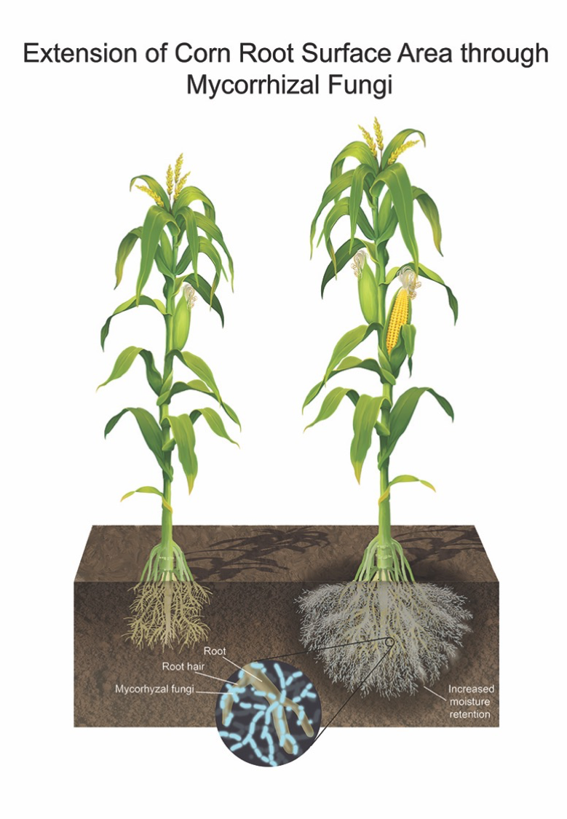
Illustration by Carlyn Iverson.
Notes:
Mycorrhizal fungi form associations with the roots of plants, such as with the corn growing in this illustration. The fungi connect with the root hairs of the corn and extend their hyphae through the soil, thus “extending” the root surface area of the plant. This provides an opportunity to transfer carbon and nutrients with the fungi while also increasing the stability of the soil and the moisture retention in the soil.

Slide 11
Illustration by Carlyn Iverson.
Notes:
Mycorrhizal fungi form associations with the roots of plants, such as with the corn growing in this illustration. The fungi connect with the root hairs of the corn and extend their hyphae through the soil, thus “extending” the root surface area of the plant. This provides an opportunity to transfer carbon and nutrients with the fungi while also increasing the stability of the soil and the moisture retention in the soil.

Slide 12
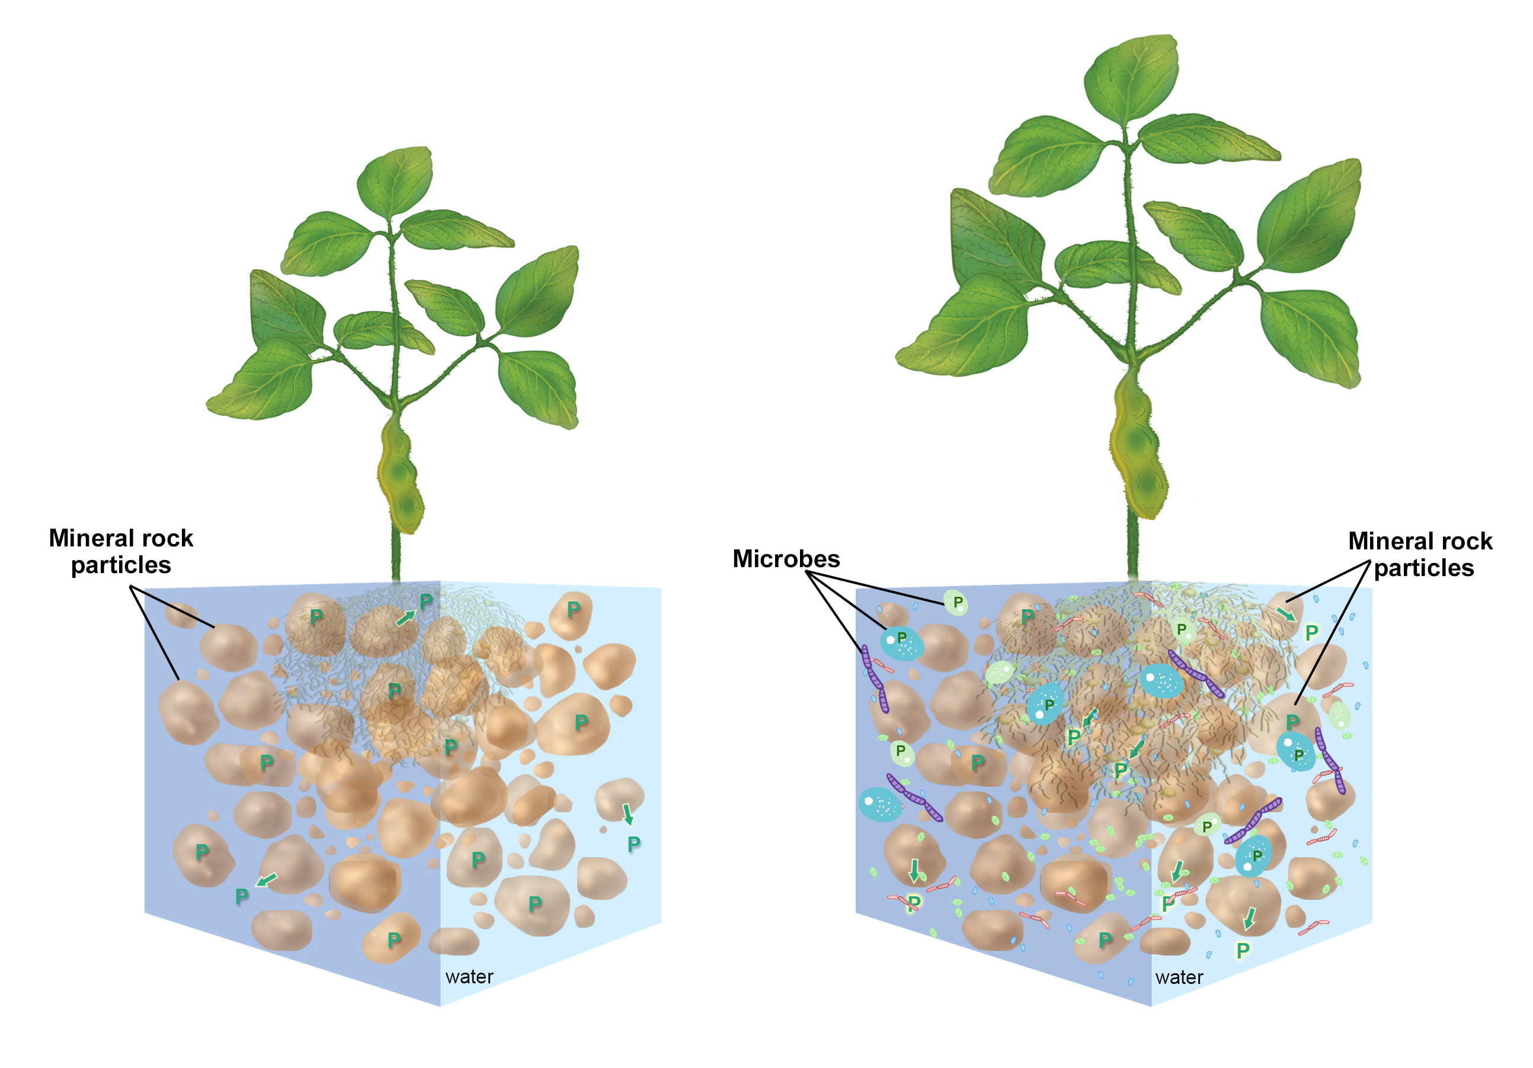
Illustration design by Carlyn Iverson; concept from Michael Lehman.
Notes:
Soil is comprised of particles of inorganic and organic material and water. The particles in the soil bind to elements and nutrients like phosphorus, which is an important nutrient for plant growth (see left). When microorganisms are present in the soil, through various mechanisms they are able to free phosphorus from its bound state to the particles and enable plants to use the phosphorus (see right).

Slide 13
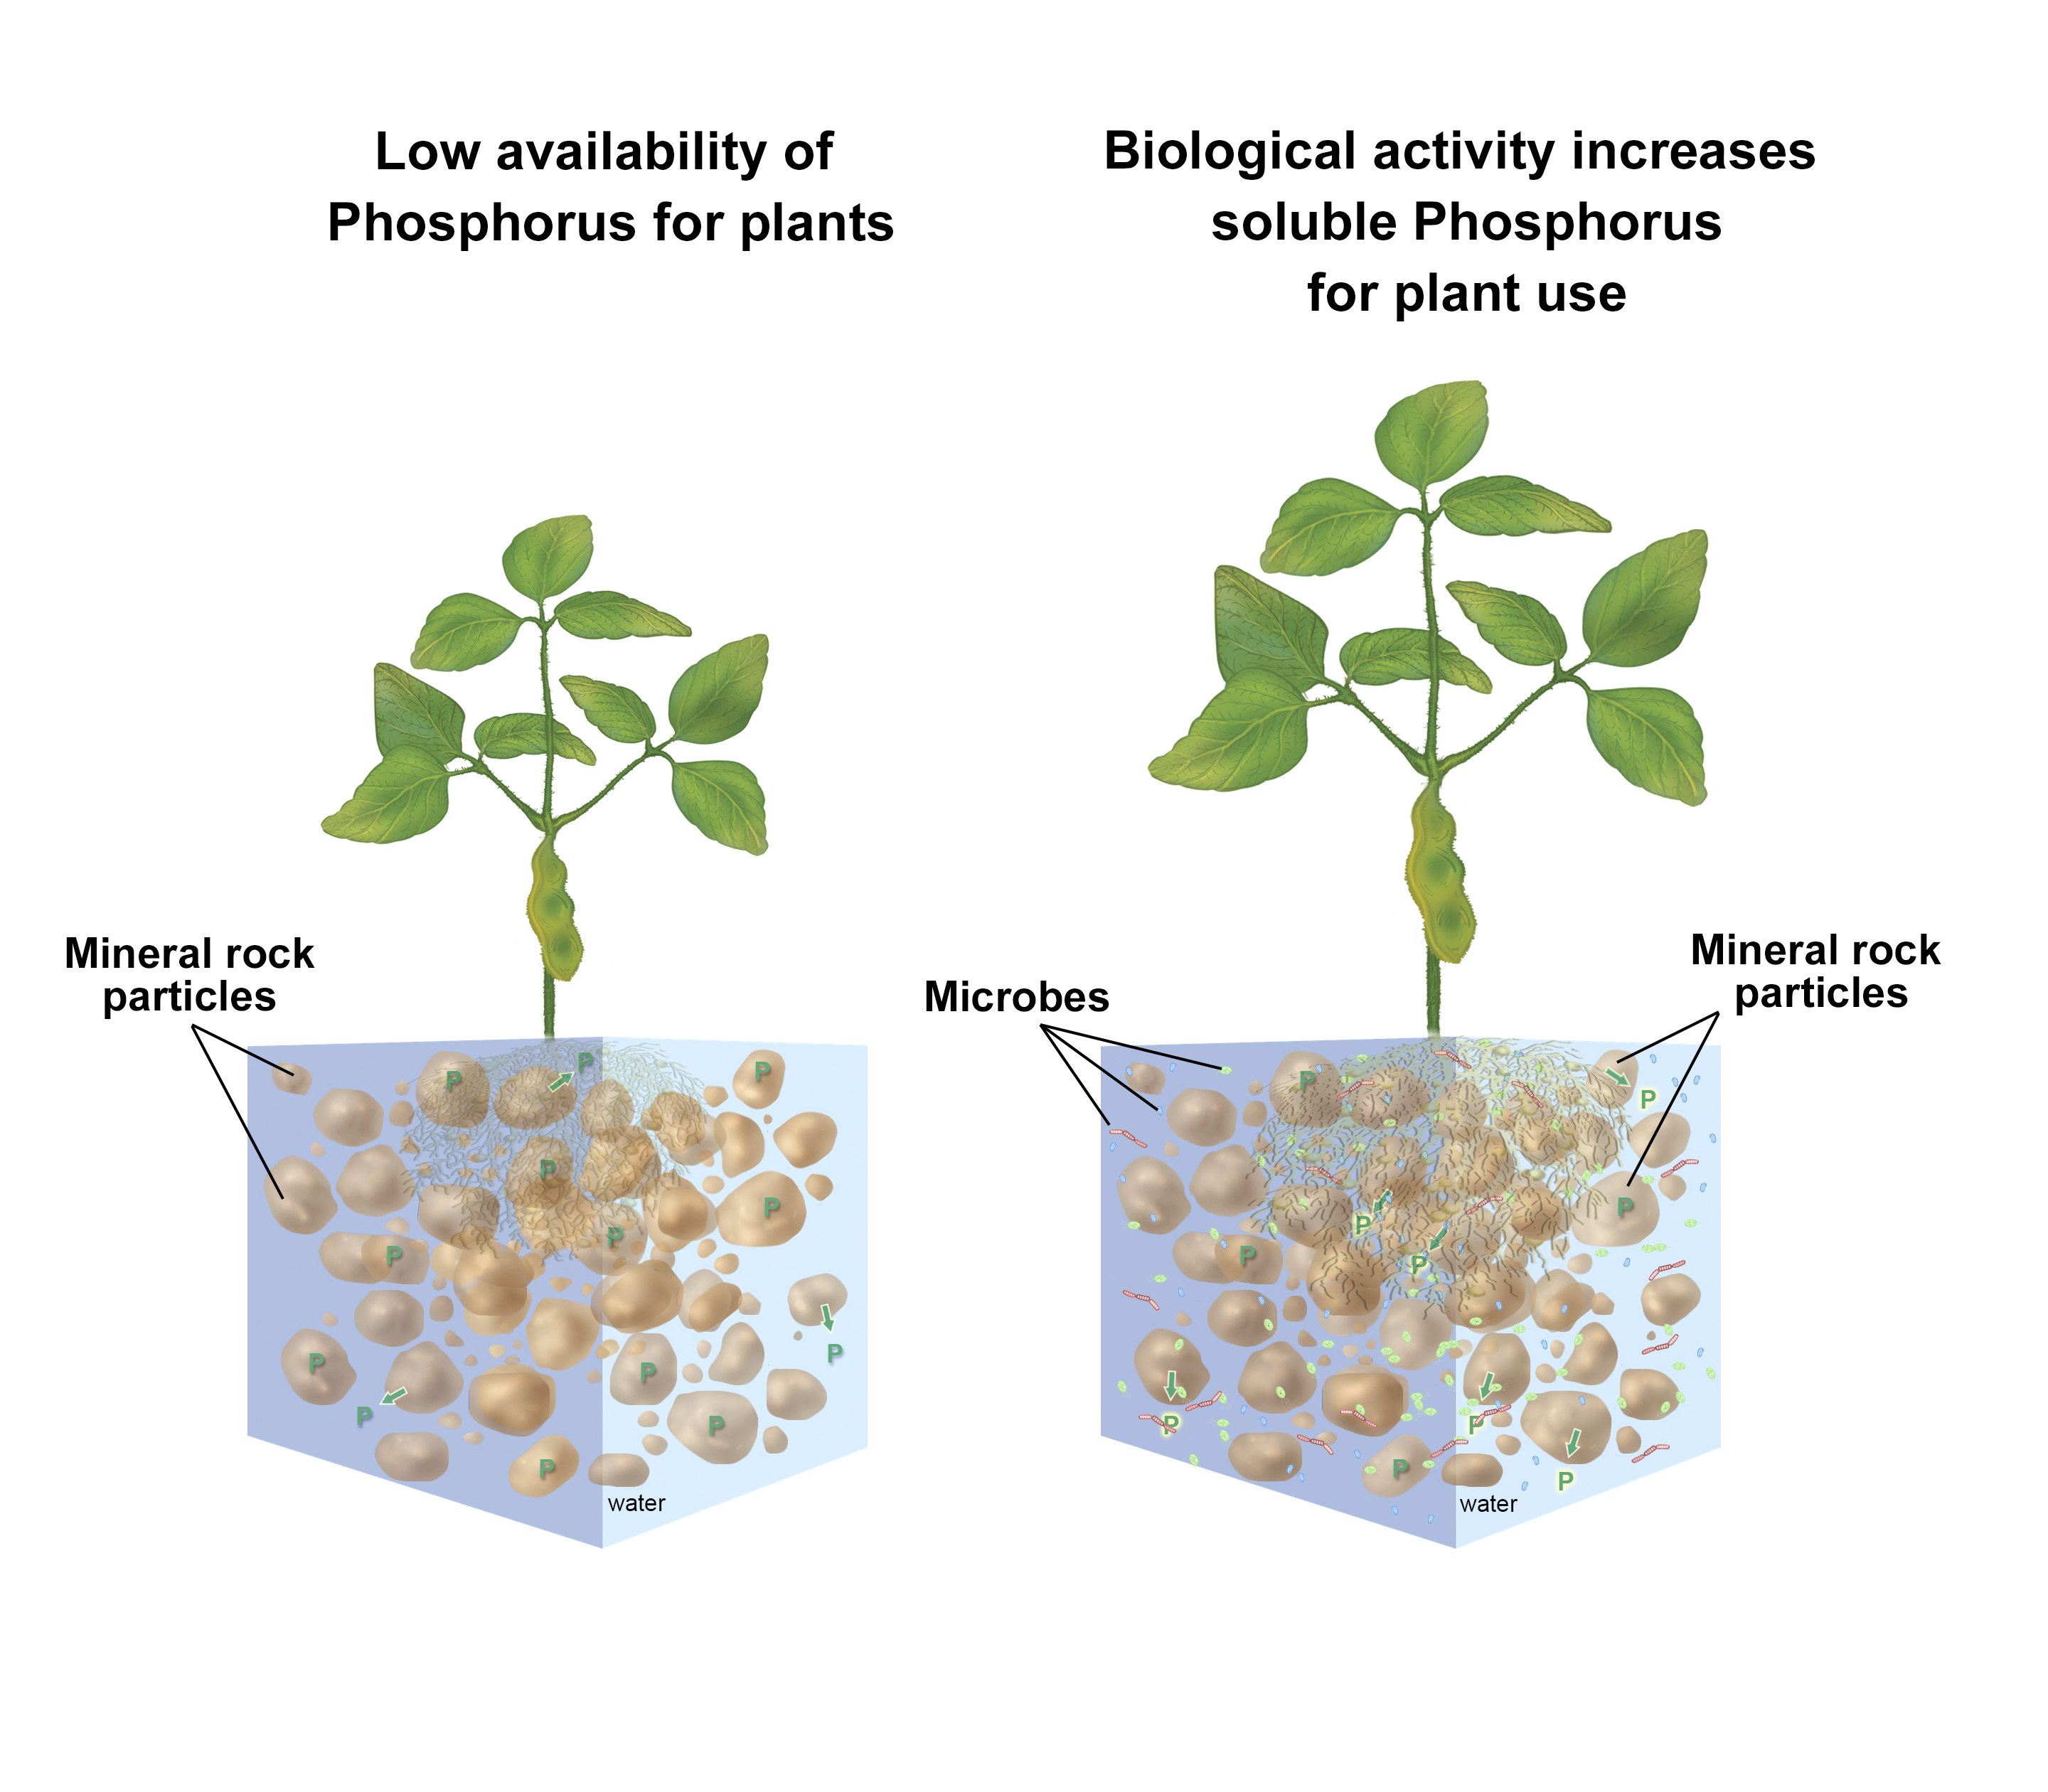
Illustration design by Carlyn Iverson; concept from Michael Lehman.
Notes:
Soil is comprised of particles of inorganic and organic material and water. The particles in the soil bind to elements and nutrients like phosphorus, which is an important nutrient for plant growth (see left). When microorganisms are present in the soil, through various mechanisms they are able to free phosphorus from its bound state to the particles and enable plants to use the phosphorus (see right).

Slide 14
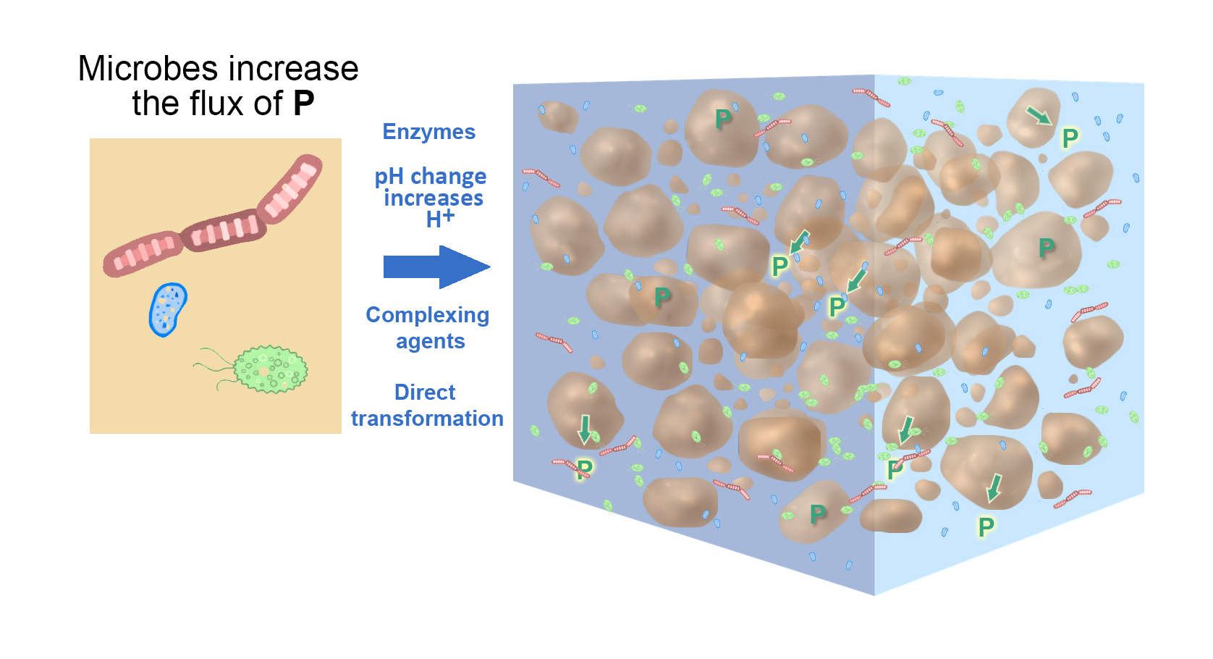
Illustration design by Carlyn Iverson; concept from Michael Lehman.
Notes:
Microbes (left) in the soil are able to increase the rate at which phosphorus is bound and unbound to particles in the soil. Imagine that the soil is a mixture of particles and water (as shown on the right), and this mixture is like a solution (like when you mix salt or sugar with water). The phosphorus in that solution is typically bound to the particles and in this state the phosphorus isn’t available for plants to use. But microbes (left) are able to use various mechanisms (center) to increase the rate at which the phosphorus becomes available for plants to use (right).

Slide 15
Illustration design by Carlyn Iverson; concept from Michael Lehman.
Notes:
The next four illustrations expand upon the concepts from the previous illustration, describing four of the mechanisms by which microbes in the soil are able to increase the rate at which phosphorus is bound and unbound to particles in the soil and thus made available to plants.

Slide 16
Illustration design by Carlyn Iverson; concept from Michael Lehman.

Slide 17
Illustration design by Carlyn Iverson; concept from Michael Lehman.

Slide 18
Illustration design by Carlyn Iverson; concept from Michael Lehman.

Slide 19
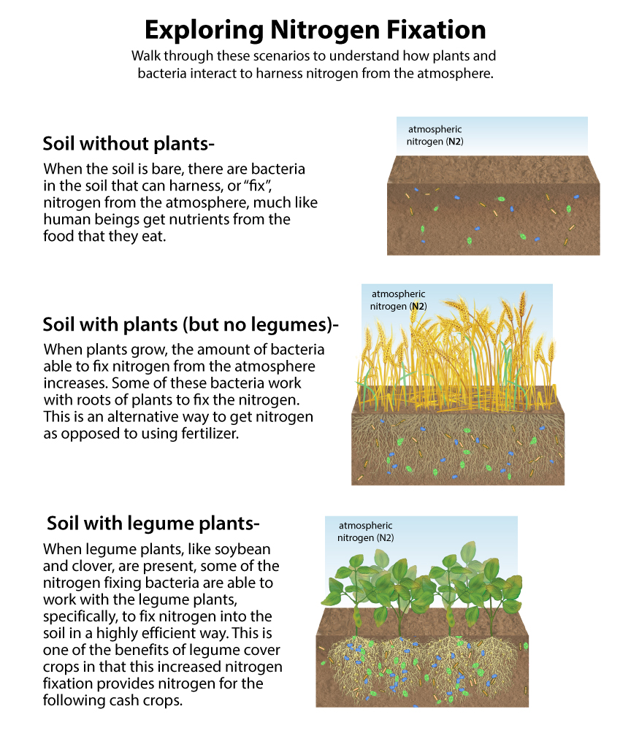
Illustration design by Carlyn Iverson; concept from Michael Lehman.
Notes:
This illustration demonstrates the interaction of nitrogen fixing bacteria in the soil with plants. Depending upon the type of plant present, the quantity and nature of nitrogen fixing bacteria will change. The captions to the left of each illustration offer a guide.

Slide 20
Illustration by Carlyn Iverson.
Notes:
(Top) Soil compaction is a big issue for agricultural production. Compacted soil particles reduce the pore space in the soil profile, thus preventing the flow of air and water through the soil layer. This compaction also impedes the growth of plant roots (left). When rain events happen on a compacted soil, the water runs off the surface of the soil instead of penetrating into the soil surface (right). This increases rates of erosion and prevents the deeper soil layers from being replenished with moisture.
(Bottom) When cover crops with good root growth, such as radishes with their taproots or cereal rye with its fibrous root network, are planted, they create pathways in the soil to allow air and water flow and relieve soil compaction. This allows rainfall to penetrate the soil layer, improves subsurface soil moisture, and allows other crops to root deeply.

Slide 21
Illustration by Carlyn Iverson.
Notes:
Soil compaction is a big issue for agricultural production. Compacted soil particles reduce the pore space in the soil profile, thus preventing the flow of air and water through the soil layer. This compaction also impedes the growth of plant roots (left). When rain events happen on a compacted soil, the water runs off the surface of the soil instead of penetrating into the soil surface (right). This increases rates of erosion and prevents the deeper soil layers from being replenished with moisture.

Slide 22
Illustration by Carlyn Iverson.
Notes:
When cover crops with good root growth, such as radishes with their taproots or cereal rye with its fibrous root network, are planted, they create pathways in the soil to allow air and water flow and relieve soil compaction. This allows rainfall to penetrate the soil layer, improves subsurface soil moisture, and allows other crops to root deeply.

