Slide 1
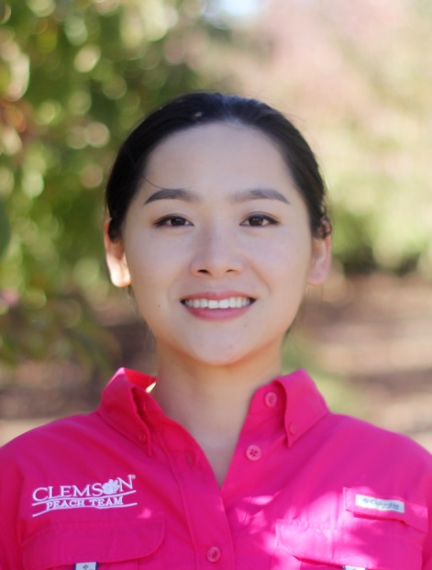
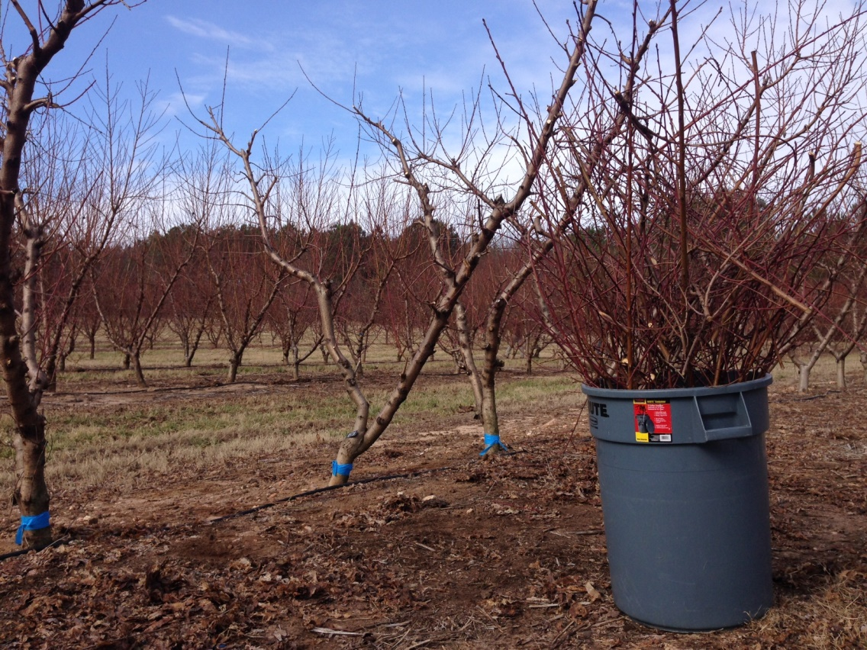
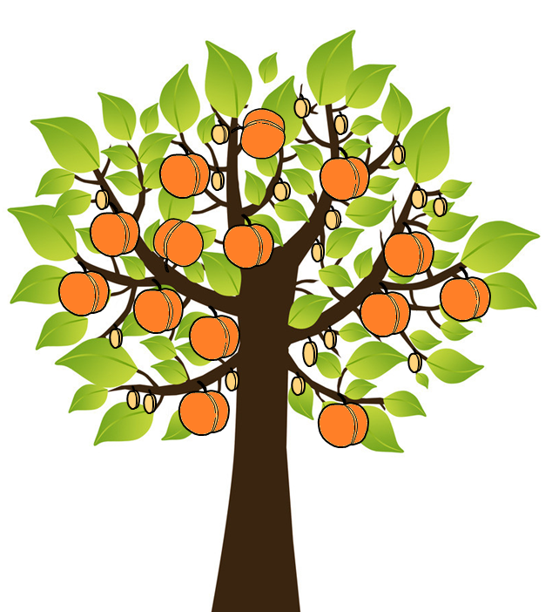
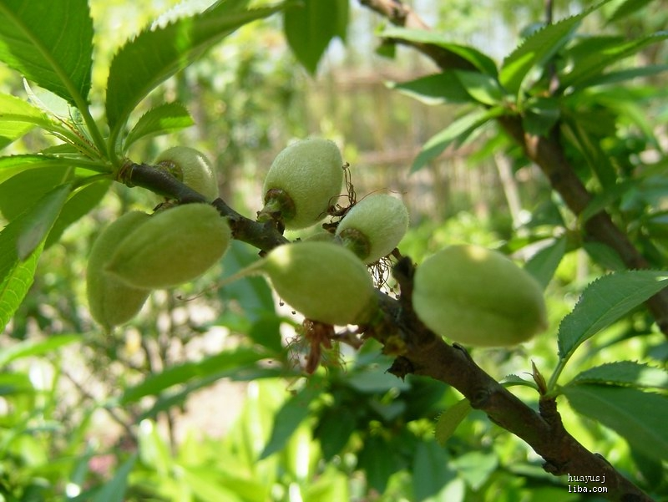
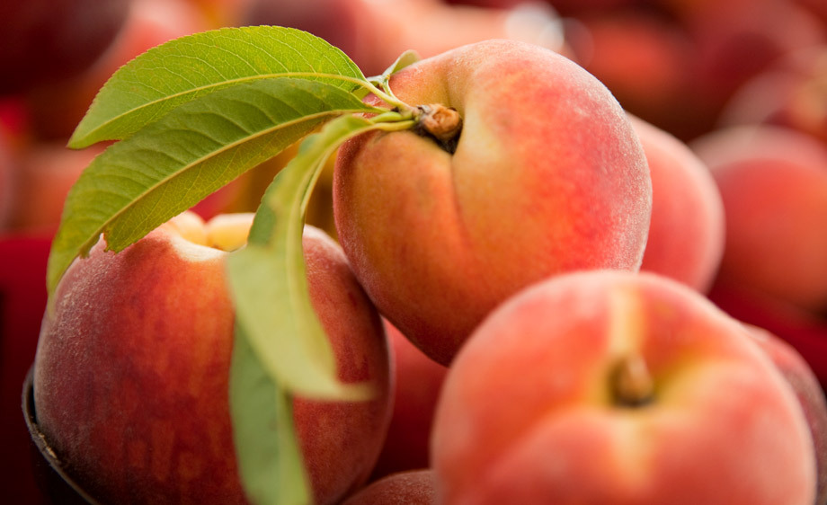
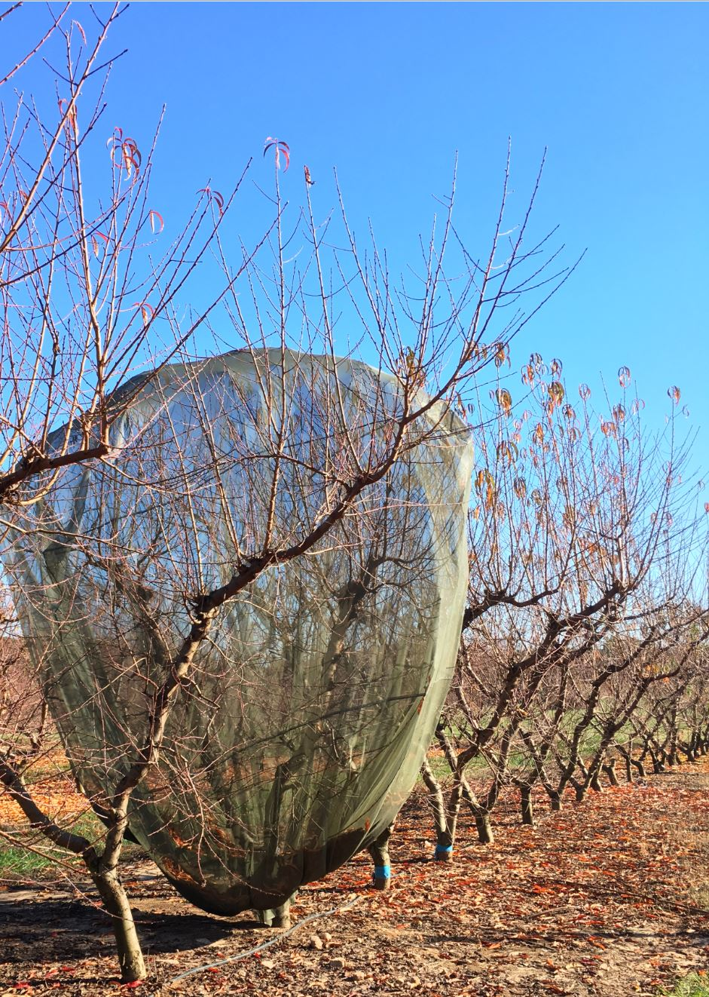
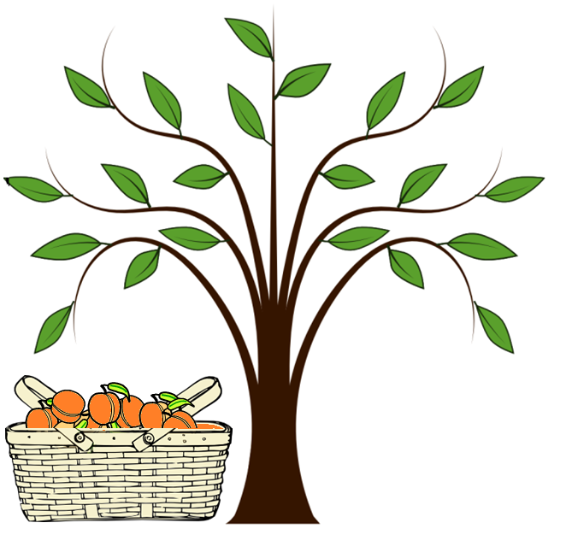
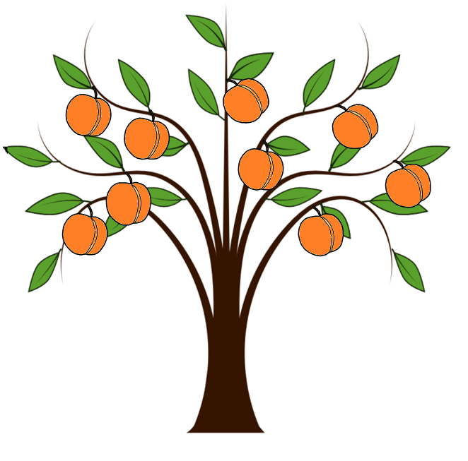
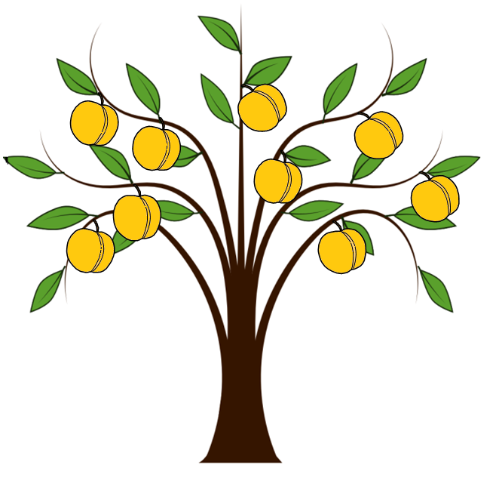
Optimizing Nutritional Management in fruit tree production in Southern U.S.
Qi Zhou; Juan Carlos Melgar qzhou3@clemson.edu, jmelgar@clemson.edu
Clemson University, Department of Plant and Environmental Sciences, Biosystems Research Complex, Lab 204, Clemson, SC 29634, USA
Introduction
Results
Throughout the year what nutrients are lost from a peach tree and in what quantities are they removed?
Pruned woods
Thinned fruitlets
Pruning
Thinning
 | N (g) |  | P (g) |  | K (g)
 | 2015 | 2016 | 2015 | 2016 | 2015 | 2016
Early | 61.79a | 59.32a | 8.32a | 8.45a | 82.86a | 46.05a
Mid | 28.95b | 45.05a | 4.46b | 5.73a | 37.12b | 29.36b
Late | 34.68b | 35.96a | 5.36b | 4.88a | 34.82b | 23.92b
 | N (g) |  | P (g) |  | K (g)
 | 2015 | 2016 | 2015 | 2016 | 2015 | 2016
Early | / | 8.15a | / | 1.12a | / | 13.22a
Mid | 1.34a | 4.38a | 0.14a | 0.56b | 1.68a | 5.54b
Late | 1.84a | 4.77a | 0.17a | 0.57b | 1.98a | 6.94b
Early-season peach tree lost more nitrogen, phosphorus and potassium than late-season peach tree through pruning.
Early-season peach tree lost more phosphorus and potassium than late-season peach tree through thinning.
Harvested Fruits
Fallen leaves
 | N (g) |  | P (g) |  | K (g)
 | 2015 | 2016 | 2015 | 2016 | 2015 | 2016
Early | 1.08b | 41.70a | 0.25c | 3.14a | 2.69c | 119.50a
Mid | 13.49a | 26.54a | 3.78b | 2.63a | 39.53b | 87.16a
Late | 19.90a | 37.81a | 7.21a | 2.21a | 71.57a | 104.45a
 | N (g) |  | P (g) |  | K (g)
 | 2015 | 2016 | 2015 | 2016 | 2015 | 2016
Early | 20.66a | 20.68a | 3.83a | 3.24a | 39.18a | 57.18a
Mid | 13.49a | 14.81a | 3.62a | 1.39b | 19.05a | 29.89b
Late | 13.87a | 15.18a | 2.98a | 0.94b | 24.05a | 30.07b
Harvest
Leaf Fall
Late-season peach tree lost more nitrogen, phosphorus and potassium than early-season peach tree through harvesting.
Early-season peach tree lost more phosphorus and potassium than late-season peach tree through leaf fall.
Are there differences in nutrient requirements among early-, middle-, and late-season peach varieties?
Total Removed Dry Weight
Summer leaves
 | Pruning(kg) |  | Thinning(kg) |  | Harvesting(kg) |  | Leaf Fall(kg)
 | 2015 | 2016 | 2015 | 2016 | 2015 | 2016 | 2015 | 2016
Early | 8.09a | 8.06a | / | 0.59a | 0.13b | 0.69a | 1.79a | 1.84a
Mid | 4.04b | 4.72b | 0.056a | 0.28a | 2.41a | 0.22a | 1.21a | 1.23a
Late | 4.31b | 4.61b | 0.062a | 0.33a | 4.18a | 0.32a | 1.18a | 1.30a
 | N (%) |  | P (%) |  | K (%)
 | 2015 | 2016 | 2015 | 2016 | 2015 | 2016
Early | 2.44a | 2.32a | 0.24a | 0.20a | 4.15a | 3.94a
Mid | 2.37a | 2.22a | 0.21a | 0.18b | 3.49b | 2.82b
Late | 2.40a | 2.22a | 0.20a | 0.13b | 3.45b | 3.12b
Early cultivar
Harvest in
May
Middle cultivar
Harvest in
Jun-Jul
Late cultivar
Harvest in Aug-Sep
Early-season peach tree have more pruned wood, less harvesting fruits and more fallen leaves than late-season peach tree.
Leaf analysis shows that nitrogen and phosphorus is in sufficient level but potassium is much higher than the recommended level.
How can differences in nutrient requirements affect the way we fertilize different varieties?
Conclusions
Peach trees that ripen at different points in the season have differences in nutrient requirements. Under the same fertilizer condition, early-season peach tree have more vegetative growth but have less fruits.
In order to maintain a good balance between vegetative growth and yield, farmers should consider apply less fertilizer to early-season peach trees compare to mid- and late-season peach trees.
Material & Methods
Location:
Clemson University Musser Fruit Research Farm, South Carolina
Cultivars:
Early-Season (‘Desiree’ & ‘Spring Snow’); Mid-Season (‘Sweet N Up’ & ‘Coralstar’); Late-Season (‘Snow King’ & ‘Snow Gem’)
Sample Analysis:
N: Dumas Method; P: Murphy-Riley Method; K: Atomic Absorption Spectrophotometry
Different season peach trees
Different fertilization
This project is supported by the National Institute of Food and Agriculture, U.S. Department of Agriculture, under award number RD309-137/S001520 through the Southern Sustainable Agriculture Research and Education program under subaward number GS17-174. Any opinions, findings, conclusions, or recommendations expressed in this publication are those of the author(s) and do not necessarily reflect the view of the U.S. Department of Agriculture or SARE. USDA is an equal opportunity employer and service provider.
This project is also funded by the SC Peach Council, under project number 2010511.
The authors are grateful to Jeffrey Hopkins, Brian Lawrence and the stuff from Clemson University Musser Fruit Research Farm for their assistance.

