Slide 1

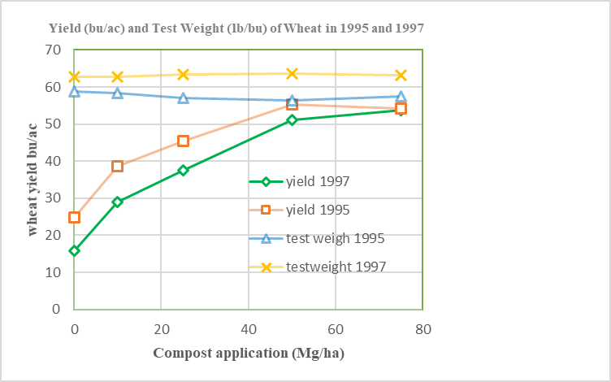
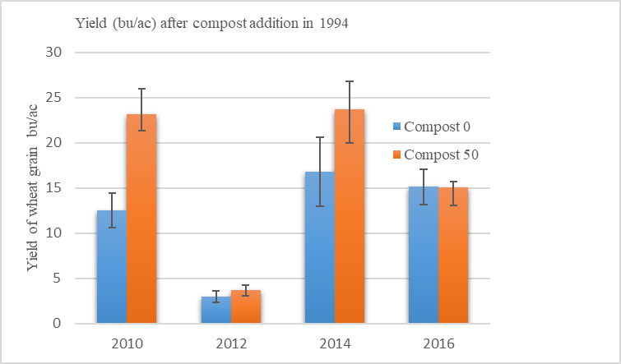
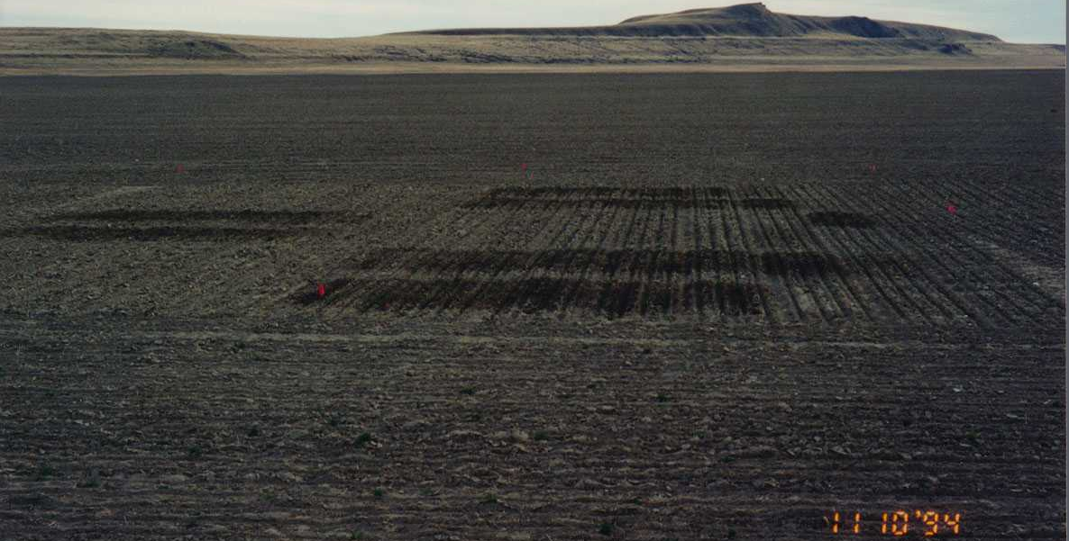
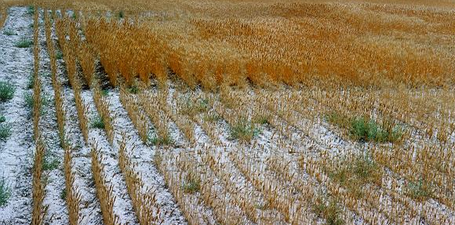

Compost Effects on Organic Winter Wheat
in Dryland Condition, Utah
Phearen Miller, Paul Stukenholtz, Richard Koenig, Jennifer Reeve, David Hole, Bruce Miller
SW96-032
David Hole, Bruce Miller
Abstract
Characteristics of Hansel Wheat
Two compost experiments were conducted on South and North sides of a dryland organic farm at Snowville, Utah from 1994 to 1996.
Materials and methods in research:
Compost was made from dairy cow manure and grain straw bedding. The experiment were randomized complete block designs with five compost application rate (0,10,25, 50 and 75 Mg dry weight/ha). Hard red winter wheat varieties were used in the experiment.
- Results: Compost and soil moisture played an important role in increasing wheat yield (Stukenholtz et al., 2002).
Hansel wheat is one of the hard red winter wheat varieties which was used for the experiment. Hansel was developed and released by Utah Agric. Exp. Station in 1974. Hansel was selected because of its high quality of resistance to dwarf bunt and resistance to races of stripe rust which are commonly found in Utah. In addition, Hansel was considered to have a good baking quality (strong sedimentation and mixing properties and good loaf volume).
Results
South farm location where compost was applied in 1994
To determine if compost still has a significant impact on the wheat yield and soil quality in the study, Reeve et al., 2012, sampled the soil in the South side and determined the residual effects of compost on soil quality and wheat yield. Reeve et al., (2012) found that residual effects of compost applied in 1994 have long-term carryover effects on improve organic wheat yield, higher microbial biomass, organic C, soil enzyme activities, higher plant available nutrients (P, K and Zn).
Adapted from Stukenholtz et al., 2002
The difference of precipitation between 1995 (22 inches) and 1996 (10 inches) had impacts on the yield of winter wheat.
In 1995 (South Side): yield increase 242% (1347 to 3256 lb/acre) with the greatest compost application between 0 and 10 Mg/ha
In 1996 (North Side): yield increase 254% (767 to 1948 lb/acre) with the greatest compost application between 10 and 25 Mg/ha
References:
Stukenholtz, P. D., Koenig, R. T., Hole, D. J., & Miller, B. E. (2002). Partitioning the Nutrient
and Nonnutrient Contributions Of Compost to Dryland-Organic Wheat. Compost Science & Utilization, 10(3), 238–243. https://doi.org/10.1080/1065657X.2002.10702085
Reeve, J. R., Endelman, J. B., Miller, B. E., & Hole, D. J. (2012). Residual Effects of Compost on Soil Quality and Dryland Wheat Yield Sixteen Years after Compost Application. Soil Science Society of America Journal, 76(1), 278–285. https://doi.org/10.2136/sssaj2011.0123
Differences between compost and non compost treatments
This project is supported by the National Institute of Food and Agriculture, U.S. Department of Agriculture, under award number 96-COOP-12414 through the Western Sustainable Agriculture Research and Education program under subaward number SW96-032. Any opinions, findings, conclusions, or recommendations expressed in this publication are those of the author(s) and do not necessarily reflect the view of the U.S. Department of Agriculture or SARE. USDA is an equal opportunity employer and service provider.

