Slide 1

Cover Crops
A general overview of opportunities with cover crops
PRESENTER
Affiliation
Notes:
This presentation was prepared by Sami Tellatin and Rob Myers and provided by the USDA-SARE program to educators and producers for outreach and educational purposes. Other cover crop slide sets are also available at the website: http://sare.org/cover-crops
Tips for presenters:
You are about to give your audience a lot of information; show them that this is worth learning by being interested in the topic yourself and letting that be seen through your presentation.
Make it personal. Tell your own stories (that complement the material and are concise). You want to create a narrative that flows throughout your presentation.
Encourage learning and discussion by asking questions of the audience and encouraging their participation. Moderate your time so that you can cover everything, while also fostering audience participation.
Speak to your knowledge. If you don’t know something, it is okay to say so.
This slide set is a template offered for your use. You can add or delete slides and change things as you need. Use it to best complement your educational style to meet your goals.

Slide 2
Objectives
Define cover crops and introduce common species
Explore trends in cover crop adoption and impacts
Discuss planting, equipment, and opportunities
Meet cover crop innovators
Resources on cover crops
Explore different scenarios
Questions?

Slide 3
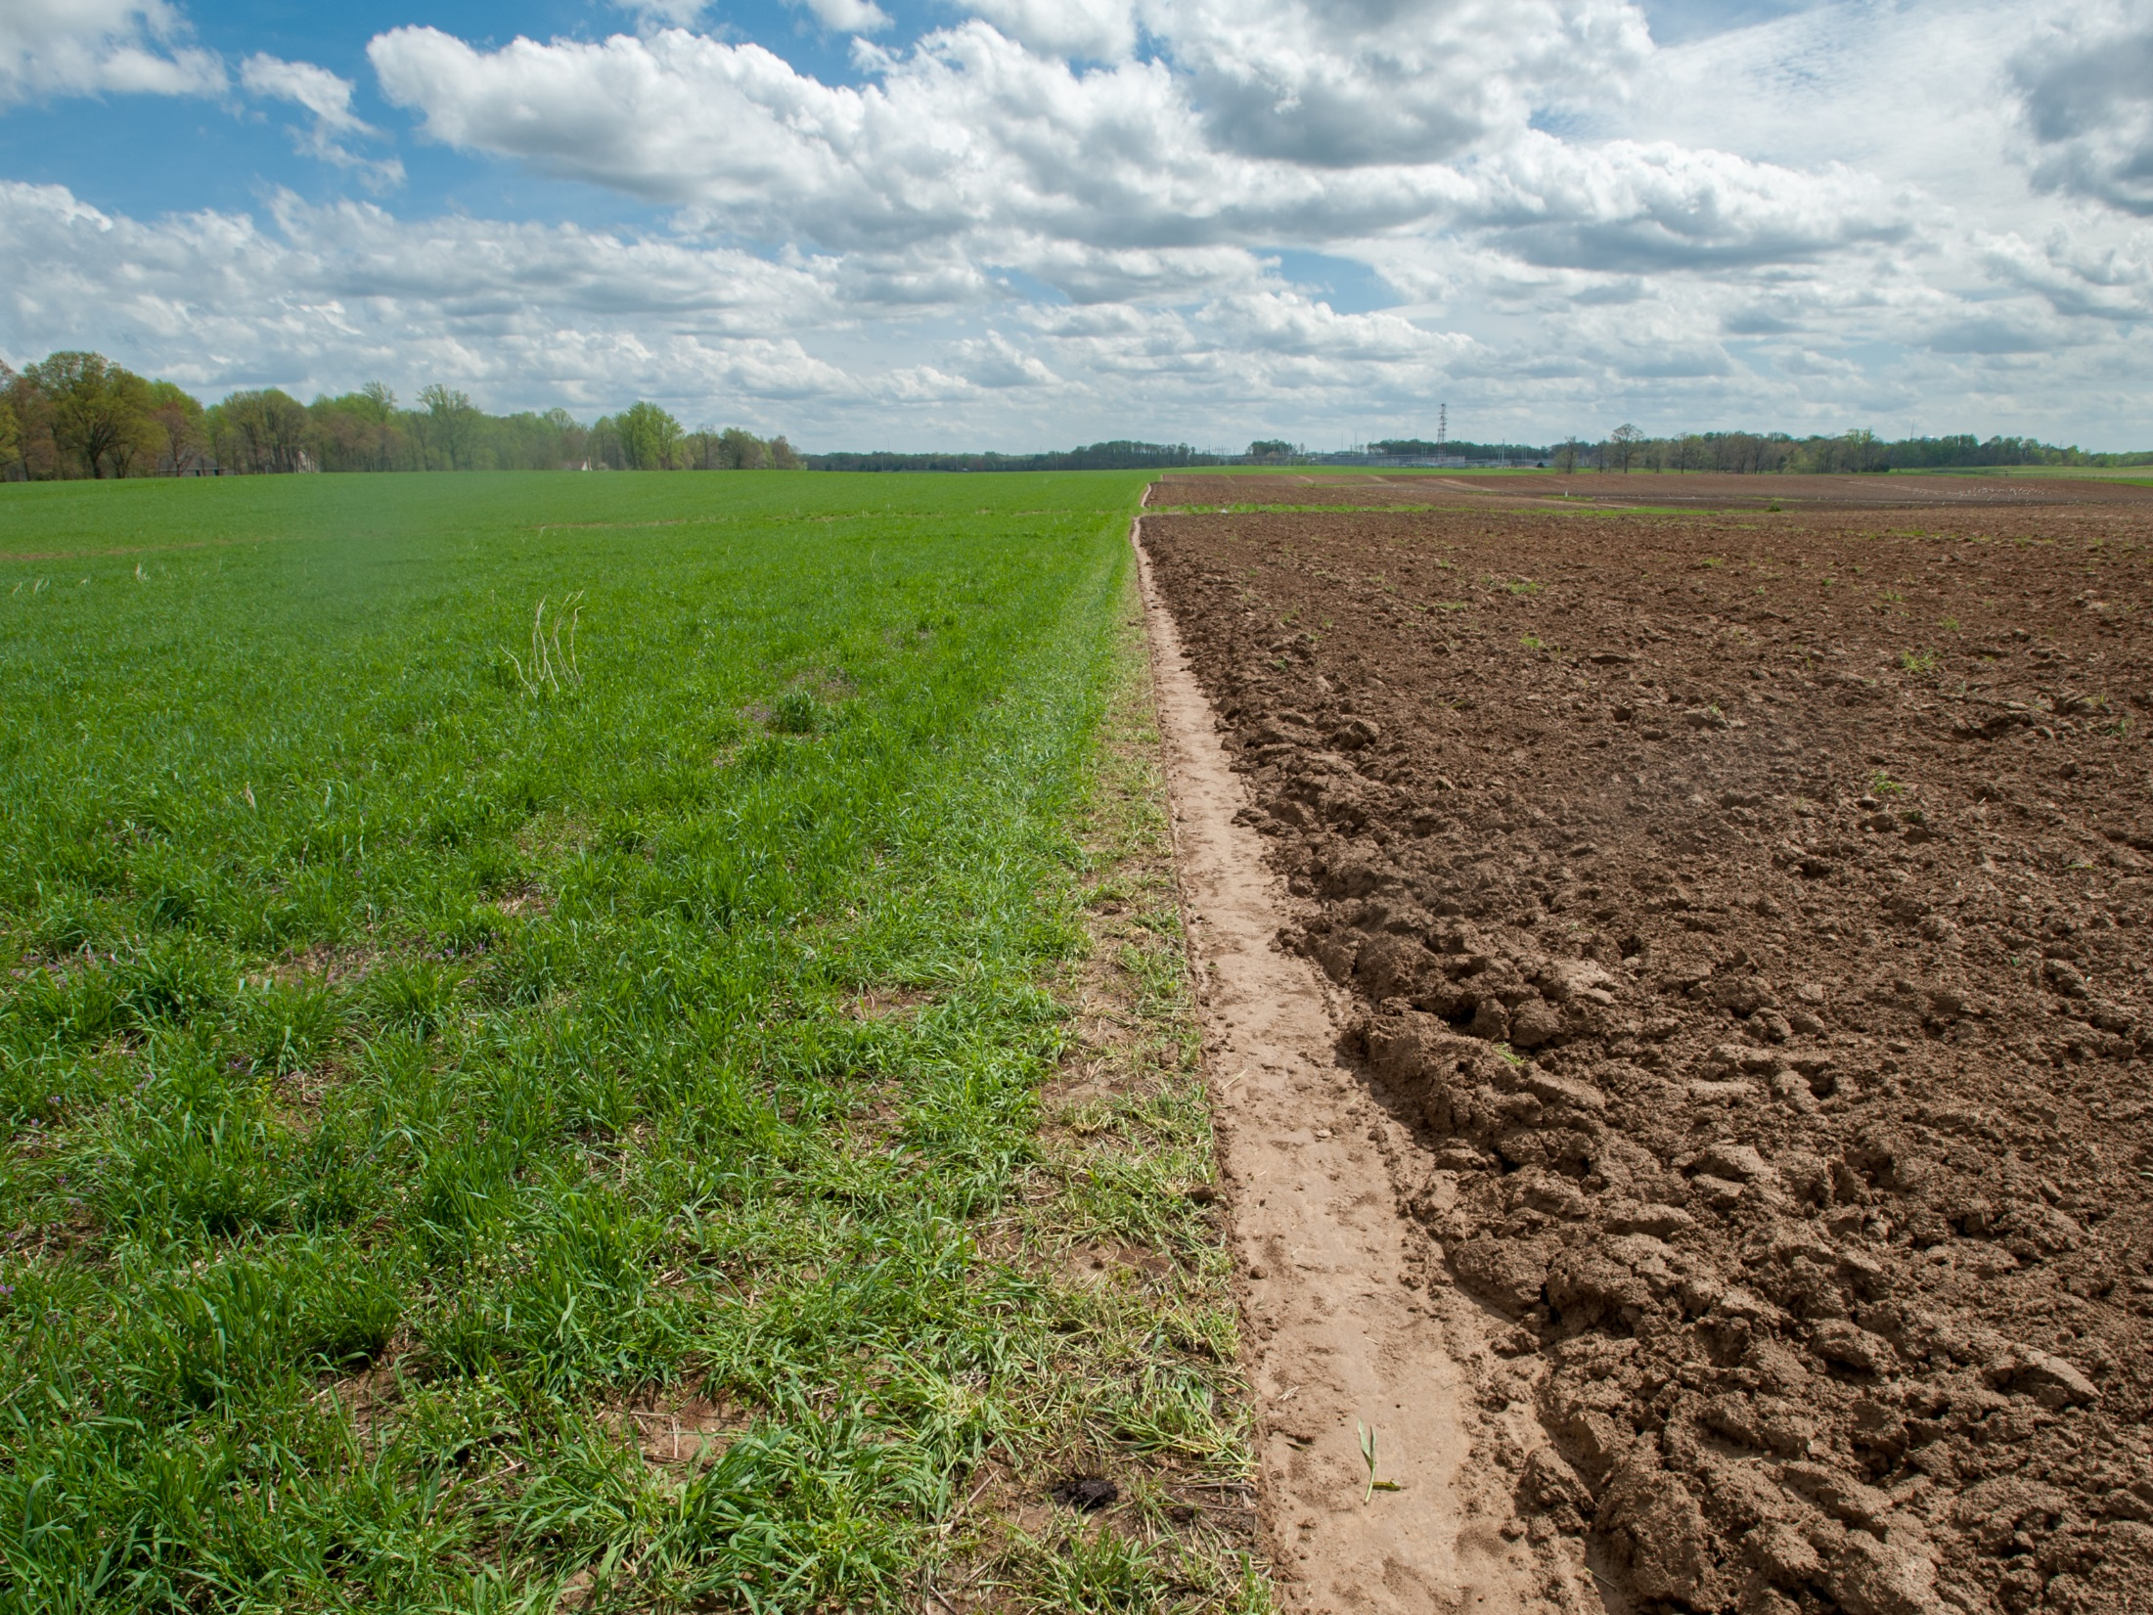
What are cover crops?
Bare soil in fallow
Cover crop of annual ryegrass
Photo: Edwin Remsberg
Notes:
About Cover Crops
Crops grown during a time of the year when we wouldn’t normally plant anything, such as during winter or summer fallow periods in row crop operations. Sometimes used as living cover grown with other crops to cover the soil, provide nutrients, and prevent weeds.
Dozens of different species in use today in U.S.
Used all over the globe
Applicable in multiple U.S. agricultural systems, including viticulture, annual row crop agriculture, horticulture systems and as livestock pasture.
Photo taken at Steve Groff’s farm in Holtwood, PA.

Slide 4
Trends
SARE/CTIC Cover Crop Survey 2016
Acres of cover crops per respondent
Notes:
Trends in cover crop adoption:
There were a reported 10.3 million cover crops in 2012 according to the USDA Census of Agriculture
A cover crop survey has been conducted since 2012 to understand general trends in cover crops. These annual surveys have been administered primarily by the Conservation Technology Information Center (CTIC) and SARE.
The surveys have demonstrated an increasing trend in cover crop acreage. There was a 25% increase in planted acres among respondents from 2014 to 2015
Following these trends, national cover crop acreage is likely near to 20 million acres cover crops now.
Note that the 2016 data included the projected cover crop plantings for the 2016 season by farmers surveyed in early 2016, rather than actual cover crop acreage data.

Slide 5
Cereals and grasses, 2015
Notes:
The most popular cover crop across the country is cereal rye.

Slide 6

Cereal rye
Photo: Edwin Remsberg
Notes:
Cereal rye is known as the “queen” of cover crops as it is the most popular cover crop. It is well known to prevent erosion and scavenge nitrogen.
Photo taken in Harford County, MD.

Slide 7
Brassicas, 2015
Notes:
The radish is the most popular of the Brassica cover crops, followed by rapeseed.

Slide 8
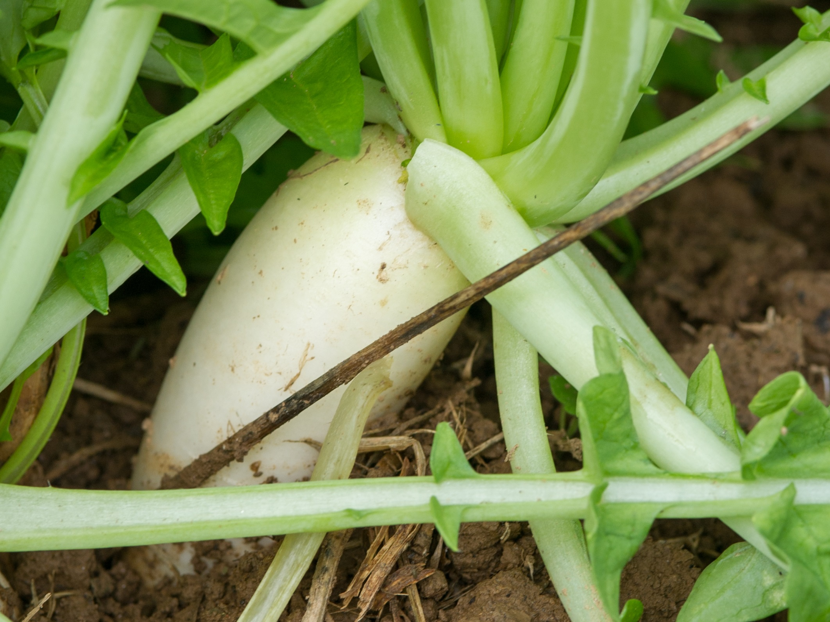
Forage radish
Photo: Edwin Remsberg
Notes:
The radish is a Brassica cover crop that is known for its ability to reduce soil compaction and discourage certain pests and weeds.
Photo taken in Maryland

Slide 9
Legumes, 2015
Notes:
Crimson clover is the most popular legume cover crop, followed by winter pea and hairy vetch.

Slide 10
Crimson clover
Photo: Rob Myers
Notes:
Crimson clover is a legume cover crop known for its ability to supply nitrogen to the soil.
Photo taken in Columbia, MO.

Slide 11
Summer annual non-legumes, 2015
Notes:
There are also cover crops that are more suitable for the summer fallow season. These include buckwheat, millet, and sorghum sudangrass.

Slide 12
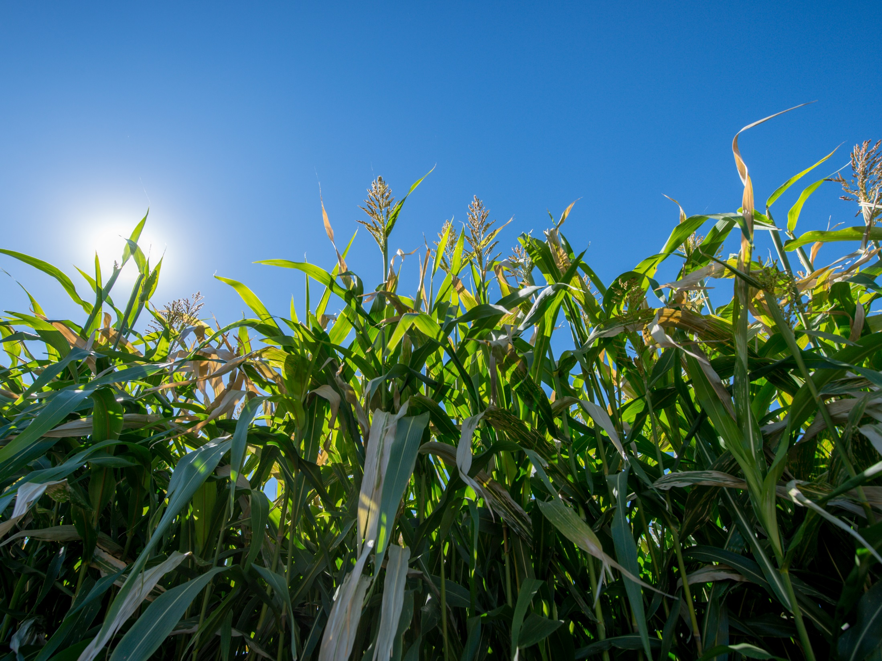
Sorghum Sudangrass
Photo: Edwin Remsberg
Notes:
Sorghum Sudangrass, a summer annual non-legume cover crop, growing at the Washington State University Organic Farm in Pullman, WA.

Slide 13
Cover crop mixes planted, 2015
Notes:
This slide, pulled from the 2015-2016 Cover Crop Survey, illustrates the acres of cover crop mixes that were planted in 2015 by participating farmers. 48% of the respondents reported that they planted mixes in 2015 and intended to do so again in 2016.

Slide 14
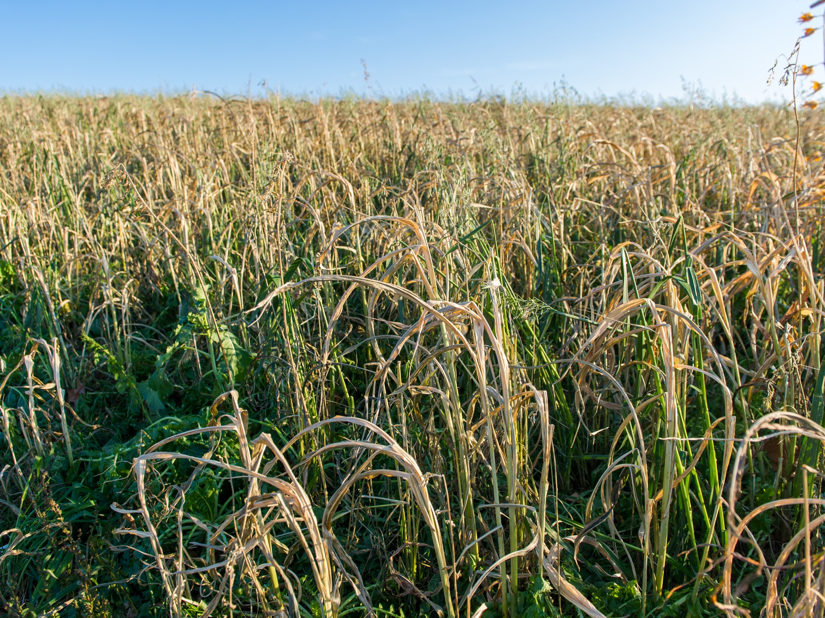
Mixed radish, triticale, and oats
Photo: Edwin Remsberg
Notes:
Mixes are a popular option for maximizing benefits from cover crops.
Photo from Steve Groff’s farm in Holtwood, PA.

Slide 15
Source of cover crop mix
22%, Custom mix designed by crop consultant or cover crop sales person
18%, Pre-packaged mix
60%, Custom mix designed by the farmers, themselves
n = 769
Notes:
It seems that most cover crop mix users tend to prefer to design mixes themselves.

Slide 16
Motivation to use cover crops
Notes:
The cover crop survey demonstrated that farmers are motivated to use cover crops primarily because of the positive impacts of cover crops on soil health, building soil organic matter, reducing soil compaction and preventing soil erosion.

Slide 17
Impacts
How do cover crops impact the environment, soil health, the economics of farm management, and crop productivity?

Slide 18
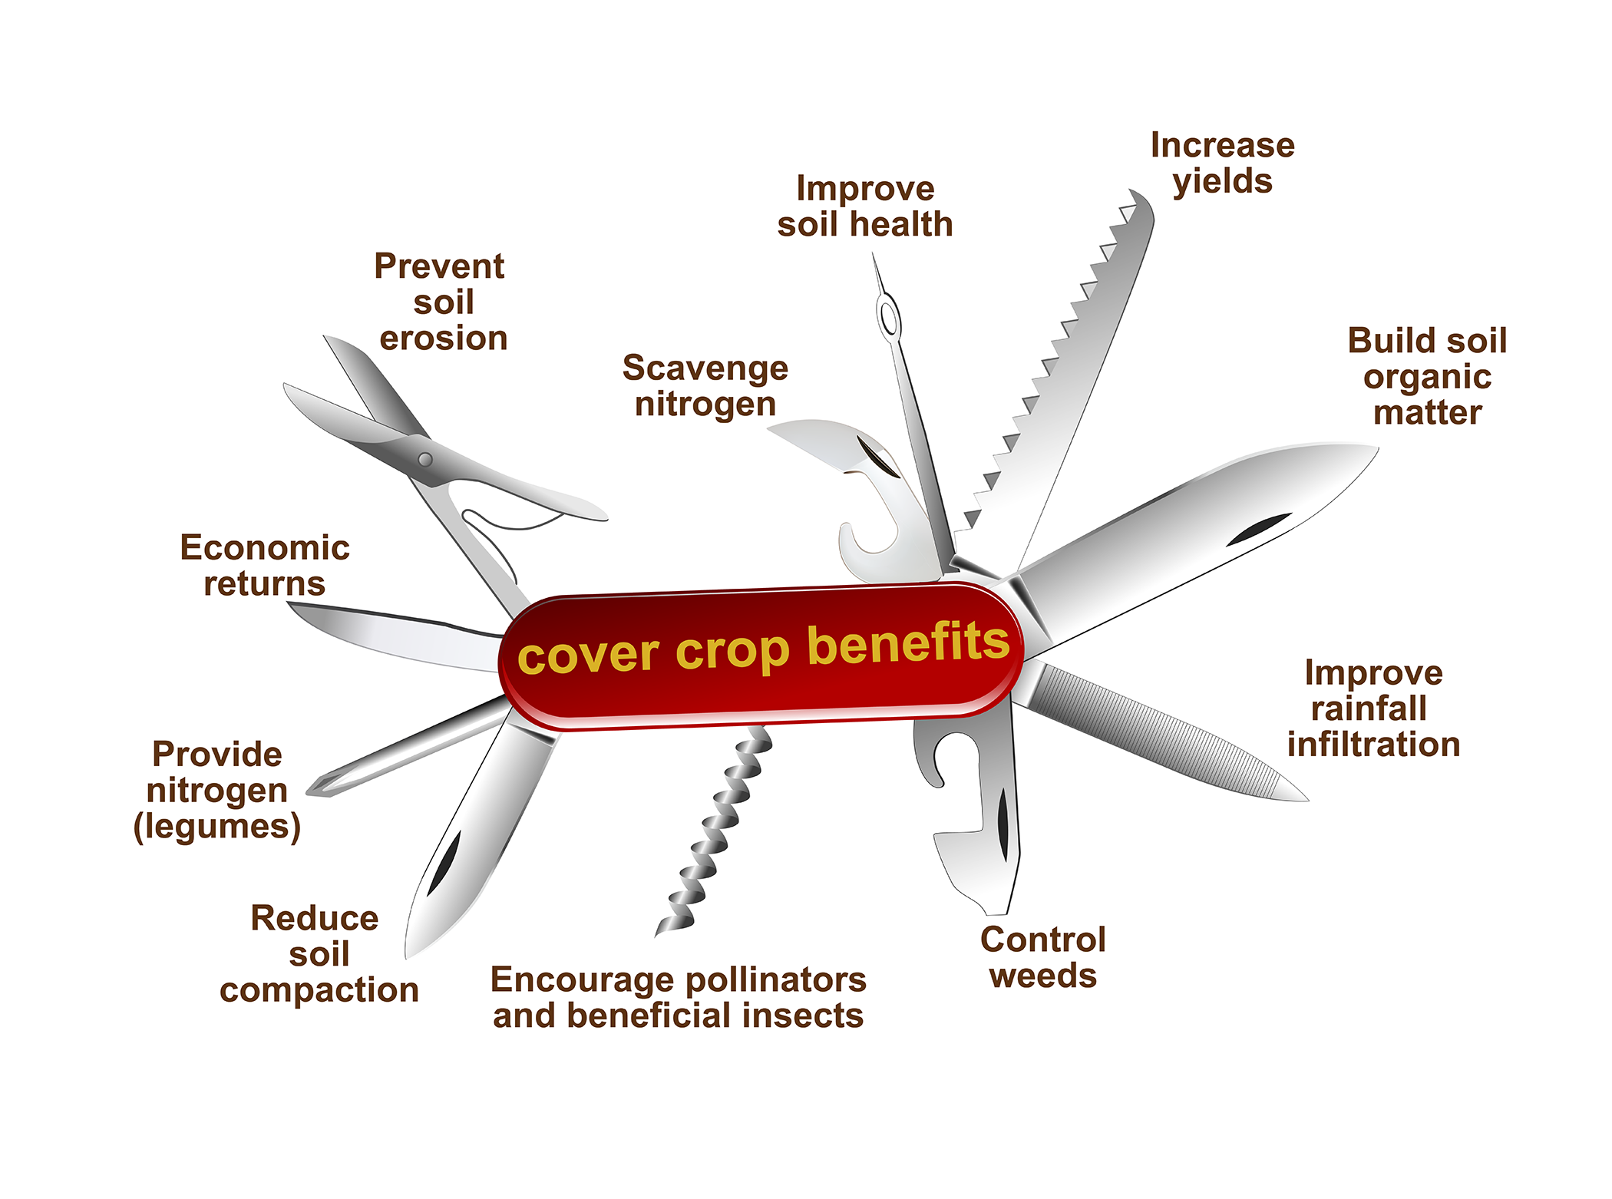
Illustration by Carlyn Iverson
Notes:
Farmer motivation to use cover crops is based on the fact that cover crops can offer a host of benefits to the farm. They are so useful, in fact, that they can be likened to a Swiss army knife.
Studies have been conducted to measure the factors listed above and have shown that cover crops provide benefits in most areas.
Reducing soil erosion and soil compaction
Increasing rainfall infiltration to the soil profile
Enhancing the soil organic matter and storing soil carbon
Encouraging and building habitat for pollinators and other beneficial insects
Controlling weeds
Providing nitrogen
Scavenging nitrogen (which also positively impacts water quality)
Bolstering a farm’s financial resources by reducing input costs and increasing yields.

Slide 19
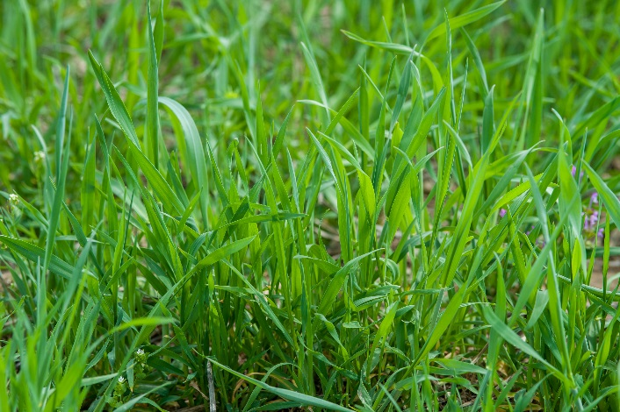
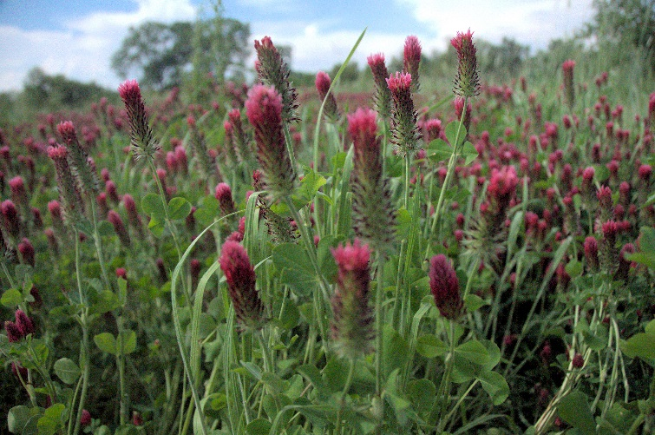
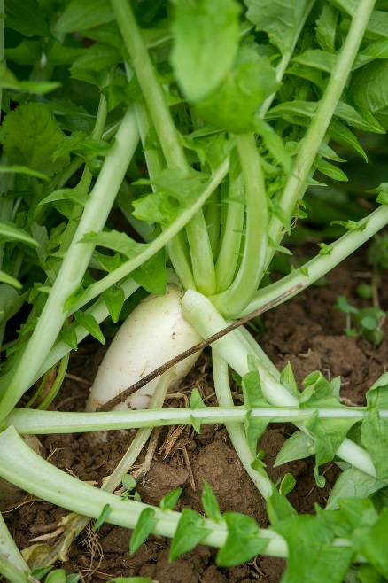
Plant certain types of cover crops based on your goals
Grasses
Annual ryegrass: nitrogen scavenger, erosion prevention, weed suppression
Legumes
Crimson clover: nitrogen source, erosion prevention
Brassicas
Forage radish: erosion prevention, weed suppression, soil compaction reduction
Photos: Edwin Remsberg
Notes:
With all of these benefits accounted for, it is important to note that certain species of cover crops are more adept at certain functions than others.
For example:
Annual ryegrass acquires great amounts of biomass and is known for scavenging nitrogen, preventing erosion and suppressing weeds.
Brassicas and mustards, like the radish, are known to prevent erosion but also to reduce soil compaction and suppress weeds. Radishes have large tap roots that act to naturally aerate and open up the soil, like a plow.
Crimson clover is a legume crop; legumes are known for their ability to provide nitrogen. Crimson clover is also effective at preventing erosion.
You’ll notice that each of these cover crops, though different, share benefits.
For example, they all prevent erosion.
But their differences are important and are one reason many farmers have started to plant mixtures of different cover crop species, so that there are multiple benefits to their soil.
This also increases the biodiversity of a landscape, which is very important to promoting ecosystem health.
Photo locations: top left was taken in Holtwood, PA; bottom left was taken in MD; right photo was taken at the USDA NRCS Plant Materials Center in MO.

Slide 20
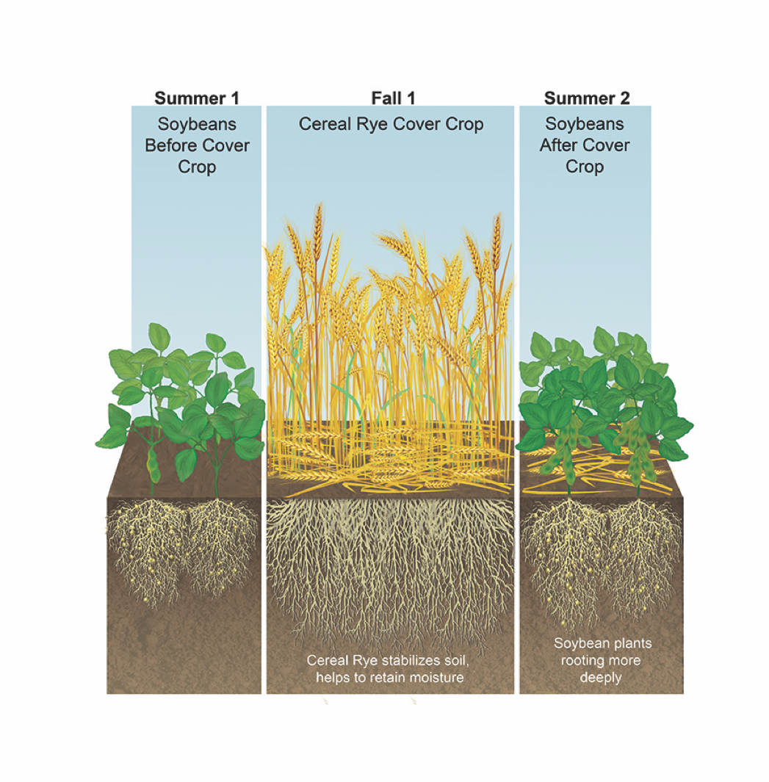
Soil stabilization, increases in rooting depth
Illustration by Carlyn Iverson
Notes:
This illustration demonstrates how cereal rye stabilizes the soil, conserves and retains soil moisture, and is able to help the following soybean cash crop root more deeply, helping soybean roots reach more water and nutrients and thus potentially improving growth.

Slide 21
Cover crops reduce soil compaction
Illustration by Carlyn Iverson
Notes:
Cover crops prevent soil compaction.
On the left, a compacted soil reduces pore space and limits the ability of water to infiltrate the soil layer, contributing to runoff and erosion.
On the right, after a radish cover crop is planted, the soil is less compacted, pore space increases, and the soybean crop is able to root more deeply with less runoff and erosion, and increased rainfall infiltration.

Slide 22
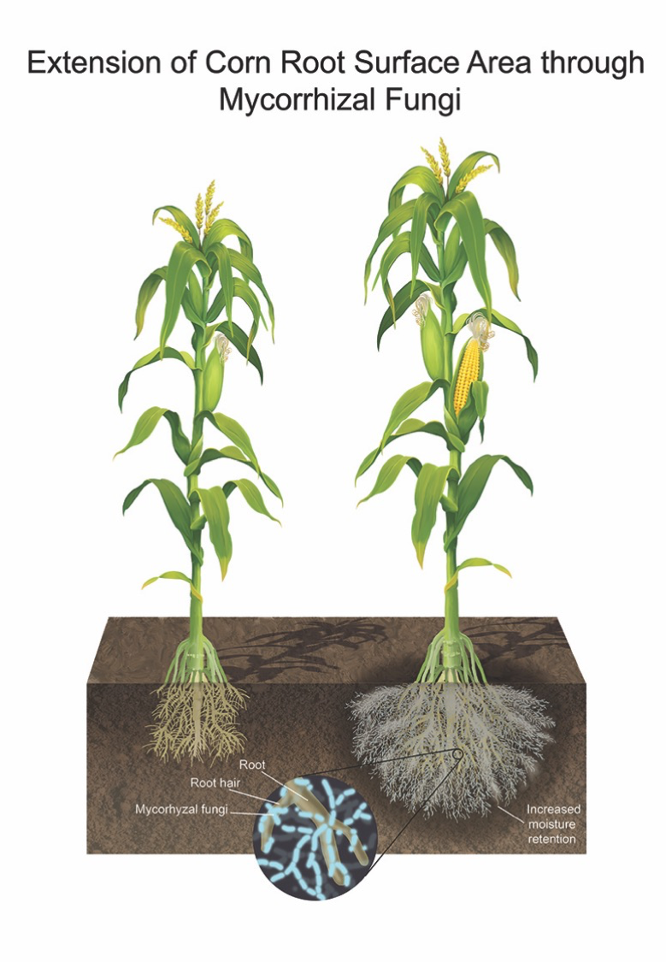
Illustration by Carlyn Iverson
Notes:
Recent research on soil health has shown the great importance of mycorrhizal fungi to crop production.
These fungi form fibrous networks in the soil, protecting plant roots from certain diseases and boosting numerous soil quality measures, such as water holding capacity.
No-till and cover crop management are two practices which can allow the mycorrhizal fungi to survive in the soil throughout the year, so that the benefits of a healthy mycorrhizal population can be seen in crop production.

Slide 23
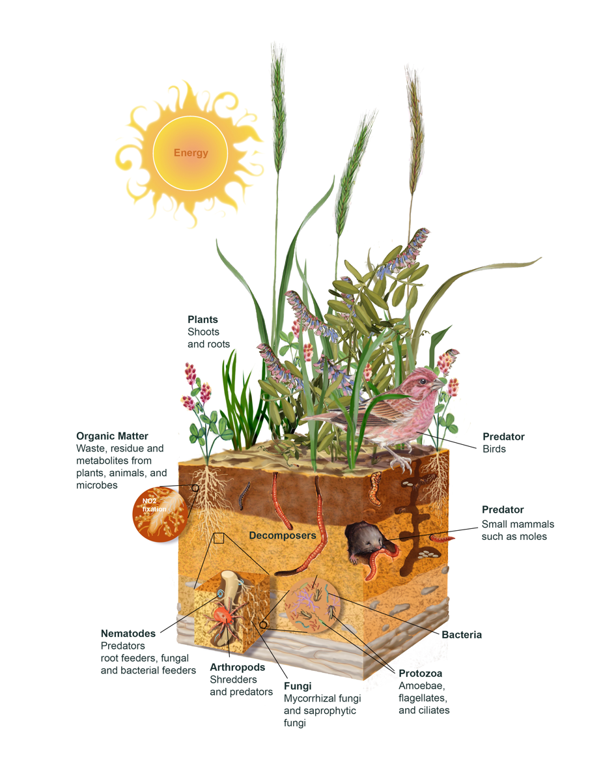
Cover crops increase biodiversity
Cover crops increase both aboveground and belowground diversity.
Cover crops support the soil food web.
Illustration by Carlyn Iverson
Notes:
And, cover crops increase the diversity of an agricultural system, providing habitat for pollinators, earthworms, soil microbes, and other organisms. A diverse soil ecosystem is a healthy soil ecosystem.

Slide 24
2-12% yield increases reported in corn and soybean crops planted after a cover crop
Crop Year | Corn | Soybeans
2012 | 9.6% | 11.6%
2013 | 3.1% | 4.3%
2014 | 2.1% | 4.2%
2015 | 1.9% | 2.8%
Data provided from farmers in the SARE/CTIC national cover crop survey. Differences are statistically significant based on analysis by Purdue University.
Notes:
Yield comparisons were provided by farmers based on fields that had comparable management other than use of cover crops or no cover crops.
In 2012, approximately 200 farmers provided yield data.
In years 2013-2015 approximately 500 farmers provided yield data each year.
Yield responses vary across fields and farms, and certain farmers did not see increases in yield, but the data presented here are the averages among the participating farmers.
The yields did tend to be greater over time since first planting cover crops, so a yield increase may be less significant during the first year of cover crop use.

Slide 25
Increases in soybean yield over time since planting cover crops
Notes:
The yield benefits of cover crop management can be seen to increase over time. Like a long term investment that accrues interest, so the benefits of managing cover crops will grow over time.
(The x-axis labels are in ”years since planting cover crops” and the numbers in parentheses are the “number of responses”)

Slide 26
Most farmers agree that cover crops can reduce yield variability during extreme weather events.
Notes:
Cover crop surveys have shown a 2-12% yield increase in corn and soybean crops grown after a cover crop is terminated.
These yield increases were greater during periods of extreme weather, like the Midwest drought of 2012.
We’ve seen how cover crops can positively impact soil water storage and reduce erosion. These impacts can translate to farm resilience in the face of extreme weather and boost the productivity of soil.

Slide 27
Planting, equipment, and opportunities

Slide 28
Timing of cover crop planting
31%
I typically plant cover crops prior to harvest
69%
I typically plant cover crops after harvest
Notes:
An important component to cover crop management is in deciding when to plant the cover crop: before or after harvesting the cash crop?
Some producers want to maximize the benefits of cover crops by allowing them to cover the ground and grow for longer periods of time throughout a typical fallow season.
To do this, they will plant cover crops before harvesting their cash crop but they must have the proper equipment to make this happen.
As you can see from this graphic, the majority of cover crop farmers are still planting their cover crops after harvesting their cash crops.

Slide 29
Which of the following methods did you use to plant your cover crops?
Question asked of row crop producers in the 2014-2015 Cover Crop Survey
Notes:
Cover crop planting timing and method are equally important, and the decision made about one may impact the other.
Ways to plant cover crops: drilling (with a no-till drill, for instance), aerial seeding, broadcasting the seed, use of a fertilizer spreader, precision planting, and more.
The most popular method in the 2014-2015 cover crop survey was drilling cover crop seed.
In many cases, farmers have to modify their existing equipment to plant cover crop seeds. Here, creativity and resourcefulness allow a farmer to make use of what they have in order to bolster their soil health.

Slide 30
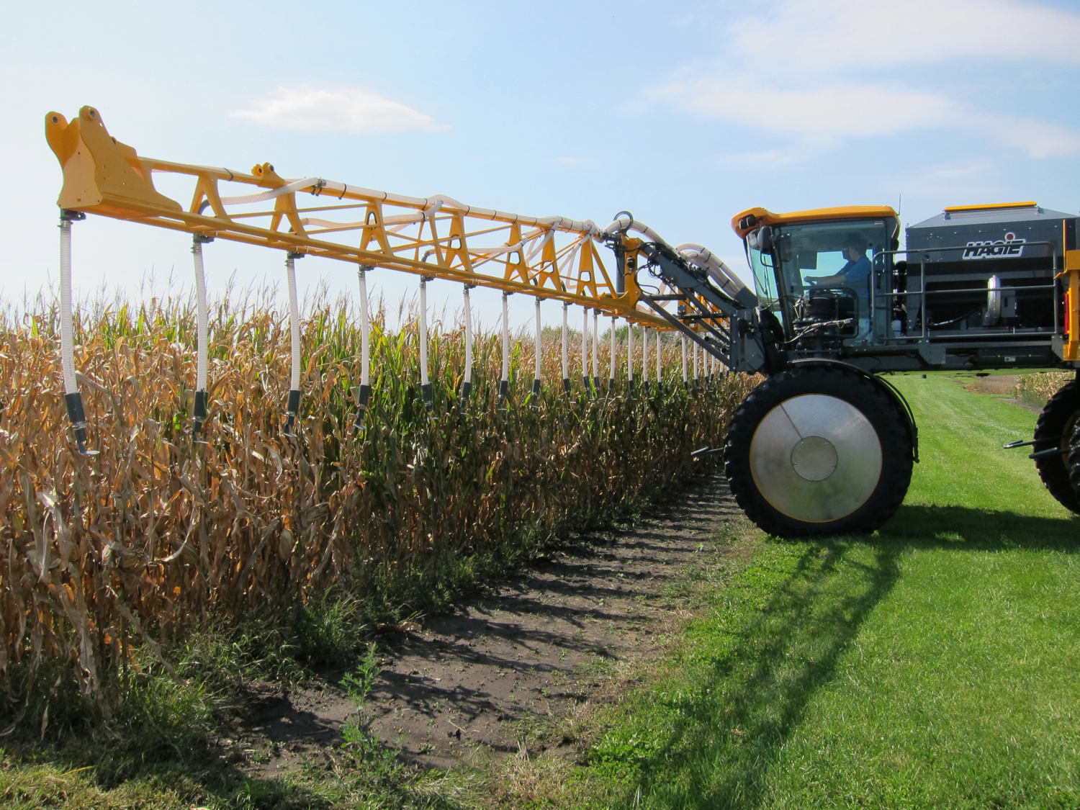
High clearance seeder
Photo: Rob Myers
Notes:
Planting and equipment: High clearance seeder
Here you can see a high clearance seeder lined up to plant a cover crop in between standing rows of corn that are almost ready for harvest.
This will allow the cover crop to be seeded before harvest and extend the growing season before winter sets in.
Though high clearance seeders are available, they are not as suitable for planting cover crop mixes comprised of multiple species.
Photo taken in Ames, IA.

Slide 31

Roller crimper
Photo: Edwin Remsberg
Notes:
Equipment, termination of cover crop
Ways to terminate cover crops: chemical applications of herbicides, mowing the cover crop, rolling the cover crop down, or using tillage.
Some producers use this piece of equipment, known as the roller crimper, to manually roll down the cover crop before planting a cash crop.
This method allows the farmer to use no-till management and further steward their soil health.
Photo taken in Maryland.

Slide 32
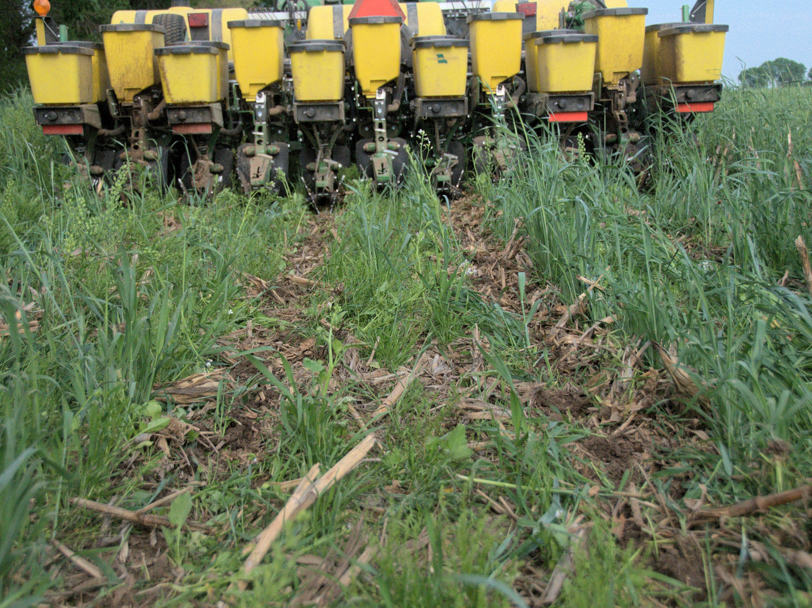
No-till drill seeder
Photo: Jason Vance
Notes:
Equipment:
As with the high clearance seeder, the opportunity exists to modify equipment to allow cash crops to be overseeded into the standing cover crop, or vice versa. This will allow cover crop growth for longer periods and maximize some of the cover crop benefits.
In this image you can see a no-till drill seeder running through a cover crop mixture to plant the cash crop while the cover crop is still growing.
This no-till drill seeder could be used with the roller crimper from the previous slide.
Photo was taken in Missouri. In this photo, the no-till drill seeder was being used to plant corn into hairy vetch, cereal rye, and tillage radishes.

Slide 33
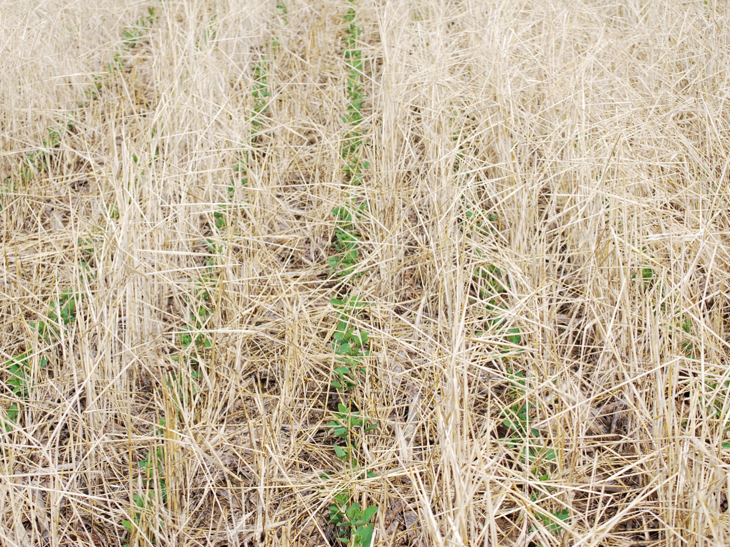
Soybeans seeded into cereal rye residue
Photo: Dave Chance in Boone County, IN
Hosted by www.plantcovercrops.com
Notes:
This photo shows soybeans that were overseeded into cereal rye, which has been terminated. The soybeans were able to sprout under the mulch cover of the cereal rye residue, which prevents erosion and retains soil moisture.

Slide 34
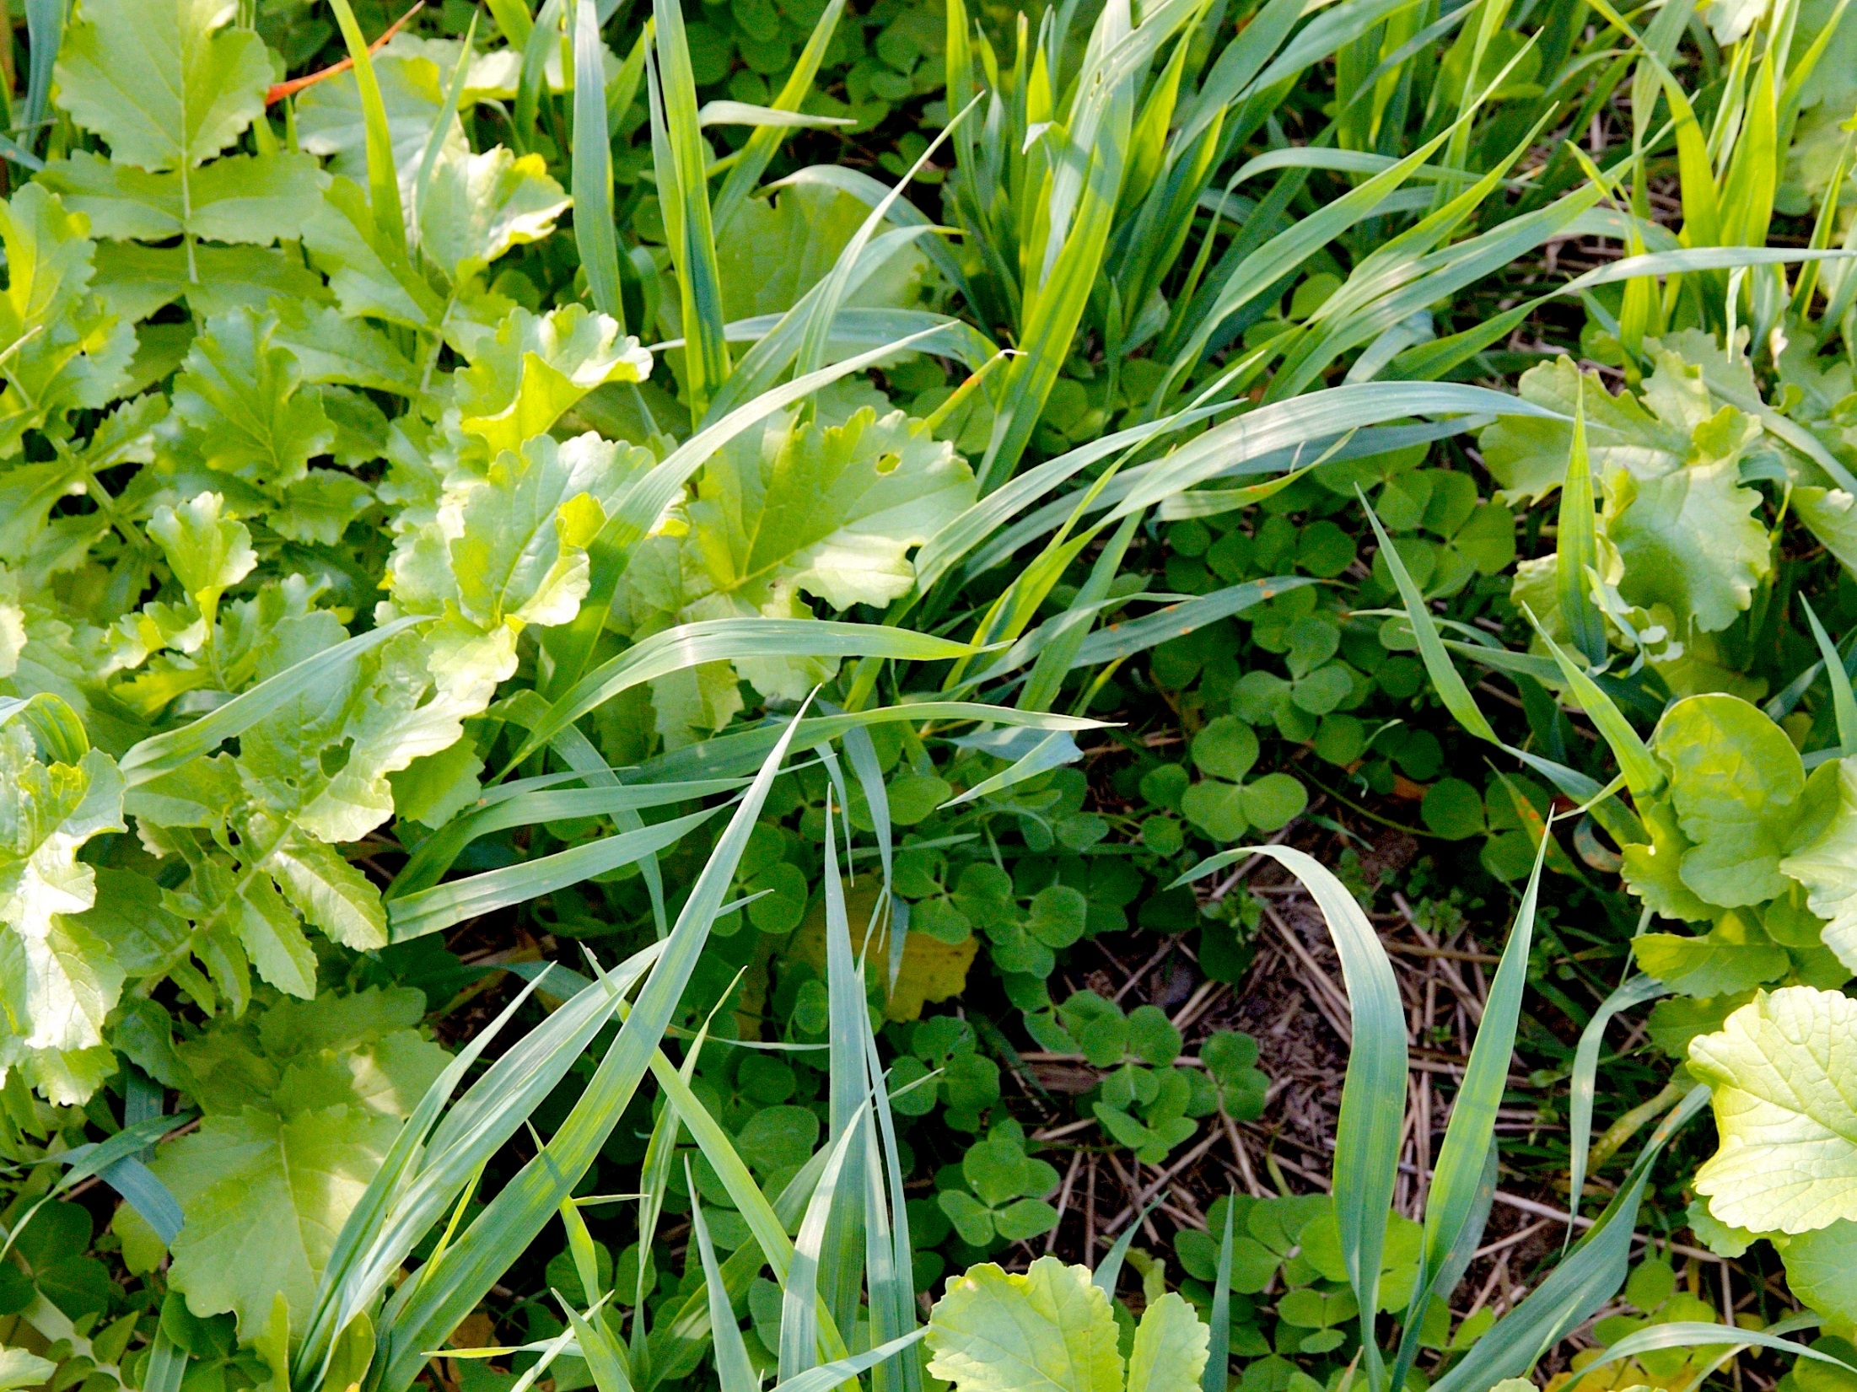
Cover crops can save money by reducing reliance on fertilizer and pesticides.
Cover crop mix at Dan DeSutter’s Farm in Attica, IN
Photo by Rob Myers
Notes:
Another opportunity with cover crops is to save money by reducing input costs through a decreased reliance on fertilizers and pesticides. Cover crop residues will prevent natural weedy vegetation from taking root through the fallow season and can add nitrogen to the soil that will be available for use by the following cash crop.

Slide 35
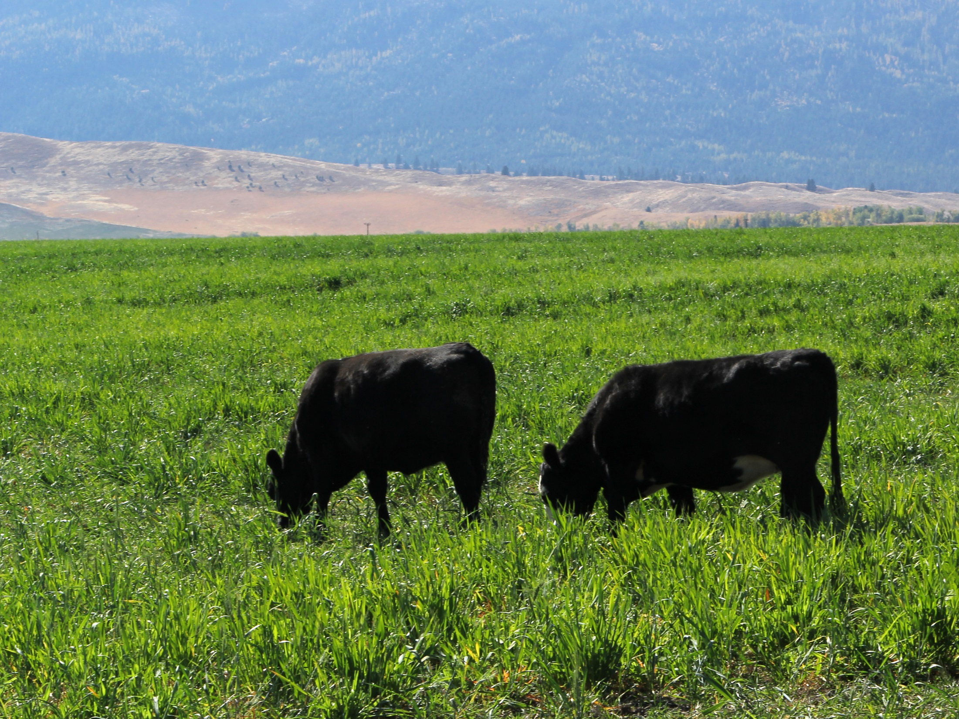
Cattle graze on cover crops in Wallowa County, Oregon
Photo via Aaron Roth and NRCS Oregon
Notes:
An opportunity in cover crops is to generate income in new ways, such as by grazing cattle over cover crops in the winter time. Purple top turnips are a one grazing option.
Photo: Aaron Roth, NRCS Oregon, 2015 (via flickr)
https://www.flickr.com/photos/nrcs_oregon/24327480489/in/photolist-qTwszA-qTvewm-r8MV5w-o741Hq-BwQWfh-BqsjPX-BWF7Zf-BwQZHj-BWEZMQ-BYY2Se-BWENj9-BWEyFN-B2swg7-BWEq5j-B2ykrD-BYYoEX-B2yn1R-BRFE7F-zjzSkW-BYYGRg-BwQLq7-B2z3i8-B2sqvE-HKAdgK-Gy4BxG-CEHCMd-GuBM8P-CEHFmm-Db7ryC-DCe4az-GuBEh4-D4JH7R-D4JGoM-CEQpMF-DzUJGw-DzUHAJ-BPnJwb-BPo83o-BwR8Cs-BWEVPu-B2ywWx-BWF5Vf-B2sn49-HHLmsr-BWF3Eo-B2sZRY-B2yqm8-g7HboH-BWEh9Q-kwzQpv/

Slide 36
Cover crop champions and innovators
Dan DeSutter: Indiana
  4,500 acres
  No-till, cover crops, manure
  National no-till innovator of the year in 2013
  https://youtu.be/cwS21jZd9a4
And many more. Visit the SARE Cover Crop Innovators Series on the SARE Program website to learn about more cover crop innovators.
Notes:
It is extremely important to highlight the stories of those who’ve had success with cover crops.
The SARE website is home to a library of over 20 different short videos documenting farmers from across the country that use cover crops. On this slide we highlight just one of the many cover crop champions and innovators across the United States.
Dan DeSutter farms 4,500 acres in Indiana using no-till, cover crops and manure to build his soil quality. He was the National No-till Innovator of the Year in 2013 and is active in his community.
Link to Dan’s video: http://www.sare.org/Events/Cover-Crop-Conferences/National-Conference-on-Cover-Crops-and-Soil-Health/Cover-Crop-Innovators-Video-Series/Dan-DeSutter-Attica-Indiana
Articles featuring Dan
http://ocj.com/2016/09/understanding-soil-biology-offers-a-competitive-advantage-on-the-farm/
http://ccsin.iaswcd.org/ccsi-farmer-profile-dan-desutter/
https://www.nytimes.com/2016/02/07/business/cover-crops-a-farming-revolution-with-deep-roots-in-the-past.html?_r=0

Slide 37
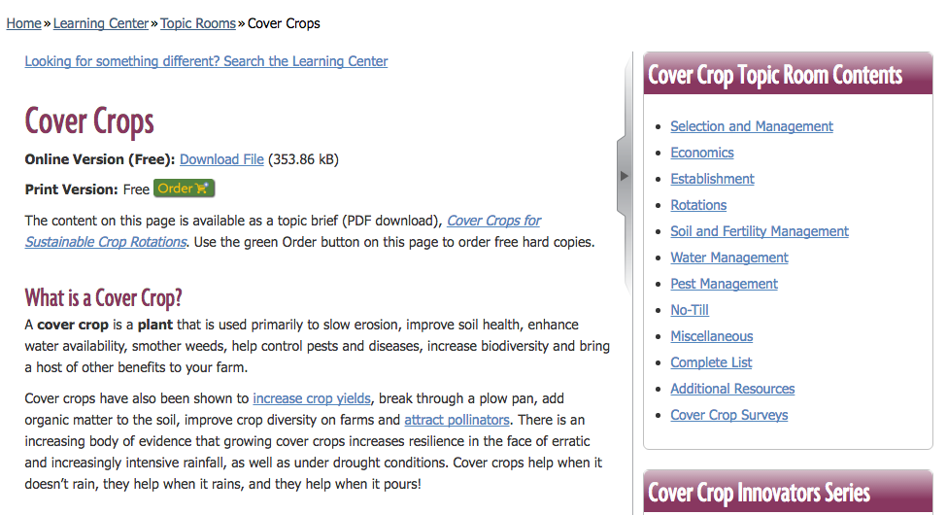
Informational Resources
SARE Cover Crops Topic room: http://www.sare.org/Cover-Crops
  Videos
  Links to the SARE National Cover Crop Conference program materials
  Publications
  Research reports
  Survey data
Notes:
There is a variety of educational resources about cover crops and soil health.
SARE Cover Crop Topic Room with online resources about cover crop selection, growth and management.

Slide 38
Informational Resources (cont’d)
SARE Books:
  Managing Cover Crops Profitably
  Building Soil for Better Crops
  E-reader versions available on SARE’s website
SARE Bulletins:
  “Cover cropping for pollinators and beneficial insects”
  “Cover crops for sustainable crop rotations”
Notes:
SARE books and bulletins online
The bulletins are available for free (online or print)
Books are also available in digital format online for free, and in print for purchase.
Print versions of the books are:
Managing Cover Crops Profitably = $19.00
Building Soil for Better Crops = $20.95

Slide 39
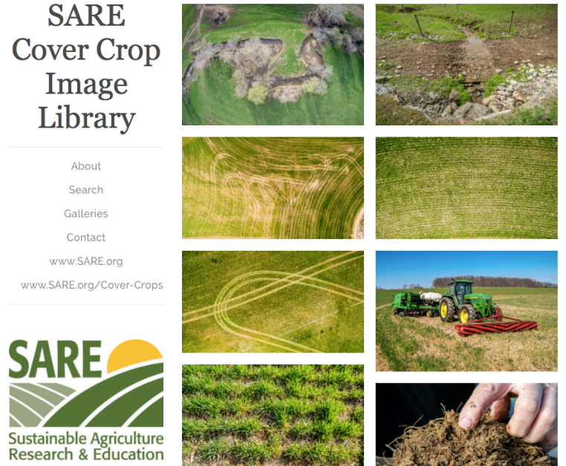
Library of cover crop and soil health images
http://www.sare.org/Learning-Center/Topic-Rooms/Cover-Crops/Cover-Crop-Images-Library
Database of visuals to encourage farmers and landowners to improve soil health.
Photo database includes aerial shots, equipment, photos of species, growers.
Soil Health gallery of illustrations with explanatory notes
Available for download and free, non-commercial use
Notes:
This is a searchable database containing several hundred photos organized by topic.

Slide 40

Informational Resources (cont’d)
NRCS Soil Health
  http://www.nrcs.usda.gov/wps/portal/nrcs/main/national/soils/health/
  Several fact sheets and videos available
Soil Health Institute
  http://soilhealthinstitute.org/
Soil Health Partnership
  http://soilhealthpartnership.org/
Regional Cover Crop Councils
  Midwest Cover Crop Council:
    http://mccc.msu.edu/
  Councils also starting in the South and Northwest
”Unlock the Secrets in the Soil” and other soil health graphics available through NRCS Soil Health online
Notes:
The Natural Resources Conservation Service has an online soil health resource with fact sheets, videos, a photo gallery and links to other resources.
The Soil Health Institute aims to further the adoption of soil health management practices through scientific research.
They will offer resources online including their own technical bulletins and links to other important cover crop resources.
The Soil Health Partnership aims to measure and communicate the environmental and economic impacts of soil management strategies, pulling region-specific data from a large group of demonstration farms and establishing research protocols to standardize soil measurements.
Regional cover crop councils exist to provide information to producers about cover crop selection and management. They will often offer decision tools online.

Slide 41

Resources for funding
NRCS Environmental Quality Incentives Program
NRCS Conservation Stewardship Program
SARE Program Farmer Rancher grants
State cost-share programs
Notes:
The NRCS has several programs to offer funds for farmers wishing to incorporate conservation practices, such as cover cropping, into their production.
SARE offers a Farmer Rancher grant program which enables farmers to, independently or in collaboration with others, implement new practices on their farm while eliminating some or all of the financial burden.
And certain states, such as Maryland, have cost-share programs that enable farmers to plant cover crops at a decreased cost to them.

Slide 42
How to get started with cover crops

Slide 43
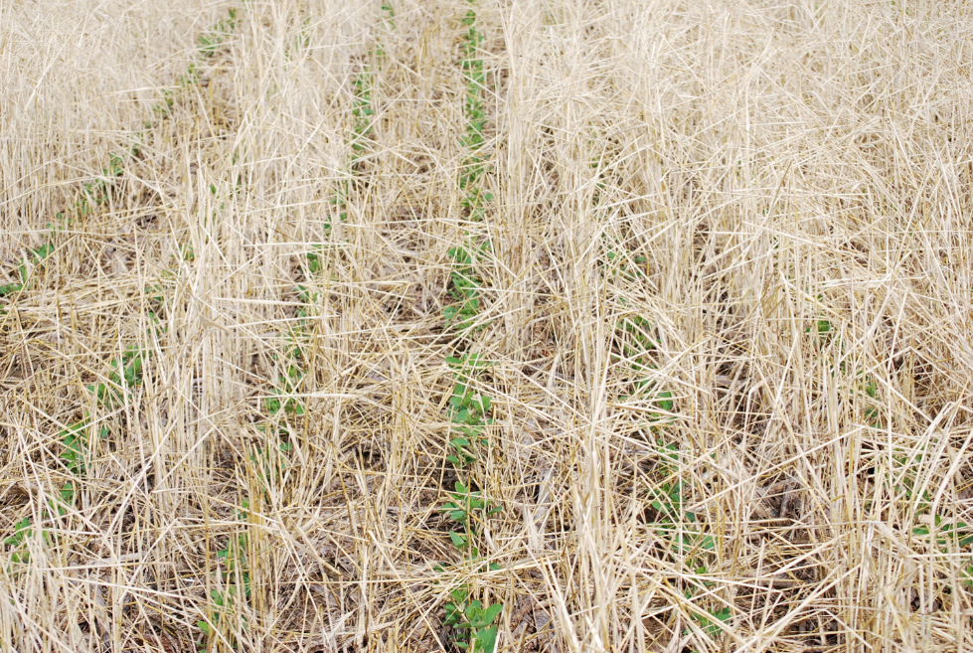
Do you grow soybeans?
Try planting cereal rye over the winter.
What producers say:
32%: cereal rye helped manage broadleaf weeds in soybeans
26%: cereal rye helped control herbicide resistant weeds in soybeans
Only 18% of respondents saw no impact on weed management
52%: soybean yields increased when planted after cereal rye
Photo: Dave Chance in Boone County, IN
Hosted by www.plantcovercrops.com
Notes:
Data from SARE/CTIC 2015-2016 Cover Crop Survey
Remember that these are only a few scenarios. Farming is a diverse, dynamic enterprise and what works well in some systems may not work well in others. It is important for producers to connect locally with others doing work with cover crops to get first hand accounts of what works and what doesn’t in their region, soil type, and production system.

Slide 44
Do you grow vegetables?
Do you have a 3-8 week summer fallow period?
  Try planting a fast-growing summer annual like buckwheat or sorghum-sudangrass.
Are you trying to manage weeds in your organic operation?
  Try a living mulch of white clover paired with your sweet corn or tomato crops.
Notes:
Remember that these are only a few scenarios. Farming is a diverse, dynamic enterprise and what works well in some systems may not work well in others. It is important for producers to connect locally with others doing work with cover crops to get first hand accounts of what works and what doesn’t in their region, soil type, and production system.

Slide 45
Do you grow nut trees or fruit crops?
Try a perennial or a reseeding annual.
White clover included in a mixture with grasses
Bromegrass or orchardgrass on orchard floors.
Crimson clover or an annual vetch to provide nitrogen.
Notes:
Remember that these are only a few scenarios. Farming is a diverse, dynamic enterprise and what works well in some systems may not work well in others. It is important for producers to connect locally with others doing work with cover crops to get first hand accounts of what works and what doesn’t in their region, soil type, and production system.

Slide 46
From the farmers:
“Start small with crops that winter kill. Realize that the real benefits will come with time. Proper mindset is crucial.”
“Soil health is key. Cover crops are better than steel.”
Notes:
These are some farmer quotes about cover crops and soil health from the SARE/CTIC Cover Crop surveys.

Slide 47
From the farmers:
“Cover crops are a long term investment in improving your soil biology.”
“Give them a try. You have nothing to lose but your soil.”
Notes:
These are some farmer quotes about cover crops and soil health from the SARE/CTIC Cover Crop surveys.

Slide 48
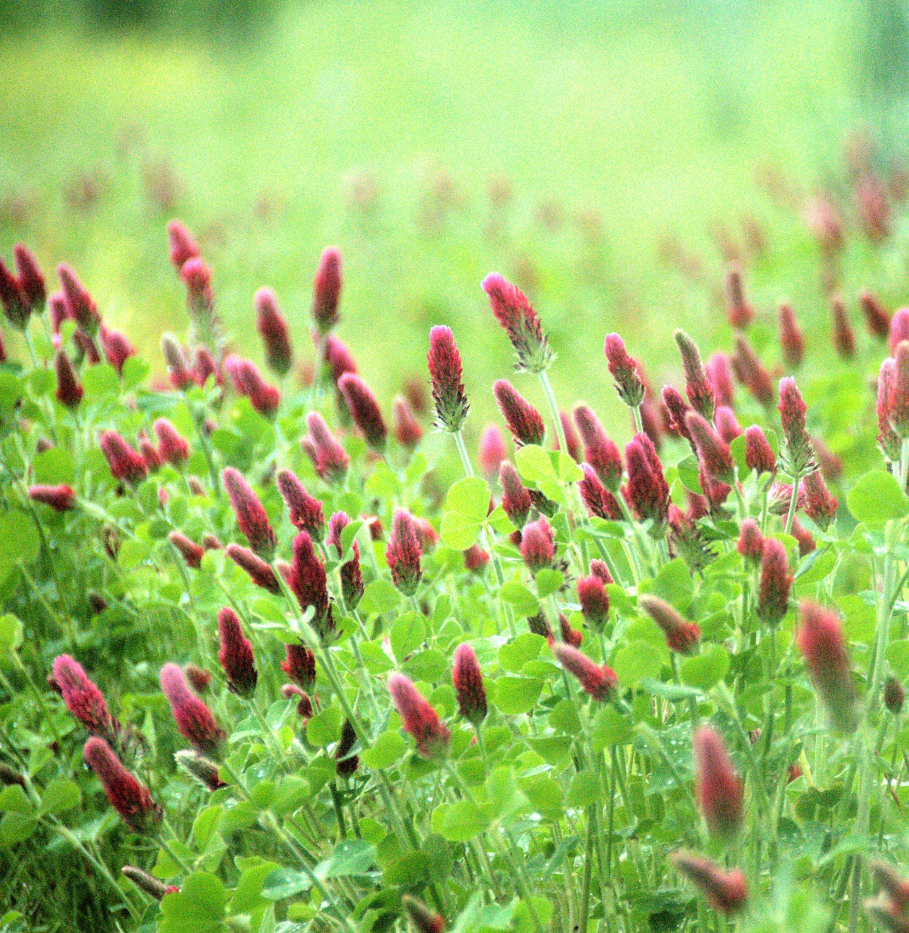
Thank you!
Photo by Jason Vance
Notes:
Photo taken at the University of Missouri Bradford Research Center in Columbia, MO.

