Slide 1
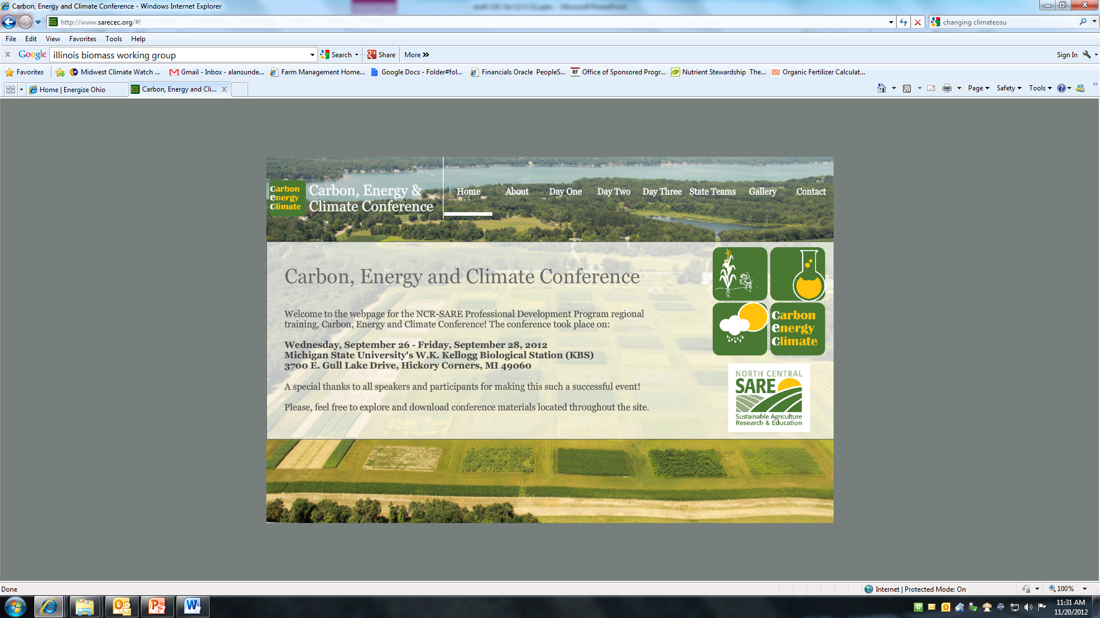
www.sarecec.org

Slide 2
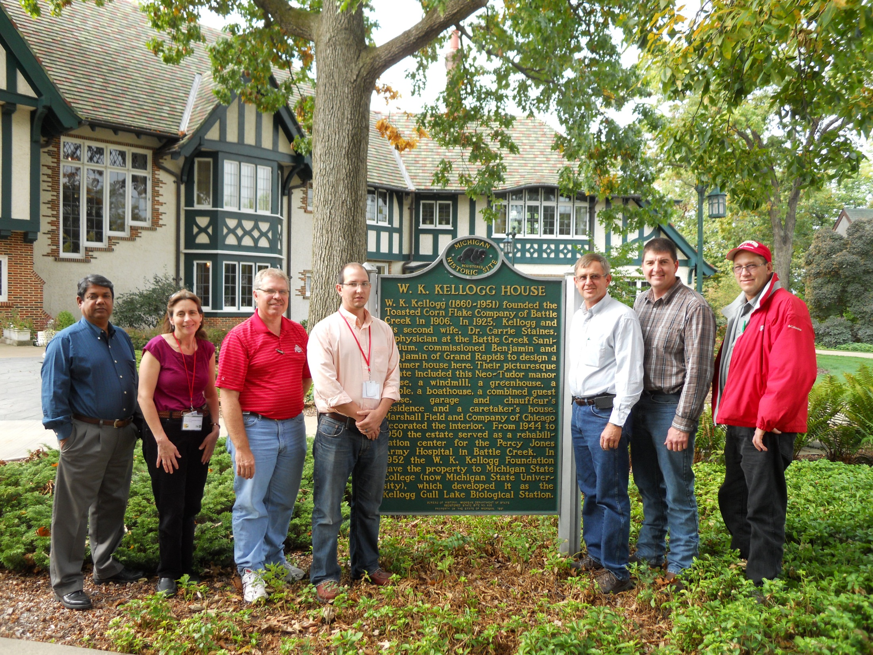

Slide 3
Climate Education

Slide 4
What Should Extension Educators Understand About Climate Change
In 2012 the Great Lakes Regional Water Program worked with 17 Extension professionals from Land Grant and Sea Grant along with NOAA and the River Network developed a list of 10 core competencies related to climate change for Extension and outreach professionals.
Notes:
Recent needs assessment conducted in 2012 by U of Wi in Mi, Ohio, Wi, suggests Ext and Sea Grant educators have low confidence in their ability to teach about climate change. Great Lakes Regional Program has developed a list of 10 core competencies for Extension and other outreach professionals.

Slide 5
Climate Change Core Competencies Include
  Climate change science
  Scientific method and consensus on climate change and potential impacts
  Public division on climate change
  History and implementation of public policy on climate change
  Ecological principles and climate change
  Evaluating risks and potential adaptations that address risks to infrastructure, economic development, and health
  Teach about climate change
Notes:
Include having a basic understanding of the following:

Slide 6
Where can you go for regional information on climate change
Great Lakes Regional Water Program
  http://greatlakeswater.uwex.edu/coordinating-climate-outreach-great-lakes-region
  Core competencies and 2012 distance short courses
NOAA’s Climate Ready Great Lakes and NERRs
  http://www.regions.noaa.gov/great-lakes/?page_id=395
  Anytime online modules great for learning about regional climate science and adaptations (great slides you can use)
OSU Climate Outreach Team
  Features webinars from experts (mostly from Ohio) who explain climate change and discuss implications for educators
  http://changingclimate.osu.edu/
Notes:
Great Lakes Regional Water Program
Initiative leaders from Ohio State University, Michigan State University and University of Wisconsin have partnered with The River Network to continue addressing climate change impacts in the Great Lakes region and to increase capacity of Extension to educate on this topic. Last year, the initiative produced a set of core competencies, a needs assessment of Land and Sea Grant Extension educators in hand, and two distance courses on climate change and water resources management. This year, the initiative will promote the development of expanded education and outreach networks to address climate change adaptation and sustainable water resources management practices for communities. The team will focus on addressing gaps in existing curricula, delivering two more short courses and a webinar, as well as continuing work towards a regional climate website.
Climate Ready Great Lakes consists of three modules designed to help create a Great Lakes region that is “climate ready.” Toward this end, these modules provide stakeholders and decision makers with clear information about Great Lakes climate, as well as what we need to adapt to, why, and how.
The OSU Climate Change Outreach Team is a partnership among multiple departments within The Ohio State University. The team’s goal is to help localize the climate change issue by bringing related research and resources to residents of Ohio and the Great Lakes region.
http://changingclimate.osu.edu/

Slide 7
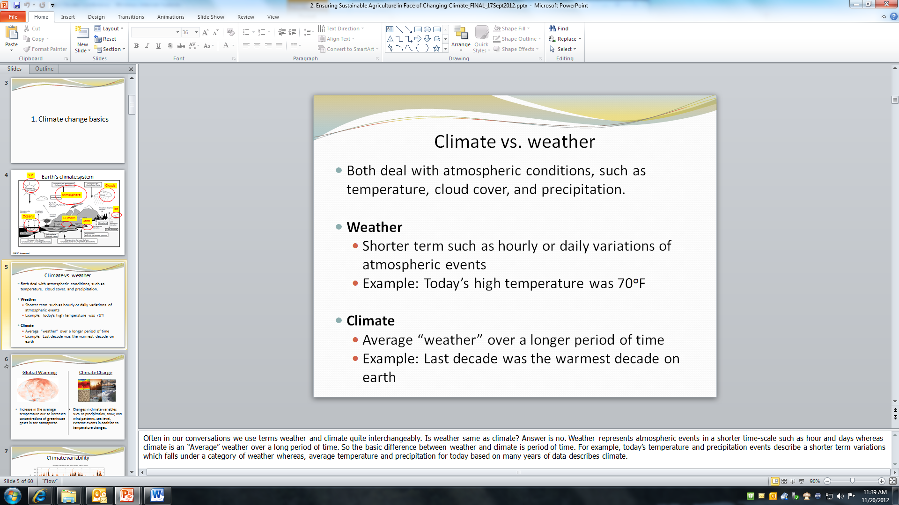

Slide 8
Climate Change: The Fundamentals
Climate
Climate describes how Weather varies at a particular location over a longer period of time.
Climate Change
Climate Change describes long-term (decades or longer) and persistent changes in Earth's Climate.
Climate Variability
Climate Variability describes fluctuations in the Climate itself over time. These changes are usually natural and brief.
Notes:
So to summarize…
[CLICK] Climate describes how Weather varies at a particular location over a longer period of time. In other words, it’s the average of all the weather spread over a long period of time. Normals are derived from averaging the weather.
[CLICK] Climate variability describes changes in the Climate itself over time. Such changes are usually natural and of a brief timescale.
[CLICK] Climate Change describes longer-term (decades or longer) and persistent changes in Earth’s Climate. This may be described as persistent or permanent changes in the Normals.

Slide 9
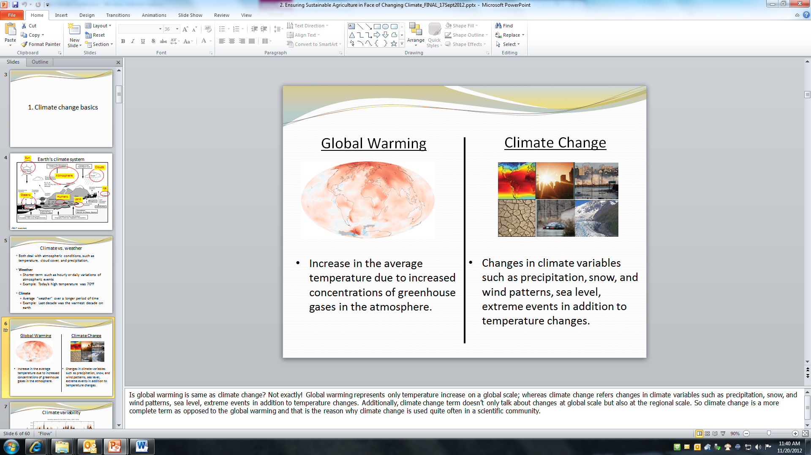

Slide 10
Climate Implications and Strategies

Slide 11
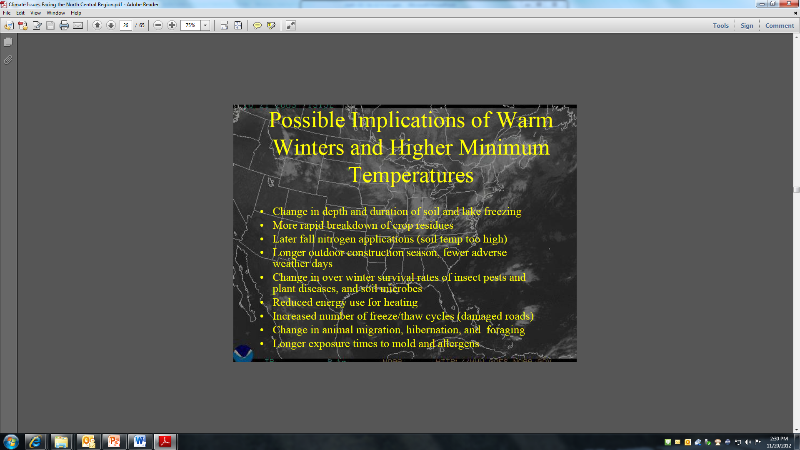

Slide 12
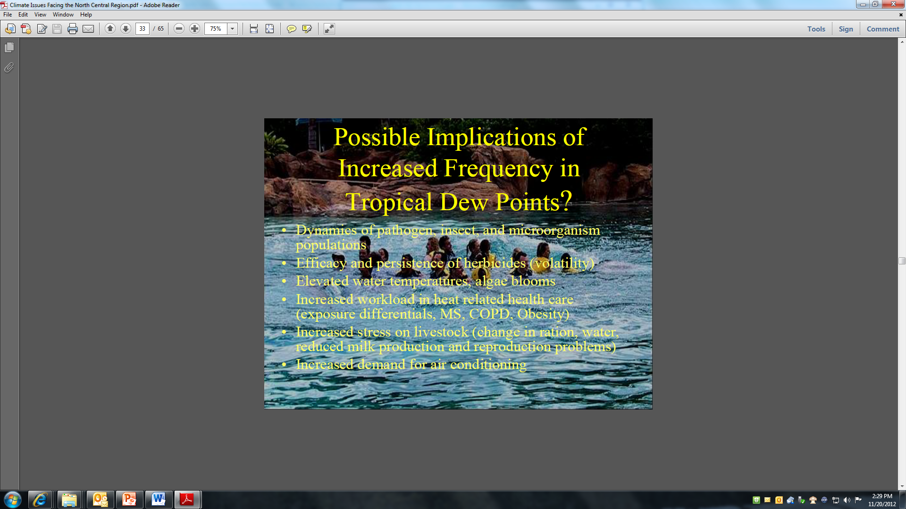

Slide 13
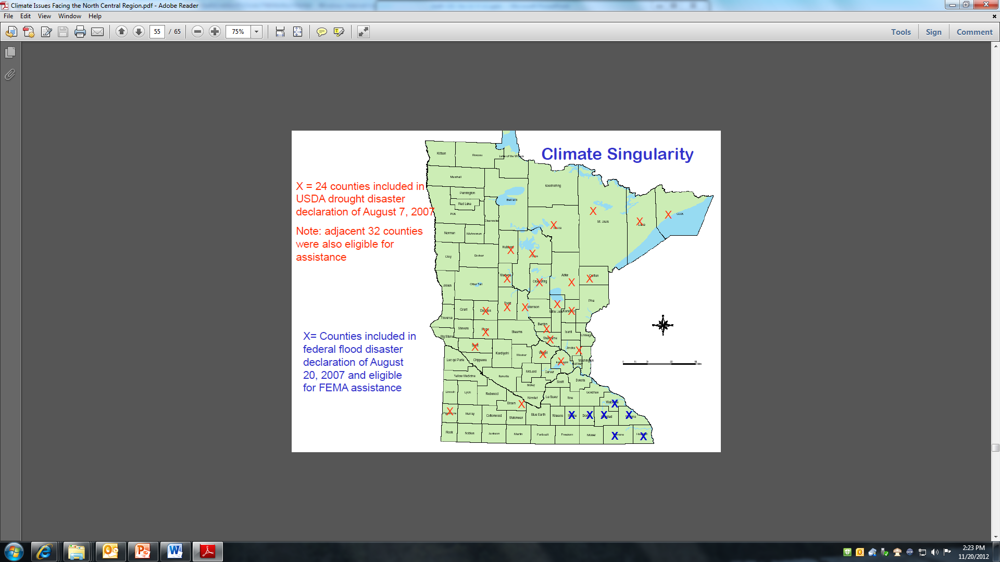

Slide 14
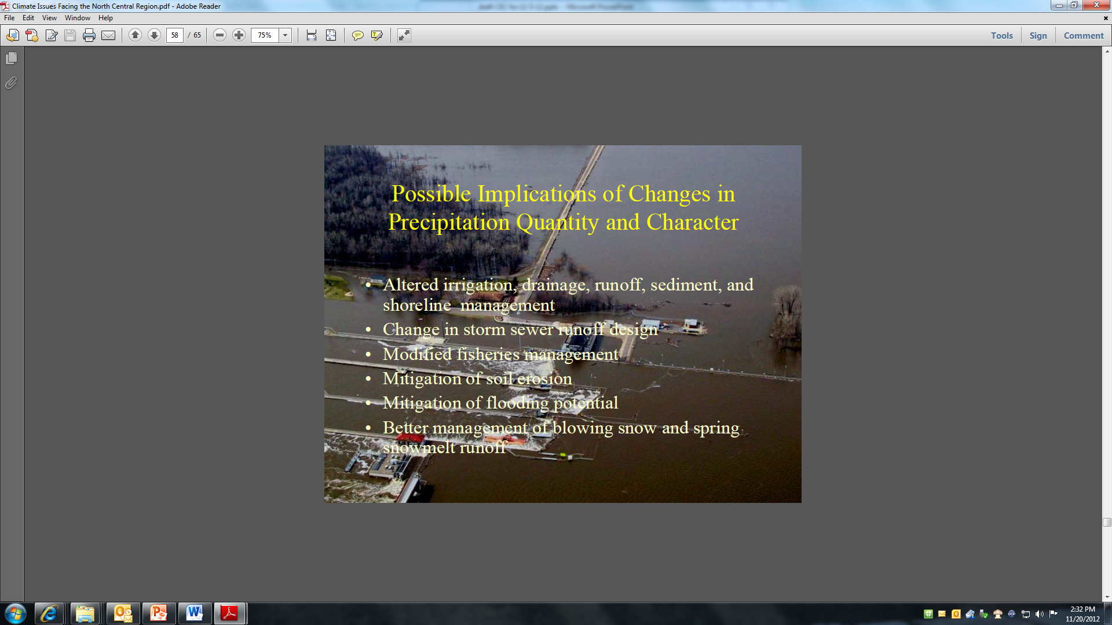

Slide 15
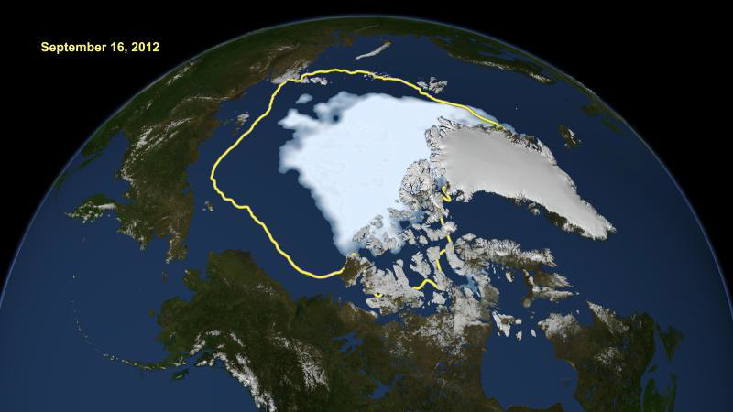
New record minimum in Arctic Sea Ice reported by the National Snow and Ice Data Center in Fall of 2012

Slide 16
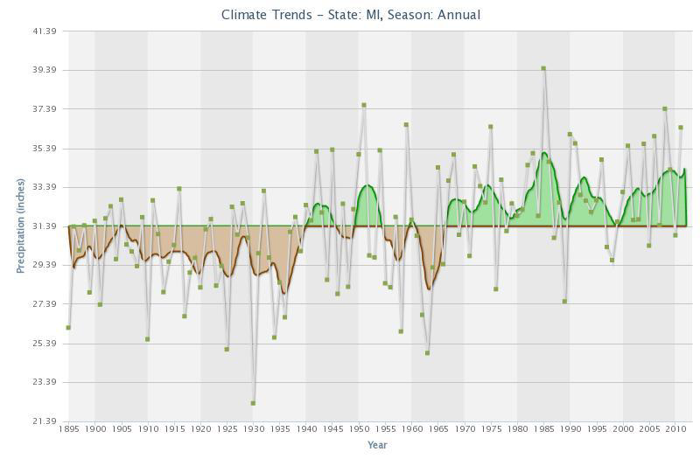

Slide 17
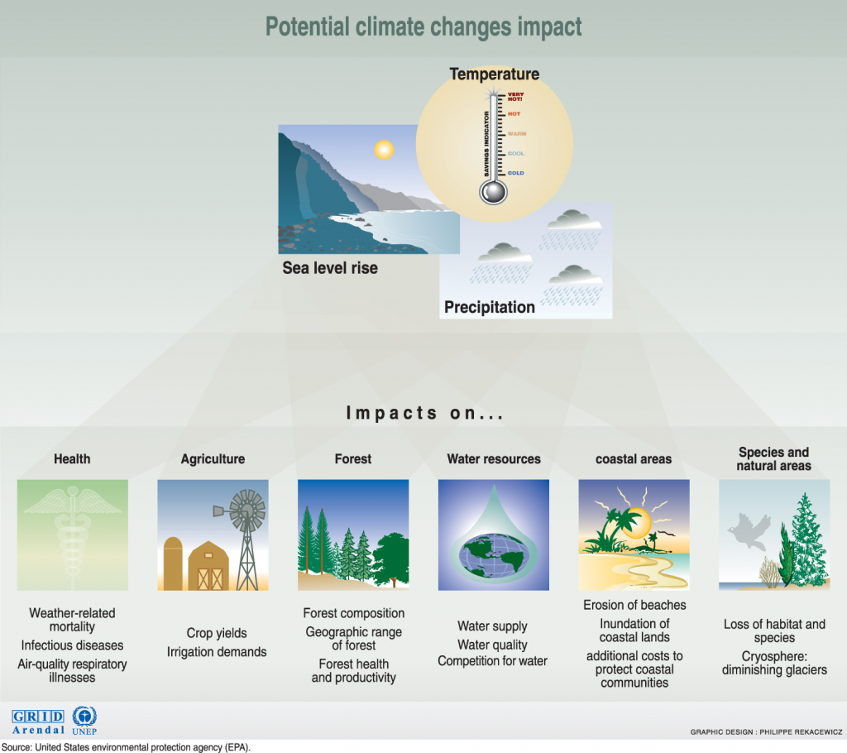
Potential Climate Changes Impact

Slide 18
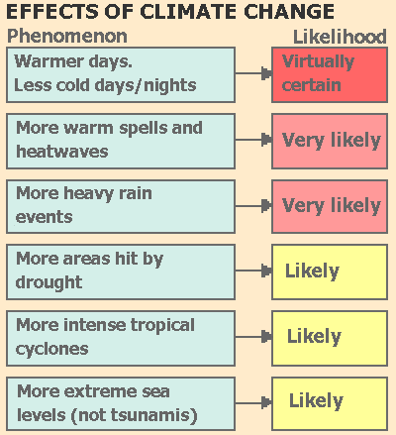
Negative Effects of Climate Change on Agriculture
http://www.theresilientearth.com/?q=content/case-doing-nothing-about-global-warming

Slide 19
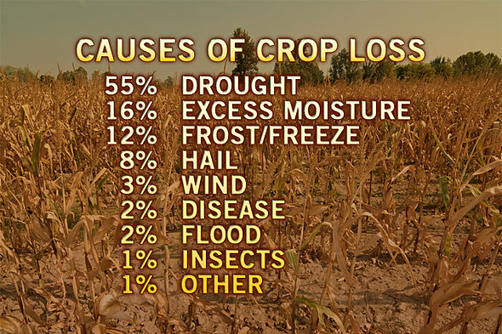
http://www.scientificamerican.com

Slide 20
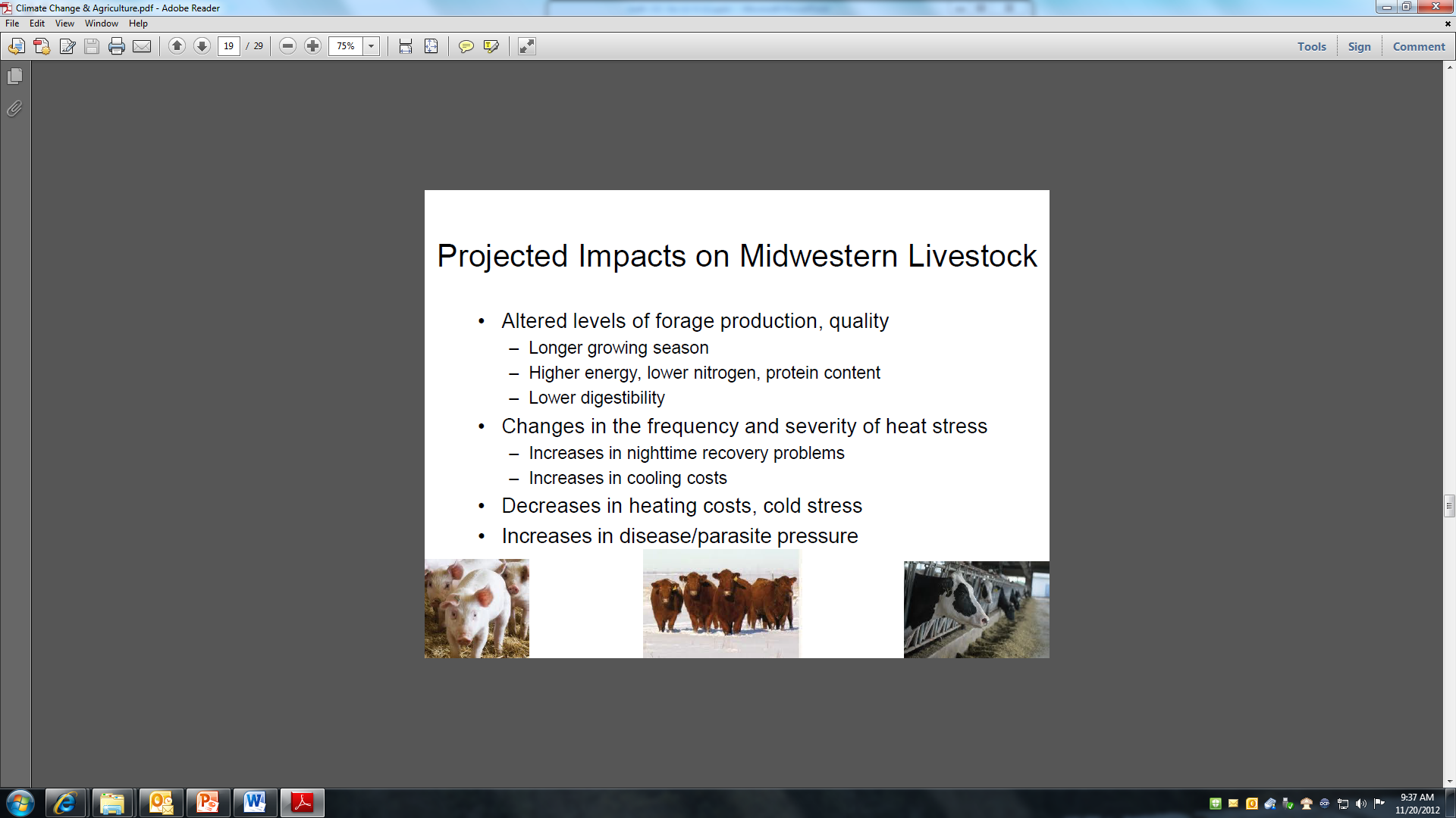

Slide 21
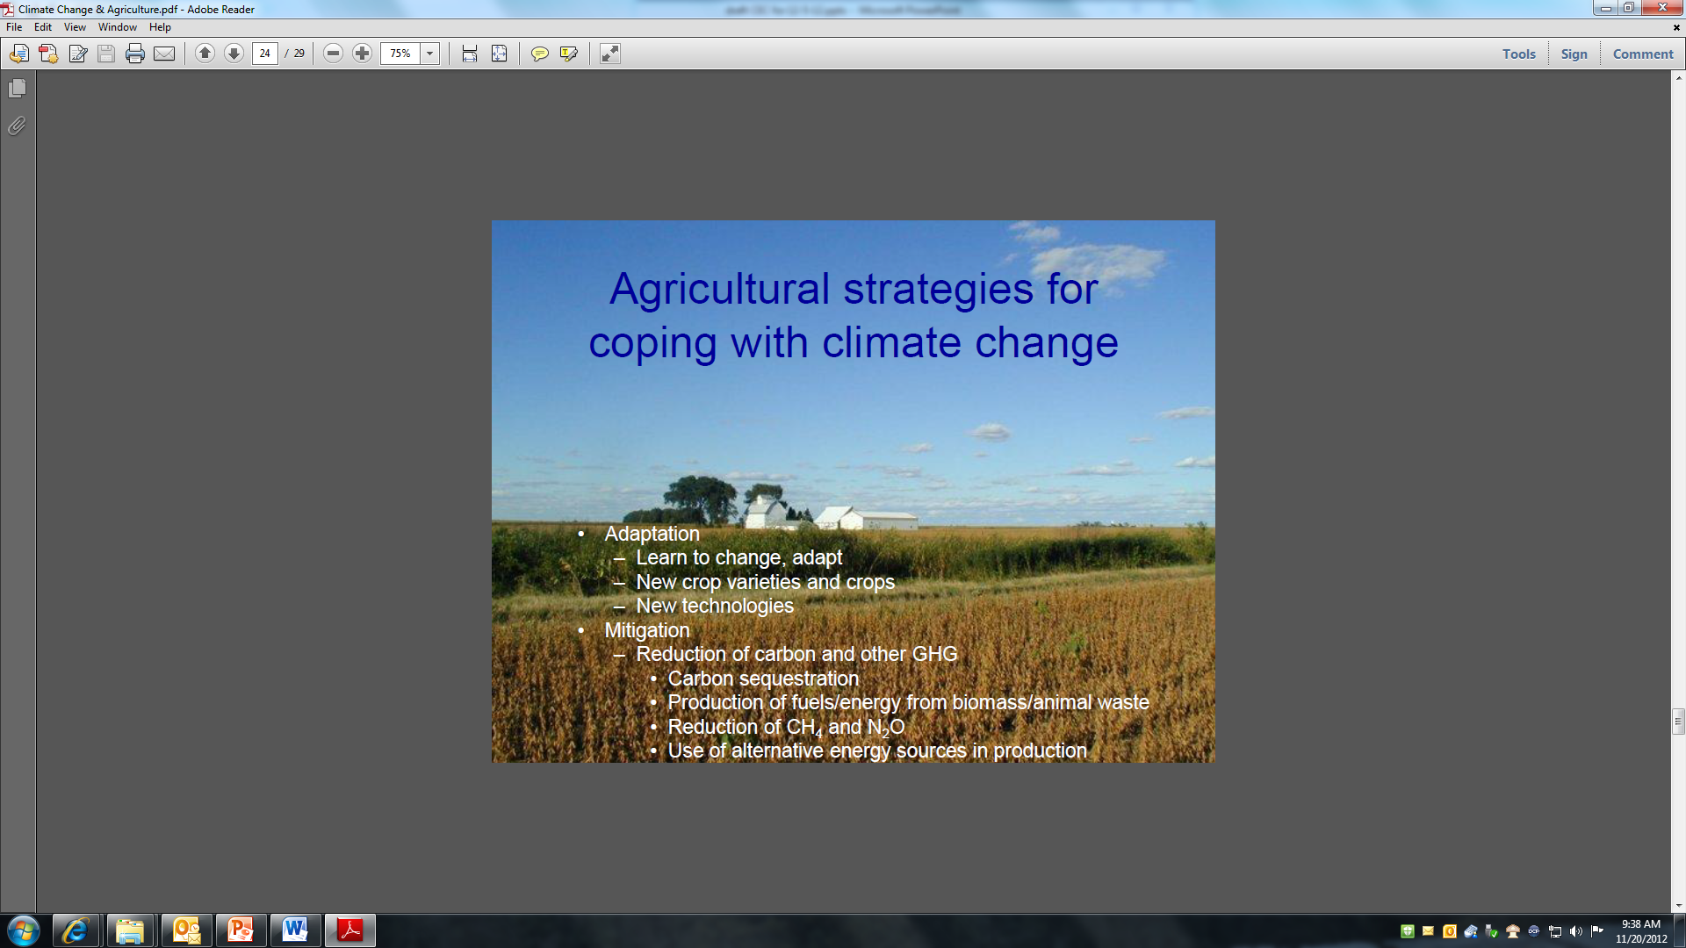

Slide 22
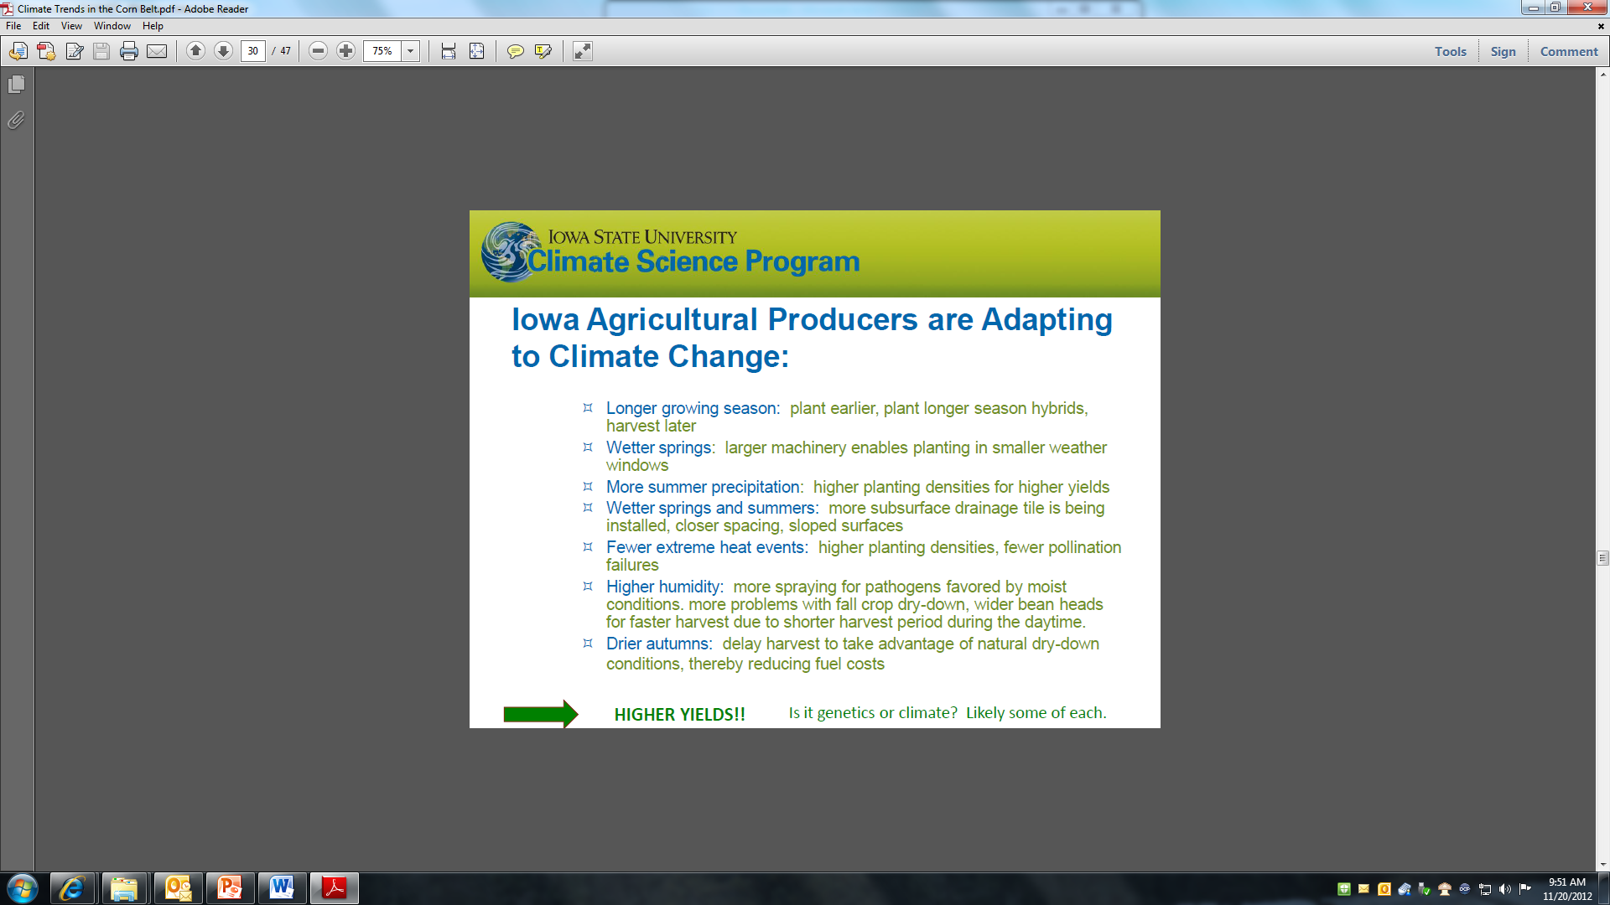

Slide 23
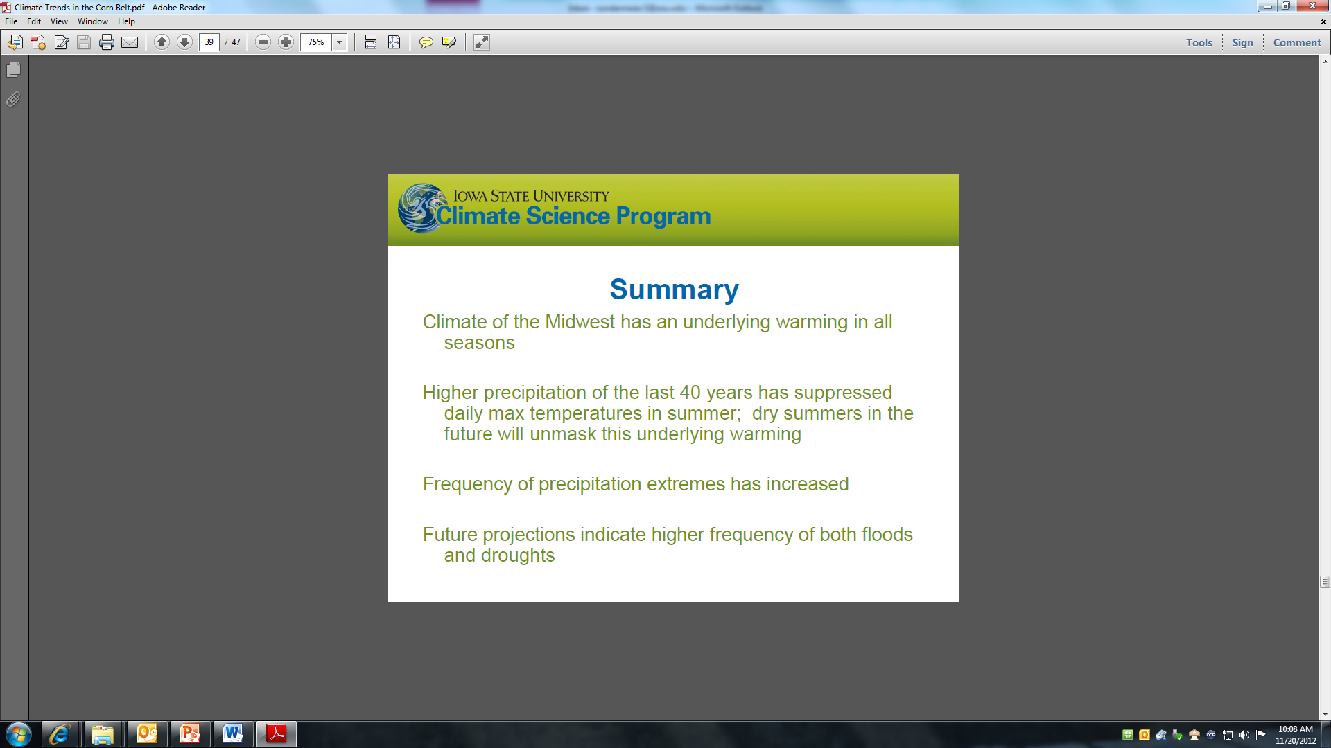

Slide 24
Climate change is real

Slide 25
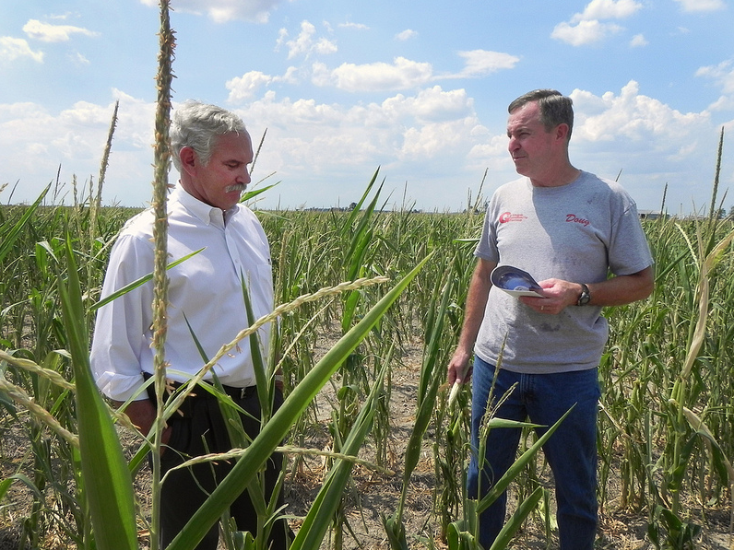
Agriculture Under Secretary for Farm and Foreign Agricultural Service Michael Scuse tours a drought stricken corn field with Doug Goyings, on the Goyings farm in Paulding County, Ohio on Tuesday, July 17, 2012. USDA photo by Christina Reed.

Slide 26
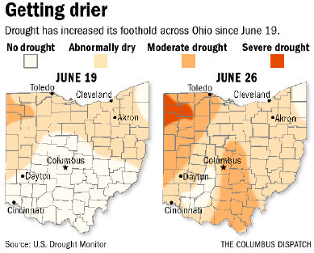

Slide 27
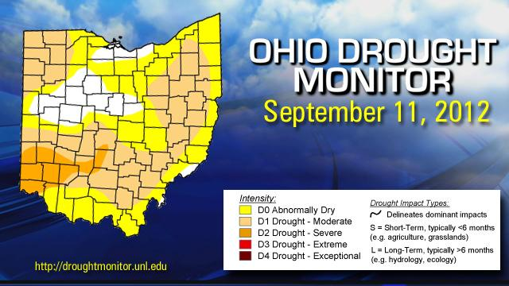

Slide 28
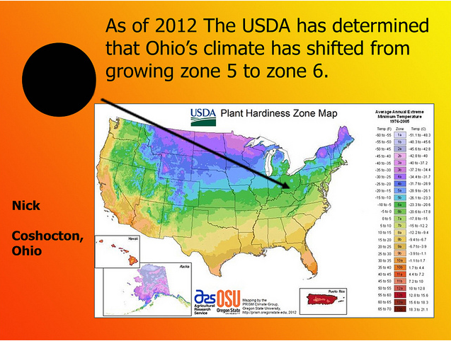
http://www.flickr.com/photos/350org/7145329315/

Slide 29
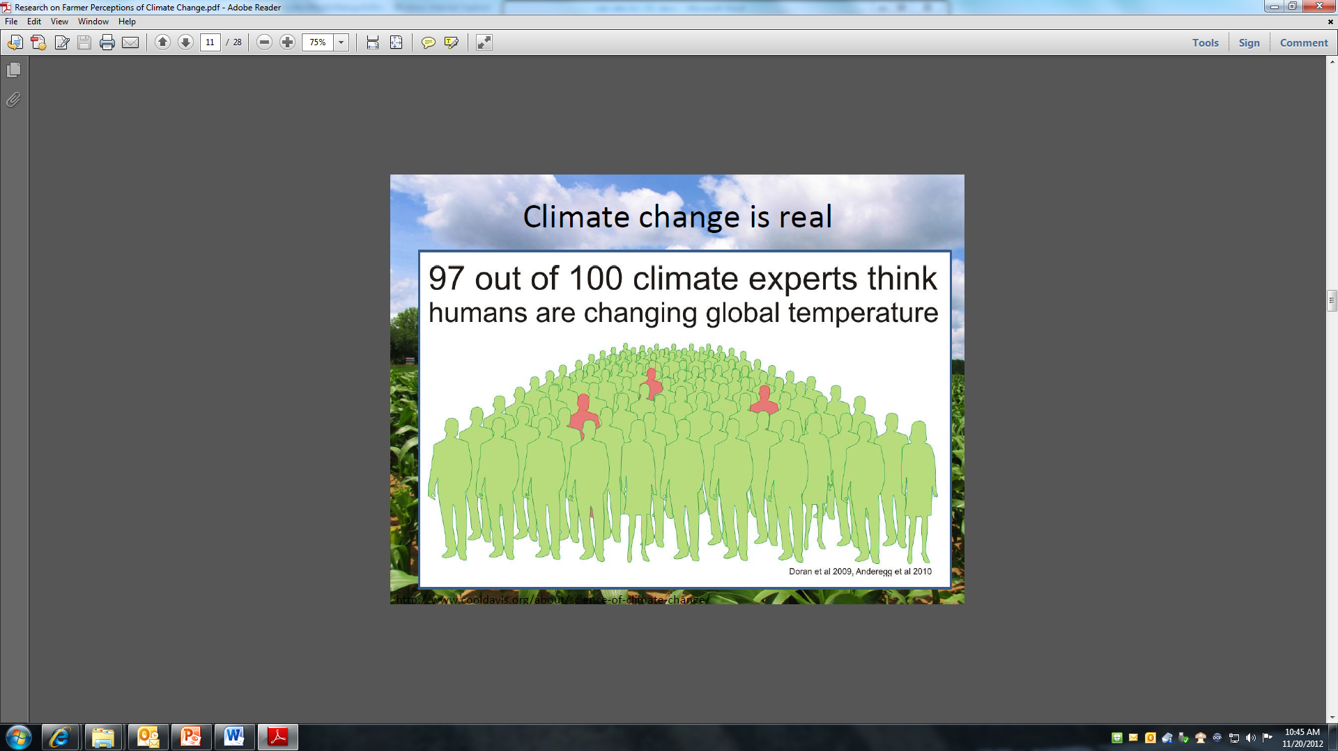

Slide 30
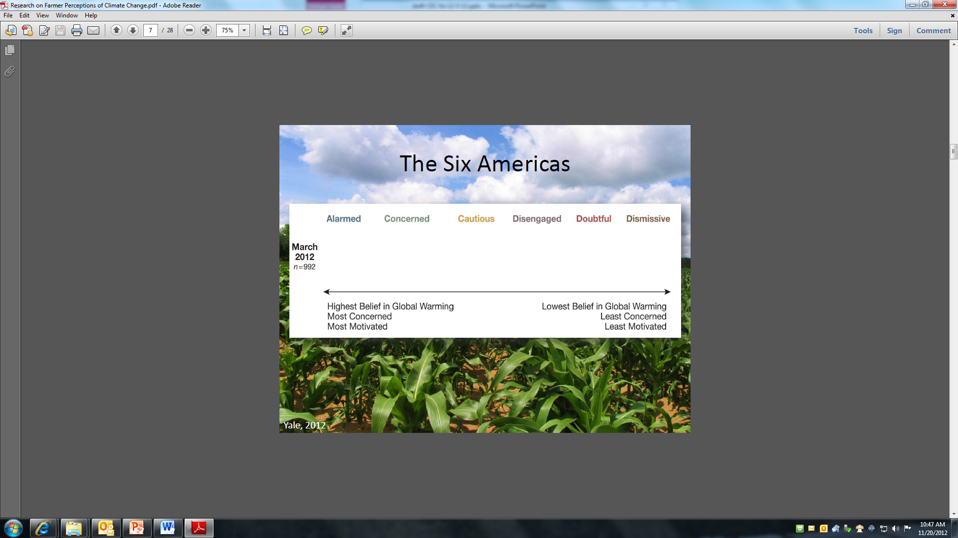

Slide 31
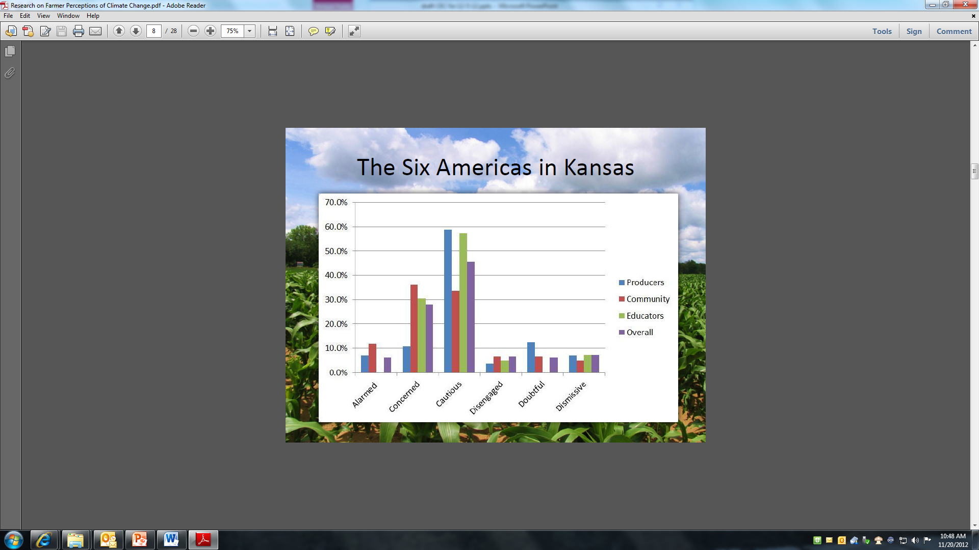

Slide 32
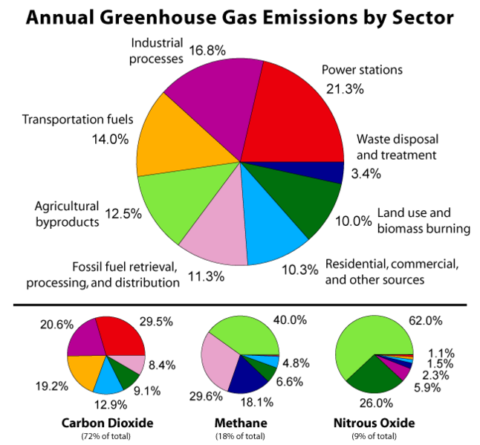

Slide 33
Energy

Slide 34
Has there been a change in what Influences Energy Decisions?

Slide 35
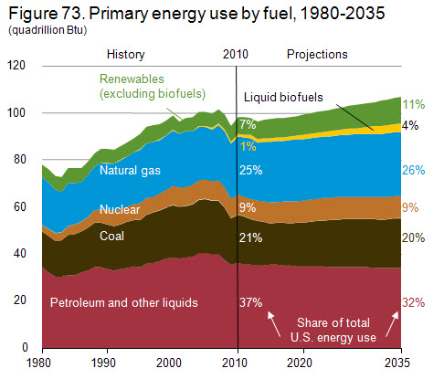
Future Energy Projections
The aggregate fossil fuel share of total energy use falls from 83% in 2010 to 77% in 2035.
Projections show a gradual shift towards lower carbon options such as natural gas and renewable sources.
Biofuels account for 10% of all petroleum and other liquids consumption in 2035.
Source: EIA Annual Energy Outlook, 2012
Notes:
Each year, the U.S. Department of Energy (DOE) issues its Energy Outlook report and long-term forecast. The analysis is based on a set of assumptions about factors that are likely to influence energy development: economic growth, past energy trends, future energy prices, and current state and federal policies.

Slide 36
U.S. Imports of Crude & Petroleum

Slide 37
National Renewable Fuel Standards (RFS2)
Source: U.S. EPA (2010) Renewable National Renewable Fuel Standard Program - Overview

Slide 38
EPA Moderated Transaction System (EMTS) Data
Source: U.S. EPA Renewable Fuel Standard (RFS1) Program Website
Note: 2012 Data is January - September.

Slide 39
Bioenergy crops

Slide 40
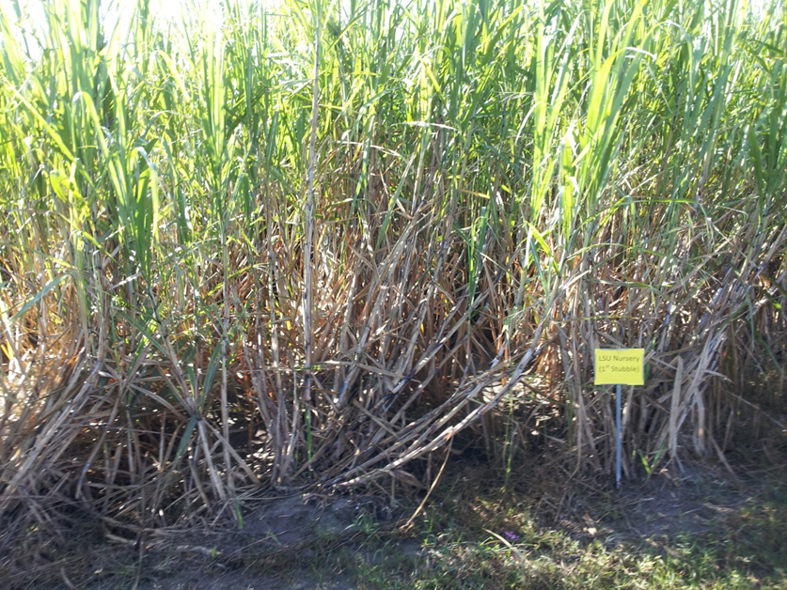
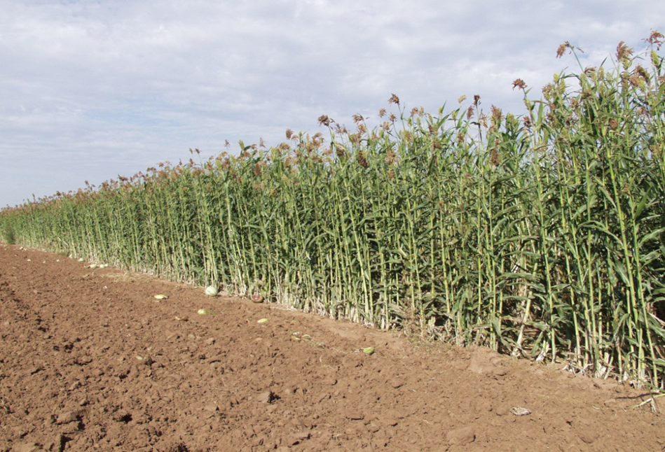
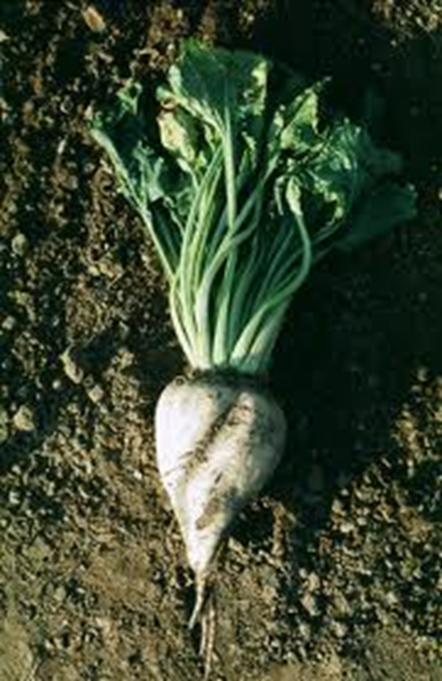
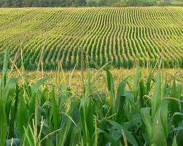
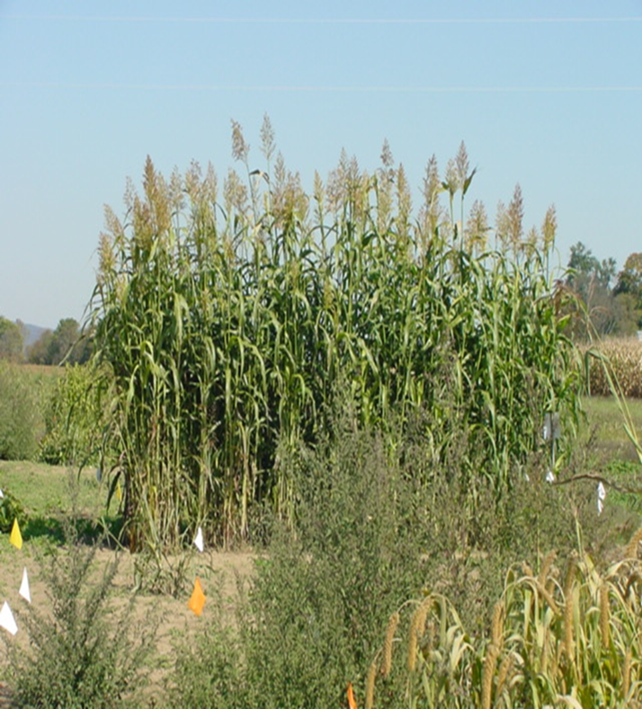
Double alcohol (butane)
Sugarcane
Sweet sorghum
Energy beet
Sweet corn
Sudan-sorghum

Slide 41
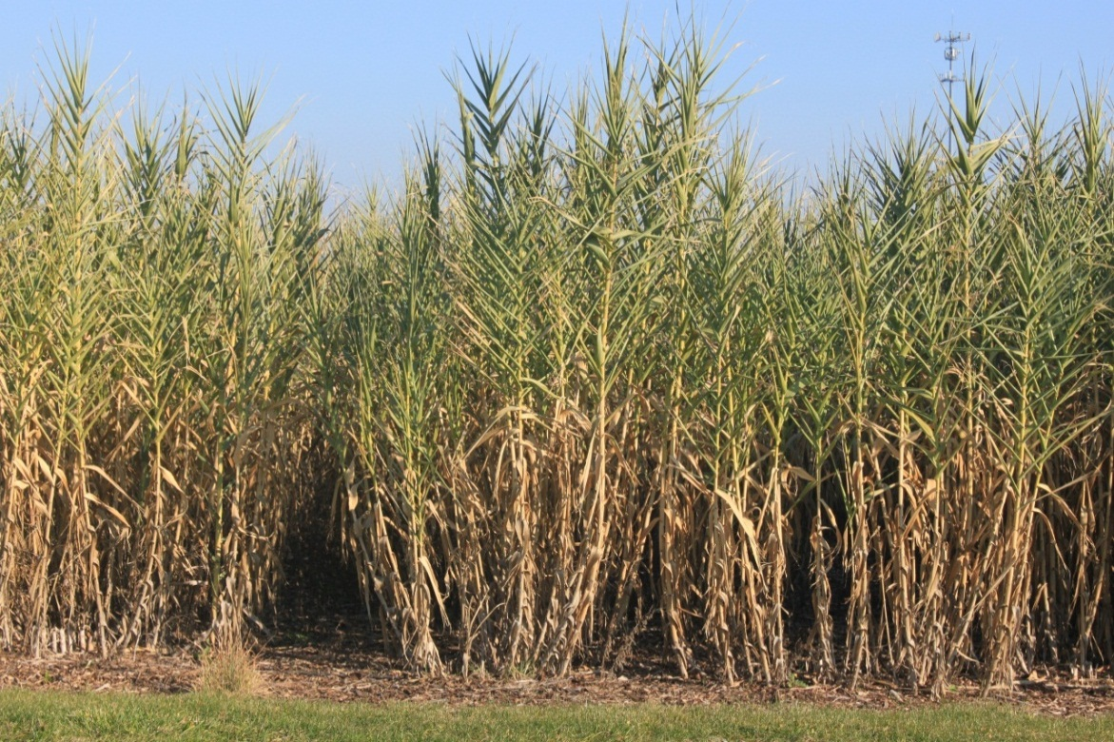
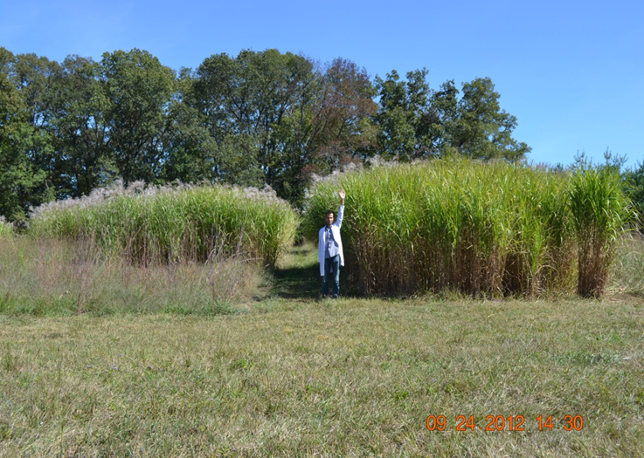
One alcohol (cellulosic)
Miscanthus giganteus
Arundo donax (Spanish cane, Colorado River Reed, Wild cane, and Giant reed.

Slide 42
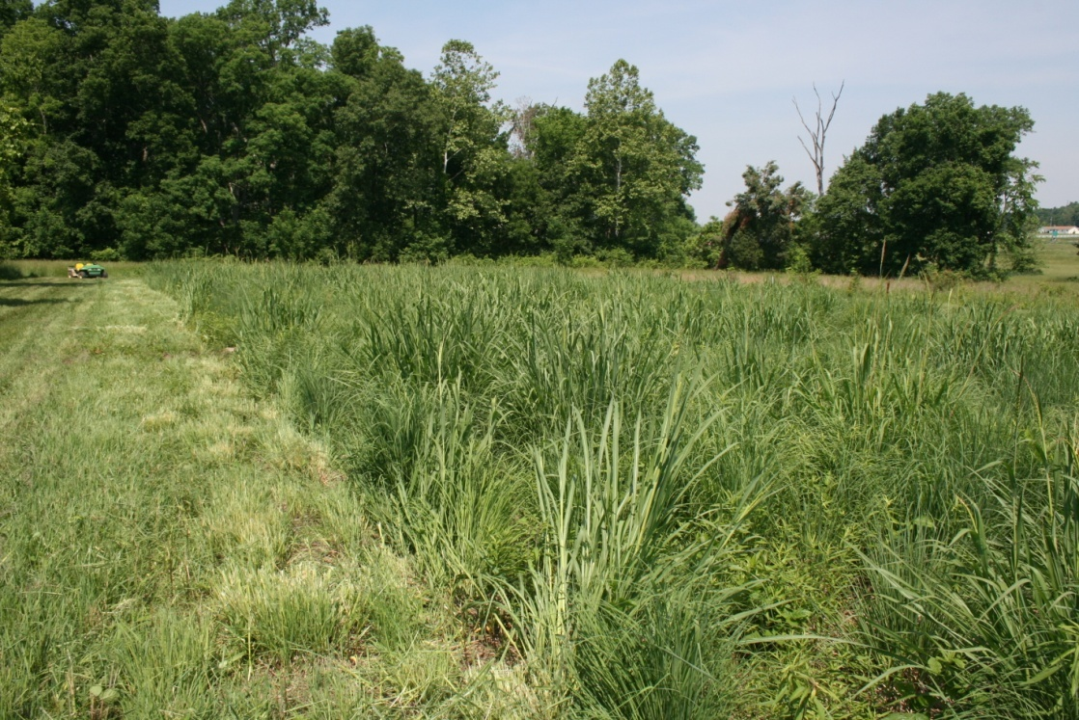
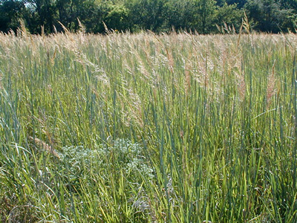
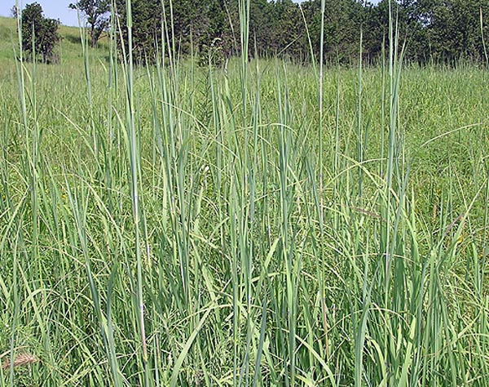
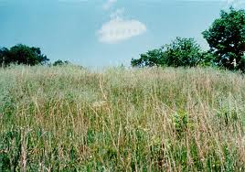
Switchgrass
Indian grass
Little bluestem grass
Big bluestem grass

Slide 43
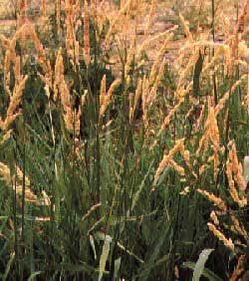
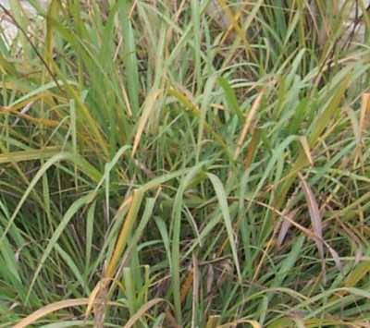
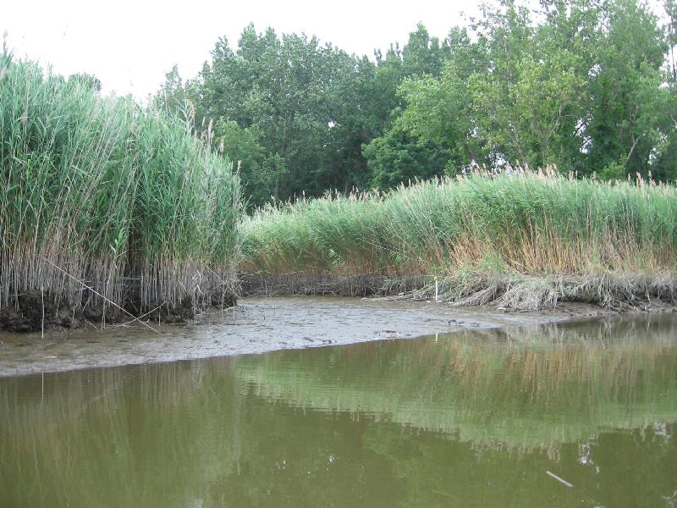
Eastern Gama grass
Reed Canary grass
Phragmities

Slide 44
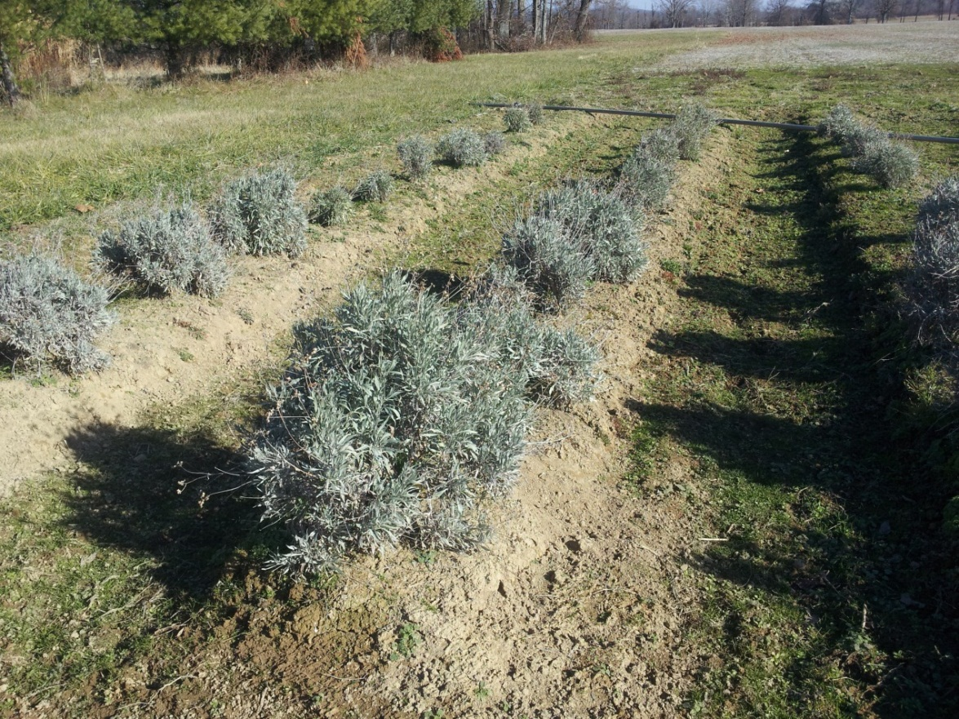
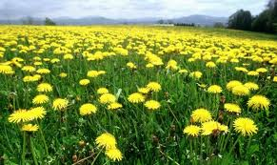
Guayule (Parthenium argentatum)
(rubber plants)
Russian dandelion

Slide 45
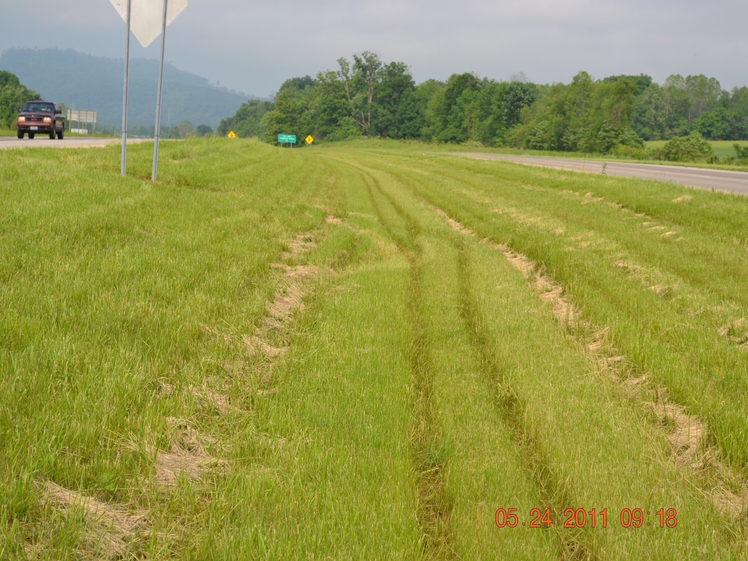
Highway Row/Median Area

Slide 46
Ohio State University’s Research and Extension Grants on Bioenergy
Yebo Li et al. (2012) received $6.5 million grant for bioenergy, biofuel research from the USDA/DOE. FABE Dept.
Katrina Cornish/Chromatin (2012) received $ 5.7 million from DOE for developing “plant-based sesquiterpene biofuels”.
Islam, K.R. and R. C. Reeder (2012) received $30,000 from Michigan Corn Growers Association on “Developing software for corn-based bioenergy feedstock system.
Norm Fausey, Warren Dick, Rafiq Islam, and Randall Reeder (2011) Received $ 1 million from USB on soybean productivity (biodiesel).

Slide 47
Ohio State University’s Research and Extension Grants on Bioenergy
Islam, K.R. and R.C. Reeder (2010) received $ 187,873 from DOE/SunGrant Initiative on Miscanthus giganteus.
Islam, K.R. and R.C. Reeder (2010) received $ 146,730 from Mendel Biotech on Miscanthus giganteus.
Dick, W., Islam, K.R., Rand Reeder, R. (2012) applied for $ 10 million Regional CAP USDA-AFRI grant on Giant Reedgrass, Switchgrass, and Miscanthus bioenergy feedstock (pending) .
Parwinder, S. Grewal, Islam, KR., and Eric Romich (2012) applied for $ 75,000 Tri-State Research & Extension grant on sustainable production of biofuel crops in the NC region (pending).

Slide 48
Carbon

Slide 49
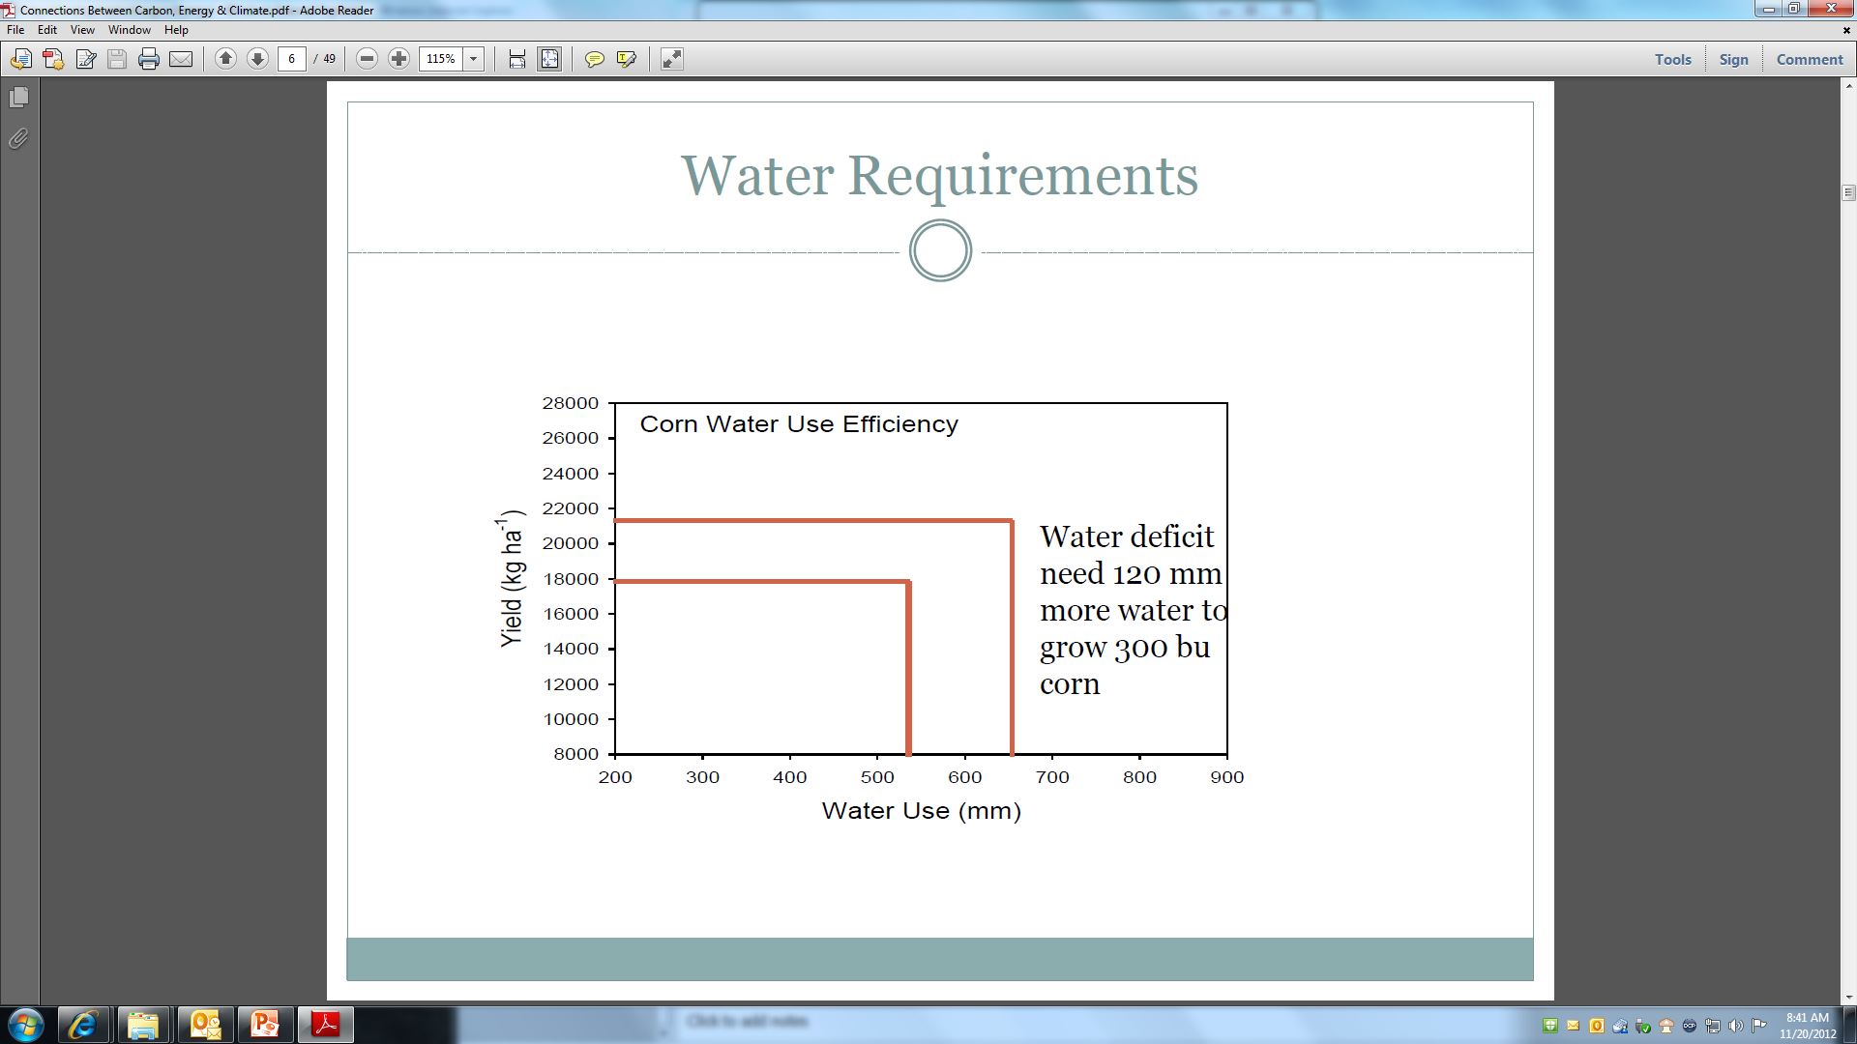

Slide 50
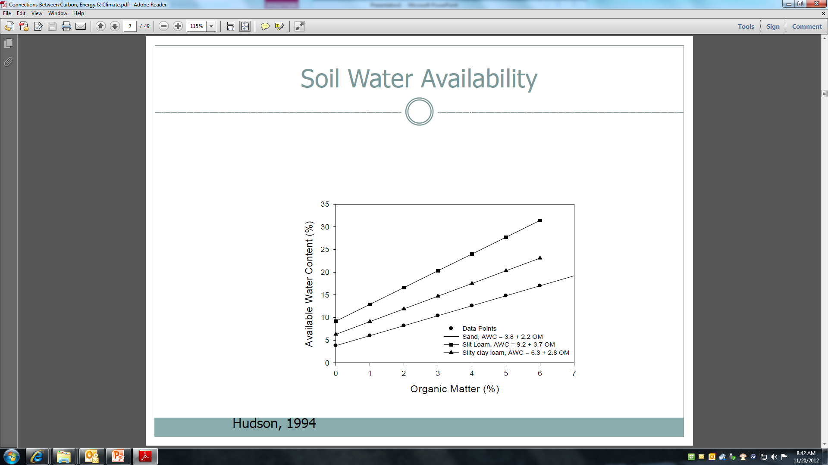

Slide 51
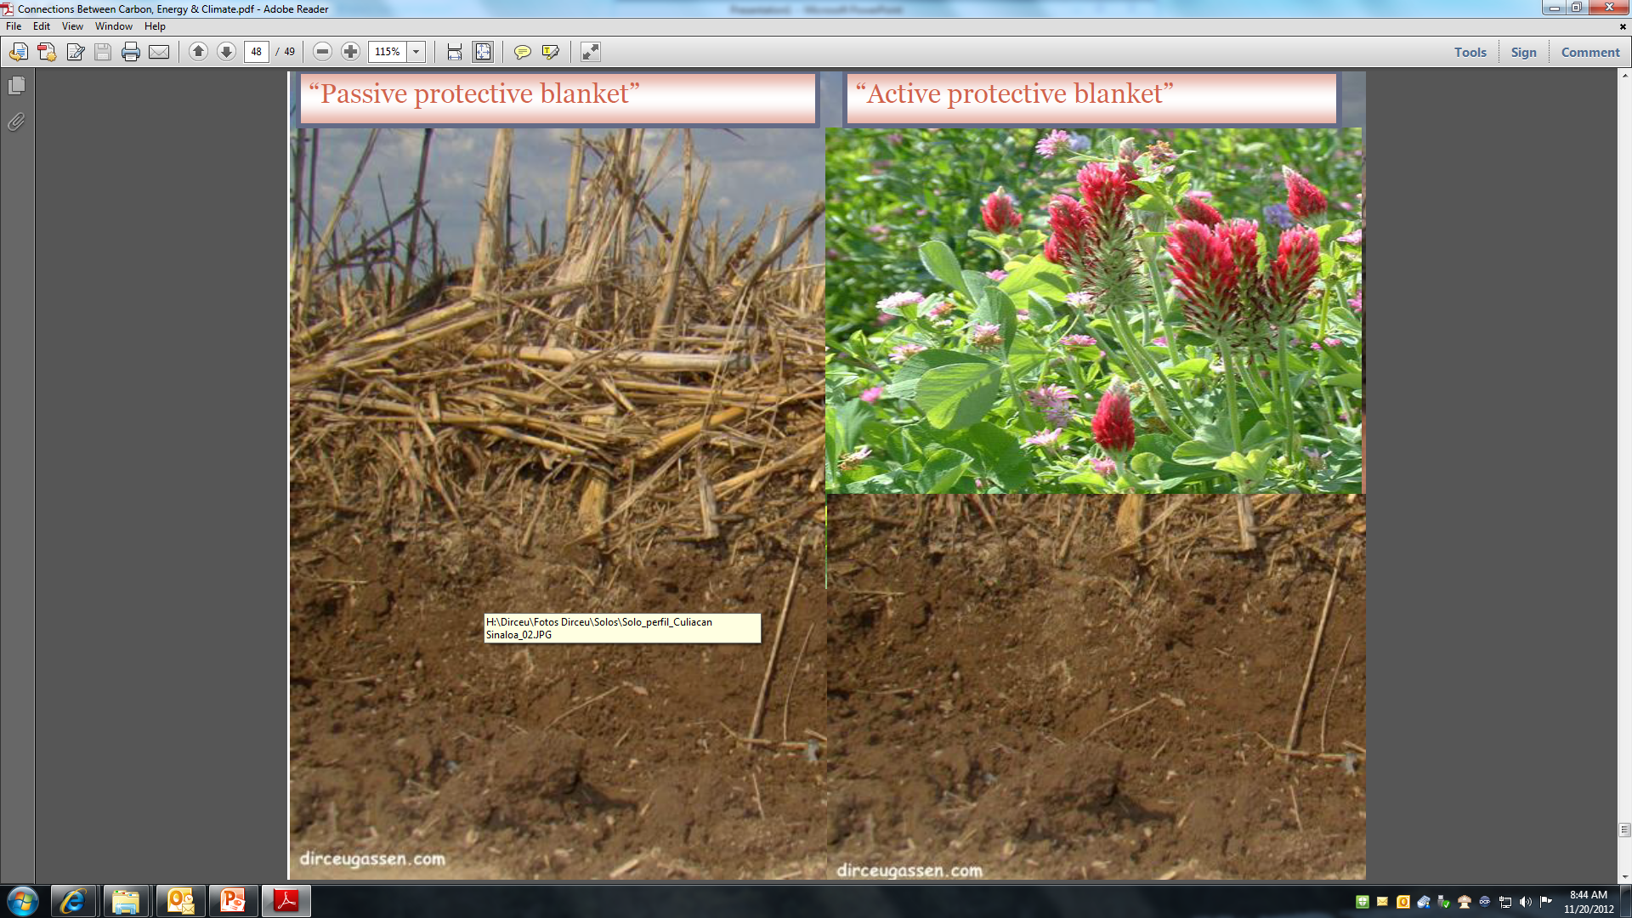

Slide 52
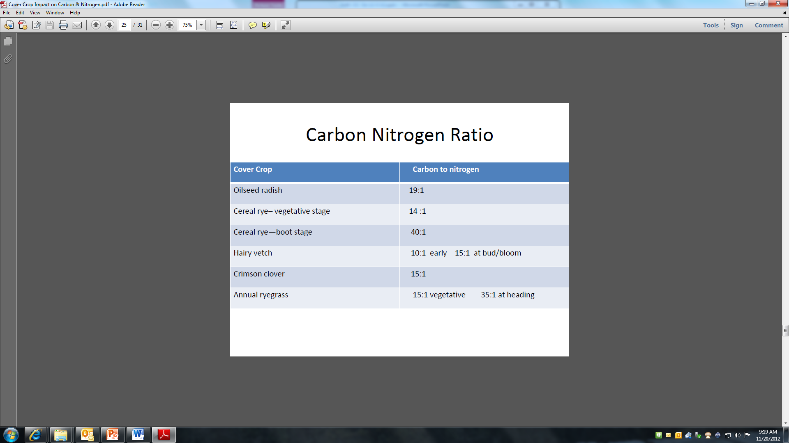

Slide 53
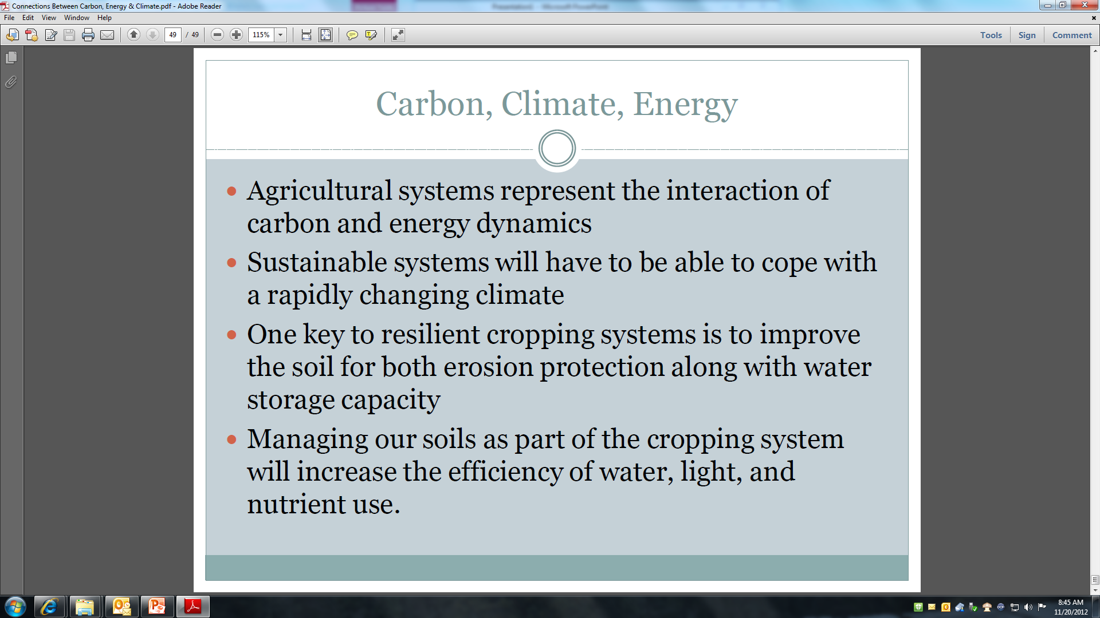

Slide 54
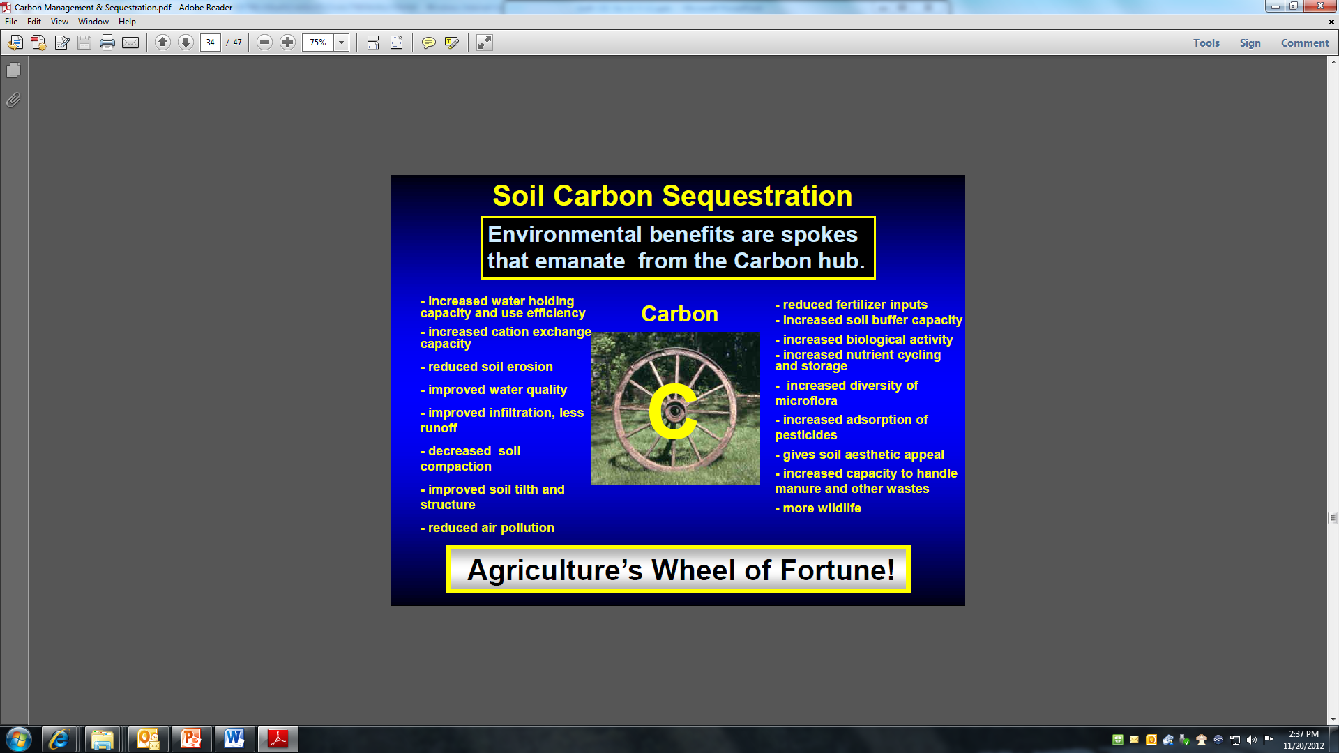

Slide 55
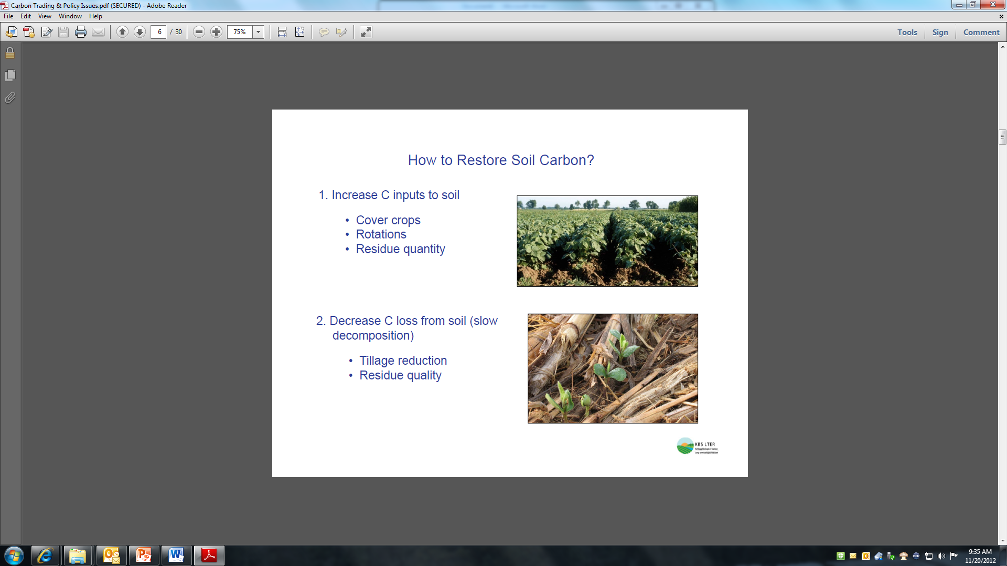

Slide 56


Slide 57


Slide 64


Slide 65

We are squeezing the word for natural resources more and more for our survival and comfort.

Slide 66

CARBON ENERGY CLIMATE WEB RESOURCES
www.northcentralsare.org
Changing Climate
http://changingclimate.osu.edu/
Energize Ohio
http://energizeohio.osu.edu/
Ohioline Factsheets
Other Landgrant and Agency websites
Located at www.northcentralsare.org then click Ohio, then state news

