Slide 1
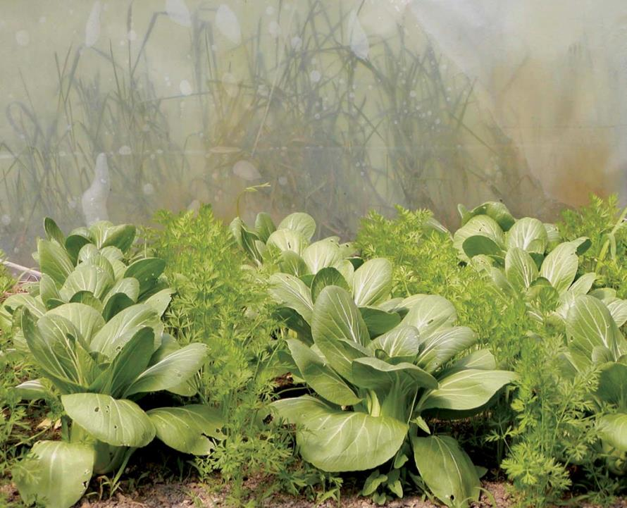
Introduction
NCR-SARE offices:
University of Minnesota
University of Missouri
Lincoln University in Missouri
photo credit: Abram Kaplan
Notes:
Welcome to this webinar about how to manage your NCR-SARE Youth Educator grant. My name is Joan Benjamin. I coordinate the Youth Educator Grant program and am available to answer your questions. My office is located at Lincoln University in Jefferson City, Missouri. You can contact me at: benjaminj@lincolnu.edu or 573-681-5545.
I will walk you through grant finances – including receiving grant payments, how to request an extension or budget change, and the steps for reporting on your grant project. This presentation will take approximately 20 minutes.

Slide 2
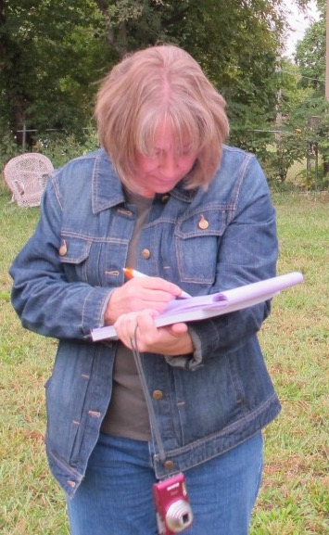
Grant Finances
NCR-SARE Youth Educator Grant recipients receive grant funds in
2 payments: 75% at the start of the project, and a final payment of 25% when the final report is approved. The final payment is a reimbursement.
Photo by Sean McGovern
photo credit: Joan Benjamin
Notes:
Many grant programs provide funding by reimbursing you once you’ve spent funds.
NCR-SARE Youth Educator Grants are different.
At the start of your project, you will receive a contract to sign as well as a form stating that you have started your project. When these are signed, returned, and approved, you will receive the first payment of your grant (75%), so you have funds to start your project. Because these grants are issued as a contract, you will receive a 1099 form for the grant payments. Please contact a tax professional if you have questions about how this might affect your taxes.
Save your receipts and invoices for your own tax purposes. NCR-SARE does not need to see them. We rely on the budget information you provide in your reports.
At the end of the first year of your project, you need to submit a progress report and budget.
When your project is finished, you are required to submit a final report and final budget. At this point, all grant funds should be spent. The final payment of 25% is a reimbursement. The final budget should show how all grant funds were spent.
If you have a one-year project, you can submit the final report instead of a progress report at the end of the first year of your project.

Slide 3
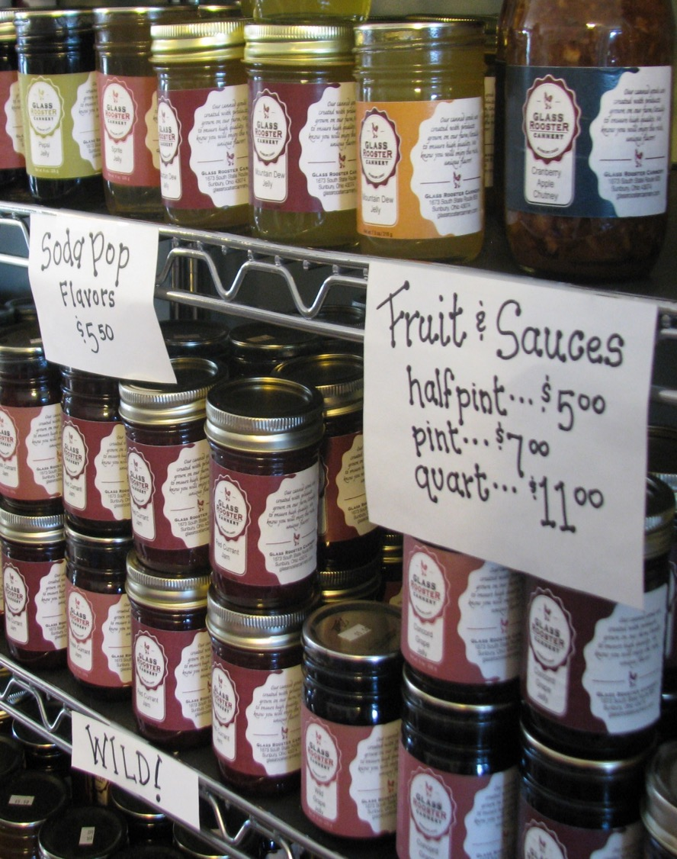
Budget Changes
Grant recipients can request budget changes as needed. For changes of $1,000 or more, you will need prior approval. Smaller changes are usually OK if they involve a price change of an item or another simple change. Be sure to contact NCR-SARE with questions.
photo credit: Jean Andeasen
Notes:
If the price of items in your budget changes as you carry out your project, you can usually move funds from one line item to another to reduce funds in one area and increase them in another. You can show small changes in your online budget in the reporting system. There is a Notes column where you can explain the changes. See more on this in the Reporting section of this PowerPoint presentation..
For larger budget changes of $1,000 or more, be sure to contact me first to make sure the change is allowed. You can email me at: benjaminj@lincolnu.edu or call me at: 573-681-5545.
We want you to be successful and will work with you on budget changes.

Slide 4
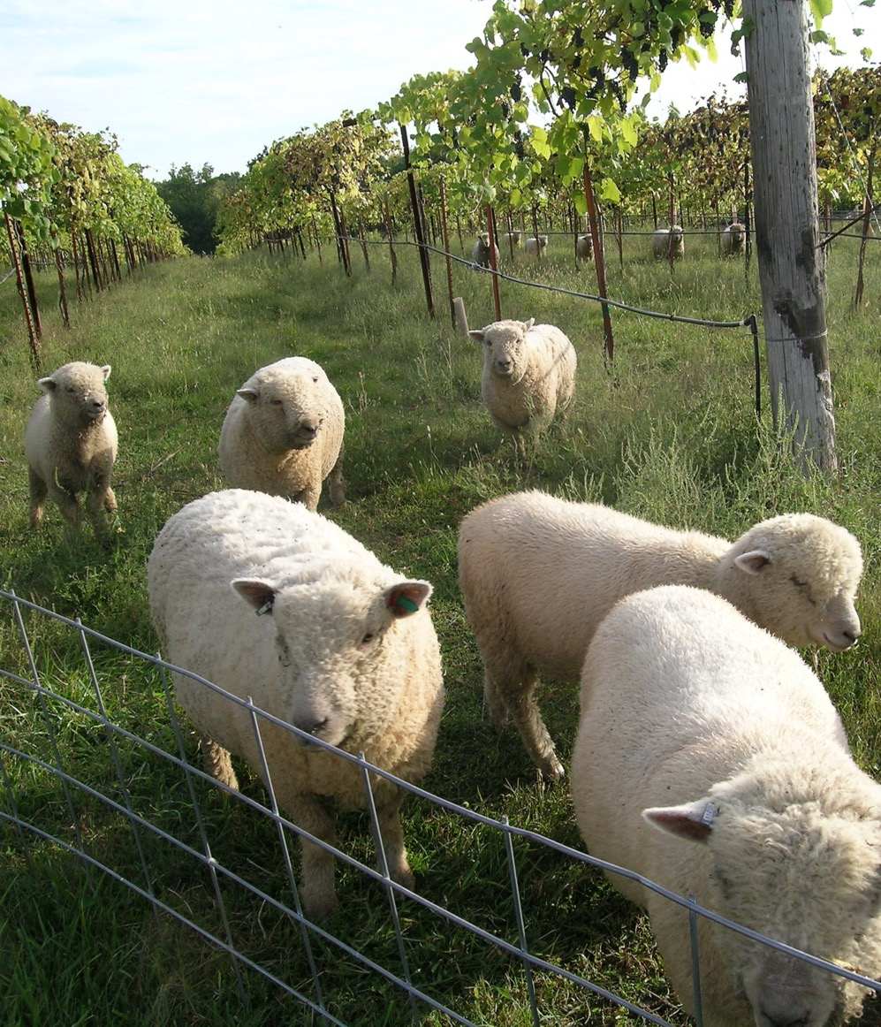
No-Cost Extensions
Grant recipients can request 6- to 11-month extensions if they are unable to complete their project within 23 months. This is in case weather or other issues prevent you from completing the project by the original deadline.
photo credit: Joan Benjamin
Notes:
All Youth Educator Grant recipients are issued a contract for 23 months. Even if you plan on a 12-month project, you will receive a contract for 23 months. This is because there are often weather problems or other issues that prevent people from completing their projects in 12 months. If your project will end up taking more than 23 months, you can request a no-cost extension.
A no-cost extension means that you need additional time for your project but are not requesting additional funds.
*** In order to receive a no-cost extension, you must be up to date on reporting. If you need a no-cost extension, please submit your request by September of the second year of your project. Be sure your progress report is completed and submitted before requesting an extension.
To request a no-cost extension, send an e-mail to me at: benjaminj@lincolnu.edu or send me a hard copy letter with signature that states the following.
I am requesting a no-cost extension for NCR-SARE project YENCXX-XXXX. (The YENC number is your Project number. It stands for Youth Educator North Central, followed by the last two digits of the year your project was funded, and the number of your grant. For example, YENC21-161.)
In order to complete my project, I am requesting a new end date of Month, date, year. (Typically, we allow 6-month extensions. If you need longer, be sure to provide reasons why you need a longer extension in your explanation.)
3. Include a brief explanation of why you need the extension.
I will let you know by email if your extension is approved or if there are further questions. This typically takes a week or two. Once approved, you will also receive an email from the NCR-SARE main office at the University of Minnesota in St. Paul, Minnesota confirming the extension for your records.

Slide 5
Reporting Instructions
NCR-SARE uses an online reporting system. Youth Educator Grant recipients must provide a progress report each year their project is active, and a final report when the project is completed. Reports are approved by an administrator.
photo credit: Joan Benjamin
photo credit: Joan Benjamin
Notes:
You have 23 months to complete your grant project. After the first year of your project, you are required to submit a progress report and budget update. One-year projects can complete a final report and final budget after the first year if all grant work is done and all grant funds are spent.
Use the SARE online reporting system to submit your report.

Slide 6
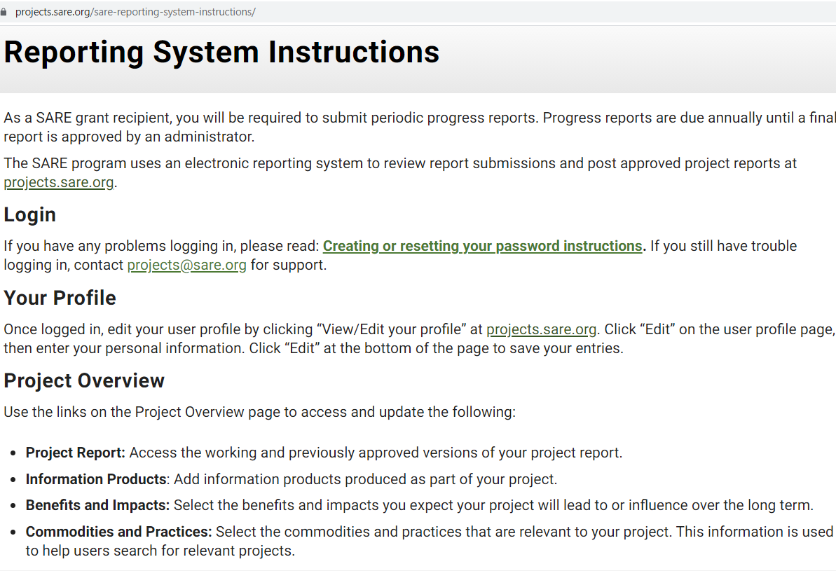
Notes:
Reports are an important part of SARE grants. They are one way to share the results of your project with other educators so they can benefit from your research and education efforts.
To access the reporting website, go to: https://projects.sare.org/
For reporting instructions, go to: https://projects.sare.org/sare-reporting-system-instructions/
In this webinar, I’ll walk you through the reporting process.

Slide 7
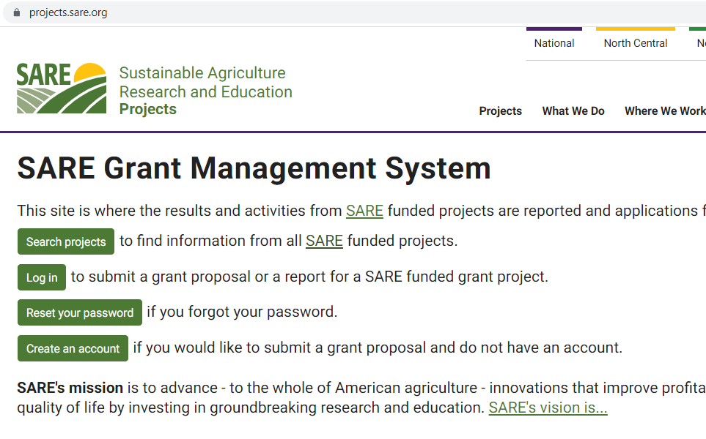
https://projects.sare.org/
Notes:
To begin the report for your NCR-SARE Youth Educator grant, go to https://projects.sare.org/ and click on Log in.
Enter the same username and password you used when you created your grant proposal. Your Username is typically your email (the one you use for SARE correspondence).
Enter your password.
If you have forgotten either of these, click on “Create or reset password” or “Find lost username.”
https://projects.sare.org/creating-or-resetting-your-password-instructions/
If you have trouble logging in, contact projects@sare.org for support.

Slide 8
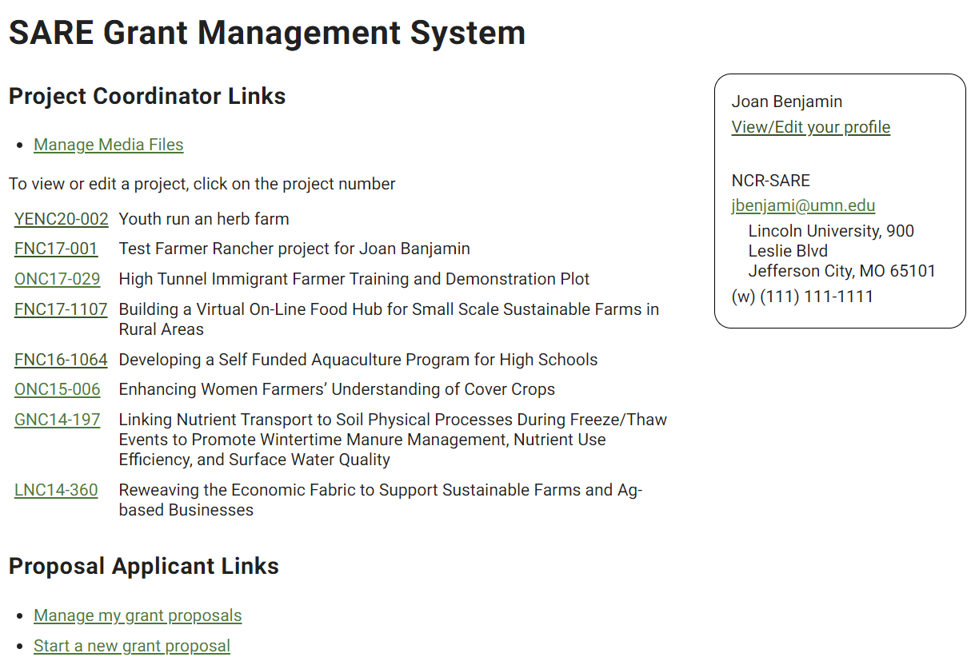
Notes:
When you log into the system, you’ll see a screen like this.
Project Coordinator Links
You’ll see a list of all SARE grant projects you’ve been associated with on the left.
Click on the project you want to report on. If this is your first grant, you will only see one project listed.
The reporting system uses progressive reporting rather than separate annual and final reports. Start by completing a Progress Report. You will add to it over time to create the final report. When a Progress Report is approved by an administrator, that version is saved, and a new version of the report is created called the Working Version.
If you have a one-year project and your project is finished at the end of the first year, you can complete the final report instead of a progress report, by answering all questions in all report sections.
Your Profile
If you have address, phone, or email changes, click on “View/Edit your profile” on the right side of the page. On the page that opens, click on the “Edit” button in the upper right corner and make any changes needed. When done, scroll to the bottom of the page and click on “Update” to save your changes.

Slide 9
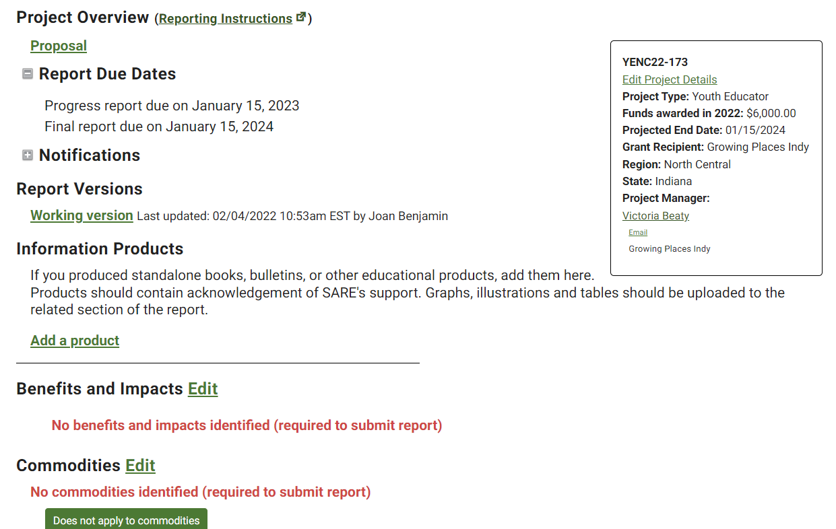
Notes:
When you click on your report link, the Project Overview page will open. It shows your Report Due Dates and other information.
Use the links on the “Project Overview” page to access the following:
Reporting Instructions: Step-by-step information on how to complete your report.
Proposal: View your original project proposal.
Working Version: Click on the Working version when you are ready to work on your report.
Add a product: Click here to add Information Products. These are stand alone items such as books, bulletins, and fact sheets produced as part of your project. (Items such as photos, graphs, and charts are not considered Information Products and should be added to your narrative report.)
If your Benefits and Impacts, Commodities, or Practices information is not filled in, complete these checklists by clicking on “Edit” beside each of the headings. The information you provide is used to help people search for projects on topics they are interested in. (Your information may already have been entered using the answers from your proposal.)
“Benefits and Impacts.” Select the benefits and impacts you expect your project will lead to or influence over the long term.
“Commodities.” Select the agricultural products that are a primary focus of your project. Select “None” if your project doesn’t involve commodities.
“Practices.” Select the practices that are a primary focus of your project.
Before leaving a checklist, scroll all the way to the bottom and click on the “Update” button to save your choices.
When you are ready to start your report, Click on the “Working Version.”

Slide 10
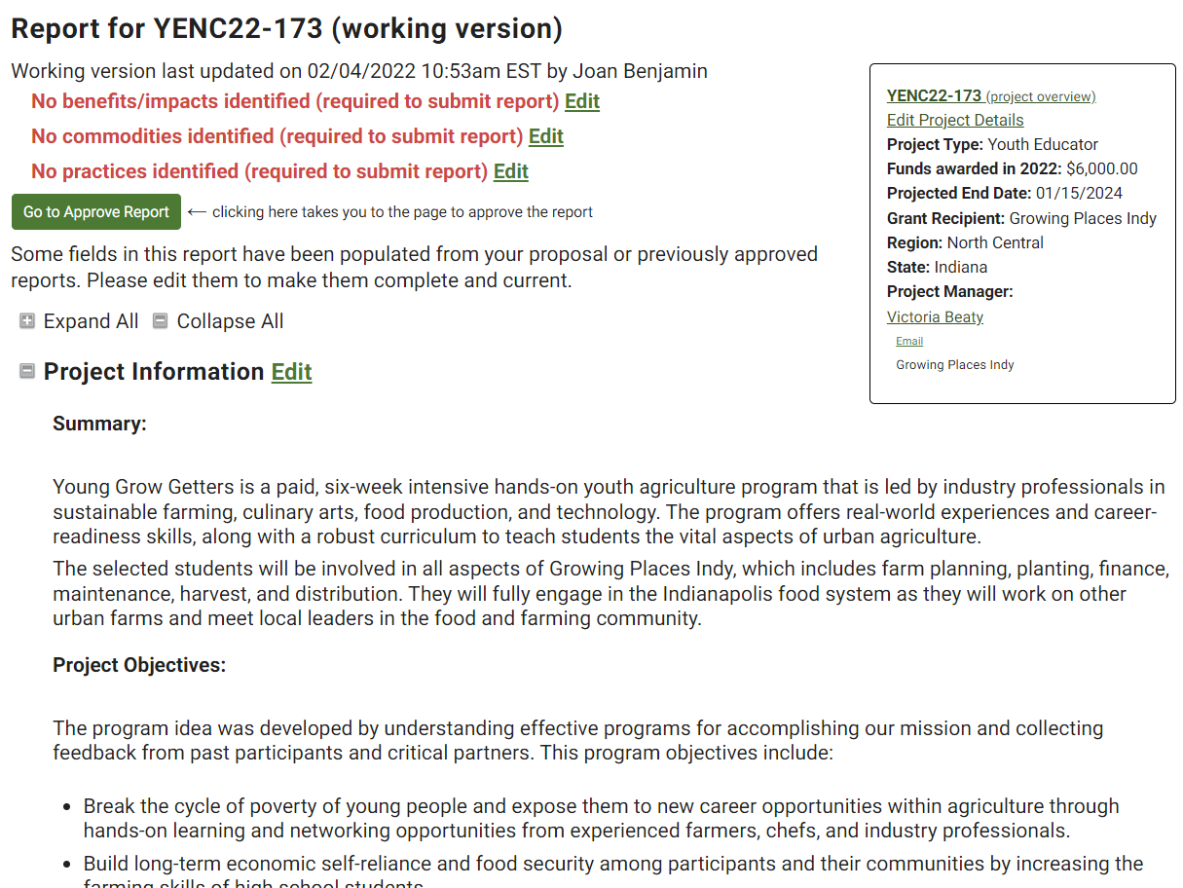
Notes:
When you click on “Working Version” you will see the headings and entries that make up your report. Scroll down to see all of the headings.
Click “Edit” next to each section heading to enter report information. A text box will open up where you can enter text and add photos, tables, and other items.
Some report information is automatically filled in using the text from your proposal. As you can see in this example, the section titled, “Project Information,” has the Summary and Project Objectives already filled in. Your Approved Budget (from your contract), is also automatically entered as part of your report.
If you have changes to make in any of these areas, click on “Edit,” make your changes, then click on “SAVE.” If there are no changes, you can move to the next section.
Click the project number in the box at the top right to exit the report and return to the “Project Overview” page.

Slide 11
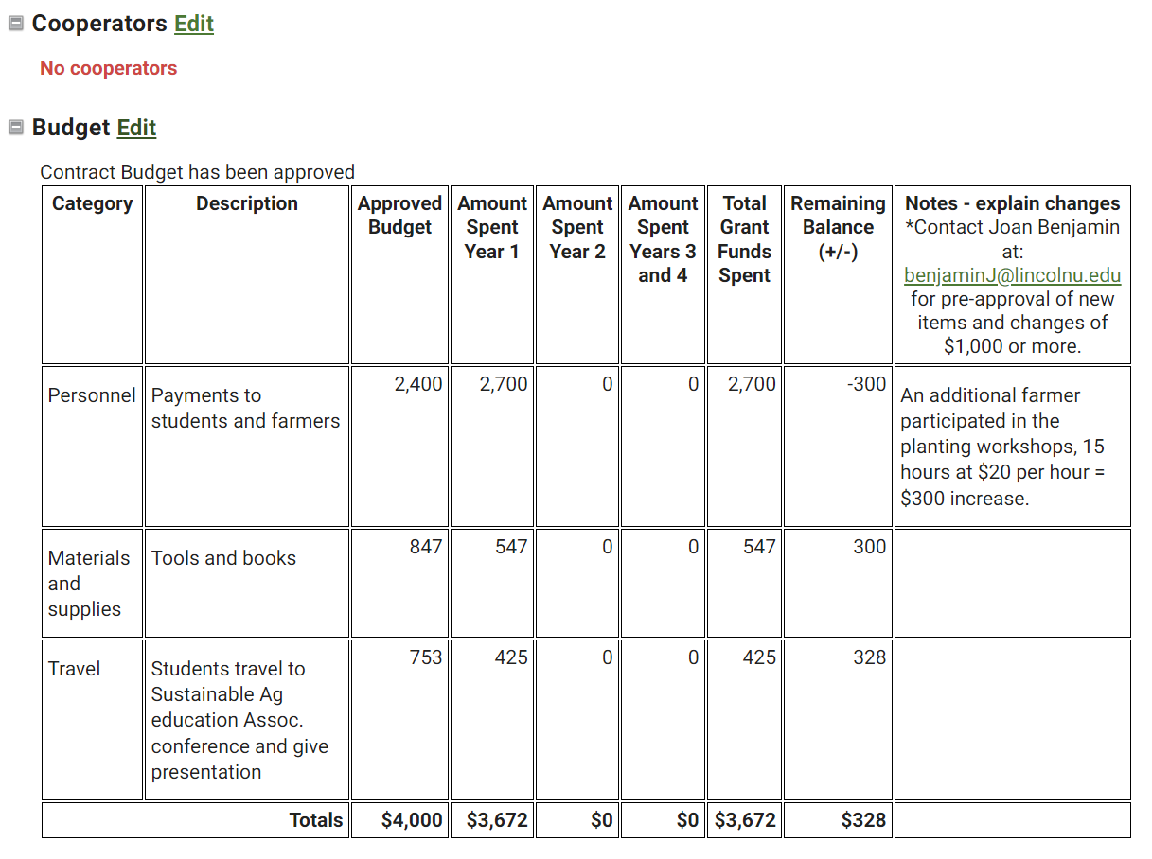
Notes:
Next, scroll down to the sections labeled Cooperators and Budget.
Open “Cooperators” by clicking on the “Edit” link. If there are people helping you with your project who play a major role in carrying out project research or educational activities, add them as “Cooperators” and click on “SAVE.” Do NOT include project coordinators in this section. If you have no cooperators, go on to the Budget.
Review the “Budget” section. The initial information is already filled in and is a copy of the budget that was approved for your contract. It shows the budget categories, descriptions of items, and the budget amount approved for each item.
*The budget is only visible to administrators. The public cannot view your budget.
**If there is budget information that you want to share with other educators, be sure to add that information to the reporting area.
Click on “Edit” to open the budget so you can add information.

Slide 12
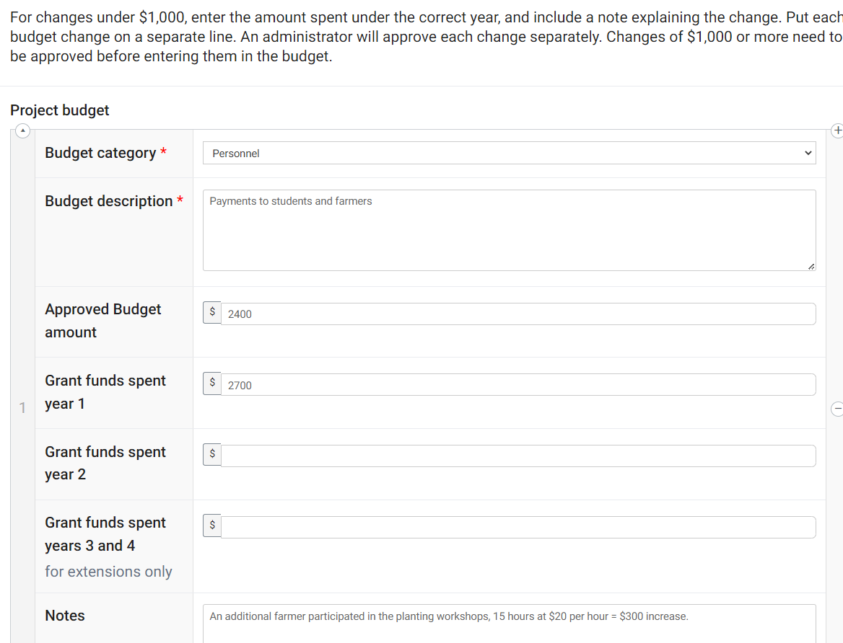
Notes:
When you click on “Edit,” the budget items will open up as text boxes that are arranged vertically and in alphabetical order.
Show what you spent in the first year of your project by filling in the “Grant funds spent year 1” column.
If you want to make minor changes to your budget, fill in the amount spent in the correct year. Explain the change in the “Notes” area at the bottom of each budget item. Click on “SAVE” when you are done. Show changes on separate budget lines, so an administrator can approve each change. Do not combine changes.
If you increase funds for one item, you will need to decrease funds for another item(s). NCR-SARE cannot add additional funds to your budget, but you can move funds from one line item to another.
For major changes of $1,000 or more, contact me first to make sure the change is OK. I will let you know if we have questions about your budget changes.
Click on “SAVE” at the top or bottom of the page when you are done. Changes will be lost if you do not click on “SAVE.”

Slide 13
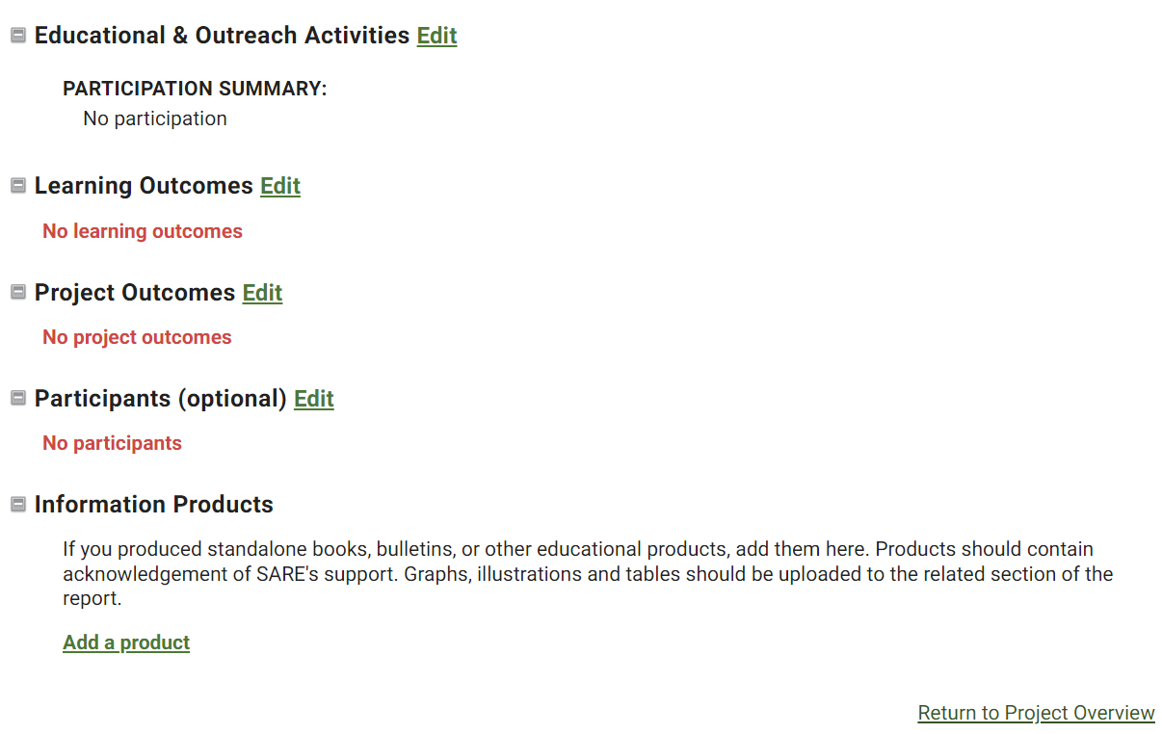
Notes:
When you are done with the budget, click on “SAVE.” You will be returned to the main report page where you can choose which section to work on next.
Scroll to the next section below the budget: “Educational and Outreach Activities.” Click on “Edit” to open the section and complete the questions. You will see a series of boxes where you can fill in numbers followed by a text box where you can enter Education and outreach descriptions. Describe the activities you indicated with numbers, as well as outreach that is in progress (e.g., newsletter, articles, upcoming presentations, etc.).
There are two options for entering report data:
• Recommended option: Enter and format report data directly in the report. This approach is least likely to result in formatting errors. You can type in text and can also add tables and images.
• Copy and Paste option: Create your report using a word processor, then copy and paste the information into the report sections. This approach may result in formatting errors when saving formatted content, tables or images.
Continue to click on “Edit” next to each section to open it. Fill in the answers for each section and click on “Save.”
Fill out the information you have available at the Progress Report stage (typically at the end of the first year). If this is a final report, fill out all sections.
Be sure to click on “SAVE” when you are done with each section to save your information. You can click on “Edit” again if you want to make changes or add information to a section later.

Slide 14
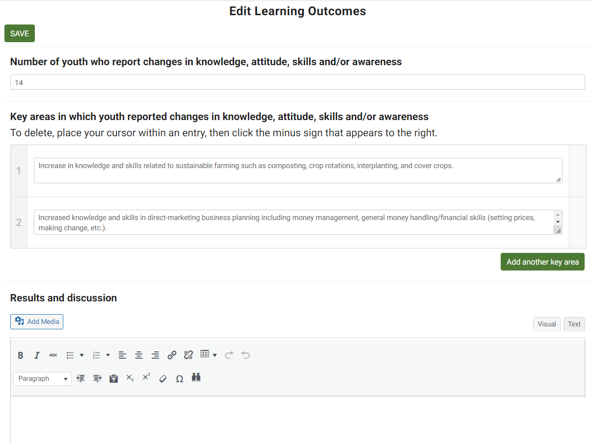
Notes:
In this example, under the heading “Learning Outcomes,” fill in the number of youth who reported changes in knowledge, attitude, skills, and/or awareness in your project. Use the text box below the number to explain what kind of changes you saw.
Under “Results and discussion,” you will see a text box where you can fill in the results you have so far.
When you are finished with a section, click “SAVE” or “Cancel” at the bottom of the screen:
• SAVE: Saves the current edits and returns you to the main report page.
• Cancel: Does not save the current edits and returns you to the main report page. If you do not click the SAVE button, your work will not be saved.

Slide 15
Notes:
In sections that have an “Add media” button, you can embed photos, drawings, or tables.
To add an attachment or embed images, place your cursor in the text box where you want the attachment or image to appear and click on the “Add Media” button.

Slide 16
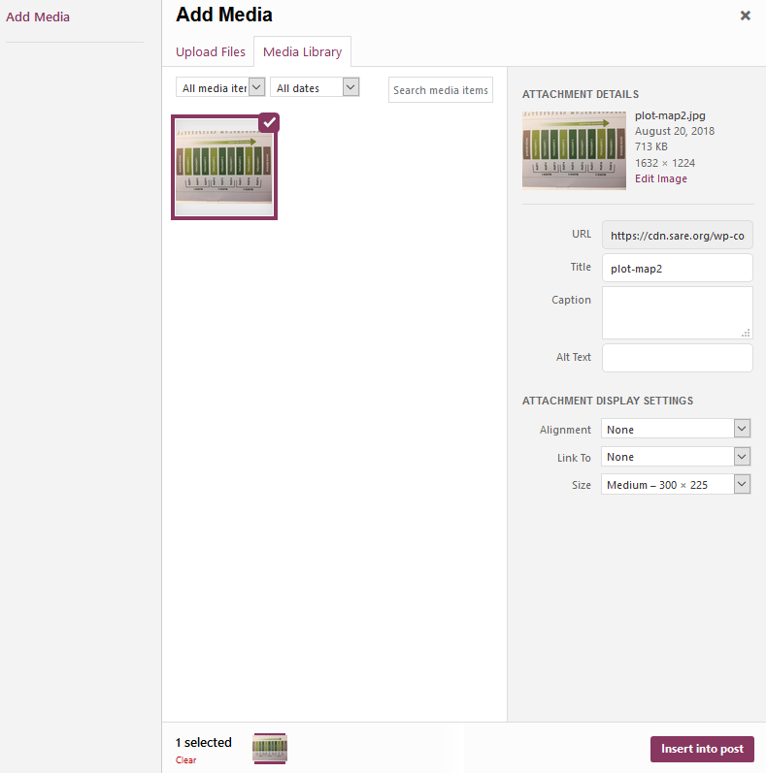
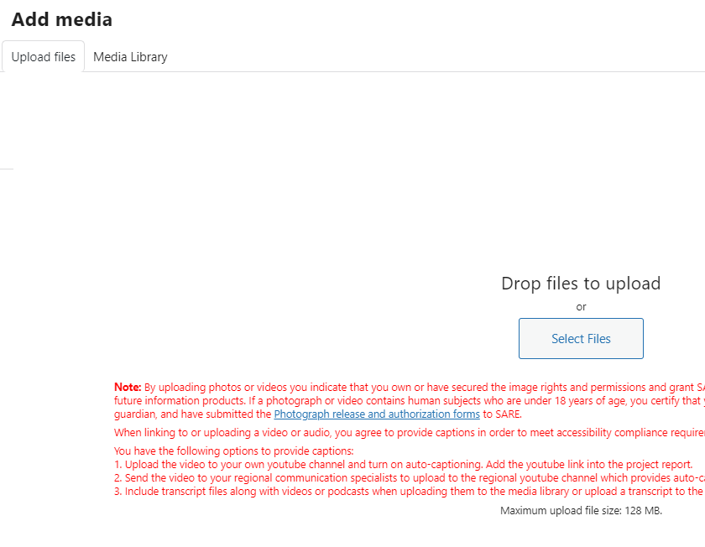
Notes:
You will be taken to your Media page. Click on “Upload files,” then “Select Files.” Open the file from your computer, add a caption, then click on “Insert into post” to add the item to your report.
Please note that the maximum size of a photo, image, or other item that you add is 64 MB. If you have larger items, you may want to provide a link to the item.
For more information on adding figures, graphs, images, and videos, see: https://projects.sare.org/inserting-figures-graphs-and-other-images/

Slide 17
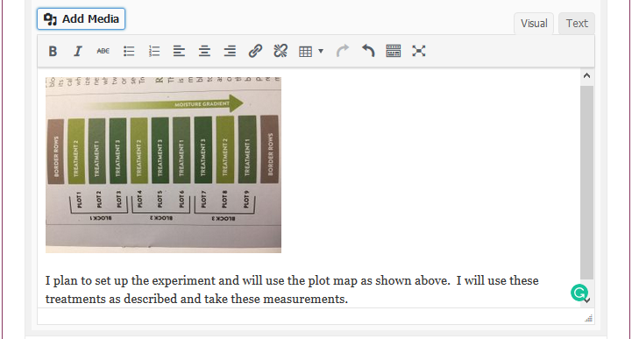
Notes:
The image will be embedded as you see here. Be sure to provide a caption so readers know what they are viewing.

Slide 18
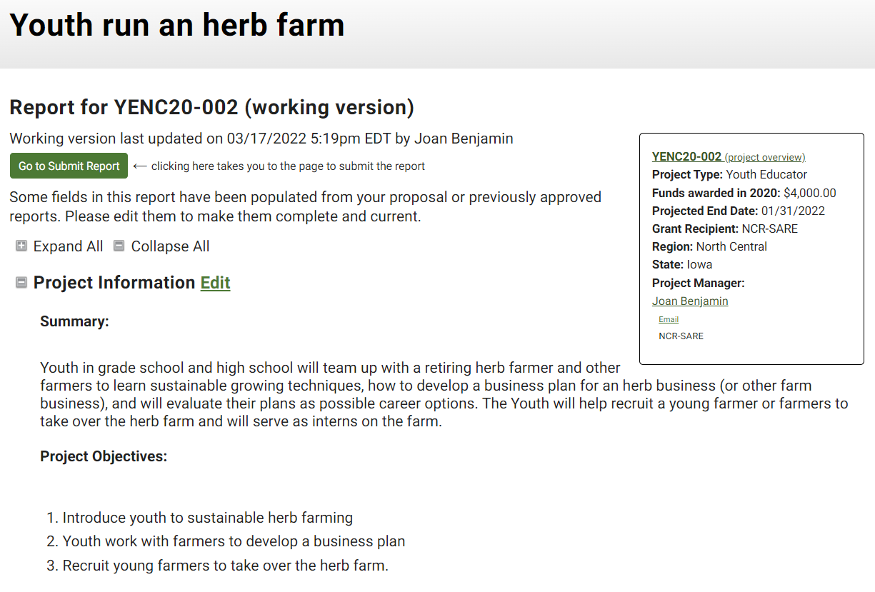
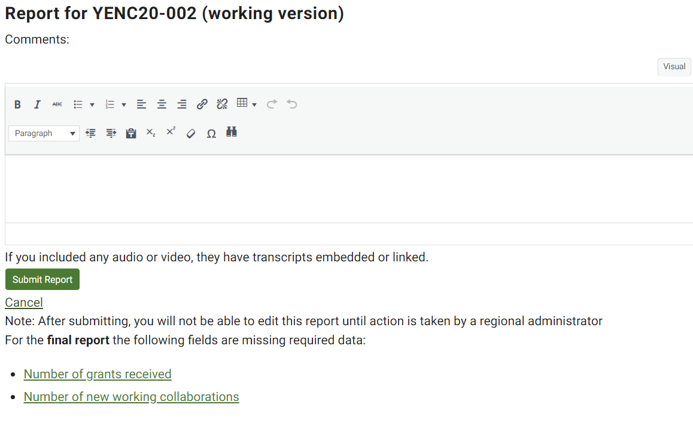
Notes:
When you have completed the report, click on the Go to Submit Report button.
If the report is Incomplete, the report system will show you which areas need to be filled in to complete a Progress Report or Final Report. If you are working on the Progress Report, you can ignore the Final Report fields. If any items are missing, complete the Progress Report by clicking on the fields that still need entries. Then click on Go to Submit Report and click on Submit Report. There is a box where you can add comments for NCR-SARE if you want to.
If you are working on a final report, if any items are missing, the system will list items that you still need to complete. Click on each missing item, answer the questions, and click on SAVE. When all items are completed, click on Go to Submit Report, then click on Submit Report. When you submit a final report, check the box noting that this is the final report.

Slide 19
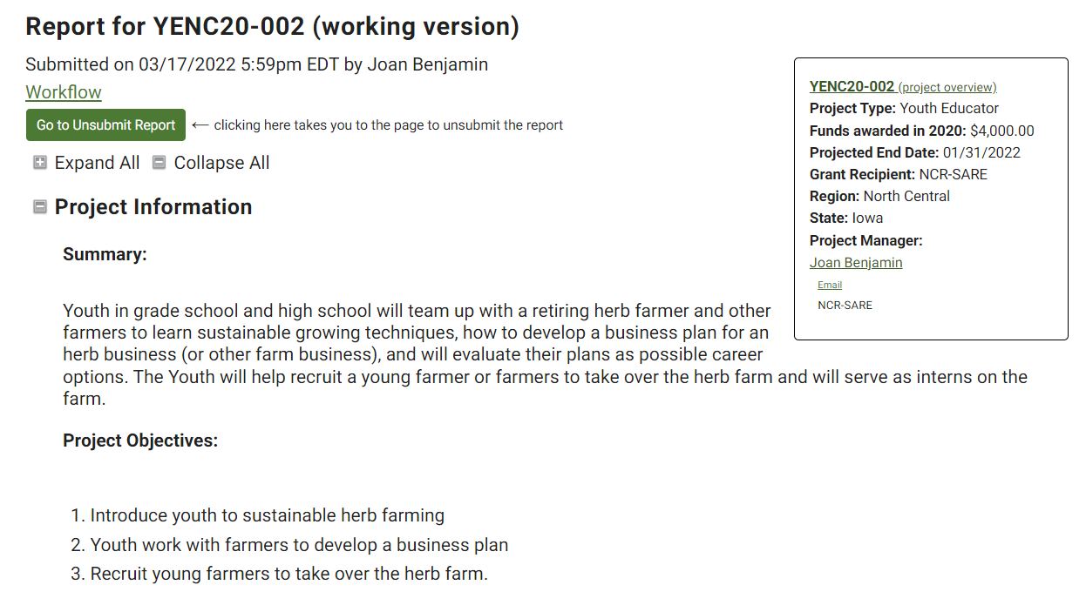
Notes:
When you click on Submit Report, the system sends an email message to NCR-SARE administrators so we know your report is ready for review. If you are not ready to submit the report, click on Cancel.
If you forgot something, click on Go to Unsubmit Report, click on Unsubmit Report, make any changes necessary, then click on Submit again.
You are welcome to add information after your project ends.
This is not required, but if you would like to add information after your project ends and the final report is approved, please do! It often takes more time than the 23 months of the grant project to get all of the results on your project. Educators and others who are interested in your work appreciate updates and so do SARE staff.
When you submit your final report, no Working Version is created. Once your report is approved, you can create a new Working Version by going to the Approved version and clicking on “Start a new draft report.” Edit, save, and submit as before.
Feel free to ask questions anytime!

Slide 20
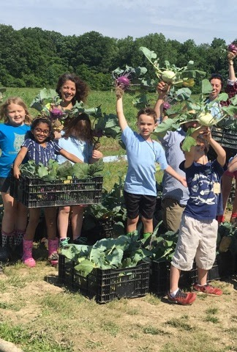
Good luck with your report!
If you have questions contact
Joan Benjamin
by phone: 573-681-5545
by email: benjaminj@lincolnu.edu
https://northcentral.sare.org/
photo credit: Mary Ellen St. Angelo
Notes:
The report will be reviewed by North Central region SARE staff. You will receive an email via the reporting system when your report is approved or if there are questions. The public cannot see your report until it is approved by an administrator.
If you have any questions contact NCR-SARE.

