Slide 1


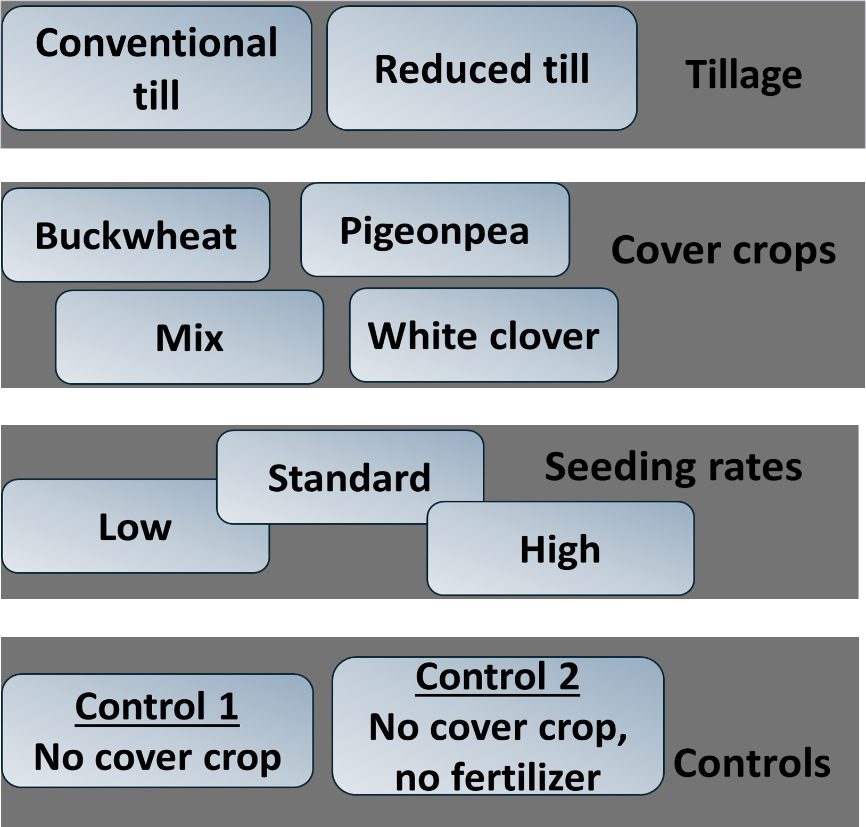
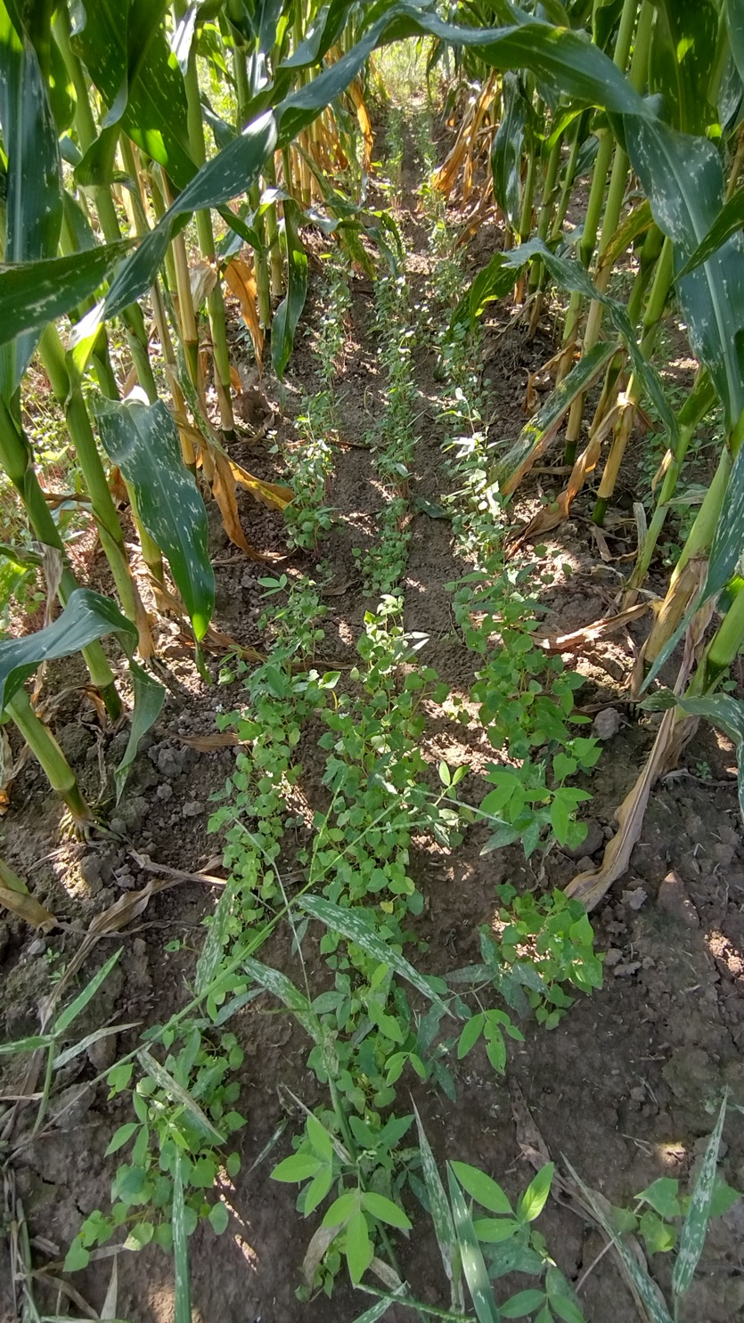
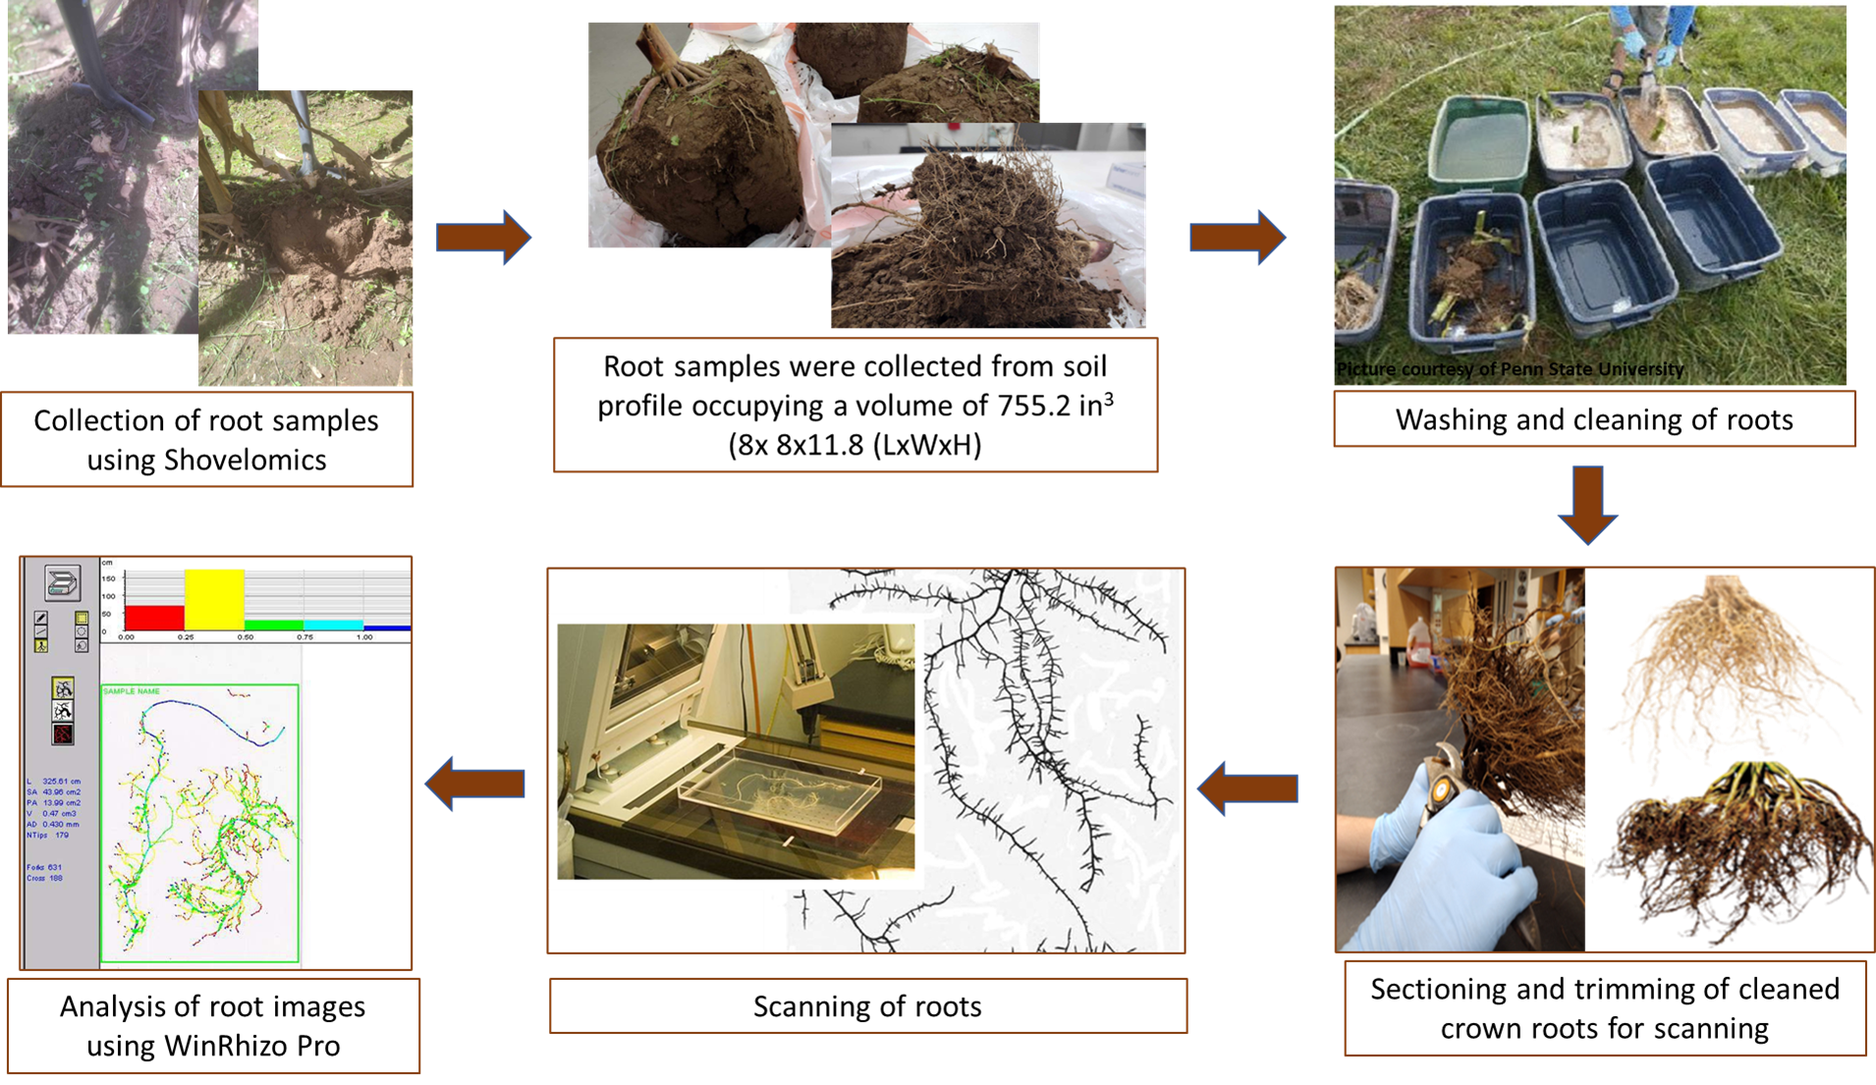
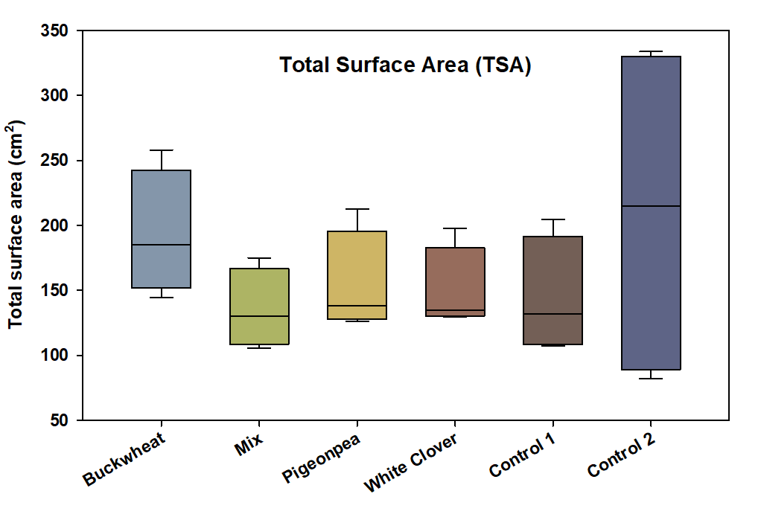
Effects of Cover Crop Interseeding on Root Morphological
Traits of Organic Corn
Beckham McCarthy, Luvina B. Madrid, and Sruthi Narayanan
Clemson University, SC
Abstract
Interseeding cover crops into organic corn can enhance belowground processes, yet it remains unclear whether root responses reflect complementarity or competition. We conducted a split-plot RCBD field experiment in 2023 with two tillage systems and four cover crops (buckwheat, pigeonpea, white clover, and a mixture) interseeded at three seeding rates, evaluated against two controls: Control 1 (no cover crop, with fertilizer) and Control 2 (no cover crop, no fertilizer). Corn root traits measured were total root length (TRL), total surface area (TSA), and total root volume (TRV). Corn without fertilizer (Control 2) had the greatest TRL, TSA, and TRV, reflecting enhanced foraging under limited nutrient conditions. Compared to the fertilized control (Control 1), interseeded buckwheat enhanced TRL, TSA and TRV, indicating complementarity, whereas interseeded mixture, pigeonpea, and white clover had neutral effects. These findings demonstrate species-specific outcomes, with buckwheat showing great potential to complement corn in an interseeded system.
Methods
Treatments
Experimental design: Split-plot RCBD
Interseeded at V8-V9 corn growth stage
Results
Total root length (TRL) is the sum of all root segment lengths per plant— shows how extensively roots explore soil.
Total surface area (TSA) - sum of the surface area of all root segments per plant— indicates the root–soil contact surface for water and nutrient uptake.
Total root volume (TRV) - total root space per plant— indicates the overall root system size for soil resource acquisition and anchorage.
Corn root length, surface area, and volume were the greatest when grown without any interseeded cover crops and supplemental fertilizers (Control 2).
Corn root length, surface area, and volume were greater when buckwheat was interseeded, compared to the fertilized control (Control 1).
Interseeded pigeonpea, white clover, and the mixture did not alter corn root length, surface area, and volume compared to the fertilized control (Control 1).
Conclusions
Control 2 showed the greatest TRL, TSA, and TRV. Relative to control 1, interseeding with buckwheat increased TRL, TSA, and TRV, indicating complementarity resulting in greater soil exploration and a larger absorptive interface. Corn TRL, TSA, and TRV were similar when interseeded with pigeonpea, white clover, and the mixture compared to those of monoculture corn supplemented with fertilizers (Control 1), indicating neutral, non-competitive effects of those cover crops. Overall, responses were species-dependent: buckwheat demonstrated the strongest complementarity.
This material is based upon work that is supported by the National Institute of Food and Agriculture, U.S. Department of Agriculture, under award number (20213864034724) through the Southern Sustainable Agriculture Research and Education program, under sub-award number (LS22-374 and SUB00002854). USDA is an equal opportunity employer and service provider. Any opinions, findings, conclusions, or recommendations expressed in this publication are those of the author(s) and do not necessarily reflect the view of the U.S. Department of Agriculture.
Notes:
The arrows in Treatments are misleading.
Root angle picture under Methods is actually irrelevant as you are not presenting the data.

