Slide 1
Predatory mites for organic thrips control in high tunnel cucumbers
Judson Reid
Cornell Vegetable Program
A NESARE sponsored project
presented at the
2012 Northeast Organic Farming Symposium

Slide 2
Organic Pest Control in Protected Agriculture
Cultural
  Prevention
  Sanitation
  Exclusion
Plant resistance
Grafting
Rotation
Sprays
Beneficials

Slide 3
Natural Pest Management in New York High Tunnel and Greenhouse Vegetables
23 on-farm trials
4 on-farm workshops
7 formal winter meetings
20 articles
1 webinar.

Slide 4
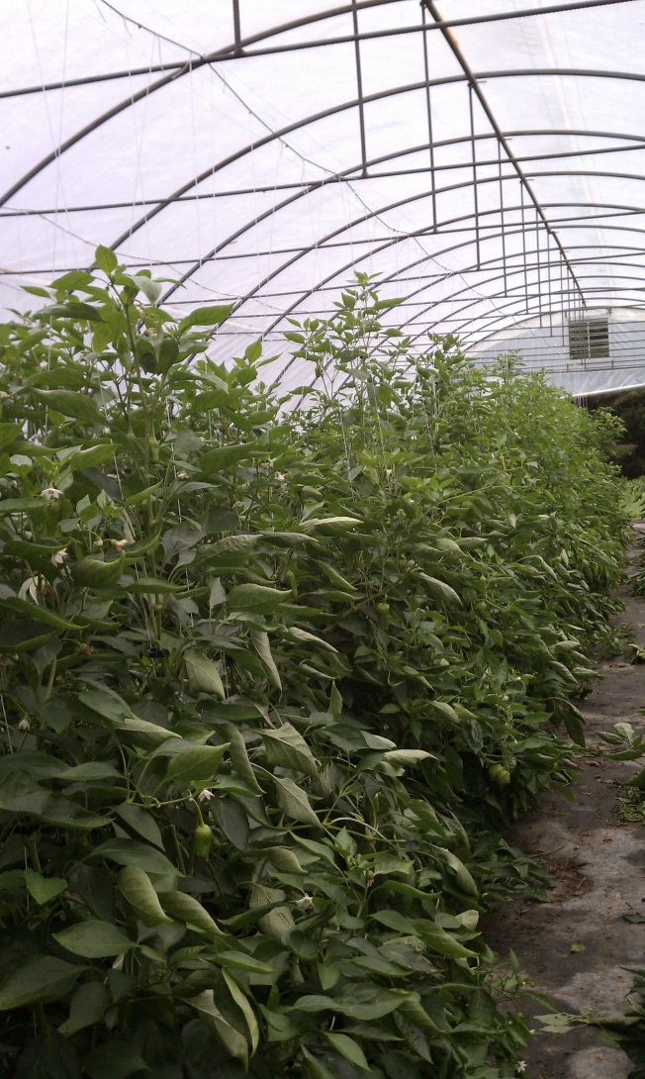
Tunnels and Pests
Thrips
Spider Mites
Aphids
Whiteflies
Cabbage worms
Slugs

Slide 5
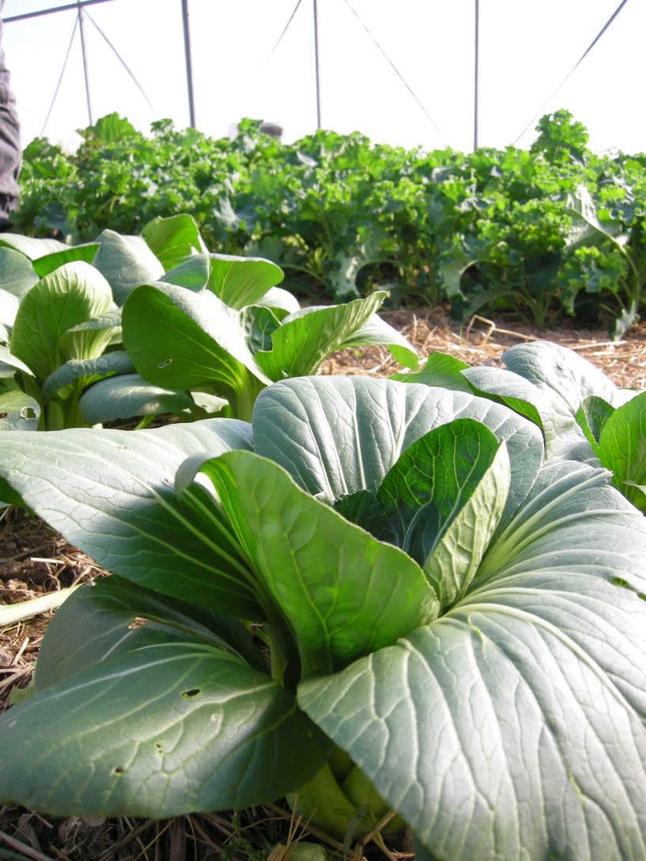
Cultural Control
Sanitation
Physical Exclusion
Pruning
Temperature
Moisture

Slide 6
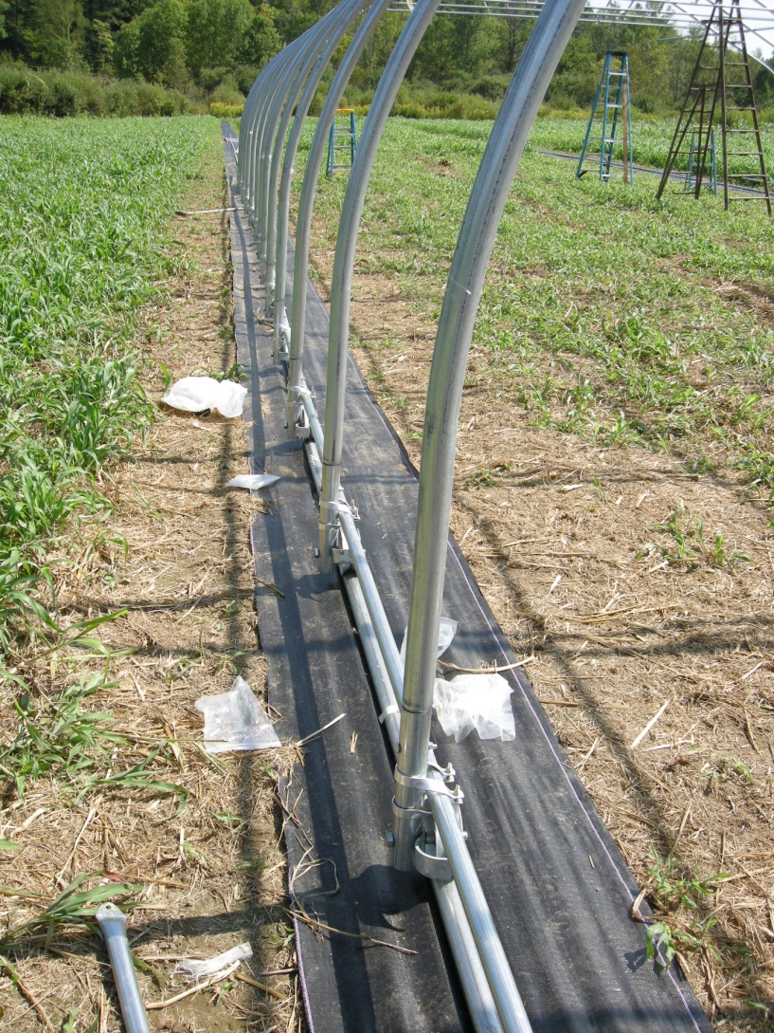
Sanitation
Weeds harbor:
  Mites
  Thrips
  Aphids
Excess water promotes:
  Shore flies
  Fungus Gnats

Slide 7
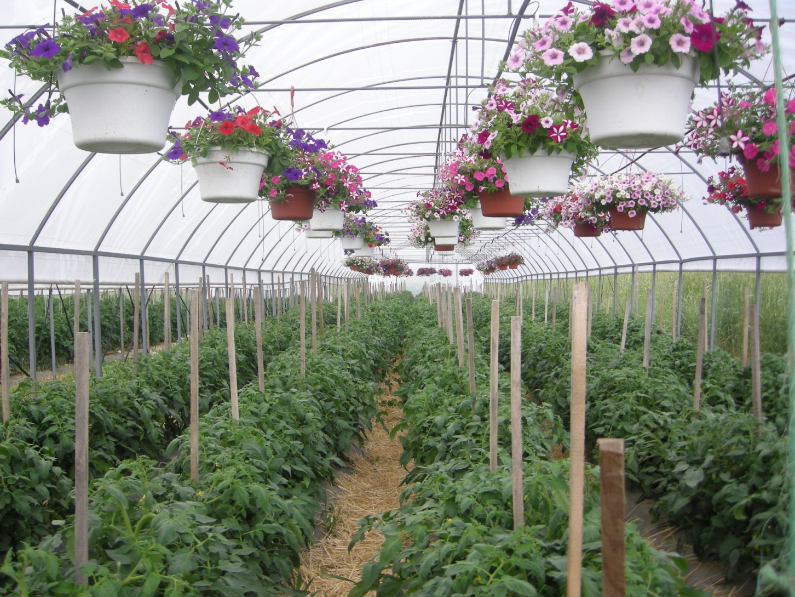
Exclusion

Slide 8
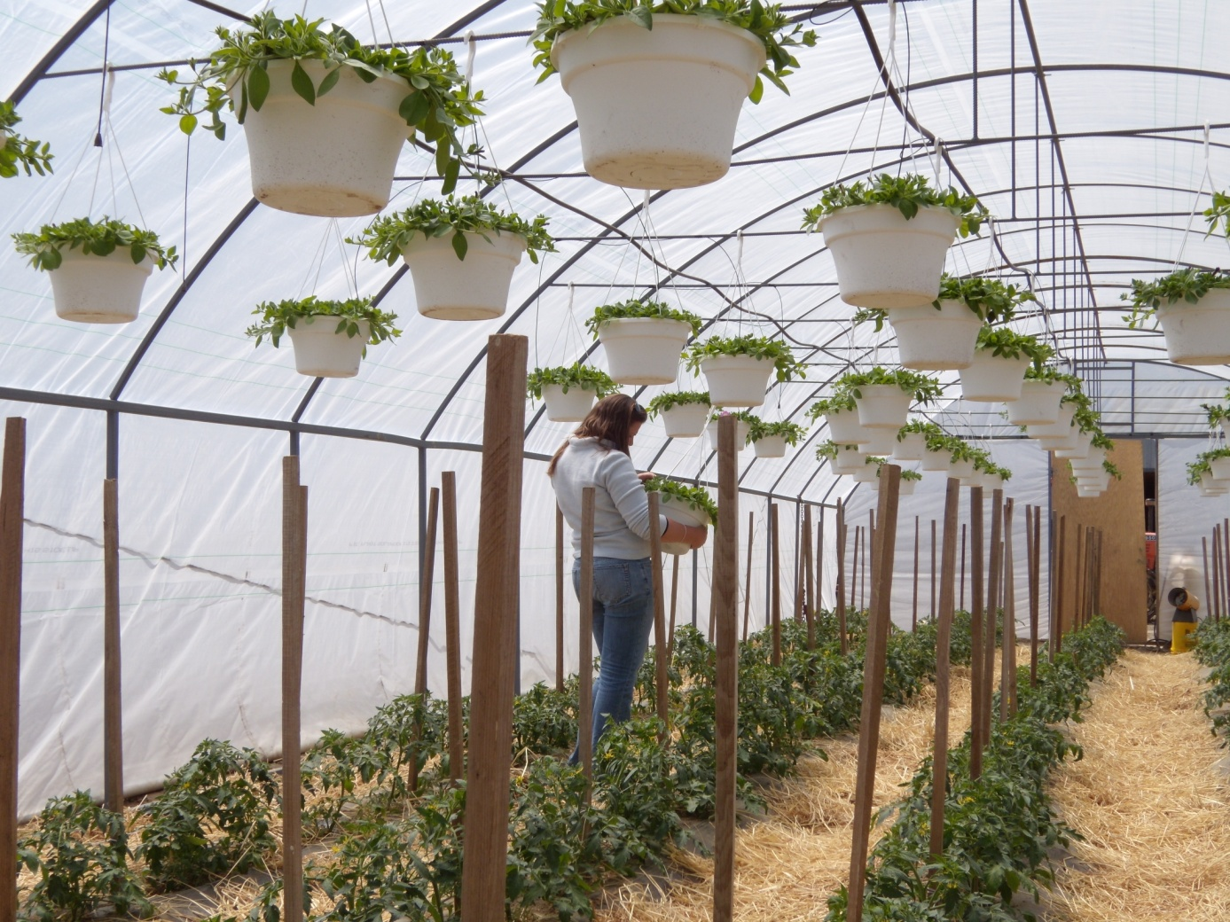
Scout warm season crops.

Slide 9
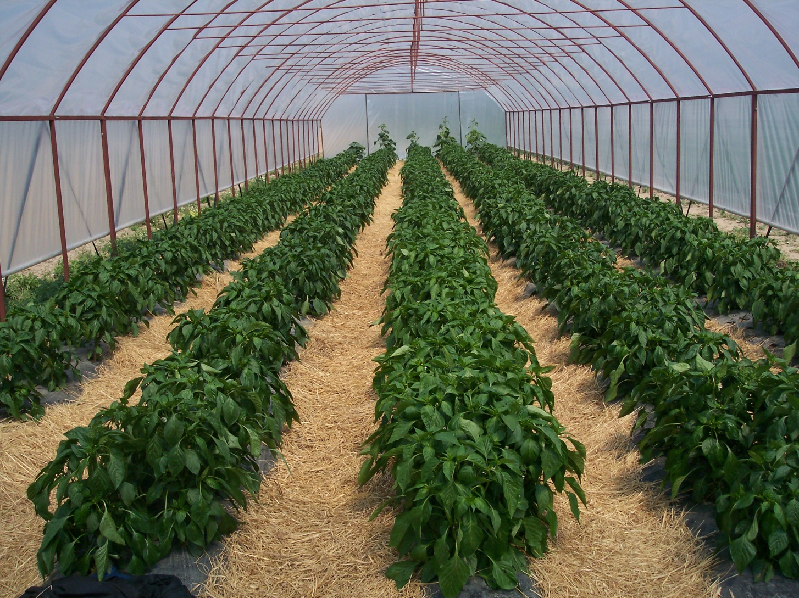

Slide 10
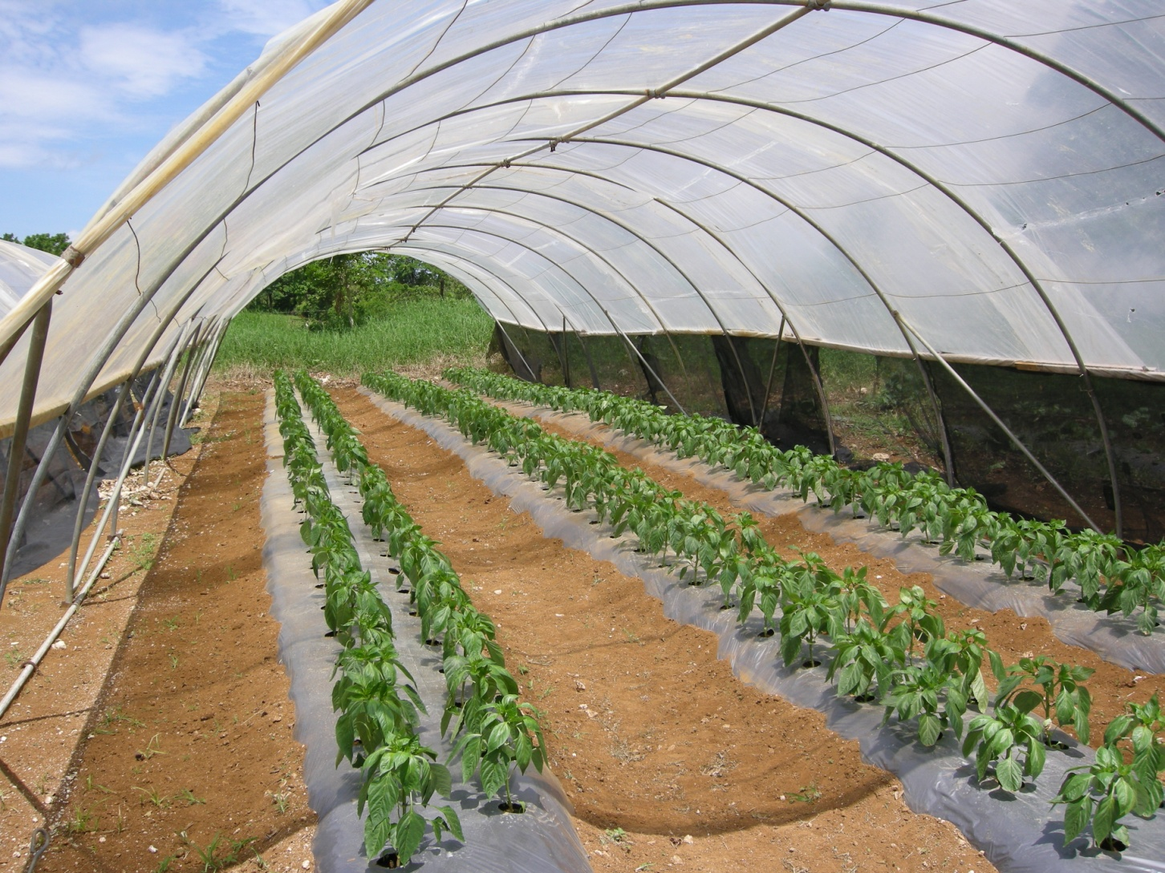
Insect Screening

Slide 11
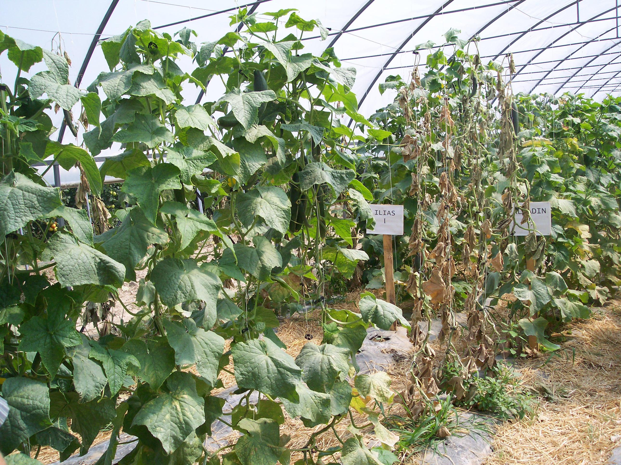

Slide 12
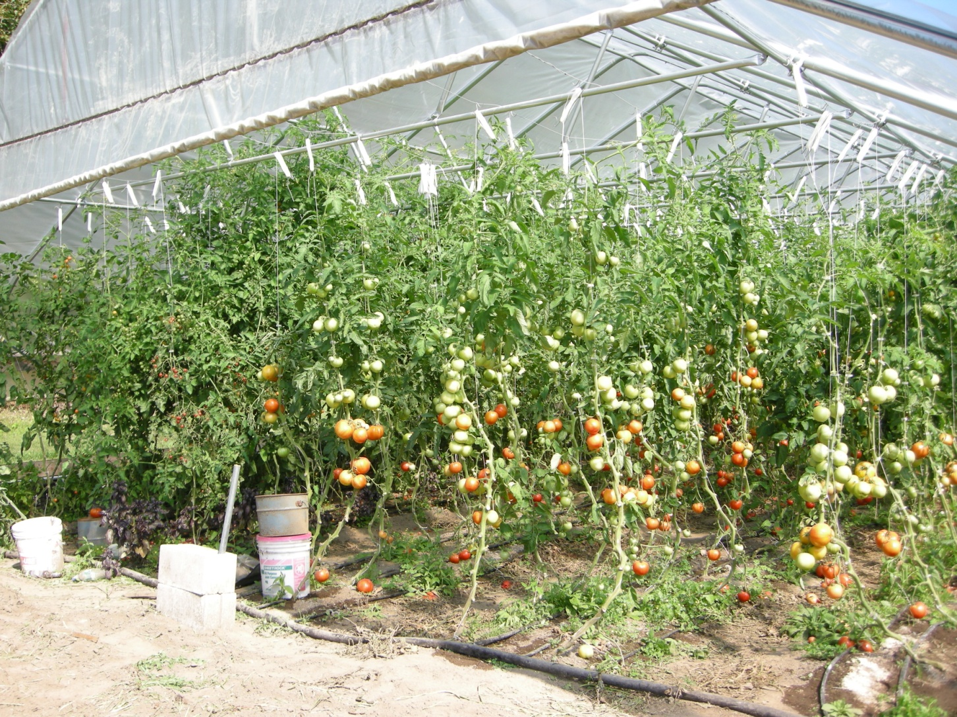
Pruning

Slide 13
Plant Resistance
Insect resistance:
  Some varieties are less attractive.
  Some varieties are more tolerant.
Cucurbits
  Striped cucumber beetle are less attracted to plants with low levels of cucurbitacin (non-bitter types).

Slide 14
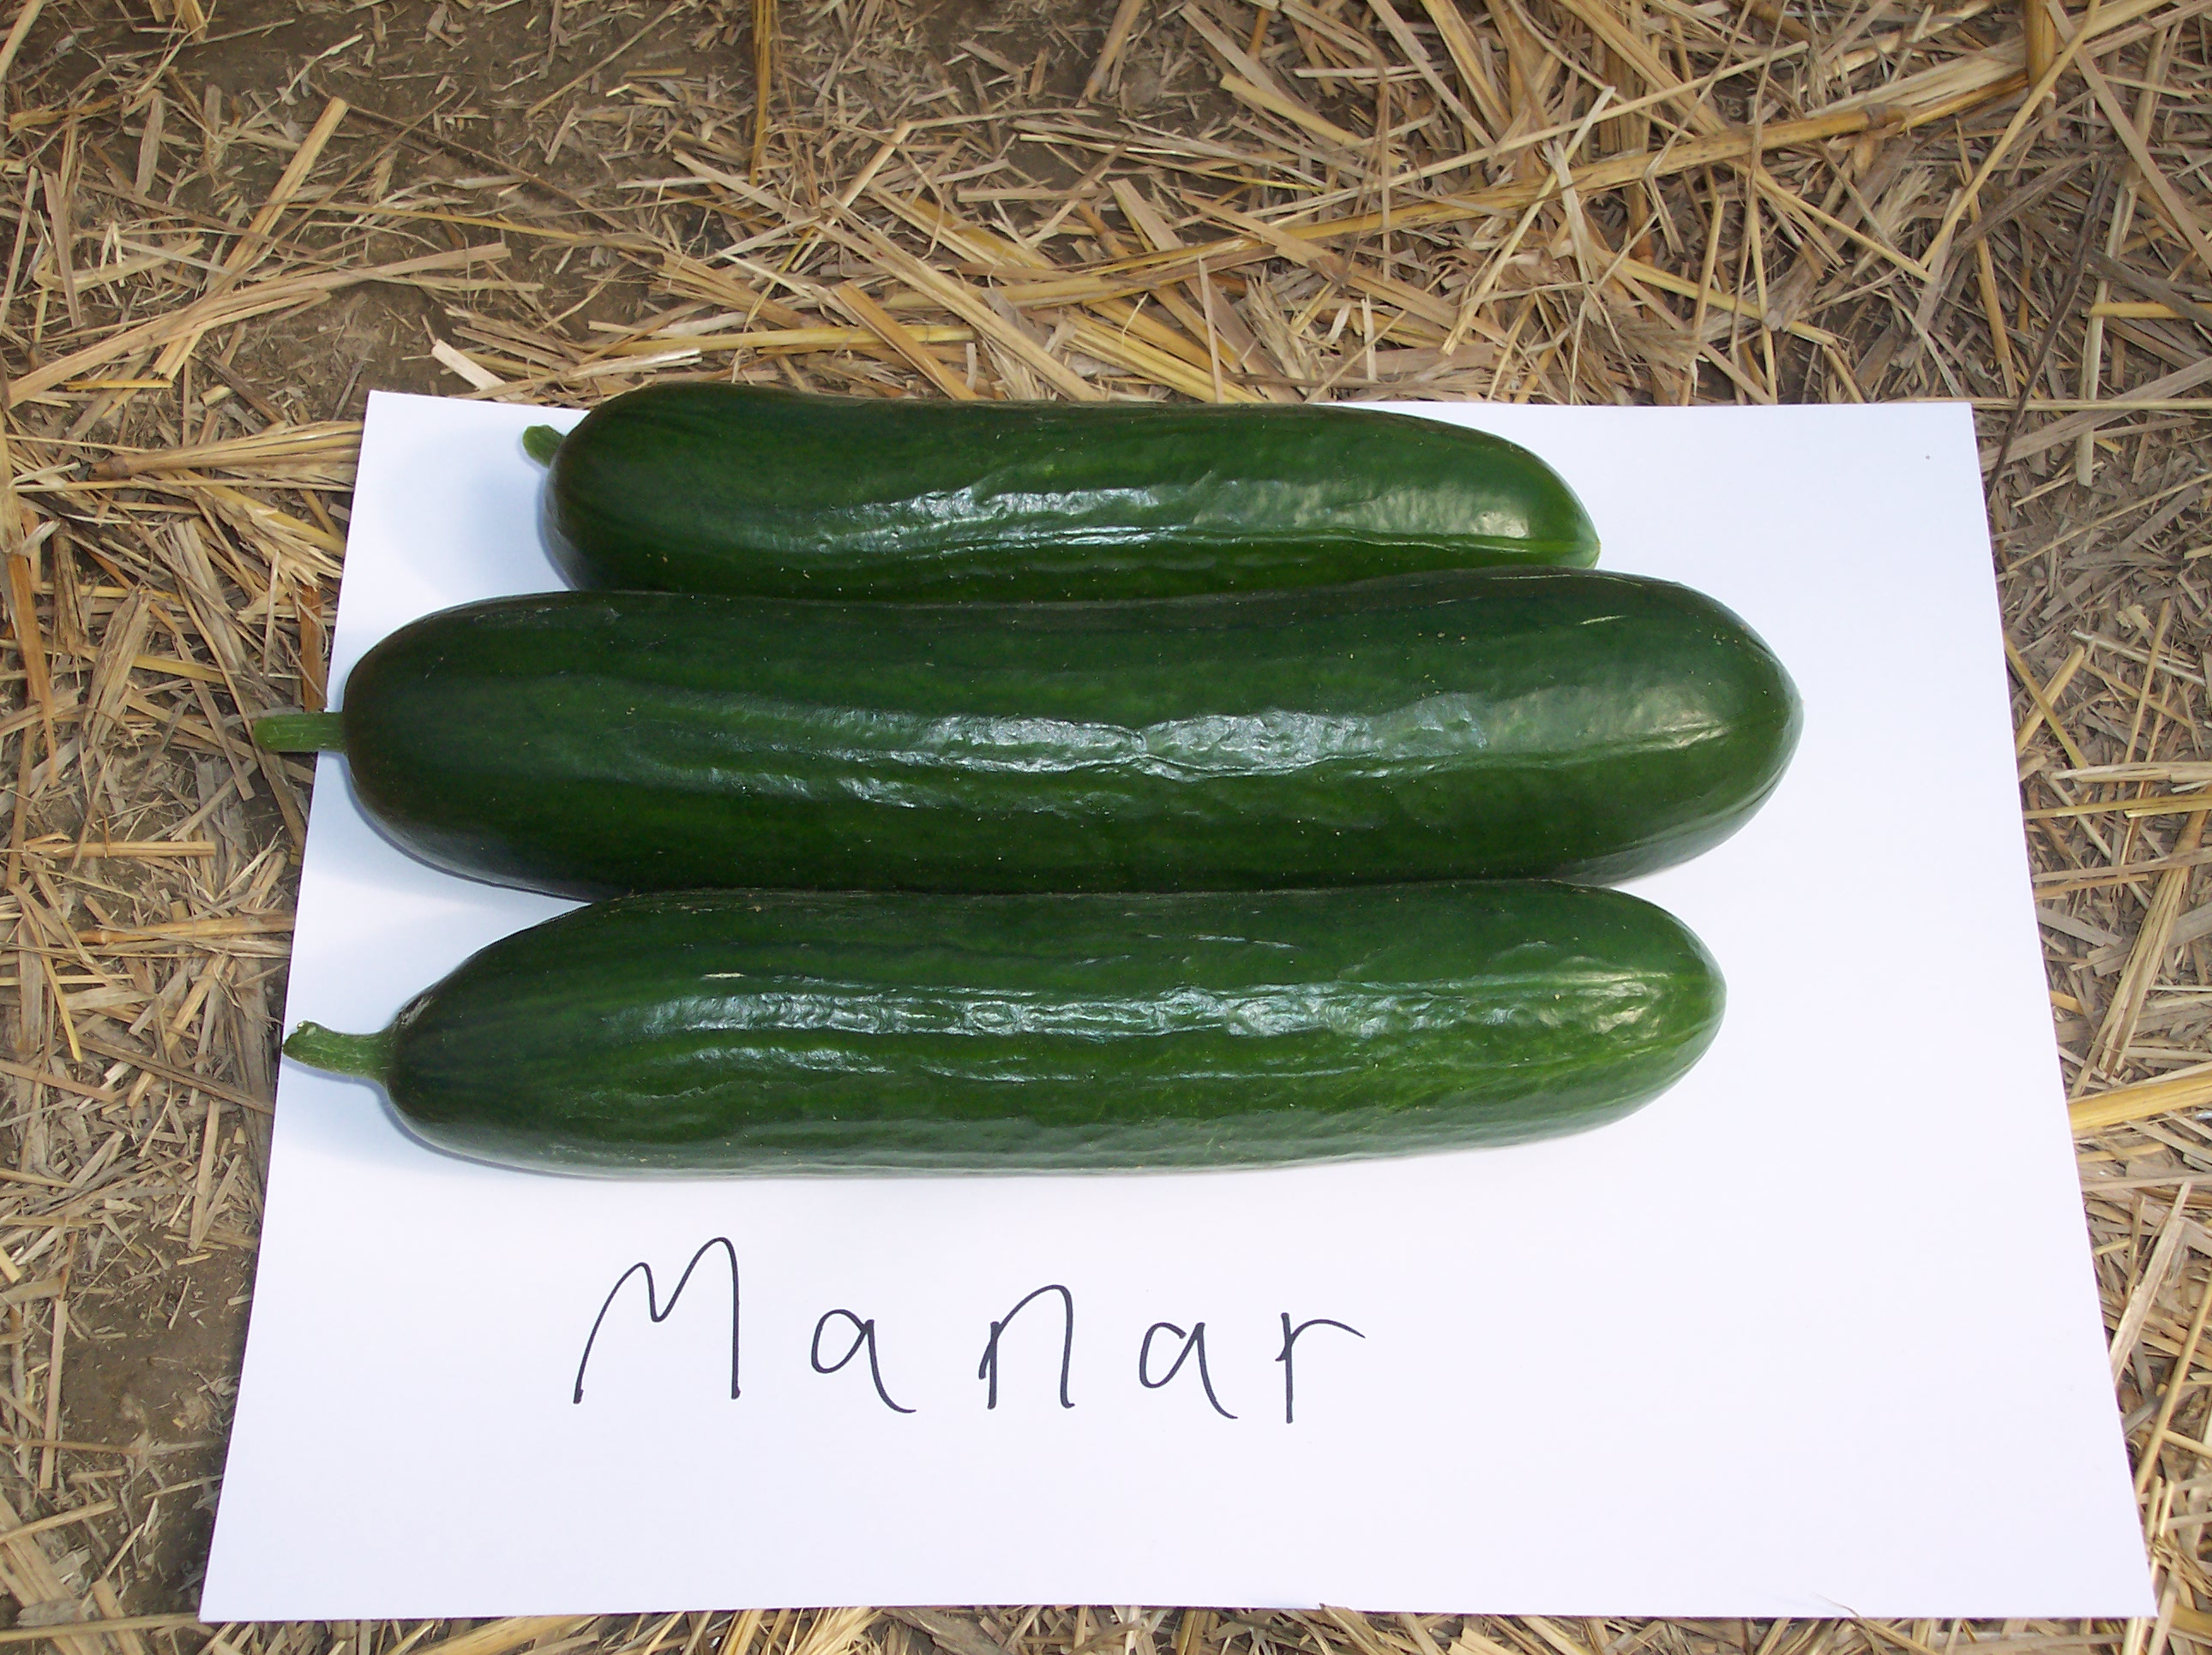

Slide 15
Tomato Varieties: Trust vs Boa
Two Spotted Spider Mites

Slide 16
Grafting
We graft a desirable fruiting variety onto a vigorous rootstock.
Generally used to confer:
  Vigor
  Disease resistance
May also be a tool for insect/mite management.
Grafting is allowable for Certified Organic.

Slide 17
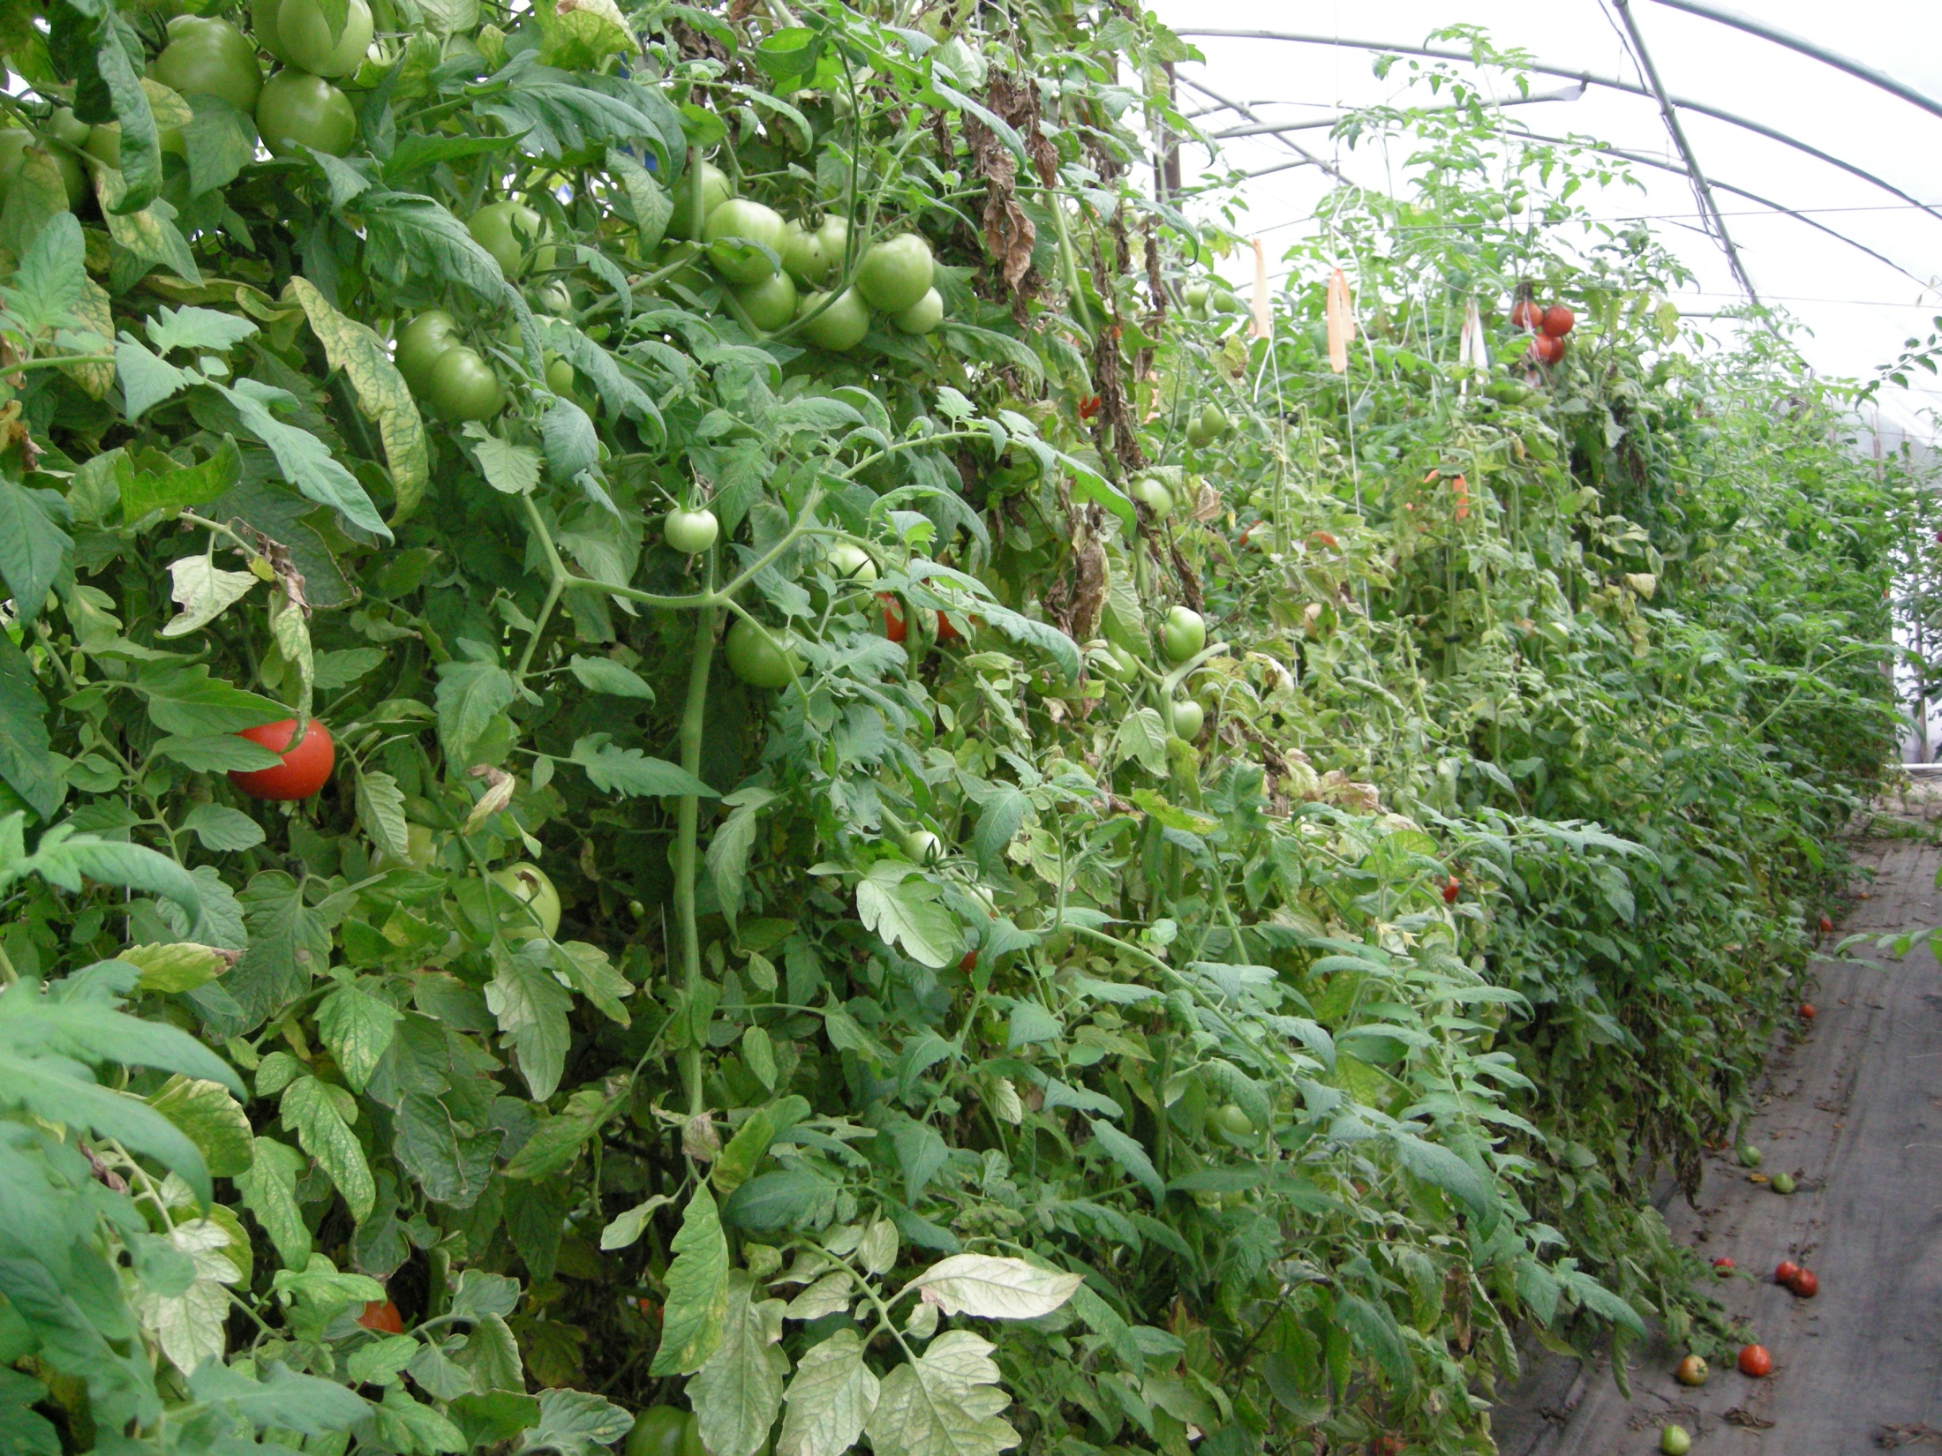

Slide 18
Average Pounds of Tomatoes per Plant, Grafts vs. Un-Grafted

Slide 19
Rotation

Slide 20
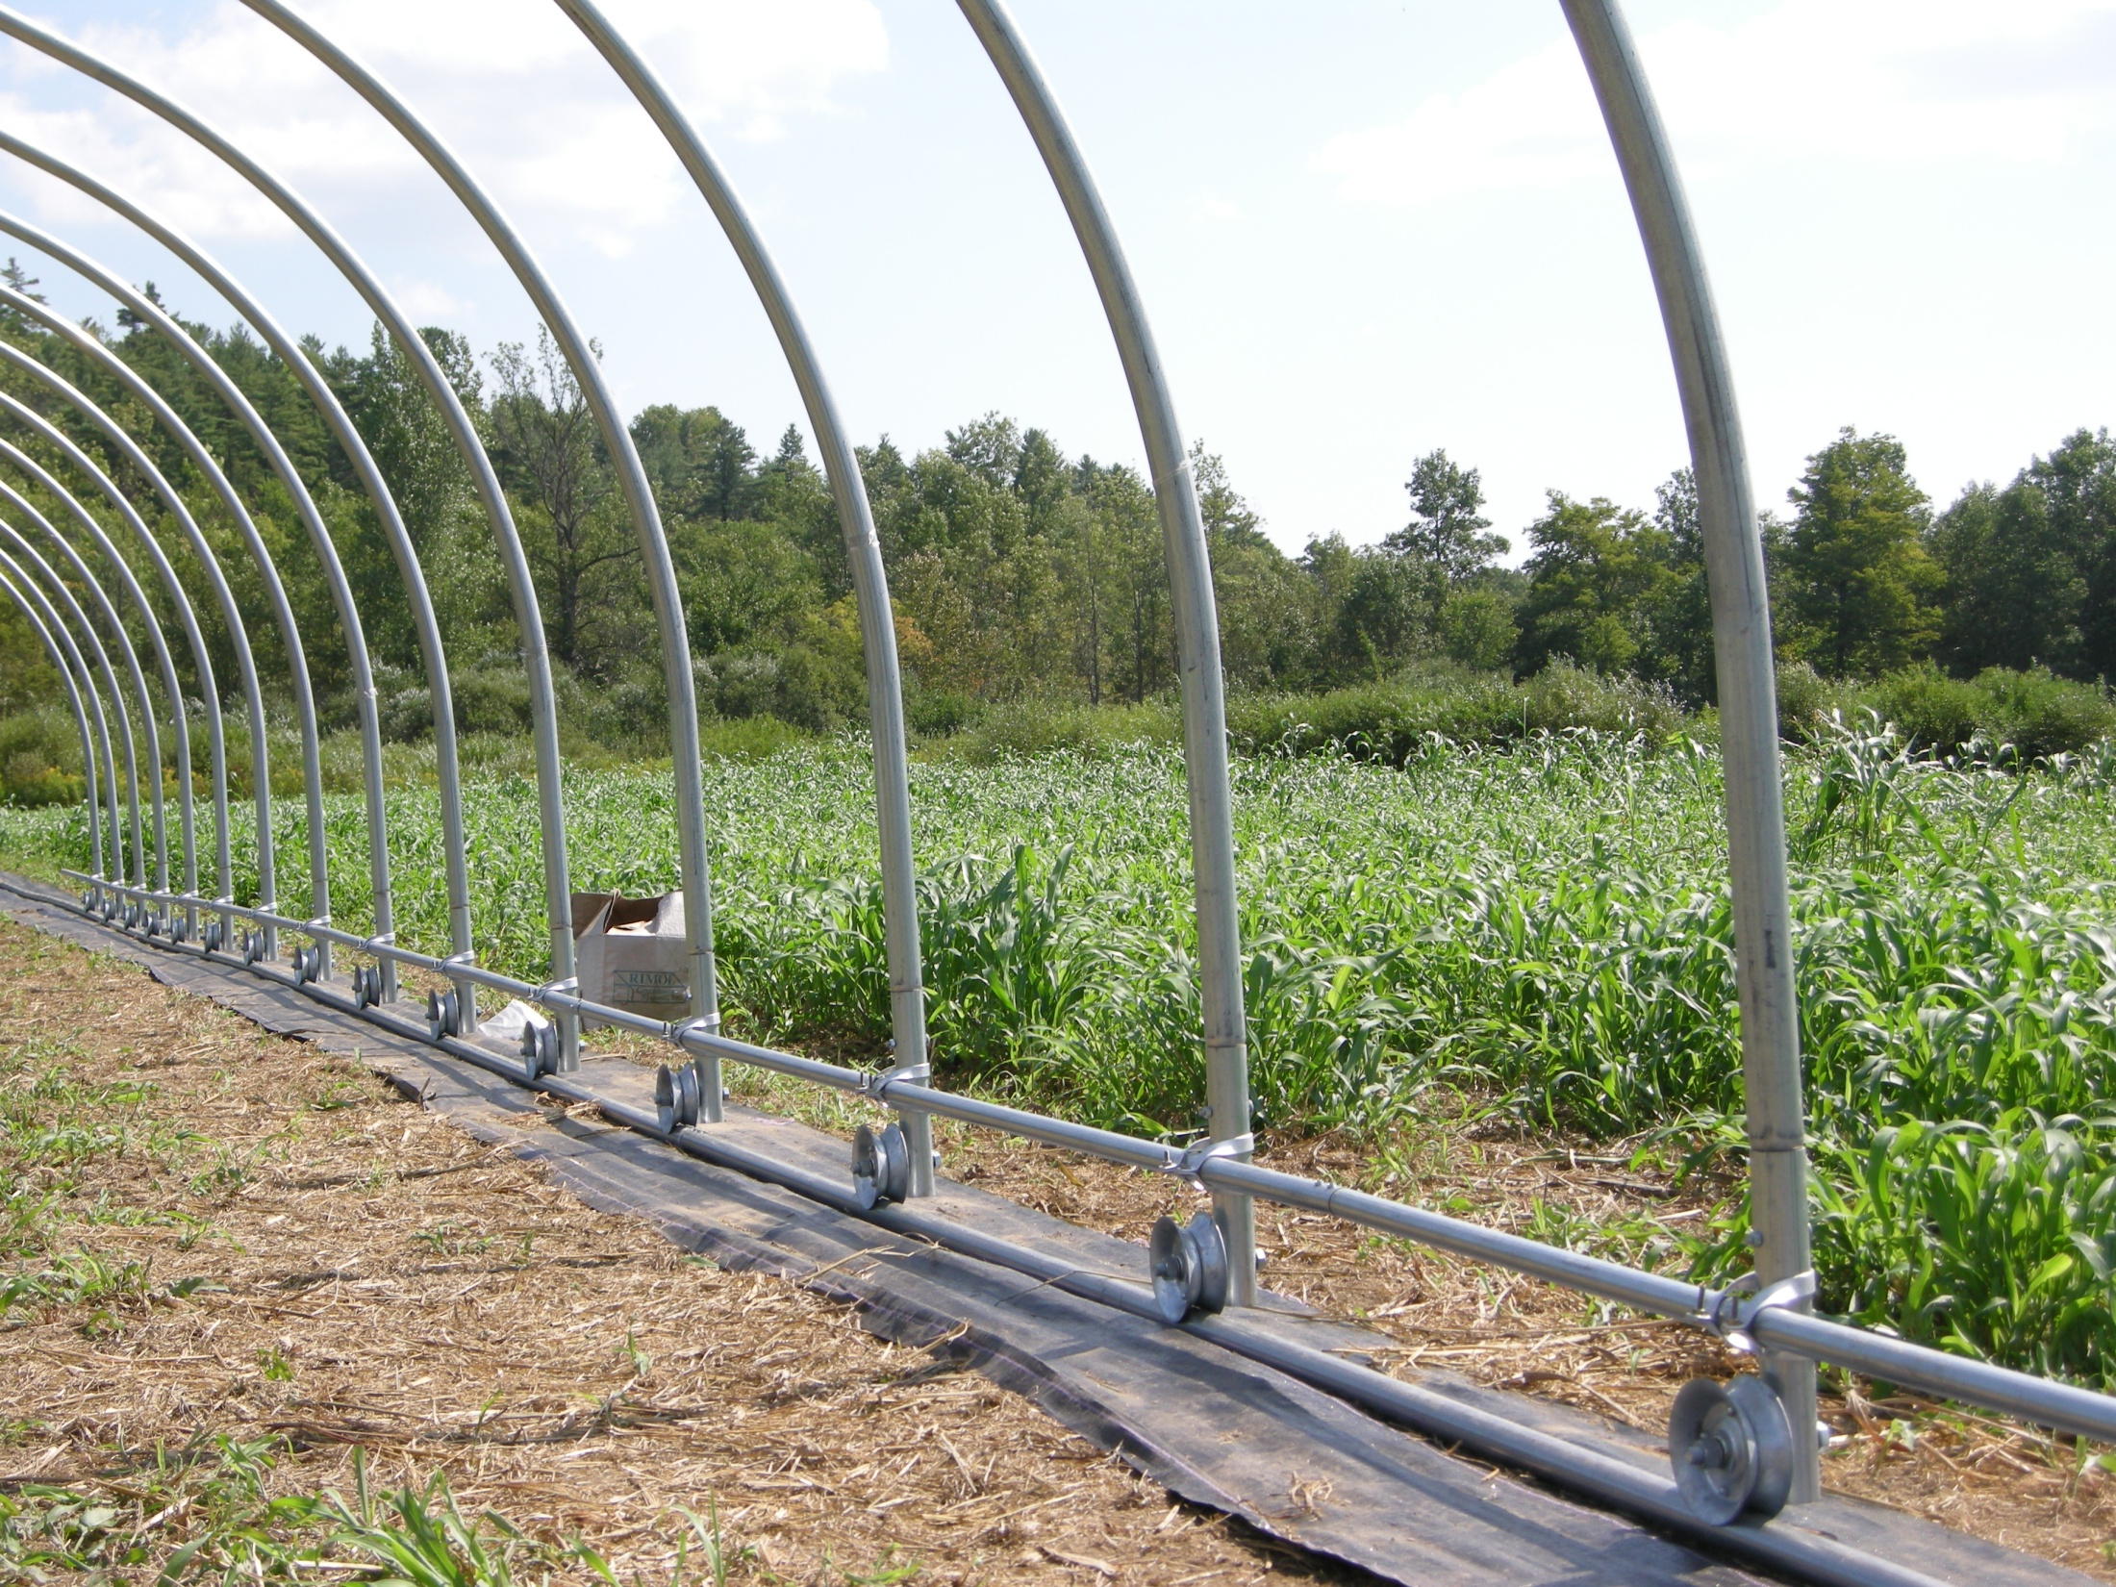
Tunnel Movement = Rotation

Slide 21
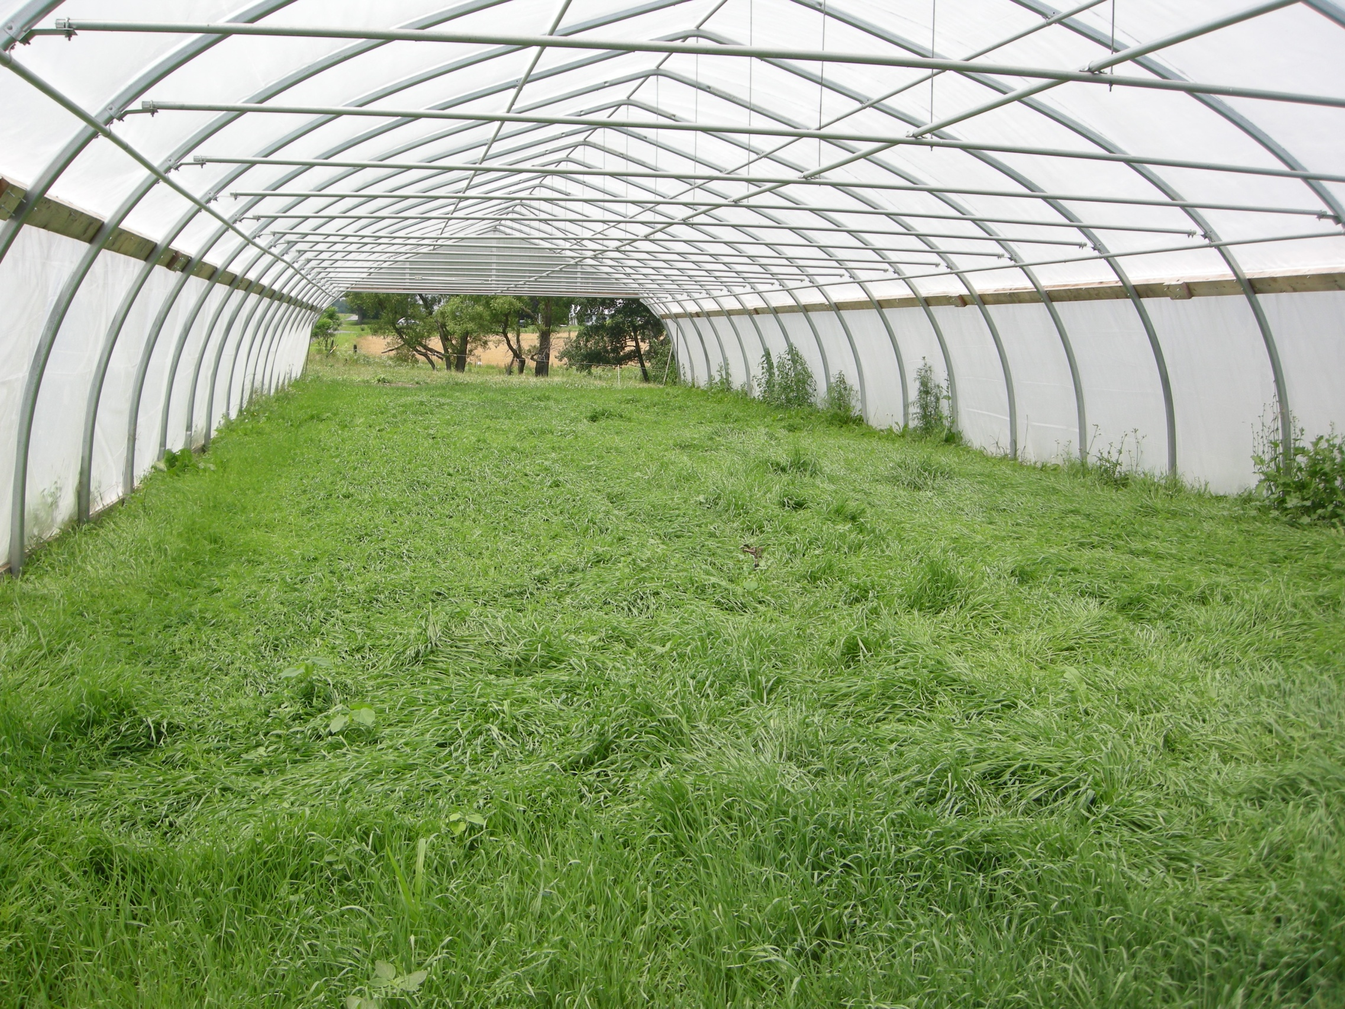
Triticale, oats and vetch cover crop preceding a winter greens crop.

Slide 22
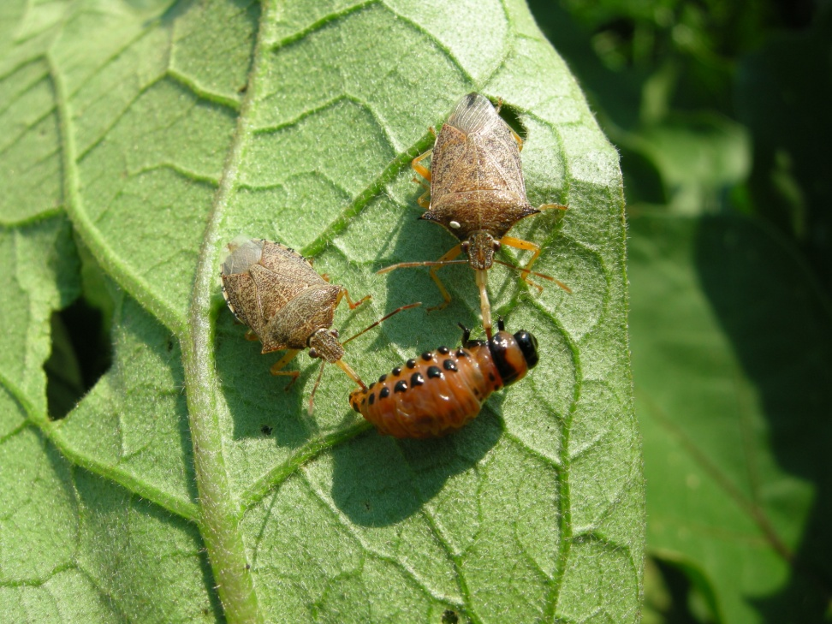
Biological Control

Slide 23
Biological Control
Beneficial arthropods
Well-researched in greenhouse settings.
Require time to work.
Must be used preventatively.

Slide 24
Beneficials:
Predators
  Specialists vs. generalists
Parasitoids

Slide 25
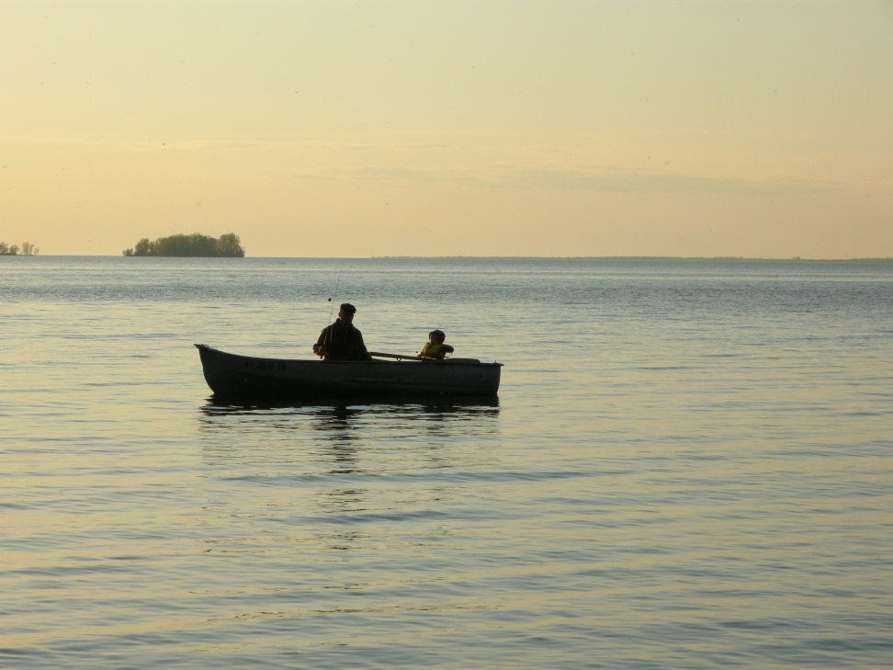
Why use Biologicals?
They work when you rest.
  Less labor than repeated application of oils, soaps,etc.
They don’t ‘burn’ plants.
No Re-entry Interval
No Pre-Harvest Interval.
They work!

Slide 26
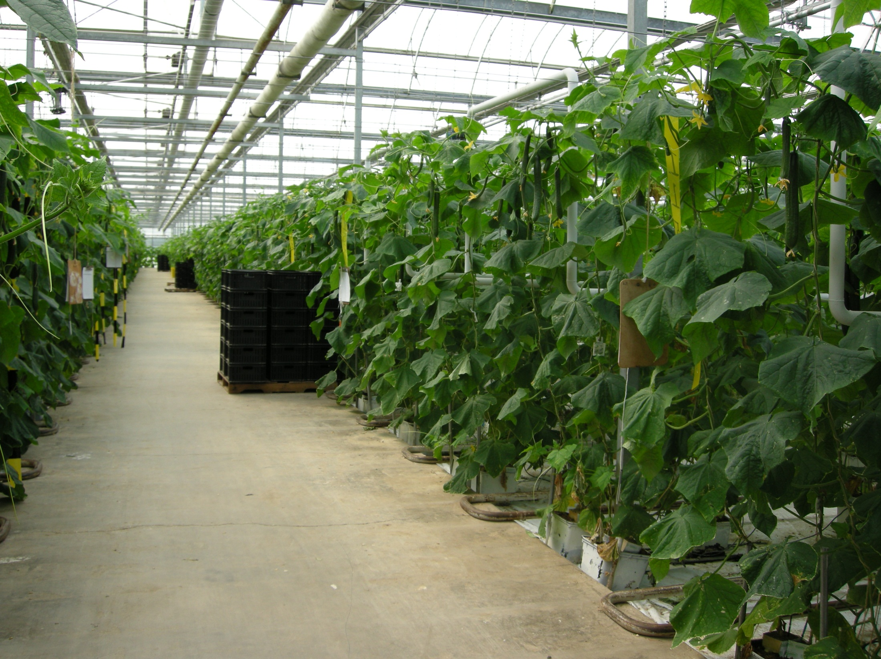

Slide 28
Environmental Management
The most aggressive beneficial insects need specific temperature and relative humidities.
Small greenhouses (or tunnels) have wide swings in temp and RH.
This requires selecting less sensitive benificials, repeat releases, creating habitat (banker plants).

Slide 29
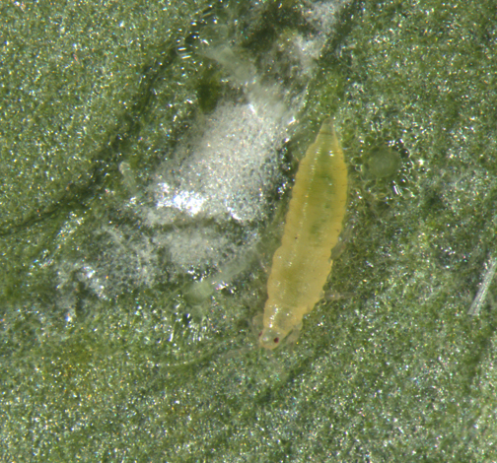
Thrips
Photo credit: Utah State University

Slide 30
Thrips
Multiple species
  Western Flower Thrips (Frankliniella occidentalis)
  Onion Thrips (Thrips tabaci)
Wide range of hosts
Cukes, Tomatoes, Eggplant, Peppers…
Transmit Viruses
Most often found on the underside of leaves and inside flowers.
Foliar damage easily confused with nutrient deficiencies or disease.

Slide 31
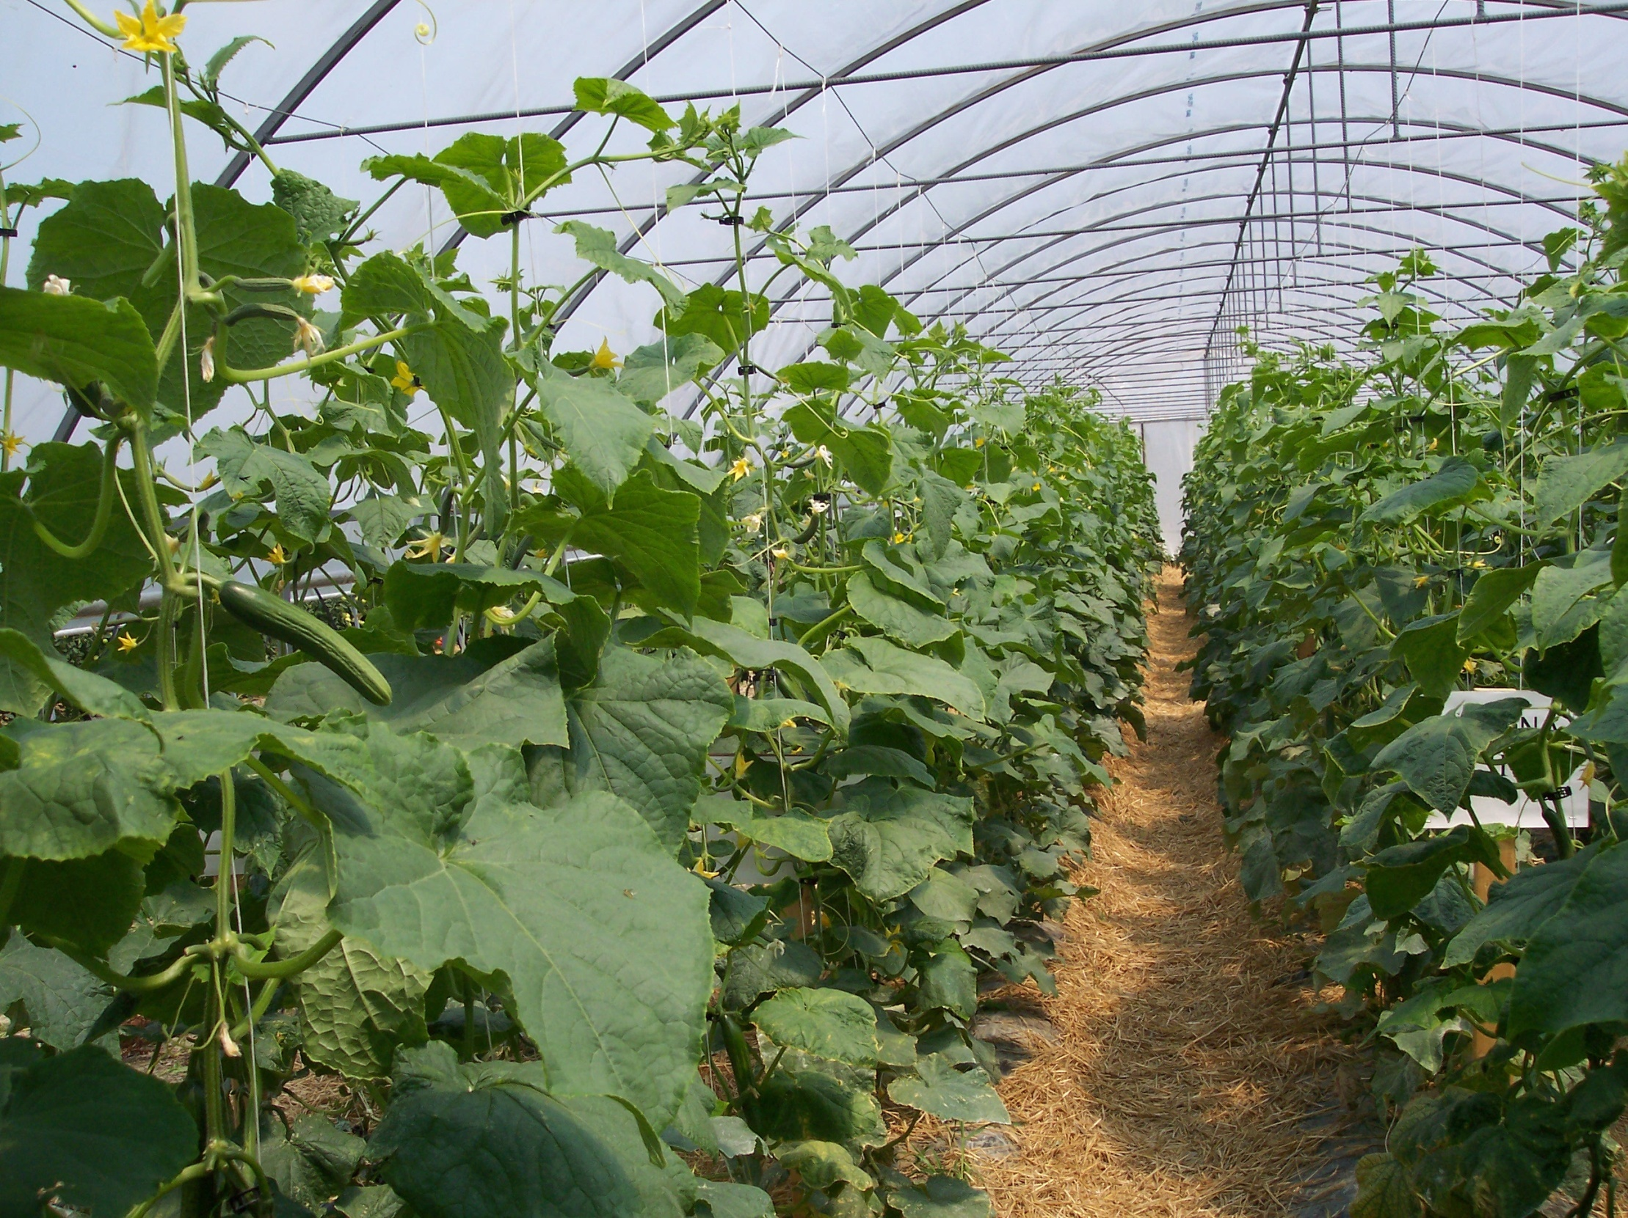

Slide 33
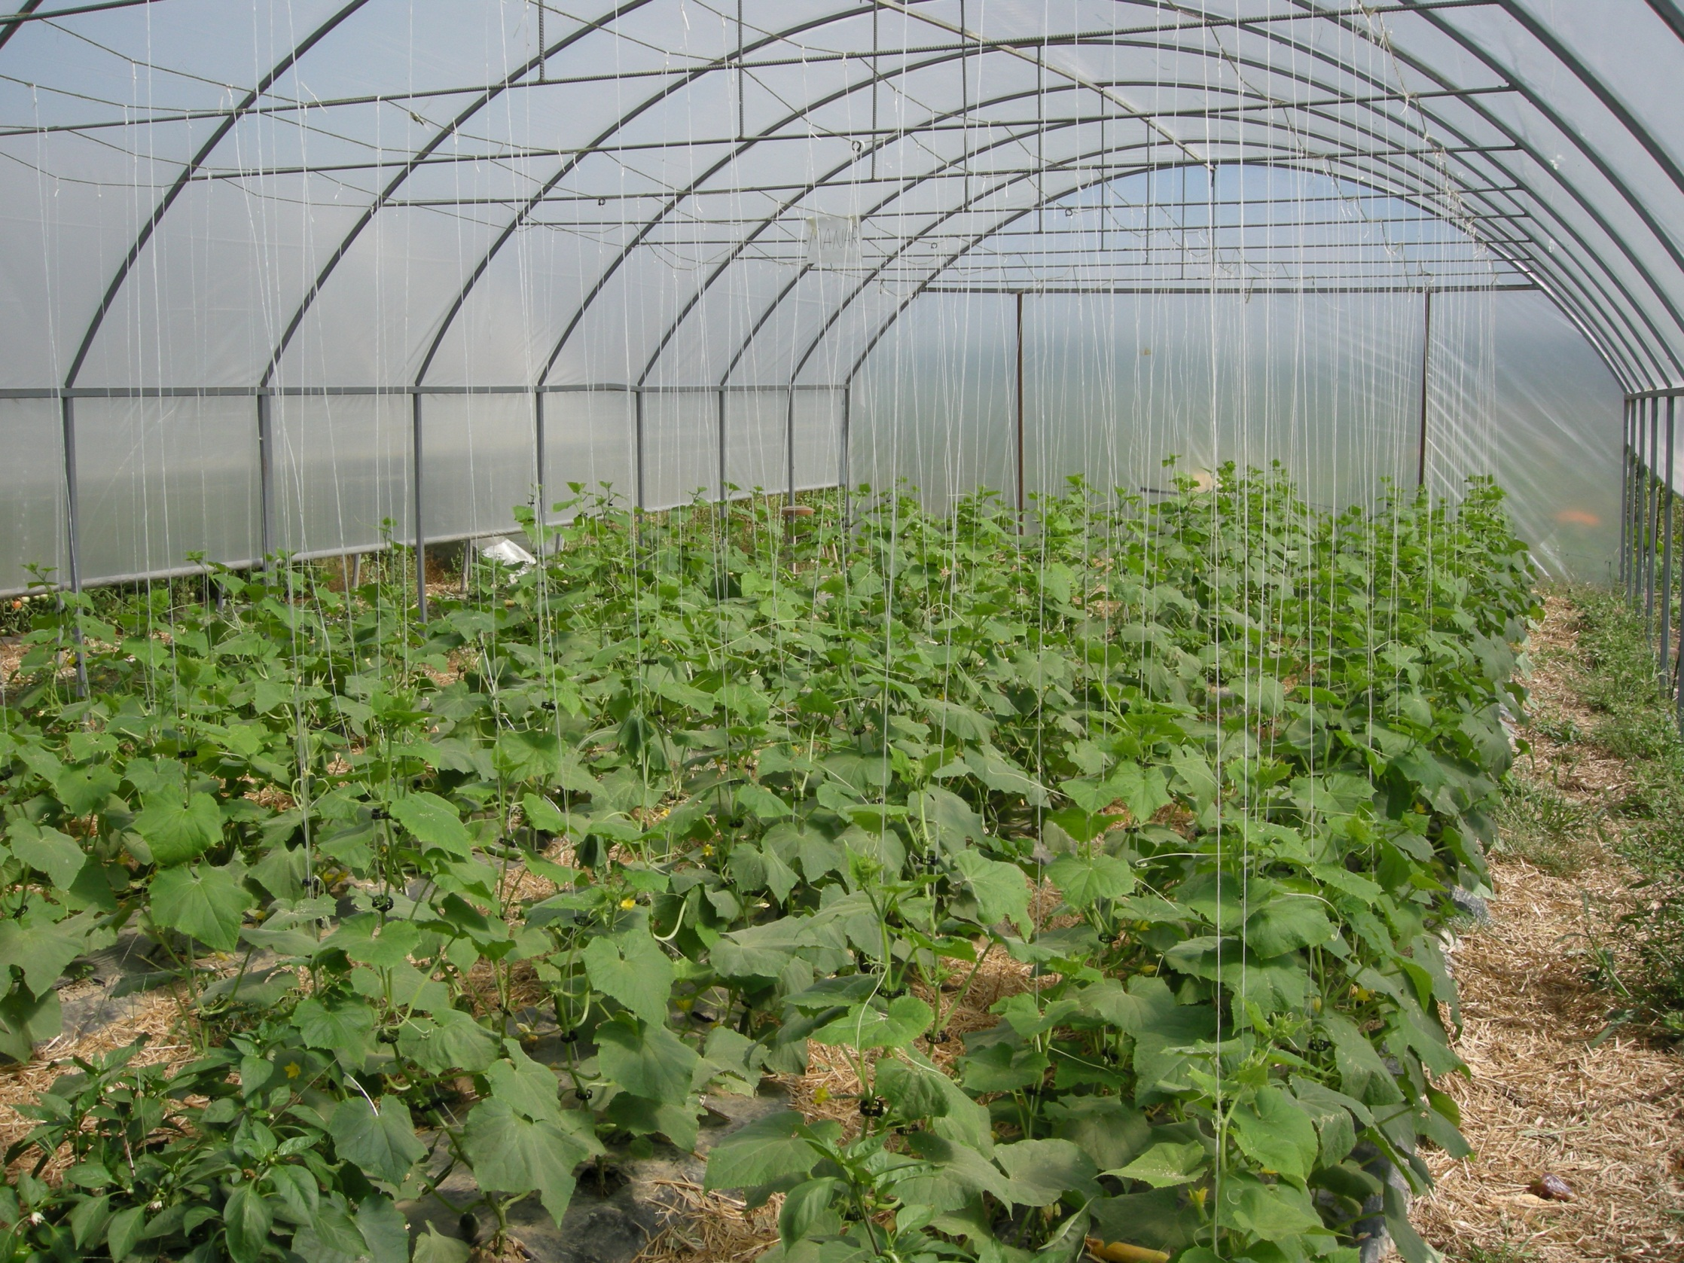

Slide 34
A High Value Crop
Tunnel Size (square feet): | 3000 sq ft
Number of Plants: | 1500
Variety or Cultivar: | Presidio
Yield: | 64950 cucumbers
Marketing: | 1 cucumber@ 0.33
Total Revenue | $21433.50
Total Costs | $ 5,609.7
Total Revenue | $ 15823.80
Sq ft return=$5.27

Slide 35
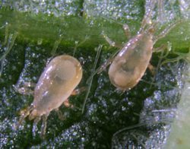
Amblyseuis cucumeris

Slide 36
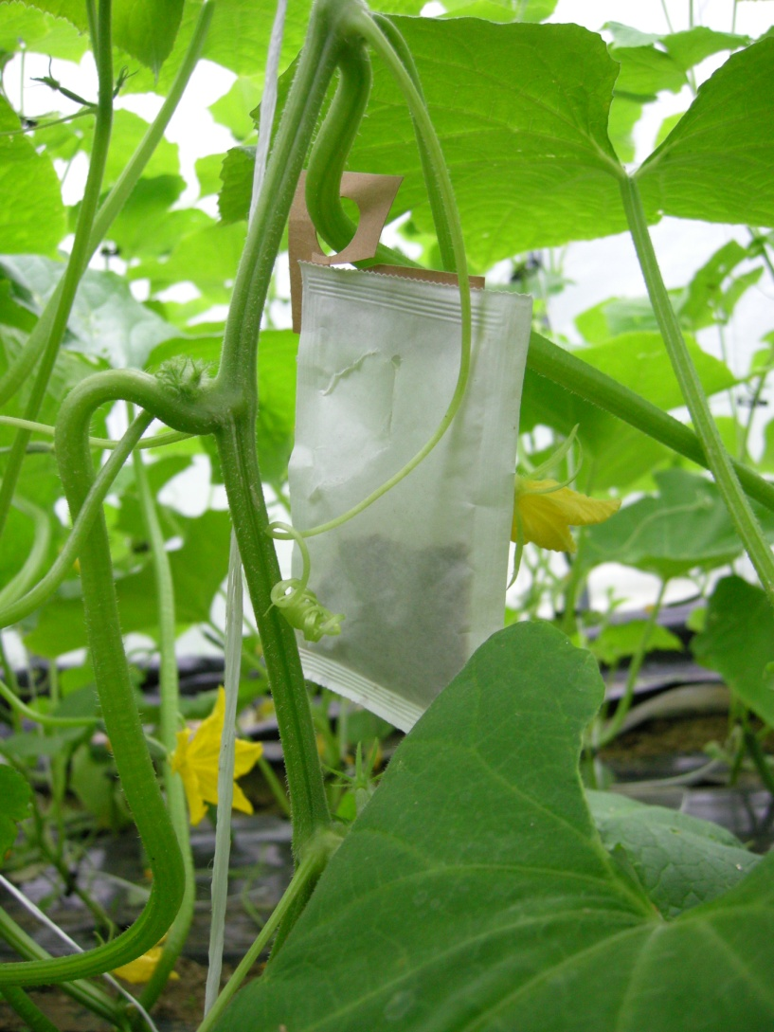

Slide 37

Amblyseius cucumeris
I like this one!
It is a generalist predator.
Attacks juvenile stages of thrips and other pests.
Can survive on pollen if prey become unavailable.
Cost effective.

Slide 38
Biological Control in 2007 HT cukes
Released 10,000 cucumeris
Released 10,000 cucumeris
Released 500 Orius
Released 10,000 cucumeris

Slide 39
Cucumeris released June 2 & 26

Slide 40
Results?
Out of 23 farmers completing our survey; 20 adopted biological and/or natural pest control methods in warm season greenhouse/high tunnel crops.

Slide 41
Farmer responses on the impact or value of implementing natural pest management:
“Natural pest control can save an entire crop. It is highly effective and valuable”

Slide 42
Farmer responses on the impact or value of implementing natural pest management:
“Natural pest control takes less times, works 24-7, seems to do a great job. Great public relation tool”

Slide 43
Farmer responses on the impact or value of implementing natural pest management:
“I can't quite put a dollar value on my crop, but I can say we were able to control the mites with beneficials, to the point where we could continue harvesting.”

Slide 44
Beneficial Insect Lessons
Scout often.
Order beneficials prior to, or immediately after finding a pest outbreak.
Know your suppliers delivery schedules and deadlines.
Effects will not be immediate, continue scouting.
Plan ahead for pest intensive crops (Vine Crops, Berries and Eggplant)

Slide 45
Common Reasons for Failure:
Introduction rates too low, pest levels too high at beginning
Introductions started too late
Poor environmental conditions for beneficials (temp and humidity)
Poor quality and reliability of natural enemy shipments
Crop tolerance for some pests/damage too low
Grower impatience

Slide 46
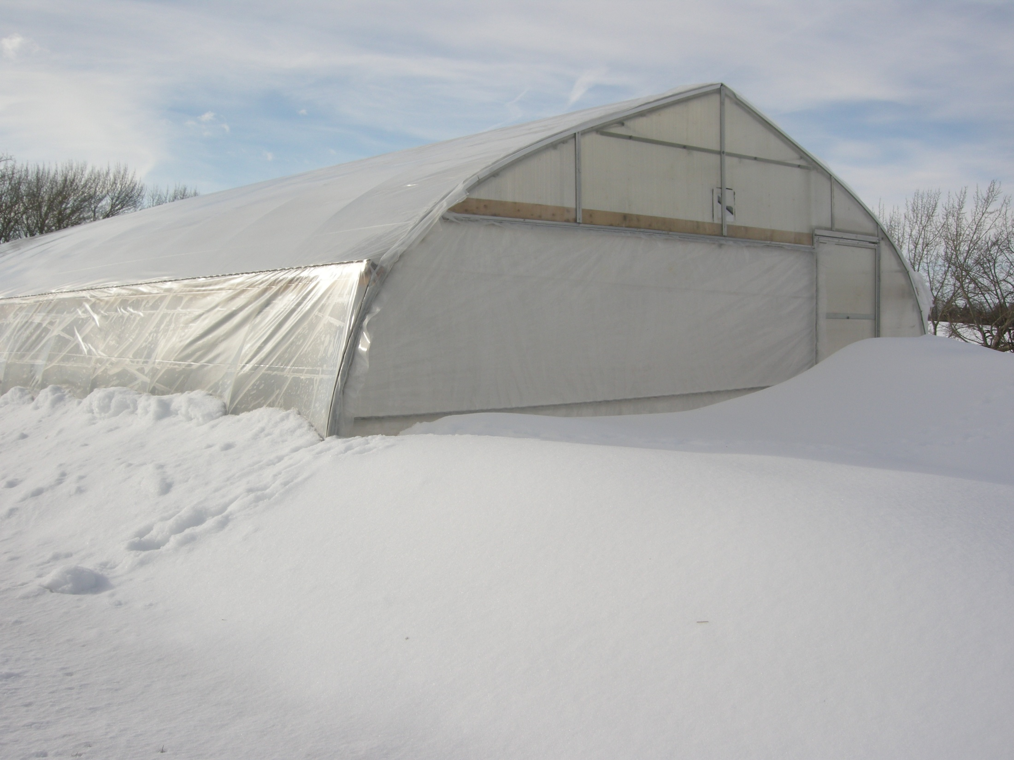

Slide 48
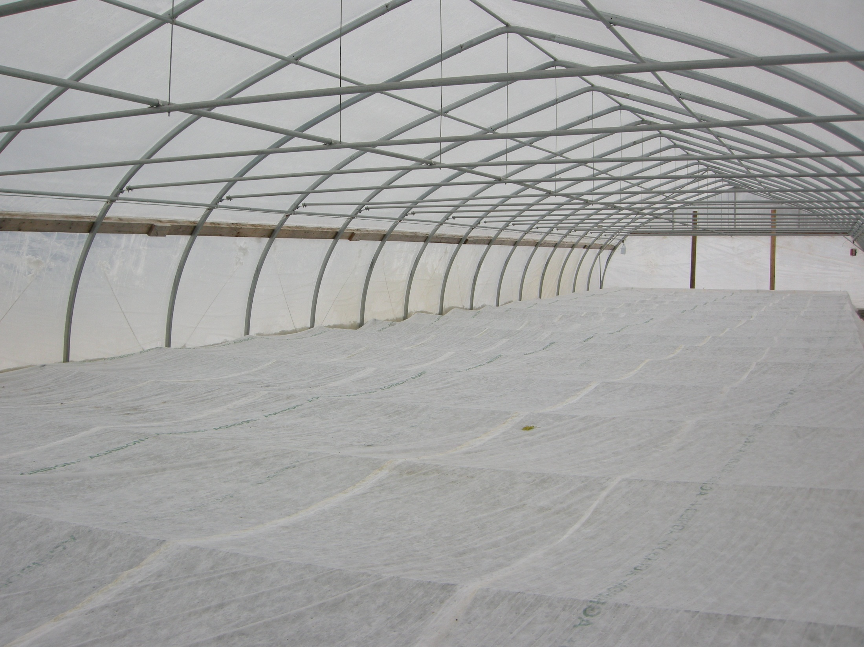

Slide 49
courtesy-H.C. Wien
Date, 2010 | Low temperatures, F
 | Outside air | High tunnel air | Low tunnel air | Soil under low tunnel
Jan. 9 | +12 | 22 | 30 | 33
10 | -2 | 11 | 24 | 33
11 | -9 | 4 | 21 | 33
23 | +8 | 13 | 26 | 39

Slide 50
Molt-X and Mycotrol

Slide 51
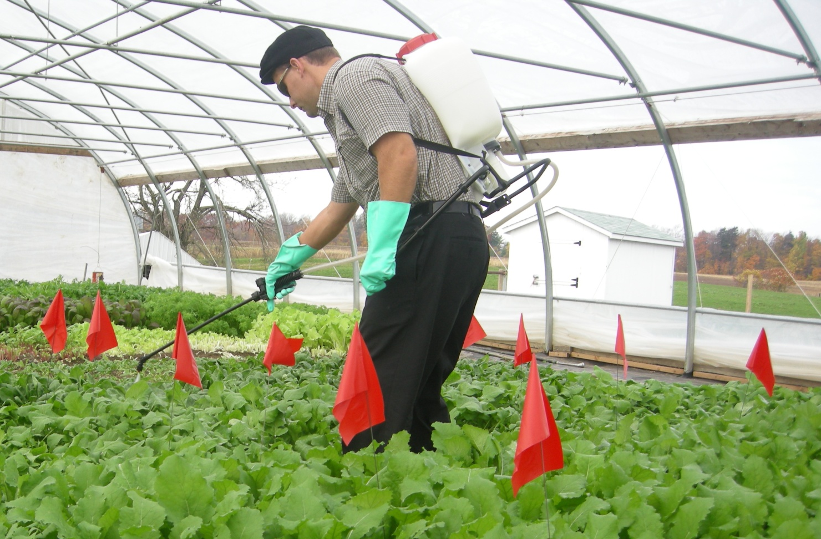
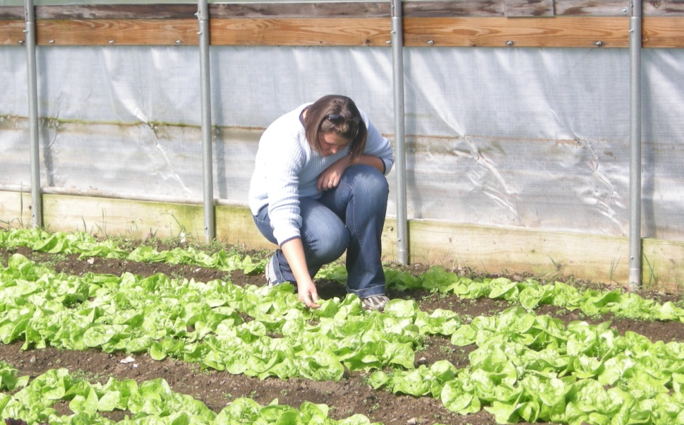
jer11@cornell.edu
kep39@cornell.edu

