Slide 1

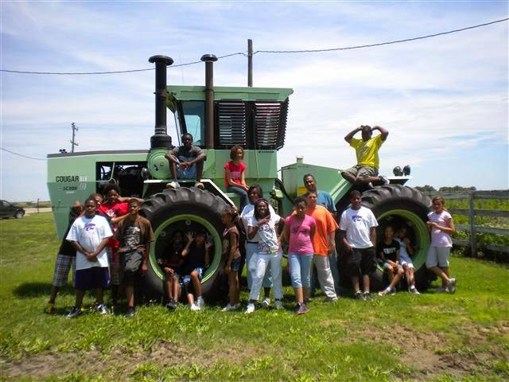



DINING AT THE FARMER’S TABLE
YENC-13-060
JohnElla J. Holmes, Ph.D.
Nicodemus Educational Camps (NEC)
Zelia Wiley, Ph.D.
Assistant Dean College of Ag (KSU)
Switzer/KSU Agriculture Camp for Youth
Project Objectives:
A Moment of Pride!
Dining will introduce inner city youth to a Farm and Farmer in Historic Nicodemus, KS
Dining will introduce inner city youth to produce and crops grown on farms.
Dining will introduce youth to vegetables not normally included in their meal selection – Eggplant won this year!
Dining introduced the inner city youth to recipes containing Eggplant.
Dining will introduce inner city youth to a Farmer’s Market.
Dining will provide inner city youth with recycling shopping bags and a payment voucher for $20 to be used at the Farmer’s market.
Values:
Agriculture and Education: Our youth, parents, community and consumers
Citizenship: Self-awareness, Leadership, Economic self and community development
Conservation: Land use, research, community, and earths many and mighty resources.
Camp Newsletter: https://cdn.sare.org/wp-content/uploads/20171204131551/979440camp-newsletter-2-11-14.pdf
NEC moment of pride 100% of its high school seniors have graduated, three of which were National Honor Society honorees and one was named a National Honor Society honoree in Jr. High!
NEC moment of pride 100% of its high school seniors have been accepted to a university, college, or trade school specializing in nursing. We presently have former campers at University of New Mexico, University of Missouri Kansas City, University of Texas Houston, Kansas State University, Fort Hays State University, McPherson College, Seward County Community College, and Northwest Area Technical College
NEC in a 10 year partnership with the College of Agriculture Diversity Programs Office has served 510 inner city low income youth from across the country!
Motto:
Accepting the challenge to learn about Agriculture, contribute to sustain and conserve our earth’s resources, will always work to my full potential, and will NEVER stop learning.
Sample Eggplant Recipe Tested
Dr. Zelia Wiley has developed a pre and post assessment for the campers. Provided below are a few statistical results of the assessment.
Eggplant Grilled Cheese Sandwiches (chosen by the Reduce Group)
Makes 4 sandwiches (serves 4)| Hands-On Time: 20m| Total Time: 20m
Ingredients
1 medium eggplant (cut into 4 thin slices)
8 slices of bread
4 slices of provolone cheese
4 slices of cheddar cheese
2 slices of mozzarella cheese
1 tablespoon olive oil
2 tablespoons butter melted
1 tablespoon mayonnaise (optional)
Directions
Heat griddle to 400° F. placed sliced eggplant on griddle 3-4 minutes each side (until tender). When eggplant is cool enough to handle, cut to size of bread, discarding the skin.
Butter outer side of bread stack 1 slice of provolone, eggplant, 1/2 slice of mozzarella, 1 slice of cheddar cheese, (mayonnaise is optional), top sandwich with bread butter side out.
Place on solid griddle cook for 2 minutes on each side or until bread is golden brown. Cheese may ooze out so please be careful it will be HOT! Slice in two and serve.
Recipe developed by Michelle White Godinet, 2011.
Assessment Results:
Respondent # | Hands-on Activities-Water Field day | Having Fun While Learning about Agriculture | Investigating our Natural Resources | Enthusiastic about farm tours | A Knowledgeable College instructor | The Dairy Barn Tour | MANRRS presentation | Milling Science | Having the Chance to Share My Opinions… | Reflecting on What I’ve Learned…
12 | 7 | 6 | 6 | 8 | 7 | 6 | 8 | 7 | 5 | 8
20 | 10 | 10 | 9 | 10 | 10 | 9 | 8 | 10 | 10 | 10
21 | 9 | 10 | 10 | 10 | 10 | 9 | 10 | 8 | 6 | 8
27 | 10 | 10 | 10 | 10 | 10 | 10 | 10 | 10 | 10 | 10
11 | 10 | 10 | 5 | 10 | 10 | 10 | 5 | 10 | 10 | 10
32 | 9 | 10 | 10 | 10 | 8 | 9 | 10 | 7 | 6 | 9
13 | 9 | 5 | 7 | 10 | 7 | 10 | 5 | 10 | 5 | 10
26 | 10 | 9 | 8 | 6 | 10 | 10 | 10 | X | 10 | 7
38 | 10 | 10 | 1 | 10 | 10 | 10 | 10 | 1 | 6 | 2
10 | 9 | 10 | 8 | 10 | 10 | 8 | 10 | 10 | 9 | 8
17 | 10 | 9 | 9 | 10 | 10 | 9 | 8 | 9 | 9 | 9
22 | 10 | 7 | 6 | 10 | 10 | 10 | 5 | 5 | 4 | 7
29 | 10 | 10 | 10 | 10 | 10 | 2 | 1 | 8 | 10 | 5
35 | 10 | 10 | 10 | 10 | 10 | 10 | 9 | 10 | 10 | 9
36 | 10 | 10 | 9 | 10 | 10 | 10 | 10 | 10 | 10 | 10
28 | 7 | 6 | 8 | 4 | 7 | 8 | 5 | 7 | 8 | 9
14 | 7 | 8 | 7 | 10 | 9 | 10 | 8 | 9 | 7 | 6
30 | 8 | 8 | 7 | 8 | 9 | 6 | 8 | 5 | 5 | 4
18 | 10 | 10 | 7 | 9 | 10 | 9 | 1 | 8 | 9 | 10
33 | 8 | 10 | 9 | 10 | 10 | 10 | 10 | 10 | 9 | 10
15 | 9 | 9 | 9 | 9 | 10 | 10 | 8 | 10 | 9 | 10
16 | 9 | 10 | 10 | 10 | 9 | 9 | 7 | 5 | 9 | 9
Average | 9.1 | 8.9 | 7.9 | 9.2 | 9.3 | 8.8 | 7.5 | 8.0 | 8.0 | 8.1
This project is supported by the National Institute of Food and Agriculture, U.S. Department of Agriculture, under award number YENC 13-060 through the North Central Region Sustainable Agriculture Research and Education program. Any opinions, findings, conclusions, or recommendations expressed in this publication are those of the author(s) and do not necessarily reflect the view of the U.S. Department of Agriculture or SARE. USDA is an equal opportunity employer and service provider.

