Slide 1
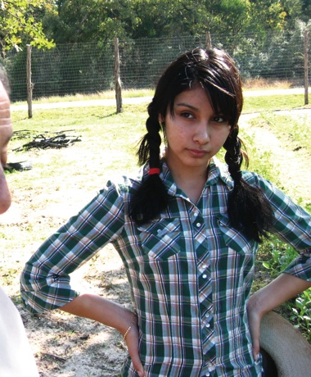


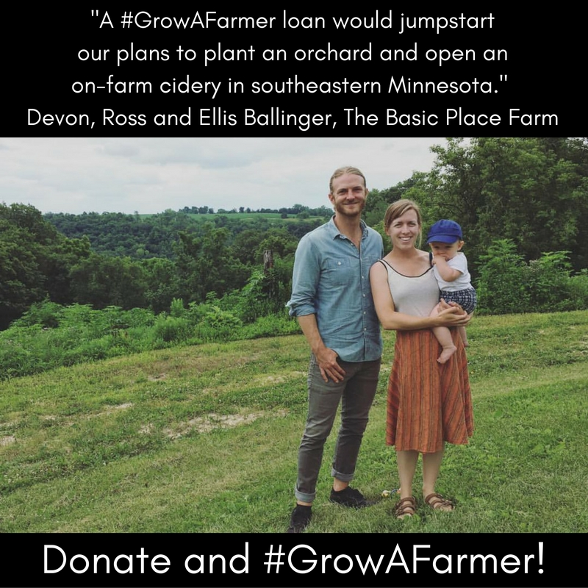
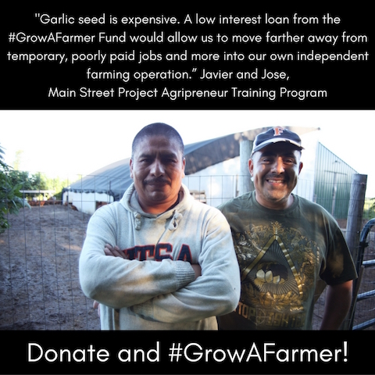
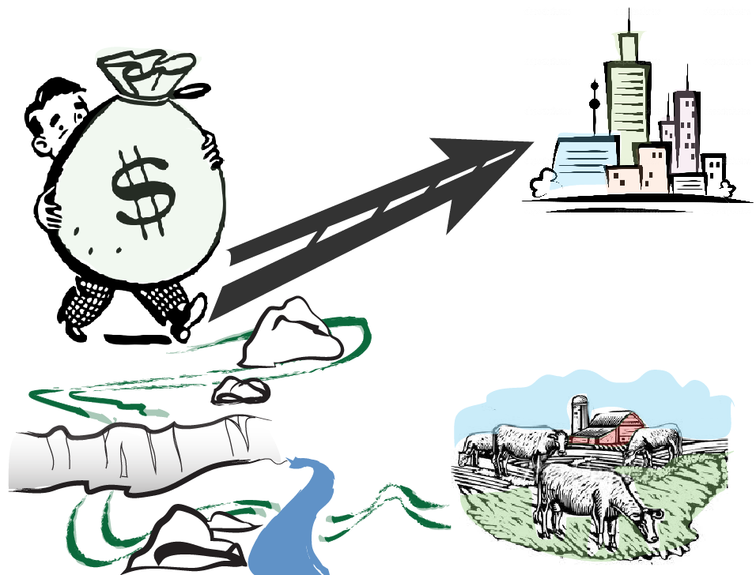
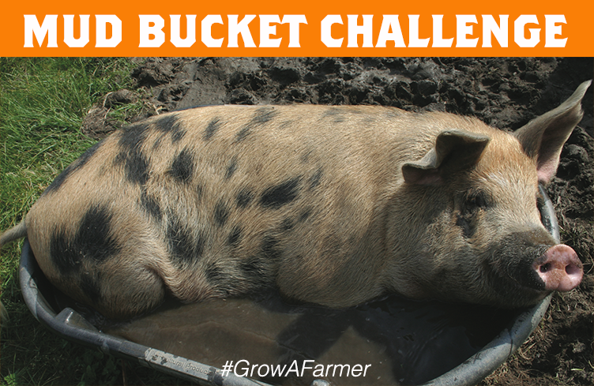


Reweaving the Economic Fabric to
Support Sustainable Farms and Ag-based Businesses
LNC14-360
JAN JOANNIDES
The Issue
Approach
Outcomes
Many farm and food businesses face barriers when it comes to accessing financial resources to grow or start a business.
Financing challenges include:
• Outside the mainstream
• Under collateralized
• Lack of affordable land
• Ducks not in a row
• Complicated processes
Half of this project was focused on helping farmers to better navigate the financial resources that were already available.
300 farmers and local food makers received training and/or assistance in navigating the confusing maze of financing options
Over 1,000 people learned about ways to invest in farm and food businesses closer to home
A Slow Money Minnesota Network was formed
The Grow a Farmer Revolving Loan Fund was created
$98,000 was raised through a Barnraiser.com, events, and house parties in which over 250 individuals, businesses and foundations contributed
The first loan of $15,000 was provided in 2017
In addition to loans through Grow a Farmer, over $500,000 in investments were made due to connections through this process.
We knew that in many cases there was
capital available, it just t wasn’t flowing to the right places.
AND that you had to be a pinball wizard to get access to the capital.
So we developed trainings that we presented at several farmer conferences and also met one-on-one with farmers.
At the Same Time
There is a growing interest among people in communities to invest closer to home and to align investments with their values, but they face barriers too.
The other half of this project was organizing and educating investors, which we did by launching a Slow Money Minnesota Network. Then we developed a mechanism that piloted linking investors to farmers. This mechanism was Grow a Farmer, a campaign to raise dollars for a loan fund (which we also named the Grow a Farmer fund).
Investment Challenges:
• Current paradigm
• Few investment options
or pathways
• Regulatory landscape
The campaign included events, house parties, and a barnraiser.com. It also included creative outreach including social media posts with photos of farmers who spoke to the benefit of this type of loan, posts from contributors, and a Mud Bucket Challenge.
To Address these Issues
This project developed financing mechanisms to infuse capital into sustainable farms and ag-related businesses. Concurrently, we developed pathways for individuals and businesses to invest in their local food and farming systems.
We were successful in raising $98,000 from 250 individuals, businesses and foundations. The loan fund was set up at the Southern Minnesota Initiative Foundation and the first loan was granted in 2017! We plan to replicate this in other parts of the state and continue to grow more connections between farmers, foodmakers and investors.
Our Project Advisory Team included: farmers, lenders, a food co-op manager, a community foundation representative, a financial planner, an attorney, an extension staff member, a university staff member, an accredited investor, and two nonprofit representatives.
renewingthecountryside.org • slowmoneyminnesota.org
The Advisory Committee for the project included: farmers, lenders, a food co-op manager, a community foundation representative, a financial planner, an attorney, an extension staff member, a university staff member, an investor, and two nonprofit representatives.
This project is supported by the National Institute of Food and Agriculture, U.S. Department of Agriculture, under award number 2014-38640-22156 through the North Central Region Sustainable Agriculture Research and Education program under subaward number H004403709. Any opinions, findings, conclusions, or recommendations expressed in this publication are those of the author(s) and do not necessarily reflect the view of the U.S. Department of Agriculture or SARE. USDA is an equal opportunity employer and service provider.

