Slide 1
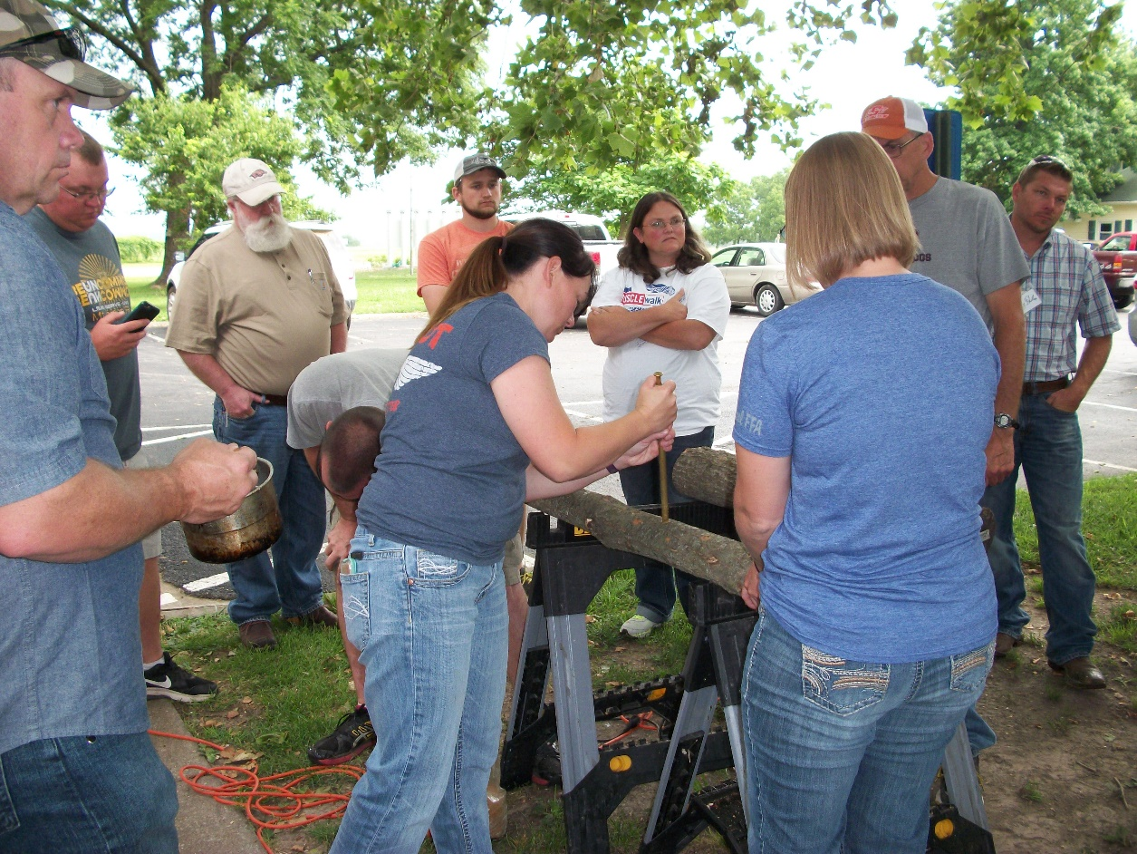
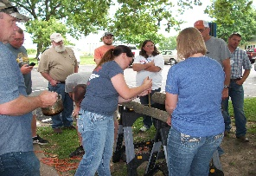
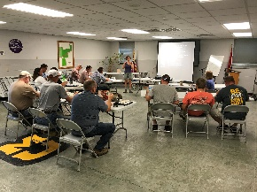
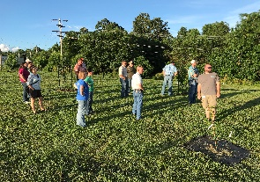
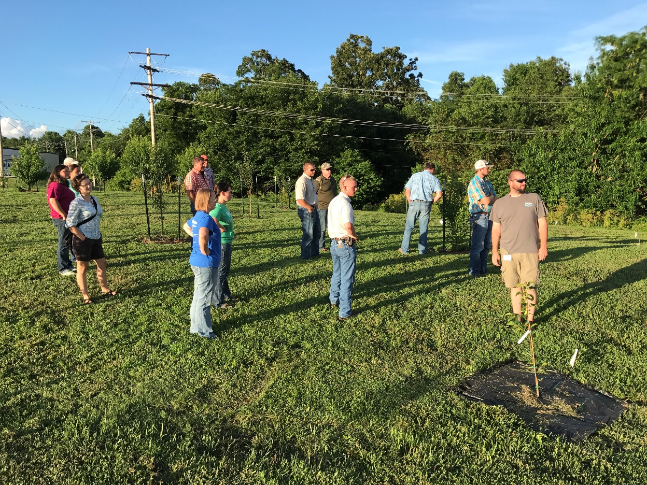
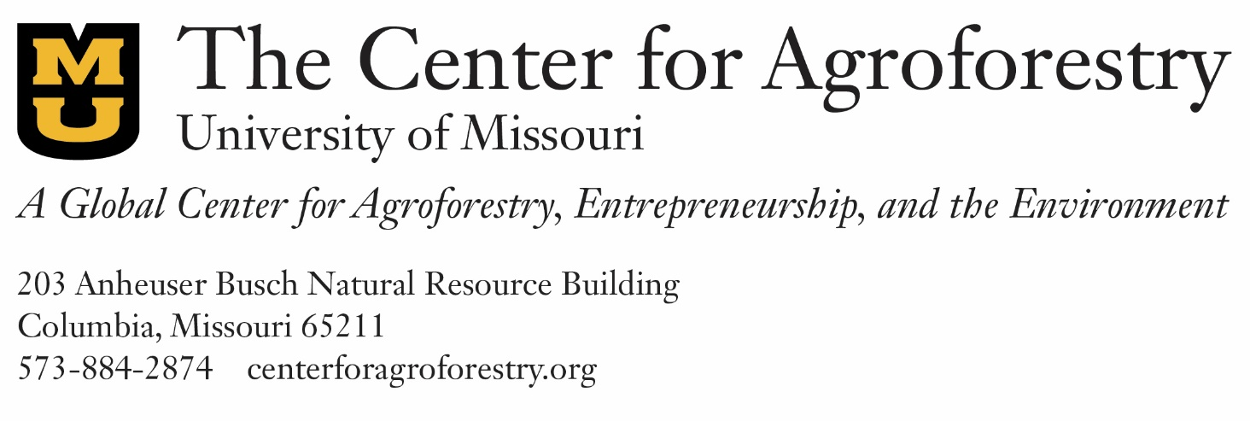
Agroforestry Education for High School Agriculture Science:
A Collective Case Study of Novel Content Implementation
Hemmelgarn, H.L.ª, Gold, M.A.^{b}, Ball, A.L.^{c}, Stelzer, H.E.^{d}
University of Missouri Center for Agroforestry ^{a,b}; University of Missouri Agricultural Education and Leadership ^{c}; University of Missouri Forestry Extension ^{d}
Introduction
Motivation to pursue new content
Existing material is outdated
Access to and awareness of resources
Limited funding available
Classroom applicability of curriculum
Hands-on project-based activities are desired
Professional development should provide direct class application
Limited time available
Regional networks (teachers and ag business professionals) and online sources are most accessible
Early career teachers lack content knowledge to teach all that is expected of them
Desire to teach to Career Development Events (CDE)
Need for student engagement
Conclusions
Agroforestry is a sustainable agriculture system that integrates conservation and environmental services with economically viable agricultural production, employing combinations of trees and/or shrubs with crops and/or livestock. Rooted in traditional indigenous cultivation systems, agroforestry practices include silvopasture, forest farming, alley cropping, windbreaks and riparian buffers. Today, the science of agroforestry is emerging as a critical element of agricultural resilience.
Given that roughly 70% of US farm operators do not complete a college degree⁸, and that more than 60% of Missouri high school agriculture students pursue careers in agriculture following high school⁵, UMCA is interested in reaching the generation of young farmers who will be empowered with an agroforestry skill set by introducing a curriculum that addresses the science and technology of agroforestry as a set of sustainable land use practices.
In 2016, Missouri’s FFA and Dept. of Education curriculum development groups began redesigning the Agriculture Science II curricula that will include, for the first time, an agroforestry unit.
High school agricultural educators are charged with delivering this curriculum, yet are largely unfamiliar with agroforestry practices. Additionally, due to the contextual nature of content adoption and teacher self-efficacy^{1,2,3,6,7}, effective implementation of an agroforestry curriculum calls for an understanding of the process of teacher sourcing, learning, and use of novel content.
Results
A Model of Missouri HS Agriculture Novel Content Implementation Processes
Experiential learning opportunities are a critical component of agricultural education at the high school level. Not only do these hands-on and project-based lesson components encourage student engagement, according to this sample of educators, they also allow for the agriculture teacher to learn alongside their students.
Based on this research, novel sustainable agriculture content is most likely to achieve classroom enactment when:
The content is made accessible to early career teachers;
The materials are presented in a fashion that reduces additional teacher modification efforts;
The curriculum is formatted with project-based and other experiential learning components;
Opportunities for teacher learning address both content and pedagogical aspects of the curriculum; and when
The content aligns with assessment standards (in the case of high school agriculture studies in the US: Career Development Event tests).
As agricultural educators become more familiar with agroforestry content, project coordinators at the University of Missouri Center for Agroforestry are encouraging these educators to join a mapped community of practice on the Savanna Institute’s online “Perennial Map” where farmers, producers, supporters, researchers, and educators may join an action-oriented conversation about making agroforestry and other sustainable agriculture content more accessible to all.
____________________________________________________________________________________________________________________________________________________________________________________________________________________________________________
Based on what was learned from Phase 1: Novel Content Implementation Inquiry (process model above), an agroforestry curriculum and professional development program was designed to address opportunities and barriers for novel content implementation.
In 2016 and 2017 UMCA offered one- and two-day Agroforestry Teacher Workshops that were free to first year educators, during which time, Phase 2: Professional Development Program Evaluation took place. The programs featured hands-on, classroom, and peer-to-peer learning opportunities. In 2016, 13 educators attended the Agroforestry Teacher Workshop hosted at the University of Missouri Horticulture and Agroforestry Research Center in New Franklin, MO. In 2017, 15 educators attended the workshop hosted at the University of Missouri Southwest Research Center in Mount Vernon, MO.
Maintain up-to-date materials that include relevant technologies
Reach early career teachers through existing networks
Include agroforestry content in Career Development Event assessments
Offer professional development at low cost and short duration during summer programs
Support ongoing pedagogical content knowledge development
Reach existing regional and online teacher networks (e.g. National Agricultural Educators Assoc.)
Develop project-based lesson components
Assist with resource acquisition for hands-on applications
Methods
References
This collective case study employed triangulation of multiple sources of data for strength of validity⁹ using an explanatory sequential mixed methods approach. Three phases of the research were conducted as teachers shared their experiences going through the process of novel content implementation.
Phase 1: Novel Content Implementation Inquiry
Semi-structured interviews with 3 purposively sampled agricultural educators in Missouri; document analysis of 20 conversation threads on an online Communities of Practice curriculum forum for agricultural educators; and 2 classroom observations⁴.
Objectives were to:
Explore how Missouri high school agricultural educators source, learn about, modify and enact novel curriculum materials; and to
Describe the process of novel content implementation among Missouri high school agricultural educators.
Phase 2: Professional Development Program Evaluation
Pre- and post-Agroforestry Teacher Workshop surveys during the one-day professional development program (PDP) event.
Objectives were to:
Describe the demographic make-up of agricultural educators participating in a short-duration novel content PDP;
Describe the change in content understanding and planned content use from attendance of the PDP; and to
Identify elements of the PDP, the individual teachers, and their teacher learning context that may influence the teacher’s sense of their ability to implement the novel content.
Phase 3: Content Enactment and Teacher Efficacy
Online Qualtrics survey administered to the group of educators who attended the 2016 Agroforestry Teacher Workshop followed by semi-structured interviews with 5 teachers who consented to continue participating in the research.
Objectives were to:
Describe the variation in Teacher self-efficacy and content enactment in the first school year following the teacher’s attendance of the PDP;
Identify specific sources of teacher self-efficacy that may have influenced the teacher’s ability to implement the novel content.
1. Ball, D.L., & Cohen, D.K. (1996). Reform by the book: What Is, or might be, the role of curriculum materials in teacher learning and instructional reform? American Educational Research Association, 25(9), 6-8+14
2. Borko, H. (2004). Professional development and teacher learning: Mapping the terrain. Educational Researcher, 33(8), 3-15.
3. Covay Minor, E., Desimone, L.M., Caines Lee, J., & Hochberg, E. (2016). Insights on how to shape teacher learning policy: The role of teacher content knowledge in explaining differential effects on professional development. Educational Policy Analysis Archives, 24(6), 1-29.
4. Creswell, J.W. (2014). Research Design: Qualitative, Quantitative, and Mixed Methods Approaches (4th ed.). Thousand Oaks, California: Sage Publications Inc.
5. Department of Elementary and Secondary Education (DESE). (2017). “Agricultural Education in Missouri”. Retrieved from www.dese.mo.gov.
6. Shulman, L.S. (1987). Knowledge and teaching: Foundations of the new reform. Harvard Educational Review, 57(1), 1-22.
7. Tschannen-Moran, M., & Hoy, A. W. (2001). Teacher efficacy: Capturing an elusive construct. Teaching and Teacher Education, 17(7), 783-805.
8. US Department of Agriculture Economic Research Service. (2012). Share of principal farm operators with college degrees has increased. Retrieved from http://www.ers.usda.gov/data-products/chart-gallery/detail.aspx?chartId=32868.
9. Yin, R.K. (2014). Case Study Research: Design and Methods. Sage Publications: Thousand Oaks, CA.
Hands-on learning
Teachers practiced inoculating shiitake mushroom logs at the 2017 workshop, an activity that can easily be replicated for classroom, SAEP, or CDE contest applications.
Classroom instruction
Teachers are provided with complete lesson plans and given opportunities to teach their peers in order to build classroom efficacy with the material.
Peer-to-peer learning
During the 2017 teacher workshop, fellow agricultural educators led the group on a tour of their high school food forest in Mount Vernon, MO.
“Project based learning does help when you don’t know as much about it because as the kids are exploring, you are learning.”
More than 60% of the participating teachers were in their first five years of teaching, confirming the stressed need to fill content knowledge gaps in early career agriculture teaching.
High school agricultural educators who attended an Agroforestry Teacher Workshop expected to teach a total of 490 hours of agroforestry content in their classes. Based on enactment survey data, the majority of educators taught at least 90% of their originally estimated time.
Teachers reported (below) that regional educator networks and competitive Career Development Event assessments were some of the most influential drivers of their pedagogical content knowledge and classroom enactment.
Acknowledgements
“She called some ag teachers, and we just got together and showed up one day and had a kind of intervention. All ag teachers have that network if they ask for it. Now it’s 15 years down the road and she’s still teaching.”
“All the ag teachers are really interested in the curriculum, but you know nothing motivates a teacher more than a contest”...You want it taught, put it in a contest, it’ll get taught.”
This work was funded through the Center for Agroforestry at the University of Missouri under Cooperative Agreements 58-6227-9-059 with the USDA-ARS and USDA-NCR-SARE. Any opinions, findings, conclusions or recommendations expressed in this publication are those of the author(s) and do not necessarily reflect the view of the USDA.

