Slide 1
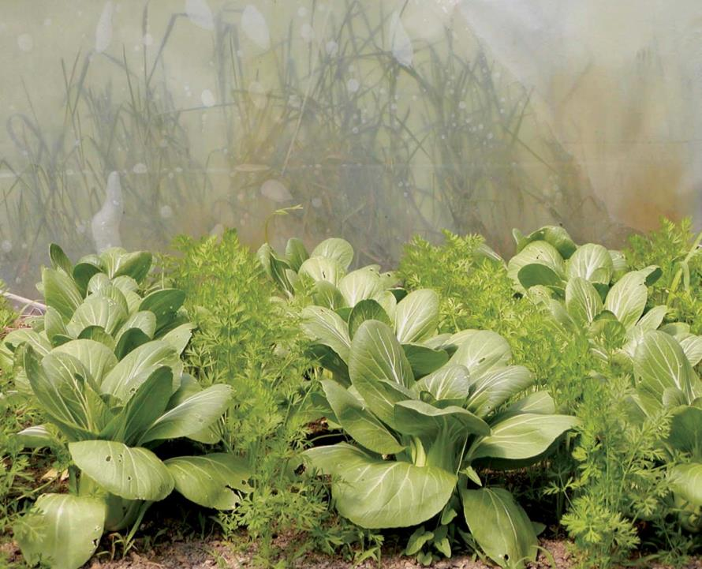

Introduction
NCR-SARE offices:
University of Minnesota
University of Missouri
Lincoln University in Missouri
Find this PowerPoint presentation at:
https://northcentral.sare.org/grants/apply-for-a-grant/farmer-rancher-grant/
photo credit: Abram Kaplan
Notes:
Welcome to this PowerPoint presentation about how to apply for an NCR-SARE Farmer Rancher grant.
The Farmer Rancher grant program is a competitive grant program to fund on-farm research and education projects in the North Central region. The grants are intended to help you solve a problem on the farm or ranch using innovative sustainable agriculture practices and to help you share your project results with others.
My name is Joan Benjamin and I coordinate the NCR-SARE Farmer Rancher Grant program. I will tell you briefly about the SARE program, I’ll go over a few grant-writing basics, then will give you specifics about the Farmer Rancher grant and the online application process. This PowerPoint is available on the NCR-SARE website at: https://northcentral.sare.org/grants/apply-for-a-grant/farmer-rancher-grant/

Slide 2
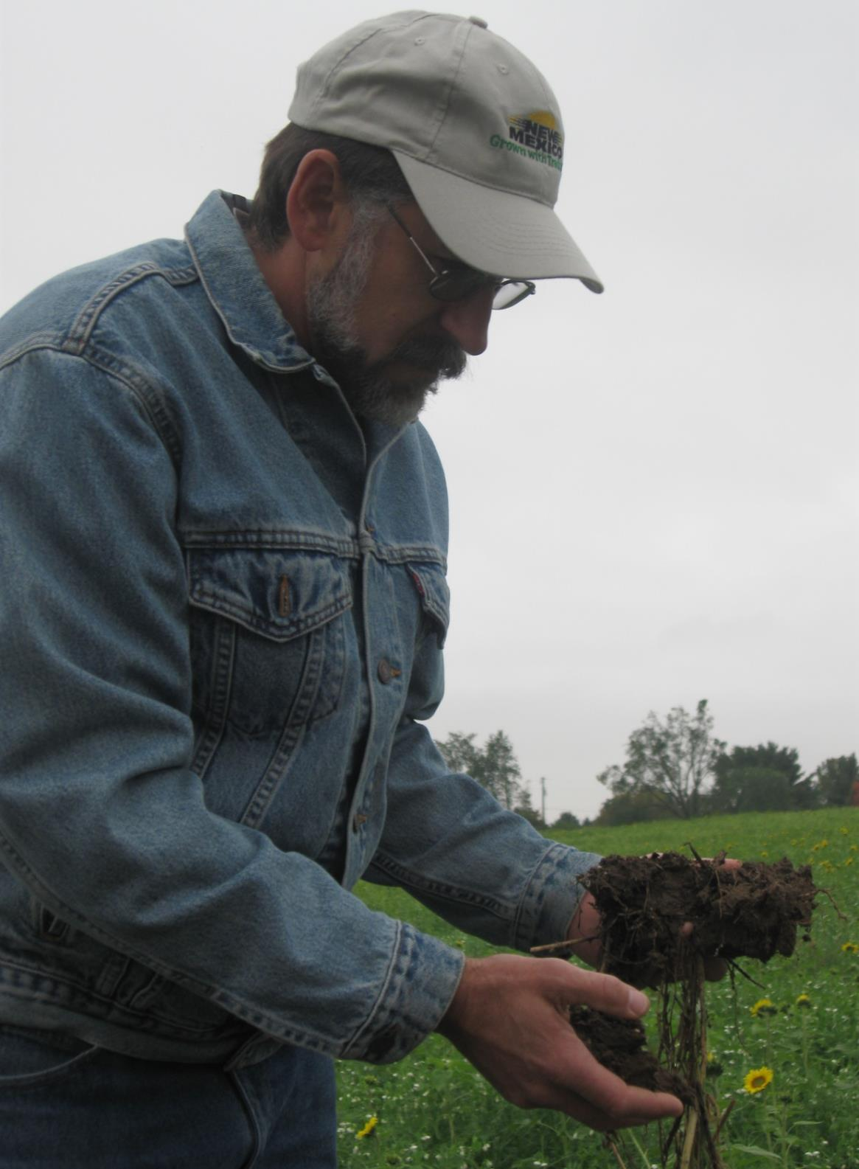
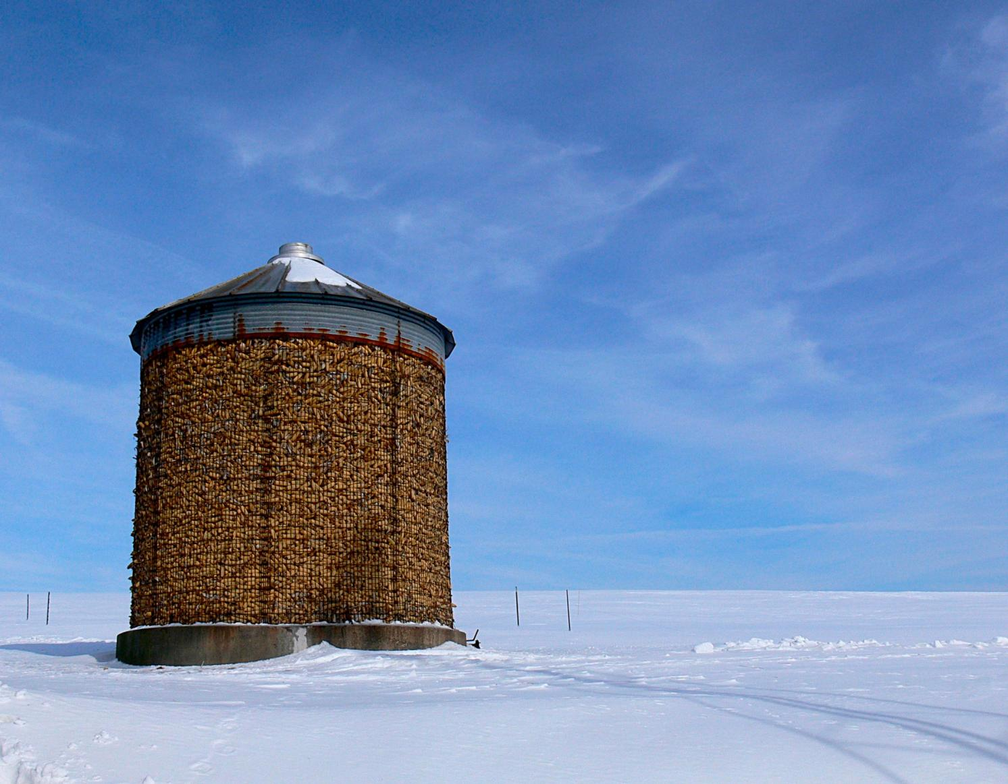

What is SARE?
Grants and outreach to advance sustainable innovations to
the whole of American agriculture.
Photo by Sean McGovern
photo credit: Abram Kaplan
Notes:
SARE is part of USDA and is funded through the National Institute of Food and Agriculture or NIFA program.
SARE’s purpose is to provide grants and outreach to advance sustainable innovations to the whole of American agriculture.

Slide 3
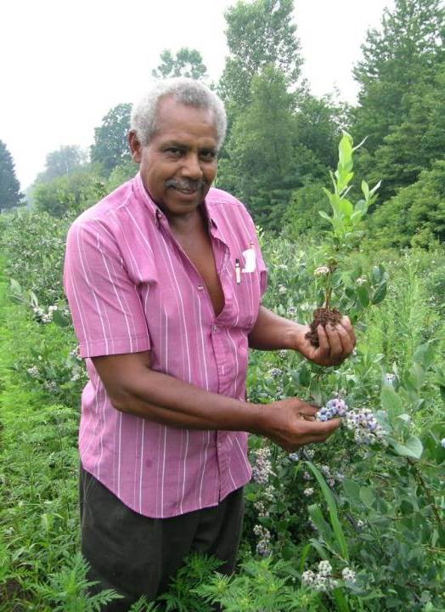

Something New and Different
SARE was started in 1988, conceived as a
decentralized, science-based, grassroots, practical,
problem-solving,
and inclusive
competitive grant-making and outreach program.
photo credit: Joan Benjamin
Notes:
The program is run by four regions—North Central, Northeast, South, and West, each guided by a volunteer Administrative Council that makes grants and sets regional priorities.
SARE is a decentralized, grassroots grant program in that each of the four regions makes its own funding decisions, including what type of grant programs to offer in their respective region.
NCR-SARE’s proposal review teams and the governing Administrative Council include regional farmers and ranchers, educators, researchers and personnel from state and federal agencies.
The Farmer Rancher Grant Review committee is made up mostly of farmers and ranchers representing all 12 states in the North Central Region. When you write a Farmer Rancher Grant, this is the audience you are addressing: farmers and ranchers from the North Central Region. They are interested in practical proposals and accurate budgets.

Slide 4
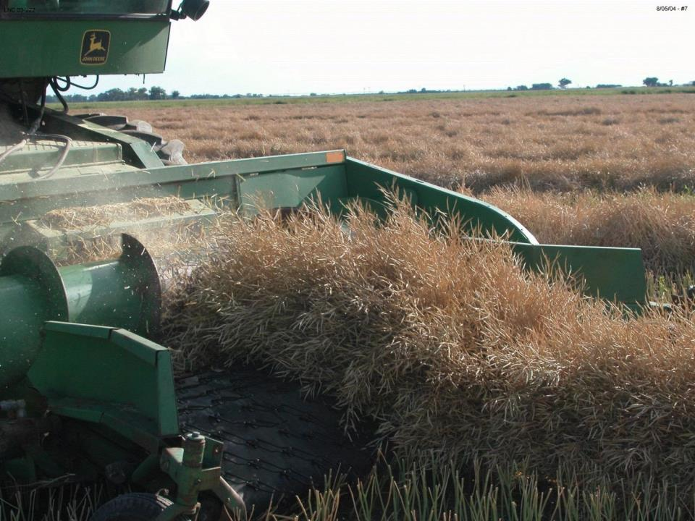
The SARE Model
The SARE Model
Four regional councils set priorities and make grants
SARE Outreach produces practical information
USDA-NIFA supports SARE
Other USDA agencies and land-grant universities are partners
photo credit: David Baltensperger
Notes:
The North Central Region of SARE consists of 12 states: Illinois, Indiana, Iowa, Kansas, Michigan, Minnesota, Missouri, Nebraska, North Dakota, Ohio, South Dakota, and Wisconsin.
SARE Outreach is the national outreach group for SARE. They work with SARE's regions to share grantee research results with farmers, ranchers, educators, consumers and others interested in sustainable agriculture. SARE publications cover a wide variety of sustainable agriculture topics in many formats, from books on cover crops and building soil health to bulletins on managing rangeland and water resources to online resources like YouTube videos and Topic Rooms that cover subjects such as high tunnels and small ruminants.
SARE Outreach materials and information on all funded SARE grant projects can be found on the SARE website: www.sare.org
Most resources are free to download and print bulletins can also be ordered for free.
Look at the Project Reports tab on the NCR-SARE website to see reports from funded projects at: https://northcentral.sare.org/project-reports/
When you first start thinking about your grant idea, check the SARE project reports and other resources to see how you can build on previous work instead of repeating it. This will make your grant proposal more competitive.

Slide 5
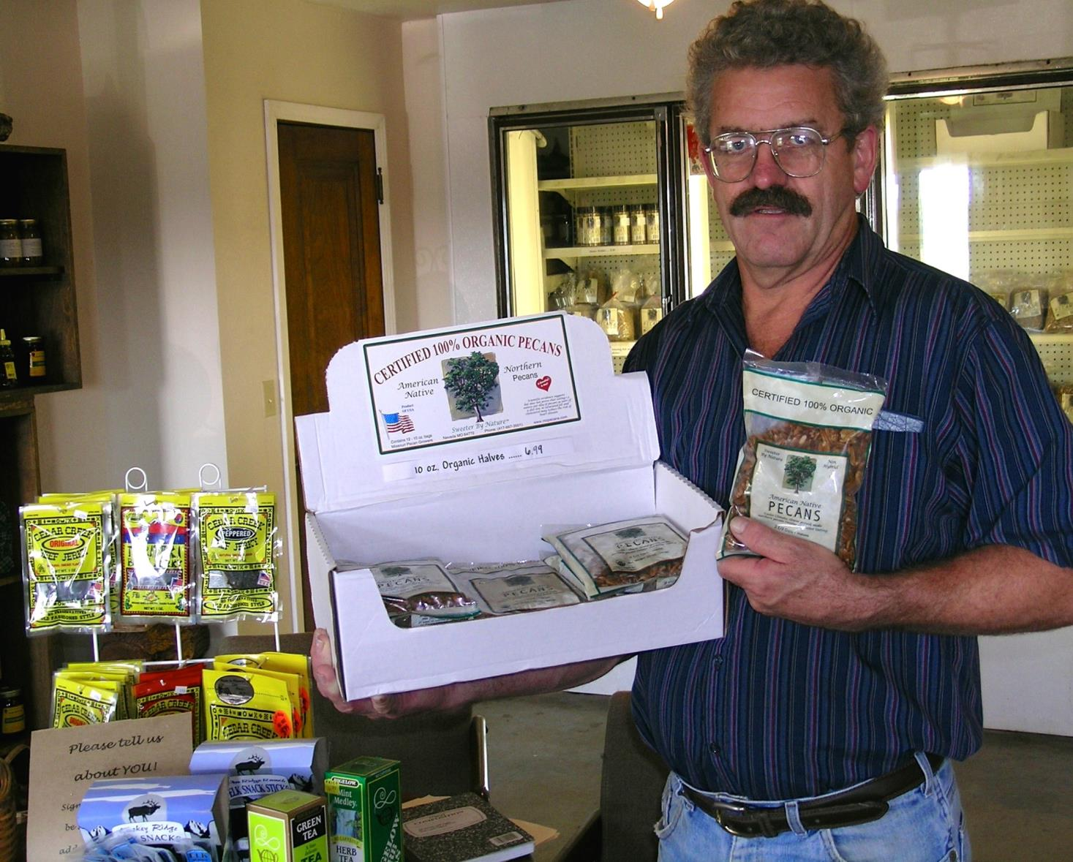
The Three Principles
The SARE Model
  Successful SARE grantees are engaged in projects that are guided by the 3 principals of
  _{sustainability…}
Stewardship of our nation’s land and water
Profit over the long term
Quality of Life for farmers, ranchers, and their communities
photo credit: Ken Schneider
Notes:
Successful SARE grant projects simultaneously address the three principles of sustainability.
Simply put, Sustainable Agriculture is:
Ecologically sound
Economically viable
Socially responsible
Or to put it another way, it involves:
Sustaining and improving the environmental quality and natural resource base on which agriculture depends
Improving the profitability of farmers/ranchers and associated agricultural businesses
Enhancing the quality of life for farmers/ranchers, communities, and society as a whole
In your proposal, you should explain how your project addresses each of the three principles of sustainable agriculture, even if it emphasizes one principle over the others.

Slide 6
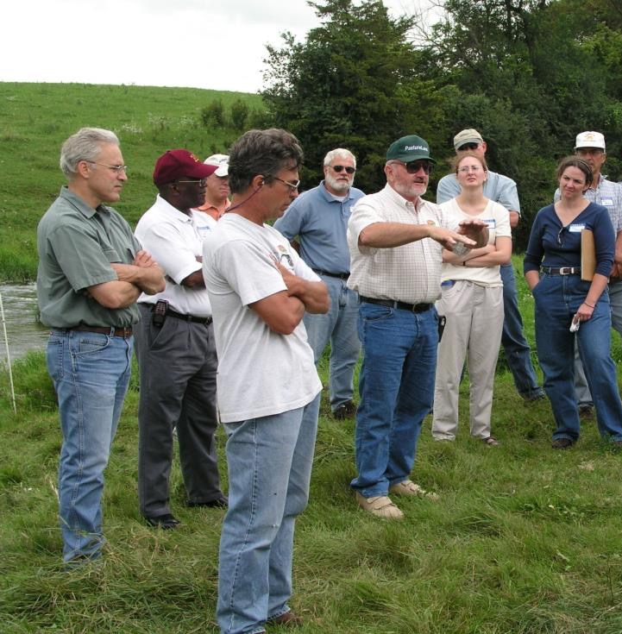
Stakeholder Involvement
Stakeholder Involvement
Problem identified by farmer/rancher and researcher
Farmers/ranchers involved in research
and outreach
Photo by Beth Nelson
Notes:
As in all successful SARE projects, farmers and ranchers are considered major stakeholders in the project’s research/demonstration and outreach process.
Applicants for the Farmer Rancher Grant Program must identify specific problems and potential solutions to those problems.
This grant program is for sustainable agriculture research, demonstration, and education projects; NOT for start up costs or everyday farming expenses except those directly related to the project.
Projects that involve whole farm systems research and education are encouraged.
Livestock projects need to comply with reasonable animal care requirements to insure that animals are properly cared for.
Projects that include a youth component are also welcome and encouraged.

Slide 7
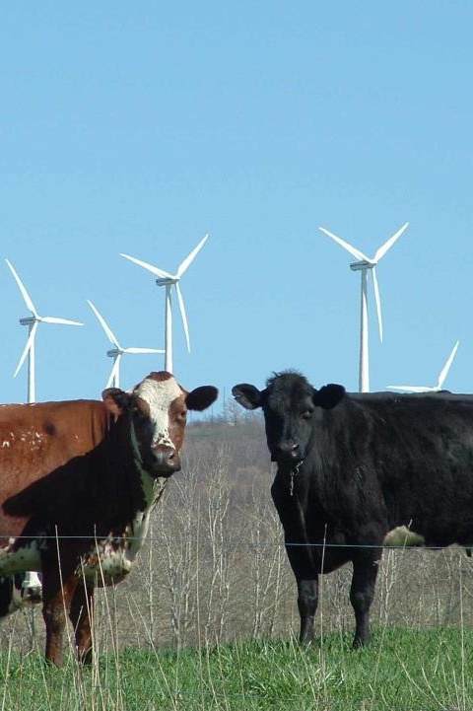
The SARE Portfolio
The SARE Portfolio
Sustainable pest/weed management
Clean energy
Marketing
Stewardship of land and water
Systems research
Community development
Crop diversification
Soil quality
Nutrient management
Rotational grazing
…and much more
Photo by Troy Bishopp
Notes:
Since 1992, NCR-SARE has awarded over $10.5 million to fund farmer and rancher research and education through the Farmer Rancher Grant Program
Past Farmer Rancher award recipients have been given grants to studying topics such as:
alternative grain crops as animal feed
alternative uses for CRP land
biological weed & pest control
energy alternatives & conservation
farmland access
food sovereignty
health and safety of employees
holistic management
labor issues
livestock & crop production systems
marketing
organic farming
quality of life issues
rotational grazing
soil conservation
waste management
water quality
water conservation

Slide 8
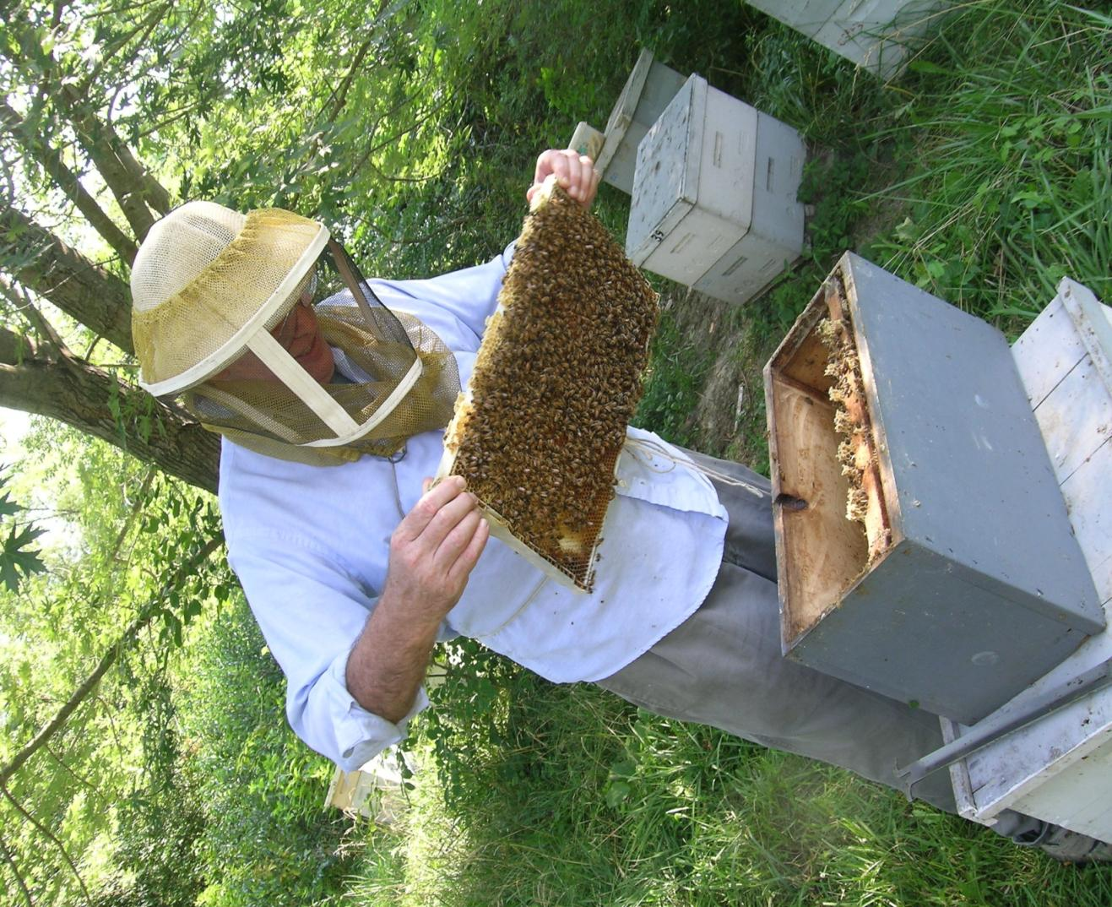
Farmer Rancher
Grant Program
Grants directly fund farmers and ranchers to explore new production methods or marketing approaches for their farms or ranches
Up to $15,000 for an Individual farmer or rancher and up to $30,000 for Teams (two or more farmers or ranchers)
Encouraged to link with university or non-profit partners
40 projects funded per year
Coordinated by Joan Benjamin
photo credit: Joan Benjamin
Notes:
Any farmer/rancher or group of farmers/ranchers who farm or operate a ranch in the North Central Region may apply. For this program, a farmer or rancher is defined as someone who raises crops or livestock, especially as a business.
Applicants may be just beginning the transition to a more sustainable operation, or may already be using some sustainable practices and want to implement additional changes. The grants help reduce the risk of trying out new ideas. These grants do not require matching funds.
Farmers/Ranchers are invited to submit proposals that test, evaluate, and adapt sustainable agriculture practices for their operations; to conduct learning circles, educational events, field days or demonstrations to further disseminate information to other farmers/ranchers; develop new technologies; or create or modify equipment. If you’ve never applied for a grant before, this is a good one to start with.
I am the Farmer Rancher Grant Coordinator for the North Central region and I’m located at Lincoln University in Jefferson City, Missouri. Most of our staff is located at the University of Minnesota in St. Paul.
Feel free to contact me with specific questions regarding the Farmer Rancher Grant.

Slide 9
Grant Writing Basics: top ten tips
Determine if this is the right grant for you. Make sure your idea fits program priorities.
Read the Call for Proposals carefully. Highlight important points & deadlines.
Plan ahead on how to accomplish your project. Think about the details before you fill out the proposal.
Keep the writing simple and explain terms. A grant proposal is not a mystery novel - get to the point quickly, concisely, logically.
Notes:
Make sure your idea fits the grant priorities or it won’t get funded. Call the grant coordinator for additional details and advice.
Understand review process and the criteria for evaluating your proposal so you know where to put the most effort.
Follow the guidelines in the Call for Proposals. Calls change each year. Be sure you're using the most current call.
Develop clear goals. Whether you are trying to solve an insect pest problem, conduct a marketing project or do something no one’s even thought of yet, simple and clear goals let the reviewers know WHAT your goal is. Then—as they read your application—they can see HOW you are going to reach your goal.
Proposals with clear objectives and methods are the most successful. Focus on what you can actually accomplish during the project time period. Do not promise more than you can deliver.
Plan ahead on how to accomplish your project. Think about the details before you fill out the proposal. If you are doing a research project and choose to use an experimental design, make sure the design is capable of yielding conclusive results. If you need help on a research design, include a cooperator with experience in on-farm research. Also see the SARE bulletin: How to Conduct Research on Your Farm or Ranch. If you are planning an education project, you may want to involve other educators to help you develop surveys or other methods to evaluate the success of your education efforts.
Keep the writing simple Write your proposal logically - make it easy for reviewers. Avoid acronyms.

Slide 10
Grant Writing Basics: top ten tips
Measure your results. Be sure that what you are measuring will give you the information you need to tell if you have accomplished your objectives.
Timing is everything. Let reviewers know WHEN you will be doing the things you plan to do.
Involve other groups and people who can complement your skills. Pick cooperators carefully, and make sure each one has the skills you need, whether that’s research, marketing, outreach or another skill.
Notes:
Measure your results. Whether it is crop yield, reduced erosion, milk protein content, bigger tomatoes, increased market share for a cooperative, or community involvement, make sure that what you are measuring will give you the information you need to tell if you have accomplished your objectives. If you take samples—for example, plants or insects—make sure that your samples are representative of the whole field or plot.
Timing is everything. A detailed timetable lets reviewers know that you have given this work some thought and that you have a clear idea of the time it will take.
Choose cooperators to complement your skills. When you enlist the cooperation of people who have expertise in areas that you don’t—research, marketing, education, outreach, whatever—they’ll help you make your project better and increase your chances of receiving funding. Pick your cooperators carefully, and make sure each one has the skills you need.
The strongest proposals demonstrate that the project will be planned and carried out by a variety of individuals or organizations. Successful grant projects have involved Extension educators; Natural Resource Conservation Service (NRCS) staff including Resource, Conservation & Development (RC&D) Council staff; nonprofit group participants; other farmers or ranchers; youth, and/or other members of the community.

Slide 11
Grant Writing Basics: top ten tips
Develop a clear outreach plan to share what you learn from your project.
Develop a realistic budget. Include a strong justification for each budget item.
Follow directions. Proposals can be disqualified if the applicant does not answer all questions or follow general format directions regarding word counts, etc.
Notes:
Develop a clear outreach plan. Outreach activities can include field days, workshops, publications, social media or any method to get the results of your project to people who can use those results to practice sustainable agriculture.
Develop a realistic budget. Itemize your expenses and include a budget justification. This should show how you arrived at the figures in your budget. Make phone calls or search the web to find accurate cost estimates.
Whether you are funded or not:
You will receive reviewer comments. They can provide you with valuable advice for future grant applications. Not all good proposals are funded – there isn’t enough funding.

Slide 12
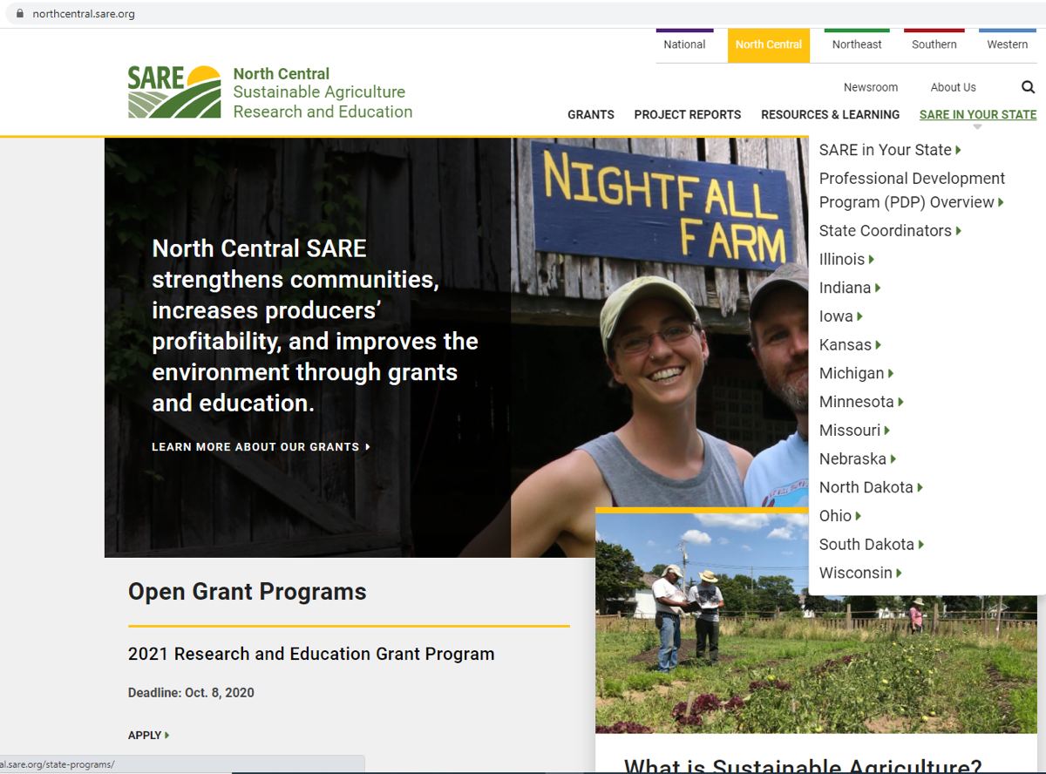
Grant Writing Help: Each NCR-SARE State has one or more State SARE Coordinators. Find your state coordinator here.
Notes:
Go to the NCR-SARE Home page at: https://northcentral.sare.org/
Click on: SARE IN YOUR STATE

Slide 13

More Grant Writing Help:
Grants Advising for Farmers and Agricultural Entrepreneurs in the Midwest
MFAI’s Grant Advisory & Resources program can help you apply to grants and cost-share programs of state or federal sources that could help you achieve your farming or ag-related business goals.
Michael Fields Grants Advising is a free service available to farmers, farmer organizations and institutions in the Upper Midwest region of the United States: Illinois, Indiana, Iowa, Kansas, Michigan, Minnesota, Missouri, Nebraska, North Dakota, Ohio, South Dakota, Wisconsin.
Contact MFAI Grants Advisor: Martin Bailkey at 608-698-9478 or martinbailkey@gmail.com.
For more information see:
http://www.michaelfields.org/grant-advising-resources/.
Notes:
About Michael Fields Agricultural Institute from the Michael Fields website:
Our board and staff are deeply committed to sustainable agriculture, but it is through our many collaborations that we have the most reach. We also focus on fostering the next generation of sustainable agriculture proponents, and our interns and alumni have gone on to work in sustainable agriculture in diverse ways.
We are based in East Troy, Wisconsin, but our work affects the state, the country, and beyond. Our goal is to reach out to all types of farmers whether they consider themselves conventional, organic, or biodynamic.

Slide 14
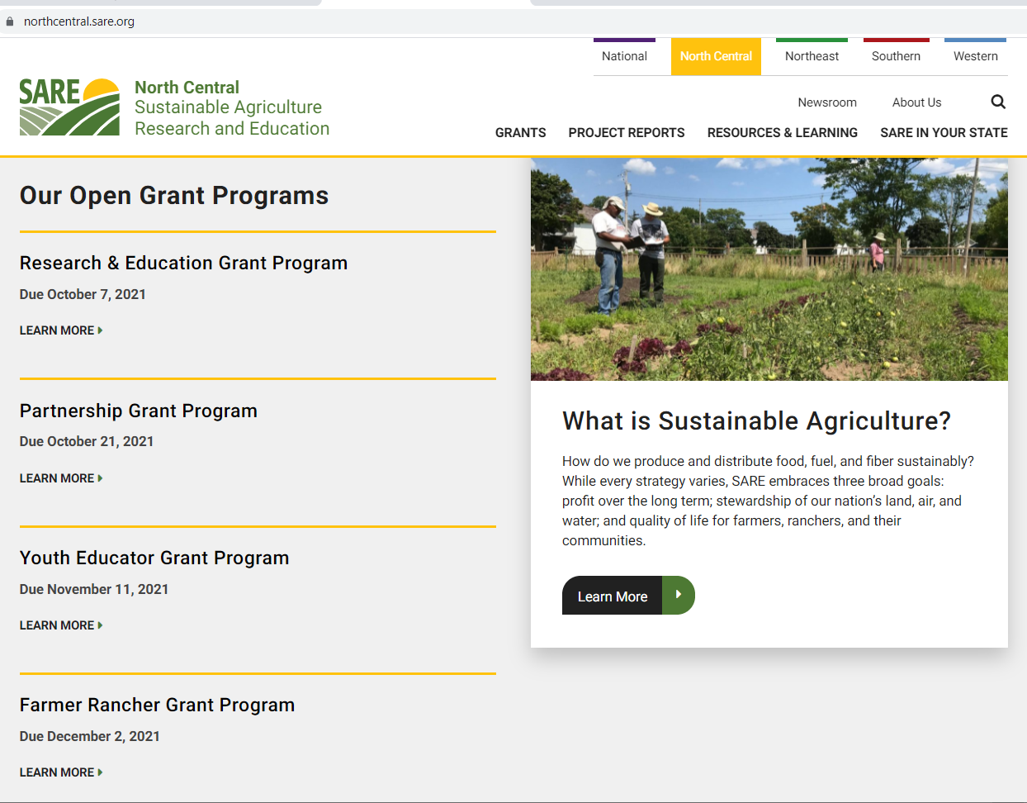
Notes:
NCR-SARE uses an online submission system to take applications. Open calls for the various grant programs can be found on our homepage at: https://northcentral.sare.org/.
For details, scroll down to the Farmer Rancher Grant Program and click on “LEARN MORE”

Slide 15
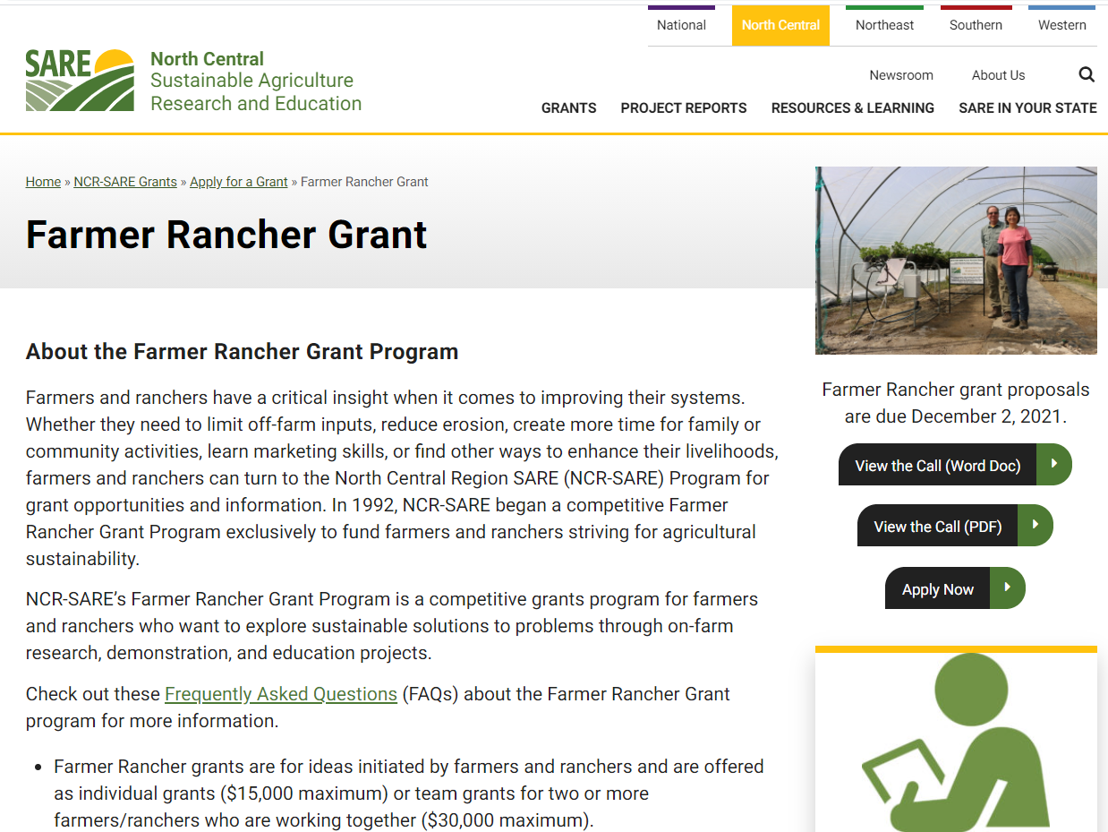
Notes:
Look over the information about Farmer Rancher Grants, then download and read a copy of the current call for Farmer Rancher grant proposals. It is available as a Word document or as a PDF file. You can use the Word document to prepare a draft of your application.
Make sure you have the current call, as there are typically a number of changes from the previous call. If you have any problems downloading the proposal, contact the NCR-SARE office and we can email you a copy, or send you a hard copy.
The Online Submission Deadline is 4:00 p.m. CST, Thursday, December 2, 2021. If you are unable to use the online system, you may submit a proposal by mail or e-mail. Mail and e-mail submissions must be received by 4:00 p.m. CST on Thursday, December 2, 2021 at the NCR-SARE main office in Saint Paul, Minnesota.
Proposals sent by Fax will NOT be accepted. They are too hard to read.
You will also see a link to Apply Now, which you can click on after reading the Call for Proposals.

Slide 16
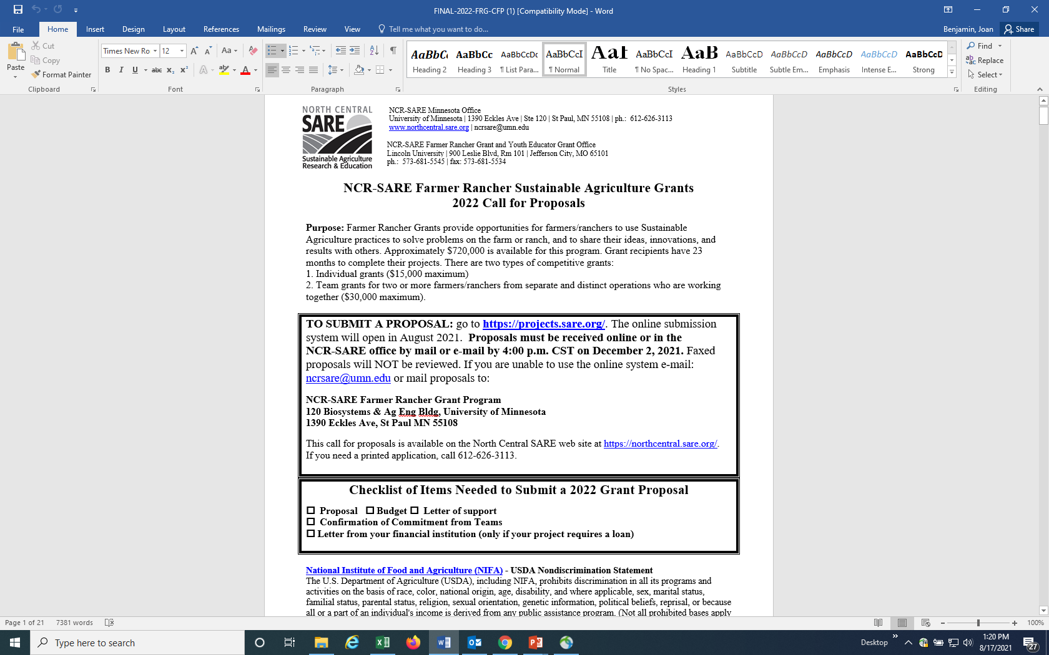
Notes:
Whenever you apply for a grant, be sure to read the Call for Proposals first. It contains directions and the application and can help you determine if the grant is a good match for you.
At the top of the Farmer Rancher Grant Call for Proposals, you will see the link where you can submit a proposal. Or you can click on Apply Now on the NCR-SARE website.

Slide 17
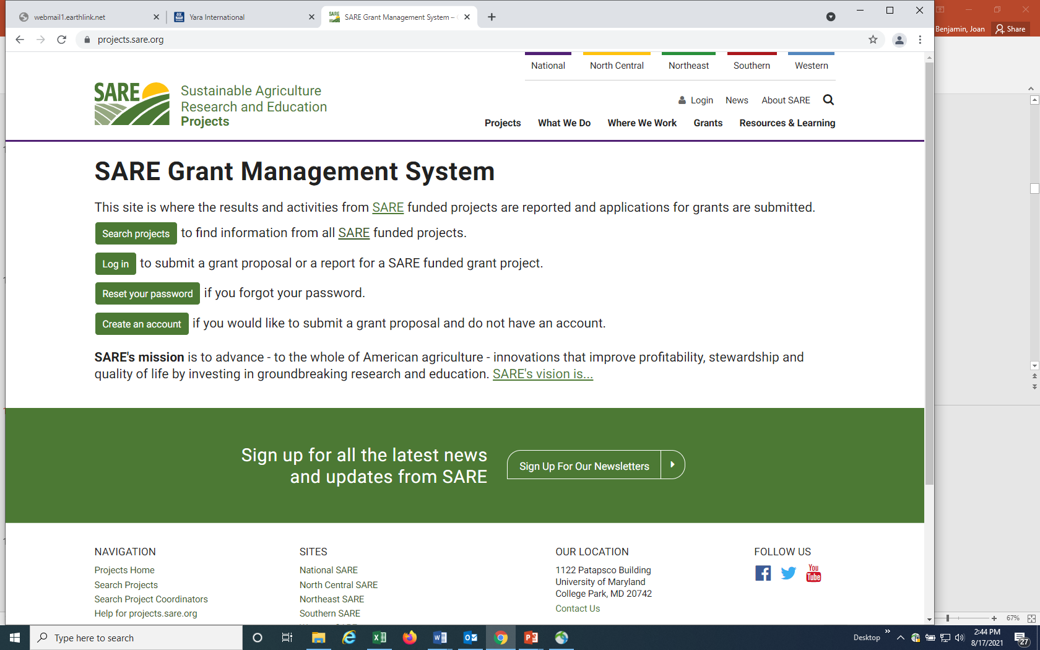
https://projects.sare.org/
Notes:
When you click on “Apply Now,” or go directly to the site by using the link in the Call for proposals (https://projects.sare.org/), you will see this page.
I’ll now guide you through using the online application system.
If you’ve never had a SARE grant before, you will first need to create an account and complete your user profile. Click on “Create an account.”
If you’ve had a SARE grant previously and filed reports in this system, your profile will already be in the system and you can “Log in” with the information you used for reporting.

Slide 18
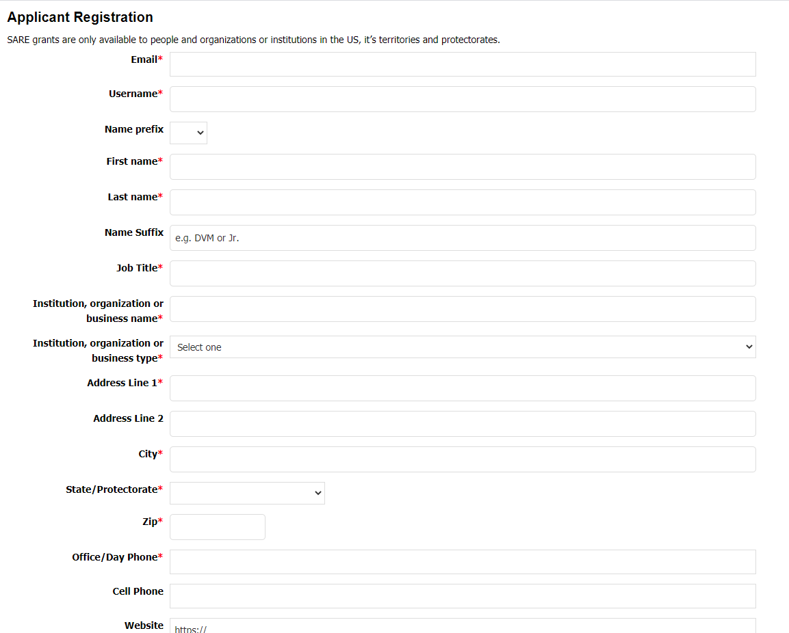
Notes:
To “Create an account,” Complete the requested information, then click on “Register” in the lower left hand side of the webpage. Information regarding this application will be sent to the email address you provide here.
We also request demographic information. The North Central Region SARE program is committed to an ethic of openness, inclusiveness, and diversity in all of its programs, policies, and procedures.
To monitor our performance in these areas, we collect demographic information. We appreciate your help with this.
Demographic information is not linked to your proposal. You must answer the demographic questions, but you may choose “prefer to not answer” for each question. If you have questions, please contact Joan Benjamin.

Slide 19
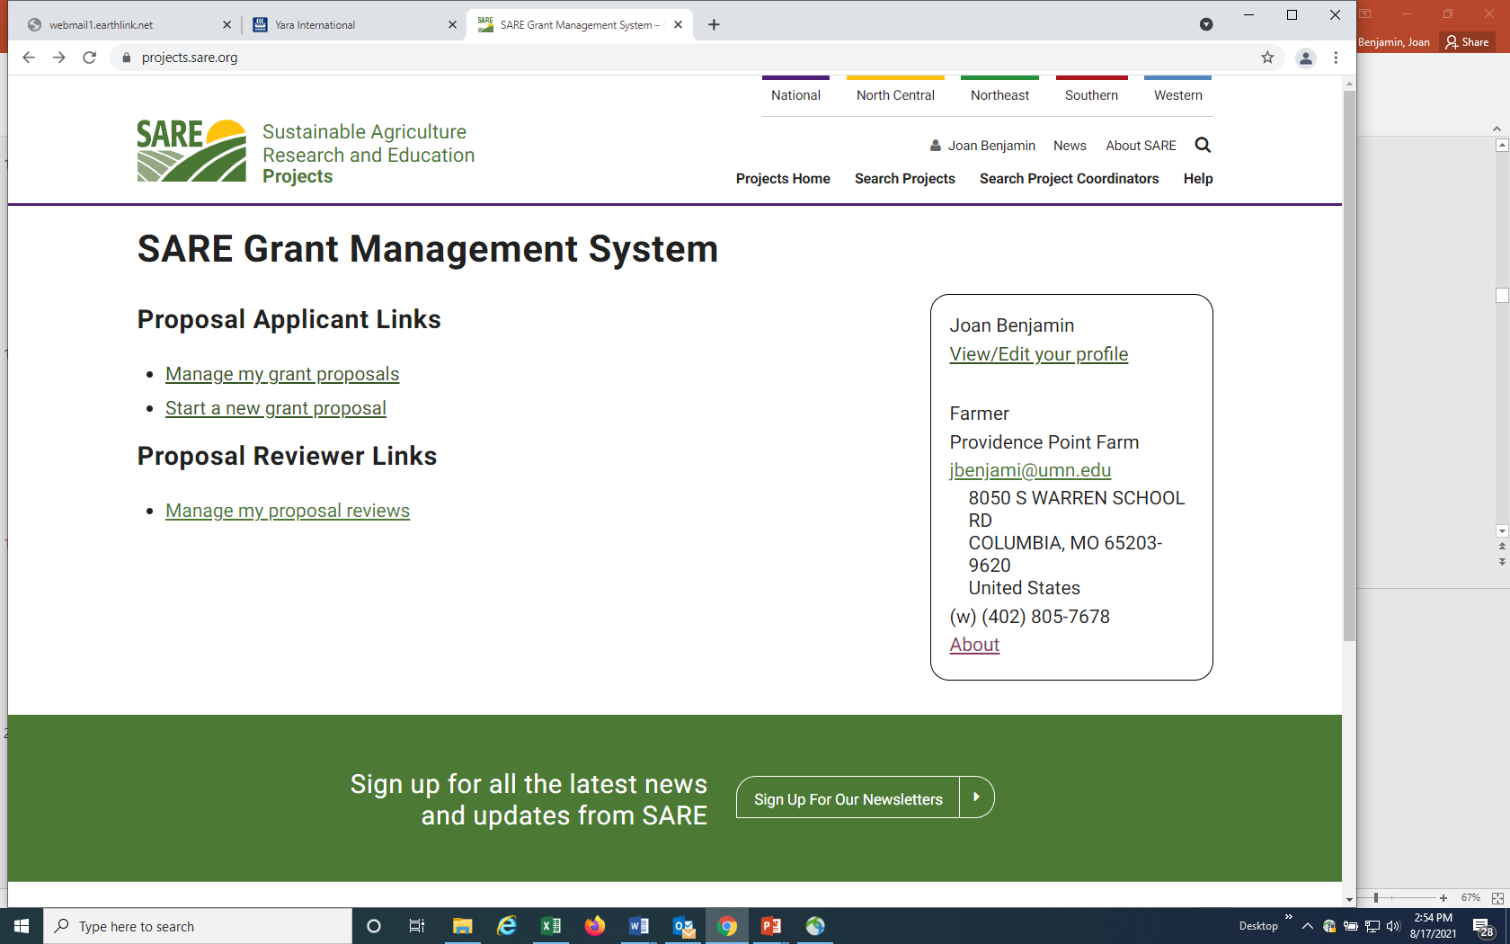
Notes:
Once you have completed the information and logged into the system, you’ll see this screen.
Click on “Start a new grant proposal.”
If you’ve submitted projects before, or had a project funded before, you’ll see them listed on this page.

Slide 20
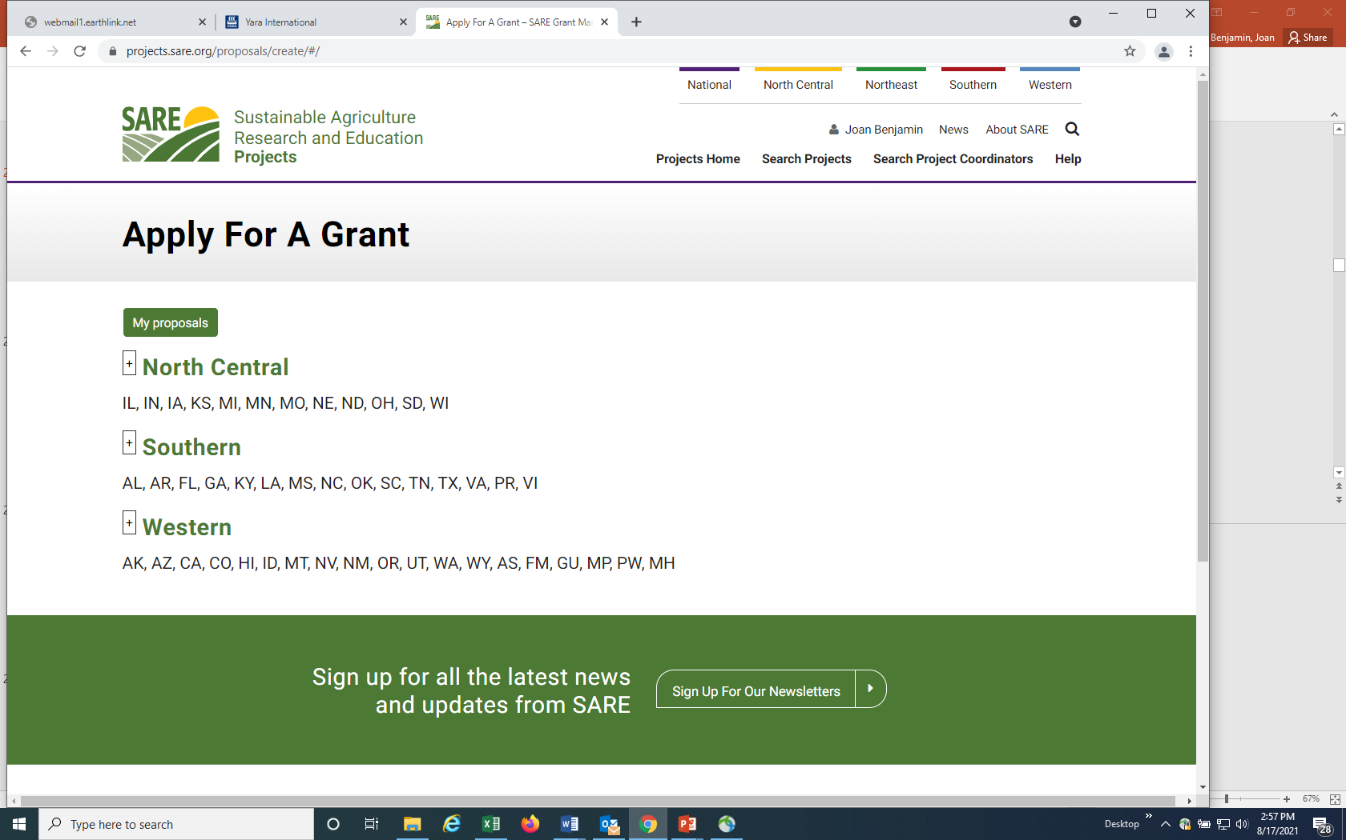
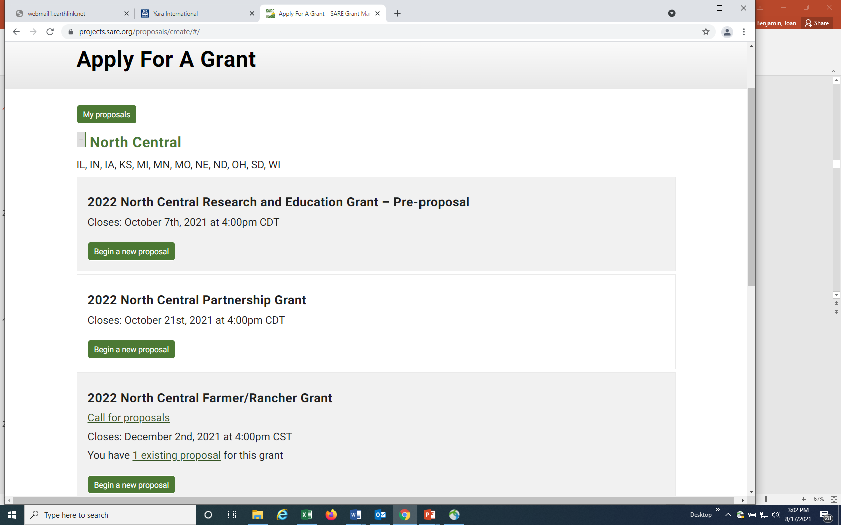
Make sure you choose the North Central Region and the correct grant program. Then click on Begin a new proposal.
Notes:
You will see a list of all open grant applications, for all four SARE regions.
Make sure you choose the North Central Region and the correct grant program. You will be completing the North Central Farmer/Rancher Grant application.
Click on “Begin a new proposal.”

Slide 21
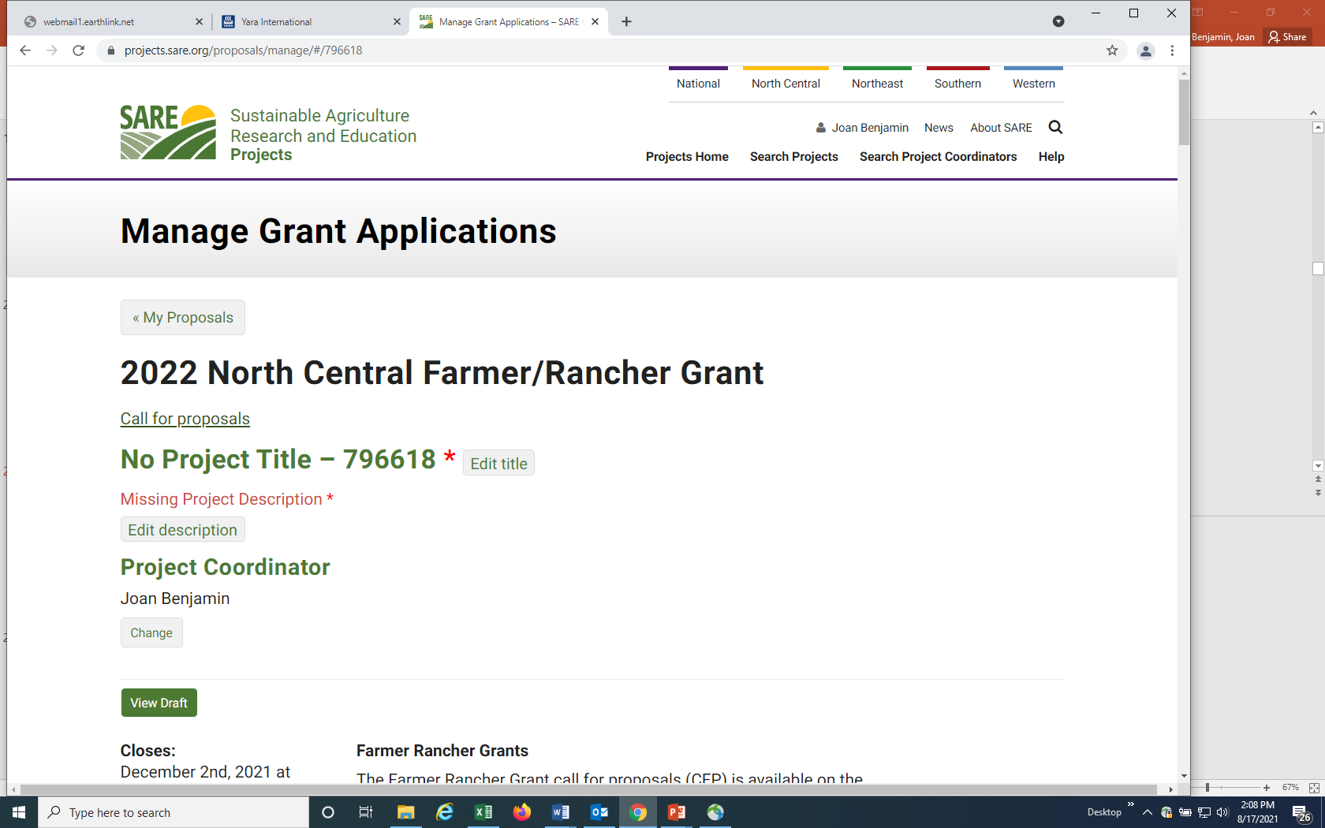
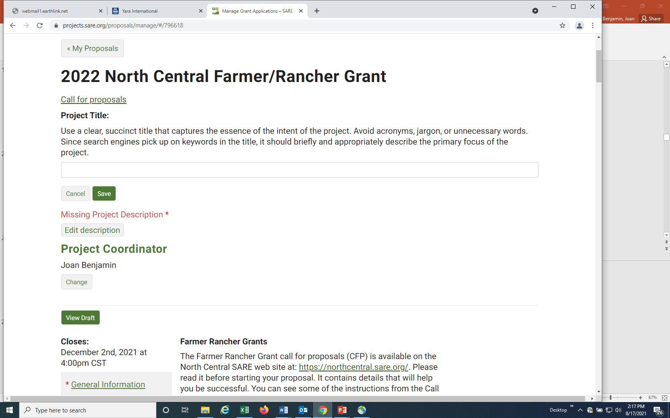
Click on
“Edit title”
Then enter your title in the space provided.
Click on “Save”
Notes:
Items that must be completed are marked with a red asterisk.
Click on “Edit title,” then type in the title of your proposal in the space provided. This lets reviewers know what your project is about – be descriptive but not too wordy.
Use key words that are useful for finding your project in a website search, keeping the title to 150 characters or less.
Click on “Save” to save your title. Note that throughout the application, you must click on “Save” after every entry to save the information you’ve entered.

Slide 22
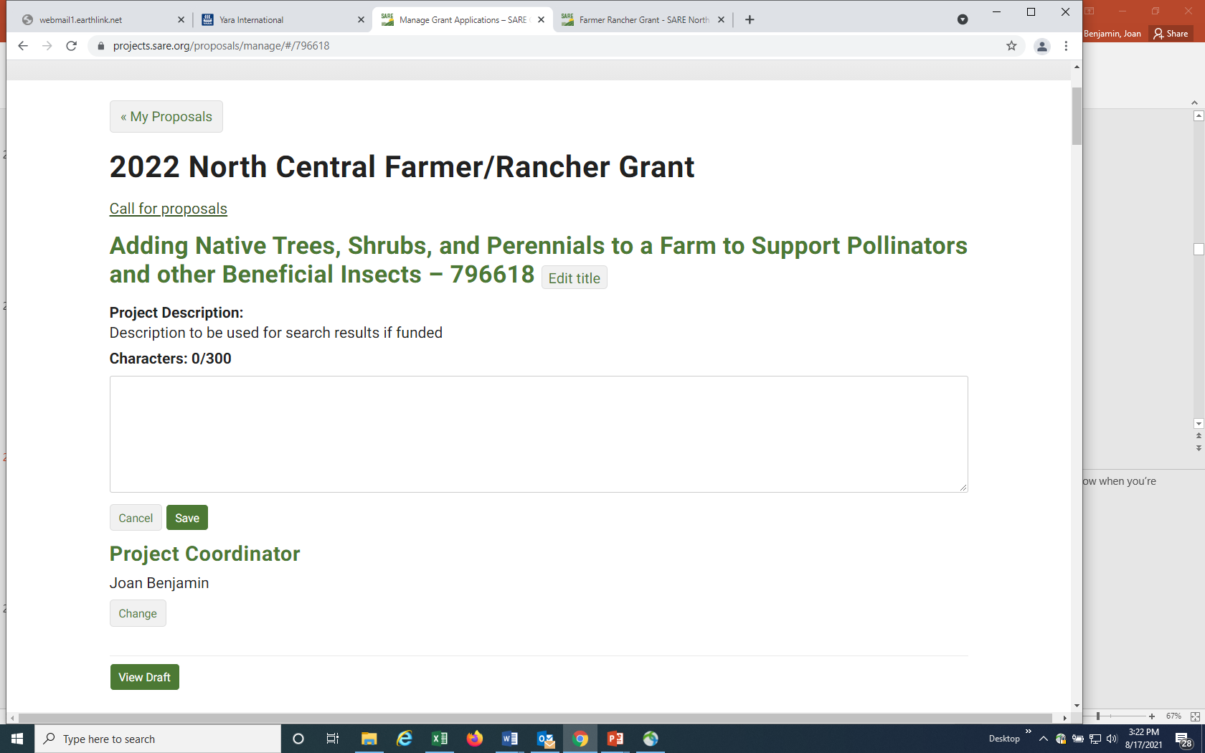
Click on “Edit Description” to fill in the Missing Proposal Description* and enter a brief description of your project.
Note that for answers with character or word limits, the system tracks your character or word count.
Click on “Save”
Notes:
Click on “Edit description” and provide a brief proposal description (160 characters or less). For most answers with a character or word limit, the system tracks the entry so that you know when you’re running out of room. The system allows you to use more than 160 characters for this entry, but please limit your description to 160 characters. Click on “Save” to save the description.

Slide 23
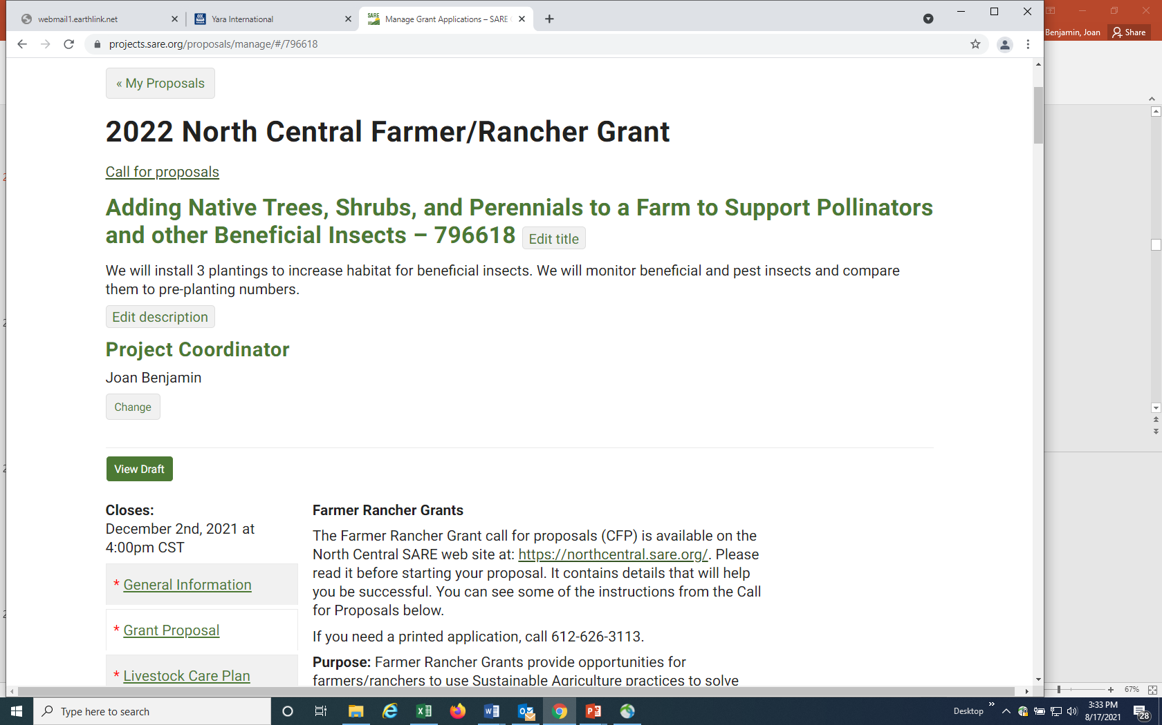
Click on
“General Information” to answer the questions in that section.
Notes:
You’re ready to move on to the first section of the application, “General Information.”

Slide 24
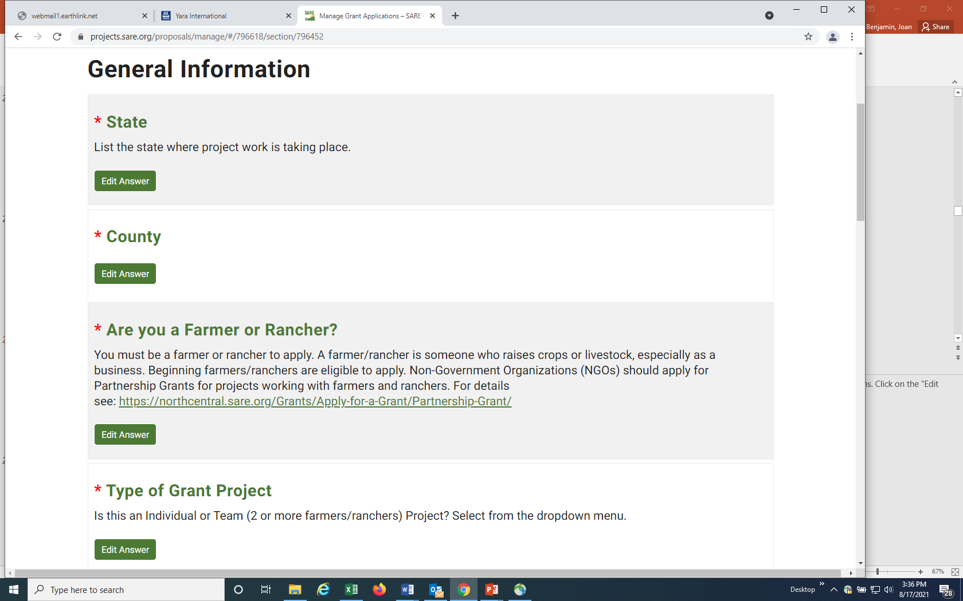
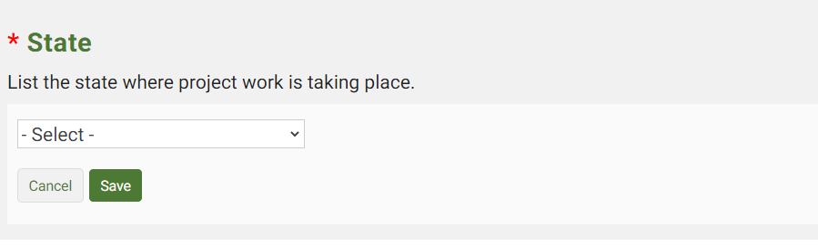
Notes:
Click on the “Edit Answer” button for each question and complete the information. Note that some boxes have the word “Select” which means there is a drop down menu that that will be visible when you click on the “down” indicator. Be sure to click on “Save” after you answer each question.

Slide 25
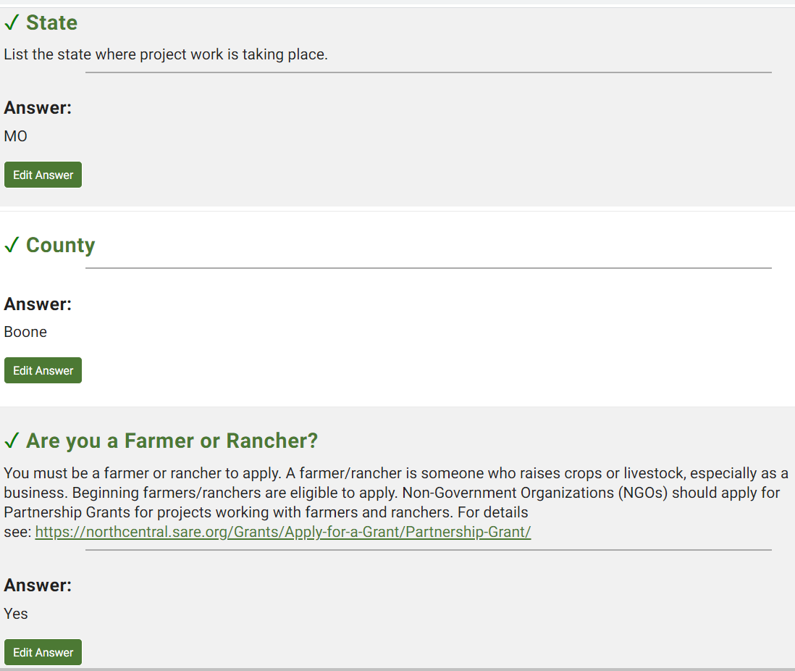
When a question is completed and saved, a green check mark appears.
You can change your answer by clicking on Edit answer and resaving.
Notes:
Once you have completed and saved an answer, a green check mark appears next to that question.

Slide 26
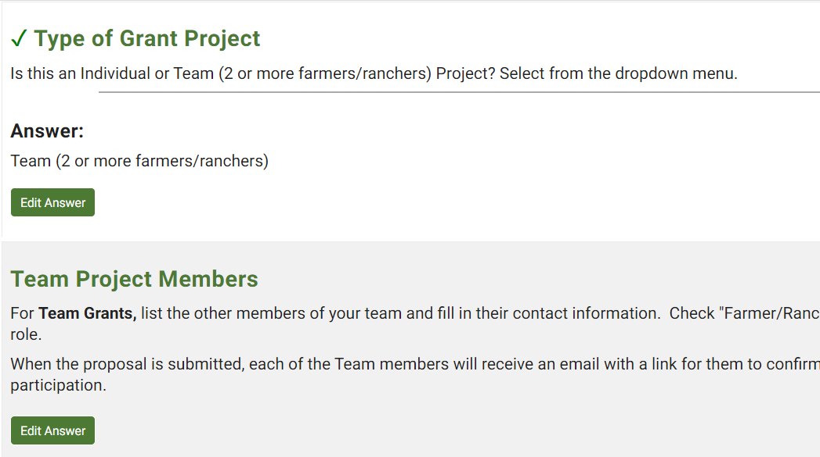
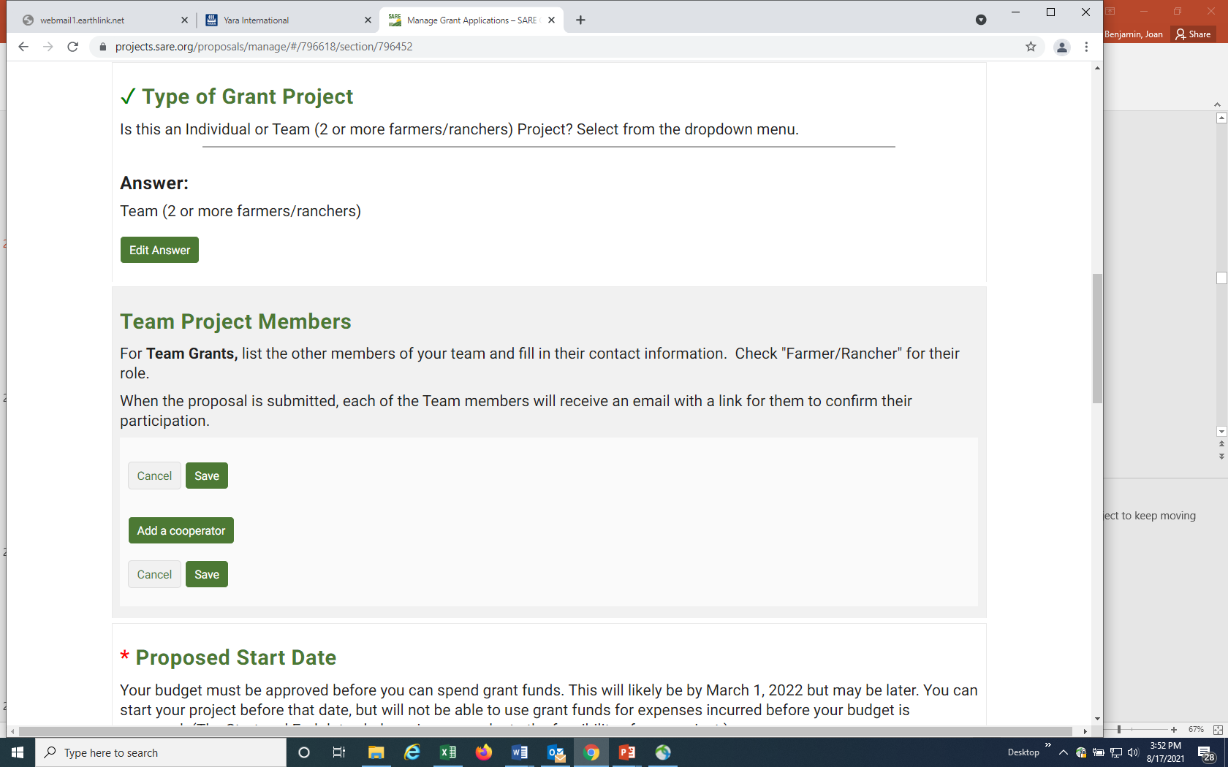
For a “Team Grant”,
you must complete contact information for each of your team members by clicking on “Edit Answer,” then “Add a cooperator.” Let your team members know that they will be sent an email to confirm their participation.
Notes:
You must provide contact information for your fellow farmers/ranchers if you are applying for a Team grant with 2 or more farmers/ranchers. Click on “Add a cooperator” to add each team member’s information.
Once the application is submitted, they will be sent an email message asking them to confirm their participation on your grant. They must confirm within a week in order for your project to keep moving through the review process.

Slide 27
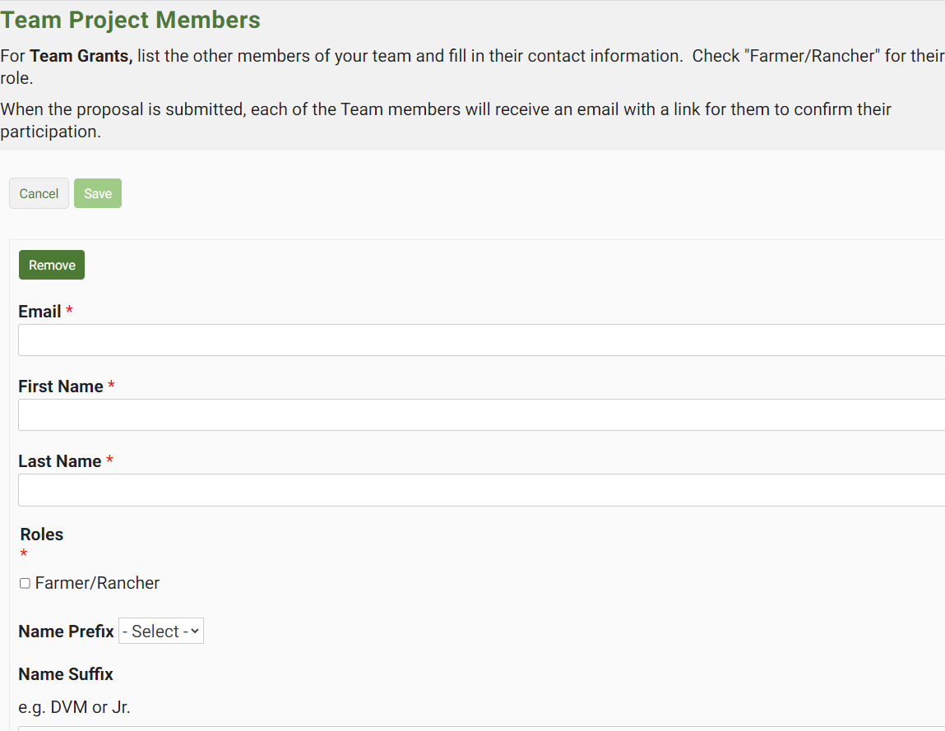
Fill in the contact information for your team members. Be sure to fill in the email. If they do not have an email address, they will need to provide a brief (1 paragraph) statement explaining their role in the project. You can attach this statement to your proposal.
Notes:
Complete the contact information for your team members. Include their email addresses so we can send them a link to confirm their participation. If they do not have an email address, ask them to write or type a brief (1 paragraph) statement explaining their role in the project and have them include their contact information. Attach the statement to your grant proposal.

Slide 28

When you have completed this section, scroll to the bottom or top of the webpage and click on “Next Section” or “Proposal Overview.”
Notes:
Once you have completed all required and applicable information and saved all information in the “General Information” section, click on “Next Section” to move on to the next set of questions, or click on “Proposal Overview” to see which sections are yet to be completed. These options are available at the top and bottom of the web page.

Slide 29

If you return to Proposal Overview, the green check mark by “General Information” confirms that you have completed all required information for that section. Click on “Grant Proposal” to complete the next section.
Notes:
The green check mark by “General Information” indicates that you have completed all required information for that section. You can proceed to the next section, “Grant Proposal.”

Slide 30
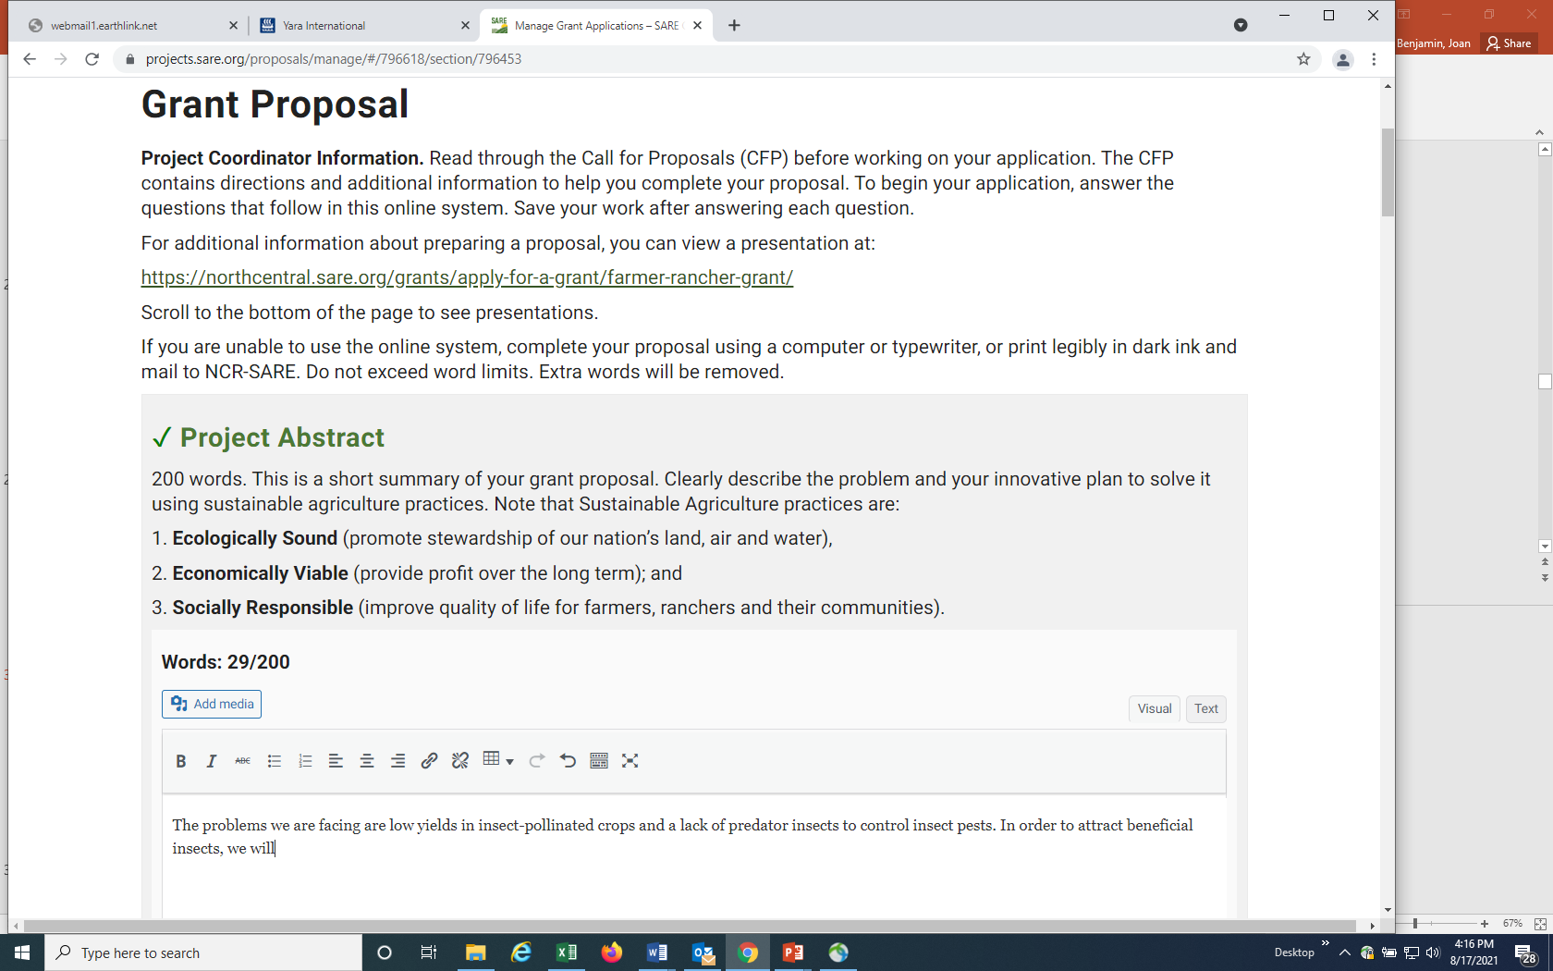
Complete the information for each question and “Save”.
For text sections with word limits, the system tracks the words used.
Notes:
Answer each question in this section. The system will show you how many words you have used so you don’t go over the limit. In this example, 29 out of 200 words have been used.
Don’t forget to save your answer.

Slide 31
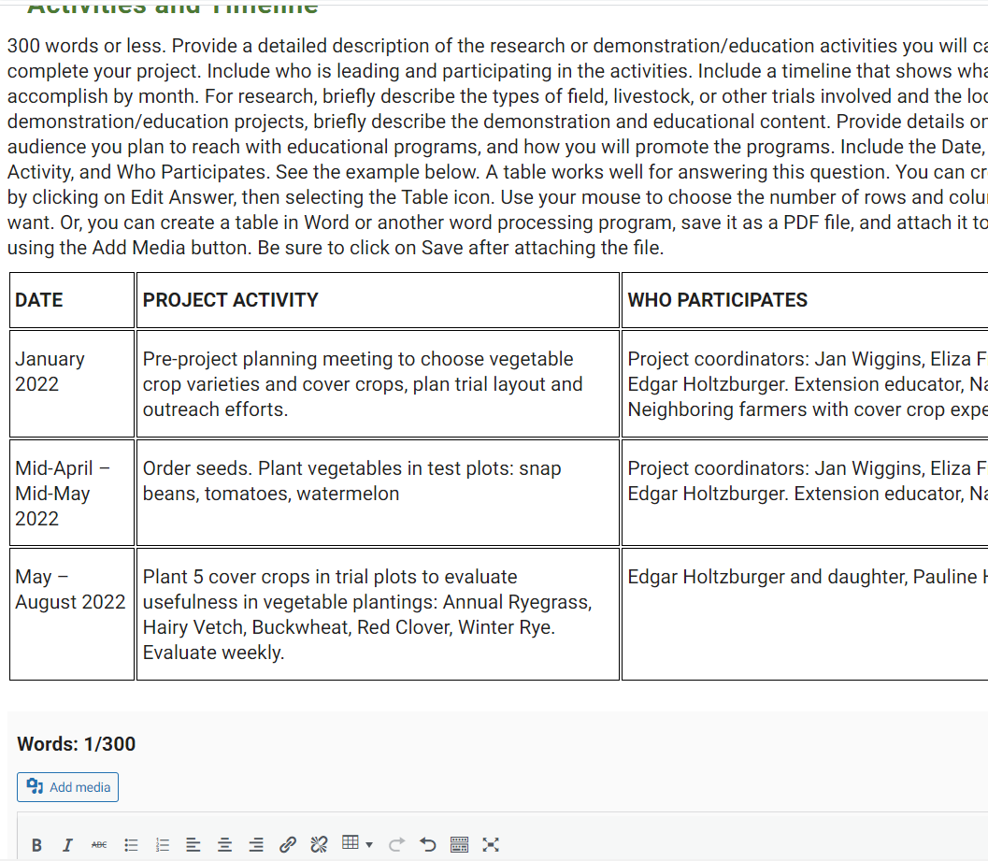
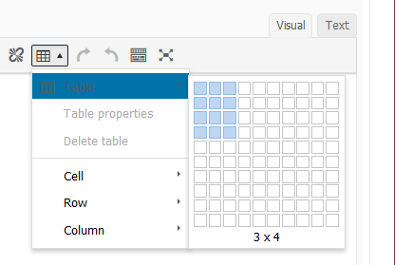
A table works well in the Activities and Timeline section.
You have several options for including a table. You can copy and paste a Word or Excel table into the answer box, or you can create a table in the application. To create the table seen here, click on “Edit Answer,” then click on the table icon, choose table, and choose the 3 x 4 grid.
Notes:
I’ll demonstrate how to add information as a table in this question about Activities and Timeline.
Click on the table icon, then use the mouse to choose the 3 columns by 4 row grid and click.
For more information on creating a table in the online application system, See: https://projects.sare.org/inserting-tables-into-your-report/.

Slide 32
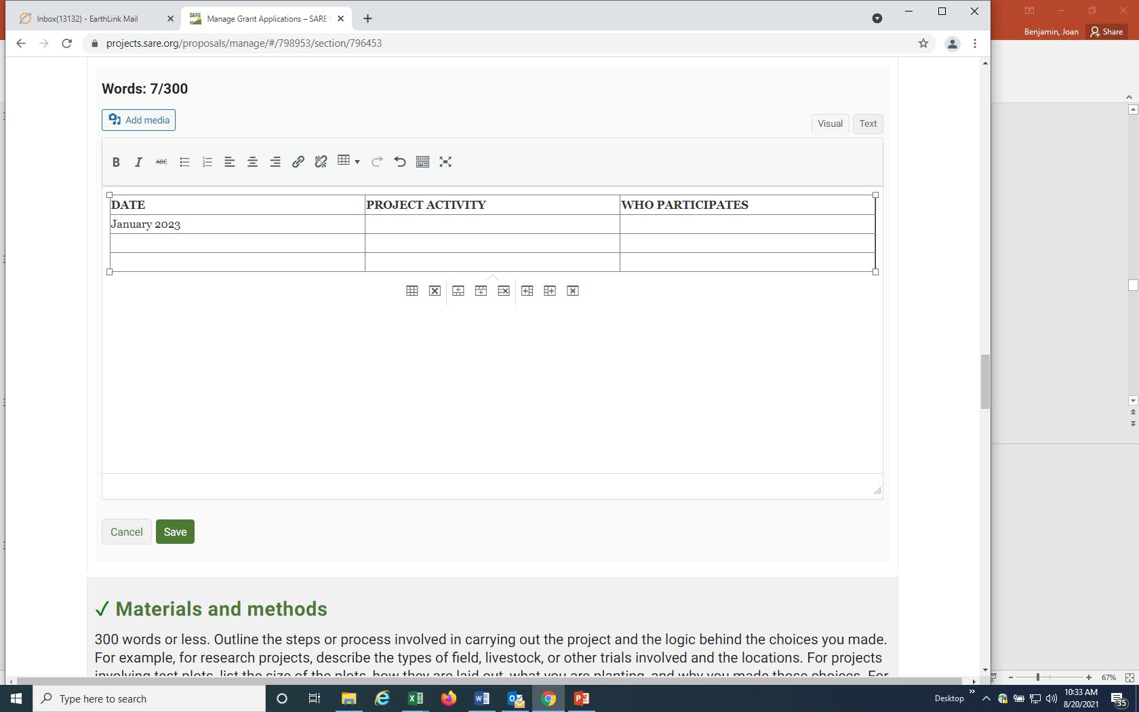
You can complete each section of the table.
The icons below allow you to add or delete columns or rows.
You can also upload a table as an attachment. It must be in pdf format (see next slide for uploading attachments.)
Notes:
Complete each section of the table. The icons below the table allow you to add rows or delete rows from the table. You can also upload a completed table as an attachment, but it must be in pdf format.

Slide 33
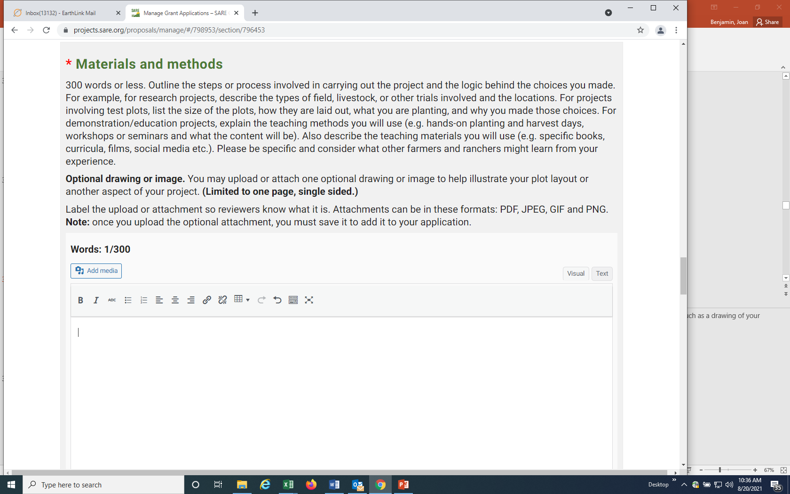
Some sections have an “Add Media” button. You can upload attachments including pictures or diagrams to those sections by clicking the “Add Media” button.
Notes:
In some sections, you can add an attachment or embed images by clicking on the "Add Media" button. For “Materials and methods,” you might want to include information such as a drawing of your research plot layout, or a map or photo of your test area. Don’t add more than one image and limit it to one page, single sided.

Slide 34
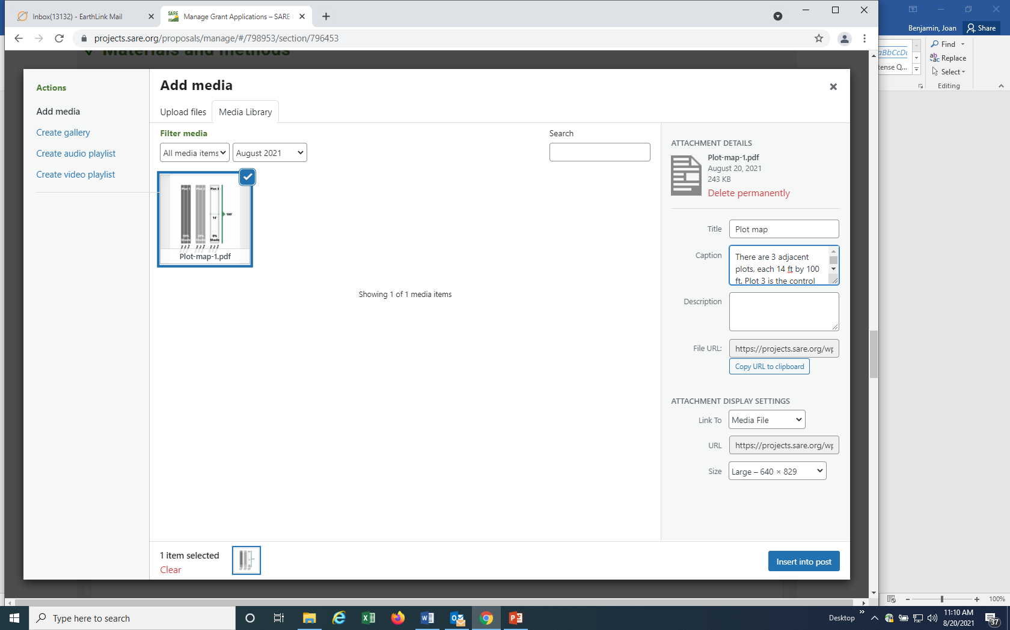
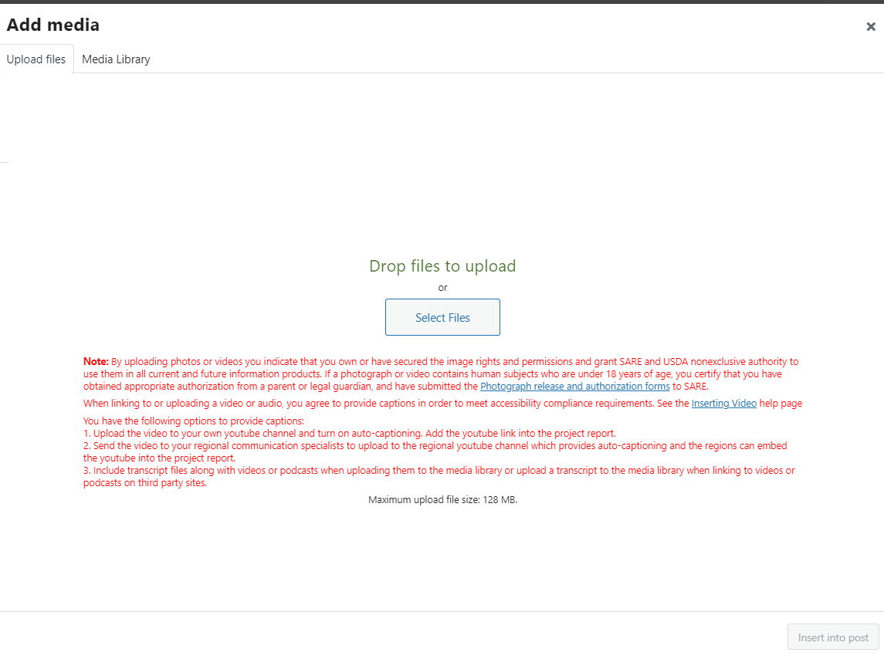
You’ll be taken to your “media page.”
To upload from your computer, click on “Select Files, then “open” the file from your computer.
You’ll see the uploaded file listed in your media library. Add a caption to explain what the attachment is, then click on “Insert into post” in the lower right hand corner to add to your application section.
Notes:
To add an image or photo to a section that has an “Add Media” button, place your cursor where you want the item to appear. Click on “Add Media”, then “Select Files". Open the file from your browser and click on “Insert into post”

Slide 35
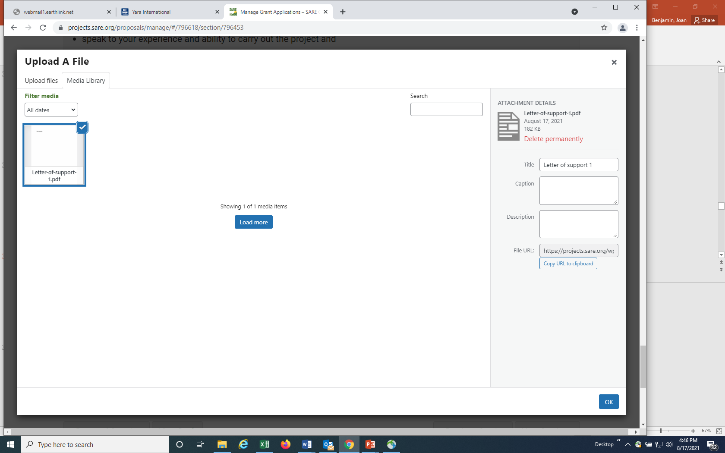
Your uploaded file should be listed on the right side. Click on “OK” in the lower right hand corner to upload.
Notes:
If you’ve uploaded the file you want, which will be listed on the right hand side of the webpage, then click OK in the lower right hand corner to upload it to your application.

Slide 36
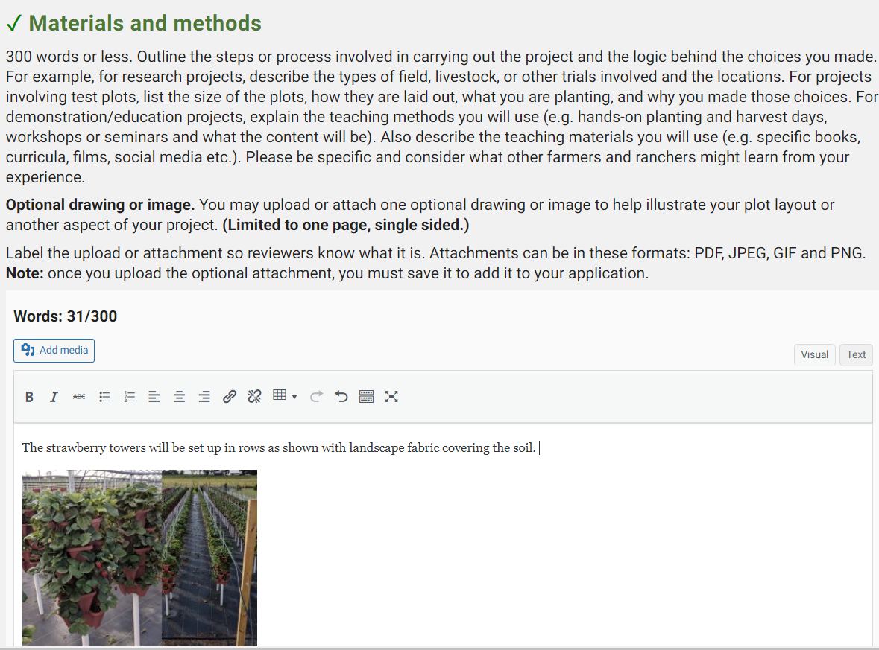
The image will be embedded as you see here.
Notes:
The image will be embedded as you see here. If the attachment is a PDF file, it will appear as a link.

Slide 37
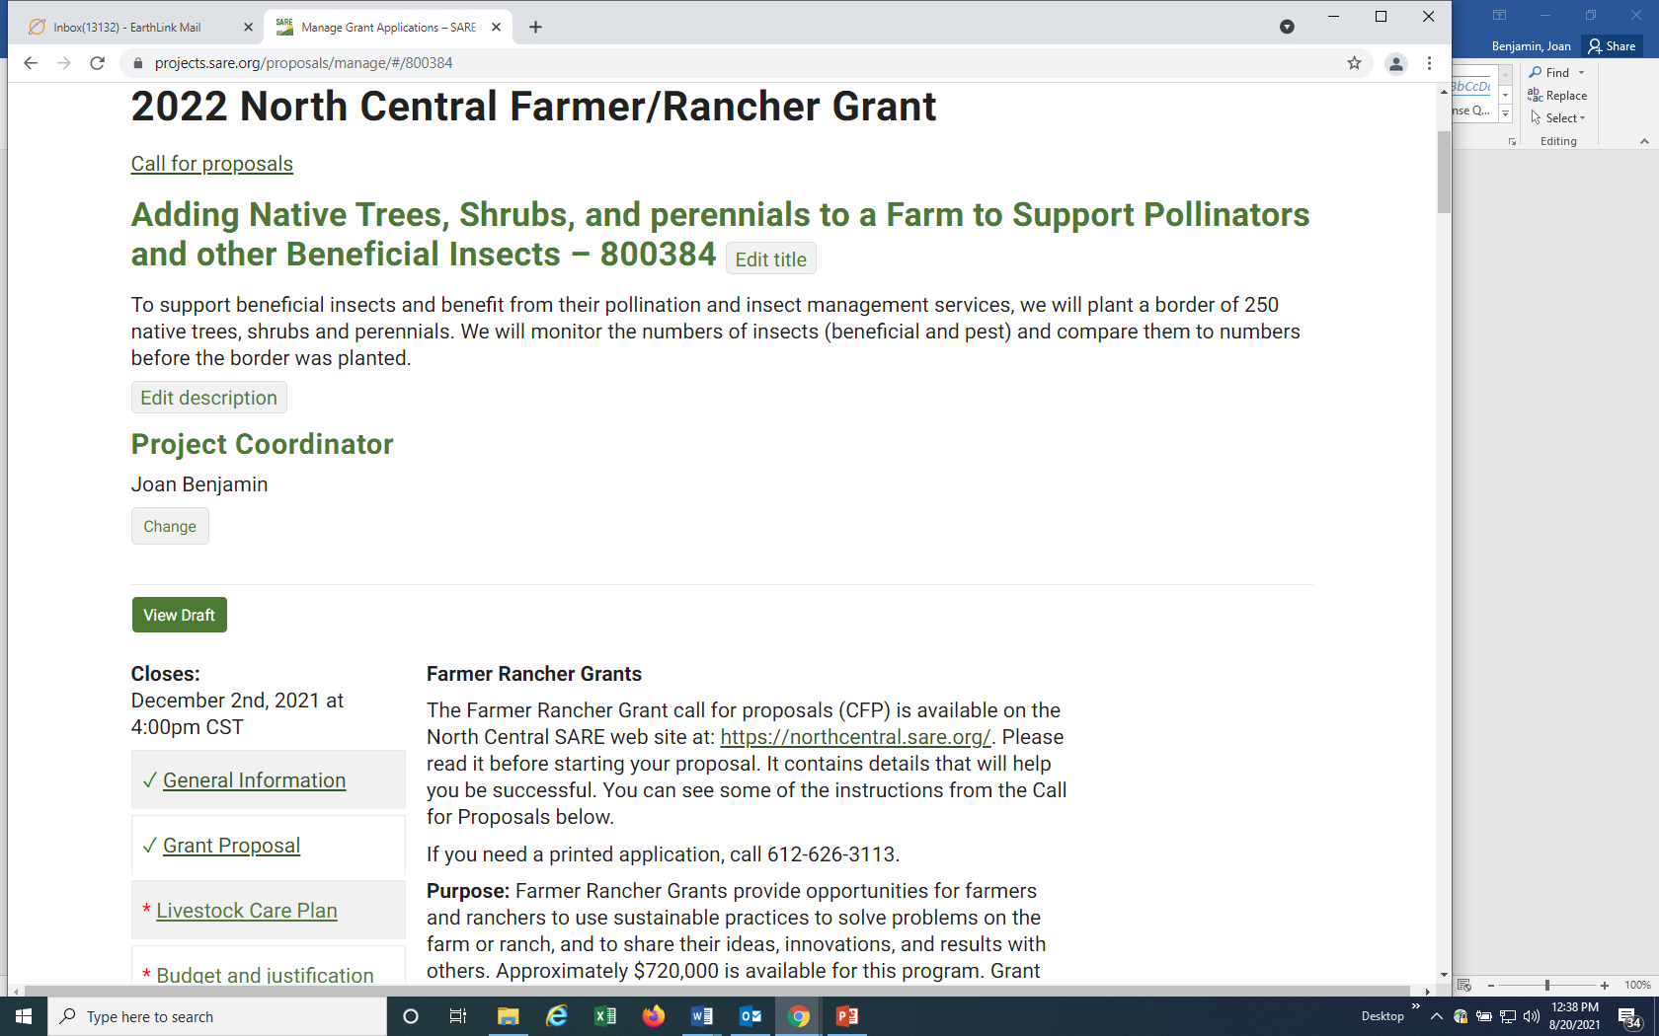
Once you’ve completed the required information in the Grant Proposal section, click on Project Overview to return to the proposal main page.
At any time, you can click on “View Draft” to view your proposal, or to share a draft with a collaborator.
Notes:
Again you have the choice of going on to the Next Section or returning to the Project Overview. If you return to the Project Overview, you’ll see that you’ve successfully completed and saved all required information in the first two sections. They have green check marks.
You can view a draft of your proposal at any time by clicking on “View Draft”. This will open a new window where you’ll see the draft of what you’ve entered. This page also provides a link to the draft that you can share with collaborators.

Slide 38
Notes:
If your project does not involve livestock, open the Livestock Care Plan form and answer “No” to the first question which is: Does your project involve livestock? Click on “Save,” then click on “Next Section” to go to the Budget and justification section.
If your project does involves livestock, be sure to answer all of the questions in the Livestock Care Plan form and click on “Save.” Then move to the next section: Budget and justification.

Slide 39
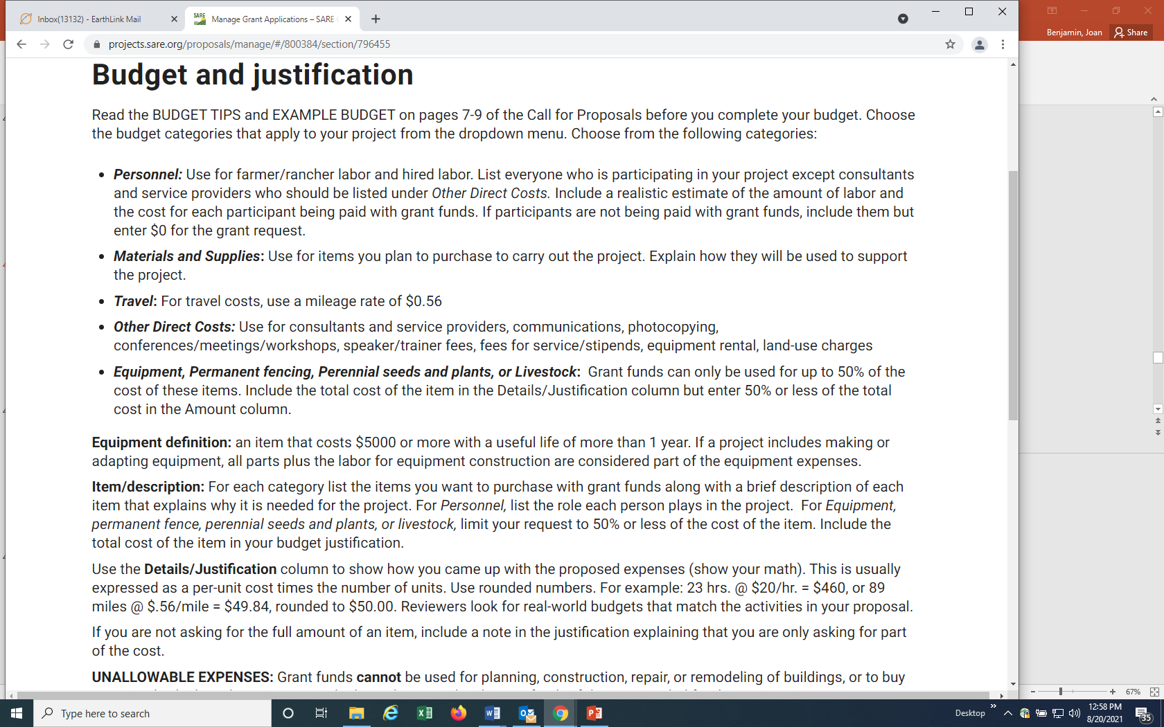
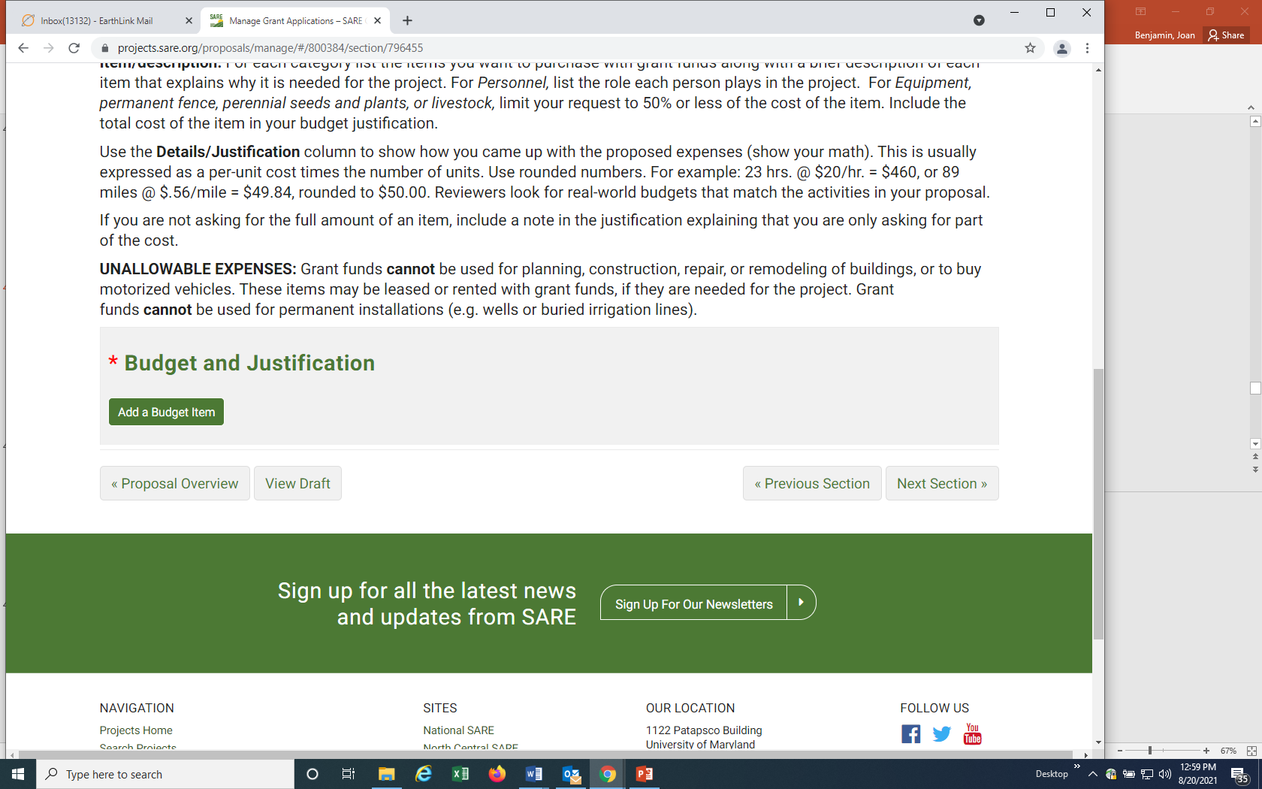
Read the instructions, then enter each item of your budget by clicking on “Add a Budget Item.”
Notes:
Follow the guidelines provided to enter each item of your budget.

Slide 40
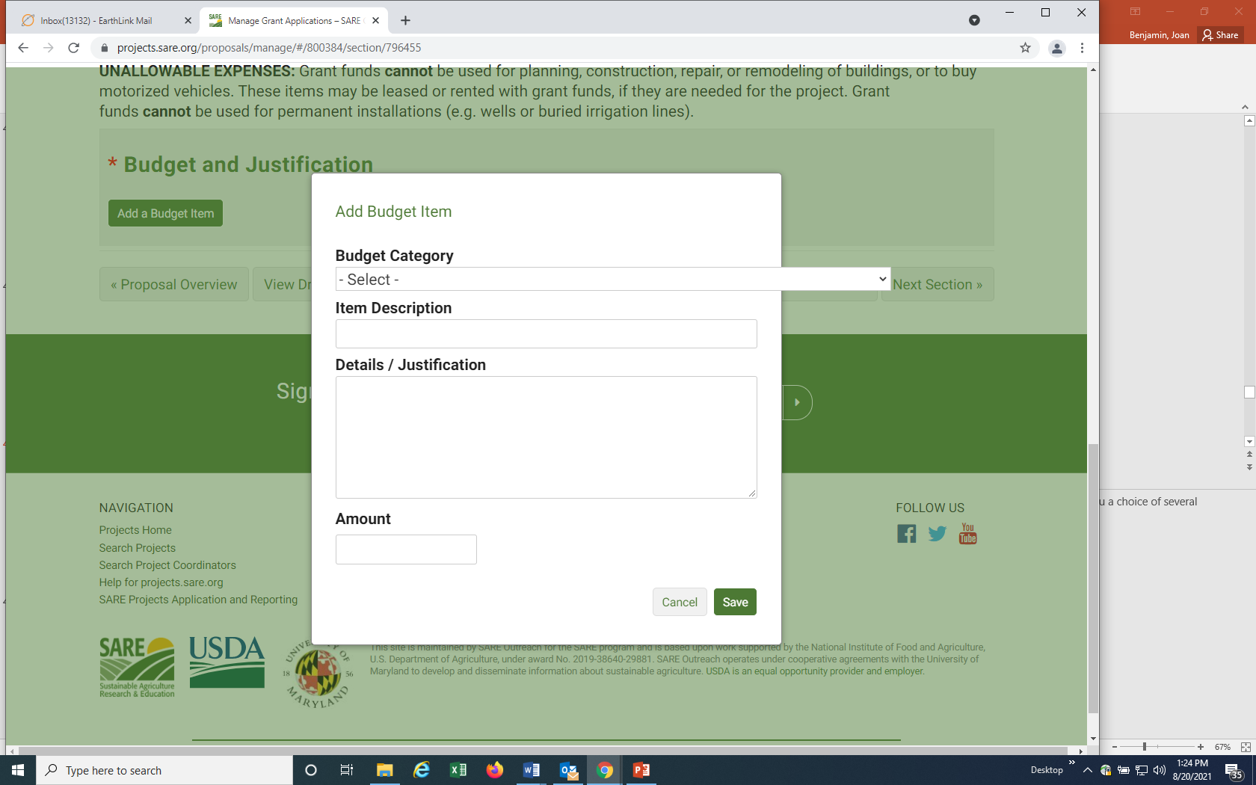
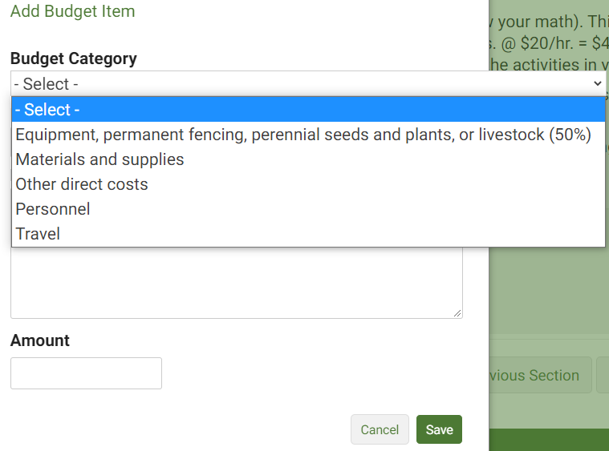
Follow the guidelines to enter each item of your budget.
Notes:
Click on “Add a budget item” then click on the down arrow under “Budget Category” to open up the drop down menu of budget categories. Chose the category for the item you want to add.

Slide 41
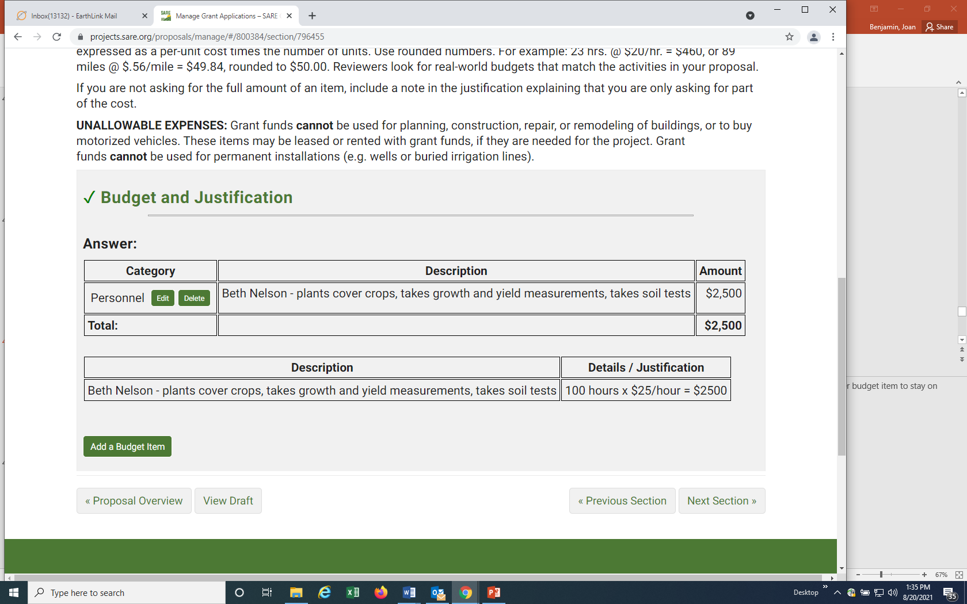
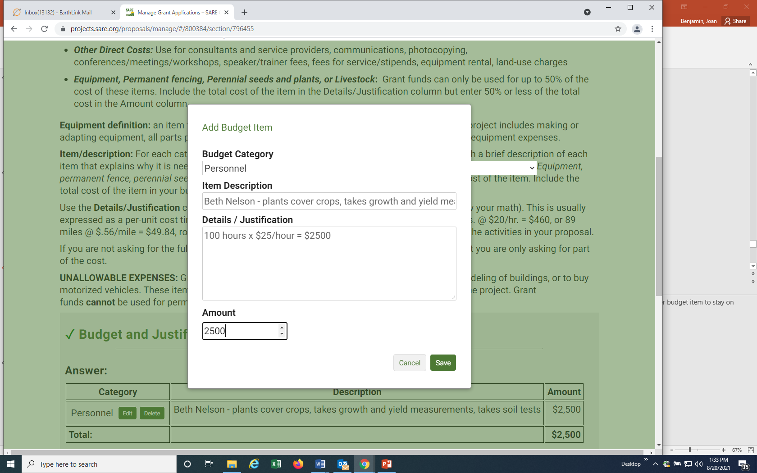
After you select the “Budget Category,” fill in the “Item Description.” Then, under “Details/Justification,” show how you came up with the amount for that item (show your math), and fill in the “Amount” you want the grant to cover for that item. When you click on “Save” the item appears as shown above.
Saved Budget Item
Notes:
Complete the item description. Under Details/Justification, show how you calculated the total cost for that item (show your math). You can add keep adding budget items by clicking on “Add a Budget Item,” but none of the information will be saved until you click on the “Save” button.

Slide 42
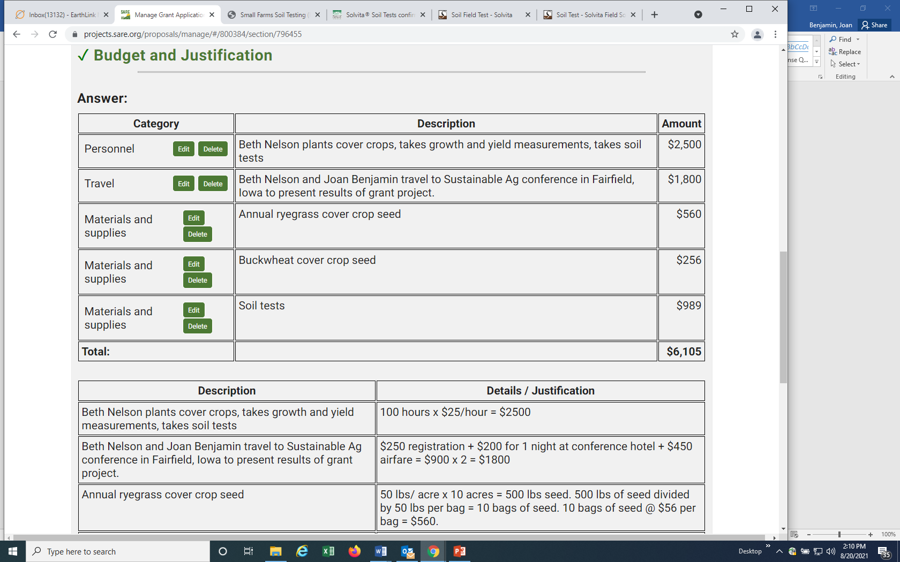
Notes:
Here is part of a sample budget. Once you’ve entered all your items and clicked on “Save,” scroll to the top or bottom of the webpage and click on “Proposal Overview” or “Next Section.”

Slide 43
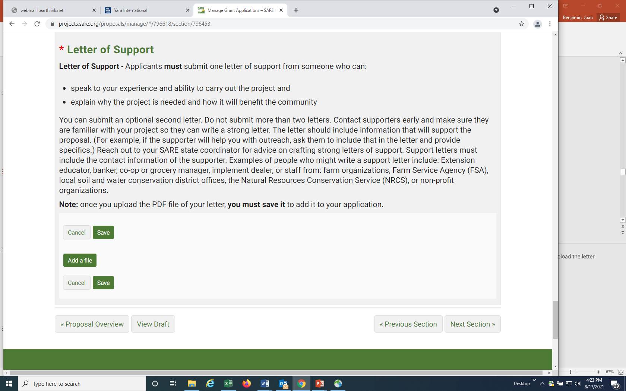
Upload a letter of support to your application.
Notes:
In addition to completing the proposal, you must also upload a letter of support for the project to your application. You do this by Clicking on “Letter of Support” and using the “Add a file” button. Be sure to “Save” after you upload the letter.

Slide 44
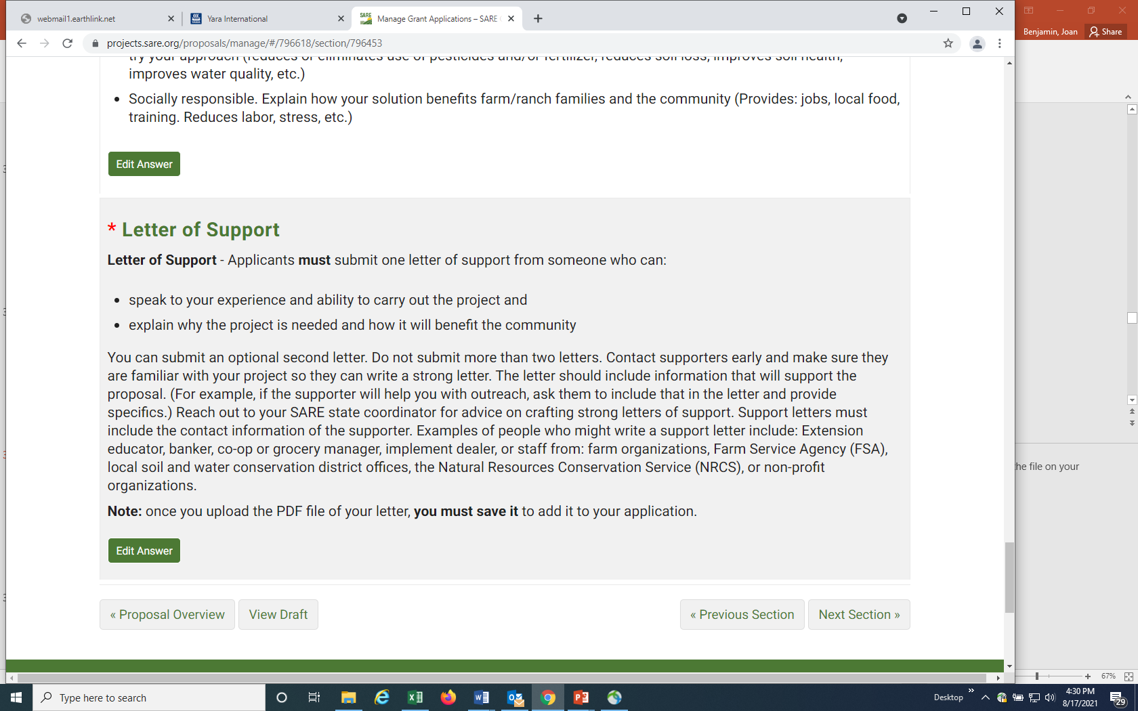
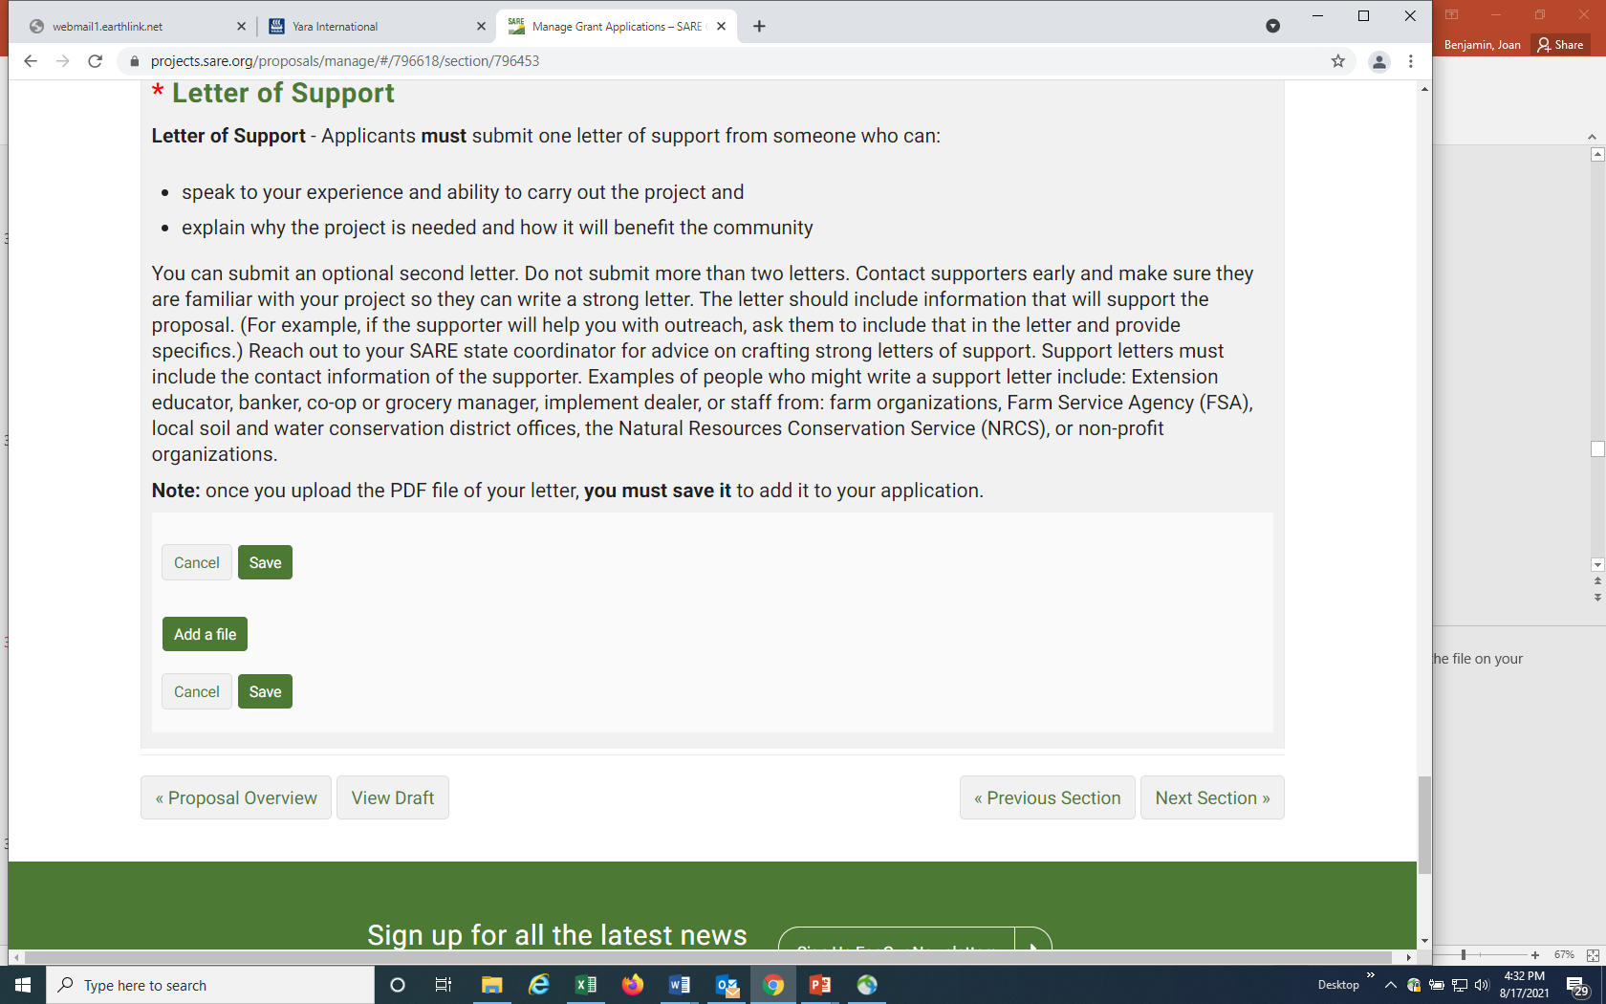
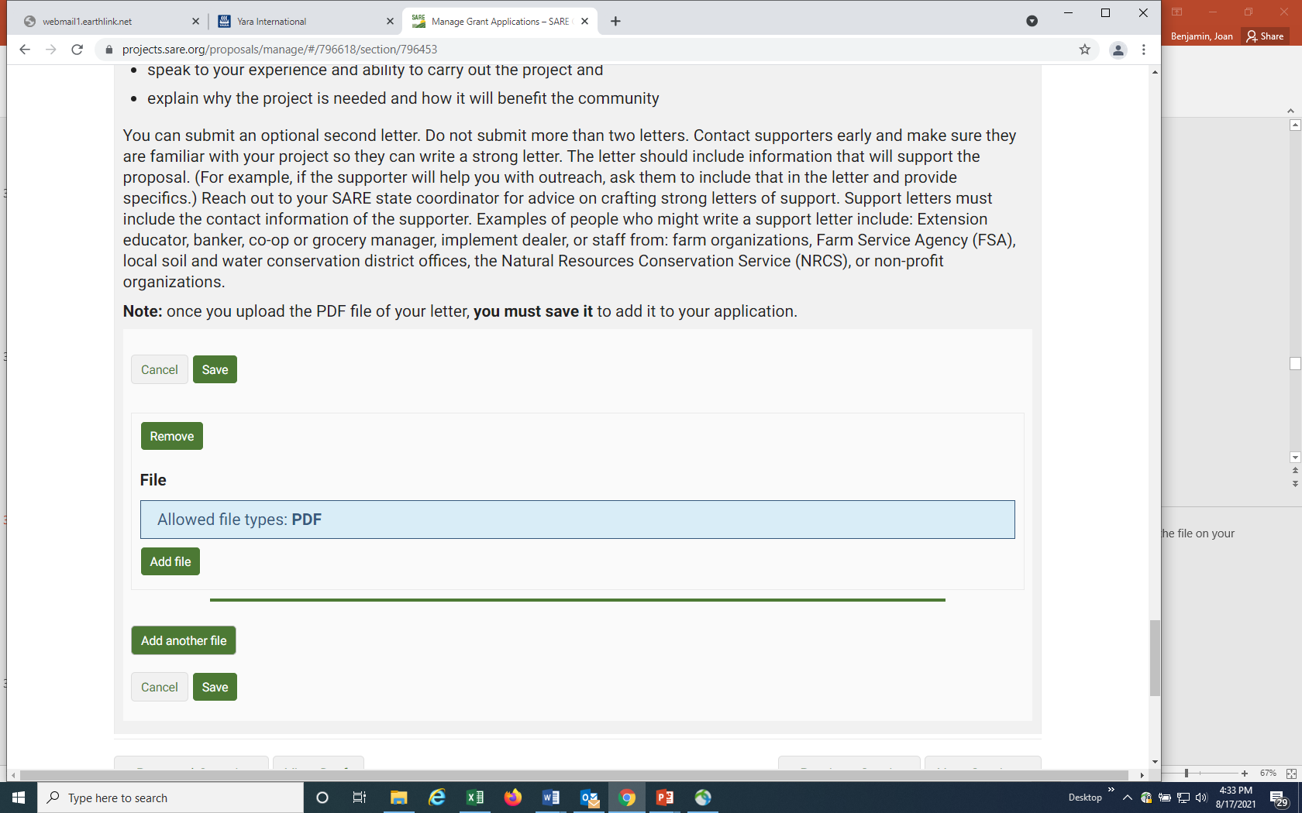
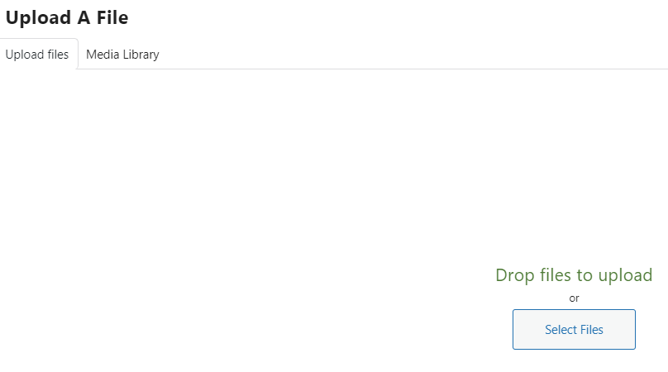
Uploading a letter of support to your application.
“Open” file from your browser.
Notes:
To upload the letter of support in this section, click on “Add a file,” then on “Add file” on the next screen, then “Select Files.” Select the file you want to upload, then click “open” on the file on your computer. The system only accepts PDF files for the letter of support.

Slide 45

You’ll see your uploaded attachment listed here. You must click on “Save” to make it part of your application.
Notes:
Your attachment will be listed here on your application page. Be sure to click on “Save” to add the letter to your application.

Slide 46

Notes:
You’ve now completed all required sections, and are ready to submit the proposal. It’s a good idea to click on “View Draft” before you submit your proposal. Review your proposal. When you are satisfied with how you have answered all of the questions, click on “Submit Proposal”.

Slide 47

You will land on this web page, confirming your submission. Note that you can “Unsubmit” and make corrections and then “Submit” again, but you must resubmit prior to the grant close date.
You will also receive an email confirming your submission.
To “Unsubmit,” click on PROPOSAL OVERVIEW. To review your proposal, click on VIEW PROPOSAL.
Notes:
You will see this confirmation page. Note that in this system, you can “Unsubmit” and make changes PRIOR to the closing date for the grant program. Make sure you resubmit by the closing date and time or your proposal will not be considered for funding.
Once your proposal is submitted, you can click on “Project Overview” to “Unsubmit” your proposal or “View Proposal” to review your application.

Slide 48

If you need to make changes to your proposal after you submit it, click on “Unsubmit Proposal.” After you make changes, be sure to “Submit” your proposal again before the grant deadline.
Notes:
If you click on Proposal Overview you will see the “Unsubmit Proposal” option.

Slide 49


Good luck with your proposal!
If you have questions contact Joan Benjamin at:
573-681-5545
or
benjaminj@lincolnu.edu
https://northcentral.sare.org/
Follow us on:
Our Facebook Page
Our Twitter Page
Our YouTube Channel
photo credit: Joan Benjamin
Notes:
Congratulations! You have now submitted your Farmer Rancher Grant Proposal.
The proposals will be reviewed by a team of North Central region Farmers and Ranchers between the date the application closed and the February 2022 Administrative Council meeting, when the funding decisions will be made.
Notifications will go out by mid to late February 2022.
Good luck with your proposal.
If you have any questions contact NCR-SARE.
https://www.facebook.com/NCRSARE
https://twitter.com/#!/ncrsare
https://www.youtube.com/NCRSAREvideo

