Slide 1
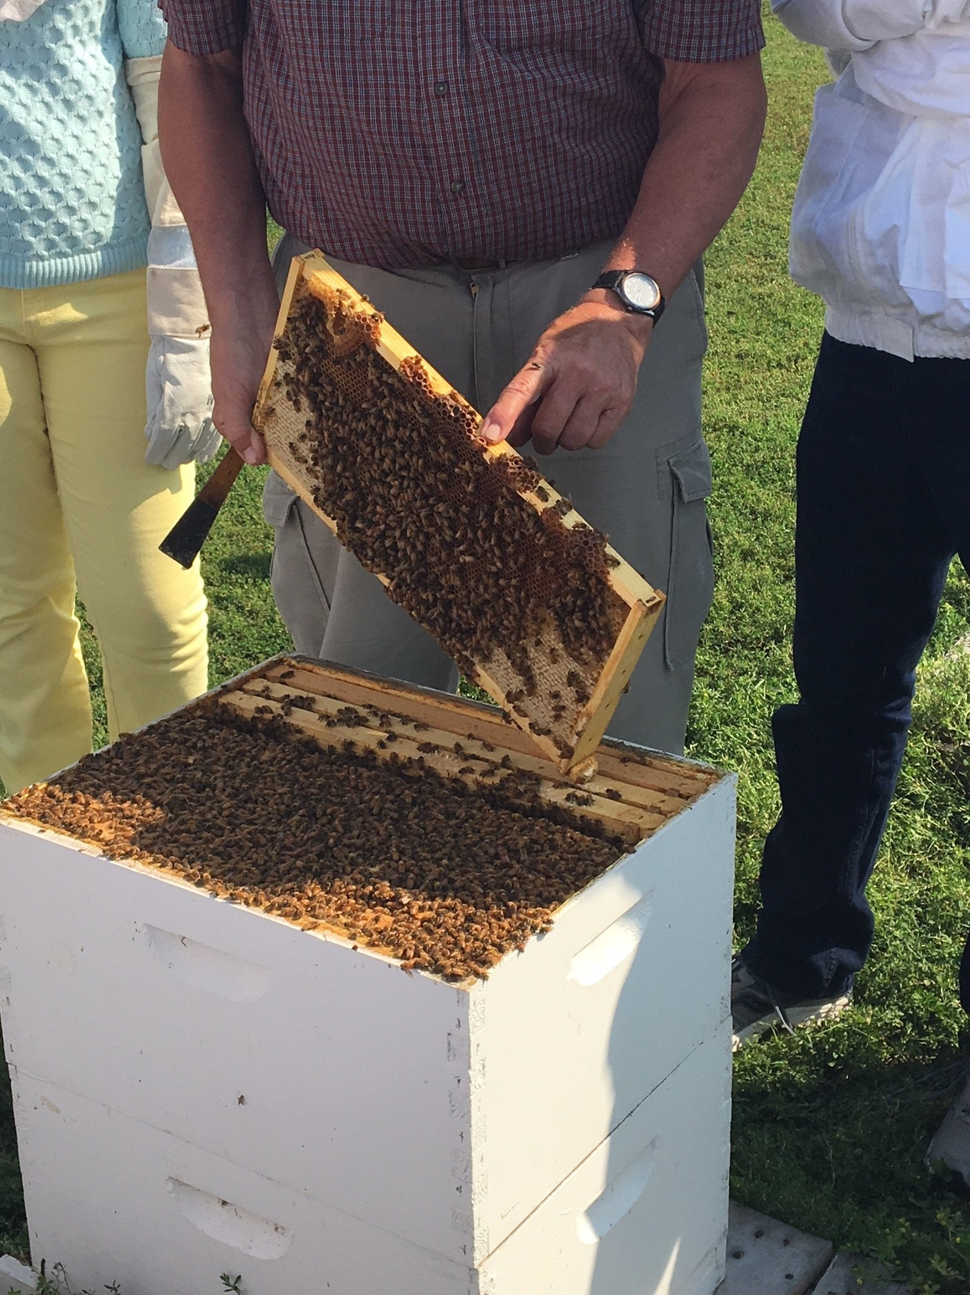
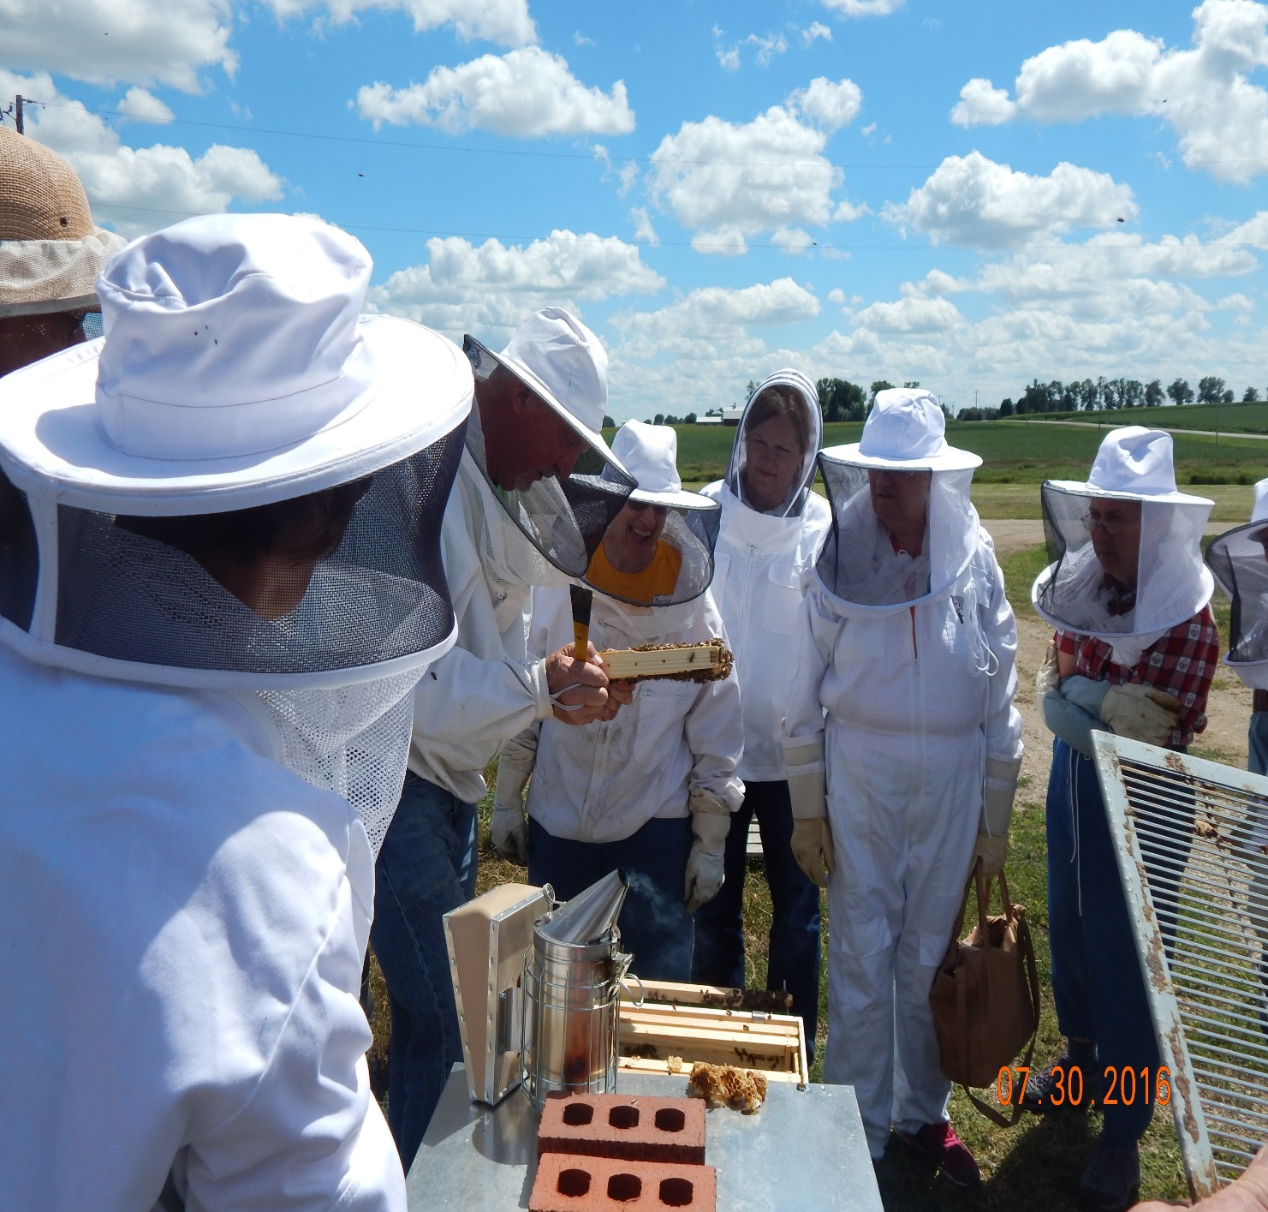
Our Farms Our Future Conference
Enter SARE Project Number and Project Leader’s Name →
LNC15-365
Dr. Duane Bajema
SAMPLE CONTENT BOXES
As seen in the template.
These boxes can be copied and pasted as often as needed.
They can be resized: click inside the box, then click and drag one of the squares that appear on the corners of the box.
SUB HEADER
Recommend Gill Sans font in 60pt size.
Beekeeper Education and Support in Northwest Iowa
Sub header in Gill Sans 60pt
Problem
Methods
TEXT BOX
Recommend Georgia font in 28pt size.
Note that 18pt-20pt is the minimum size recommended for readability at a two-foot distance.
Increased interest in wanting to learn how to become involved in beekeeping, with limited training activities available
Poor success rate of first-time beekeepers
Lack of access to solid technical assistance for problem-solving
Lack of contact between first-time beekeepers
Lack of support for first-time beekeepers from experienced beekeepers
Employment of two technicians to provide onsite technical assistance on evenings and Saturdays
Implement two summer Field Days – early and late
Establish a local viable club/association
Work with state associations and the state apiarist
Develop an introductory course that provides essentials to start beekeeping:
Equipment, location, and preparation
Bee acquisition and installation
Bee biology applied and bee management
Enter text here.
TEXT BOXES FOR PHOTOS, FIGURES, etc.
Sample title box for a photo, table, figure, etc. Gill Sans 44pt
Results & Observations
This box can be used for captions for photos, tables or figures. Select and copy box to use. Resize it by clicking and dragging the corners. This is in Gill Sans 28pt
Beginner Beekeeping Classes provided to 90 students
86 students (95%) chose to become beekeepers
77 of these 86 students (90%) currently have active hives – with robust bee numbers – which produce appropriate amounts of honey
Attendees were about ½ female, ½ male
Attendees were mostly middle-aged
Varied reasons for wanting bees:
Environmental concerns • Past family history
Pollination concerns • Family activity – parent/child
Honey • Local food – allergy concerns
Beekeeper association formed
35-50 people attend
Two successful Field Days
Average attendance 46
Technician visits – 65
SAMPLE TABLE
Column names are set to 32pt Gill Sans; Data cells are 28pt Gill Sans.
To add more rows or columns: put mouse in row/column next to where you want the new one added, then go to Table Tools>Layout and chose an option (insert above/below/left/right).
To resize the table: click inside a cell, then click and drag one of the squares that appear on the corners of the table.
The training emphasized hands-on activities
at the field days and during technician visits
Conclusions
Technician support on site was very effective and highly valued
The formation of a local club provided sustainability on ongoing development
SARE grant led to another grant from the Leopold Center to continue work
Activity spreading out to include more people interested in beekeeping
Solid support from Iowa Honey Producers Association, with Dordt College
hosting their 2018 Annual Field Day
Solid support from Iowa Department of Agriculture & land Stewardship
Name of table
Colum Name | Column Name | Column Name | Column Name | Column Name | Column Name | Column Name | Column Name
Plot 1 | 34” | treatment | 24 lbs/ac | yes | 0.68 | Mid to late | Minimal damage
This project is supported by the National Institute of Food and Agriculture, U.S. Department of Agriculture, under award number 2013-38640-20901 through the North Central Region Sustainable Agriculture Research and Education program under subaward number LNC15-365. Any opinions, findings, conclusions, or recommendations expressed in this publication are those of the author(s) and do not necessarily reflect the view of the U.S. Department of Agriculture or SARE. USDA is an equal opportunity employer and service provider.
LNC-15-365

