Slide 1
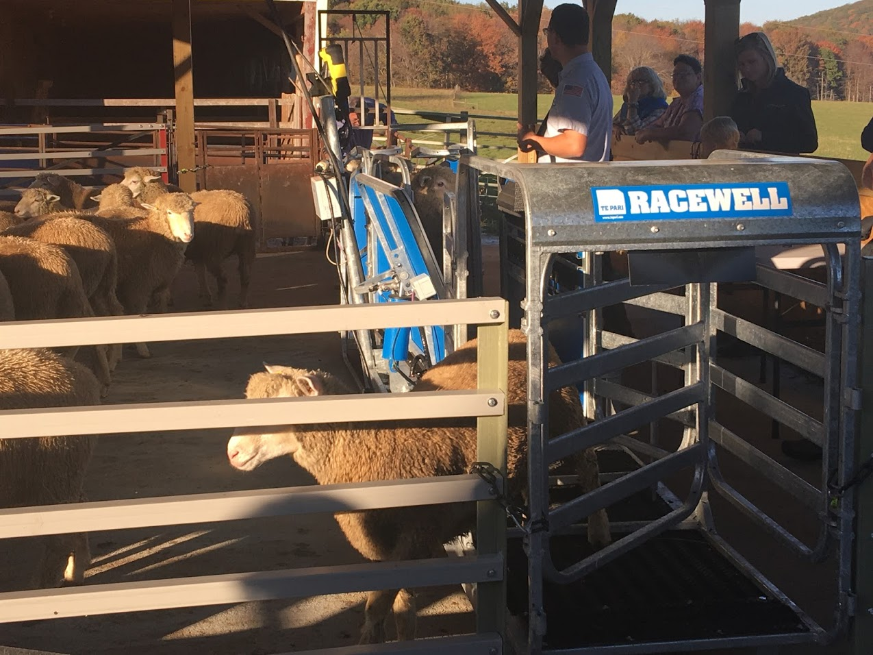
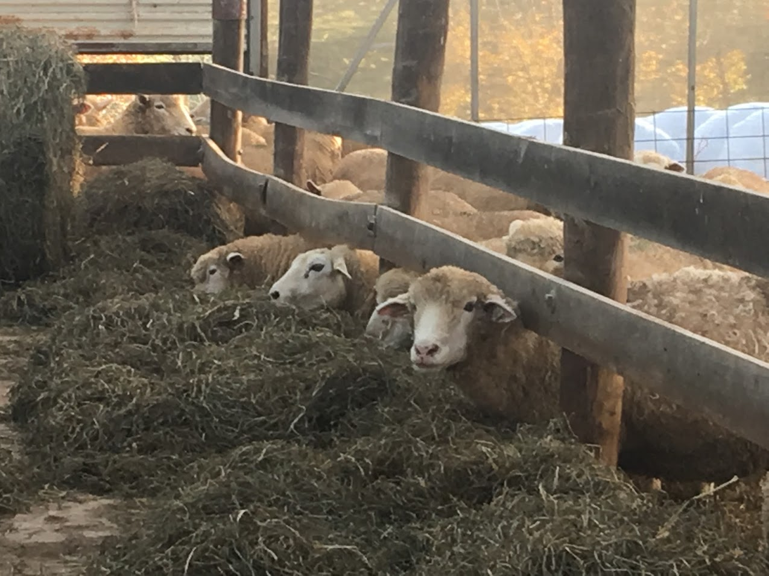
Our Farms, Our Future Conference - The Next 30 Years of Sustainable Agriculture. St. Louis, Missouri, April 2018
ONE14-223
¹D. Singh-Knights and ²M. Knights, ^{1,2}Associate Professor, West Virginia University
Enhancing productivity of sheep through greater access and use of genetically evaluated breeding stock
Introduction
Objectives
Project Approach and Outreach
Significant increases in productivity due to genetic improvements have been recorded in every other livestock sector in the US, except in the sheep industry. Rams consigned to the WV Ram Test over the last 15 years show that little improvement occurred in key traits, which is partly due to limited availability and use of genetic information.
The National Sheep Improvement Program (NSIP) reported some success in attempts to increase the genetic merit of sheep. Lambs born to genetically evaluated rams with an average EPD (Expected Progeny Difference) of +2.6 gained 3.8 lbs. over 120-days than non-evaluated rams, leading to increased revenue by about $650/100 lambs. In an attempt to further improve genetic value of animals and to allow sheep producers faster access to a larger number of economically relevant traits, the NSIP adopted the Lambplan genetic evaluation system, which is capable of providing EBVs (Estimated Breeding Values) for 20 traits and 4 indices. This allows producers to select breeding animals and build a flock suited to their local environment, economic motives and industry requirements.
However, low enrollment of flocks in the Lambplan System and limited use of genetically evaluated rams remains an issue in WV and surrounding states, significantly compromising the productivity and profitability of the region’s sheep producers. To address this problem we conducted an educational program to: increase producers’ competence in using genetic information for selection decisions; increase registration of flocks from WV in the NSIP Lambplan system; and increase access to/use off genetically evaluated rams.
The aim of this project was to improve productivity and profitability of sheep producers in WV, PA and MD, through:
Increasing knowledge on the importance of genetic evaluation in flock management decisions, and of the NSIP Lambplan System as a tool for genetic evaluation;
Developing a cadre of producers competent in using genetic information for selection and other management decisions;
Increasing the number of flocks enrolled in the NSIP’s Lambplan System to determine their breeding values; and
Increasing the availability of breeding animals with known genetic values to commercial producers.
Based on increases in weight gain observed in NSIP evaluated rams, using genetically evaluated animals will result in a minimum of $200,000 in additional revenue per year from sale of lambs in the targeted regions, and will lower production costs from using animals better genetically suited for the local environment. These benefits are consistent with productivity goals set by NSIP and the American Sheep Industry.
15 Workshops/Field Days on importance of genetic evaluation and selection, including:
Approaches to selection of breeding animals
Benefits of knowing the genetic value of animals
Developing breeding objectives consistent with economic goals and buyer requirements
Understanding economic impacts of traits and indices reported in Lambplan
Navigating and enrolling in Lambplan
Record-keeping and input of data into Lambplan
Benchmarking and interpreting Breeding Values (BVs) of different traits and indices
Using BVs to inform selection and management decisions
12 On-Farm Demonstrations to assist with and demonstrate data to be collected and setting up related record-keeping systems, and how to navigate and use the Lambplan software.
47 Consultations on Lambplan, including hands-on computer training to develop appropriate animal IDs, collating and uploading historical flock data, and interpreting results generated from the Lambplan system.
3 Annual Ram Tests, with project support for consigning animals, to allow producers to evaluate their rams’ genetic performance and allow commercial producers greater access to superior rams in the targeted region.
Results
“I have made significant investments in sheep handling and data recording systems to support genetic evaluations of my animals based on increased buyer interest.”
Key Lessons
Overall, the project reached 4 agricultural service providers, and 130 farmers who manage more than 3,250 head of sheep.
Participants’ evaluations show increased knowledge in potential benefits of genetically evaluated animals, using the Lambplan System, what traits could be improved, what variables need to be measured, what records to keep, and how to keep good records.
Six (6) new producers enrolled in Lambplan; 4 more indicated interest in doing so in the very near future. Prior to our project only 4 farms across WV, MD and PA actively assessed the genetic value of their animals.
Additionally, over 50 commercial producers indicated that they were interested in getting “the numbers” on the animals in order to inform their selection decisions. Producers were particularly interested in the ability to select for tolerance/resistance to internal parasites, which has been included as part of the 2018 WV Ram Test.
More than 25 rams originating from farms enrolled in Lambplan and with known breeding values were tested and made available to producers for purchase.
Three (3) producers from within WV purchased animals from flocks enrolled in Lambplan and known to possess premium genetics.
Seedstock producers represent a small proportion of sheep producers in WV, and only 2 producers possessed animals with known breeding values prior to the start of the project. Therefore, getting 6 new producers to enroll, and 4 more to consider using the Lambplan System in the near future to genetically evaluate their animals was a significant achievement.
Additionally, a larger number of producers are now aware of the tremendous impact that using genetically evaluated animals can have on the productivity of their animals, and more producers continue to express interest in obtaining and using genetic values in their selection decisions.
One producer who enrolled in the NSIP’s Lambplan System was assessed to possess sheep genetics that ranked in the top 10 percentile in growth traits, which resulted in significant interest in and value of his animals at the WV Ram Sale.
The project also contributed to a significant increase in the availability of a wider base of animals with known genetic values. Producers report that there have also been commensurate increase in buyers interested in these animals.
The increase in availability of improved animal genetics, and increased knowledge and competence of producers in making better selection and management decisions, will ultimately help enhance productivity and profitability of sheep producers in WV and surrounding states.
“I know what questions to ask my suppliers in order to assess the genetic merit of the animals I am purchasing.”
This material is based upon work supported by the National Institute of Food and Agriculture, U.S. Department of Agriculture, through the Northeast Sustainable Agriculture Research and Education program under sub-award number ONE14-223. Any opinions, findings, conclusions, or recommendations expressed in this publication are those of the author(s) and do not necessarily reflect the view of the U.S. Department of Agriculture or SARE. USDA is an equal opportunity employer and service provider.

