Slide 1

An Introduction to Cover Crop Economics
Do cover crops pay?
Notes:
This presentation was prepared by Sami Tellatin and Rob Myers and provided by the USDA-SARE program to educators and producers for outreach and educational purposes. Other cover crop slide sets are also available at the website: http://sare.org/cover-crops
Prepared in March, 2017.
Please note that the analyses in this slide set are based on corn and soybean production.
Tips for presenters:
Be engaging. You are about to give your audience a lot of information; show them that this is worth learning by being interested in the topic yourself and letting that be seen through your presentation.
Make it personal. Tell your own stories (that complement the material and are concise). You want to create a narrative that flows throughout your presentation.
Encourage learning and discussion by asking questions of the audience and encouraging their participation. Moderate your time so that you can cover everything, while also fostering audience participation.
Speak to your knowledge. If you don’t know something, it is okay to say so.
This slide set is a template offered for your use. You can add or delete slides and change things as you need. Use it to best compliment your educational style to meet your goals.

Slide 2

Objectives
Identify the costs of planting cover crops
Explore the benefits and returns
How do costs and benefits add up?
Long-term and off-farm benefits
Resources for funding

Slide 3
First, what are the costs?
 | Cost per acre
Seed | $20-30
Planting the seed | $10-12
Terminating the cover crop | $0-10
Total | $30-50
Average cost for seed and seeding the cover crop: $37/acre,
based on SARE/CTIC/ASTA cover crop survey data.
Notes:
Costs from the SARE Cover Crop surveys
Note that this data will vary depending upon each farm’s unique production system, and may vary from year to year, or season to season. Additionally, it’s important to note that often terminating a cover crop can correspond with regular weed control measures, such as applying pesticides before spring planting of cash crops. This may reduce the cost of cover crop termination. Some cover crops will also winter kill, and thus eliminate the need to terminate them at all.
Prepared in March, 2017.
None of these figures account for time or labor costs, or equipment costs.
Please note that the analyses in this slide set are based on corn and soybean production.

Slide 4
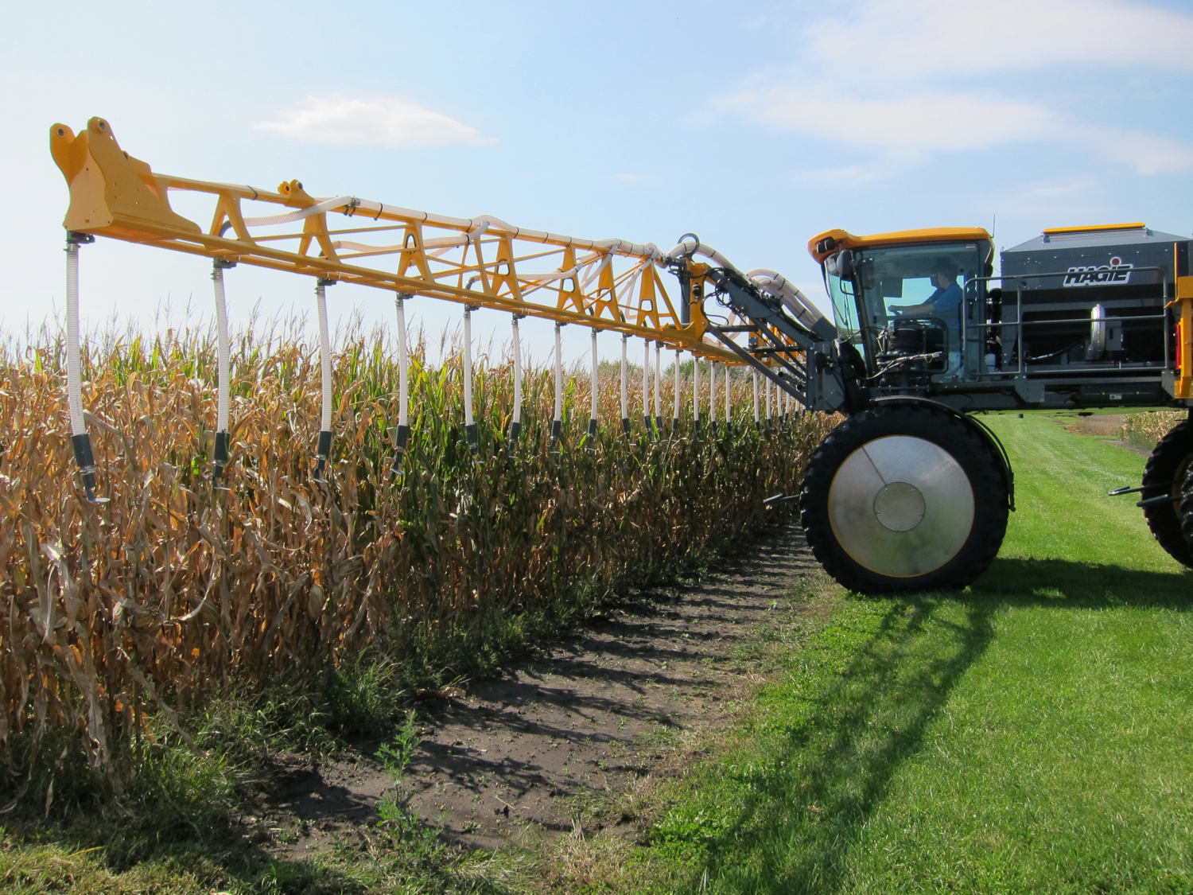
Incorporating cover crops into the cropping system may require adapting current equipment or hiring someone to do the planting equipment, possibly with a high clearance seeder which allows the planting of a cover crop before a cash crop is harvested.
Photo: Rob Myers

Slide 5
Benefits and returns
2-12% yield increases reported in corn and soybean crops planted after a cover crop
Crop Year | Corn | Soybeans
2012* | 9.6% | 11.6%
2013 | 3.1% | 4.3%
2014 | 2.1% | 4.2%
2015 | 1.9% | 2.8%
Data provided from farmers in the SARE/CTIC national cover crop survey. Differences are statistically significant based on analysis by Purdue University. 2012 was a major drought year, where cover crop benefits were striking due to better soil moisture management.
Notes:
Yield comparisons were provided by farmers based on fields that had comparable management other than use of cover crops or no cover crops.
In 2012, approximately 200 farmers provided yield data.
In years 2013-2015 approximately 500 farmers provided yield data each year.
Yield responses vary across fields and farms, and certain farmers did not see increases in yield, but the data presented here are the averages among the participating farmers.
The yields did tend to be greater over time since first planting cover crops, so a yield increase may be less significant during the first year of cover crop use.

Slide 6
Increases in soybean yield over time (years) since starting the use of cover crops
Notes:
The yield benefits of cover crop management can be seen to increase over time. Like a long term investment that accrues interest, so the benefits of managing cover crops will grow over time.
(The x-axis labels are in ”years since planting cover crops” and the numbers in parentheses are the “number of responses”)

Slide 7
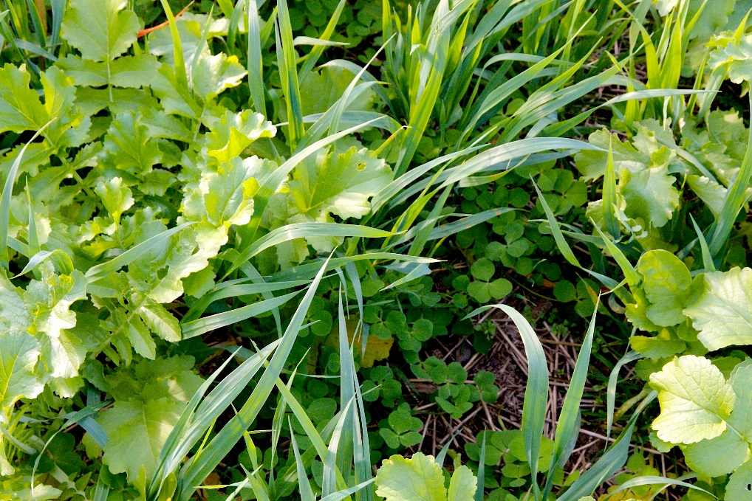
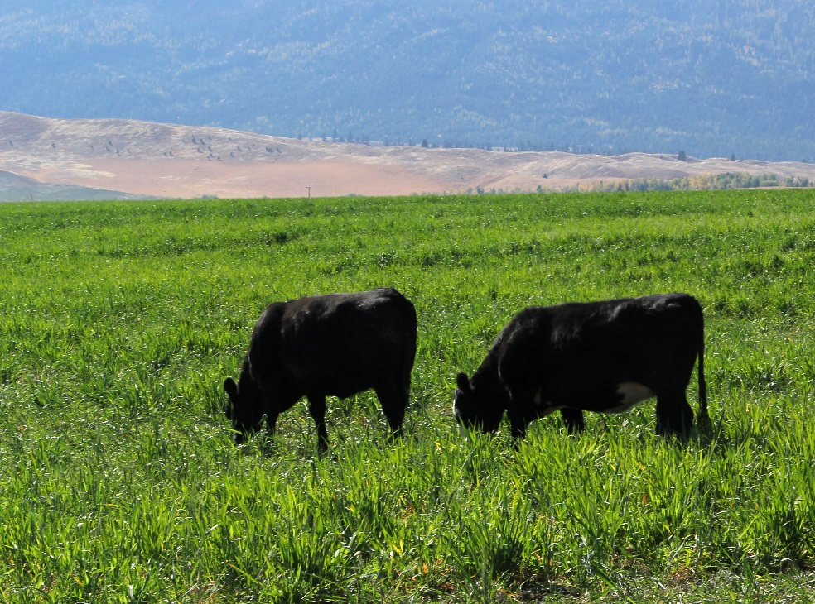
Cover crops can also add to a farm’s bottom line by sometimes reducing the need for inputs like fertilizer or pesticides and by adding an opportunity to graze livestock on cover crops as a high value forage.
Photo by Rob Myers
Photo by Aaron Roth
Notes:
The organic matter, and aboveground and belowground biomass produced by the cover crop can provide nutrients to the soil and to the following cash crops.
Some cover crops, such as legumes, are adept at even adding nitrogen directly to the soil through natural processes.
Additionally, by covering the soil and through allelopathy, cover crops can reduce pest pressure.
They also provide habitat for pollinators and beneficial insects, some of which are predatory insects that deter pests. This means that cover crops can reduce a producer’s reliance on pesticide and fertilizer.
Photo to the left taken in Wallowa County, Oregon.
Photo to the right taken on Dan DeSutter’s farm in Attica, IN.

Slide 8
Returns
 | Return per acre
Yield increase | $25 - 32
Nitrogen fertilizer savings | $0-41 (corn) $0-5 (soybean)
Weed and pest management | $0-23
Grazing opportunities | $19-38*
*Based on stocking two head of cattle per acre for one to two months at Missouri land leasing values for animal grazing. This may undervalue the high quality of cover crop fall forage compared to existing pasture grass.
Notes:
Yield increase:
Assume a 5% average yield increase
2016 national average corn and bean yields: 174 bu/acre (corn, grain); 52.1 bu/acre (soybean)
Price received: $3.71/bushel (corn, grain, 2015); $9.49 (soybean, 2015)
National Ag Statistics Service data from 2016 via https://www.nass.usda.gov/Statistics_by_Subject/index.php?sector=CROPS
Calculations:
Corn = 0.05 * 174 bu/acre * $3.71/bu = $32.28
Beans = 0.05 * 52.1 bu/acre * $9.49/bu = $24.72
Nitrogen fertilizer savings:
Assume the cover crop can replace none to all fertilizer needed for crop production
Average price of nitrogen fertilizer (across all types): $583 per material short ton (2013)
Average use of fertilizer: 140 lb/acre (corn, 2010), 16 lb/acre (soybean, 2012)
Average cost of nitrogen use:
Corn: $583/short ton / 2000 lb * 140 lb/acre = $40.81/acre
Soybean: $583/short ton / 2000 lb * 16 lb/acre = $4.66/acre
Source: https://www.ers.usda.gov/data-products/fertilizer-use-and-price/fertilizer-use-and-price/#A single Excel workbook with all tables in multiple worksheets
Pesticide savings:
Assume the cover crop can replace none to all of the pesticide needed for crop production
Pesticide (herbicide, insecticide, fungicide) expenditure ($/acre):
$22.84/acre corn, 2005
$17.12/acre soybean, 2002
Source: https://www.ers.usda.gov/publications/pub-details/?pubid=43855
Forage:
Cover crops, including rye, radish, millet, oat and lentil, produce between 1340-3880 lb. of dry matter per acre (fall to spring, dependent upon species)
One animal between 1000 and 1400 lb. will be able to graze on this dry matter on one acre for between 18 and 50 days.
Sources: http://practicalfarmers.org/app/uploads/2015/07/Combining-CC-and-Livestock.pdf and http://ipcm.wisc.edu/download/pubsNM/Rye_090507_final.pdf
$8.80 per acre per month is the value of land leased for grazing yearling at stocking rate of 0.46 → $8.80/0.46 = $19.13 per acre per month to stock 2 yearlings on an acre
http://agebb.missouri.edu/mgt/cashrent2015.pdf
Two yearlings on an acre will consume about 1600 lb. of DM per month.
Source: Joe Horner, MU Extension
A cover crop, depending on the species and season will produce enough DM to feed these yearlings for 1-2 months on an acre.
This means that returns from grazing cattle on cover crops could be between $19-38 per acre.
This number could vary greatly depending upon the type of animal being grazed, the quality of the cover crop stand, the species of cover crop, the climate, the location-specific costs and prices for grazing, and other factors.
None of these figures account for time or labor costs, or equipment costs.
Please note that the analyses in this slide set are based on corn and soybean production.
Prepared in March, 2017

Slide 9
Crimson clover
Legume cover crops fix atmospheric nitrogen and may therefore provide nitrogen to other crops and may reduce fertilizer-related input costs.
Photo: Rob Myers
Notes:
Crimson clover is a legume cover crop known for its ability to supply nitrogen to the soil.

Slide 10
Net Returns?
 | Cost per acre |  | Return per acre
Seed | $20-30 | Yield increase | $25-32
Planting the seed | $10-12 | Nitrogen fertilizer savings | $0-41 (corn) $0-5 (soybean)
Terminating the cover crop | $0-10 | Weed and pest management | $0-23
 |  | Returns before grazing Grazing potential income | $25-101 $19-38
Total | $30-52 | Total potential return with grazing included | $44-139
Potential exists for positive net returns if cover crops are managed and utilized well.
Notes:
Prepared March, 2017.

Slide 11
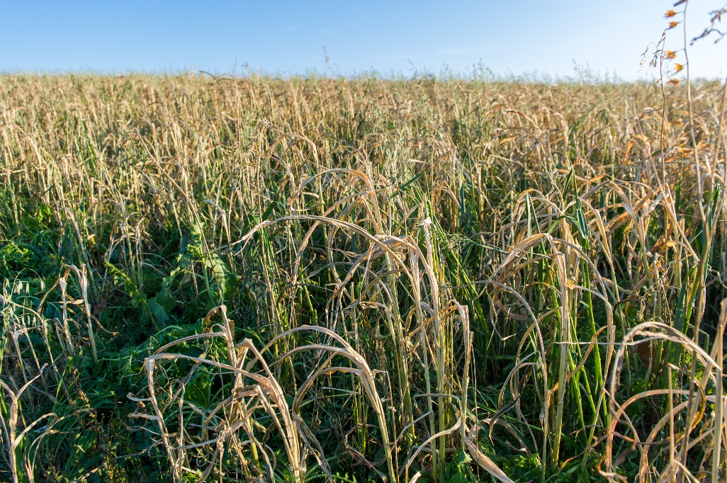
Long-term returns
Build soil organic matter – improve nutrient cycling, soil moisture, and land value
Reduce soil compaction (potentially eliminate deep tillage)
Reduce disease pressure by increasing system diversity
Improve overall soil health – improve yields, increased resilience
Reduce erosion of soil
Mix of oats, radish, and triticale in Holtwood, PA on Steve Groff’s farm.
Photo by Edwin Remsberg

Slide 12
Most farmers agree that cover crops can reduce yield variability during extreme weather events.
Notes:
Cover crop surveys have shown a 2-12% yield increase in corn and soybean crops grown after a cover crop is terminated.
These yield increases were greater during periods of extreme weather, like the Midwest drought of 2012.
We’ve seen how cover crops can positively impact soil water storage and reduce erosion. These impacts can translate to farm resilience in the face of extreme weather and boost the productivity of soil.

Slide 13
Off-farm returns to society
  Less sedimentation in streams and rivers
  Reduced movement of pesticides off of farms
  Reduced nutrient loading of surface waters – local rivers, lakes, and even further to areas like the Gulf of Mexico
  Increased sequestration of carbon into the soil
  Benefits for wildlife, pollinators
  Countryside value – greener landscape fall to spring

Slide 14
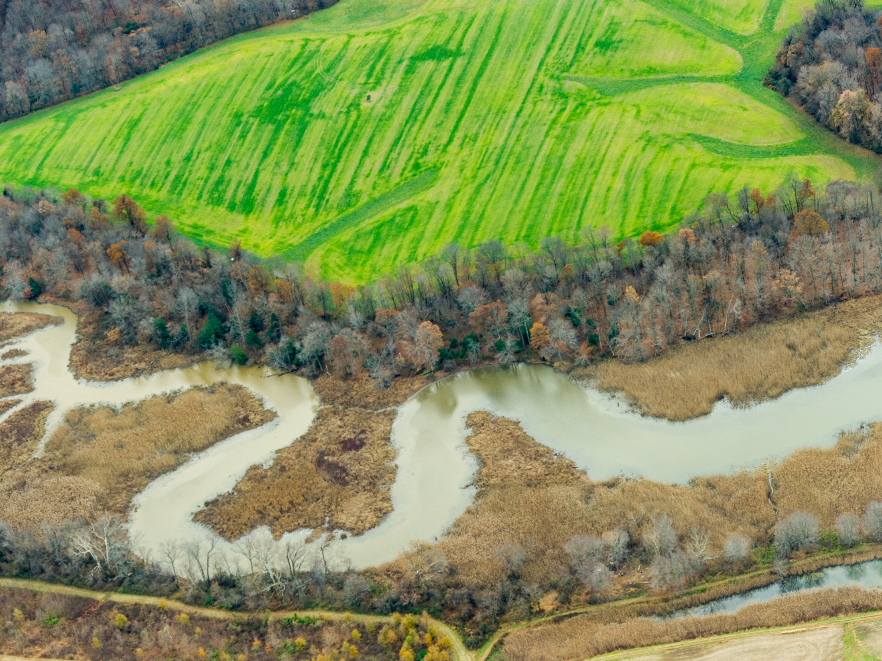
Landscapes are connected by air and water.
Cover crops not only benefit the farmer but also benefit society, through off-farm returns in water and air quality enhancement and the creation of habitat for pollinators.
Photo by Edwin Remsberg
Notes:
Photo of cover crops lining a riverbank in Maryland.

Slide 15
From the farmers:
“Cover crops are a long term investment in improving your soil biology.”
“Start small with crops that winter kill. Realize that the real benefits will come with time. Proper mindset is crucial.”
Notes:
These are some farmer quotes about cover crops and soil health from the SARE/CTIC Cover Crop surveys.

Slide 16
Takeaways
Many see cover crops as a long term investment in their soil health and productivity
The profitability of cover crops depends upon each particular enterprise and management decisions.
Cover crops should be managed and planned for like any other part of the enterprise.
It may take a trial and error process to get the system that works best.

Slide 17

Resources for funding
NRCS Environmental Quality Incentives Program
NRCS Conservation Stewardship Program
SARE Program Farmer Rancher grants
State cost-share programs
Notes:
The NRCS has several programs to offer funds for farmers wishing to incorporate conservation practices, such as cover cropping, into their production.
SARE offers a Farmer Rancher grant program which enables farmers to, independently or in collaboration with others, implement new practices on their farm while eliminating some or all of the financial burden.
And certain states, such as Maryland, have cost-share programs that enable farmers to plant cover crops at a decreased cost to them.

Slide 18
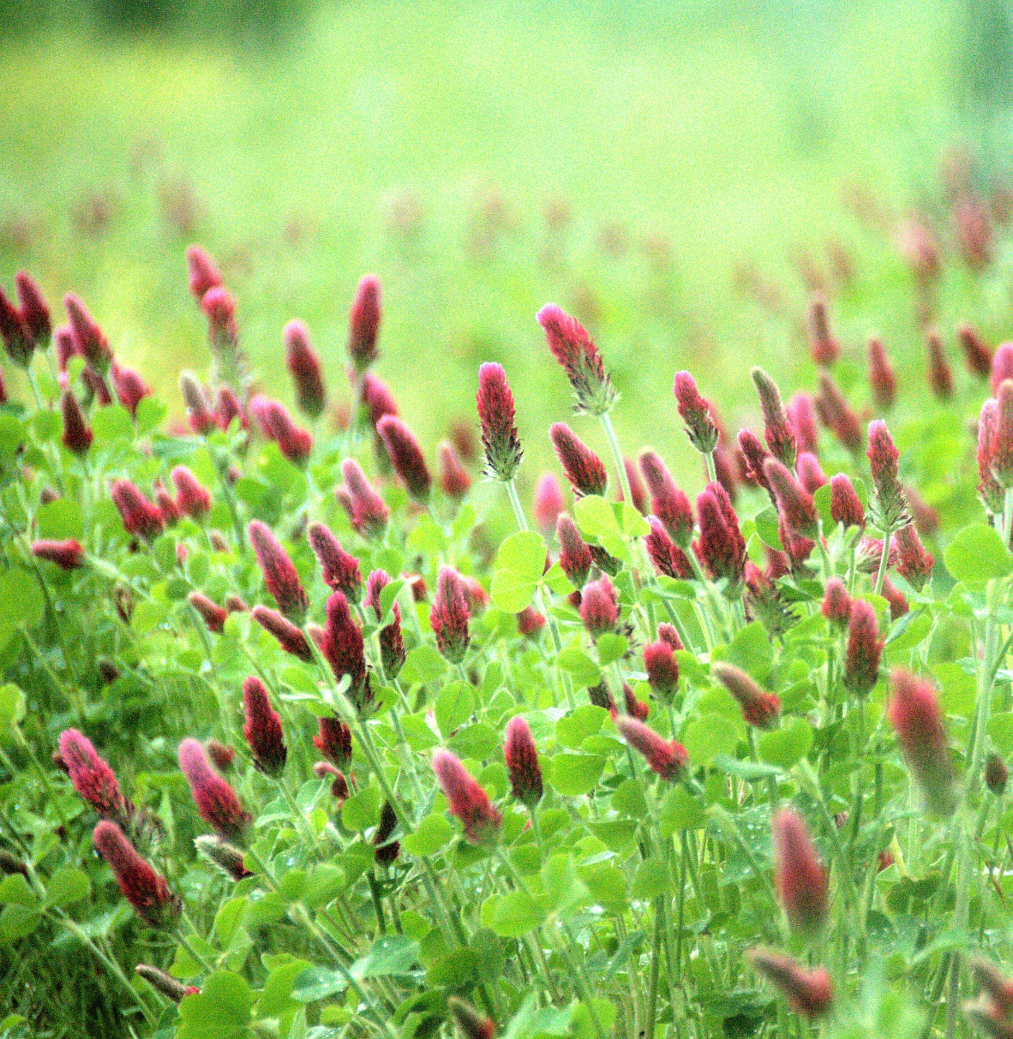
Thank you!
Photo by Edwin Remsberg
Notes:
Photo taken at the University of Missouri Bradford Research Center in Columbia, MO.

