Slide 1
Cover Crops and Clean Water
Exploring the water quality and environmental benefits of cover crop use
Notes:
This presentation was prepared by Sami Tellatin and provided by the USDA-SARE program and the EPA for outreach and educational purposes. Other cover crop slide sets are also available at the website: http://sare.org/cover-crops
Prepared in June, 2017

Slide 2
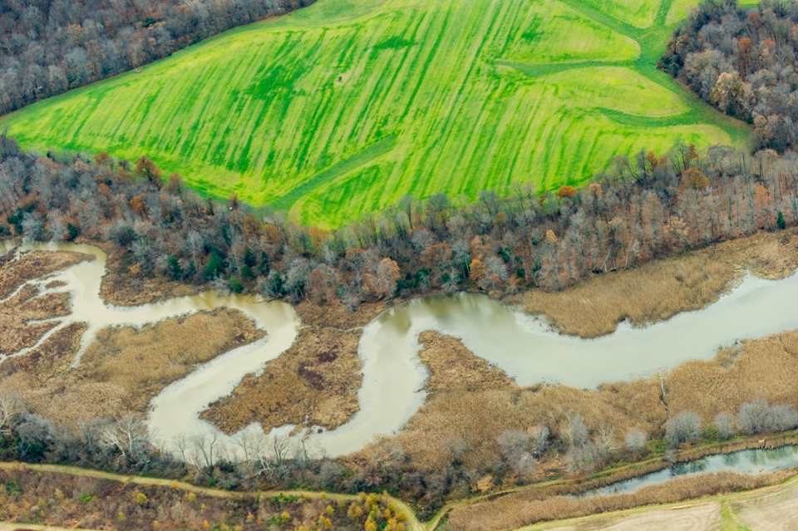
Objectives
Describe cover crops
Understand how cover crops impact soil loss, water infiltration, nutrient losses, and soil organic matter on agricultural fields
Identify the water quality implications
Photo by Edwin Remsberg
Notes:
Use the notes on the slide set to help guide your presentation.

Slide 3
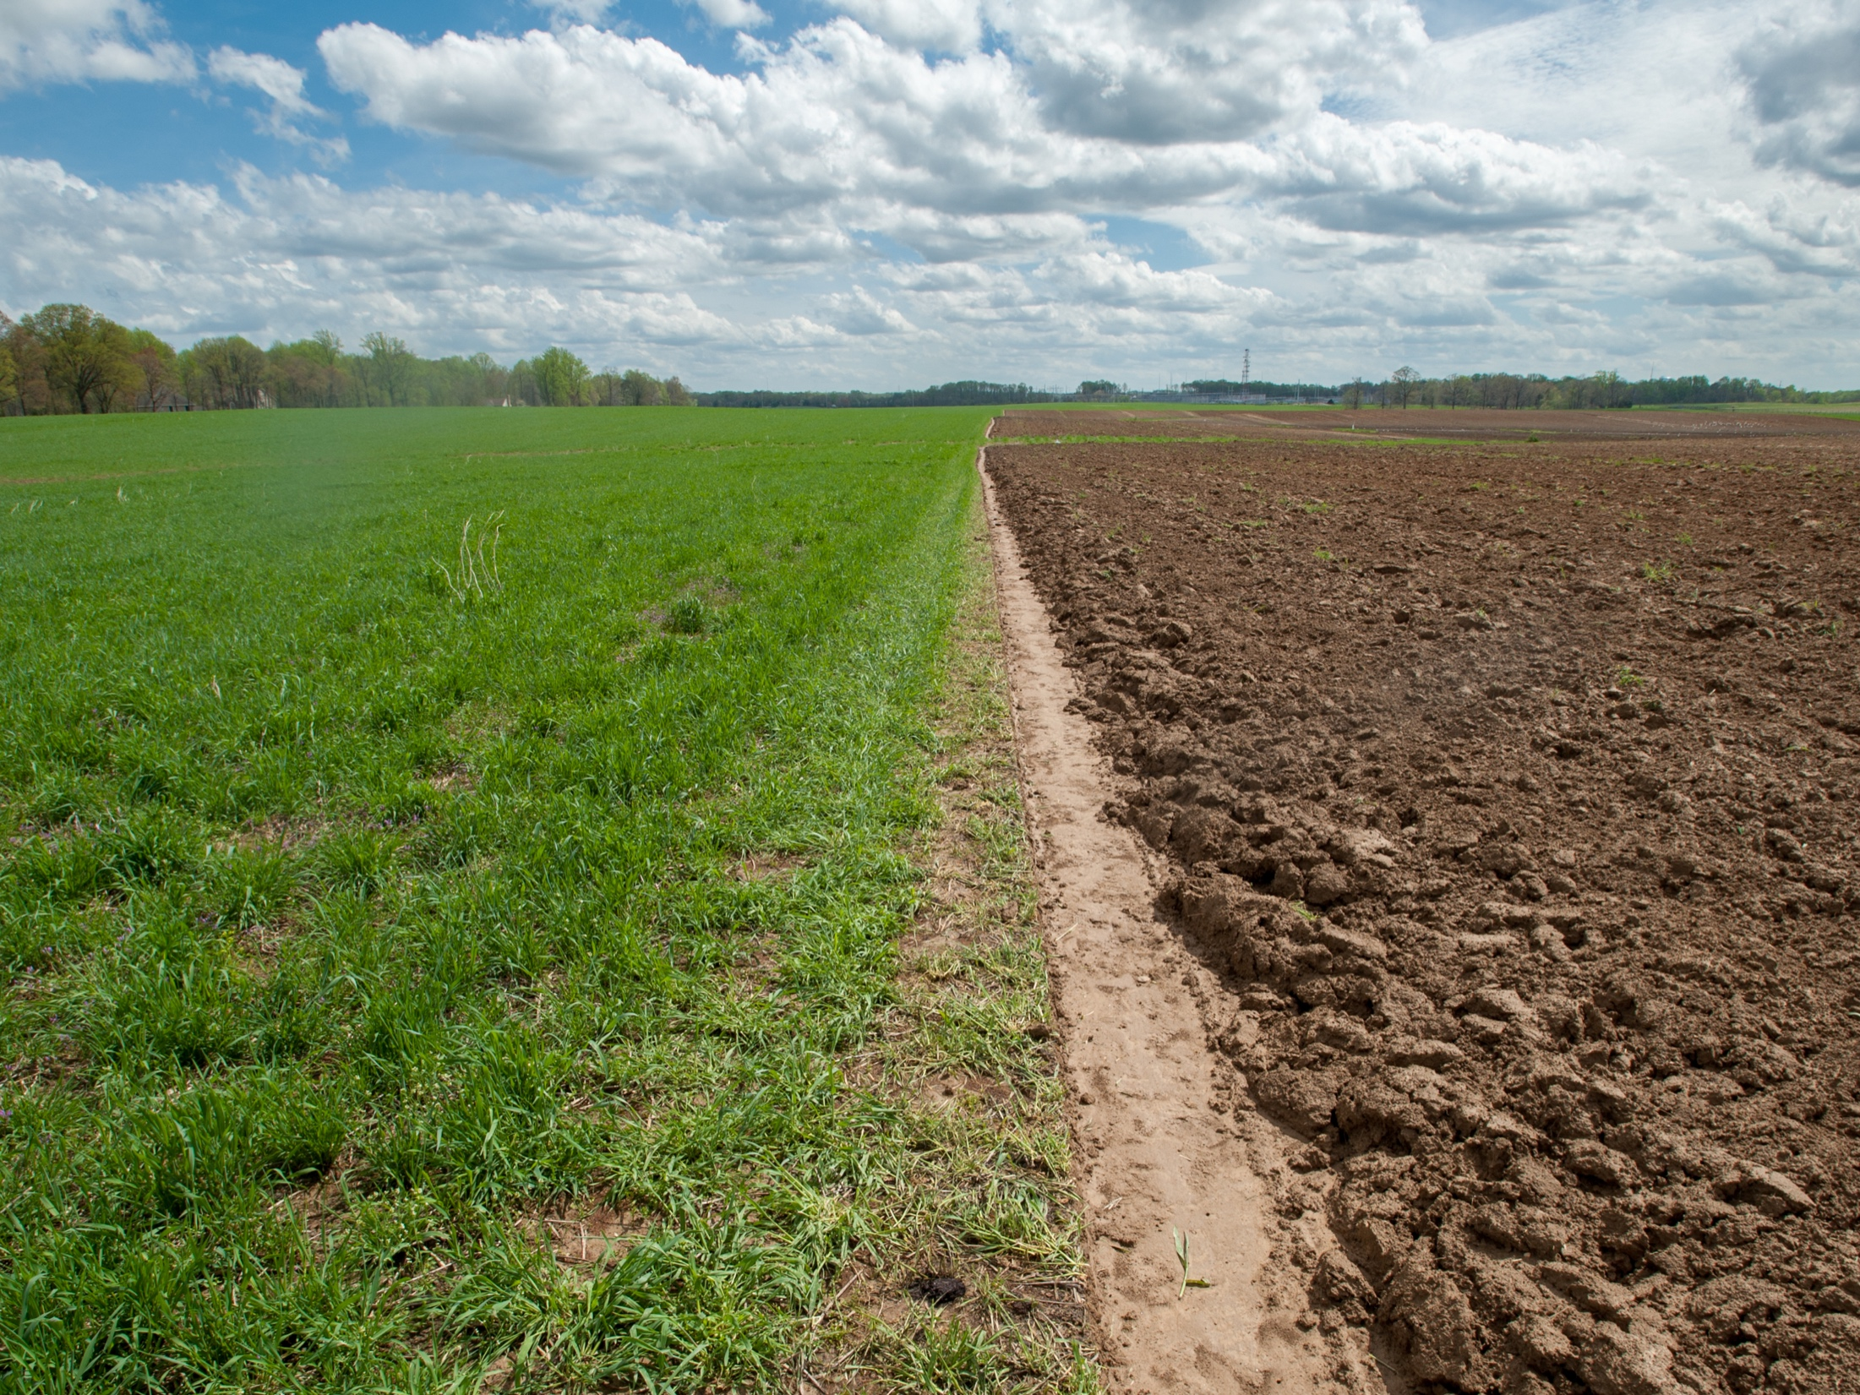
What are cover crops?
Bare soil in fallow
Cover crop of annual ryegrass
Photo: Edwin Remsberg
Notes:
About Cover Crops
Crops grown during a time of the year when we wouldn’t normally plant anything, such as during winter or summer fallow periods in row crop operations. Sometimes used as living cover grown with other crops to cover the soil, provide nutrients, and prevent weeds.
Photo taken at Steve Groff’s farm in Holtwood, PA.

Slide 4
About Cover Crops
Cover crops are tools to keep the soil in place, improve water quality and reduce pollution from agricultural activities.
They include:
Cereals, brassicas, legumes and other broadleaf species
Annuals, biennials, perennials
Cover crops are adaptable to various cropping systems
Notes:
More about cover crops:
Dozens of different species in use today in U.S.
Used all over the globe
Applicable in multiple U.S. agricultural systems, including viticulture, annual row crop agriculture, horticulture systems and as livestock pasture.

Slide 5
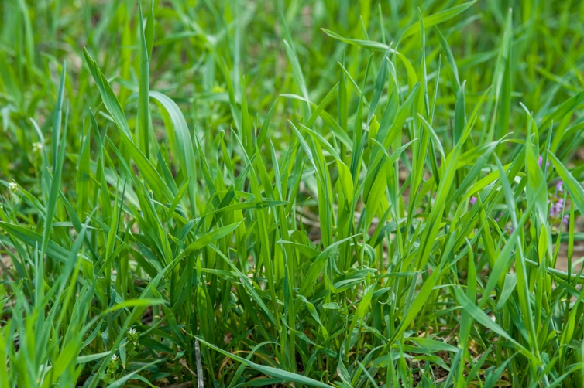
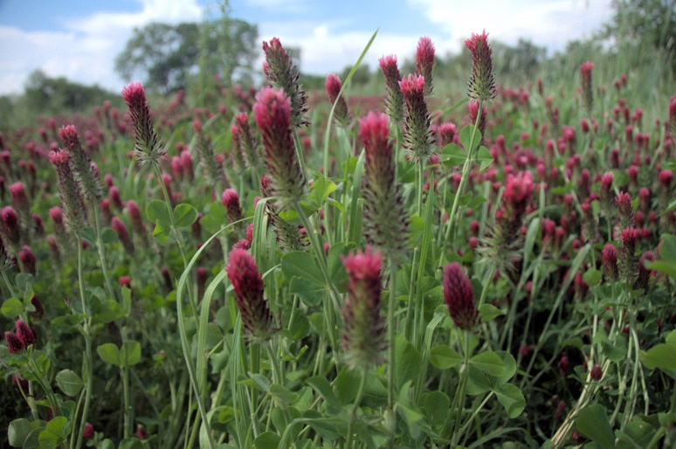
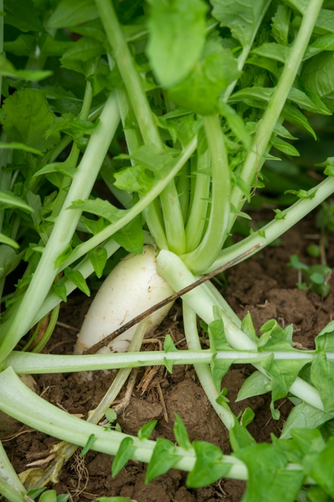
Popular Cover Crops
Cereal rye: nitrogen scavenger, erosion prevention, weed suppression
Radish: erosion prevention, weed suppression, soil compaction reduction
Crimson clover: nitrogen source, erosion prevention
Photos by Edwin Remsberg
Notes:
Annual ryegrass acquires great amounts of biomass and is known for scavenging nitrogen, preventing erosion and suppressing weeds.
Brassicas and mustards, like the radish, are known to prevent erosion but also to reduce soil compaction and suppress weeds. Radishes have large tap roots that act to naturally aerate and open up the soil, like a plow.
Crimson clover is a legume crop; legumes are known for their ability to provide nitrogen. Crimson clover is also effective at preventing erosion.
You’ll notice that each of these cover crops, though different, shares benefits.
For example, they all prevent erosion.
But their differences are important and are one reason many farmers have started to plant mixtures of different cover crop species, so that there are multiple benefits to their soil.
This also increases the biodiversity of a landscape, which is very important to promoting ecosystem health.
Photo locations: top left was taken in Holtwood, PA; bottom left was taken in MD; right photo was taken at the USDA NRCS Plant Materials Center in MO.

Slide 6
Cover Crop Acreage
In 2012, the USDA reported 10.3 million acres of US cropland planted to cover crops (1).
With about 267 million acres of row crop agriculture in the US, the potential for cover crop adoption is quite higher than what has actually been achieved to date (2).
Notes:
Myers, R. and C. Watts. 2015. Progress and perspectives with cover crops: interpreting three years of farmer surveys on cover crops. J. Soil Water Conserv. 70(6):125A:129A.
National Agricultural Statistics Service. 2016a. Acreage. [Online]. Available at http://www.usda.gov/nass/PUBS/TODAYRPT/acrg0616.pdf (verified 16 September 2016).

Slide 7
Why Plant Cover Crops?
Illustration by Carlyn Iverson
Notes:
The scientific literature is ripe with data about the benefits of planting cover crops. They have been shown to decrease, or almost completely eliminate, erosion from agricultural fields, increase rainfall infiltration to the soil layer, keep nutrients like nitrogen and phosphorus in place and prevent the loss of these nutrients to vulnerable waterways, and increase soil organic matter levels (which are a measure of soil fertility).
They’re a lot like this Swiss Army Knife – a useful and dynamic tool!

Slide 8
Reductions in Soil Loss
Erosion causes the displacement of soil and sediment from agricultural fields.
Sediment is a costly pollutant in US waterways, with estimated average sediment losses of 2.7 tons per acre per year across the US (3).
On average, cover crops reduced sediment losses by:
20.8 tons per acre on conventional-till fields
6.5 tons per acre on reduced-till fields
1.2 tons per acre on no-till fields
Notes:
Main Idea: Cover crops can successfully decrease, or almost completely eliminate, soil loss from various production systems.
They do this by:
- Providing coverage of the soil surface and protecting it from rain and wind
- Rooting into the soil profile and improving soil structure
- Encouraging rainfall infiltration to the soil profile
Studies have shown decreases in soil loss from fields planted into different types of cover crops:
- Non-legume cover crops, including rye, ryegrass, triticale, barley, and wheat, reduced soil loss by 31 to 100%.
- Legume cover crops, including red clover, crimson clover, lentil, and pea, reduced soil loss by 38 to 69%.
- Mustard, a brassica cover crop, reduced soil loss by up to 82%.
On average, cover crops reduced sediment losses from erosion by 20.8 tons per acre on conventional-till fields, 6.5 tons per acre on reduced-till fields, and 1.2 tons per acre on no-till fields.
(3) Natural Resources Conservation Service. 2007 National Resources Inventory. National soil erosion results tables. [Online]. Available at: https://www.nrcs.usda.gov/wps/portal/nrcs/detail/national/home/?cid=stelprdb1041678 (verified 18 July 2017).

Slide 9
Cereal rye
Non-legume cover crops, including rye, were found to reduce soil loss by 31 to 100%.
Photo: Edwin Remsberg
Notes:
Cereal rye is known as the “queen” of cover crops as it is the most popular cover crop. It is well known to prevent erosion and scavenge nitrogen.
Non-legume cover crops, including rye, ryegrass, triticale, barley, and wheat, reduced soil loss by 31 to 100% as compared to fields in which no cover crops were grown.
Legume cover crops, including red clover, crimson clover, lentil, and pea, reduced soil loss by 38 to 69% compared to no cover crops.
Mustard, a brassica, reduced soil loss by up to 82% compared to no cover crop.
Photo taken in Harford County, MD.

Slide 10
Increases in Water Infiltration
Cover crops increased rainfall infiltration to the soil layer by more than six-fold in some systems.
Improvements in rainfall infiltration to the soil surface signal two important benefits to cropping systems: decreased runoff and thus less erosion risk, and improved soil water and soil structural conditions which can benefit crop production.
Notes:
Main Idea: Cover crops can successfully increase the infiltration of rainfall or irrigation water into the soil layer.
They do this by covering the ground with their biomass, and improving soil structure with their roots. Some specific mechanisms include:
- Preventing soil surface sealing (where the soil essentially becomes impermeable after rainfall)
- Improving soil structure with increased soil aggregate stability, soil porosity, and water storage capacity

Slide 11
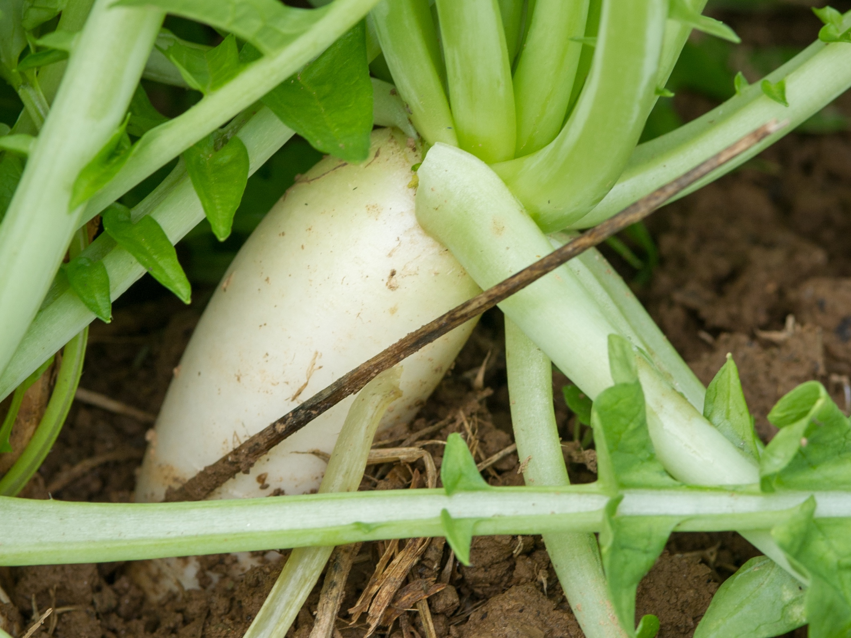
Oilseed radish
The oilseed radish as a cover crop reduces soil compaction and improves water infiltration. Cover crops have been shown to improve infiltration by six fold.
Photo: Edwin Remsberg
Notes:
The radish is a Brassica cover crop that is known for its ability to reduce soil compaction and discourage certain pests and weeds.
By relieving soil compaction, the radish opens up the soil to receive water and allow for better water infiltration.
Photo taken in Maryland

Slide 12
Reductions in Nutrient Losses
48% reductions in nitrogen losses
Cover crops reduced the amount of nitrogen leaving a field by 1 to 89%, with a median value of 48% (across 10 studies and 16 observed reductions).
Several sources also illustrated the ability of cover crops to reduce average total phosphorus losses to waterways by 15 to 92%.
Notes:
Main Idea: Cover crops can lead to smart nutrient management on the farm, and mitigate water pollution by keeping nutrients in place.
Cover crops are able to successfully reduce nitrogen losses to waterways because they cover the ground and prevent runoff and erosion, scavenge soil nitrogen thus preventing it from being leached, and can provide natural sources of nitrogen to the following cash crops and thus reduce the amount of fertilizer needed for production.
- Cover crops reduced nitrogen yields in runoff and leachate water samples by 7 to 89%, with a median value of 62% (across 12 studies and 28 observed reductions).
They also reduced nitrogen concentrations in water samples by 1 to 89%, with a median value of 48% (across 10 studies and 16 observed reductions).
For context, “nitrogen yields” refers to the physical amount, the mass, of nitrogen per unit area – so the amount of nitrogen being displaced from a given amount of soil or farmland. This is important for estimating the contributions of specific sources to water pollution, and also matches the way that nitrogen inputs are often measured (unit mass per area). “Nitrogen concentrations” refer to the mass of nitrogen per unit volume of water, and this measurement also has important water quality implications – namely for the biology of water ecosystems. If a concentration of a given nutrient, like nitrogen, in a water body exceeds a certain amount, some organisms will thrive and deplete the oxygen levels in the water, thus harming other organisms (like fish) who need oxygen to survive.
Compared to the impact of cover crops on erosion or nitrogen losses, the impact of cover crops on phosphorus in the field is less studied and the research inconclusive.
- Phosphorus can be transported to waterways by above- or below-ground water flows.
- Some studies report finding no significant impact of cover crops on total phosphorus losses, sometimes because the cover crops may have reduced total phosphorus losses but increased soluble phosphorus losses (often in below-ground, leachate water).
- However, reductions have been observed, showing that cover crops reduced total phosphorus loads in water samples by 15 to 92%.
- The main mechanism by which cover crops may inhibit phosphorus losses is through preventing soil loss by covering the ground and rooting to secure the soil in place.

Slide 13
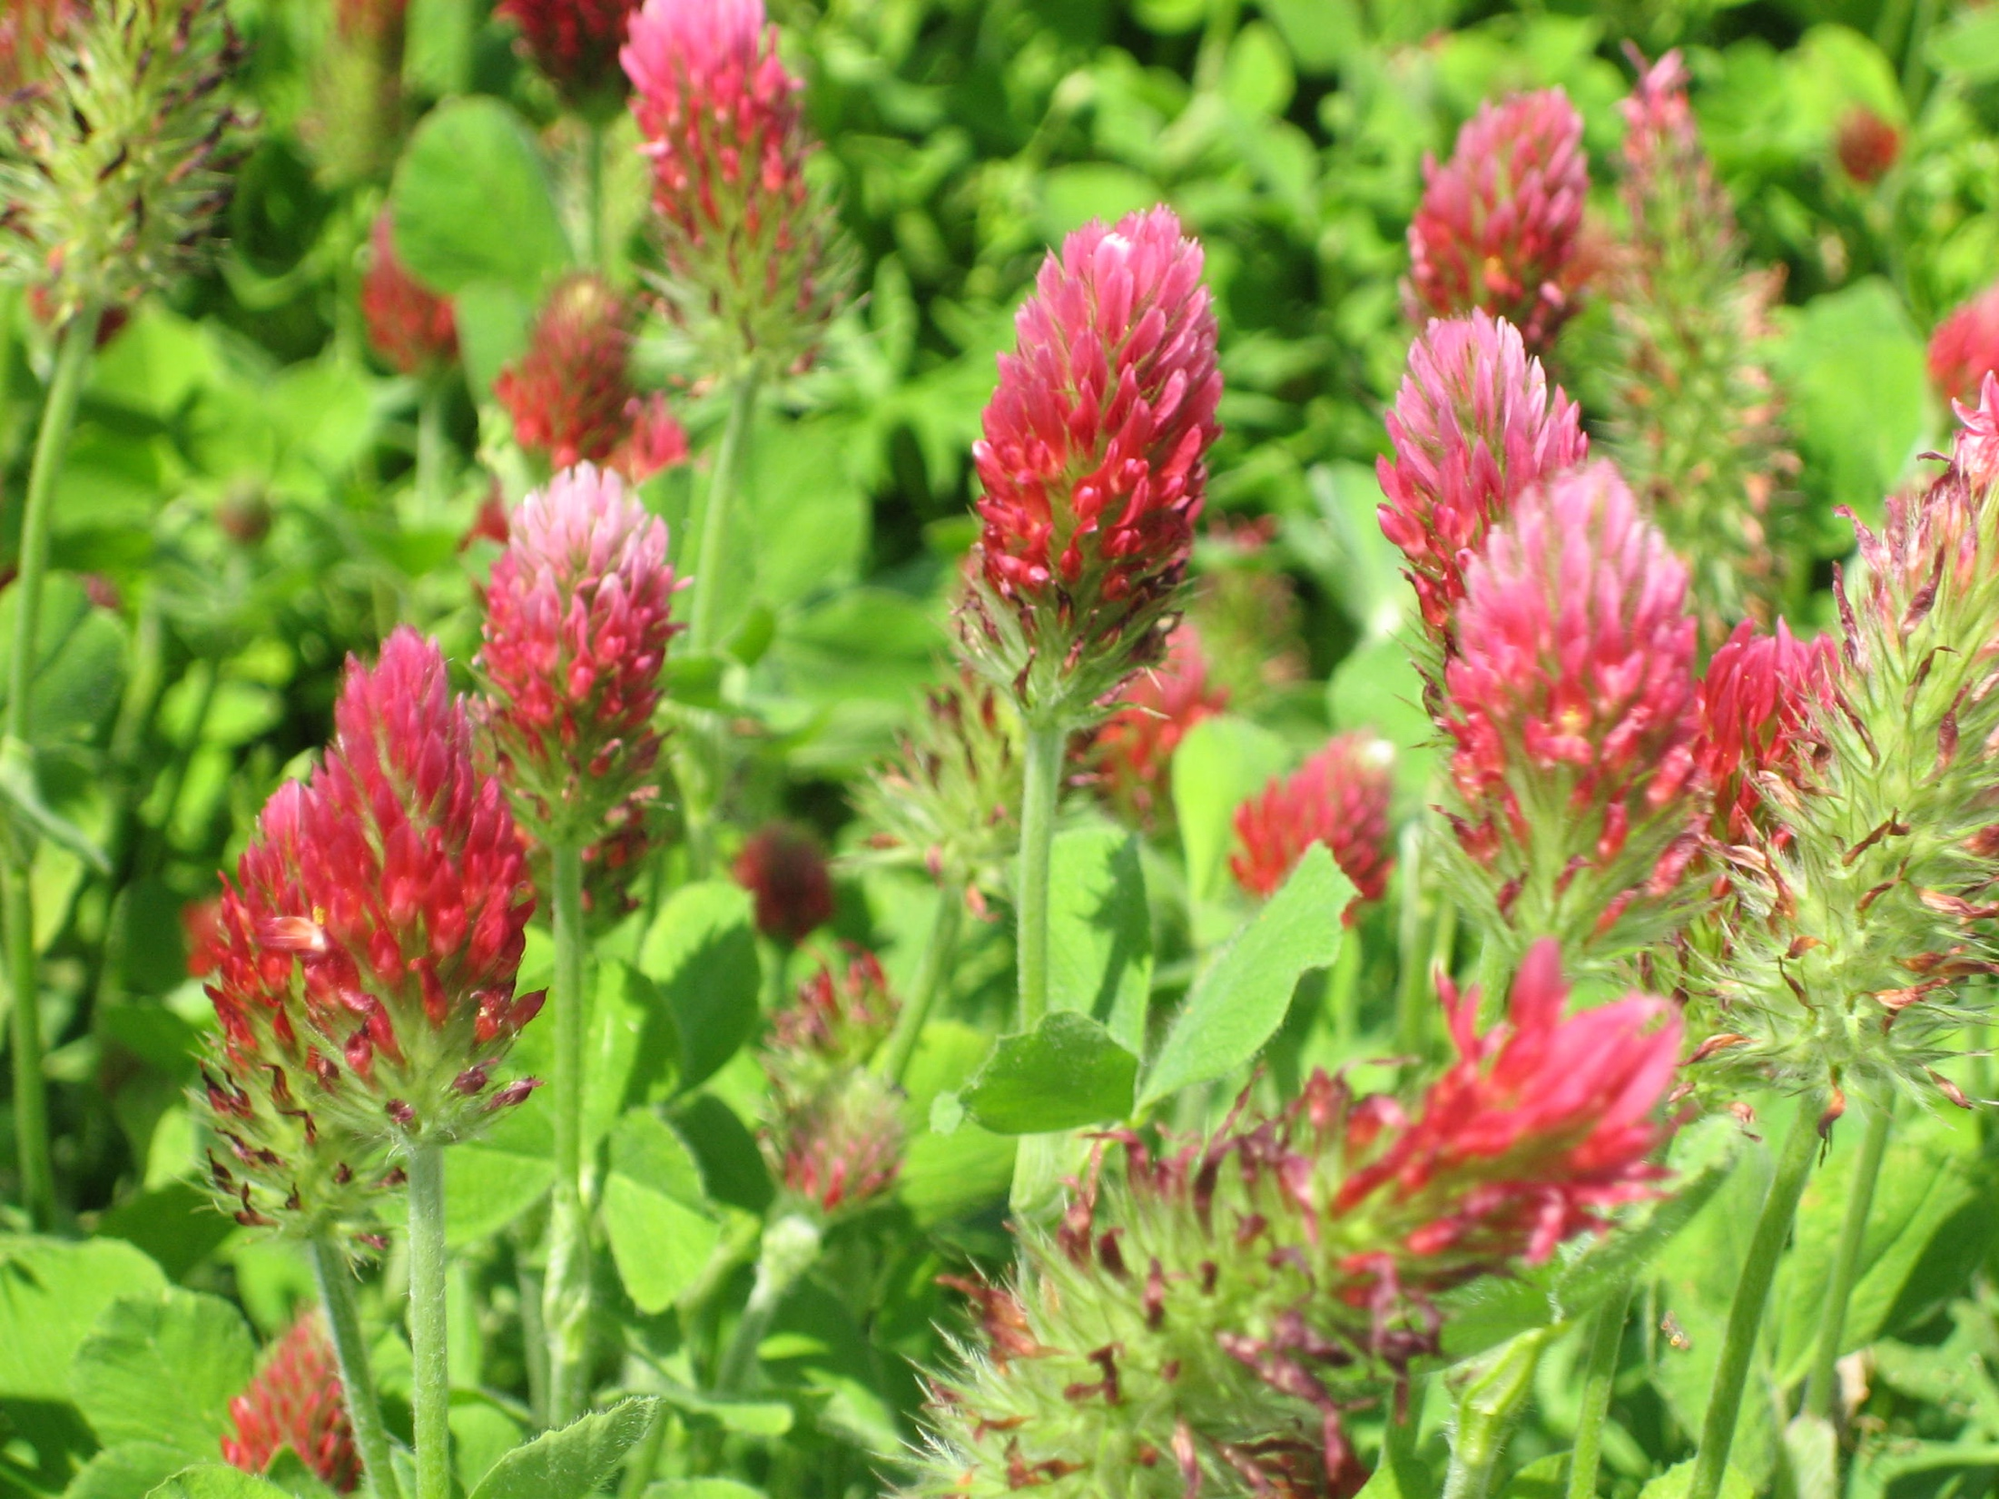
Legume cover crops, like crimson clover, can contribute to reductions in nitrogen losses in a less direct way than scavenging nitrogen in the soil. Through the natural process of nitrogen fixation, these cover crops can add nitrogen for other plants to use and thereby decrease the amount of industrial fertilizer needed.
Photo: Rob Myers
Notes:
Crimson clover is a legume cover crop known for its ability to supply nitrogen to the soil.
Photo taken in Columbia, MO.

Slide 14
Increases in Organic Matter
Legume crops were found to increase levels of soil organic matter by 8 to 114%.
Non-legume cover crops, including grasses and brassicas, were found to increase soil organic matter by 4 to 62%.
Notes:
Definition of soil organic matter: Soil organic matter is decomposed organic material (leaves, roots, microorganisms) that exists in the soil and acts as a reservoir of water and nutrients.
Main Idea: Cover crops increase soil organic matter.
They do this by protecting the soil surface from erosion, adding biomass to the soil, especially below the soil surface, and creating a habitat for microorganisms like fungi that contribute to the soil biology and provide more pathways for nutrient management in the soil ecosystem.

Slide 15
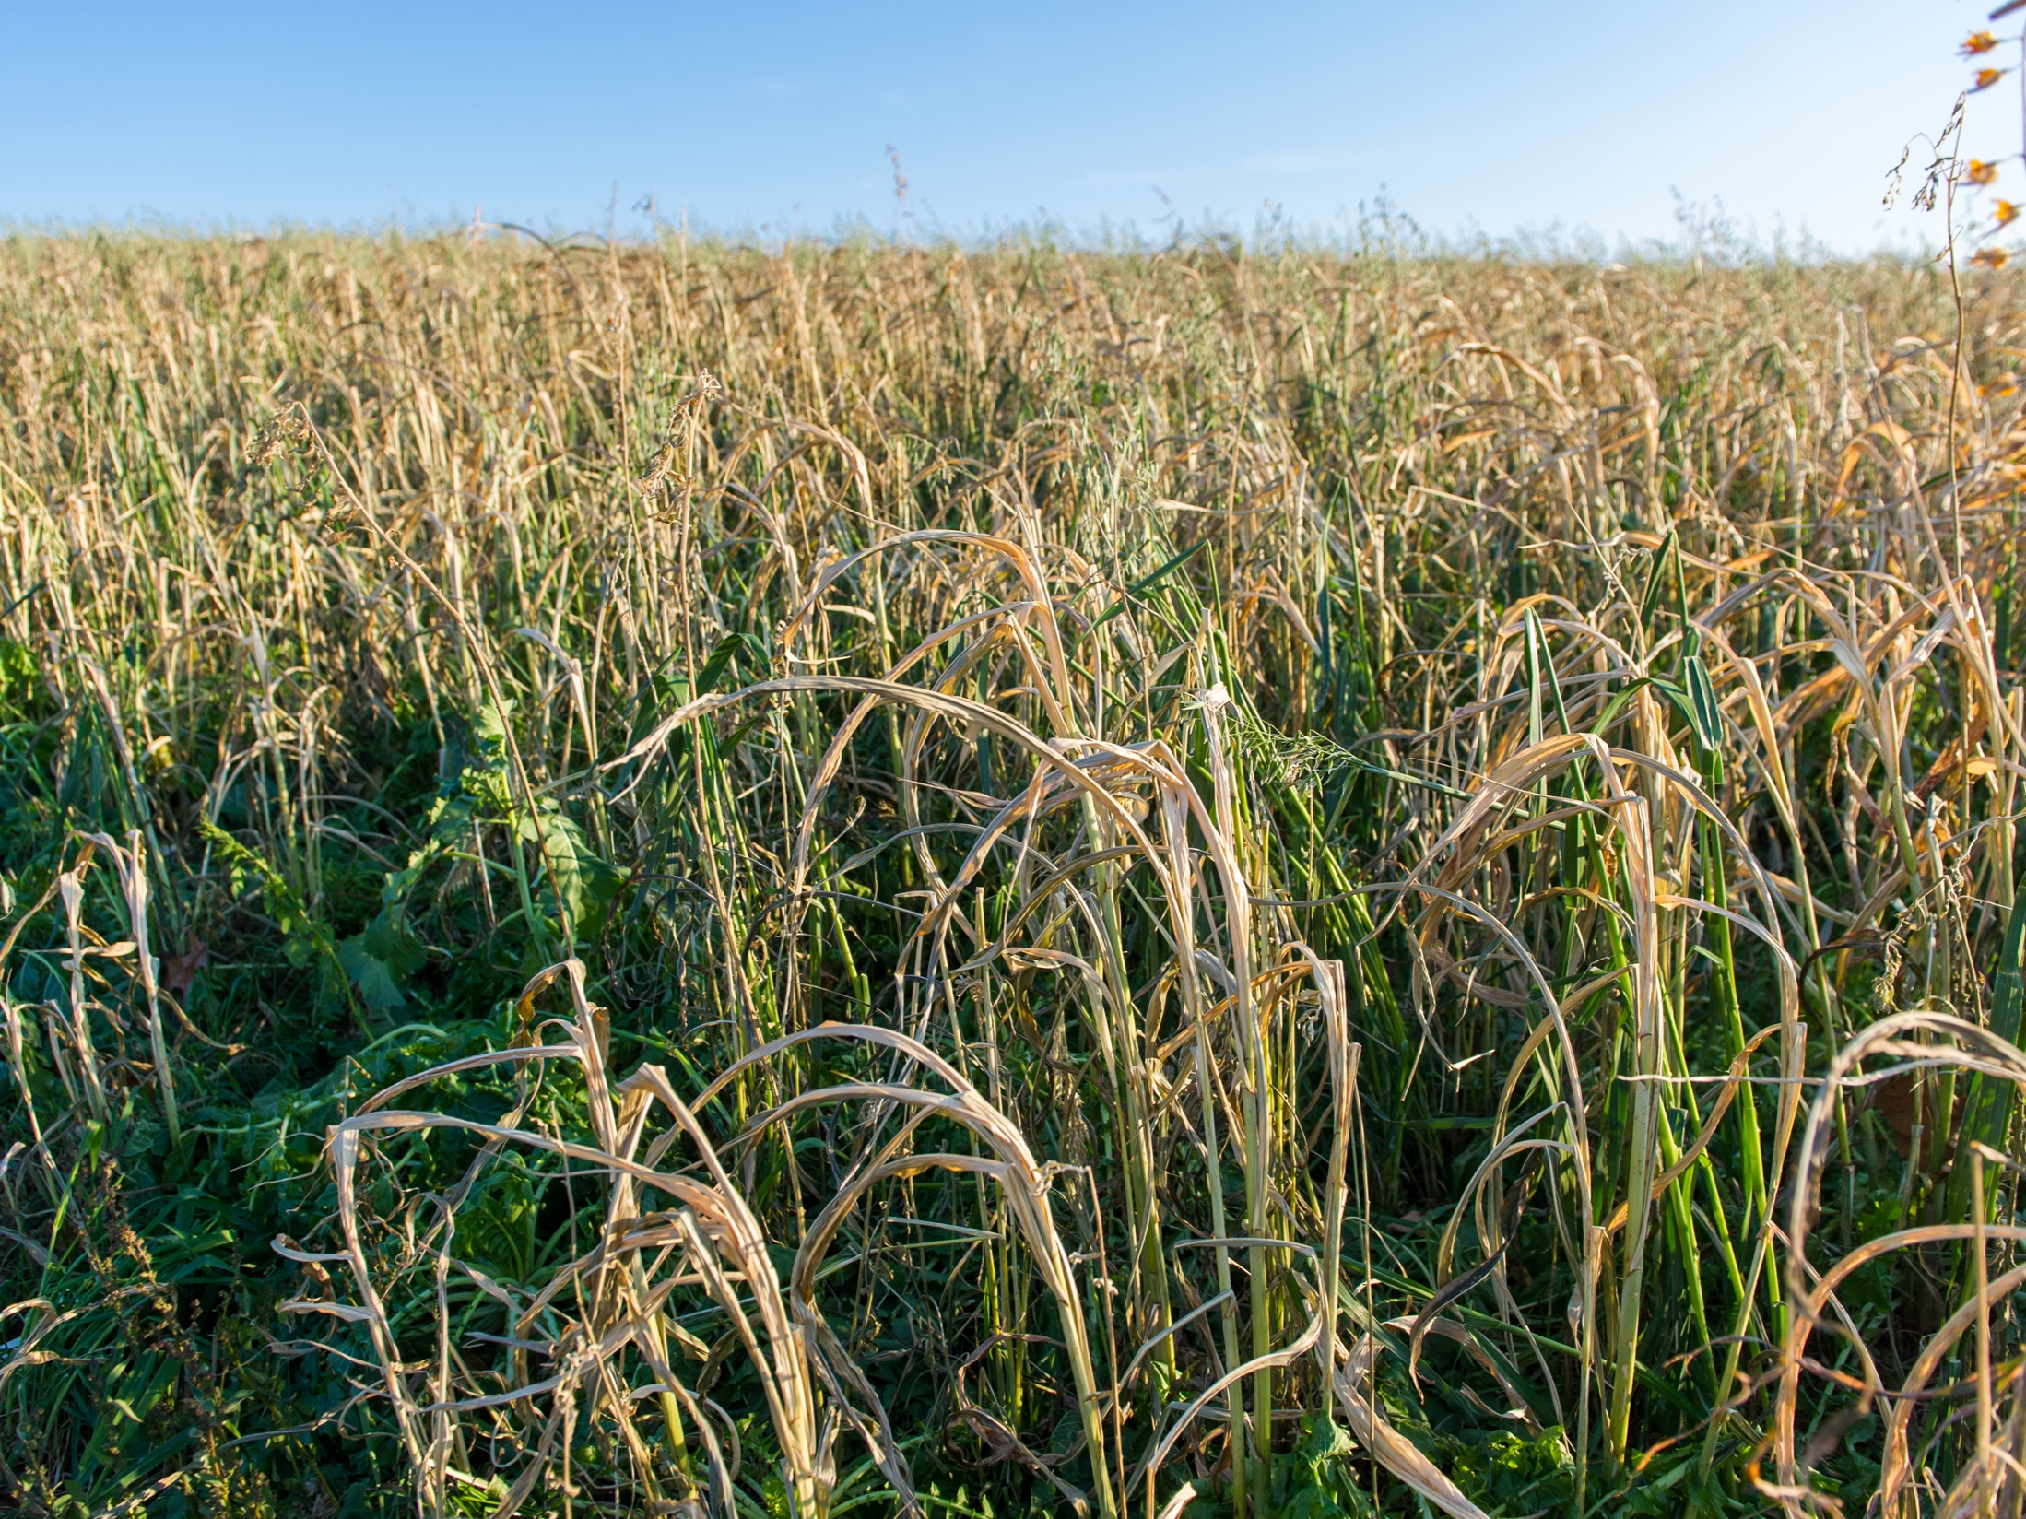
Mixed radish, triticale, and oats
Cover crop mixes can be designed to include both legume and non-legume species. These mixes can also be managed to have longer cover crop growth throughout the season, thus adding more time and plant growth to build soil organic matter.
Photo: Edwin Remsberg
Notes:
Mixes are a popular option for maximizing benefits from cover crops.
Photo from Steve Groff’s farm in Holtwood, PA.

Slide 16
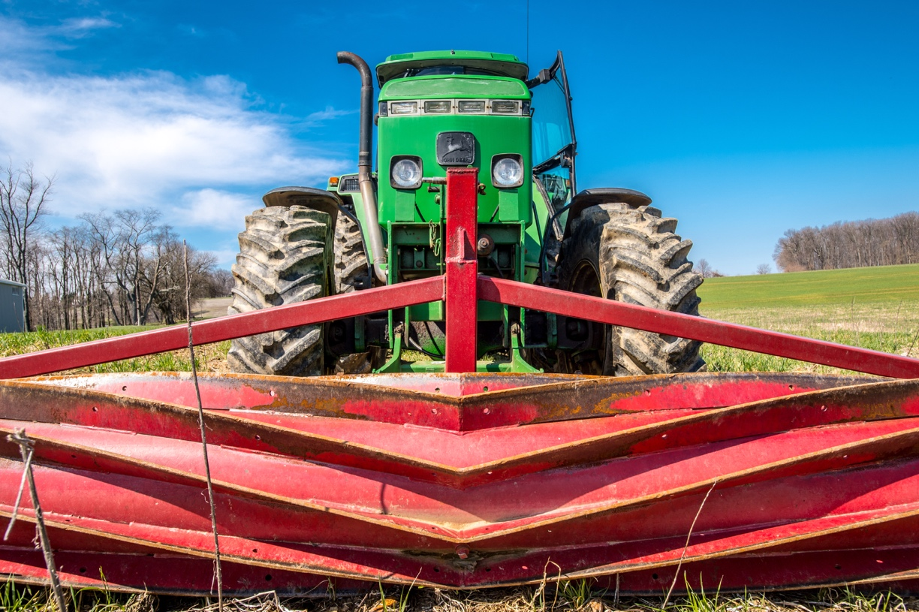
Combining Management Strategies: Tillage
Conservation tillage practices were responsible for an 89% reduction in soil loss as compared to conventional tillage practices.
Photo: Edwin Remsberg
Notes:
Main Idea: Cover crop management can be combined with no-till management and intentional manure management to create healthy conditions on the farm and in surrounding ecosystems.
Some producers use this piece of equipment, known as the roller crimper, to manually roll down the cover crop before planting a cash crop.
This method allows the farmer to use no-till management and further steward their soil health.
Photo taken in Maryland.

Slide 17
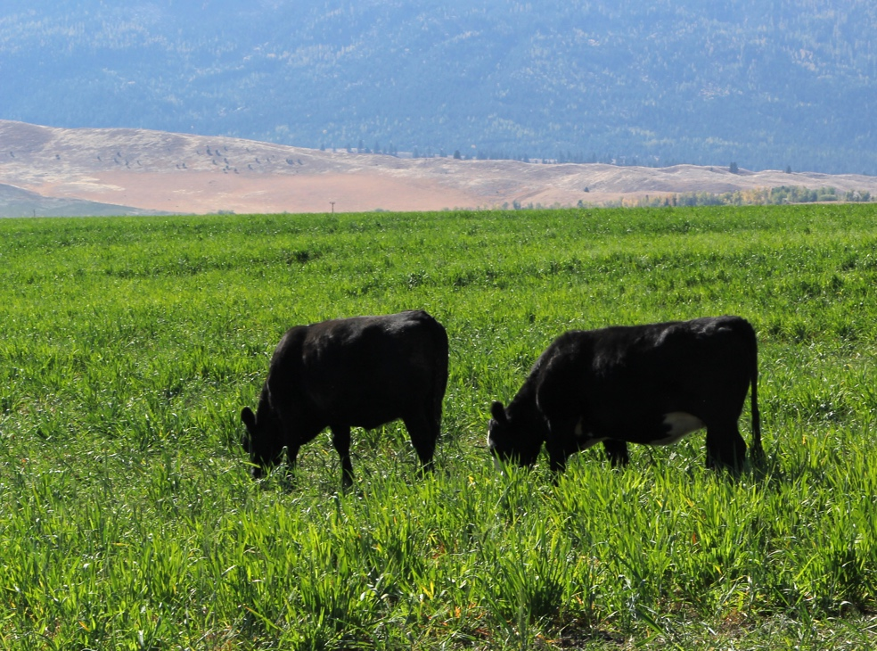
Combining Management Strategies: Manure
Manure application rates can be managed in a way to mitigate losses of nitrogen and phosphorus, especially when cover crops are planted to offset any nutrient loss risks posed by manure application.
Photo: Aaron Roth, NRCS Oregon
Notes:
Main Idea: Cover crop management can be combined with no-till management and intentional manure management to create healthy conditions on the farm and in surrounding ecosystems.

Slide 18
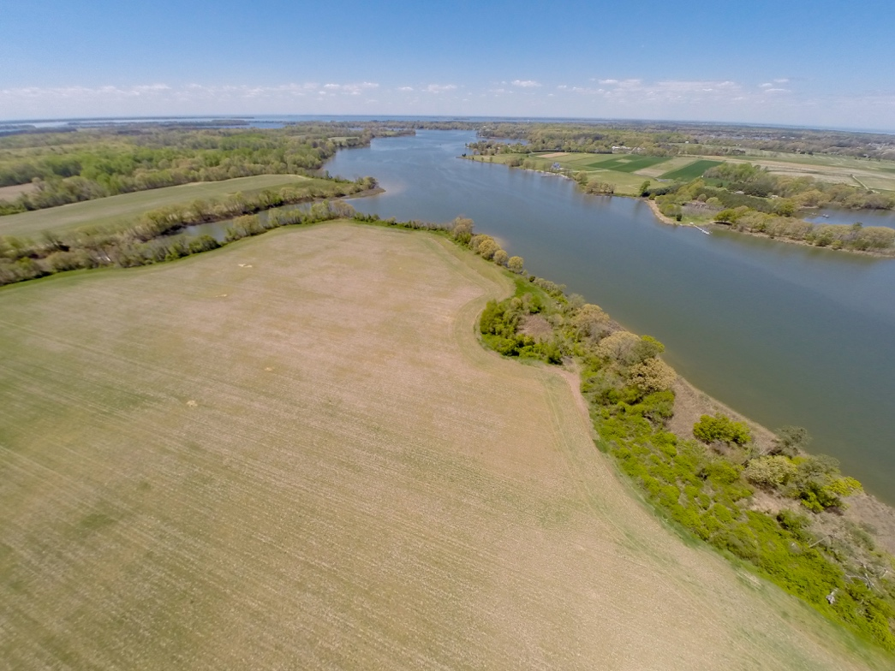
Water Quality Implications
Soil erosion and water infiltration:
Decreases in soil loss combined with increases in infiltration signal less risk of water pollution by displaced soil and nutrients.
Photo: Edwin Remsberg
Notes:
Photo: Aerial view of cover crops planted in Maryland next to the Chesapeake Bay

Slide 19
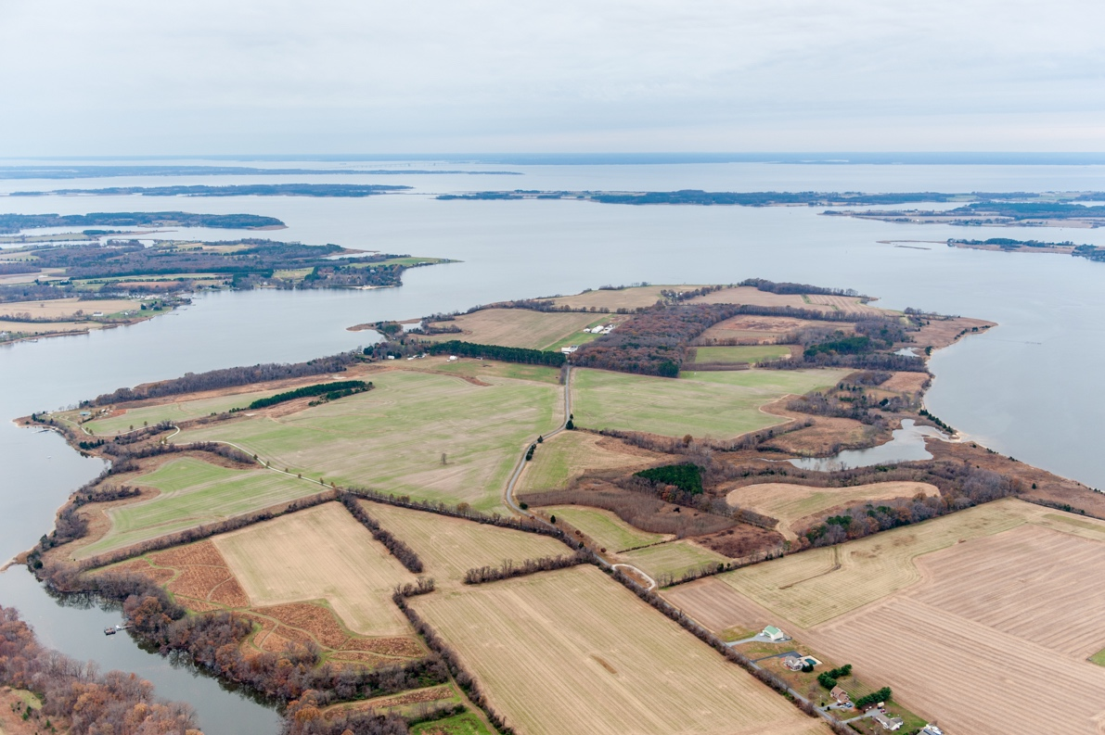
Water Quality Implications
Reduced nutrient losses:
Cover crops can help reduce nutrient losses from farm fields to waterways, further reducing eutrophication and hypoxia.
Photo: Edwin Remsberg
Notes:
Photo: Aerial views of cover crops on farm fields along the waters edge of the Chesapeake Bay

Slide 20
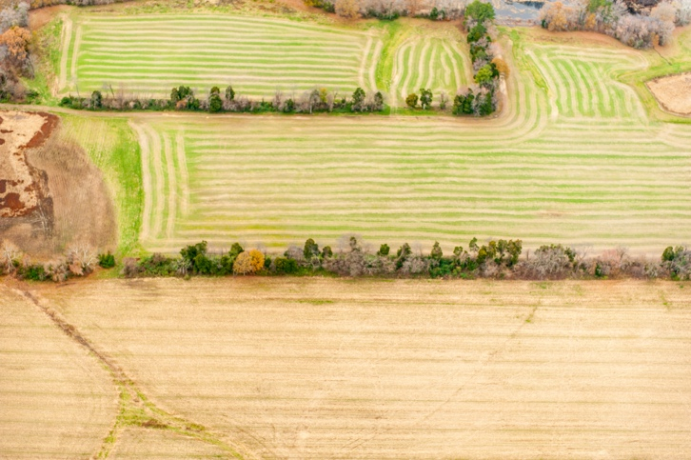
Water Quality Implications
Soil Organic Matter
Soil organic matter enhances soil processes and properties and alleviates soil compaction.
Organic matter also increases water retention capacity, stabilizes the soil during extreme weather events like drought or rainfall, helps retain nutrients within the soil and absorbs and filters pollutants in runoff.
Photo: Edwin Remsberg
Notes:
Photo: Aerial views of cover crops on farm fields along the waters edge of the Chesapeake Bay

Slide 21
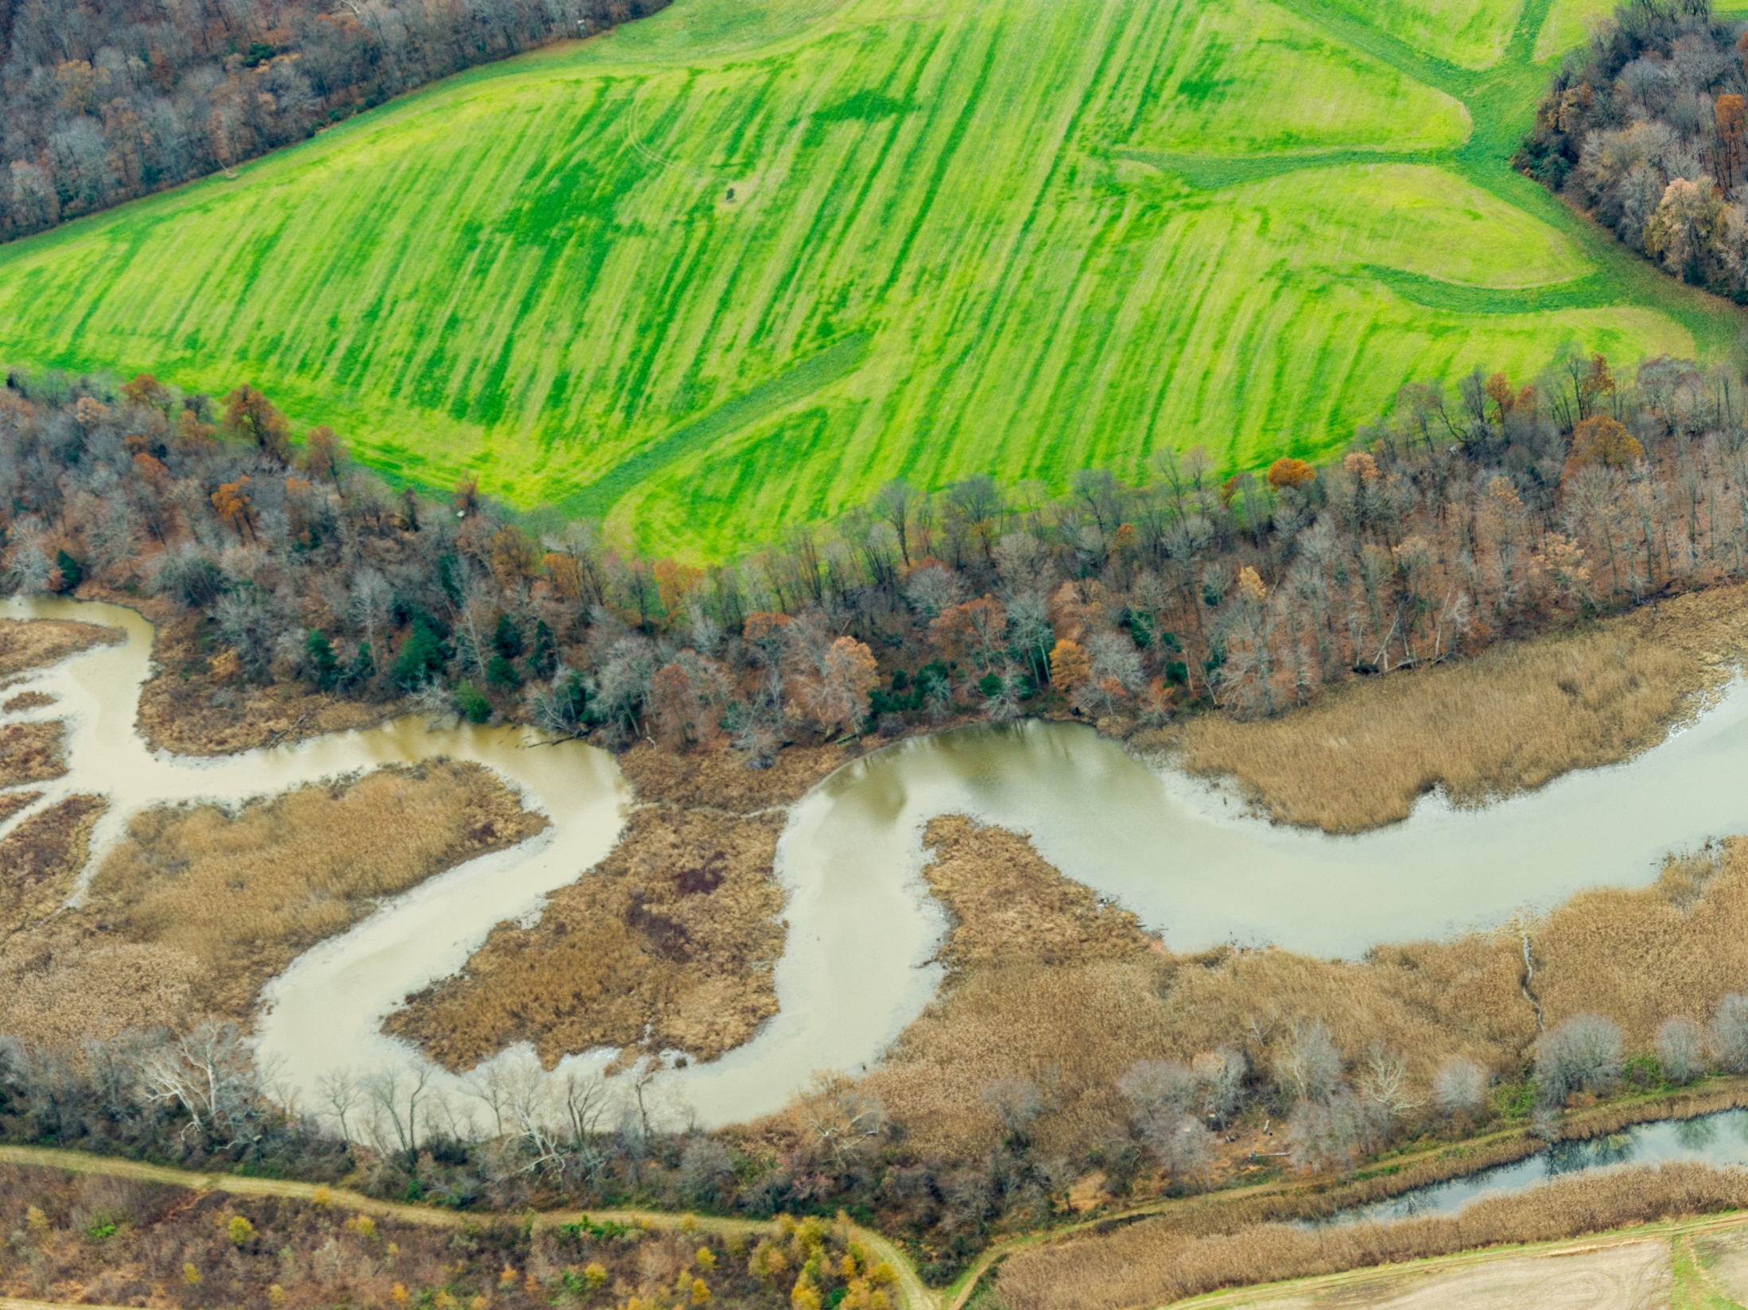
Landscapes are connected by air and water.
Cover crops not only benefit the farmer but also benefit society by reducing water quality risks. And, incorporating other conservation practices, like no-till management and smart manure management, can augment the benefits of cover cropping with their own reductions in soil loss and improvements in soil health.
Photo by Edwin Remsberg
Notes:
Photo of cover crops lining a riverbank in Maryland.

Slide 22
Takeaways
The numbers are in: cover crops reduce erosion, improve soil conditions, and protect waterways from harmful nutrient loads.
And, farmers and ranchers are curious about cover crops and increasingly incorporating them into their systems.
Though cover crop acreage has been rising by millions of acres each year, we still have an enormous amount of potential to increase the adoption of this beneficial practice and improve our land and water quality for future generations.

Slide 23
References
Unless otherwise cited, all data comes from a bibliography which will soon be available at http://www.sare.org/Learning-Center/Topic-Rooms/Cover-Crops
The bibliography reviews 98 sources that document cover crop impacts on soil and sediment loss, nutrient losses, water infiltration and soil organic matter.
This publication was developed by Sami Tellatin and Rob Myers of NCR-SARE and the University of Missouri under Cooperative Agreement No.83695601 awarded by the U.S. Environmental Protection Agency. EPA made comments and suggestions on the document intended to improve the scientific analysis and technical accuracy of the document. However, the views expressed in this document are those of the authors and EPA does not endorse any products or commercial services mentioned in this publication.

Slide 24
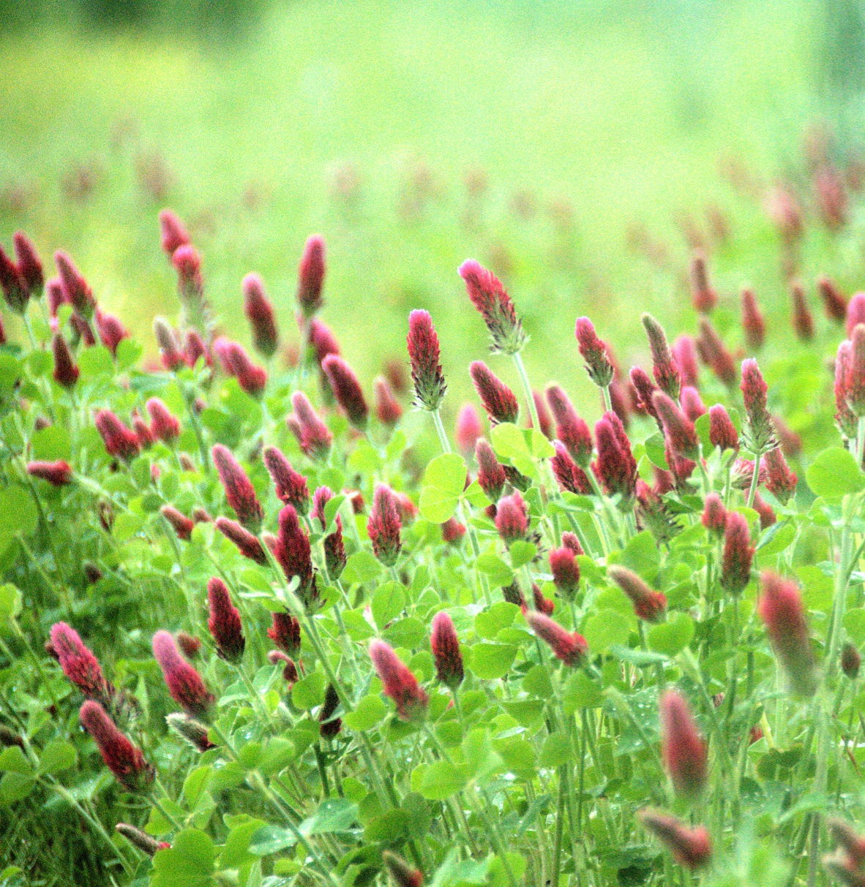
Thank you!
Photo by Edwin Remsberg
Notes:
Photo taken at the University of Missouri Bradford Research Center in Columbia, MO.

