Slide 1
Cover Crop Resources
A general overview of informational and financial resources
PRESENTER
Affiliation
Notes:
This presentation was prepared by Sami Tellatin and Rob Myers and provided by the USDA-SARE program to educators and producers for outreach and educational purposes. Other cover crop slide sets are also available at the website: http://sare.org/cover-crops
Tips for presenters:
You are about to give your audience a lot of information; show them that this is worth learning by being interested in the topic yourself and letting that be seen through your presentation.
Make it personal. Tell your own stories (that complement the material and are concise). You want to create a narrative that flows throughout your presentation.
Encourage learning and discussion by asking questions of the audience and encouraging their participation. Moderate your time so that you can cover everything, while also fostering audience participation.
Speak to your knowledge. If you don’t know something, it is okay to say so.
This slide set is a template offered for your use. You can add or delete slides and change things as you need. Use it to best complement your educational style to meet your goals.

Slide 2
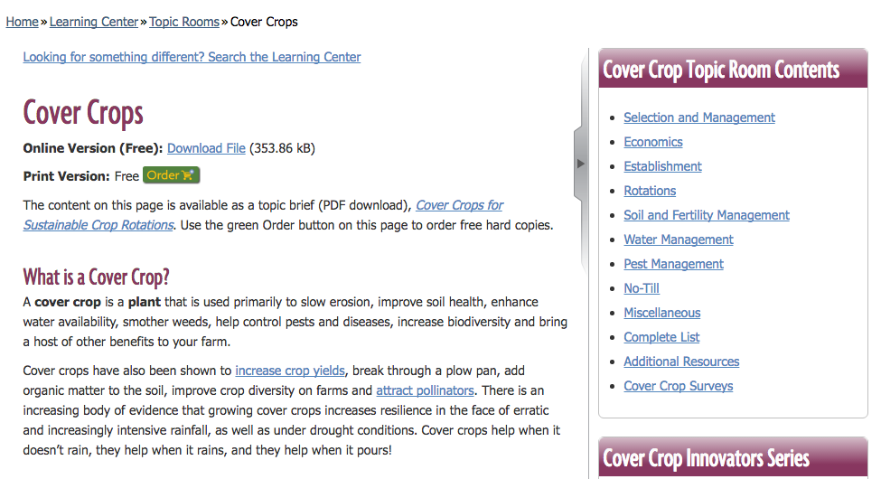
Informational Resources
SARE Cover Crops Topic room: http://www.sare.org/Cover-Crops
Videos
Links to the National Cover Crop Conference program materials
Publications
Research reports
Survey data
Notes:
There are a variety of educational resources about cover crops and soil health, many of which can be found on SARE’s website.
- SARE Cover Crop Topic Room with online resources about cover crop selection, growth and management.

Slide 3
Informational Resources (cont’d)
SARE Books:
Managing Cover Crops Profitably
Building Soil for Better Crops
E-reader versions available on SARE’s website
SARE Bulletins:
“Cover cropping for pollinators and beneficial insects”
“Cover crops for sustainable crop rotations”
Notes:
SARE offers publications like books and bulletins online.
The bulletins are available for free (online or print).
And the books are also available in digital format online for free, and in print for purchase.
Print versions of the books are:
Managing Cover Crops Profitably = $19.00
Building Soil for Better Crops = $20.95

Slide 4
Managing Cover Crops Profitably, 3rd ed.
SARE Book available online and in print
Now available in E-Reader format
The how and why of cover crops
Tips for selection
Management information
Appendices include seed suppliers
244 pages
Notes:
Digital copy (online) and e-reader format available for free.
Available in print for a cost: $19.00
Quote about this book:
“It uses science to explain complex concepts, lays out options for different systems and climates, and allows innovative farmers to digest the information and make their own intelligent decisions.” - Wolfgang Rougle (Twining Tree Farm)

Slide 5
Building Soils for Better Crops, 3rd edition
SARE Book available online and in print
Now available in E-Reader format
Guide for ecological soil management
Step by step information
Context of soil health and details about specific soil health enhancing practices
Case studies
294 pages
Notes:
Digital copy (online) and e-reader format available for free.
Available in print for a cost: $20.95

Slide 6
SARE Bulletins & Topic Briefs
SARE Bulletins
Cover Cropping for Pollinators and Beneficial Insects
Overview of pollinator & beneficial insect ecology
Cover crop selection & management
Helpful & proven rotations
16 pages
Cover Crops for Sustainable Crop Rotations
PDF that highlights the resources found in the cover crop topic room
Selection & management
Crop rotations, no-till management, & pest management.
4 pages
Notes:
The “Cover Crops for Sustainable Crop Rotations” bulletin is a companion to the online SARE resources, containing links to various topics in the SARE Cover Crops Topic room.

Slide 7
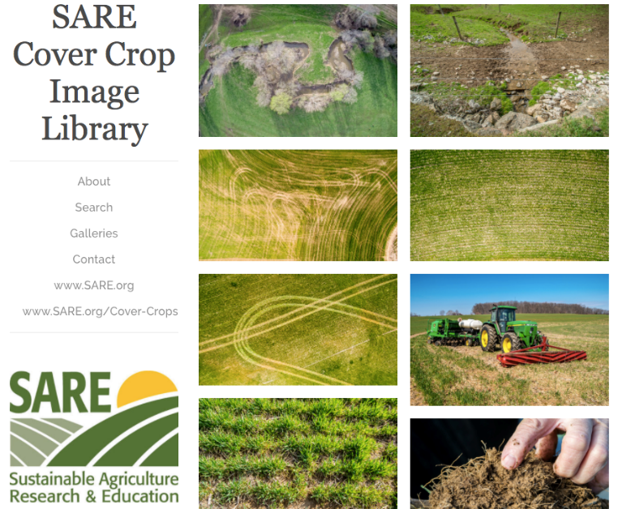
Library of Cover Crop and Soil Health Images
http://www.sare.org/Learning-Center/Topic-Rooms/Cover-Crops/Cover-Crop-Images-Library
Database of visuals to encourage farmers and landowners to improve soil health.
Photo database includes aerial shots, equipment, photos of species, growers.
Soil health gallery of illustrations with explanatory notes
Available for download and free, non-commercial use
Notes:
This is a searchable database containing several hundred photos organized by topic.
Photos in the database are from many different regions of the US – with photos from Maryland, Pennsylvania, Missouri, and Washington state.

Slide 8
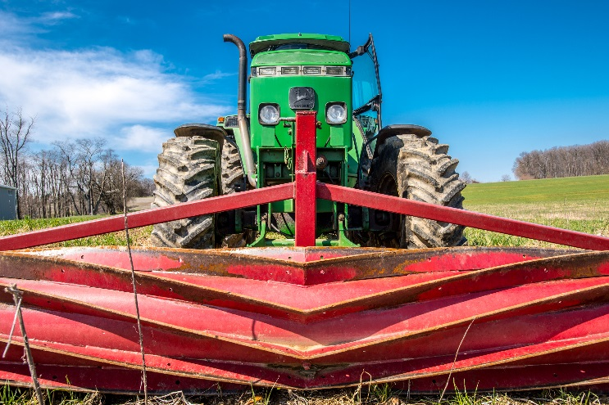
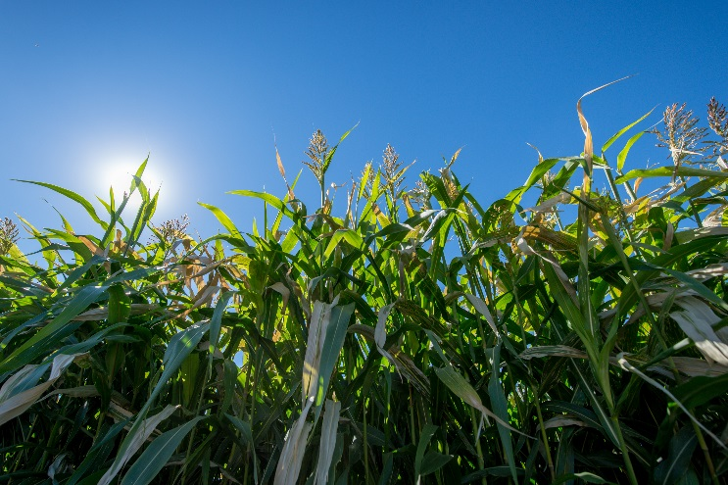
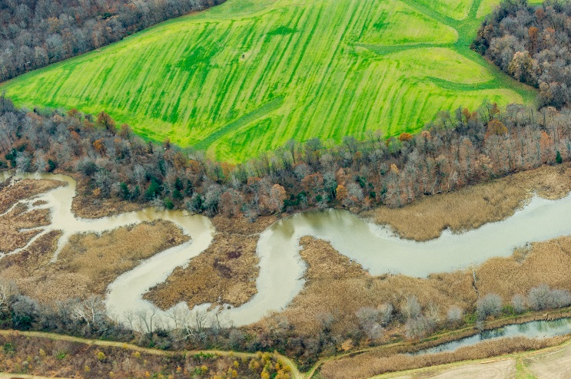
A roller crimper implement on a tractor in Maryland.
Roller crimpers are one way to effectively terminate a cover crop using no-till management.
Sorghum sudangrass grows in cover crop variety trials at Washington State University in Pullman, WA.
A field of cover crops borders a waterway in Maryland.
Photos by Edwin Remsberg.
Notes:
Examples of illustrations and photos in the Library of Cover Crops and Soil Health Images

Slide 9
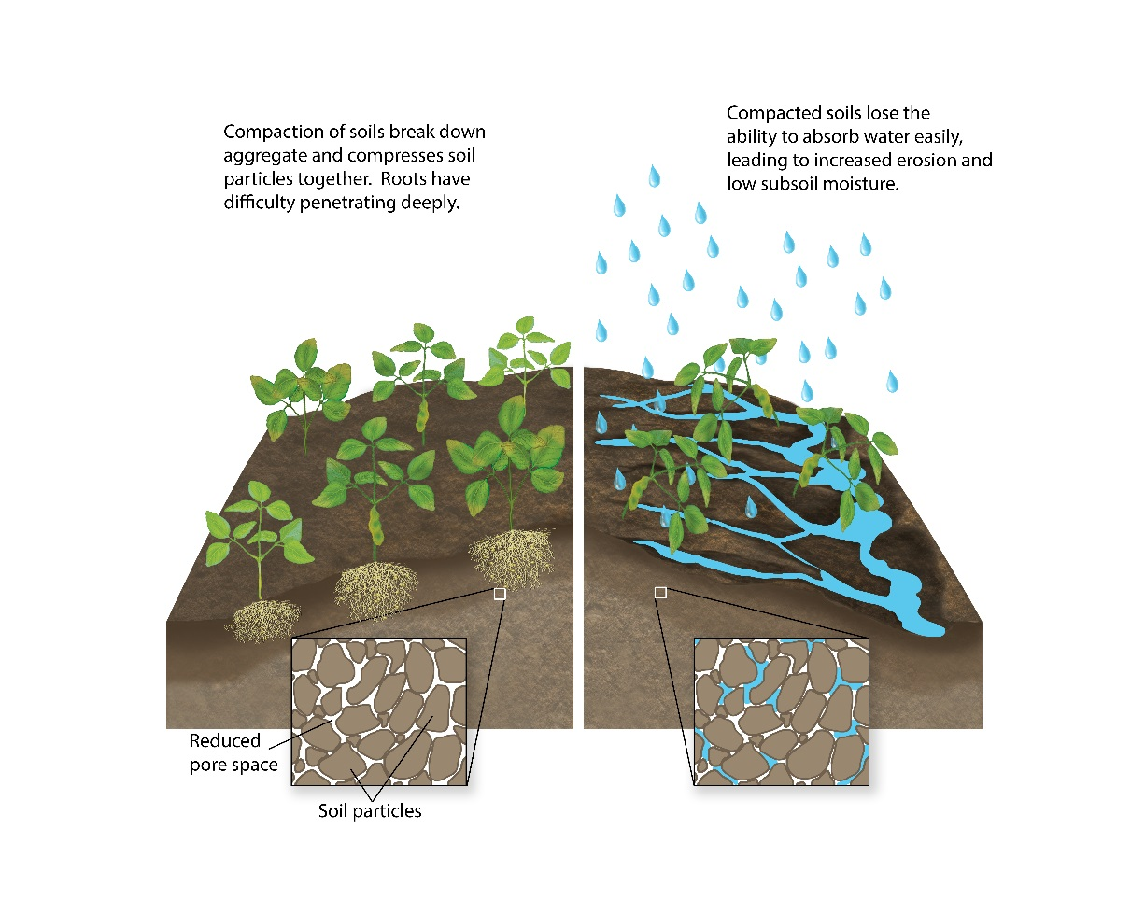
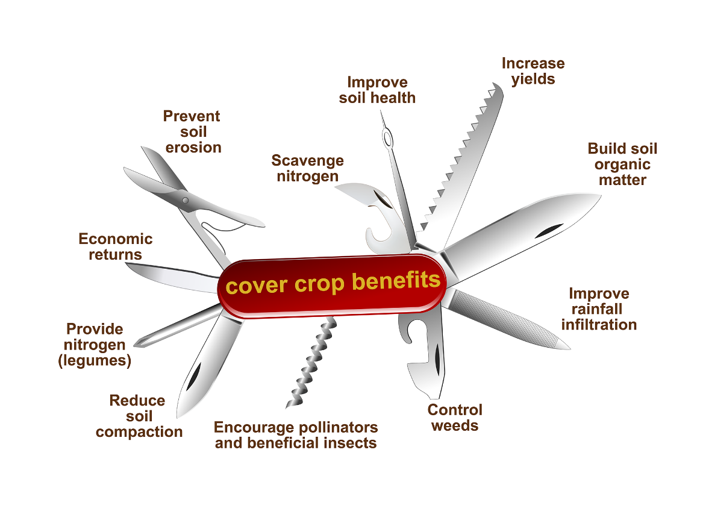
In addition to the photo collection, the SARE Cover Crop Image Library also includes fifteen Soil Health illustrations.
The illustrations are intended to explain soil health and cover crop-related concepts in a visual way.
Illustrations by Carlyn Iverson.

Slide 10
Videos from the National Conference on Cover Crops and Soil Health
“Harvesting the potential” - Feb. 17-19, 2014
Over 35 videos from the conference
On topics like grazing cover crops, environmental impacts of cover crops, nutrient management, no-till and strip-till with cover crops, termination, selection, seeding cover crops, soil health, and keynotes.
http://www.sare.org/Events/Cover-Crop-Conferences/National-Conference-on-Cover-Crops-and-Soil-Health
Notes:
Over 35 presentations from the first National Cover Crops Conference.

Slide 11
Informational Resources (cont’d)
NRCS Soil Health
http://www.nrcs.usda.gov/wps/portal/nrcs/main/national/soils/health/
Several fact sheets and videos available
Soil Health Institute
http://soilhealthinstitute.org/
Soil Health Partnership
http://soilhealthpartnership.org/
Regional Cover Crop Councils
Midwest Cover Crop Council:
http://mccc.msu.edu/
Councils also starting in the South and Northwest
”Unlock the Secrets in the Soil” and other soil health graphics available through NRCS Soil Health online
Notes:
The Natural Resources Conservation Service has an online soil health resource with fact sheets, videos, a photo gallery and links to other resources.
The Soil Health Institute aims to further the adoption of soil health management practices through scientific research.
They will offer resources online including their own technical bulletins and links to other important cover crop resources.
The Soil Health Partnership aims to measure and communicate the environmental and economic impacts of soil management strategies, pulling region-specific data from a large group of demonstration farms and establishing research protocols to standardize soil measurements.
Regional cover crop councils exist to provide information to producers about cover crop selection and management. They will often offer decision tools online.

Slide 12
Resources for funding
NRCS Environmental Quality Incentives Program
NRCS Conservation Stewardship Program
SARE Program Farmer Rancher grants
State cost-share programs
Notes:
The NRCS has several programs to offer funds for farmers wishing to incorporate conservation practices, such as cover cropping, into their production.
SARE offers a Farmer Rancher grant program which enables farmers to, independently or in collaboration with others, implement new practices on their farm while eliminating some or all of the financial burden.
And certain states, such as Maryland, have cost-share programs that enable farmers to plant cover crops at a decreased cost to them.

Slide 13
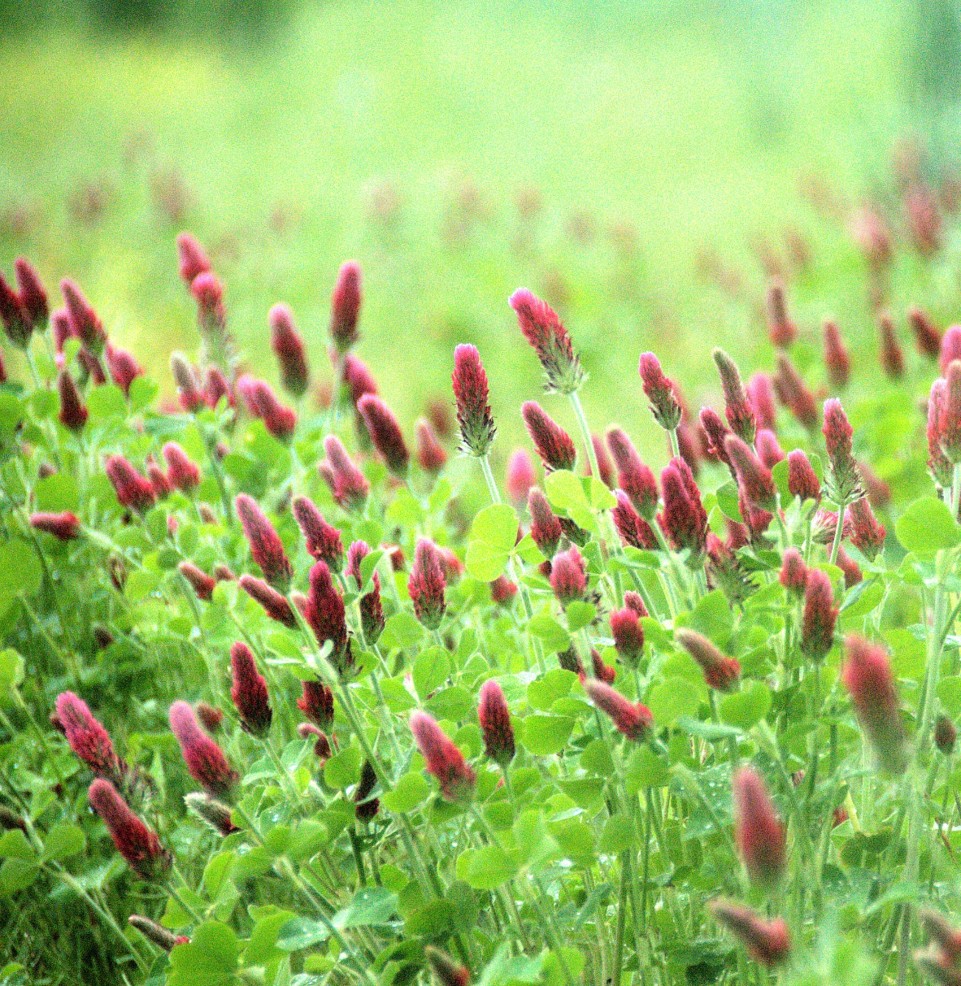
Thank you!
Photo by Jason Vance
Notes:
Photo taken at the University of Missouri Bradford Research Center in Columbia, MO.

