Slide 1
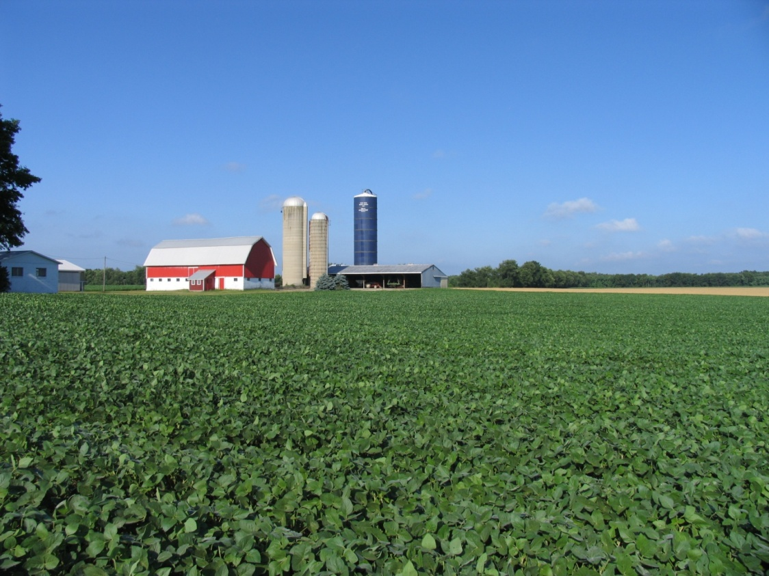
Ensuring Sustainable Field Crop Agriculture in the Face of a Changing Climate
A curriculum compiled by
Julie E. Doll and Tapan Pathak
Spring 2015 Version

Slide 2
Curriculum Outline
Climate Change Basics
Common Terminologies
Causes of Climate Change
The Greenhouse Effect
Climate Trends and Projections
National
North Central Region
Climate Change and Field Crop Agriculture
Effects of Climate Change on Production
Adaptation
Mitigation
Discussion Questions
Evaluation for Audience Members

Slide 3
1. Climate Change Basics

Slide 4
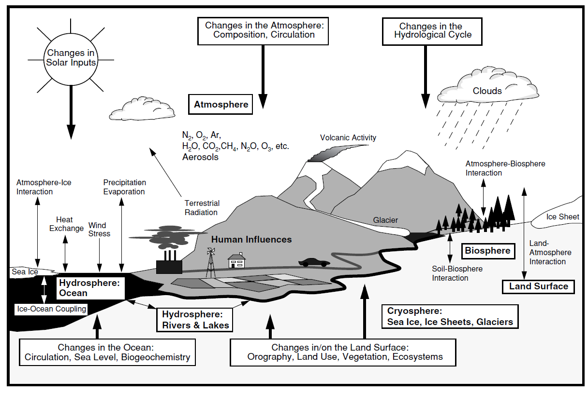
Earth’s Climate System
Sun
Clouds
Atmosphere
Ice
Oceans
Humans
Land
(IPCC, 2007)
Notes:
The Earth’s climate is a dynamic and complex. Pictures like this show how scientists understand the Earth as a system. There are many factors that influence Earth’s climate system, including the sun, the oceans, humans, clouds, land, and ice. Climate varies by different regions as a result of local differences in how these factors interact.
Today we’ll be talking about changes that scientists are noticing in the climate. First, let’s start with some basic definitions to get us started and on the same page.

Slide 5
Climate vs. Weather
Both deal with atmospheric conditions, such as temperature, cloud cover, and precipitation.
Weather
Shorter term such as hourly or daily variations of atmospheric events
Example: Today’s high temperature was 70ºF
Climate
Average “weather” over a longer period of time
Example: Last decade was the warmest decade on earth
Notes:
Often in our conversations we use terms weather and climate quite interchangeably. Is weather same as climate? The answer is no. Weather represents atmospheric events in a shorter time-scale such as hours and days, whereas climate is an “average” weather over a long period of time. So the basic difference between weather and climate is period of time. For example, today’s temperature and precipitation events describe a shorter term variations which falls under a category of weather whereas, average temperature and precipitation for today based on many years of data describes climate.

Slide 6
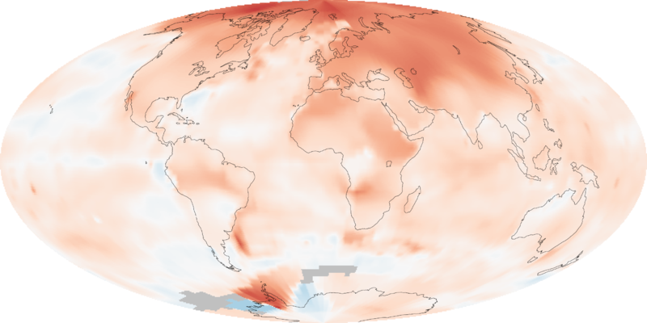
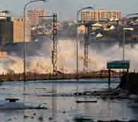
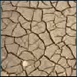
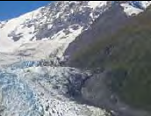
Global Warming
Climate Change
Increase in the average temperature due to increased concentrations of greenhouse gases in the atmosphere.
Changes in climate variables such as precipitation, snow,
wind patterns, sea level, and extreme events in addition to temperature changes.
Notes:
Is global warming is same as climate change? Not exactly! Global warming represents only temperature increase on a global scale; whereas climate change refers to changes in climate variables such as precipitation, snow, wind patterns, sea level, and extreme events in addition to temperature changes. Also, the term climate change doesn’t only talk about changes on a global scale but also on a regional scale. Climate change is a more complete term as opposed to global warming and that is the reason why it is used more often in the scientific community.

Slide 7
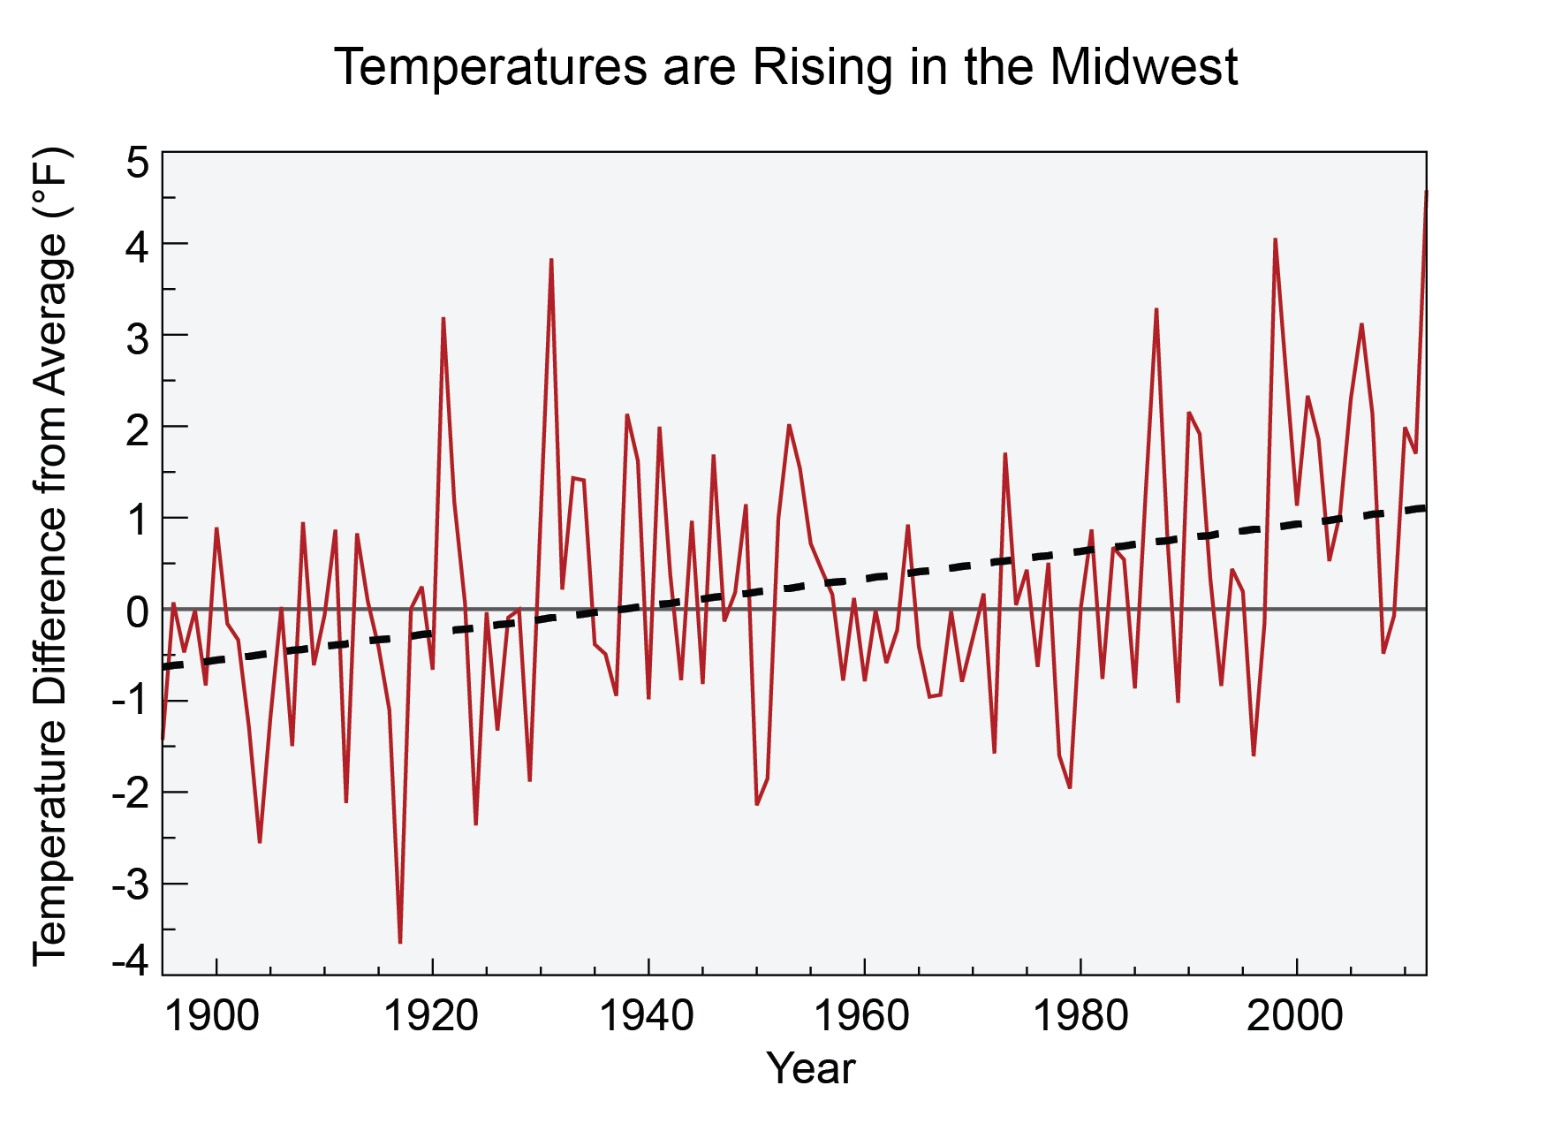
Climate Variability
Climate variability represents changes in the mean state of climate events on a short temporal and spatial scale compared to climate change
Single year climate extremes don’t individually correspond to climate change, however collective evidences over a longer period of time do.
(Pryor et al., 2014, National Climate Assessment)
Notes:
Often times, shorter term variability in climate is confused with climate change. For example, one or two consecutive rough winters may not individually prove anything about global temperature warming. Similarly, severe drought conditions or severe flooding for a few years are not sufficient enough to make any statements on climate change.
Climate variability represents changes in the mean state of climate events on a short temporal and spatial scale compared to climate change. Single year climate extremes don’t individually correspond to climate change, however collective evidences over a longer period of time do. The figure on this slide is a good example of this. There is a lot of year to year variability in temperature, but the long-term trend (heavy black line) shows greater annual temps for the Midwest, calculated over the period 1895-2012 is equal to an increase of 1.5°F.

Slide 8
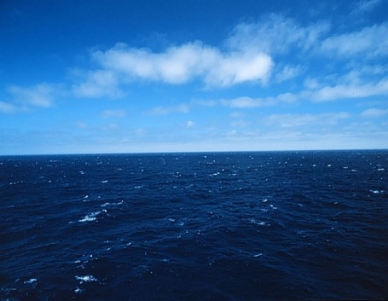
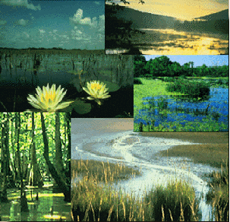
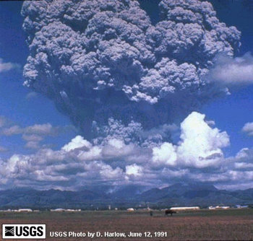
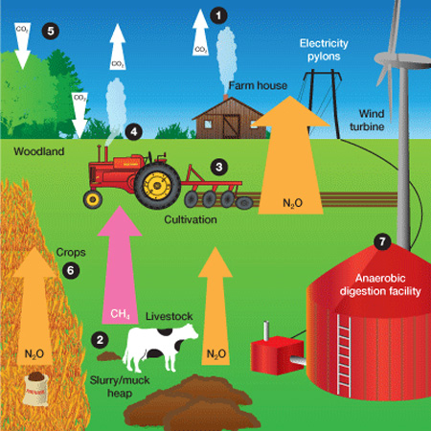
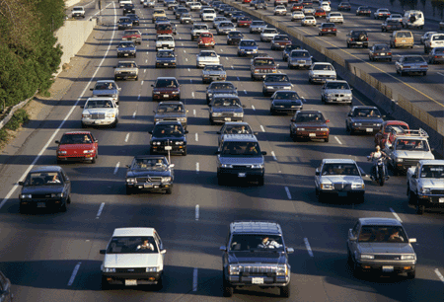
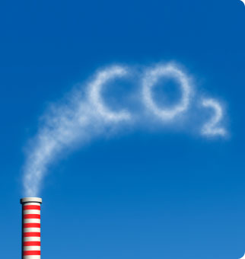
Causes of Climate Change
Natural causes
+
Human (anthropogenic) causes
Notes:
The climate at a given location seems to be relatively stable, but it is ever-changing because of its dynamic nature and many components. Cause of climate change can be broadly categorized into two parts: 1) Natural Causes and 2) Human (Anthropogenic) Causes
Natural Causes: Any natural activity that emits greenhouse gases into the atmosphere are categorized as natural causes. Examples of natural causes as shown in the picture above are evapotranspiration from water bodies, plants, and trees. Water vapor that is emitted in the atmosphere from evapotranspiration is one of the most significant greenhouse gases. Another example is wetlands which are a primary source of methane gas emission due to the decomposition process. Volcanic eruption is another example of a natural cause. When volcano erupts, aerosol particles spread into the atmosphere and creates a reflective shield which prevents radiation from coming towards the earth. Due to this natural process, we may observe somewhat cooling trend for a short time period. However, other potential greenhouse gases that are emitted in volcano such as carbon dioxide, may in longer timeframe contribute towards warming trend. These are some of the examples of natural causes of climate change.
Human Causes: The Intergovernmental Panel on Climate Change (known by the acronym “IPCC”) is a group of scientists who issue comprehensive assessments on climate science. According to the IPCC reports, we know that humans are impacting the climate. Any human activity that is resulting in greenhouse gas emissions into the atmosphere is categorized under this criteria. Some examples of human causes are energy production, fossil fuel burning, transportation, and agricultural practices such as fertilization and livestock production. We’ll talk more about agriculture’s role in this later.
In addition to GHGs, significant climate change can also be caused by changing the radiation balance (reflection vs. absorption) of the land or sea surface over large areas. Land cover changes include conversion of forest to agriculture as well as urbanization are examples. For the ocean, receding sea ice results in less reflection of solar radiation.

Slide 9
A Greenhouse
Sunlight
Slide courtesy of Steve Hamilton
Notes:
An increase in greenhouse gases is causing the changes we see in the climate due to something called “the greenhouse effect”. An ordinary greenhouse keeps plants warm in winter without using a heater. It works because the Sun’s rays shine through the glass walls and roof, warming the inside— and that same glass keeps the heat from escaping.

Slide 10
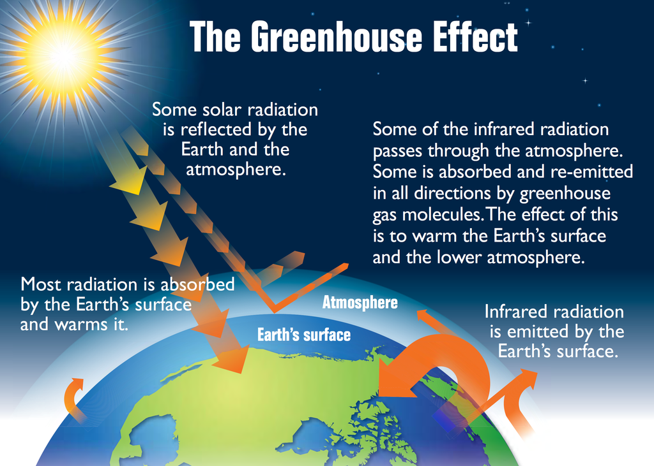
(EPA, 2014)
Notes:
The “greenhouse effect” warms the Earth (and other planets) in a similar way, although it’s not exactly the same. The Earth’s transparent atmosphere lets sunlight pass through to warm the ground and the oceans. The Earth’s warmed surface releases some of that heat in the form of infrared radiation (longer wavelength radiation)— a form of light, but invisible to human eyes.
This infrared light wants to keep on going, right back out into space, taking the warmth with it. But some gases in the atmosphere won’t let all the infrared radiation pass through. These “greenhouse gases” are very good at absorbing infrared light. These greenhouse gases then emits radiation back to the land and the oceans. So greenhouse gases act sort of (though not exactly) like the glass in the greenhouse. They let sunlight through on its way in from space, but intercept some of the infrared light on its way back out.
These greenhouse gases are carbon dioxide, nitrous oxide, methane, water vapor, ozone and halocarbons, all of which are naturally occurring except for halocarbons, which were used as coolants, solvents and refrigerants beginning in the 1930s. Over millennia, the Earth’s average surface temperature is correlated with the amount of greenhouse gases in the atmosphere. Historically, when greenhouse gas concentrations have been relatively high, so have the average surface temperatures.
The importance of this so-called “greenhouse effect” cannot be overstated. Without an atmosphere that acts as a blanket to absorb heat, the Earth would be almost 60 degrees Fahrenheit (F) cooler on average than it is now. For example, the moon, our nearest neighbor in the solar system, has surface temperatures ranging from 225 degrees F in the sun to a freezing -240 degrees F in the dark because it lacks an atmosphere. But as we’ll see in a minute, too many gases in the atmosphere can cause warming of the planet that is not beneficial to us.

Slide 11
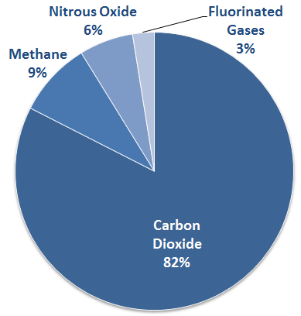
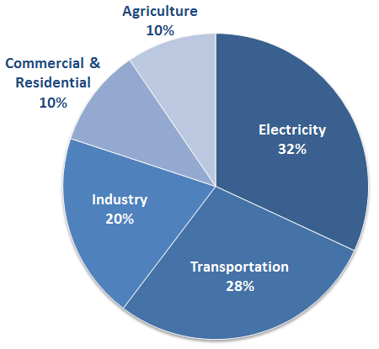
Human Impact: Greenhouse Gases
U.S. Emissions by Economic Sector
U.S. Emissions
(Inventory of U.S. Greenhouse Gas Emissions and Sinks: 1990-2012, EPA 2014)
Notes:
Even though the most important greenhouse gases occur naturally and are important for life on Earth because they help maintain Earth’s temperature at a level humans can survive, burning fossil fuels and other human activities have caused a large increase in their concentrations, especially the main greenhouse gases seen in this figure: carbon dioxide, methane, and nitrous oxide. Each of these gases has a unique relationship with agriculture, which we will discuss later. (In this figure the greenhouse gas effects are standardized to carbon dioxide equivalents.)

Slide 12
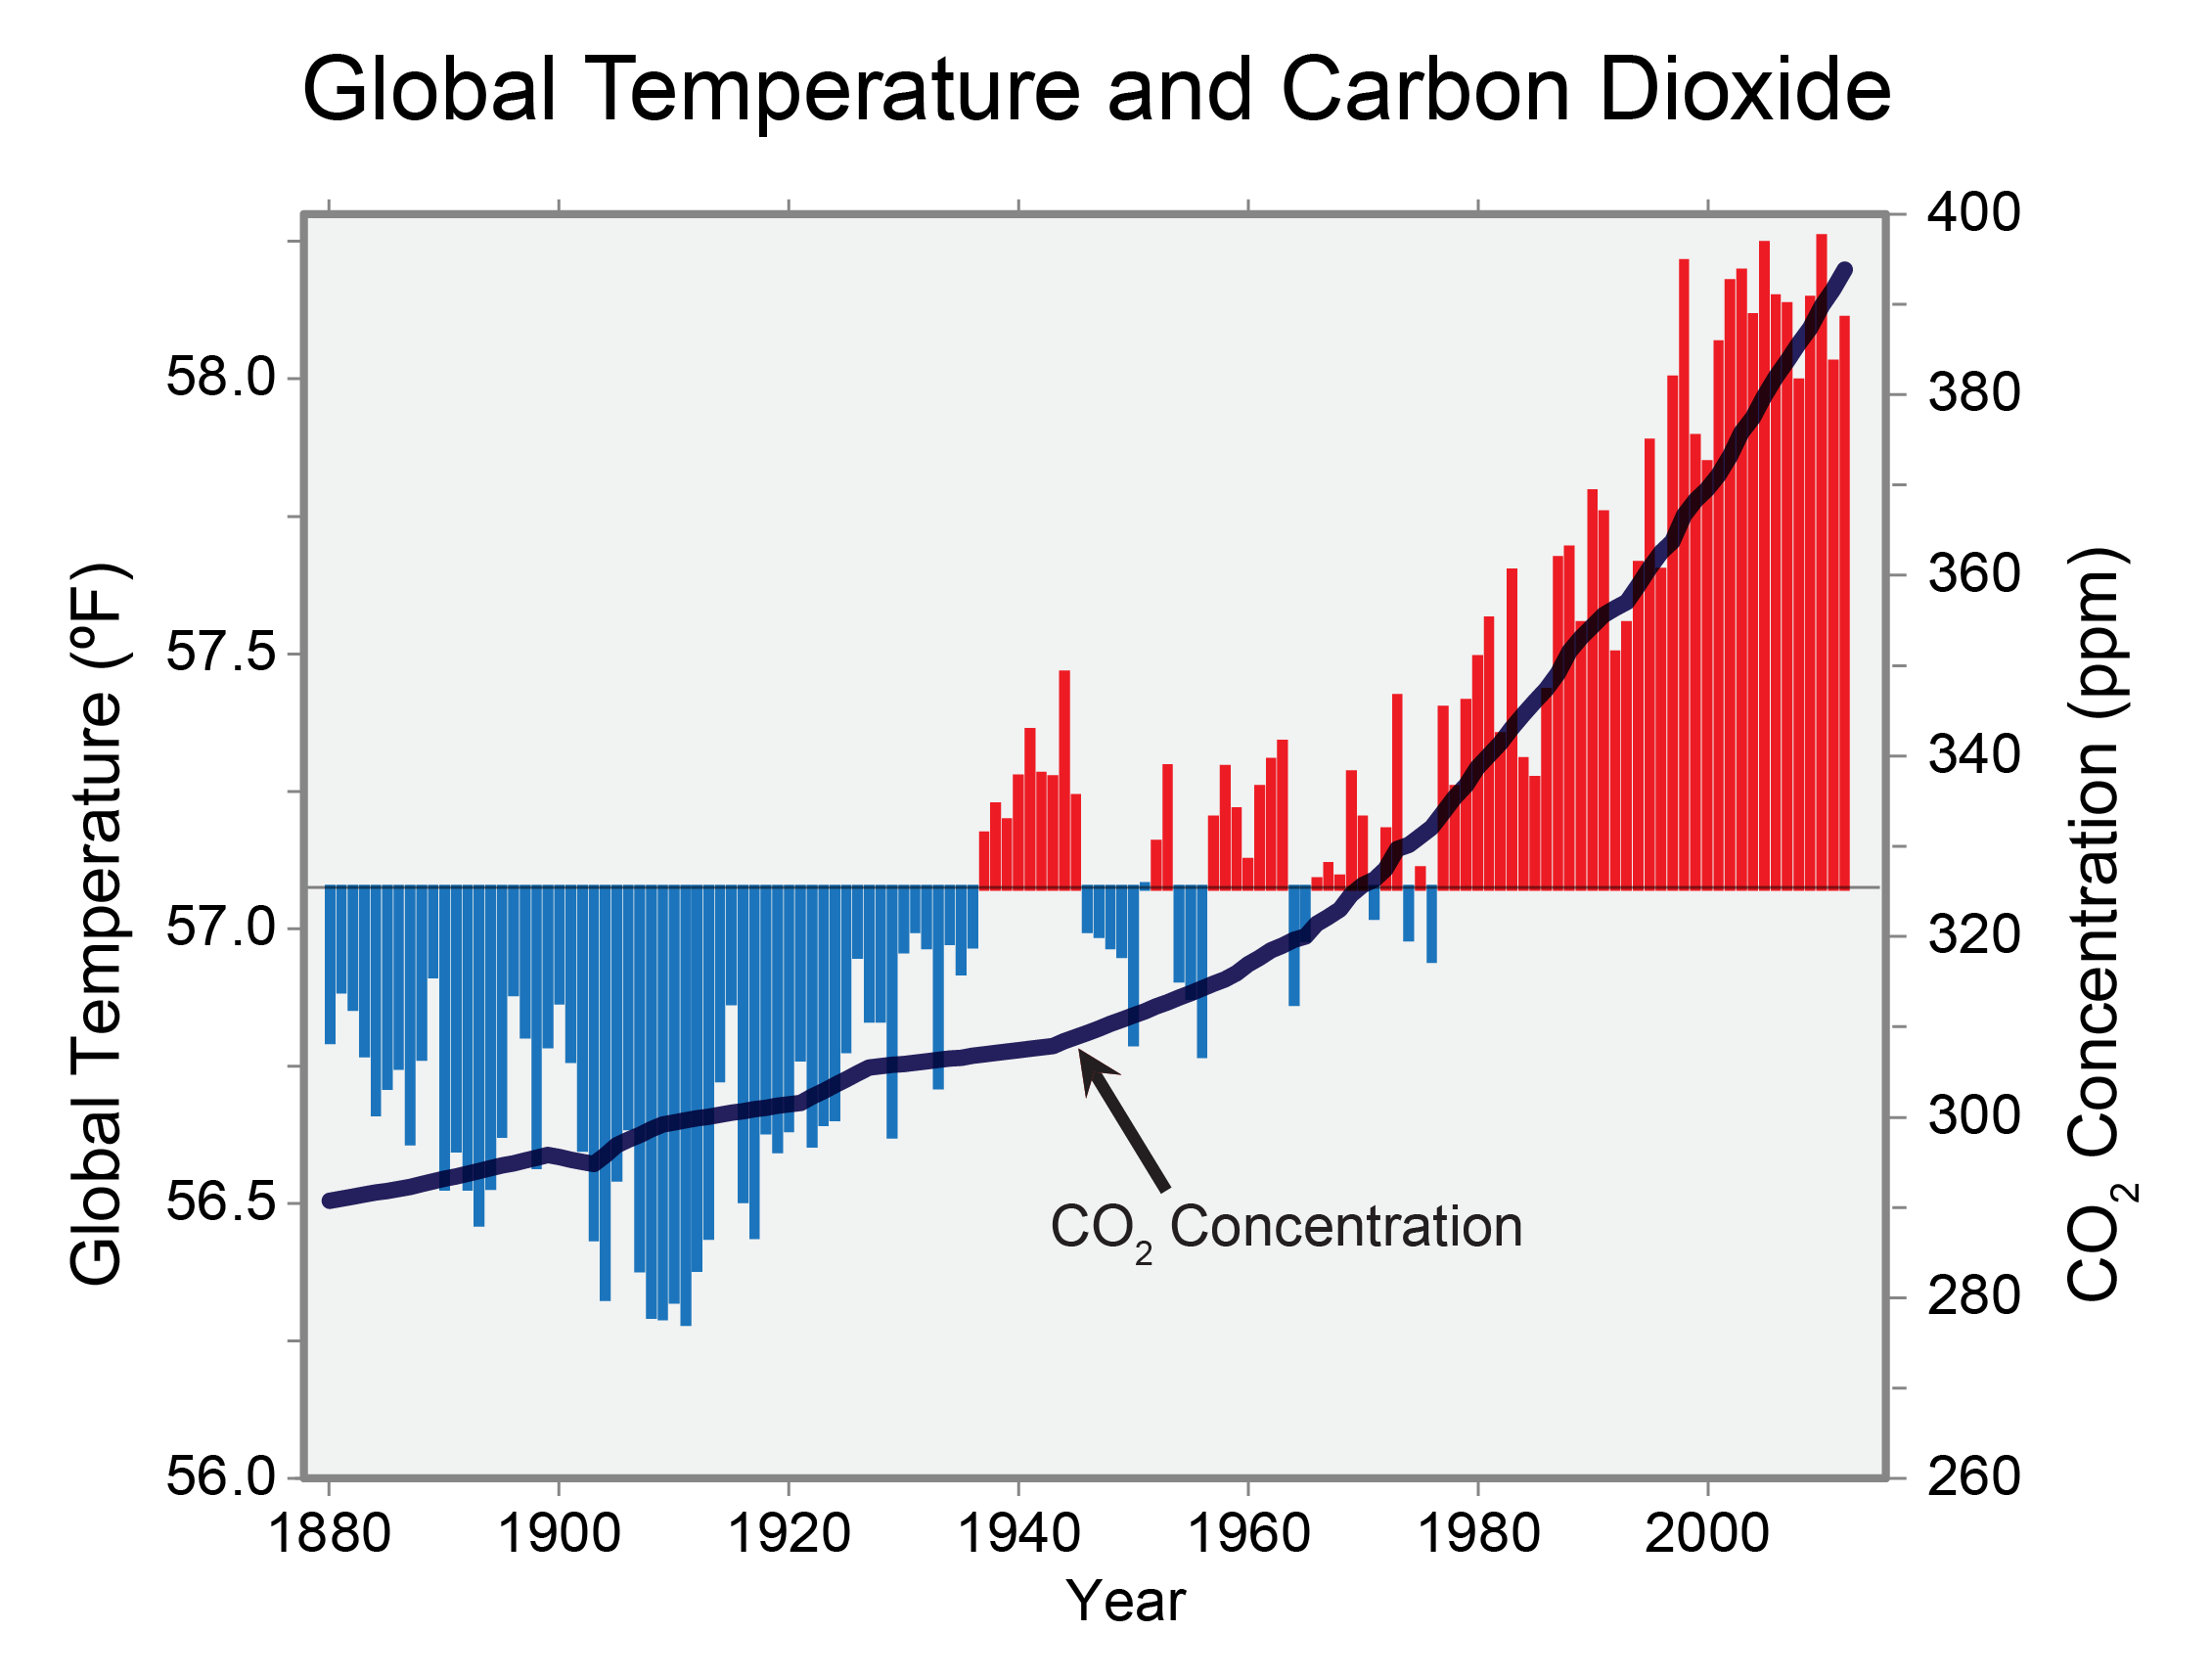
Average Global Temperatures:
Up to ~1.5°F since 1880
(National Climate Assessment, 2014)
Notes:
This rise in greenhouse gas levels matters because there is general scientific consensus among climatologists, atmospheric chemists, and other scientists who study Earth’s systems that the increase of greenhouse gas concentrations causes a rise in the average global temperature. Earth’s average global surface temperature has risen by 1.5° Fahrenheit since 1880, largely driven by human activity, as seen by this figure. The The majority of this warming has occurred in the last three decades.
Figure legend: Global annual average temperature (as measured over both land and oceans) has increased by more than 1.5°F (0.8°C) since 1880 (through 2012). Red bars show temperatures above the long-term average, and blue bars indicate temperatures below the long-term average. The black line shows atmospheric carbon dioxide (CO2) concentration in parts per million (ppm). While there is a clear long-term global warming trend, some years do not show a temperature increase relative to the previous year, and some years show greater changes than others. These year-to-year fluctuations in temperature are due to natural processes, such as the effects of El Niños, La Niñas, and volcanic eruptions. (Figure source: updated from Karl et al. 20091).

Slide 13
Is that a big deal?
During the depths of the Ice Ages it was only
9-11 F° colder than today
Rate of warming: faster than any time in the past 10,000 yr
(National Climate Assessment, 2014)
Notes:
Although this rise in temperature does not seem like much, even small changes in average global temperature can lead to changes we notice at the local level and warming in some places – in the Arctic, for example. Local changes include shifts in the patterns and severity of rainfall and snowfall, droughts, cloudiness, humidity, and growing season length. These changes have the capacity to greatly affect agriculture.
Is a 1.5 degree F increase a big deal? To put it into context, it is important to note that even small changes in the annual global temperature make a huge difference. For exmple, during the depths of the ice ages, the earth was only 9-11 degrees F colder than it is today.
And, the rate of warming is the greatest that we have seen any time in the past 10,000 years.

Slide 14
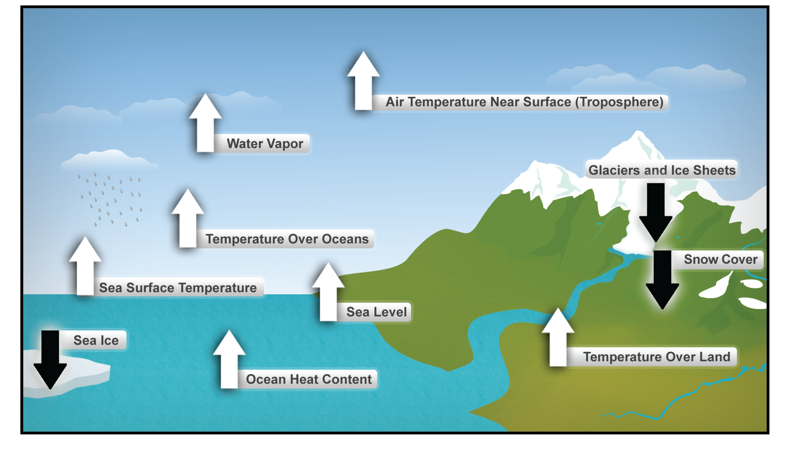
Ten Indicators of a Warming World
(Walsh et al., 2014, National Climate Assessment)
Notes:
These are just some of the indicators measured globally over many decades that show that the Earth’s climate is warming. White arrows indicate increasing trends, and black arrows indicate decreasing trends. All the indicators expected to increase in a warming world are, in fact, increasing, and all those expected to decrease in a warming world are decreasing. (Figure source: NOAA NCDC based on data updated from Kennedy et al. 2010¹).

Slide 15
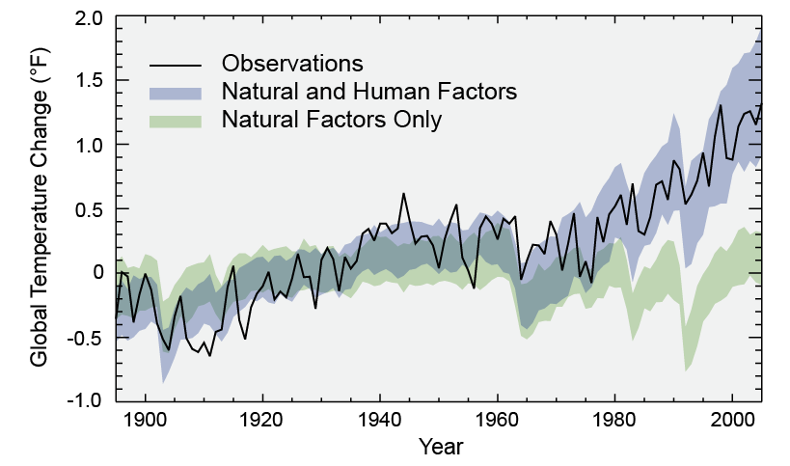
Separating Human and Natural Influences on Climate
(Walsh et al., 2014, National Climate Assessment)
Notes:
Climate scientists are able to model how the climate has changed based on certain factors. What they found is that past trends in climate change only make sense when human factors are included in the models. That’s what this figure describes. The observed global average changes are show in the black line. Model simulations using only changes in natural factors (solar and volcanic) are in green, and model simulations with the addition of human-induced emissions are in blue. The data shows that climate changes since 1950 cannot be explained by natural factors or variability, and can only be explained by human factors.

Slide 16
The Scientific Consensus
Warming observed over the last century is highly unusual.
Present conditions are outside the range of natural cycles experienced by humans.
Natural changes (sun, volcanoes, etc) continue to affect climate today…
…but warming of the last century is primarily human-induced.
Notes:
Just to summarize what the scientific consensus is on climate change:
Warming observed over the last century is highly unusual.
Present conditions are outside the range of natural cycles experienced by humans.
Natural changes (sun, volcanoes, etc) continue to affect climate today…
…but warming of the last century is primarily human-induced.

Slide 17
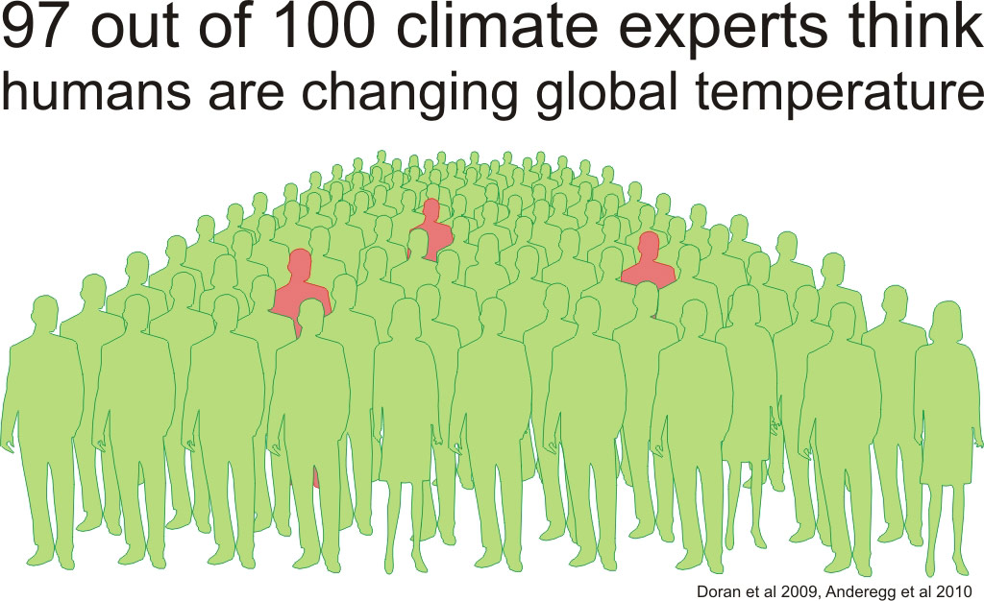
The Scientific Consensus
Notes:
Who all agrees with this scientific consensus? Repeated surveys have documented that the majority - 97% - of climate experts think humans are changing global temperature, which in turn affects the climate that we experience at the local level. This scientific consensus is not well understood by much of the general public. It’s interesting to think of this level of scientific consensus in other areas of our lives. For example, if 97% of pediatricians told us our child was sick we’d most likely look for treatment. And if 97% of engineers told us a bridge wasn’t safe to cross, most likely we wouldn’t cross it!

Slide 18
Who Agrees with the Scientific Consensus?
US Climate Change Science Program
US National Academy of Sciences and national academies of 32 other nations (none disagree)
Every major scientific organization whose members include climate scientists
More than 97% of climate researchers (NAS, 2010)
The Pentagon, Wal-Mart, American Electric Power, The Pope, The Dalai Lama
Every major religious denomination w/ a climate change statement except the Southern Baptist Convention
(Slide courtesy of Dr. Greg Hitzhusen)
Notes:
Who else agrees with this? As you can see – leaders in industry, science, and religious organizations agree with this.

Slide 19
So What’s the Big Deal?
The Earth’s climate system is dynamic. It changes. It always has and it always will.
1. We are partly responsible.
2. We might not like the changes.
Past history suggests that society may be able to cope/adapt with steady climatic changes, but possibly not with changes in variability (for example, changes in extremes, storminess).
(Slide courtesy of Dr. Jeff Andresen)
Notes:
So what’s the big deal some people may ask. The Earth’s climate system is dynamic. It changes. It always has and it always will. Why should we care about the scientific consensus?
Well, we are partly responsible, and we might not like the changes. Past history suggests that society may be able to cope/adapt with steady climatic changes, but possibly not with changes in variability (for example, changes in extremes, storminess).

Slide 20
2. Climate Change Trends and Projections
Notes:
Before we delve more fully into agriculture and climate change, let’s take a minute to look at some trends in the climate and what scientists project might happen in the future. We’ve already talked about the global rise in temperature. Let’s look more specifically at trends in the United States.

Slide 21
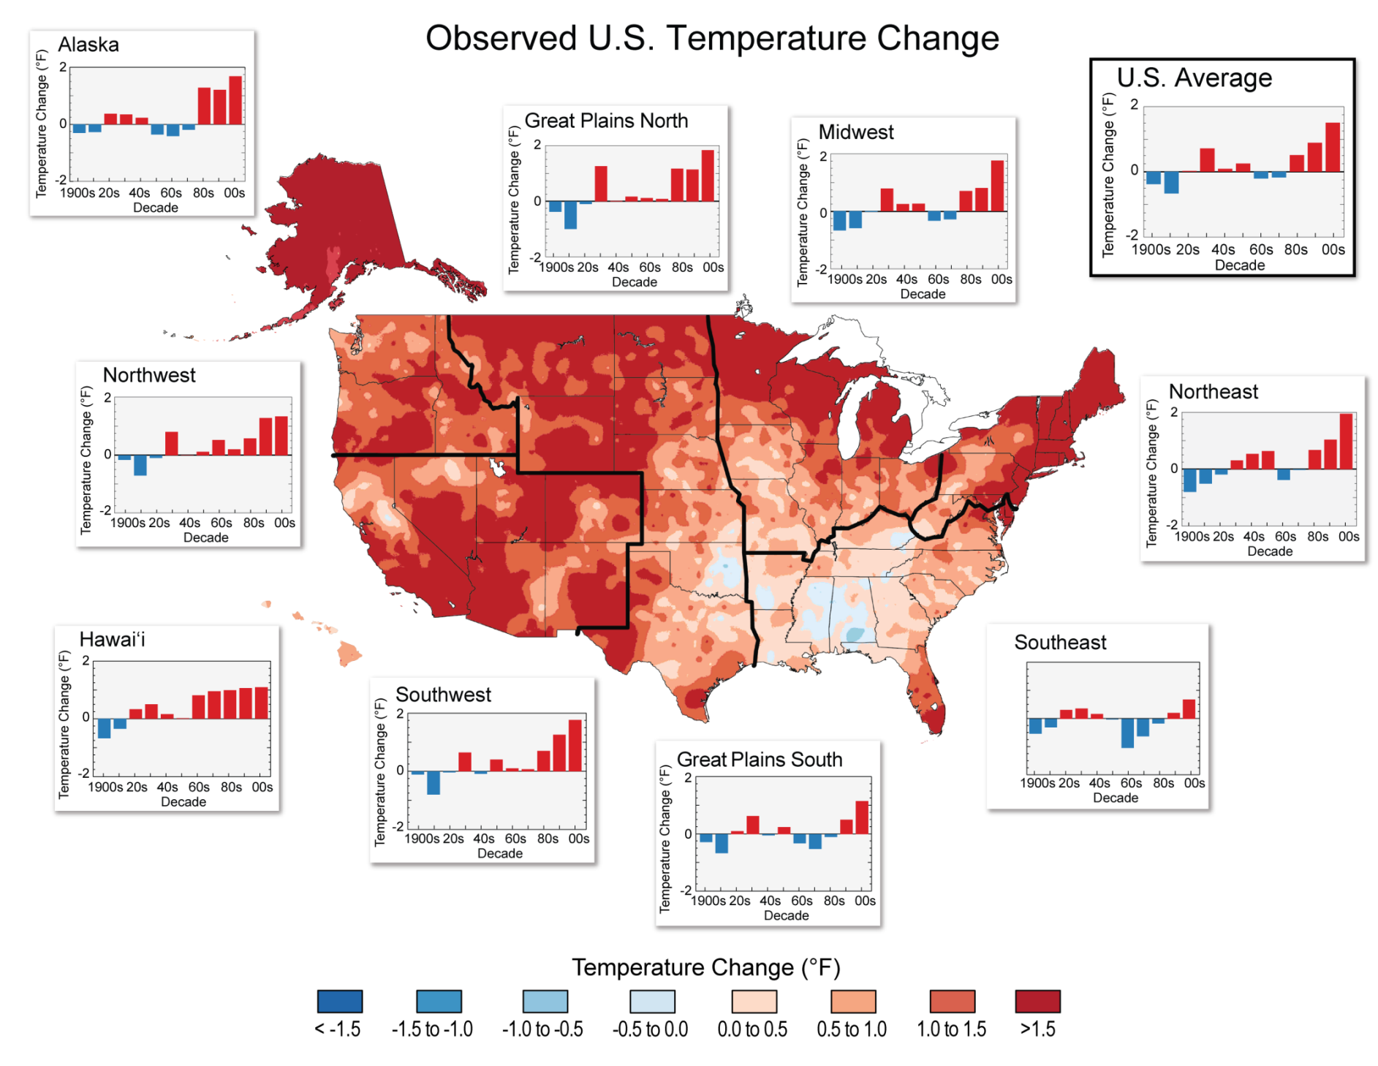
Observed U.S. Temperature Changes
(Walsh et al. 2014, National Climate Assessment)
Notes:
Figure caption, from Walsh et al. 2014: “The colors on the map show temperature changes over the past 22 years (1991-2012) compared to the 1901-1960 average, and compared to the 1951-1980 average for Alaska and Hawai‘i. The bars on the graphs show the average temperature changes by decade for 1901-2012 (relative to the 1901-1960 average) for each region. The far right bar in each graph (2000s decade) includes 2011 and 2012. The period from 2001 to 2012 was warmer than any previous decade in every region. (Figure source: NOAA NCDC / CICS-NC).”

Slide 22
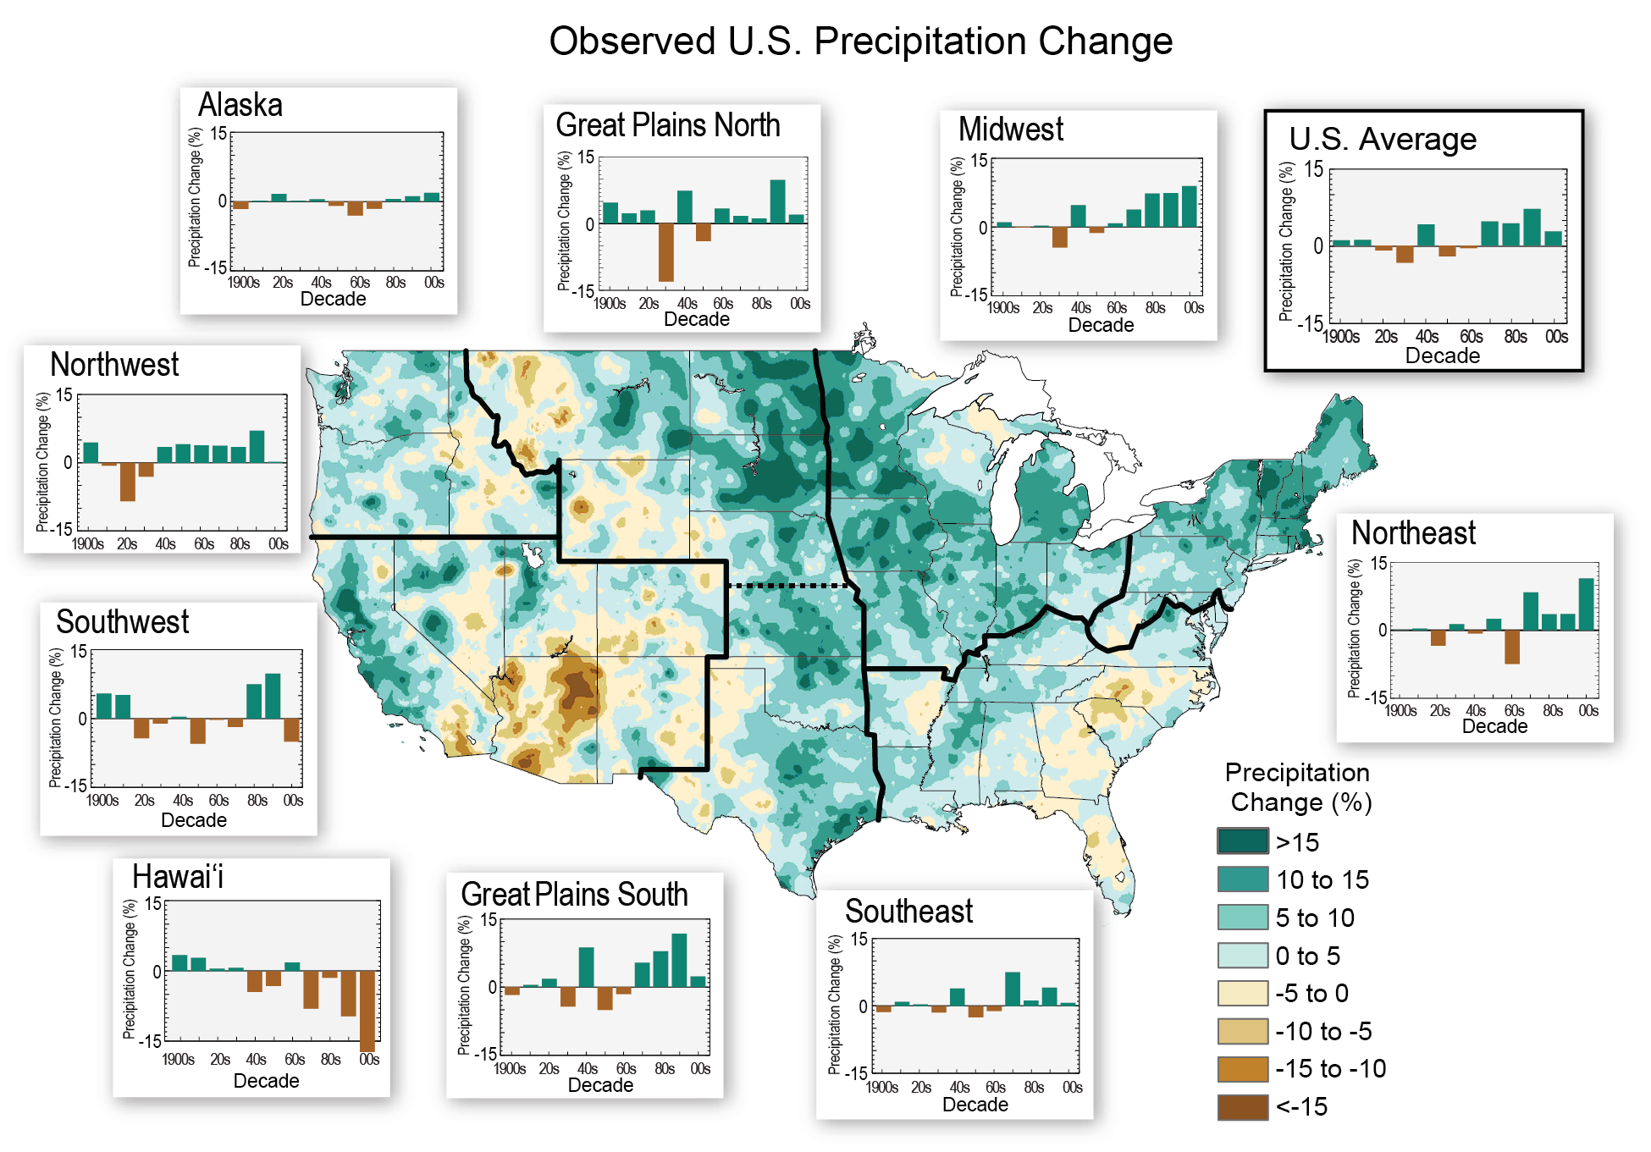
Precipitation trends
Observed U.S. Precipitation Changes
(Walsh et al. 2014, National Climate Assessment)
Notes:
The colors on the map show annual total precipitation changes for 1991-2012 compared to the 1901-1960 average, and show wetter conditions in most areas. The bars on the graphs show average precipitation differences by decade for 1901-2012 (relative to the 1901-1960 average) for each region. The far right bar in each graph is for 2001-2012. (Figure source: adapted from Peterson et al. 2013¹).

Slide 23
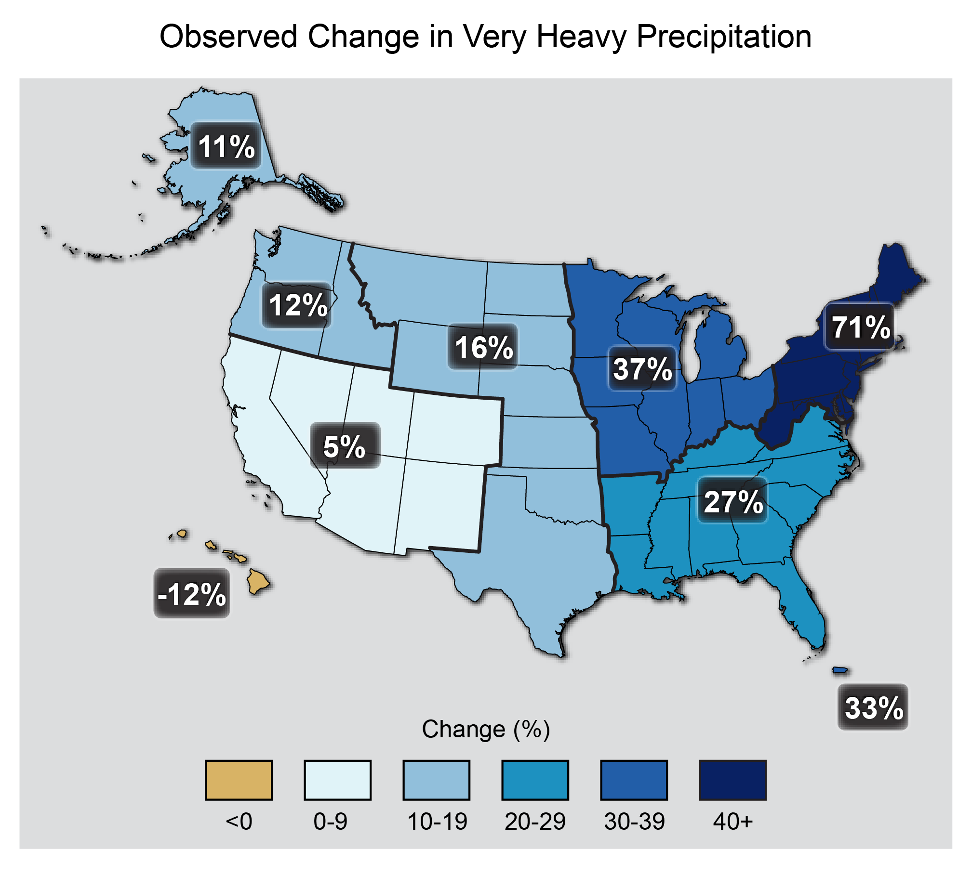
Observed U.S. Heavy Precipitation Changes
(Walsh et al. 2014, National Climate Assessment)
Notes:
The map shows percent increases in the amount of precipitation falling in very heavy events (defined as the heaviest 1% of all daily events) from 1958 to 2012 for each region of the continental United States. These trends are larger than natural variations for the Northeast, Midwest, Puerto Rico, Southeast, Great Plains, and Alaska. The trends are not larger than natural variations for the Southwest, Hawai‘i, and the Northwest. The changes shown in this figure are calculated from the beginning and end points of the trends for 1958 to 2012. (Figure source: updated from Karl et al. 2009¹).

Slide 24
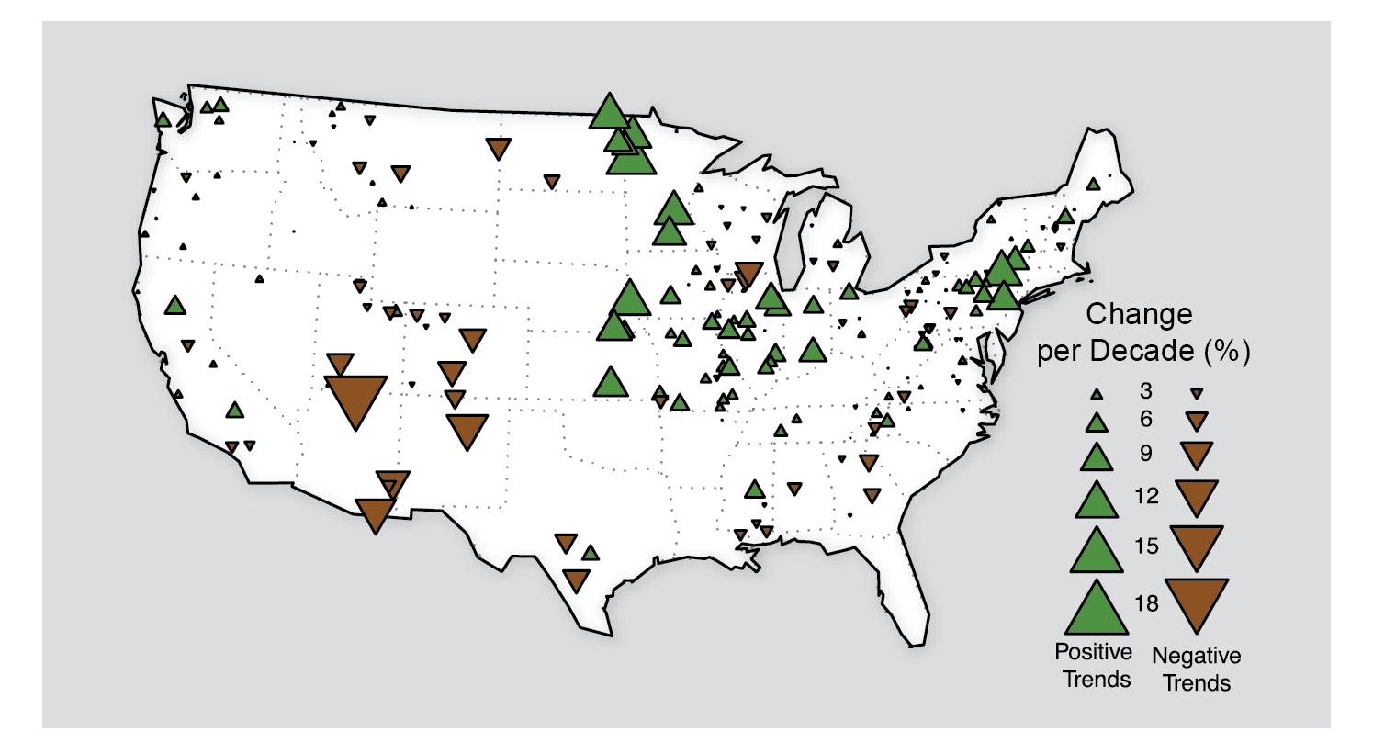
Observed trends in Flood Magnitude
(Walsh et al. 2014, National Climate Assessment)
Notes:
Trend magnitude (triangle size) and direction (green = increasing trend, brown = decreasing trend) of annual flood magnitude from the 1920s through 2008. Local areas can be affected by land-use change (such as dams). Most significant are the increasing trend for floods in the Midwest and Northeast and the decreasing trend in the Southwest. (Figure source: Peterson et al. 2013¹).

Slide 25
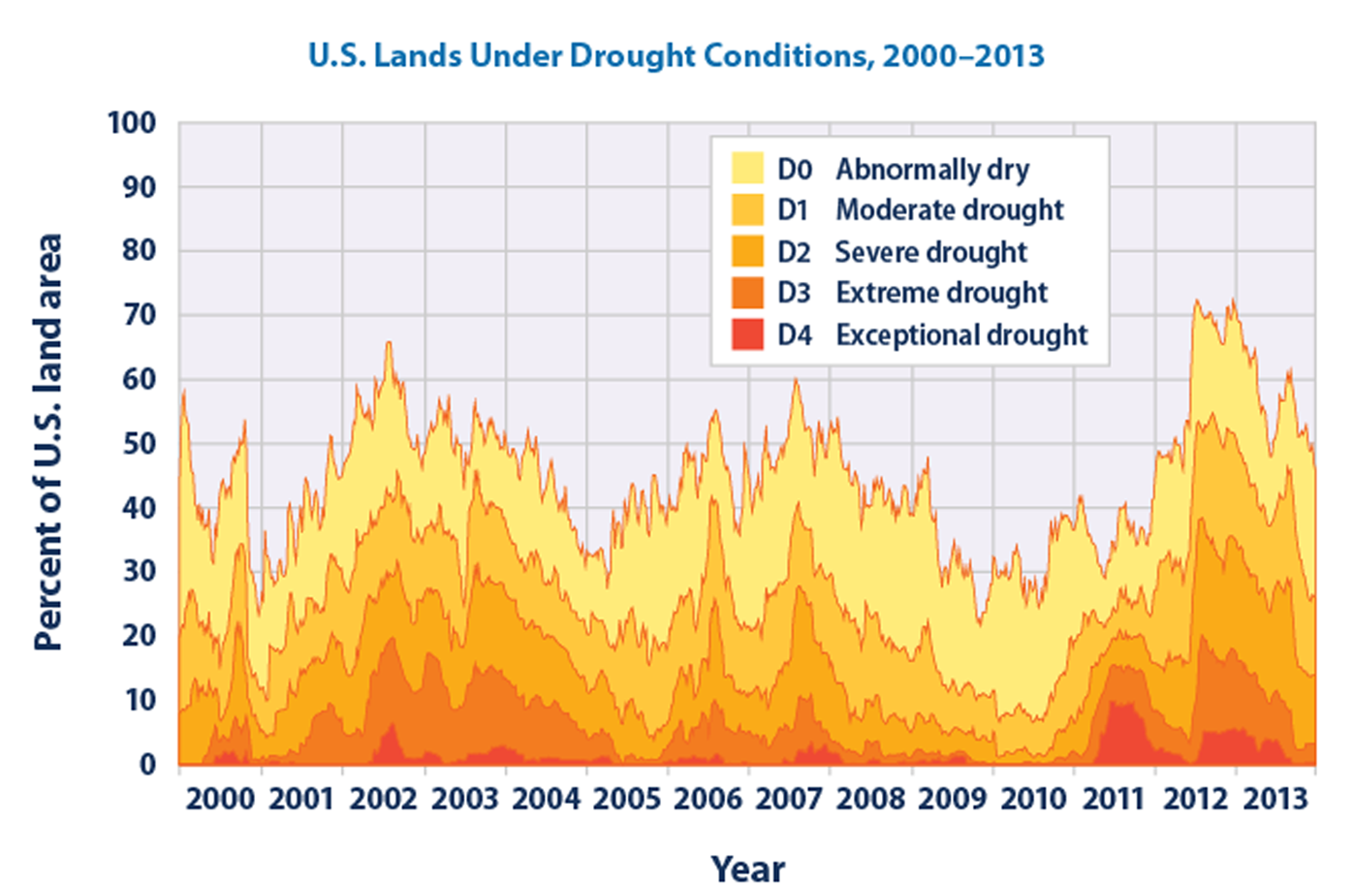
Observed U.S. Land Drought
(EPA, 2014)
Notes:
This chart shows the percentage of U.S. lands classified under drought conditions from 2000 through 2013. This figure uses the U.S. Drought Monitor classification system. The data cover all 50 states plus Puerto Rico.

Slide 26
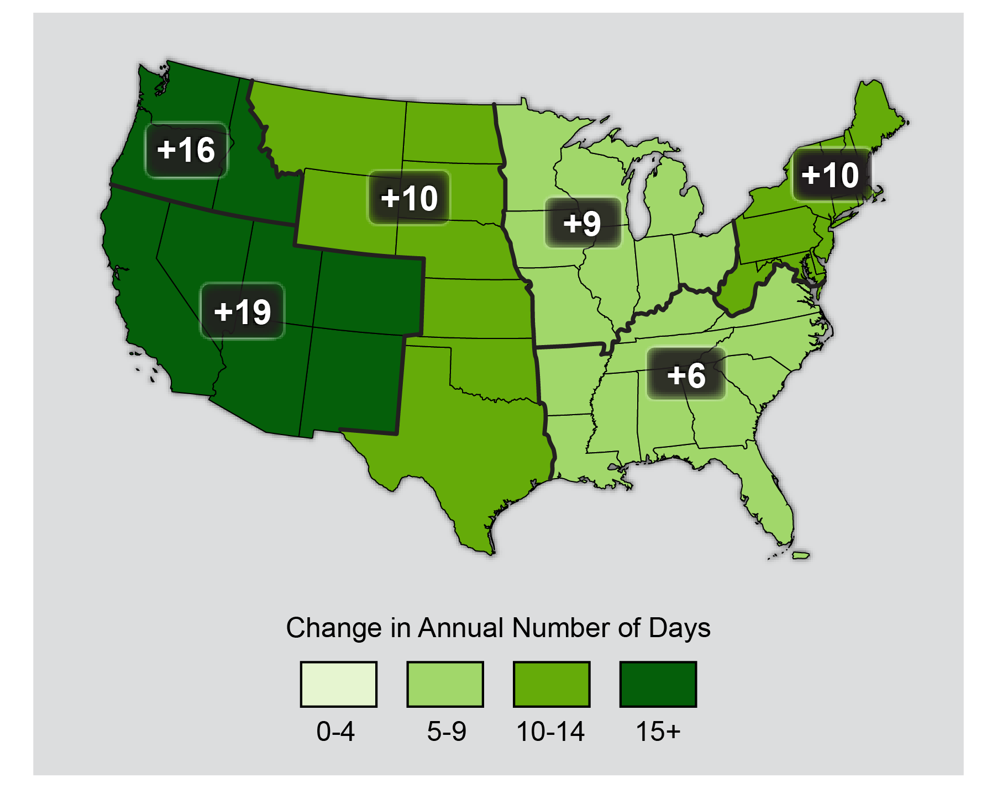
Observed Increase in Frost-Free Season Length
(Walsh et al. 2014, National Climate Assessment)
Notes:
The frost-free season length, defined as the period between the last occurrence of 32°F in the spring and the first occurrence of 32°F in the fall, has increased in each U.S. region during 1991-2012 relative to 1901-1960. Increases in frost-free season length correspond to similar increases in growing season length. (Figure source: NOAA NCDC / CICS-NC). While this may be beneficial to some annual crops, other perennial crops such as fruit trees become at greater risk for frost and freeze damage.

Slide 27
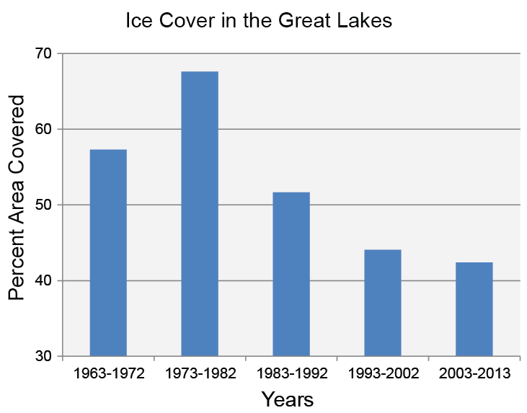
Observed Ice Cover in the Great Lakes
(Pryor et al. 2014, National Climate Assessment)
Notes:
Bars show decade averages of annual maximum Great Lakes ice coverage from the winter of 1962-1963, when reliable coverage of the entire Great Lakes began, to the winter of 2012-2013. Bar labels indicate the end year of the winter; for example, 1963-1972 indicates the winter of 1962-1963 through the winter of 1971-1972. Only the most recent period includes the eleven years from 2003 to 2013. (Data updated from Bai and Wang, 2012).

Slide 28
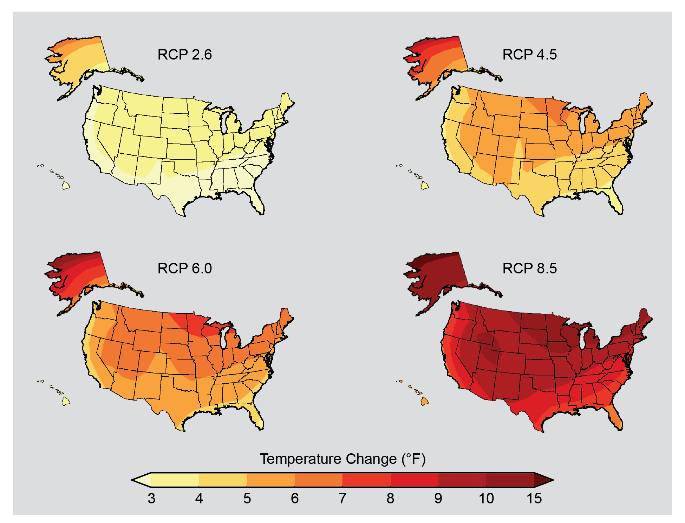
Projected U.S. Temperature Change
The United States is projected to warm 2.0 – 4.0°F
during this century
(Walsh et al. 2014, National Climate Assessment)
Notes:
Now we will look at projected changes in climate variables for the U.S. and North Central Region. These projections are helpful to show broad patterns and likely trends. Do note that we don’t want to scrutinize the model projections at fine scales, however. Projecting what will happen at a specific farm or city is beyond the scope of the models. You’ll notice that many of the projected changes will directly impact agriculture.
The largest uncertainty in projecting climate change beyond the next few decades is the level of heat-trapping gas emissions. The most recent model projections take into account a wider range of options with regard to human behavior, including a lower scenario than has been considered before (RCP 2.6). This scenario assumes rapid reductions in emissions – more than 70% cuts from current levels by 2050 and further large decreases by 2100 – and the corresponding smaller amount of warming. On the higher end, the scenarios include one that assumes continued increases in emissions (RCP 8.5) and the corresponding greater amount of warmin. Projections show change in average temperature in the later part of this century (2071-2099) relative to the late part of last century (1970-1999). (Figure source: NOAA NCDC / CICS-NC).
g. Also shown are temperature changes for the intermediate scenarios RCP 4.5 and RCP 6.0

Slide 29
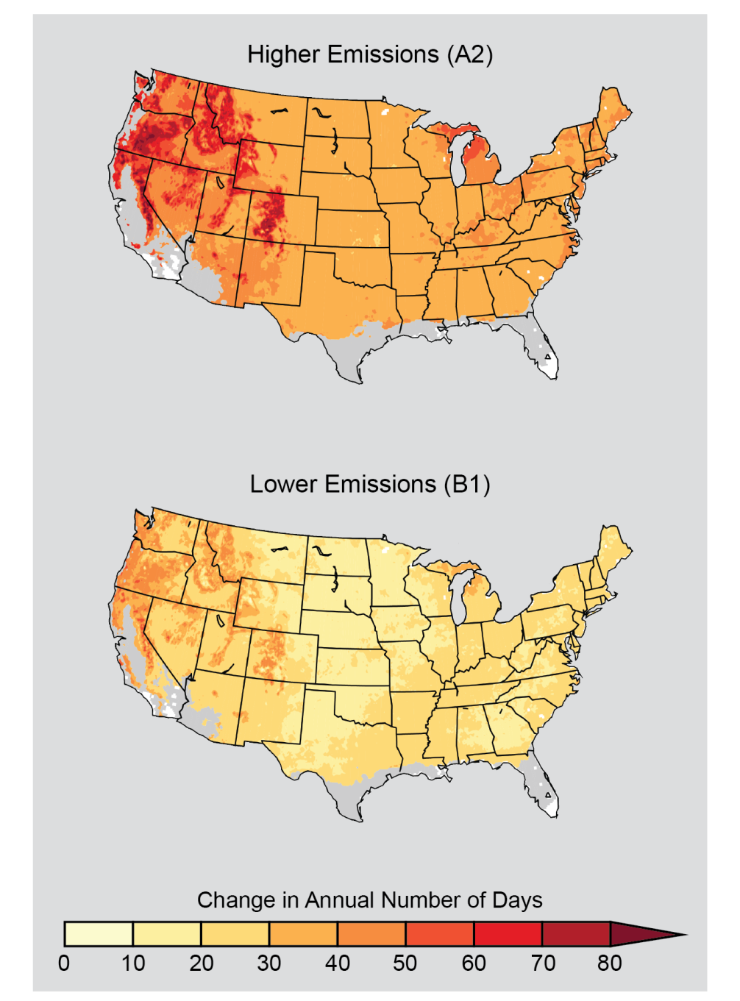
Projected Changes in Frost-Free Season Length
(Walsh et al. 2014, National Climate Assessment)
Notes:
The maps show projected increases in frost-free season length for the last three decades of this century (2070-2099 as compared to 1971-2000) under two emissions scenarios, one in which heat-trapping gas emissions continue to grow (A2) and one in which emissions peak in 2050 (B1). Increases in the frost-free season correspond to similar increases in the growing season. White areas are projected to experience no freezes for 2070-2099, and gray areas are projected to experience more than 10 frost-free years during the same period. (Figure source: NOAA NCDC / CICS-NC).

Slide 30
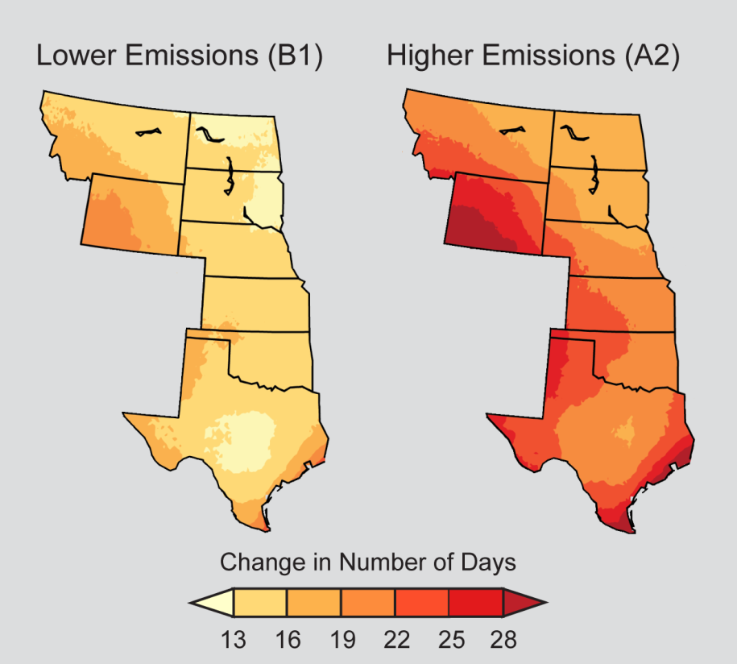
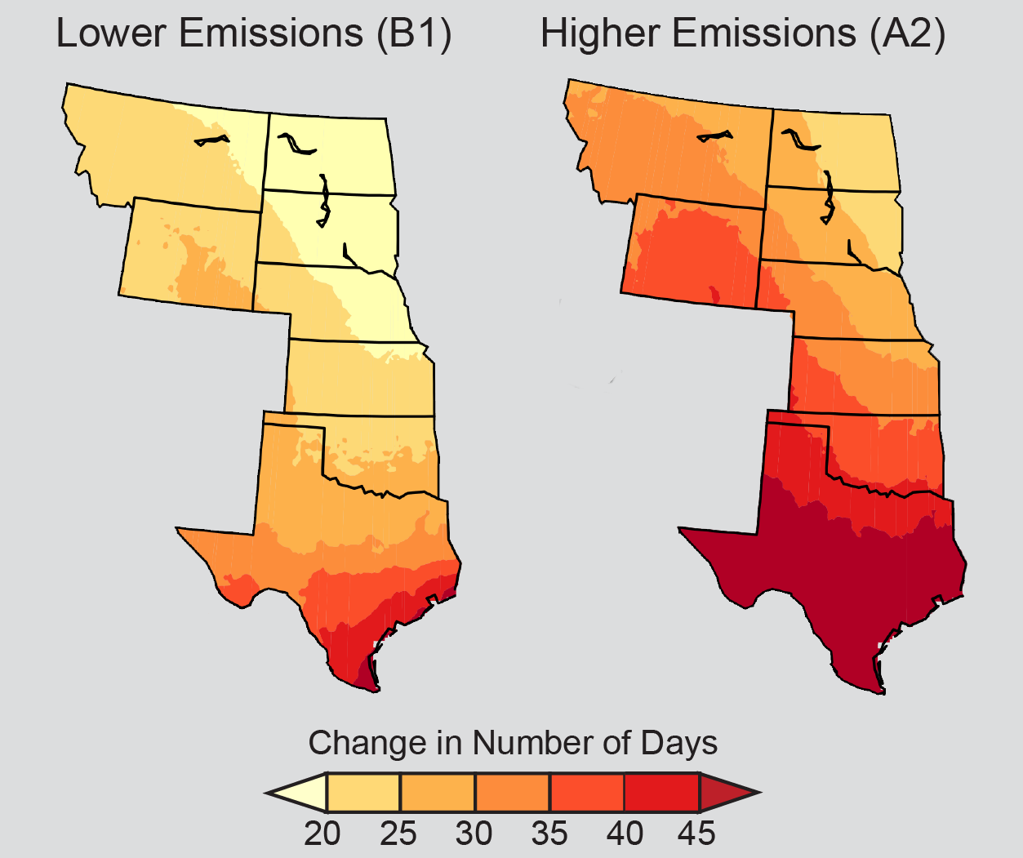
Projected Regional Temperature Changes
Number of Warm Days
Number of Warm Nights
http://www.climatechange2013.org/images/figures/WGI_AR5_Fig2-21.jpg
(Walsh et al. 2014, National Climate Assessment)
Notes:
Figure on left: The number of days with the hottest temperatures is projected to increase dramatically. The historical (1971-2000) distribution of temperature for the hottest 2% of days (about seven days each year) echoes the distinct north-south gradient in average temperatures. However, by mid-century (2041-2070), the projected change in number of days exceeding those hottest temperatures is greatest in the western areas and Gulf Coast for both the lower emissions scenario (B1) and for the higher emissions scenario (A2). (Figure source: NOAA NCDC / CICS-NC).
Figure on right: The number of nights with the warmest temperatures is projected to increase dramatically. The historical (1971-2000) distribution of temperature for the warmest 2% of nights (Top: about seven days each year) echoes the distinct north-south gradient in average temperatures. By mid-century (2041-2070), the projected change in number of nights exceeding those warmest temperatures is greatest in the south for both the lower emissions scenario (B1) and for the higher emissions scenario (A2). (Figure source: NOAA NCDC / CICS-NC).

Slide 31
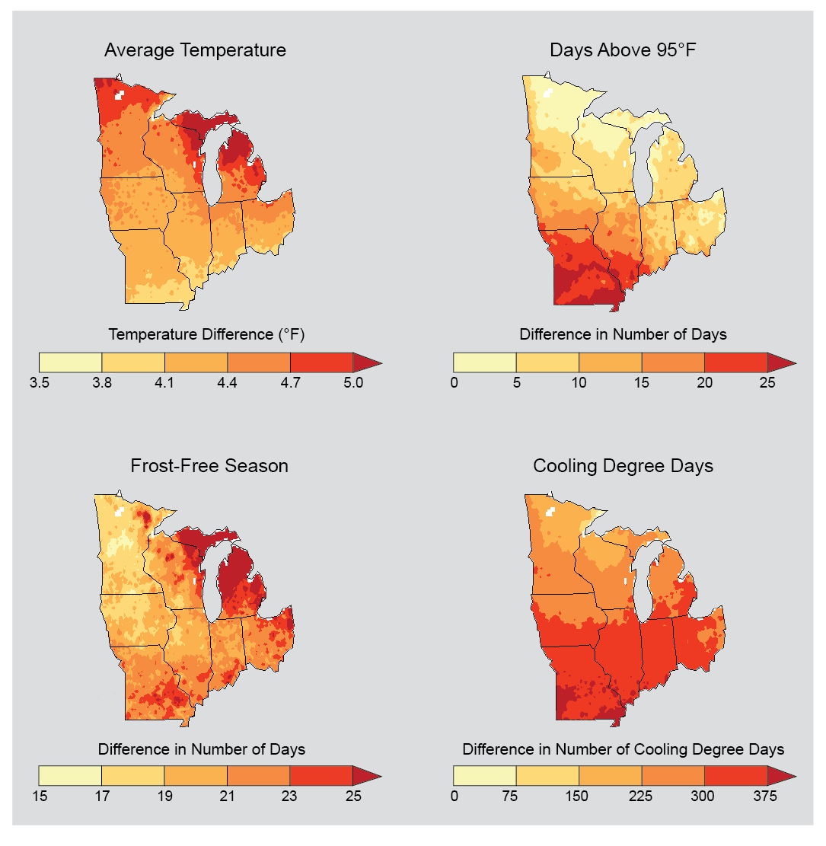
Projected Mid-Century Temperature Changes in the Midwest
(Pryor et al. 2014, National Climate Assessment)
Notes:
Projected increase in annual average temperatures by mid-century (2041-2070) as compared to the 1971-2000 period tell only part of the climate change story. Maps also show annual projected increases in the number of the hottest days (days over 95°F), longer frost-free seasons, and an increase in cooling degree days, defined as the number of degrees that a day’s average temperature is above 65°F, which generally leads to an increase in energy use for air conditioning. Projections are from global climate models that assume emissions of heat-trapping gases continue to rise (A2 scenario). (Figure source: NOAA NCDC / CICS-NC).

Slide 32
Projected U.S. Precipitation Changes
(Walsh et al. 2014, National Climate Assessment)
Notes:
Seasonal precipitation change for 2071-2099 (compared to 1970-1999) as projected by recent simulations that include a wider range of scenarios. The maps on the left (RCP 2.6) assume rapid reductions in emissions – more than 70% cuts from current levels by 2050 – and a corresponding much smaller amount of warming and far less precipitation change. On the right, RCP 8.5 assumes continued increases in emissions, with associated large increases in warming and major precipitation changes. These would include, for example, large reductions in spring precipitation in the Southwest and large increases in the Northeast and Midwest. Rapid emissions reductions would be required for the more modest changes in the maps on the left. Hatched areas indicate that the projected changes are significant and consistent among models. White areas indicate that the changes are not projected to be larger than could be expected from natural variability. (Figure source: NOAA NCDC / CICS-NC).

Slide 33
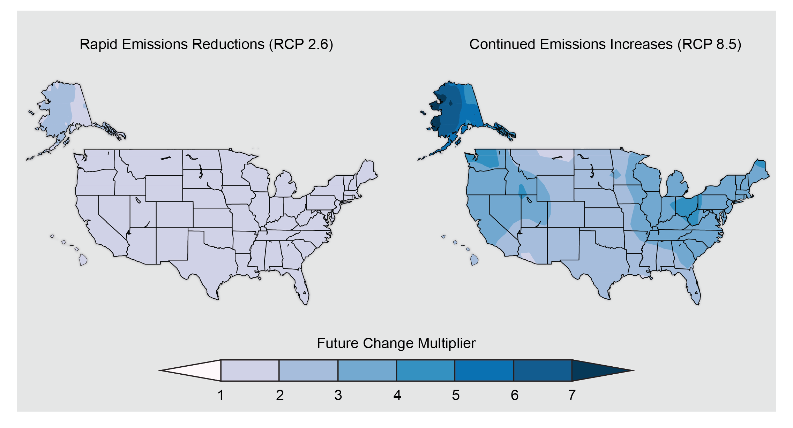
Projected Change in Heavy Precipitation Events
(Walsh et al. 2014, National Climate Assessment)
Notes:
Maps show the increase in frequency of extreme daily precipitation events (a daily amount that now occurs once in 20 years) by the later part of this century (2081-2100) compared to the later part of last century (1981-2000). Such extreme events are projected to occur more frequently everywhere in the United States. Under the rapid emissions reduction scenario (RCP 2.6), these events would occur nearly twice as often. For the scenario assuming continued increases in emissions (RCP 8.5), these events would occur up to five times as often. (Figure source: NOAA NCDC / CICS-NC).

Slide 34
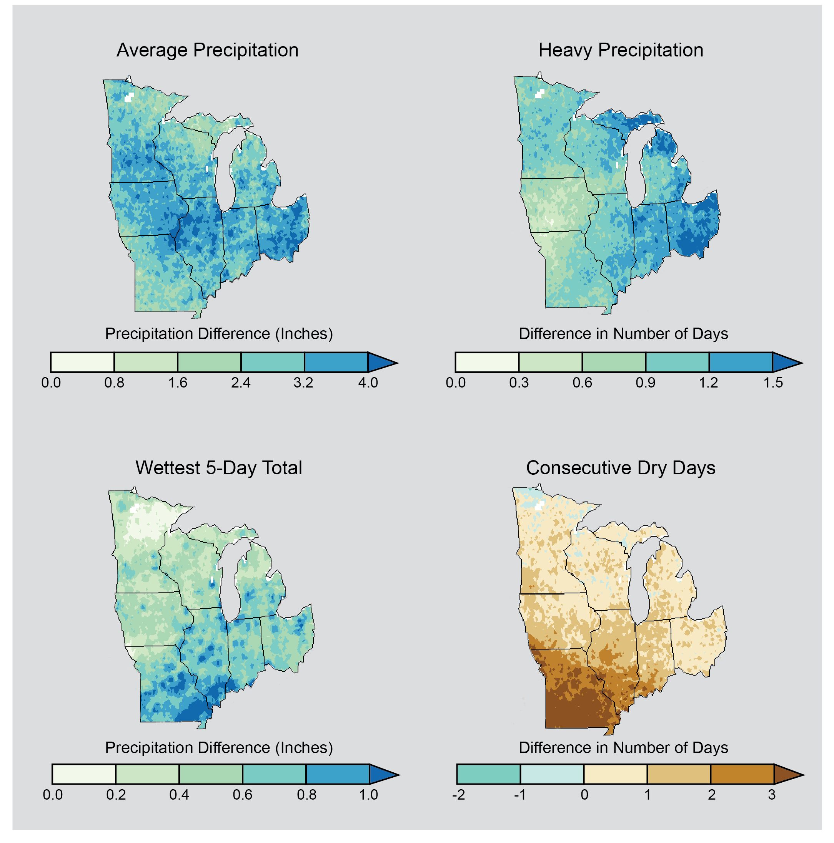
Projected Midwest Precipitation Changes
(Pryor et al. 2014, National Climate Assessment)
Notes:
Precipitation patterns affect many aspects of life, from agriculture to urban storm drains. These maps show projected changes for the middle of the current century (2041-2070) relative to the end of the last century (1971-2000) across the Midwest under continued emissions (A2 scenario). Once again, it is important to remember that we don’t want to scrutinize the model projections at fine scales. They are OK for broad patterns, but can’t speak to what will happen in a given location, even though they may appear that way.
Top left: the changes in total annual average precipitation. Across the entire Midwest, the total amount of water from rainfall and snowfall is projected to increase. Top right: increase in the number of days with very heavy precipitation (top 2% of all rainfalls each year). Bottom left: increases in the amount of rain falling in the wettest 5-day period over a year. Both (top right and bottom left) indicate that heavy precipitation events will increase in intensity in the future across the Midwest. Bottom right: change in the average maximum number of consecutive days each year with less than 0.01 inches of precipitation. An increase in this variable has been used to indicate an increase in the chance of drought in the future. (Figure source: NOAA NCDC / CICS-NC).

Slide 35
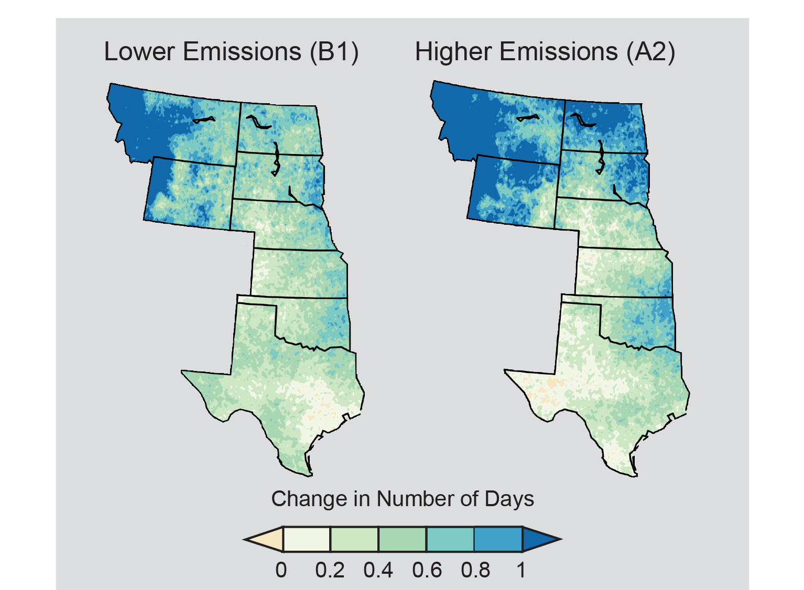
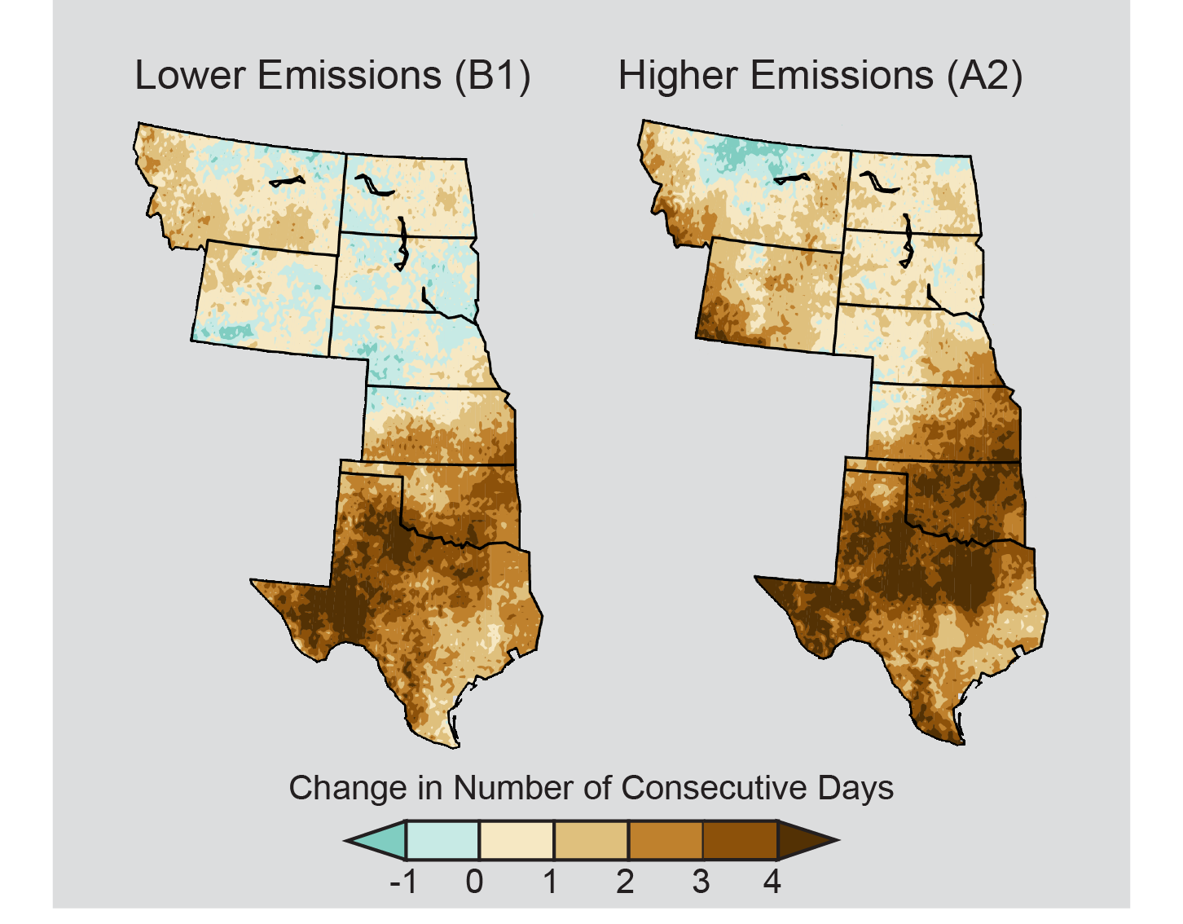
Projected Great Plains Precipitation Changes
Number of Heavy Precipitation Days
Number of
Consecutive Dry Days
(Shafer et al. 2014, National Climate Assessment)
Notes:
Left figure: The number of days with the heaviest precipitation is not projected to change dramatically. The historical (1971-2000) distribution of the greatest 2% of daily precipitation (Top: about seven days each year) echoes the regional east-west gradient in average precipitation. By mid-century (2041-2070), the projected change in days exceeding those precipitation amounts remains greatest in the northern area for both the lower emissions scenario (B1) and for the higher emissions scenario (A2). (Figure source: NOAA NCDC / CICS-NC).
Right figure: Current regional trends of a drier south and a wetter north are projected to become more pronounced by mid-century (2041-2070 as compared to 1971-2000 averages). Maps show the maximum annual number of consecutive days in which limited (less than 0.01 inches) precipitation was recorded on average from 1971 to 2000 (top), projected changes in the number of consecutive dry days assuming substantial reductions in emissions (B1), and projected changes if emissions continue to rise (A2). The southeastern Great Plains, which is the wettest portion of the region, is projected to experience large increases in the number of consecutive dry days. (Figure source: NOAA NCDC / CICS-NC).

Slide 36
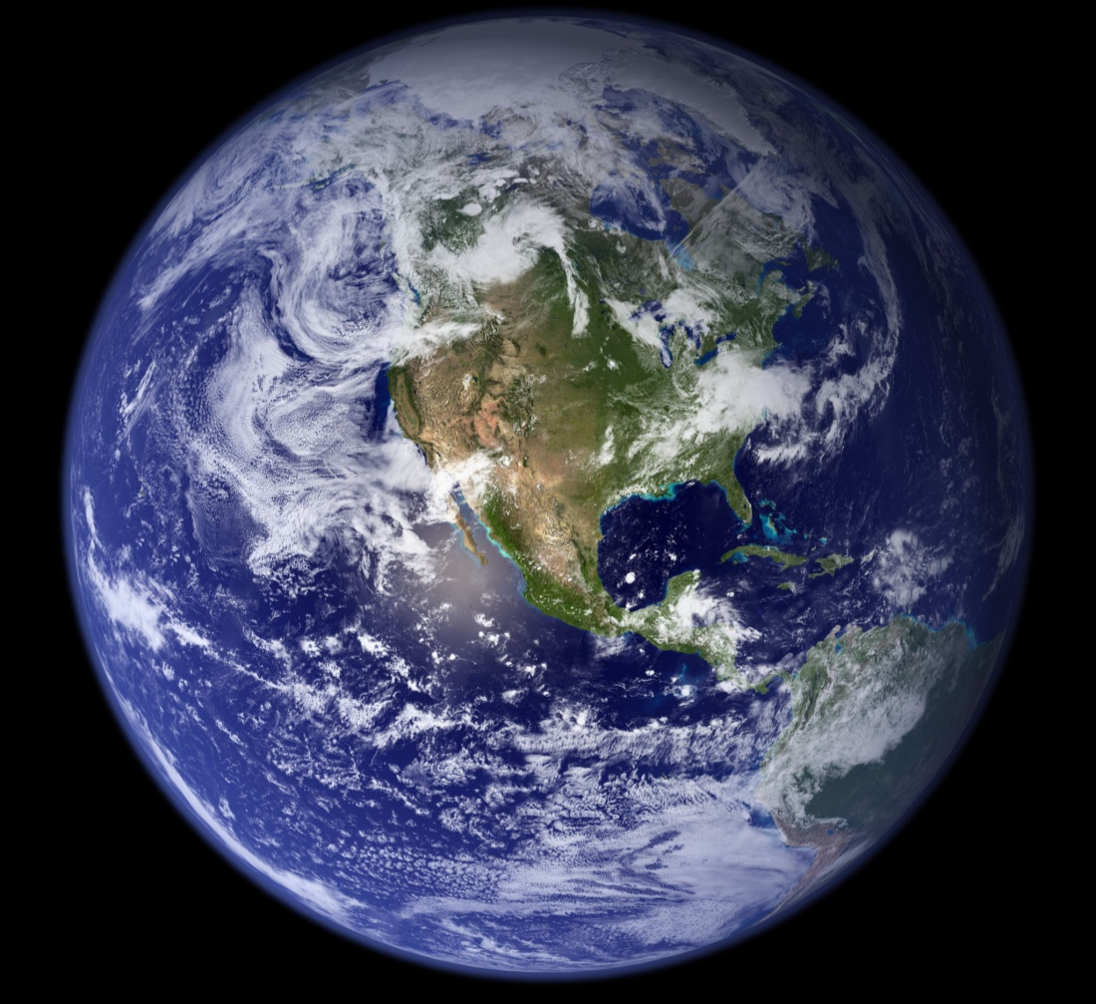
Sources of Uncertainty in Climate Projections
Lack of complete knowledge of how the climate works
Natural variability in the climate system
(UCS www.ucsusa.org; Ekwurzel, 2011)
Notes:
As you may have noticed, climate scientists are not able to tell us exactly what will happen. Even though the computer models are continually improving, there are still sources of uncertainty in the climate projections. Why is this? Here are three reasons why. First, the climate system is very complex. Even though climate and other scientists have made great strides in understanding how it works, we still don’t completely understand all of the relationships and nuances of the various parts that make up the climate system. Secondly, like any natural system, there is natural variability in the climate system that has always been there, and that will never go away.

Slide 37
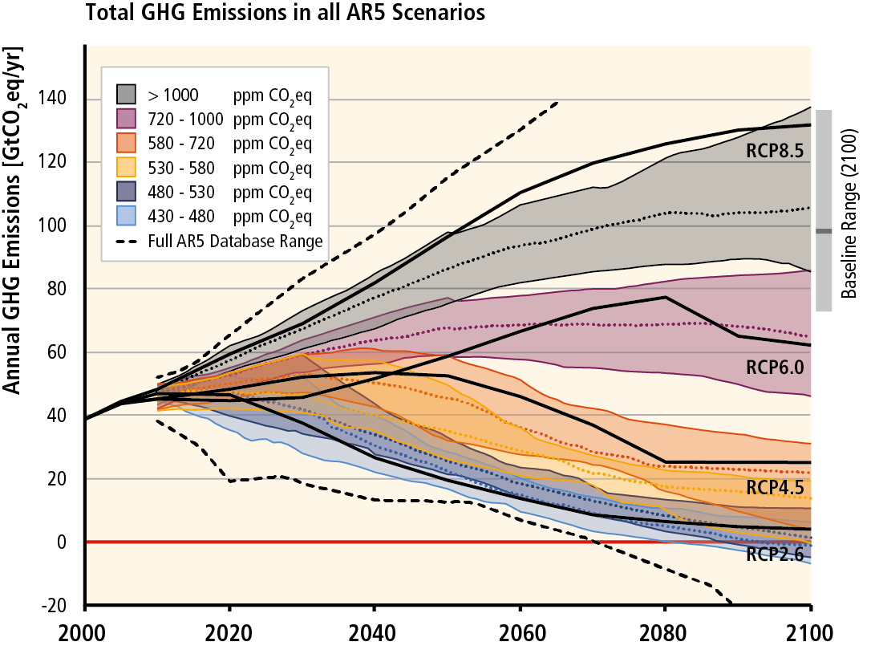
Sources of Uncertainty in Climate Projections
Inability to predict human behavior
(IPCC, 2014)
Notes:
The third reason brings in human’s influence on the climate, and our inability to predict how humans will behave. Here we are once again looking at the different pathways, or scenarios, that humans could take. Each colored line represents a different combination of economic growth, population dynamics, and technology development. Depending on what happens, on how humans behave, there will be different levels of greenhouse gases. The amount of change in the temperature depends on what these greenhouse gas levels are. Because we can’t predict exactly how humans will behave, we can’t predict exactly how the climate will change.

Slide 38
Understanding Uncertainty
Biological and social uncertainties are facts of life
For scientists, it means: “how well something is known”
For the public, it often translates to: “not knowing”
BUT, less than complete certainty ≠ not knowing anything! We know enough to take actions to protect the climate and to prepare for changes in the climate.
(UCS www.ucsusa.org; Ekwurzel, 2011)
Notes:
We are all familiar with uncertainty. We manage uncertainty in a variety of ways, even though we may not like it. For example, we prepare retirement funds, as we don’t know how long we’ll be able to work. We buy life insurance, because we don’t know when and how we will die and we want our loved ones to be taken care of. Basically, biological and social uncertainties are facts of life! But when it comes to uncertainties in science, for example in climate projections, sometimes scientists and the public talk about them and think about them in different ways. For example, for scientists, uncertainty means how well something is known. They are able to measure the levels of uncertainty, do tests on it, and understand it really well. But for the public, sometimes to us it may translate to ‘not knowing’ anything. As we just discussed, we know why there are uncertainties in climate projections, and it doesn’t mean that we don’t know anything! We know a great deal. And we know enough about how the climate works to take actions to reduce greenhouse gas levels and protect the climate. While we don’t know exactly how the climate will change, we know enough to talk in our communities about ways to prepare for changes in the climate.

Slide 39
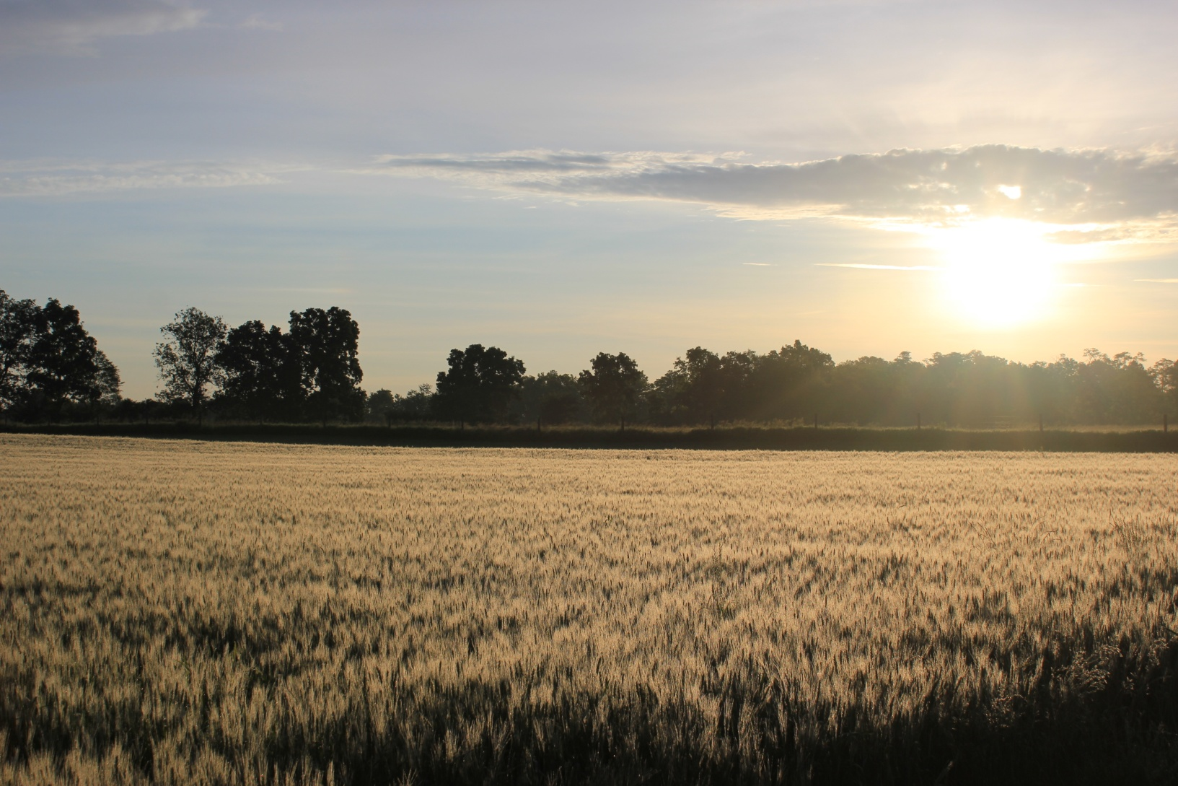
3. Climate Change and Field Crop Agriculture
Notes:
Now we’ll talk specifically about climate change and agriculture.

Slide 40
Why Address Climate Change & Field Crops?
1. Climate change is real.
2. Scientists are concerned about its effect on agriculture.
3. To help agriculture adapt to changes and be part of the climate change solution.
Notes:
Why address climate change and agriculture? There are three main reasons:
Climate change is real – as we’ve seen from the previous slides.
Scientists concerned – how will agriculture be affected?
To help farmers adapt and be part of the climate change solution: both are discussion points for scientists, policy makers, farmers, and other decision makers.

Slide 41
Effects of Climate Change on Field Crops
Temperature
Cloud cover
Precipitation
Extreme events
Carbon dioxide levels
Plant growth and development
Planting and harvest times
Weed, disease, & insect outbreaks
Irrigation needs
Soil and water quality
(Tubiello et al. 2007, Hatfield et al. 2014)
Notes:
Agronomists, plant pathologists, entomologists, and others are concerned about the effect of the changing climate on agriculture. Long-term data shows changes in temperature, cloud cover, precipitation, extreme events, and carbon dioxide levels. All of these affect agriculture directly. They affect plant growth, planting and harvest times, weed/disease/and insect outbreaks, irrigation needs, and soil and water quality directly. How will agriculture need to adapt? What’s the net effect? There is lots to consider….more than just temperature and it is not easy to predict exactly what will happen, as these variables interact in complicated ways. For example, while greater rainfall and a longer growing season can enhance crop growth, they can also lead to more plant pests. In addition, if the greater precipitation occurs in winter rather than summer, then the longer growing season may not enhance yields and may delay springtime soil drying. If, on the other hand, the greater precipitation occurs in summer but in more intense storms, the benefit may be offset by nitrogen loss, erosion, and other fertility problems. This highlights a really important point: the issue is complex.

Slide 42
The Climate and Agricultural systems are COMPLEX
(Deming et al. 2007)
Notes:
Even though it is well understood that changes in the climate will greatly impact agriculture, it is hard to say exactly what will happen. That’s because both the climate system and the agricultural system are complex. That is challenging to farmers and scientists alike, but doesn’t mean that we can’t take action. So what is known about climate change and agriculture?

Slide 43
Climate Change Effects on Field Crops
Crop production will decrease in many regions because of increased pressure from weeds, diseases, and insect pests
Loss and degradation of soil and water resources will continue because of increasing extremes in precipitation
More weather extremes (extreme heat, severe drought, and heavy precipitation) will have increasingly negative impacts on crop productivity
(Hatfield et al. 2014 , National Climate Assessment)
Notes:
From the latest National Climate Assessment we know that changes in the climate will have many adverse effects on field crops.

Slide 44
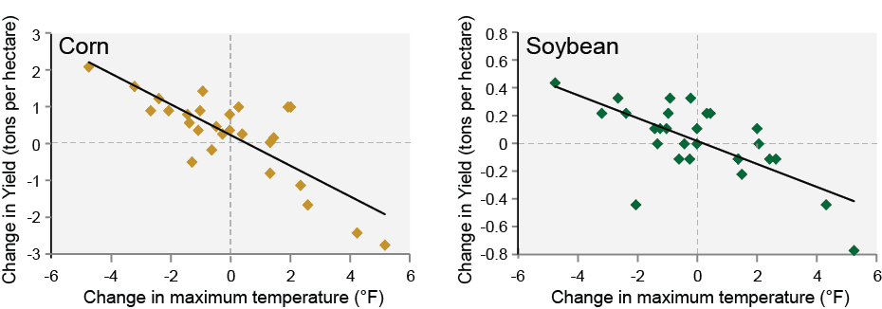
Crops Yields Decline Under High Temperatures
(Hatfield et al. 2014, National Climate Assessment)
Notes:
Crop yields are very sensitive to temperature and rainfall. They are especially sensitive to high temperatures during the pollination and grain filling period. For example, corn (left) and soybean (right) harvests in Illinois and Indiana, two major producers, yields were lower in years with average maximum summer (June, July, and August) temperatures higher than the average from 1980 to 2007. Most years with below-average yields are both warmer and drier than normal.^{1,2} There is high correlation between warm and dry conditions during Midwest summers³ due to similar meteorological conditions and drought-caused changes.⁴ (Figure source: Mishra and Cherkauer 2010⁵).

Slide 45
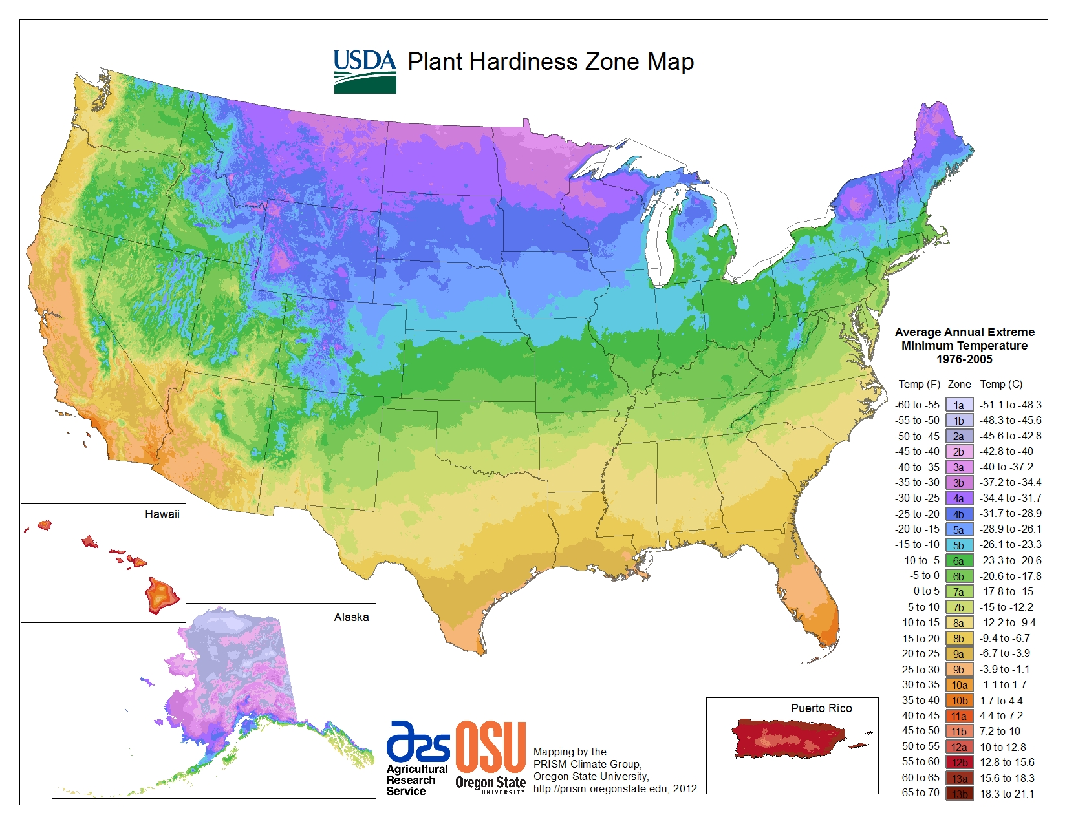
U.S. Plant Hardiness
(USDA, 2014)
Notes:
This map is divided into numbered zones based on average annual low temperatures in10-degree increments. For example, areas in Zone 7 have an average annual minimum temperature of 0 to 10°F, while areas in Zone 8 have an average annual minimum temperature of 10 to 20°F. Each zone represents group of plant species that can be sustained with respect to minimum temperatures. Comparison between hardiness zones of 1990 and 2006 shows how these zones are shifting upwards across the United States. In other words, plants that are sustained in current situation might not be sustained in the future due to climate change.

Slide 46
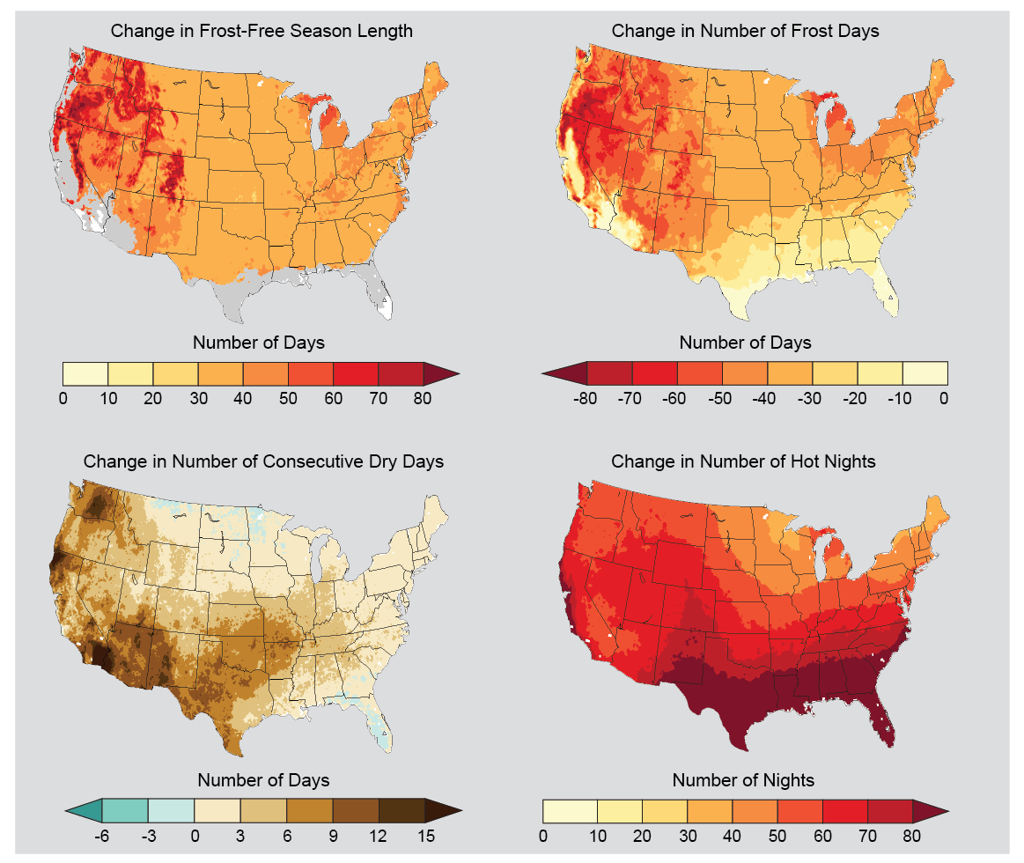
Projected Changes in Key Climate Variables Affecting
Agriculture Productivity
(Hatfield et al. 2014, National Climate Assessment)
Notes:
These changes are projected to continue. The maps above show projected changes in key climate variables affecting agricultural productivity for the end of the century (2070-2099) compared to 1971-2000. Changes in climate parameters critical to agriculture show lengthening of the frost-free or growing season and reductions in the number of frost days (days with minimum temperatures below freezing), under an emissions scenario that assumes continued increases in heat-trapping gases (A2). Changes in these two variables are not identical, with the length of the growing season increasing across most of the United States and more variation in the change in the number of frost days. Warmer-season crops, such as melons, would grow better in warmer areas, while other crops, such as cereals, would grow faster, meaning less time for the grain itself to mature, reducing productivity. Taking advantage of the increasing length of the growing season and changing planting dates could allow planting of more diverse crop rotations, which can be an effective adaptation strategy. On the frost-free map, white areas are projected to experience no freezes for 2070-2099, and gray areas are projected to experience more than 10 frost-free years during the same period. In the lower left graph, consecutive dry days are defined as the annual maximum number of consecutive days with less than 0.01 inches of precipitation. In the lower right graph, hot nights are defined as nights with a minimum temperature higher than 98% of the minimum temperatures between 1971 and 2000. (Figure source: NOAA NCDC / CICS-NC).

Slide 47
How can field crop agriculture adapt AND be part of the climate change solution?
Notes:
Many scientists, policymakers, and others are asking how agriculture can adapt to changes and be part of the climate change solution. The climate is changing, and changes are likely to happen more rapidly in the future. We do not know exactly how climate change will affect crops in the North Central Region, but we know there will be change, and the better we are prepared for it the more we can use it to our benefit. Agriculture’s ability to be nimble in adapting, as well as having good information about changes and adaptive measures is key. In addition, agricultures ability to be part of the climate solution is vital. By managing land in ways that pull greenhouse gases from the atmosphere and emits fewer greenhouse gases, agriculture can help be part of the climate change solution. That is also referred to as agriculture’s ability to “mitigate climate change”. Many scientists are interested in this and pursuing research and management aimed at this. Let’s first talk a little bit about adaptation.

Slide 48
Adaptation
The idea that changes are occurring or will occur, and we can manage the impacts of those changes.
(WICCI, 2011)
Notes:
A simple definition of climate change adaptation is ‘the idea that changes are occurring or will occur, and we can manage the impacts of those changes.” We all know farmers are better than most at adapting. They have always adapted, and always will. But the changes we’ve seen over recent decades in the climate are unlike previous changes, and the rate of change is likely to increase, which may make adapting more difficult.

Slide 49
“Adaptation toolkit”
Natural resources & inputs
Water, energy, labor, land, fertilizer, pesticides
Breeding and genetic modification
Energy, water and soil conservation
Pest management
Specialized equipment
Information technology
Crop and animal translocation
Improved agronomic practices,
including diversification/energy efficiency
Strategic marketing
Harvest and storage efficiency
Technological innovation
Human ingenuity
(Easterling, 2011)
Notes:
Agriculture will be affected both by changes in absolute values of temperature and precipitation and by increased climatic variation (Hatfield et al. 2011) and adaptive measures will be needed. Adaptation is not new to agriculture. Adaptive measures for agriculture include (i) relying on natural resources and inputs (e.g., water, energy, land); (ii) technological innovation (e.g., breeding and genetic modification; water and soil conservation; pest management); (iii) human ingenuity (e.g., relocating crop and animal production areas; improved agronomic practices); and (iv) information and knowledge (e.g., environmental monitoring systems; risk management) (Easterling 2011). However, these measures have not been tested much and their effectiveness—alone or in combination—is still in question (Easterling 2011).

Slide 50
Adaptation Issues
In many ways, agriculture has been able to adapt to recent changes in the climate (for example, changes in timing of field operations, shifts in crops grown, and changing tillage and irrigation practices)
Existing techniques likely not sufficient for forthcoming changes in the climate – new strategies will be needed
Improving resilience is key: transformative strategies may be needed
Significant portion of world’s food production already facing challenges and may not be able to invest in adaptation measures
(Hatfield et al., 2014, National Climate Assessment)
Notes:
Coupled with varying climate trends at local levels and uncertainties in climate projections for the North Central Region, this makes adapting and planning for the future somewhat difficult. Agronomists are challenged to quantify how cropping systems can be made more resilient in the face of climatic changes (Hatfield et al. 2011). Crop management strategies such as no-till and cover and companion crop integration can help reduce the need for chemical subsidies and may help manage crops under heat and/or water stress. Conservation of moisture by enhancing soil organic matter can assist in reducing the need for increased water subsidies, which will likely be required as the climate warms. Not only would such field practices help agricultural ecosystems become more resilient and adaptable to climate change, they could also be more climate friendly ways to farm, or, in other words: these practices could help mitigate climate change. (From Gage, Doll, and Safir 2015)

Slide 51
Mitigation
The idea that we can avoid, prevent or minimize undesirable things happening in the future. Two ways:
Release fewer greenhouse gases to the atmosphere
REMOVE greenhouse gases from the atmosphere
(WICCI, 2011)
Notes:
Let’s talk a little more about mitigation. By all indications the climate is changing. People are interested in how we can do things to make the change less severe. This what they mean by mitigation. We’ll talk about two ways that agriculture can help to do this: first, by releasing fewer greenhouse gases to the atmosphere. The second part is by actually REMOVING greenhouse gases from the atmosphere that are already there.

Slide 52
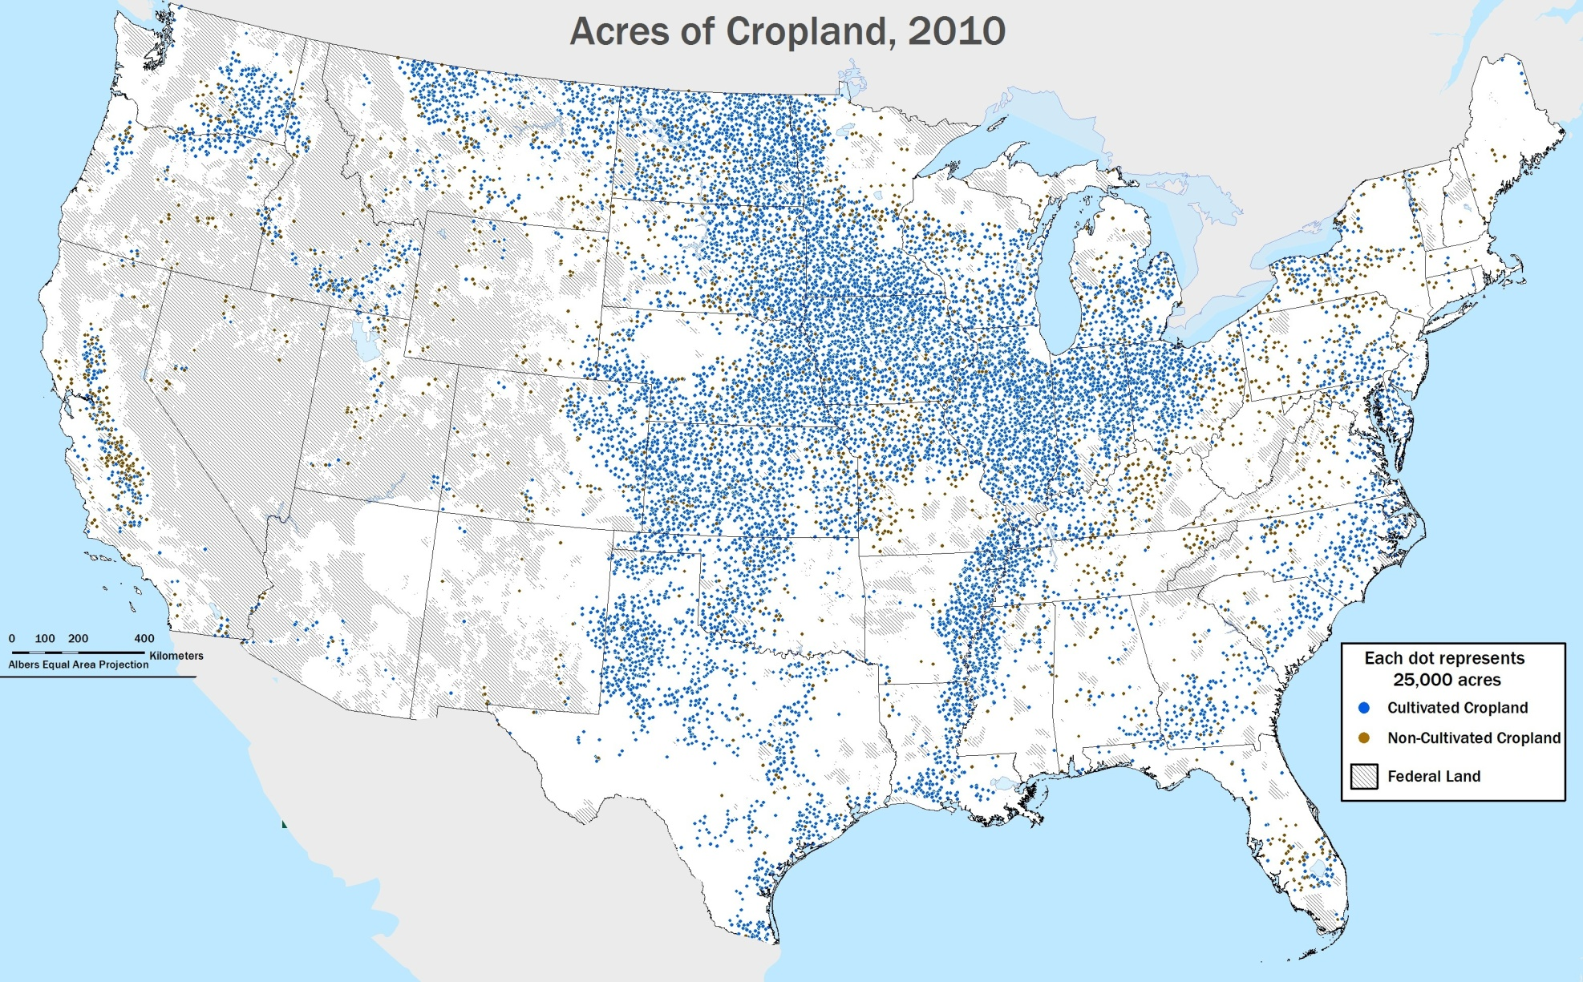
Cropland in the United States
(Adapted from USDA, 2014)
Notes:
Here’s map that shows why people are so interested in agriculture’s role in mitigation: it’s because agriculture covers a large part of the lower United States, especially in the North Central Region. For this reason, there is great potential for agriculture to be part of the climate change solution. To more fully understand this, we are going to talk a little about agriculture’s role in greenhouse gas emissions.

Slide 53
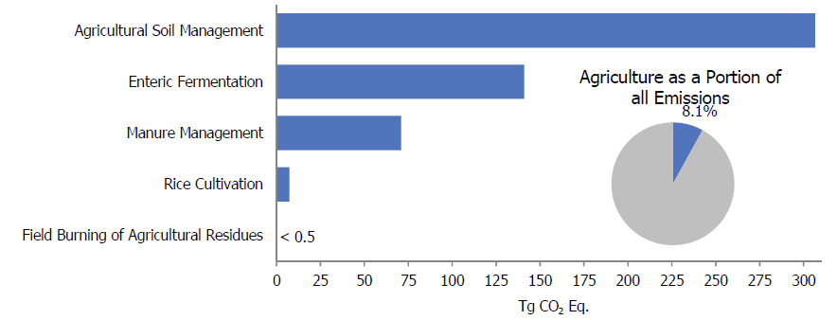
Agricultural Emissions in the United States
(EPA’s US GHG Inventory Report, 2014)
Notes:
This figure illustrates the relative magnitude of sources of greenhouse gas emissions from the Agriculture Sector. Agricultural soil management is the largest source and is more than twice the size of the next largest source, which is enteric fermentation. Agricultural residue burning is the smallest source. In addition, there is a pie chart that indicates that the agricultural sector accounted for 8.1% of U.S. greenhouse gas emissions in 2012. In 2013, greenhouse gas emissions from agriculture accounted for approximately 9% of total U.S. greenhouse gas emissions. Greenhouse gas emissions from agriculture have increased by approximately 17% since 1990. It is important to note that this does not include land cover change or other aspects of the food system, such as transportation.
Globally, agricultural emissions account for approximately 14% of greenhouse gas emissions.

Slide 54
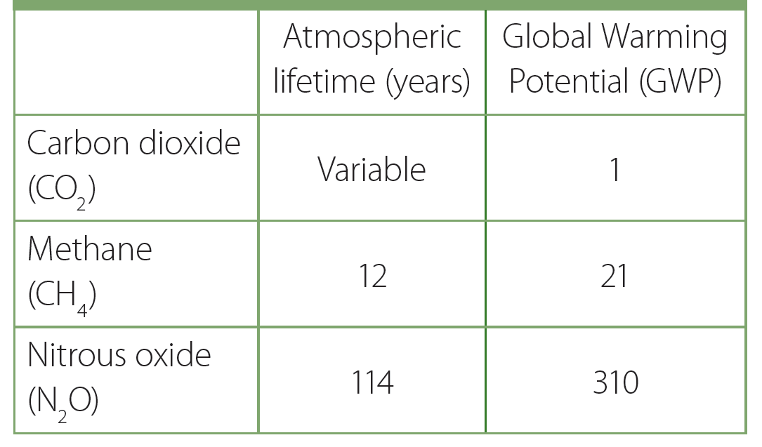
Greenhouse Gases Not Created Equal
(IPCC, 2014)
Notes:
It’s important to note that greenhouse gases are not created equally. That is, they have different capacities to absorb heat and different lifetimes in the atmosphere. Scientists use the term ‘global warming impact’ to differentiate the impacts of different greenhouse gases:
Global Warming Potential (GWP) is an index that represents the global warming impact of a greenhouse gas relative to carbon dioxide. GWP represents the combined effect of how long the gas remains in the atmosphere and its relative effectiveness in absorbing outgoing infrared heat. The table in the slide lists the GWP of the three main greenhouse gases (based on a 100-year time horizon). As the table shows, a given molecule of nitrous oxide has over 300 times the impact on global warming as does a molecule of carbon dioxide. Let’s talk a little more about nitrous oxide, because when it comes to field crop agriculture, that’s the greenhouse gas of most interest. Why is that?

Slide 55
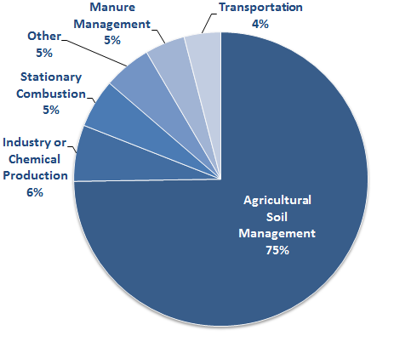
Nitrous Oxide (N₂O) Sources
(EPA, 2014)
Notes:
Agriculture is responsible for 68% of US emissions of nitrous oxide due to the use of nitrogen fertilizers and the cultivation of nitrogen-fixing crops. The next largest sources are <10% of total, and are mainly from industrial sources. As this pie chart shows, the main agricultural source of N2O is from agricultural soil management.

Slide 56
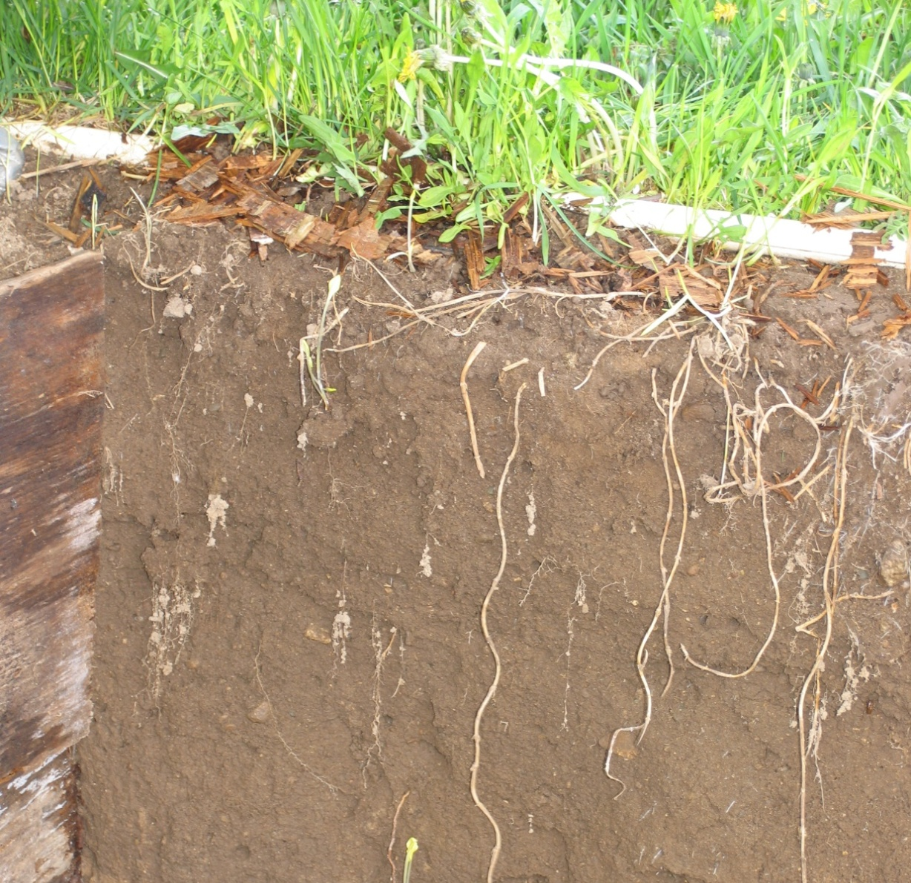
Nitrous oxide
Microbial Processes: Nitrification & Denitrification
MINERAL NITROGEN
Notes:
Nitrous oxide is produced naturally in soils through the microbial processes of denitrification and nitrification. These natural emissions of nitrous oxide (N₂O) can be increased by a variety of agricultural practices and activities, including the use of synthetic and organic fertilizers, production of nitrogen-fixing crops, cultivation of high organic content soils, and the application of livestock manure to croplands and pasture. All of these practices directly add additional nitrogen to soils, which can then be converted to nitrous oxide. Anything we do to more effectively manage nitrogen in the soils and the fields will help limit N2O emissions. Basically, the conditions that lead to nitrous oxide emissions involve wasted nitrogen…nitrogen that the crop is not using. Not having as much wasted nitrogen has multiple benefits: less extra nitrogen to leach through the soil and contaminate water, less to be emitted to the atmosphere, and less money wasted on lost nitrogen fertilizer.

Slide 57
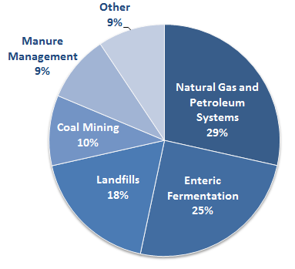
Methane (CH₄) Sources
(EPA, 2014)
Notes:
The next greenhouse gas we will discuss is methane, which is about 10% of US greenhouse gas emissions. In the United States, agriculture produces ~30% of methane emissions from the following sources:
Enteric fermentation in livestock, 25%
Livestock manure management, 9%

Slide 58
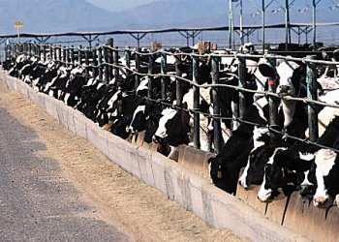
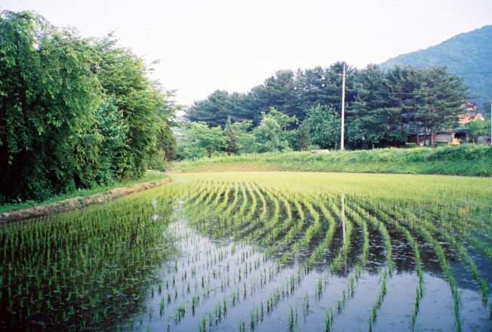
Methane: Microbial Processes
Production:
Consumption:
Notes:
Just like the other greenhouse gases, methane is produced by microbes. In the case of methane, specialized microbes that help decay organic matter under anaerobic conditions (conditions with no oxygen) are what produce it. These conditions occur in:
Rumen of livestock
Waste lagoons
Rice paddies (and natural wetlands)
Of interest is that methane is also consumed (oxidized) by bacteria in soils containing oxygen. That means that under certain conditions, microbes actually take up methane from the atmosphere, thereby reducing methane levels in the atmosphere. This happens at very low rates in soils. However, if you remember the U.S. map of agricultural lands, you’ll remember that agriculture covers many acres, so there is potential for larger amounts of methane to be consumed. This is an exciting, new area of research.

Slide 59
Land Use Change and Carbon Dioxide (CO2)
(Brady and Weil, 1999)
Notes:
The third greenhouse gas is carbon dioxide, the one most people have heard of. Farmers are more familiar than most that carbon is stored in the soil. In fact, globally, soils contain more carbon than living plants. This soil carbon – more commonly referred to as soil organic matter – changes with land use change. That’s what this figure is showing: just how much (about half) of the soil organic matter is lost from native grasslands when they are plowed and converted to agriculture. Once again, this has to do with microbes. When soil is disturbed by tillage, the soil layers mix with air, resulting in a great deal of soil microbial activity. This microbial activity causes soil organic matter (crop residue) to be broken down quickly and carbon to be converted from organic carbon that was in the soil to carbon dioxide, which escapes to the atmosphere.

Slide 60
Increase Organic Matter
(Photo courtesy of S. Snapp)
Notes:
Certain agronomic practices can help store soil carbon. You’ll also hear “storing carbon in the soil” referred to as carbon sequestration. This is removing carbon dioxide from the atmosphere and storing it in the soil. This can be accomplished through planting crops or trees that absorb carbon dioxide from the atmosphere via photosynthesis and store it in their ecosystem as roots, wood, or soil organic matter. Any way that we can farm that increases soil organic matter can help to store carbon in the soil and keep it out of the atmosphere. Examples of farming techniques that do this include conservation tillage and cover crops. These are examples of mitigating climate by bringing atmospheric greenhouse gas levels down. However, this is not a sliver bullet to solving climate change. As you know, soil organic matter takes awhile to increase. Also, one of the challenges with storing carbon in the soil is that it can be lost. Research in Michigan has shown that plowing soil that had not been disturbed for many years can result in the loss of much of the soil carbon that had been gained.

Slide 61
Mitigation Has Adaptation Benefits, Too!
(USDA-NRCS, Feb 2006)
Notes:
Mitigation strategies for agriculture come with benefits that can actually help agriculture adapt, too. Here is a figure from the USDA highlighting this fact. For example, the first row shows that conservation practices such as conservation tillage and reduced field pass intensity are promoted as ‘climate friendly’ by sequestering carbon and reducing emissions. These mitigation strategies have benefits such as improved soil and water quality and reduced soil erosion, which in turn may help make that farming system more resilient to changes and better able to adapt.

Slide 62
Summary
The climate system is dynamic; human factors are driving changes in the climate that are superimposed on the natural variability of the climate
We can expect increased warming of the Earth due to human’s impact on the climate
Agriculture stands to be greatly affected by these changes in the climate
Agriculture will need to adapt to these changes, and it can also be part of the climate change solution
Notes:
Earth’s climate is a constantly changing, dynamic process. It has changed greatly in the past and will continue to change in the future. Through increased emissions of greenhouse gases into the atmosphere, human activity has resulted in a warming climate during the past few centuries. Depending on whether future greenhouse gas emissions stabilize or increase, we can expect warming of the planet similar to or greater than what has occurred in recent years. The projected global warming of 2 to 7 degrees F is very large by historical standards and could be the largest observed temperature increase in at least 50 million years. Even though that may seem like a small change, history proves how even small changes in the global average temperature can have an enormous impact. For example, the average global temperature at the end of the last glacial epoch was only 9 to11 degrees F cooler than that of today.
Changes in climate have already affected us, and there is uncertainty about how exactly we will need to adapt to future changes. However, we can stabilize our emissions through political and behavioral choices as well as with new technologies. By staying informed and engaging in dialogue about the changes we face, communities can create plans of action to reduce negative impacts, adapt to changes, and take advantage of possible positive outcomes.

Slide 63
4. Discussion Questions
What changes in temperature have you noticed?
What changes in precipitation have you noticed?
What, if anything, surprised you about the information presented today?
What additional information would be helpful for you to adapt to changes in the climate?
How can we continue this conversation and best learn from each other about how to adapt to changes?

Slide 64
5. Evaluation for Your Audience to Complete
There is a paper available for you to use to evaluate your program. It can be printed rom the next slide.

Slide 66
“Acres of Cropland, 2010.” March 2014. Data from 2010 Natural Resources Inventory, U.S. Department of Agriculture, Natural Resources Conservation Service. Map source from Natural Resources Conservation Service, Soil Science and Resource Assessment. Resource Assessment Division, Beltsville, MD, USA. Available online at: http://www.nrcs.usda.gov/Internet/NRCS_RCA/ maps/m13160.png.
Brady, Nyle C., and Ray R. Weil. 1999. The Nature and Properties of Soils. Prentice-Hall International, Upper Saddle River, New Jersey, USA. Print.
"Climate at a Glance: Time Series." September 2014. National Climatic Data Center (NCDC). National Oceanic and Atmospheric Administration (NOAA). Available online at: http://www.ncdc.noaa.gov/cag/.
"Climate Science Glossary." Data from Doran et al, (2009) and Anderegg et al (2010). Skeptical Science. Available online at: http:// www.skepticalscience.com/graphics.php?g=1.
Easterling, W. E. 2011. “Guidelines for Adapting Agriculture to Climate Change,” in: Handbook of Climate Change and Agroecosystems: Impacts, Adaptation, and Mitigation, D. Hillel and C. Rosenzweig, Eds., Imperial College Press, London, UK: 269-286 pp.
Ekwurzel, Brenda. 2011."Certainty vs. Uncertainty: Understanding Scientific Terms About Climate Change." Union of Concerned Scientists. Available online at: www.ucs.org.
Gage, Doll, and Safir. 2015. “A crop stress index to predict climatic effects on row-crop agriculture in the U.S. North Central Region,” in:
The ecology of agricultural ecosystems: long-term research on the path to sustainability, S. K. Hamilton, J. E. Doll, and G. P. Robertson, Eds., Oxford University Press, New York, New York, USA.
Hatfield, J. L., K. J. Boote, B. A. Kimball, L. H. Ziska, R. C. Izaurralde, D. Ort, A. M. Thomson, and D. Wolfe. 2011. Climate impacts on agriculture: Implications for crop production. Agronomy Journal 103: 351–370 pp.
Hatfield, J., G. Takle, R. Grotjahn, P. Holden, R. C. Izaurralde, T. Mader, E. Marshall, and D. Liverman. 2014. “Ch. 6: Agri­culture,” in:
Climate Change Impacts in the United States: The Third National Climate Assessment, J. M. Melillo, Terese (T.C.) Richmond, and G.W. Yohe, Eds., U.S. Global Change Research Program: 150-174 pp. doi:10.7930/J02Z13FR.
IPCC. 2013. Climate Change 2013: The Physical Science Basis. Contribution of Working Group I to the Fifth Assessment Report of the Intergovernmental Panel on Climate Change, Stocker, T.F., D. Qin, G.-K. Plattner, M. Tignor, S.K. Allen, J. Boschung, A. Nauels, Y. Xia, V. Bex and P.M. Midgley, Eds., Cambridge University Press, Cambridge, United Kingdom and New York, NY, USA: 39, 1535 pp.

Slide 67
IPCC. 2014. Climate Change 2014: Impacts, Adaptation, and Vulnerability. Contribution of Working Group II to the Fifth Assessment Report
of the Intergovernmental Panel on Climate Change, Field, C.B., V.R. Barros, D.J. Dokken, K.J. Mach, M.D. Mastrandrea, T.E. Bilir,
M. Chatterjee, K.L. Ebi, Y.O. Estrada, R.C. Genova, B. Girma, E.S. Kissel, A.N. Levy, S. MacCracken, P.R. Mastrandrea, and L.L.
White, Eds., Cambridge University Press, Cambridge, United Kingdom and New York, NY, USA: 24, 122, 2008 pp.
Le Treut, H., R. Somerville, U. Cubasch, Y. Ding, C. Mauritzen, A. Mokssit, T. Peterson and M. Prather. 2007. “Ch. 1: Historical Overview of Climate Change,” in Climate Change 2007: The Physical Science Basis. Contribution of Working Group I to the Fourth Assessment Report of the Intergovernmental Panel on Climate Change, Solomon, S., D. Qin, M. Manning, Z. Chen, M. Marquis, K.B. Averyt, M. Tignor and H.L. Miller, Eds., Cambridge University Press, Cambridge, United Kingdom and New York, NY, USA.
“Opportunities for Managing Carbon Sequestration and Greenhouse Gas Emissions in Agricultural Systems.” February 2006. United States Department of Agriculture-Natural Resources Conservation Service. Available online at: http://www.nrcs.usda.gov/Internet/ FSE_DOCUMENTS/stelprdb1043605.pdf.
Pryor, S. C., D. Scavia, C. Downer, M. Gaden, L. Iverson, R. Nordstrom, J. Patz, and G. P. Robertson. 2014. “Ch. 18: Mid­west,” in: Climate Change Impacts in the United States: The Third National Climate Assessment, J. M. Melillo, Terese (T.C.) Rich­mond, and G. W. Yohe, Eds., U.S. Global Change Research Program: 418-440 pp. doi:10.7930/J0J1012N.
Shafer, M., D. Ojima, J. M. Antle, D. Kluck, R. A. McPherson, S. Petersen, B. Scanlon, and K. Sherman. 2014. “Ch. 19: Great Plains,” in: Climate Change Impacts in the United States: The Third National Climate Assessment, J. M. Melillo, Terese (T.C.) Richmond, and G. W. Yohe, Eds., U.S. Global Change Research Program: 441-461 pp. doi:10.7930/J0D798BC.
Thelen, K., C. Laboski, J. Smeenk, et al. 2007. “Field crop production systems,” in: Ecologically Based Farming Systems (Extension Bulletin E- 2983), Deming, S., L. Johnson, D. Lehnert, et al., Eds., Michigan State University, East Lansing, MI, USA: 40-59 pp.
Tubiello, F. N., J.-F. Soussana, and S. M. Howden. 2007. Crop and pasture response to climate change. Proceedings of the National Academy of Sciences, USA 104:19686-19690 pp.
"USDA Plant Hardiness Zone Map.” 2012. United States Department of Agriculture. Available online at:
www.planthardiness.ars.usda.gov/PHZMWeb.
U.S. Environmental Protection Agency. 2014. “Introduction,” in: Climate Change Indicators in the United States, third edition. 2014. U.S. EPA, Washington, DC, USA: 4 pp. Available online at: www.epa.gov/climatechange/science/indicators. EPA 430-R-14-004.

Slide 68
U.S. Environmental Protection Agency. 2014. Inventory of U.S. Greenhouse Gas Emissions and Sinks: 1990–2012. U.S. EPA, Washington, DC, USA. Available online at: http://www.epa.gov/climatechange/ghgemissions/usinventoryreport.html#fullreport. EPA 430-R-14- 003
U.S. Environmental Protection Agency. "Weather and Climate," in: Climate Change Indicators in the United States, third edition. 2014. U.S. EPA, Washington, DC, USA: 39 pp. Available online at: www.epa.gov/climatechange/indicators. EPA 430-R-14-004.
Walsh, J., D. Wuebbles, K. Hayhoe, J. Kossin, K. Kunkel, G. Stephens, P. Thorne, R. Vose, M. Wehner, J. Willis, D. Anderson, S. Doney, R. Feely, P. Hennon, V. Kharin, T. Knutson, F. Landerer, T. Lenton, J. Kennedy, and R. Somerville. 2014. Ch. 2: Our Changing Climate. Climate Change Impacts in the United States: The Third National Climate Assessment, J. M. Melillo, Terese (T.C.) Richmond, and G. W. Yohe, Eds., U.S. Global Change Research Program: 19-67 pp. doi:10.7930/J0KW5CXT.
Wisconsin's Changing Climate: Impacts and Adaptation. 2011. Wisconsin Initiative on Climate Change Impacts. Nelson Institute for Environmental Studies, University of Wisconsin-Madison and the Wisconsin Department of Natural Resources, Madison, Wisconsin.

