Slide 1
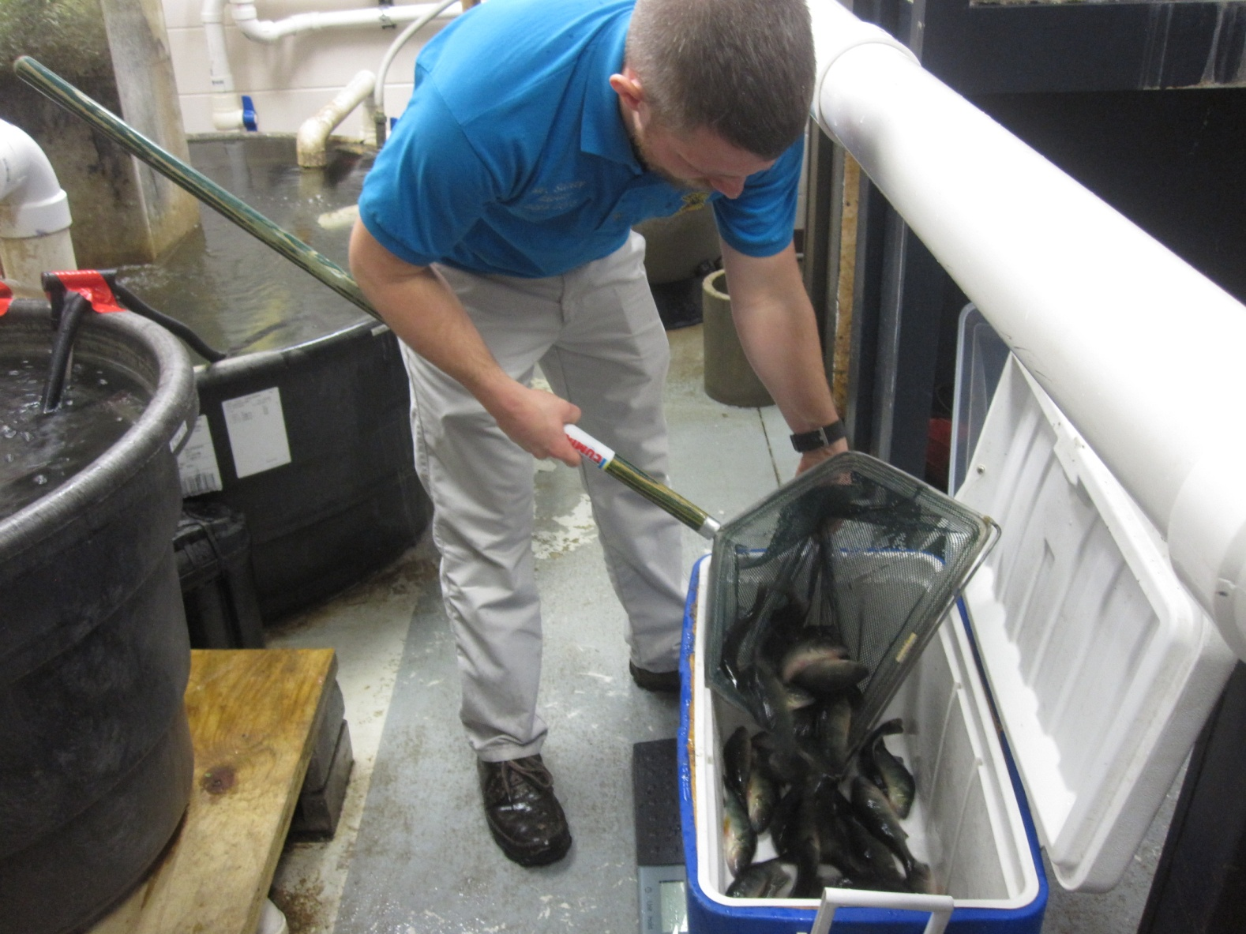
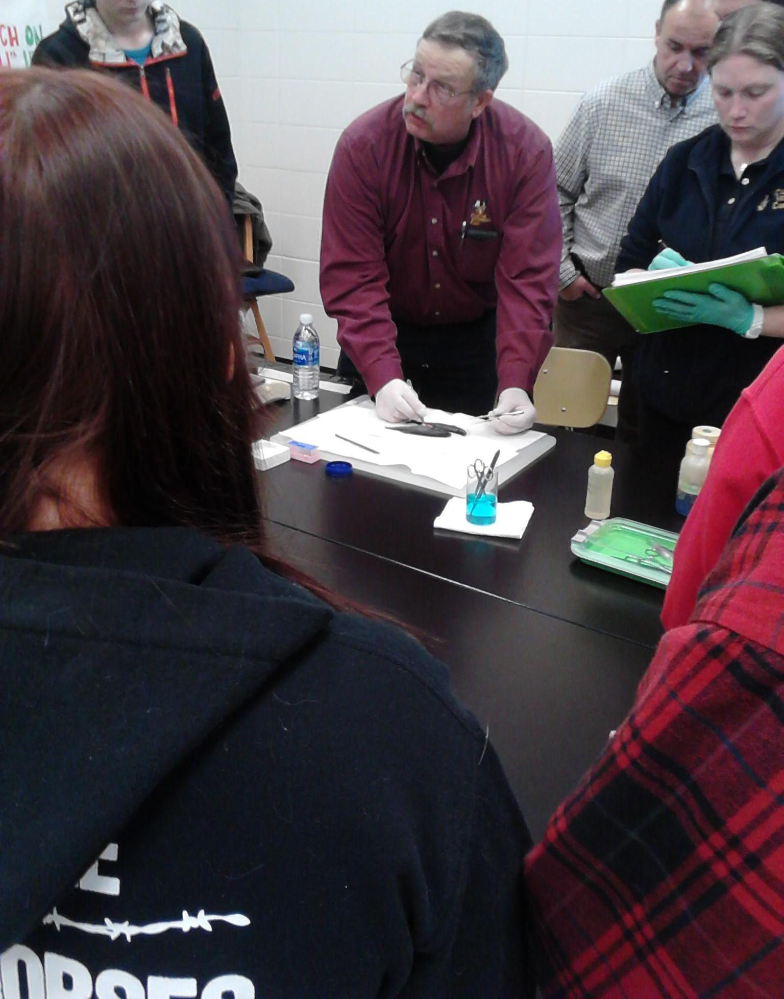
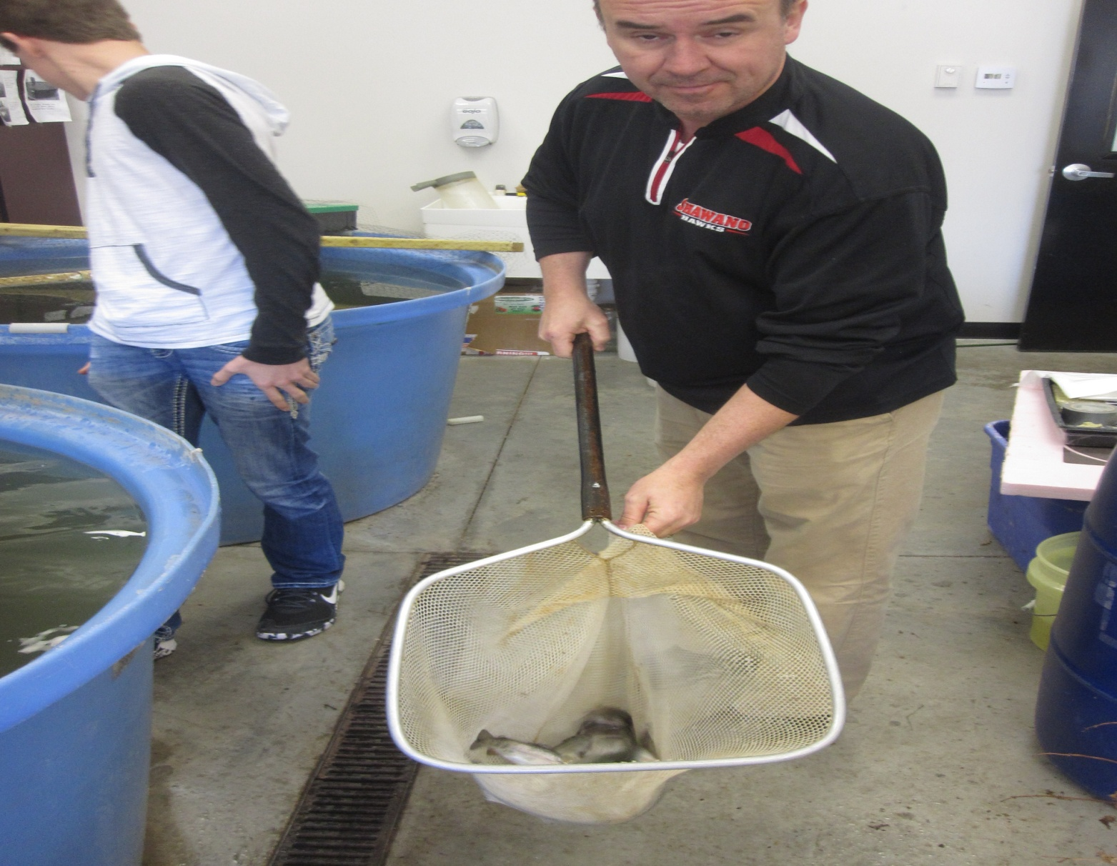
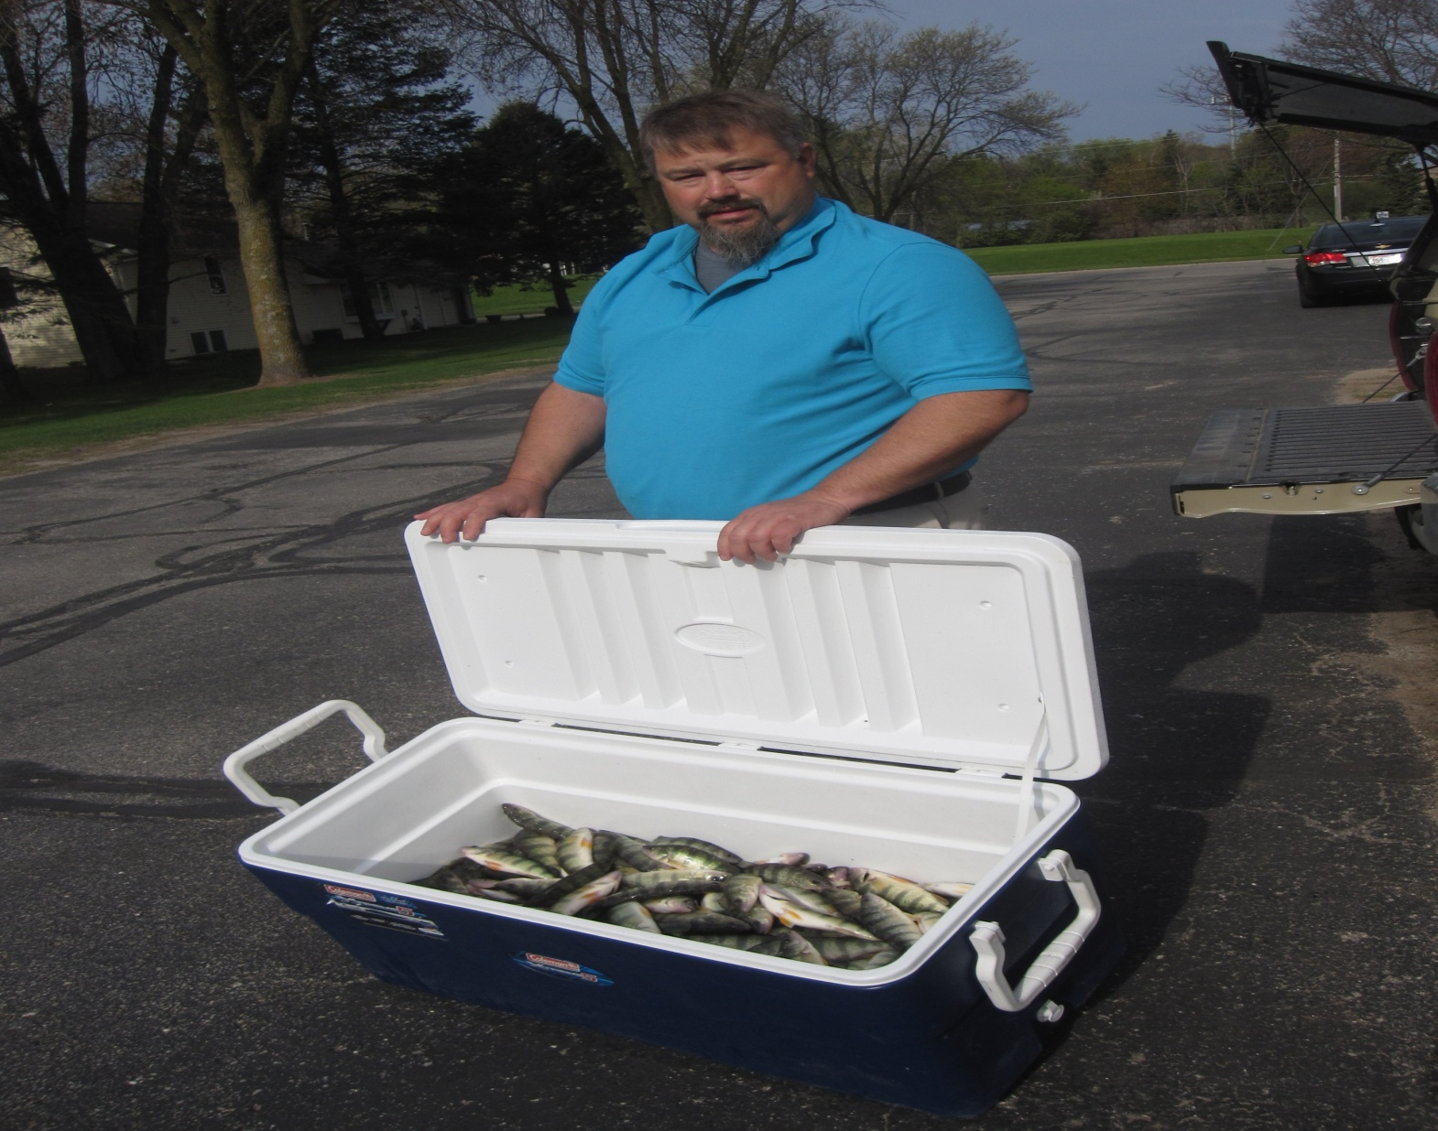
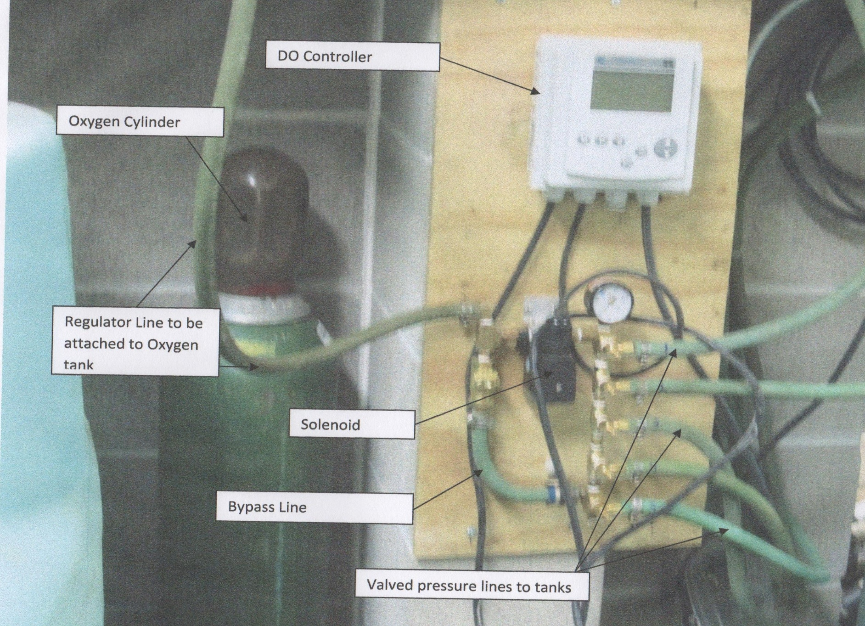
OUR FARMS, OUR FUTURE
William M . West, Mike Foster, Steve Stomberg, Kaleb Santey, Tom Sebranek
FNC16-1064
Developing a Self Funded Aquaculture Program for High Schools
Fish Farm/High School Partners
Assessing Resources/Production
- From the farmers’ point of view if we cannot assume that our fish will survive in a high school aquaculture facility we have little incentive to provide quality stock. However if we can assist the high school in making sure the equipment is adequate and run correctly, we then have a reason to provide quality fish and we can assist the teacher in making this a successful production experience.
- In the northern states, the farmer has a limited growing season and the aquaculture facilities in the school can extend the growing season – by as much as nine months.
- From the teachers’ standpoint we still have a curriculum and we should be looking at the students’ experience. Most high schools do not have access to premium fish, reasonably priced feeds and generally purchase off the shelf expensive equipment (tanks, waste treatment filters, etc.). By partnering with farmers, schools can save up to 20% on feeds and even more on equipment.
- We have the potential to incorporate the related disciplines of biology, chemistry, water chemistry, math, business, marketing, food science.
- The first step was to evaluate each school to determine if they had adequate resources to house fish and sufficient waste treatment capacity to match the carrying capacity desired. Grant funds were used for upgrades where necessary. In the first year, we purposely stocked the school systems lower to allow for a trial run.
- There needed to be a dedicated oxygen supply with a backup system and preferably a backup to the backup.
- Typically tilapia are chosen because they can tolerate poor water conditions. For this project we wanted to use indigenous fish. Fathead minnows while also very tolerant have a life cycle of four months. Perch and bluegill grow very well (one inch per month) and command a good price in the market (perch are sold from $15-$20 per pound) in premium markets. Finally trout are also grown but require higher water quality and usually require a chiller.
First Year Results at Pulaski High School
Pictures to the right show harvest day at the three schools. We also invited a fish veterinarian to give a presentation at each school along with performing a necropsy of a fish.
Optional Oxygen Backup
One of the problems we encountered was a backup oxygen supply. To provide a more or less fail safe system, we purchased a “normally open solenoid.” The solenoid is positioned between an oxygen cylinder and a manifold which feeds each of the fish tanks. The solenoid is plugged into house electricity. Should the power ever go out, the solenoid opens and feeds oxygen to the fish tanks.
Tips:
- Make sure all backup air supplies are functional
- Purchase fish from a reputable grower
- Make sure you can measure water quality – oxygen, temperature, pH, alkalinity, hardness, ammonia, nitrite, nitrate (at a minimum)
Make sure that you weigh out the exact amount of feed you need daily and resist the urge to reach in the bag to top dress more feed for demonstration.
If you have 30 students in a class, you have 60 eyes and 60 hands plus two more each for the teacher and the janitor. Eliminate as many choices as possible (valves to turn, switches, etc) Assign responsibilities! Someone has to check at the end of the day!!
The results of the first year were beyond expectations. The fish were delivered in September and measured through December. A gram weight of 120 per fish is market size at about 8 inches. Typically, these fish will have a fillet yield of between 15-17 pounds per 100 fish when 8 inches and a market value of $225 per 100 fish.
Placea
This project is supported by the National Institute of Food and Agriculture, U.S. Department of Agriculture, under award number XXXX-XXXXX-XXXXX through the North Central Region Sustainable Agriculture Research and Education program under subaward number FNCXX-XXX. Any opinions, findings, conclusions, or recommendations expressed in this publication are those of the author(s) and do not necessarily reflect the view of the U.S. Department of Agriculture or SARE. USDA is an equal opportunity employer and service provider.

