Slide 1
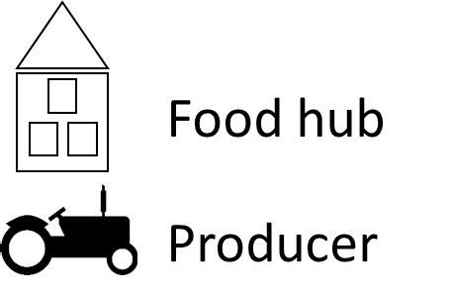
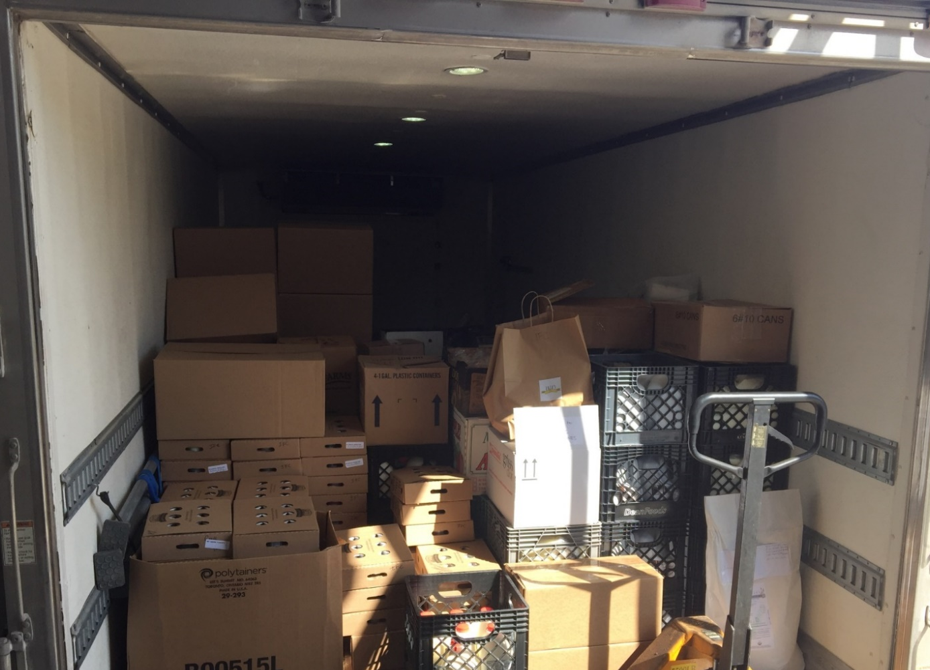
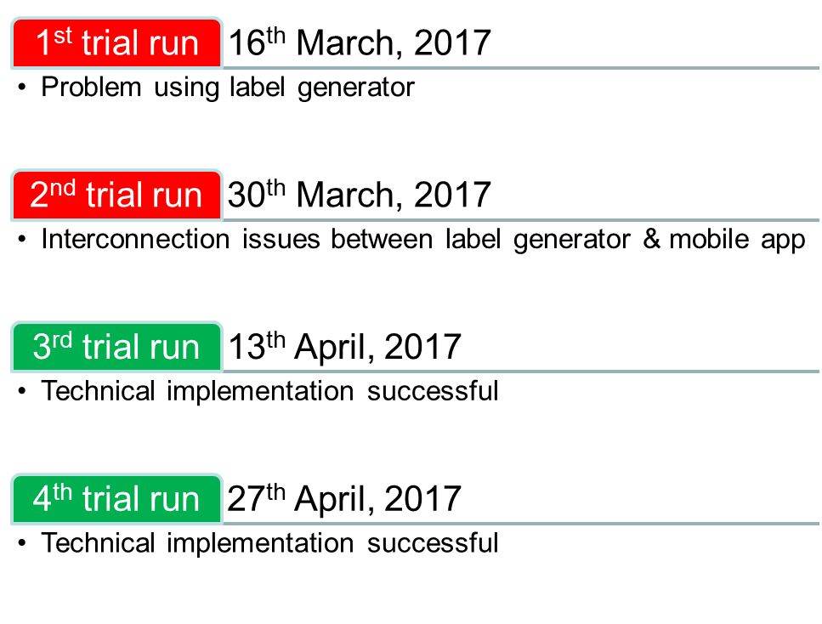
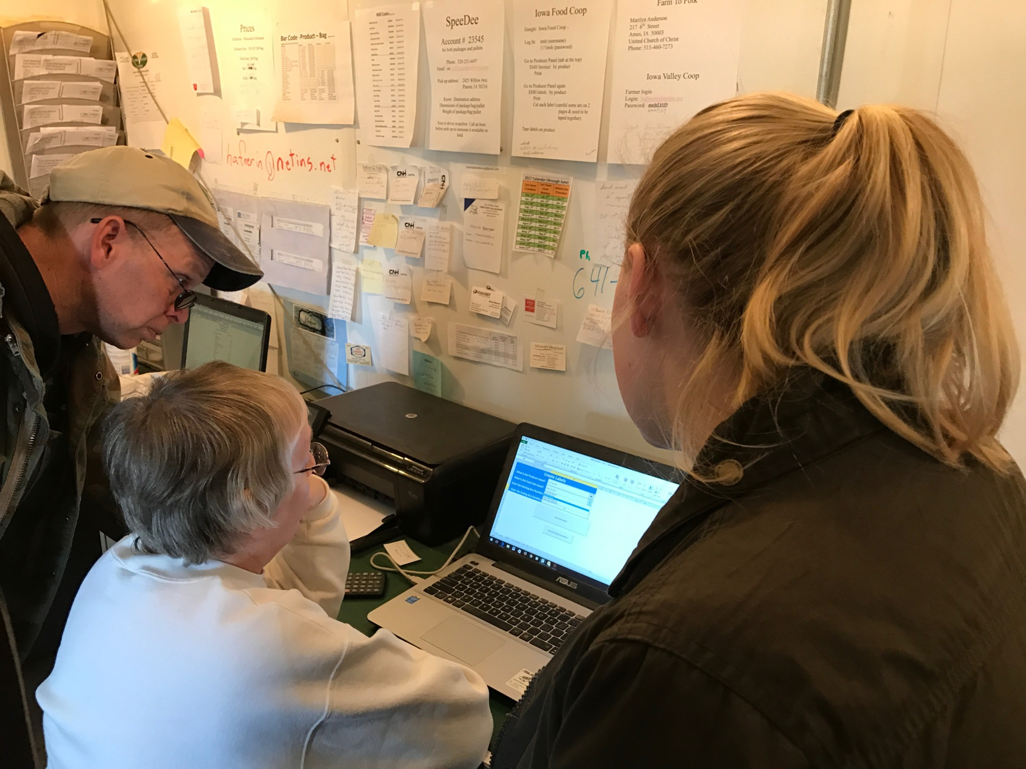
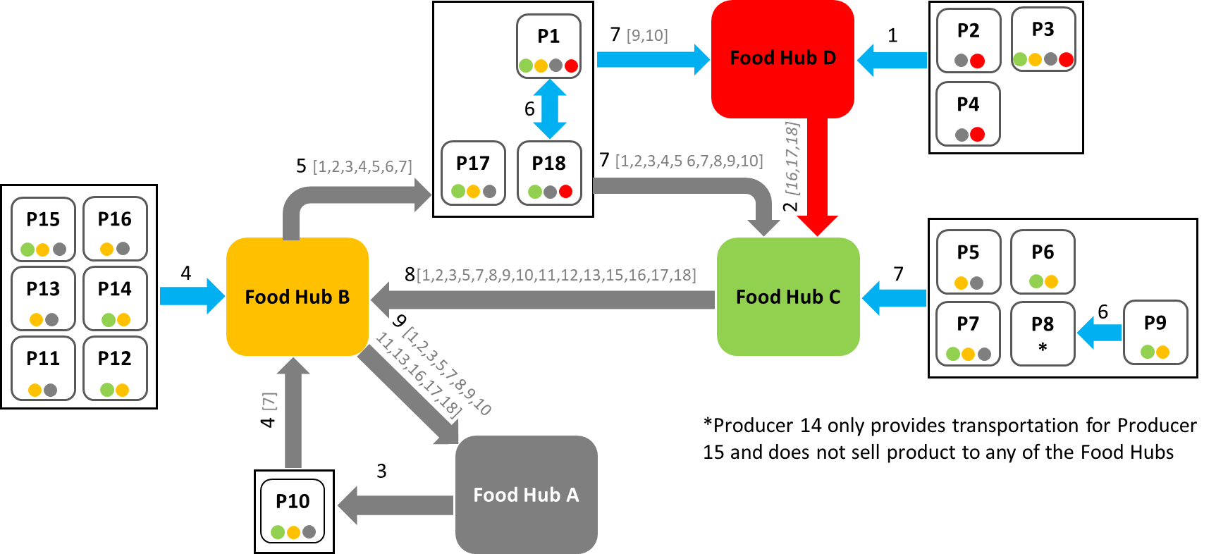
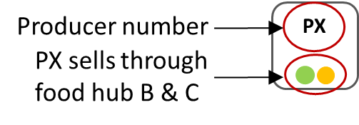
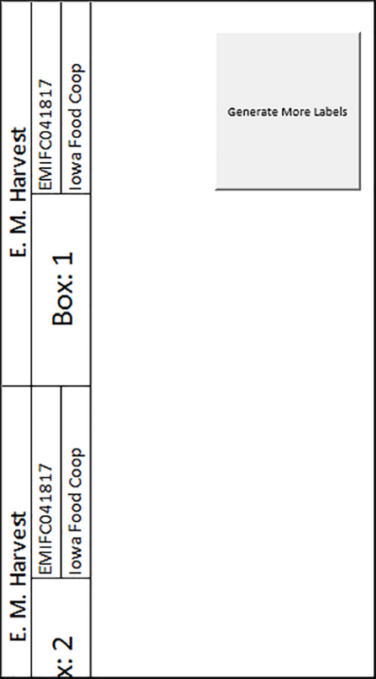
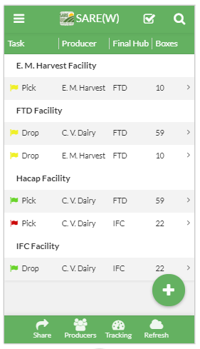
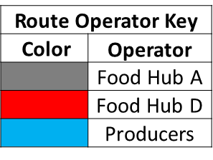
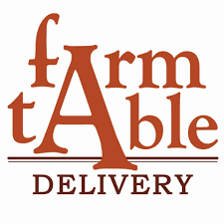
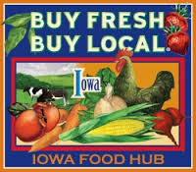
Our Farms, Our Future 2018, St. Louis
Enter SARE Project Number and Project Leader’s Name →
Anuj Mittal, Jason Grimm (PI) & Caroline C. Krejci (Co-PI)
ONC16-013
SAMPLE CONTENT BOXES
As seen in the template.
These boxes can be copied and pasted as often as needed.
They can be resized: click inside the box, then click and drag one of the squares that appear on the corners of the box.
Collaborative Food Supply Chains for Iowa’s Farmers
SUB HEADER
Recommend Gill Sans font in 60pt size.
Iowa Food Hub Network
Network Challenges
Testing & Implementation
Sub header in Gill Sans 60pt
Regional food hubs aggregate, distribute and market local food
Work with small and mid-sized farmers as strategic partners
Major challenges – supply inconsistency and high logistics costs
Potential solution – collaborative network between food hubs
Iowa Food Hub Network – shared logistics network between Iowa food hubs
Started with three food hubs and one producer in 2014
Grown to four food hubs and eighteen producers by 2017
Operational Challenges
Informal communication between food hub managers and truck drivers
Difficult to identify products’ source and destination
No platform to track products’ movement
Frequent delivery errors
Labor scheduling & storage problems
Management Challenges
No formal cost allocation procedure
Unclear allocation of responsibilities
Difficulty in growing the network
Label generator & mobile application tested with four producers and four food hubs
Training provided to food hub managers, truck drivers and producers
TEXT BOX
Recommend Georgia font in 28pt size.
Note that 18pt-20pt is the minimum size recommended for readability at a two-foot distance.
Enter text here.
Project Participants
TEXT BOXES FOR PHOTOS, FIGURES, etc.
Sample title box for a photo, table, figure, etc. Gill Sans 44pt
Food Hubs Products Inside a Truck
This box can be used for captions for photos, tables or figures. Select and copy box to use. Resize it by clicking and dragging the corners. This is in Gill Sans 28pt
“Largest problem is communicating what is being moved and how much before arriving at pick up location”
- Truck driver
“Difficulty in identifying drop off locations of the products in the truck”
- Truck driver
“Communication responsibilities are unclearly defined” - Food hub manager
Implementation Timeline
Key Benefits
Significant reduction in delivery errors
Cost effective and scalable system
Saved time and manpower
Simple interface; low training requirements
SAMPLE TABLE
Column names are set to 32pt Gill Sans; Data cells are 28pt Gill Sans.
To add more rows or columns: put mouse in row/column next to where you want the new one added, then go to Table Tools>Layout and chose an option (insert above/below/left/right).
To resize the table: click inside a cell, then click and drag one of the squares that appear on the corners of the table.
Network Members in 2014
Network Members in 2017
Products are temporarily warehoused at various food hubs
Transportation is provided by two food hubs or by producers
Producer Training
Inventory Tracking System: Label Generator & Mobile Application
Flag Colors:
RED – Task completed with errors
YELLOW–Task pending
GREEN–Task completed with no errors
Destination to be visited by the truck driver (linked to Google Maps for navigation)
Name of table
Colum Name | Column Name | Column Name | Column Name | Column Name | Column Name | Column Name | Column Name
Plot 1 | 34” | treatment | 24 lbs/ac | yes | 0.68 | Mid to late | Minimal damage
Task for truck driver (pick or drop products)
More details on the task
Number of boxes for Iowa Food Coop (IFC - food hub) from C.V. Dairy (producer)
Product’s source (producer)
Transportation Network of Food Hubs
Label Generator for Producers
Final destination (food hub)
Mobile Application
This project is supported by the National Institute of Food and Agriculture, U.S. Department of Agriculture, under award number 2015-38640-23781 through the North Central Region Sustainable Agriculture Research and Education program under sub-award number ONC16-013. Any opinions, findings, conclusions, or recommendations expressed in this publication are those of the author(s) and do not necessarily reflect the view of the U.S. Department of Agriculture or SARE. USDA is an equal opportunity employer and service provider.
Zoom here and enter Award numbers →

